Slide 1


Introduction to Spatial Data &
Using R as a GIS
Wed 26 April 2017
10:00am – 4:00pm/4:30pm
Dr Nick Bearman
@nickbearmanuk

Slide 2
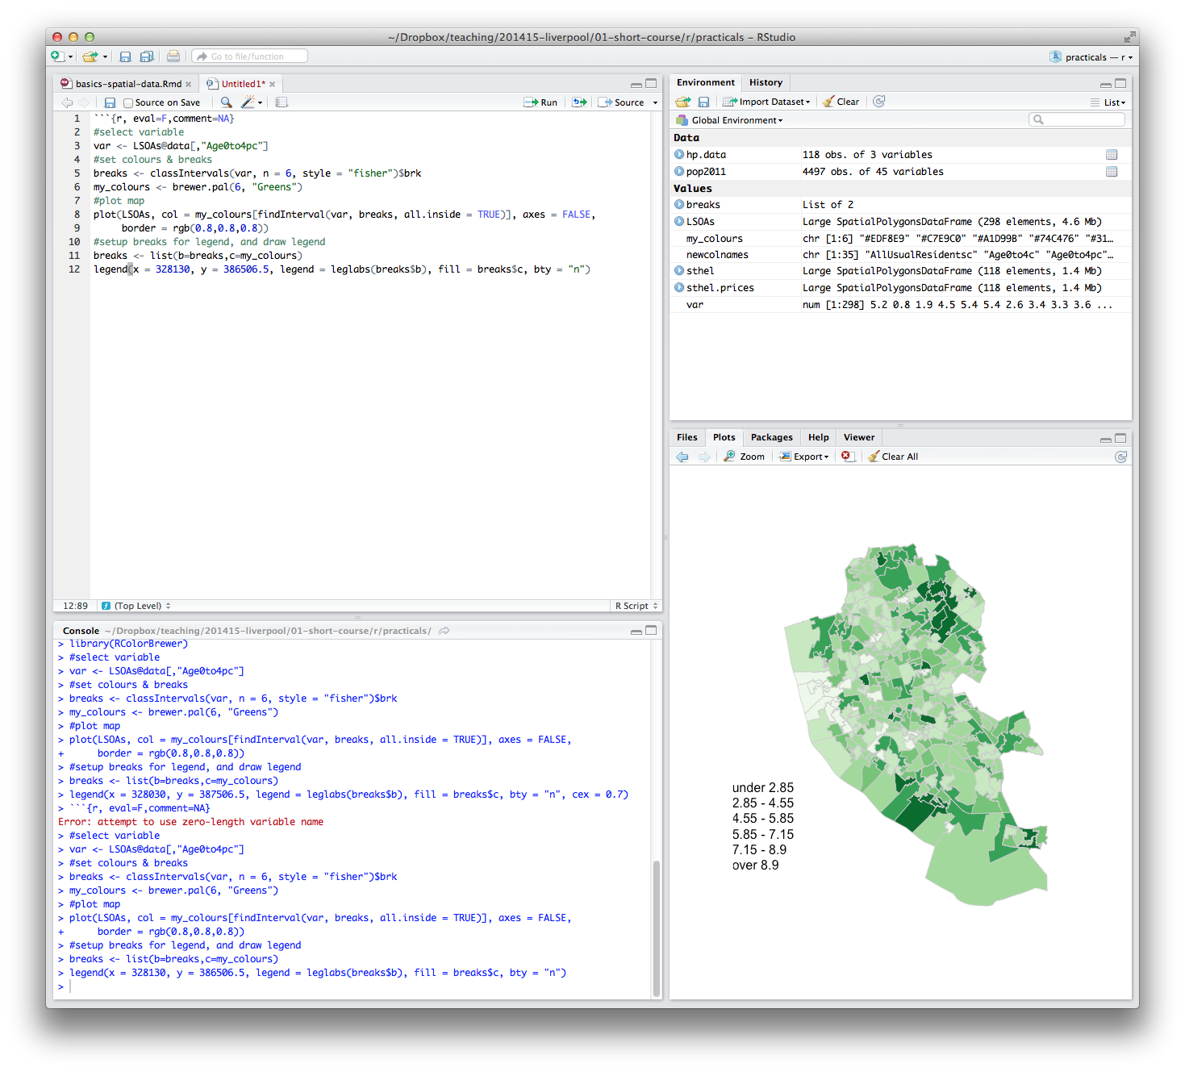
Welcome
Introductions
  Who are you?
  What GIS have you used before?
  What do you want to get from the course?

Slide 3
What will you get from the course?
Background on R and spatial data
Load spatial data
Create a map

Slide 4
What will you get from the course?
Appropriate methods of visualizing data
Basic analysis
Using your own data
Presentations etc. are
available online
Toilets
Fire Alarm
Breaks

Slide 5
Outline of the day
10:15am – 11:00am – What is GIS & R?
11:00am – 11:30am – Prac. 1 Intro to GIS & R
11:30am – 12:00pm – Classification
12:30pm – 12:30pm – Prac. 1 Intro to GIS & R
12:30pm – 1:30pm – Lunch
1:30pm - 1:45pm – Recap and Making Maps
1:45pm – 3:00pm – Prac. 2 Analysis
3:00pm – 3:15pm – Tea/Coffee
3:15pm – 4pm/4:30pm – Prac. 3 BYOD

Slide 6
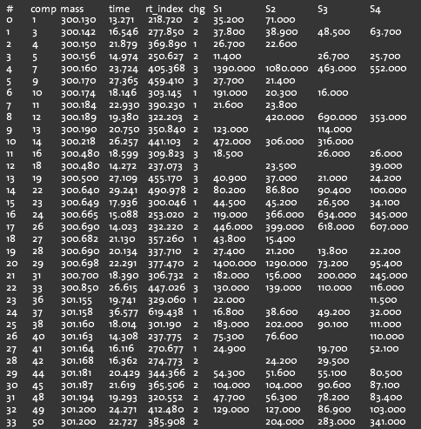
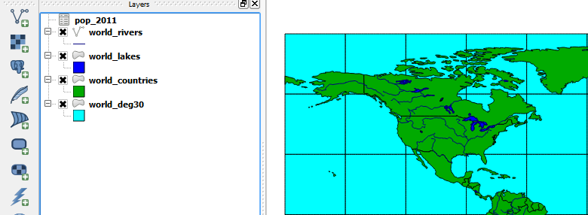
What is GIS?
Turning (spatial) data into information
Using this information to answer questions
  How have housing conditions changed in the past ten years?
http://www.flickr.com/photos/dsleeter_2000/3097476532 & ESRI Course “Teaching with GIS”

Slide 7
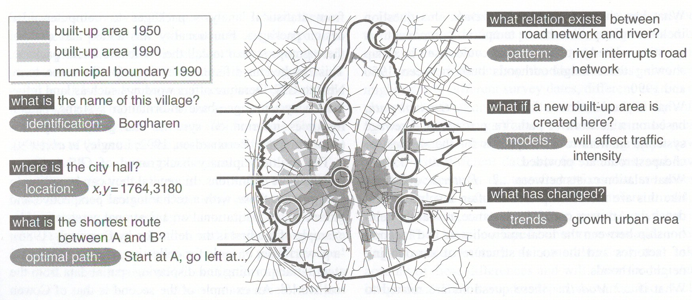
Types of questions a GIS can answer
Source: Kraak & Ormeling (2003) p.7.
Notes:
We can use a GIS for an almost infinite range of purposes, including…
-Location-based queries (e.g. where is the community centre?)
Relationship-based queries (e.g. where is the nearest Well or bore hole?)
Network analysis (e.g. what is the shortest route between A and B?)
Trend analysis (e.g. how has land use changed between time A and time B?)
3D visualisation (e.g. displaying 3d flood models)
This course will give you experience in using all three levels of using geographic information systems.

Slide 8

What is GIS?
http://www.flickr.com/photos/dsleeter_2000/3097476532 & ESRI Course “Teaching with GIS”

Slide 9
GIS – Geographic Information Systems
Almost all human activities and decisions involve an important geographic component
  the ‘where?’
Working with geographic information involves unique, complex and difficult choices
Why we need specialized software
  organize and store
  access and retrieve
  present and manage
  apply to the solution of problems

Slide 10
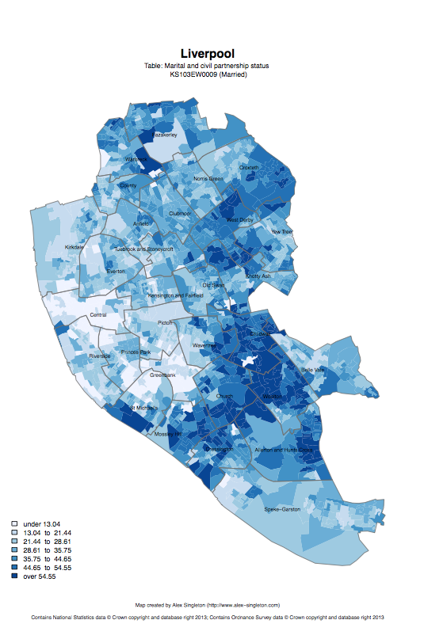
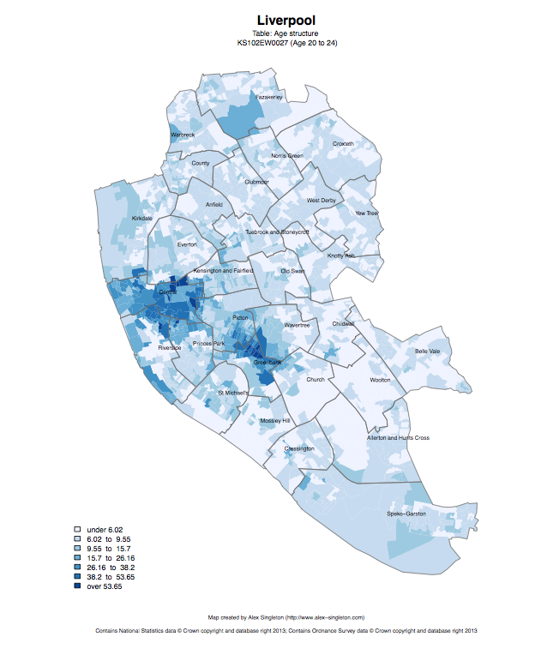
Census 2011
Married
Age structure – 20 to 24
http://www.alex-singleton.com/r/2014/02/05/2011-census-open-atlas-project-version-two/

Slide 11
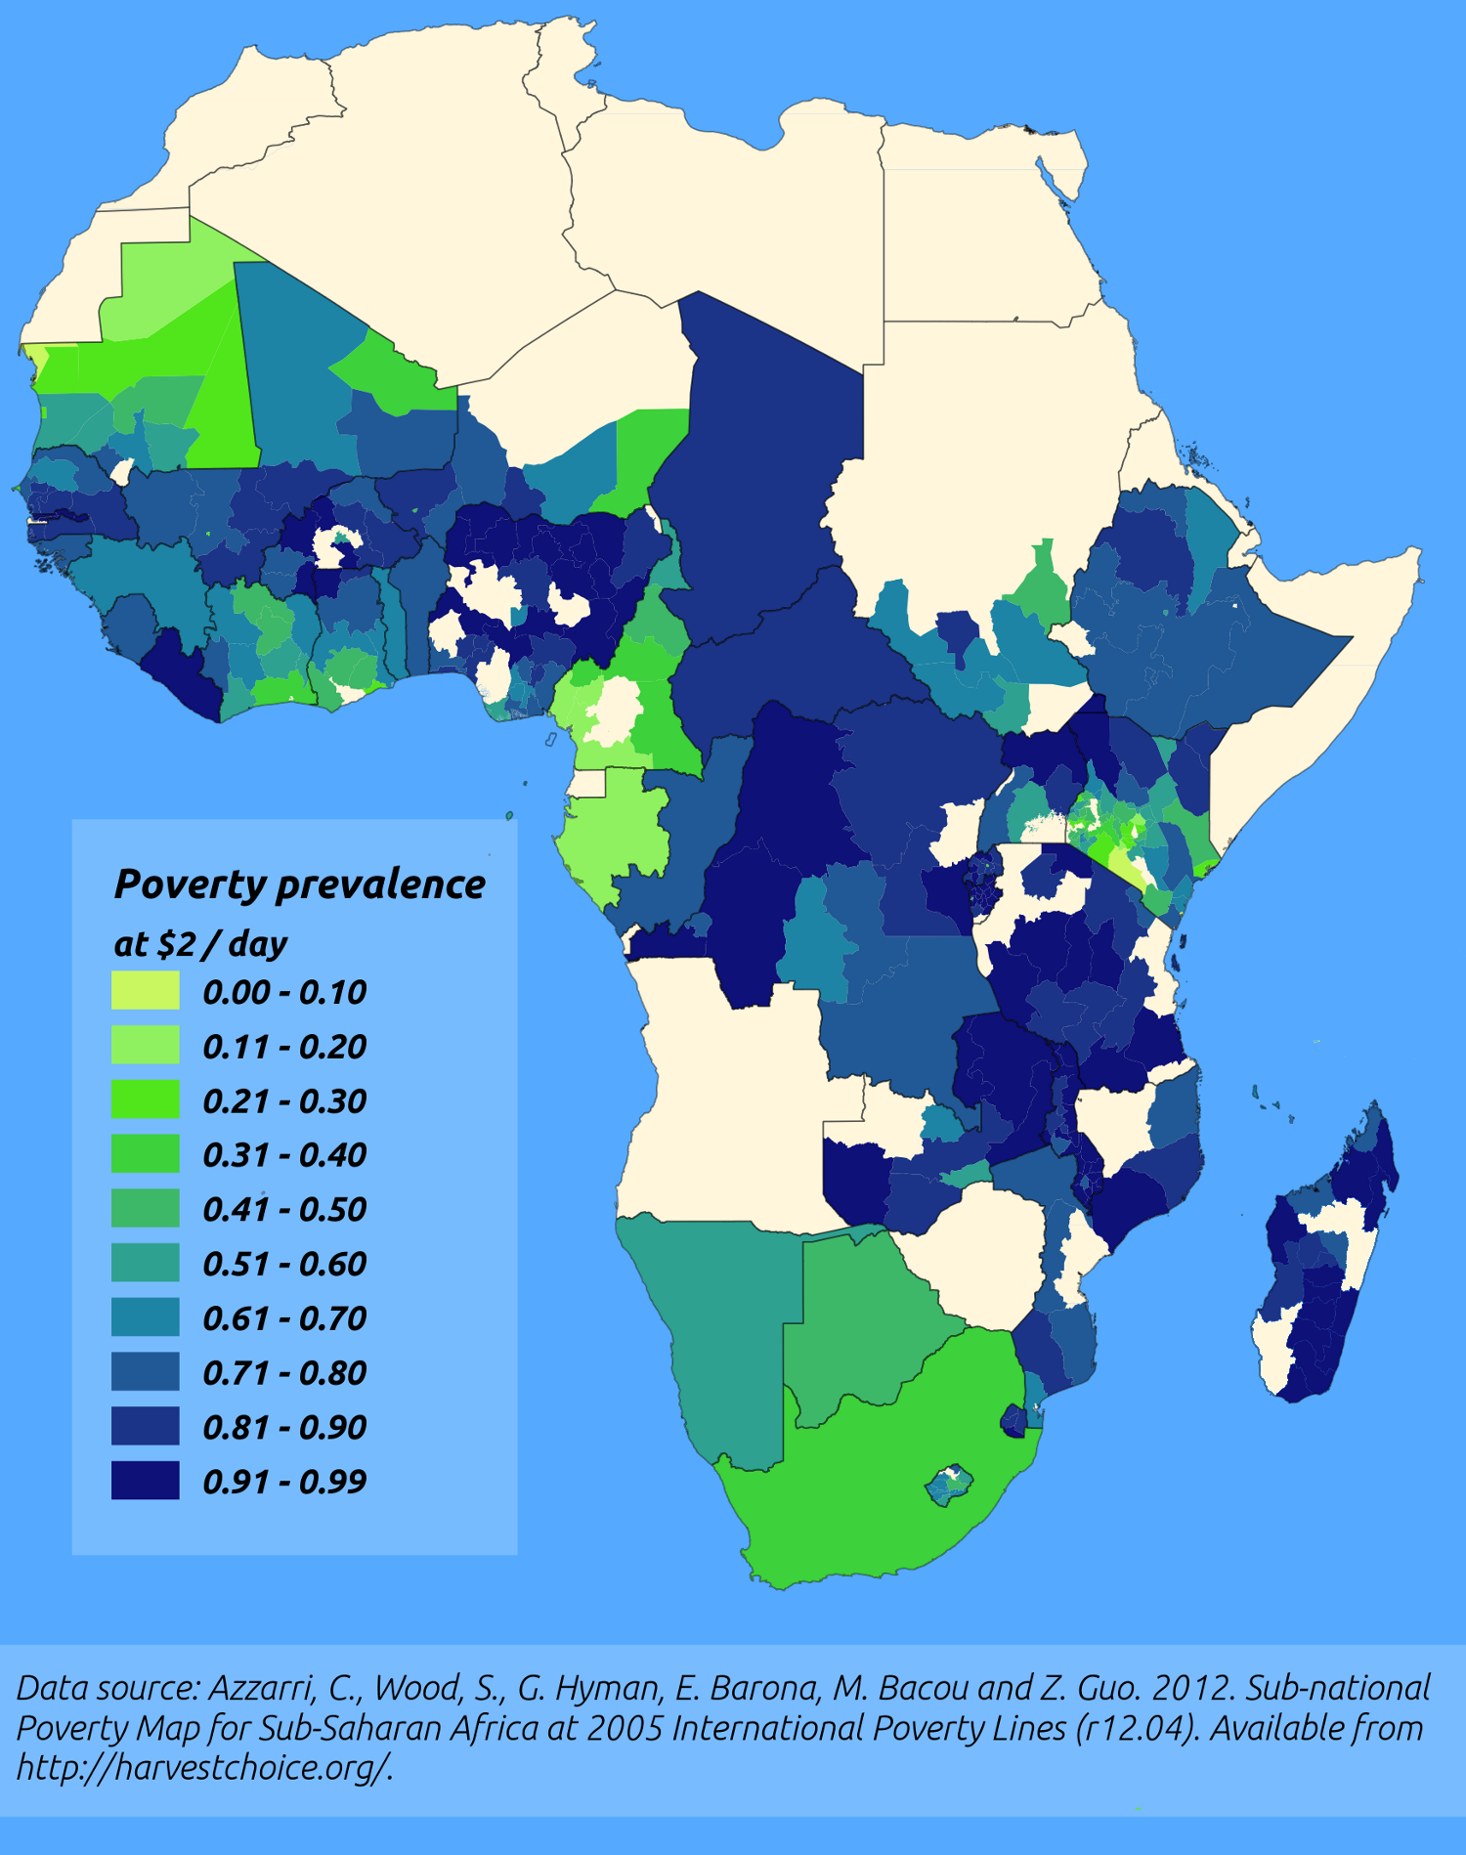
http://pvanb.wordpress.com/2012/05/09/poverty-maps-on-harvestchoice/

Slide 12
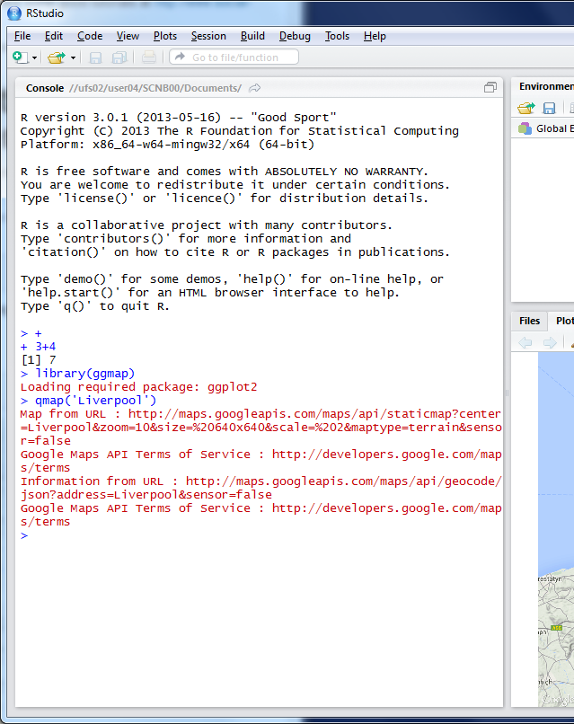
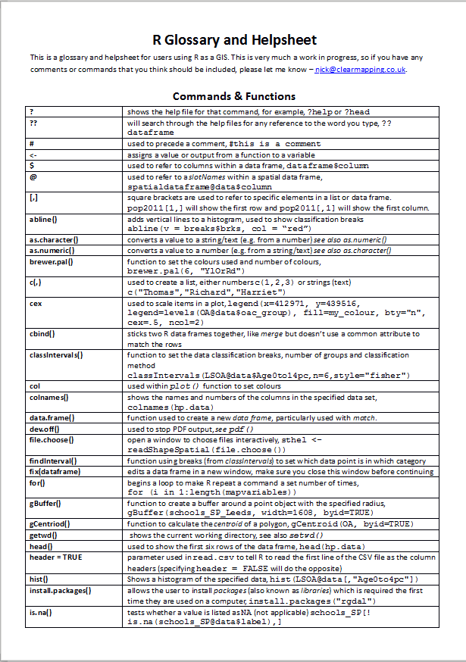

R as a GIS
Command line driven, rather than GUI
Disadvantages
  Remembering commands
    glossary
  Steeper
  learning
  curve

Slide 13
R as a GIS
Advantages
  Easy to record what you did and repeat specific pieces of work
  Lots of reproducible examples on the web
  Easily scriptable.
  134,567 maps? easy!
  2011 Census Open Atlas
  http://www.alex-singleton.com/r/2014/02/05/2011-census-open-atlas-project-version-two/

Slide 14
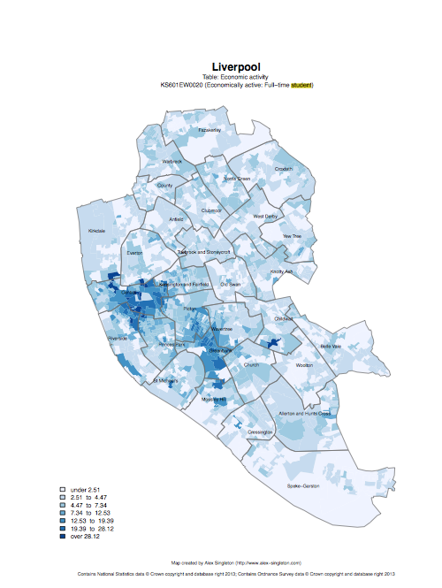

R in Action
Economically active – Full-time students

Slide 15
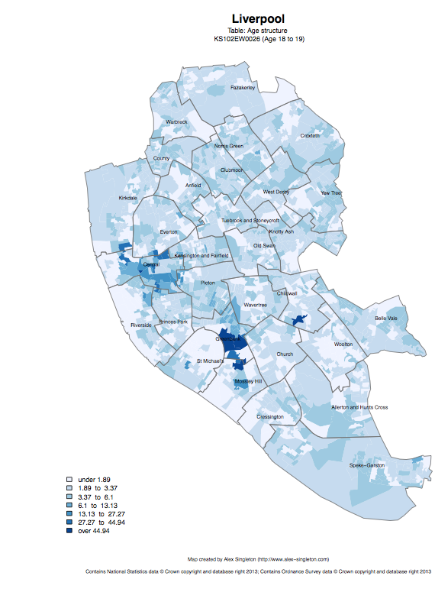
Age structure – 18 to 19
Age structure – 20 to 24

Slide 16
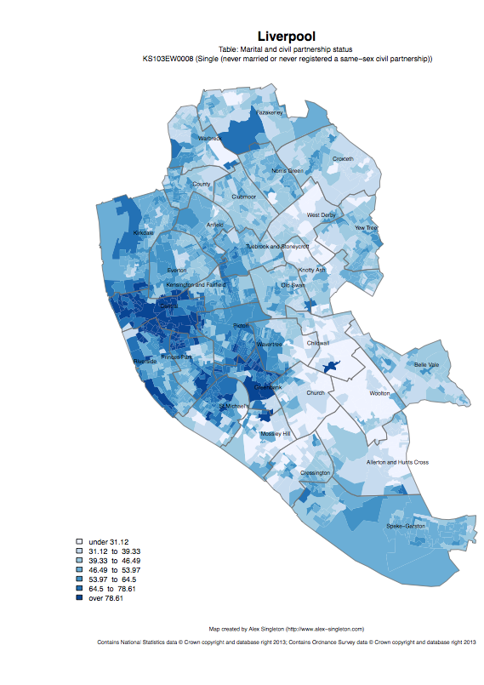
Single
Married

Slide 17
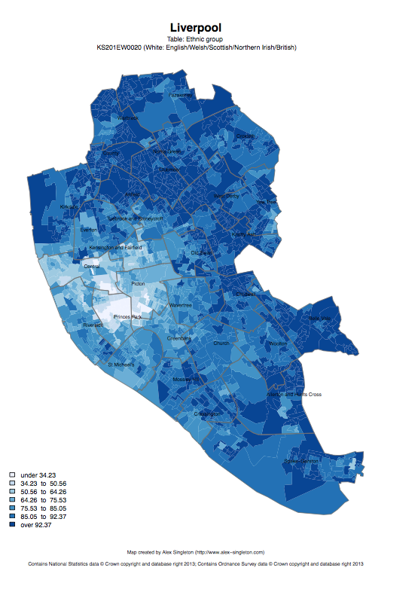
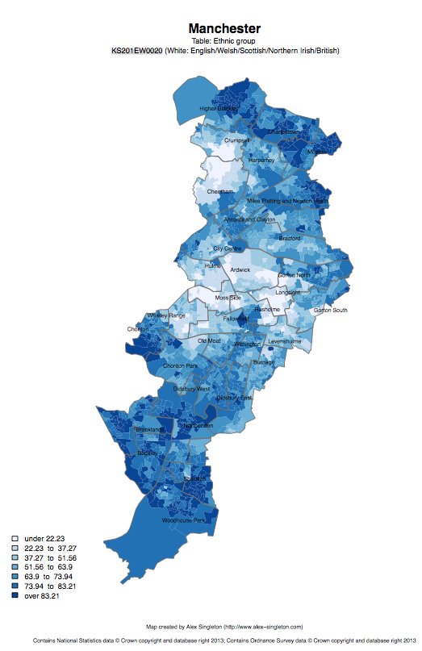
Ethnic group: white

Slide 18
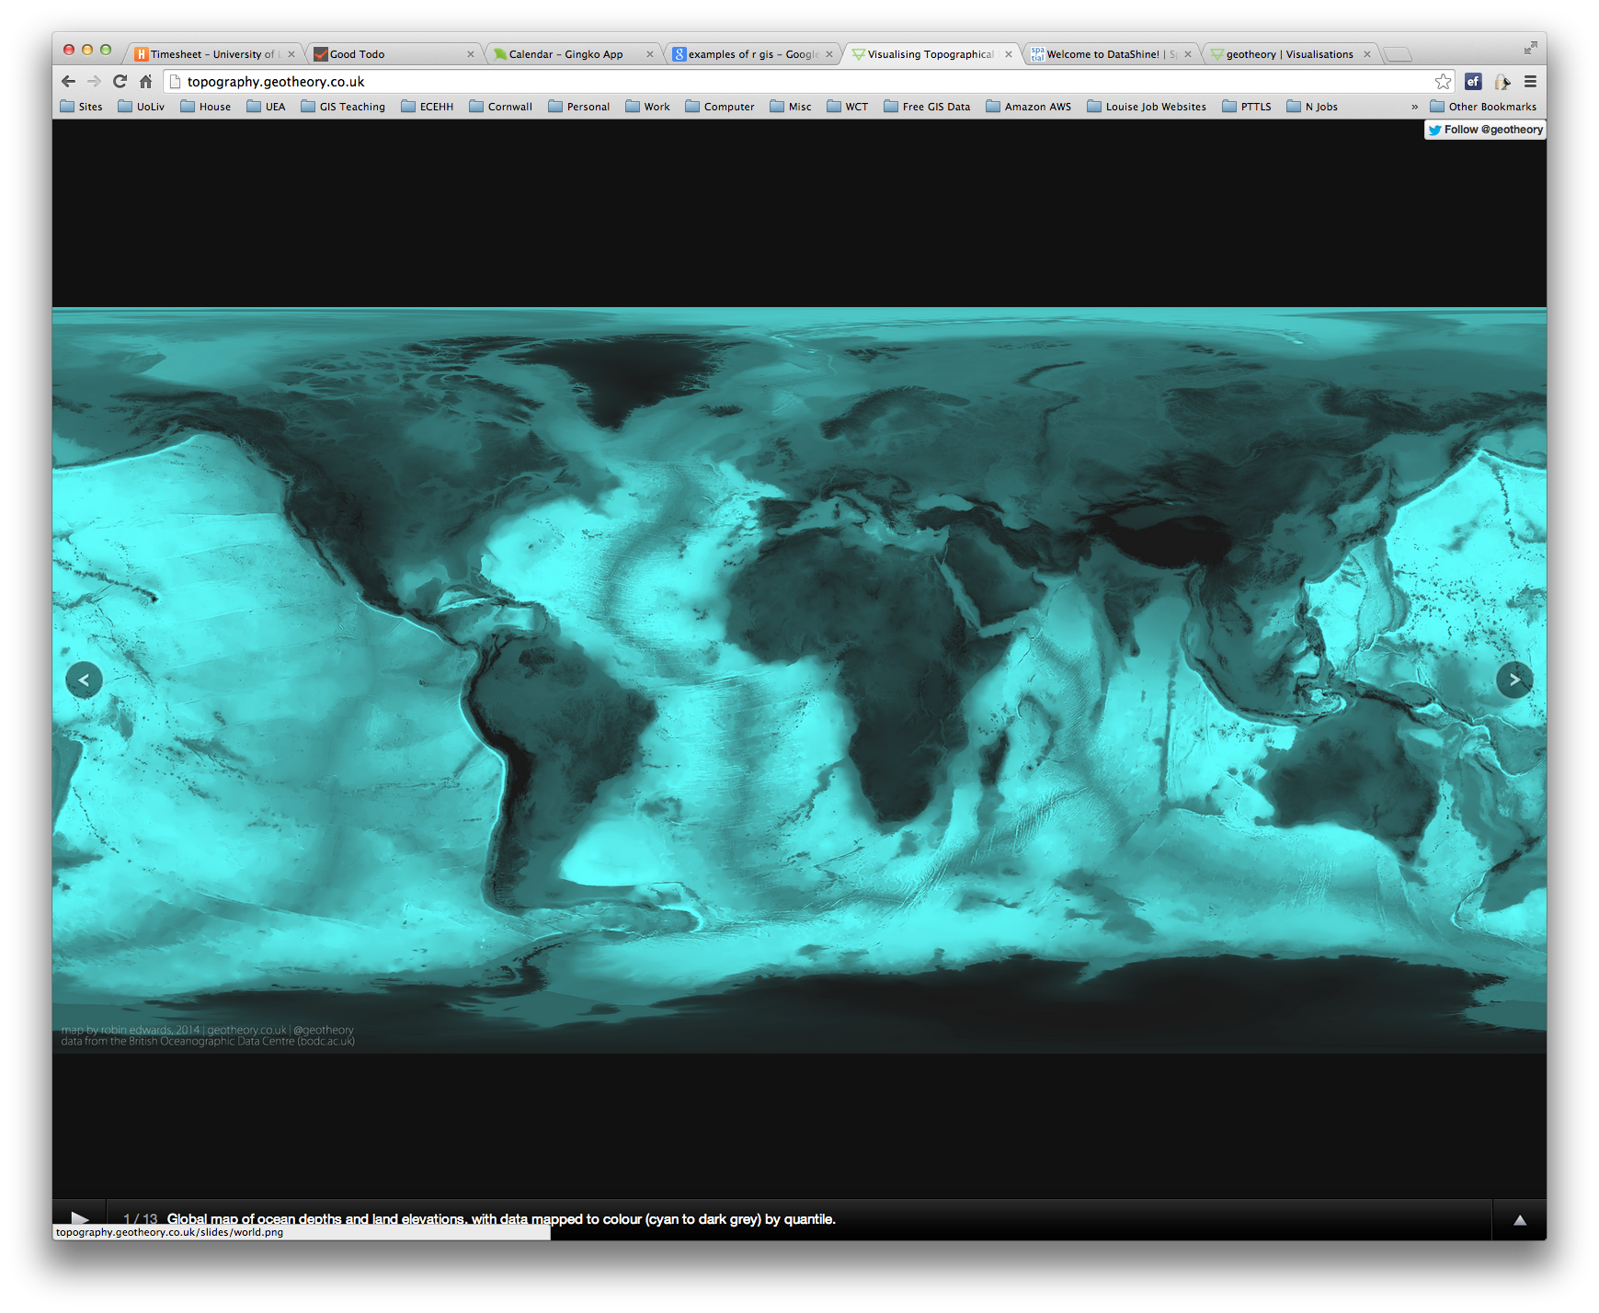

R as a GIS
Topography
http://topography.geotheory.co.uk/

Slide 19
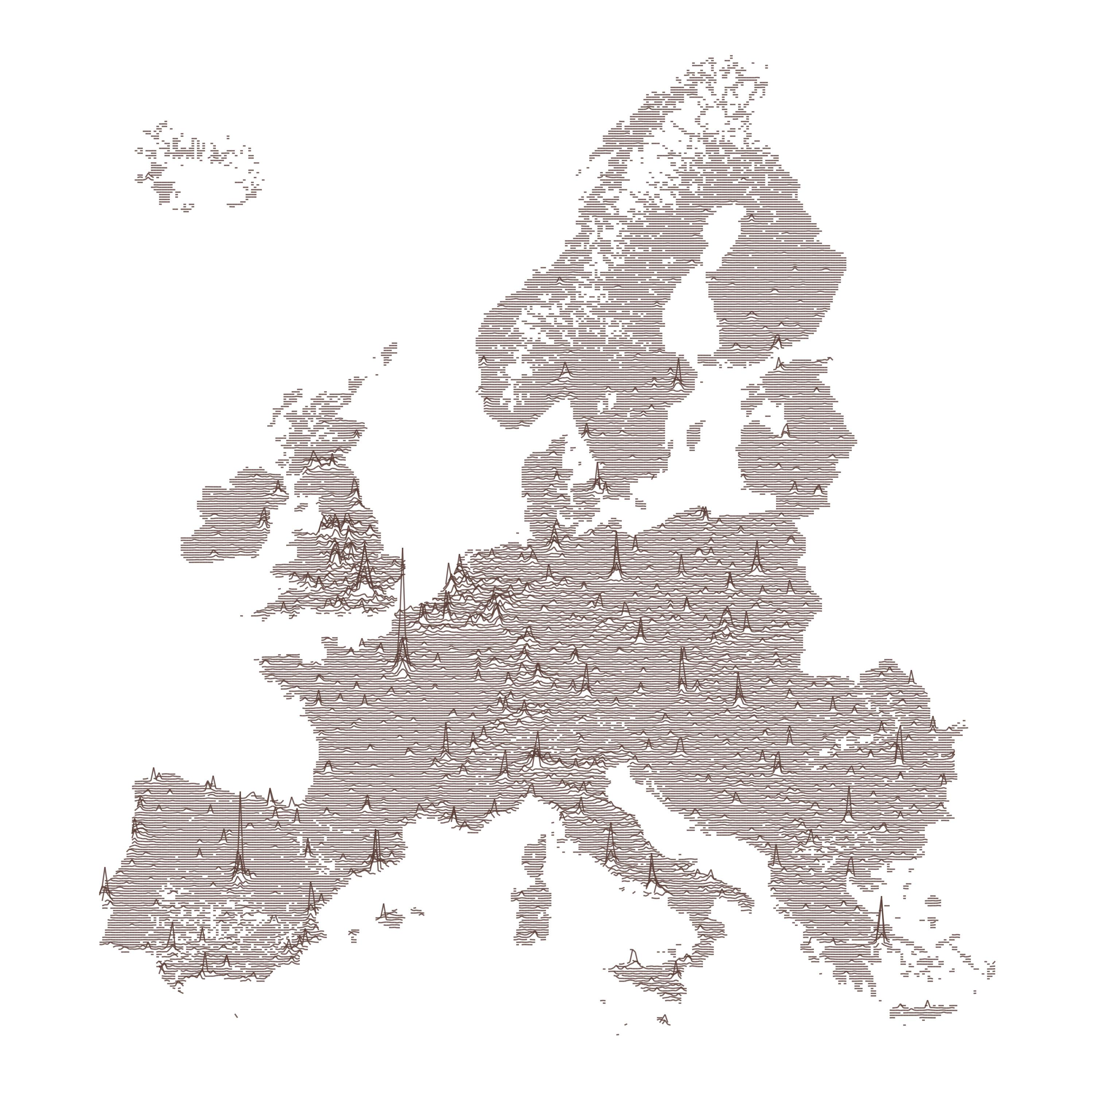
https://gist.github.com/halhen/659780120accd82e043986c8b57deae0

Slide 20
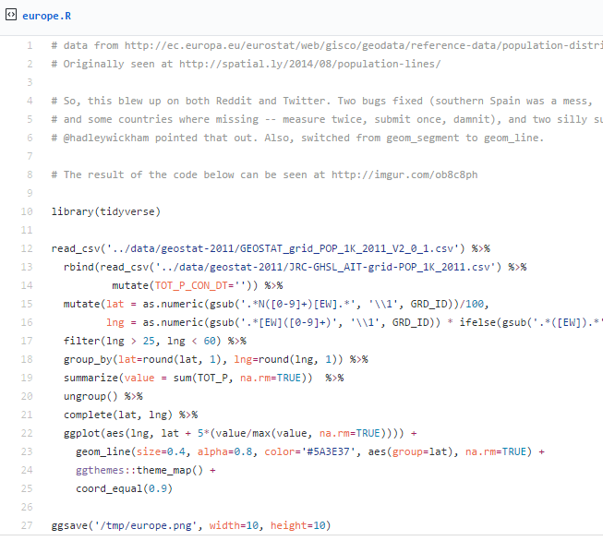
https://gist.github.com/halhen/659780120accd82e043986c8b57deae0

Slide 21




Other GIS software?
R is very different to ArcGIS, but can do many of the same operations
R is free (as is QGIS)
R is increasingly popular in academic sector
All can be useful

Slide 22
Projections and Coordinate Systems
Who has heard of these?
Why are they important?
Latitude and Longitude (WGS 1984)
52°N 37’ 30.32’’ (52.6250) 1°E 14’ 2.05’’ (1.2339)
British National Grid (Eastings & Northings)
Easting: 619301 Northing: 307416

Slide 23
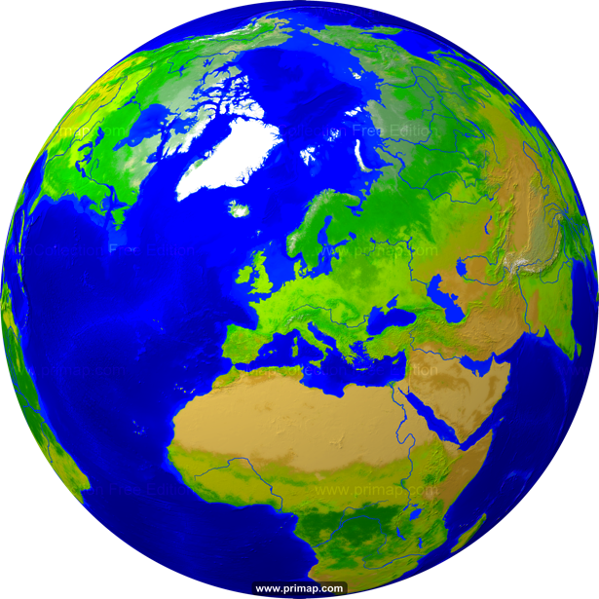
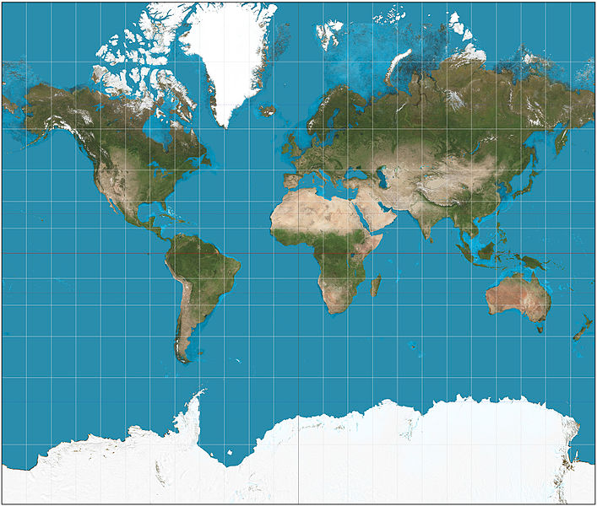
Projections
Projection – going from a sphere to a flat surface
http://www.primap.com/wsen/Maps/MapCollection/WorldMaps/Globe-(Europe-centered)-Vegetation-4000x4000.html

Slide 24

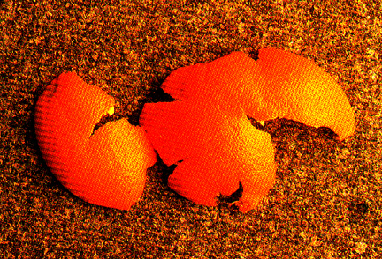
Projections
Projection – going from a sphere to a flat surface
Can’t maintain all of shape, area, angles (bearing) and distance
Video - http://flowingdata.com/2016/12/08/physical-demo-of-how-all-maps-are-wrong/
http://www.hdwallpapersos.com/orange-fruit-hd-wallpapers.html
http://krygier.owu.edu/krygier_html/geog_353/geog_353_lo/geog_353_lo05.html

Slide 25
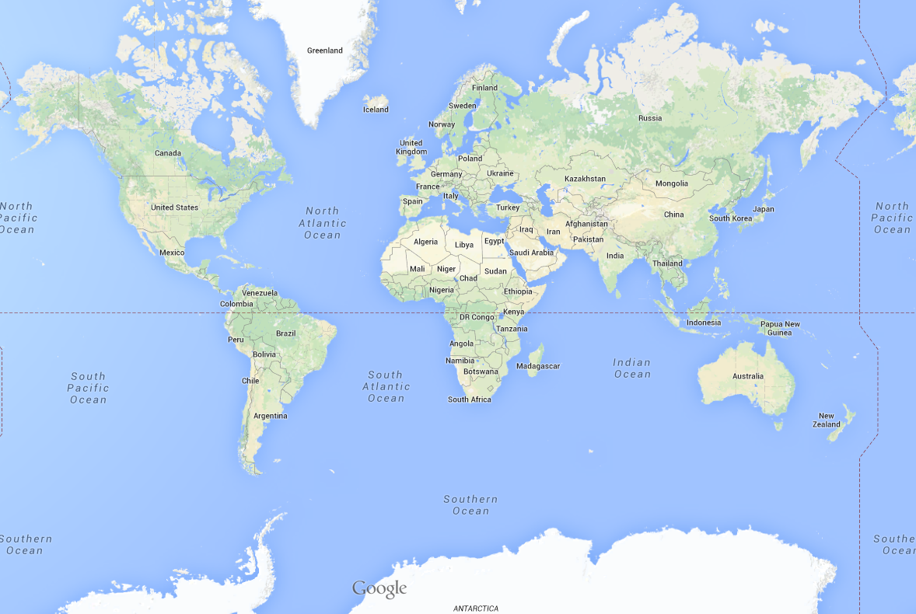
This file is licensed under the Creative Commons Attribution-Share Alike 3.0 Unported license. http://en.wikipedia.org/wiki/File:Mercator_projection_SW.jpg
Mercator projection

Slide 26
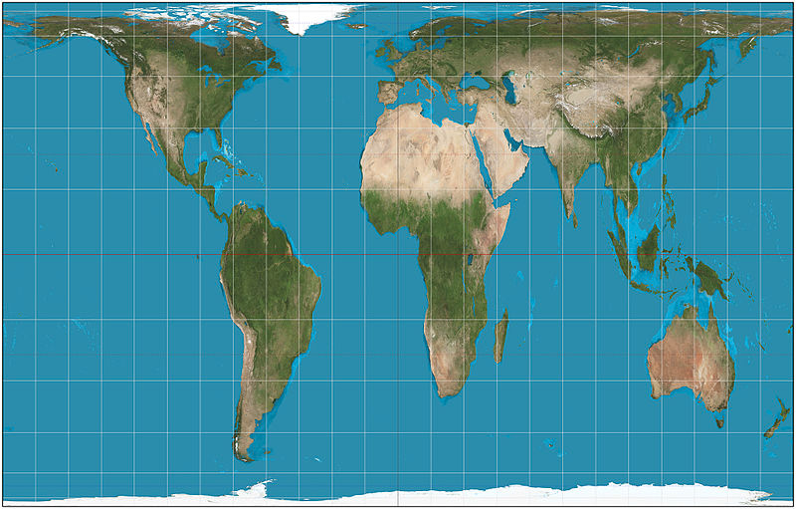
This file is licensed under the Creative Commons Attribution-Share Alike 3.0 Unported license. http://en.wikipedia.org/wiki/File:Mercator_projection_SW.jpg
Mercator projection
Gall-Peters projection
This file is licensed under the Creative Commons Attribution-Share Alike 3.0 Unported license. http://en.wikipedia.org/wiki/File:Gall%E2%80%93Peters_projection_SW.jpg

Slide 27
Africa: 30 million sq km
Greenland: 2 million sq km

Slide 28
Projections etc.
Africa: 30 million sq km
Greenland: 2 million sq km

Slide 29
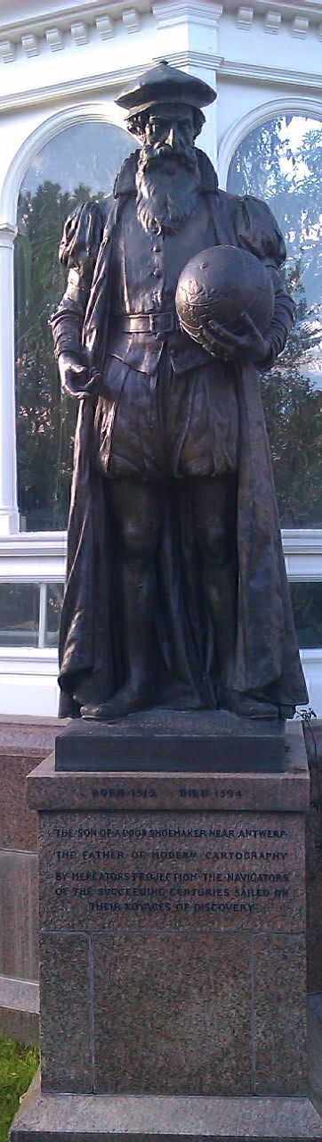
Mercator
“The Father of Modern Cartography”
By Mercator’s Projection the navigators of the succeeding centuries sailed
1569
Notes:
Maintains angle but not area.

Slide 30
Projections etc.
Reprojection
Can’t maintain
area and angles
Peters: area
Mercator: angles

Slide 31
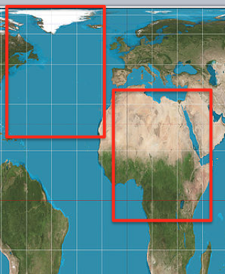
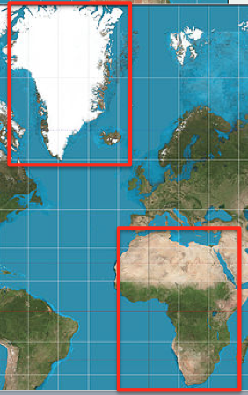
Why are Projections important?
The map(s) may not be as they appear
Data may appear in the wrong place

Slide 32
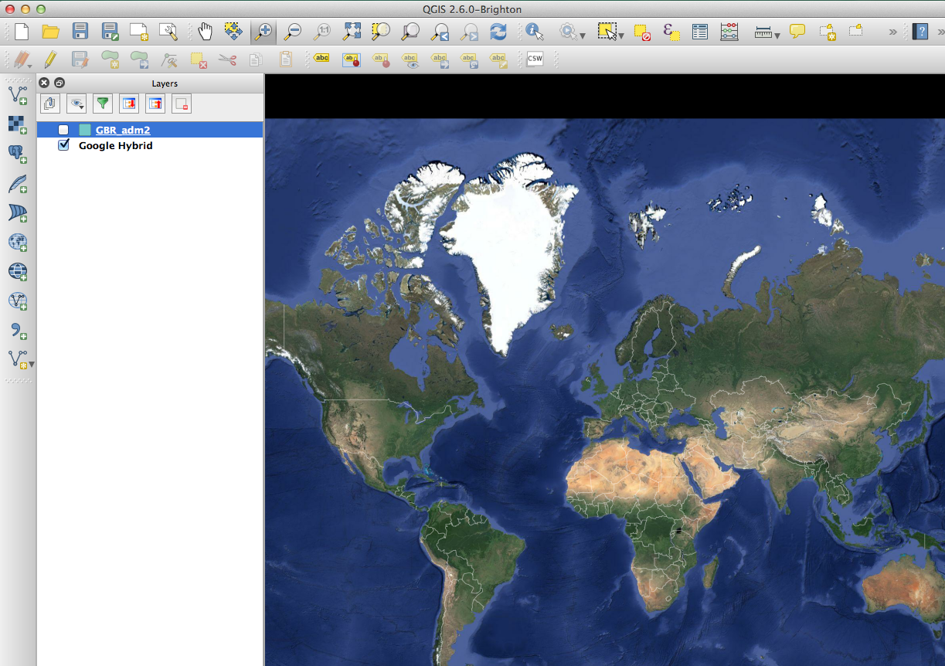

Slide 33
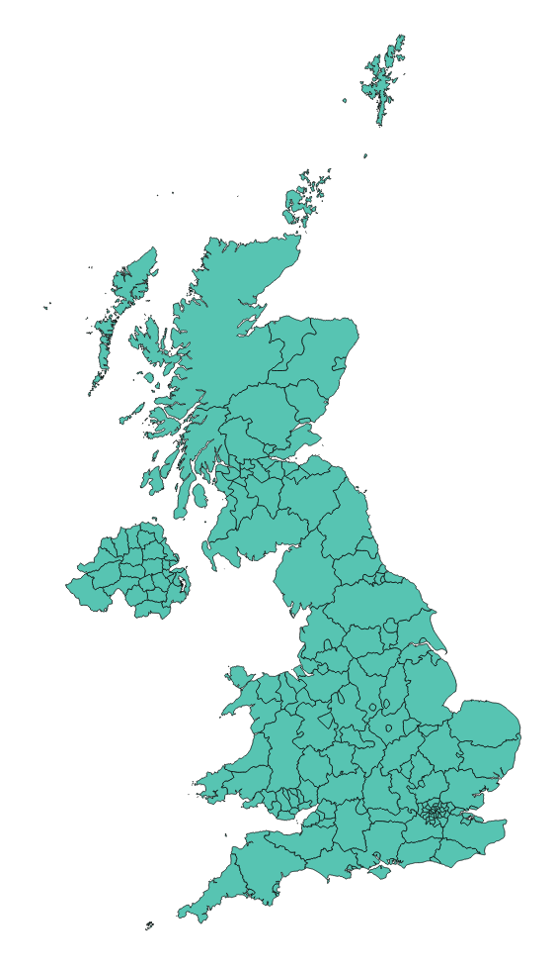

Slide 34
Why are Projections important?
The map(s) may not be as they appear
Data may appear in the wrong place
Coordinate Systems

Slide 35
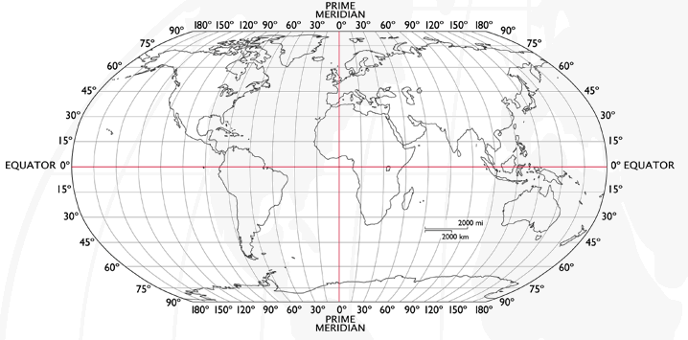
Coordinate Systems
Latitude and Longitude (WGS 1984) EPSG = 4326
  52°N 37’ 30.32’’ (52.6250) 1°E 14’ 2.05’’ (1.2339)
Notes:
-Coordinate Systems are derived from projections and are used to give coordinates (numbers) to locations on the Earth’s surface
-Best if your data is all in the same coordinate system (otherwise the coordinates might be slightly different for the same location), but ArcMap can convert between them
-Most common:
-Lat/Long (also WGS 1984) used by most GPS
-BNG (British National Grid) very common in UK data – Ordnance Survey format.
-Most important – are all your data in the same coordinate system?
-ArcMap can convert, but often if your data appears in the wrong place, it is because there is something wrong with the coordinate system.
http://www.worldatlas.com/webimage/testmaps/latslongs.htm
http://www.ordnancesurvey.co.uk/oswebsite/gps/information/coordinatesystemsinfo/guidetonationalgrid/page13.html
http://www.ordnancesurvey.co.uk/oswebsite/gps/information/coordinatesystemsinfo/guidetonationalgrid/page8.html

Slide 36
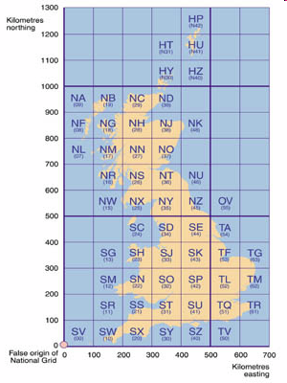
Coordinate Systems
Latitude and Longitude (WGS 1984) EPSG = 4326
  52°N 37’ 30.32’’ (52.6250) 1°E 14’ 2.05’’ (1.2339)
British National Grid (Eastings & Northings)
  Easting: 619301 Northing: 307416 EPSG = 27700
Notes:
-Coordinate Systems are derived from projections and are used to give coordinates (numbers) to locations on the Earth’s surface
-Best if your data is all in the same coordinate system (otherwise the coordinates might be slightly different for the same location), but ArcMap can convert between them
-Most common:
-Lat/Long (also WGS 1984) used by most GPS
-BNG (British National Grid) very common in UK data – Ordnance Survey format.
-Most important – are all your data in the same coordinate system?
-ArcMap can convert, but often if your data appears in the wrong place, it is because there is something wrong with the coordinate system.
http://www.worldatlas.com/webimage/testmaps/latslongs.htm
http://www.ordnancesurvey.co.uk/oswebsite/gps/information/coordinatesystemsinfo/guidetonationalgrid/page13.html
http://www.ordnancesurvey.co.uk/oswebsite/gps/information/coordinatesystemsinfo/guidetonationalgrid/page8.html

Slide 37
Coordinate Systems
Latitude and Longitude (WGS 1984) EPSG = 4326
  52°N 37’ 30.32’’ (52.6250) 1°E 14’ 2.05’’ (1.2339)
British National Grid (Eastings & Northings)
  Easting: 619301 Northing: 307416 EPSG = 27700
Why is it important?
  Some data uses uses WGS84
  LSOA use BNG (Eastings/Northings)
  Need to convert between the two
Notes:
-Coordinate Systems are derived from projections and are used to give coordinates (numbers) to locations on the Earth’s surface
-Best if your data is all in the same coordinate system (otherwise the coordinates might be slightly different for the same location), but ArcMap can convert between them
-Most common:
-Lat/Long (also WGS 1984) used by most GPS
-BNG (British National Grid) very common in UK data – Ordnance Survey format.
-Most important – are all your data in the same coordinate system?
-ArcMap can convert, but often if your data appears in the wrong place, it is because there is something wrong with the coordinate system.
http://www.worldatlas.com/webimage/testmaps/latslongs.htm
http://www.ordnancesurvey.co.uk/oswebsite/gps/information/coordinatesystemsinfo/guidetonationalgrid/page13.html
http://www.ordnancesurvey.co.uk/oswebsite/gps/information/coordinatesystemsinfo/guidetonationalgrid/page8.html

Slide 38
Joining
Area ID
1
2
3
4
5
14
7
8
11
Area ID | Deprivation
1 | High
2 | High
3 | High
4 | Average
5 | Average
6 | Average
7 | Low
8 | Low
9 | Low
10 | High
11 | Low
12 | High
13 | High
14 | Average
15 | Average
1
2
3
14
4
7
5
8
11
Data
Polygons
Lookup

Slide 39
Joining
Area ID
1
2
3
4
5
14
7
8
11
Area ID | Deprivation
1 | High
2 | High
3 | High
4 | Average
5 | Average
6 | Average
7 | Low
8 | Low
9 | Low
10 | High
11 | Low
12 | High
13 | High
14 | Average
15 | Average
1
2
3
14
4
7
5
8
11
Data
Polygons
Lookup

Slide 40
1
Area ID | Deprivation
1 | High
2 | High
3 | High
4 | Average
5 | Average
14 | Average
7 | Low
8 | Low
11 | Low
2
3
14
4
7
5
8
11
High Deprivation
Average Deprivation
Low Deprivation

Slide 41
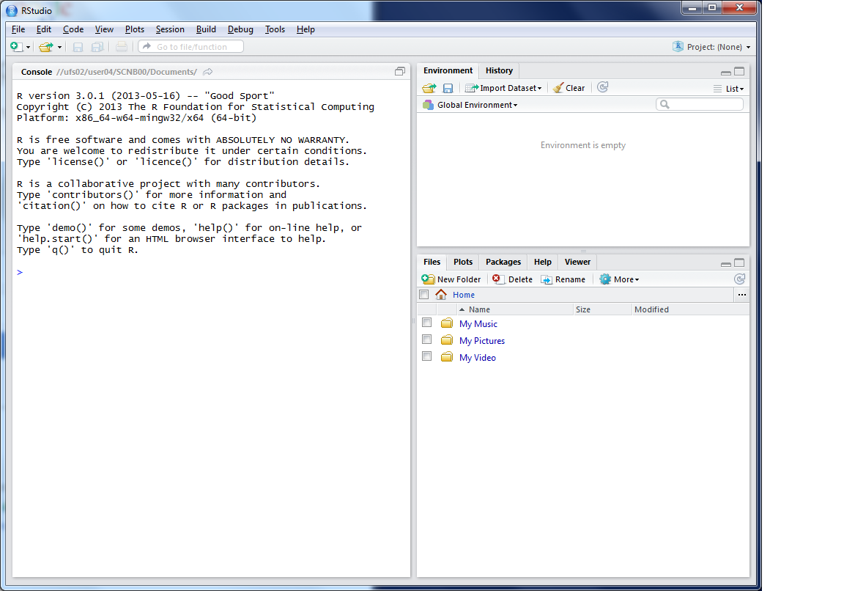
This lists the variables you have
This is the console where you can type in commands
Here will show either your files (the files tab) or your plots (the plots tab)

Slide 42
Working Directory
R uses a ‘working directory’ to store your files in
You might have a different one for each project / piece of work
e.g. M:\Documents\GIS
setwd(“M:/Documents/GIS”)

Slide 43
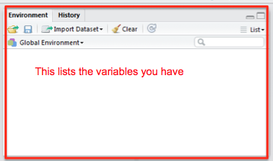
Variables
R uses variables to
store information –
listed in your ‘workspace’ (top-right)
house.prices <- c(120,150,212, 99,199,299,159)

Slide 44
Variables and Assignments
house.prices
<-
c(120,150,212,99,199,299,159)

Slide 45
Variables and Assignments
house.prices
<-
c(120,150,212,99,199,299,159)

Slide 46
Variables and Assignments
house.prices
<-
c(120,150,212,99,199,299,159)

Slide 47
Variables and Assignment
motorways
<-
readShapeSpatial('meridian-2/ motorway_polyline’, proj4string = CRS("+init=epsg:27700"))
See glossary for details

Slide 48
Variables and Assignment
motorways
<-
readShapeSpatial('meridian-2/ motorway_polyline’, proj4string = CRS("+init=epsg:27700"))
See glossary for details

Slide 49
Variables and Assignment
motorways
<-
readShapeSpatial('meridian-2/ motorway_polyline’, proj4string = CRS("+init=epsg:27700"))
See glossary for details

Slide 50
Variables and Assignment
motorways
<-
readShapeSpatial('meridian-2/ motorway_polyline’, proj4string = CRS("+init=epsg:27700"))
See glossary for details

Slide 51
Variables and Assignment
readShapeSpatial('meridian-2/ motorway_polyline’, proj4string = CRS("+init=epsg:27700"))

Slide 52
Variables and Assignment
readShapeSpatial(
’meridian-2/ motorway_polyline’
, proj4string = CRS("+init=epsg:27700")
)

Slide 53
Variables and Assignment
readShapeSpatial(
’meridian-2/ motorway_polyline’
, proj4string = CRS("+init=epsg:27700")
)
Function

Slide 54
Variables and Assignment
readShapeSpatial(
’meridian-2/ motorway_polyline’
, proj4string = CRS("+init=epsg:27700")
)
Parameter

Slide 55
Variables and Assignment
readShapeSpatial(
’meridian-2/ motorway_polyline’
, proj4string = CRS("+init=epsg:27700")
)
Parameter

Slide 56
Variables and Assignment
motorways
<-
readShapeSpatial('meridian-2/ motorway_polyline’, proj4string = CRS("+init=epsg:27700"))
See glossary for details
Case sensitive
Motorways ≠ motorways ≠ mOtOrWaYs

Slide 57
Data Formats
Data frames are like a table or spreadsheet
dataframe[rows,cols]
dataframe[1,] first row
dataframe[,1] first col

Slide 58
Practical Approach
(Primarily) self-led practical
Good to explore the options
Ask questions as we go through
Try things
Use the help ?command

Slide 59
Typing out Code
Why do I make you type out code?
  Helps the learning process
  Make you think about what the code does
(but you can copy/paste long bits)
Optional Exercises
Red and Green post-its
Breaks

Slide 60
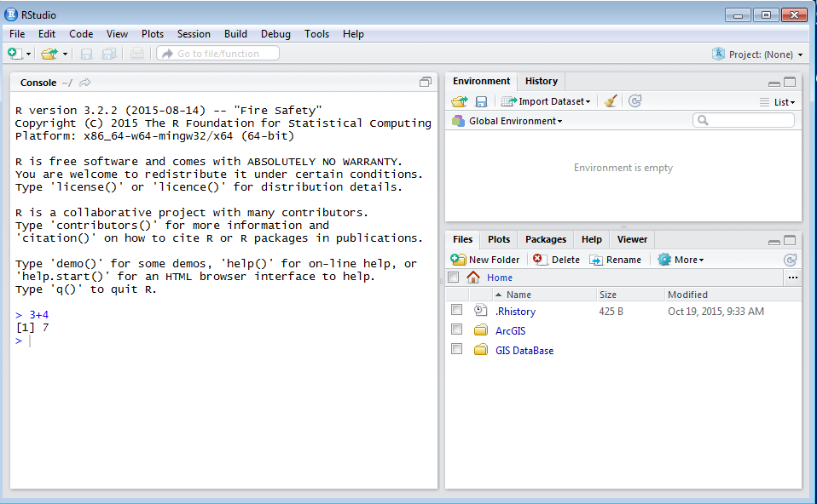
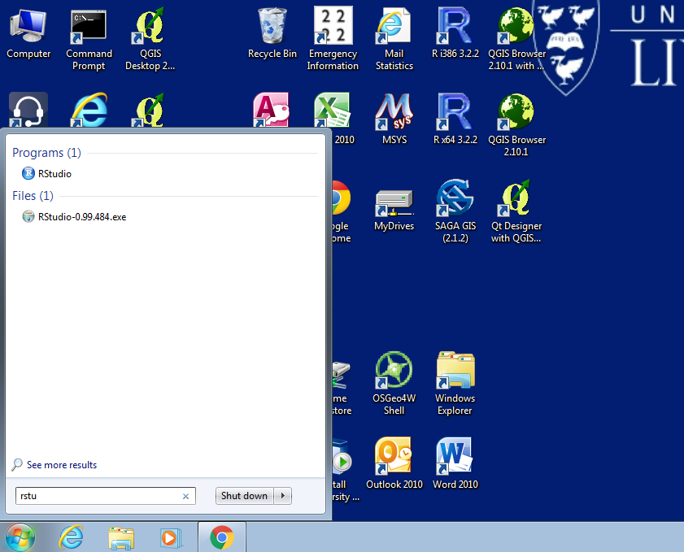
Load R

Slide 62
Outline of the day
10:15am – 11:00am – What is GIS & R?
11:00am – 11:30am – Prac. 1 Intro to GIS & R
11:30am – 12:00pm – Classification
12:30pm – 12:30pm – Prac. 1 Intro to GIS & R
12:30pm – 1:30pm – Lunch
1:30pm - 1:45pm – Recap and Making Maps
1:45pm – 3:00pm – Prac. 2 Analysis
3:00pm – 3:15pm – Tea/Coffee
3:15pm – 4pm/4:30pm – Prac. 3 BYOD

Slide 63
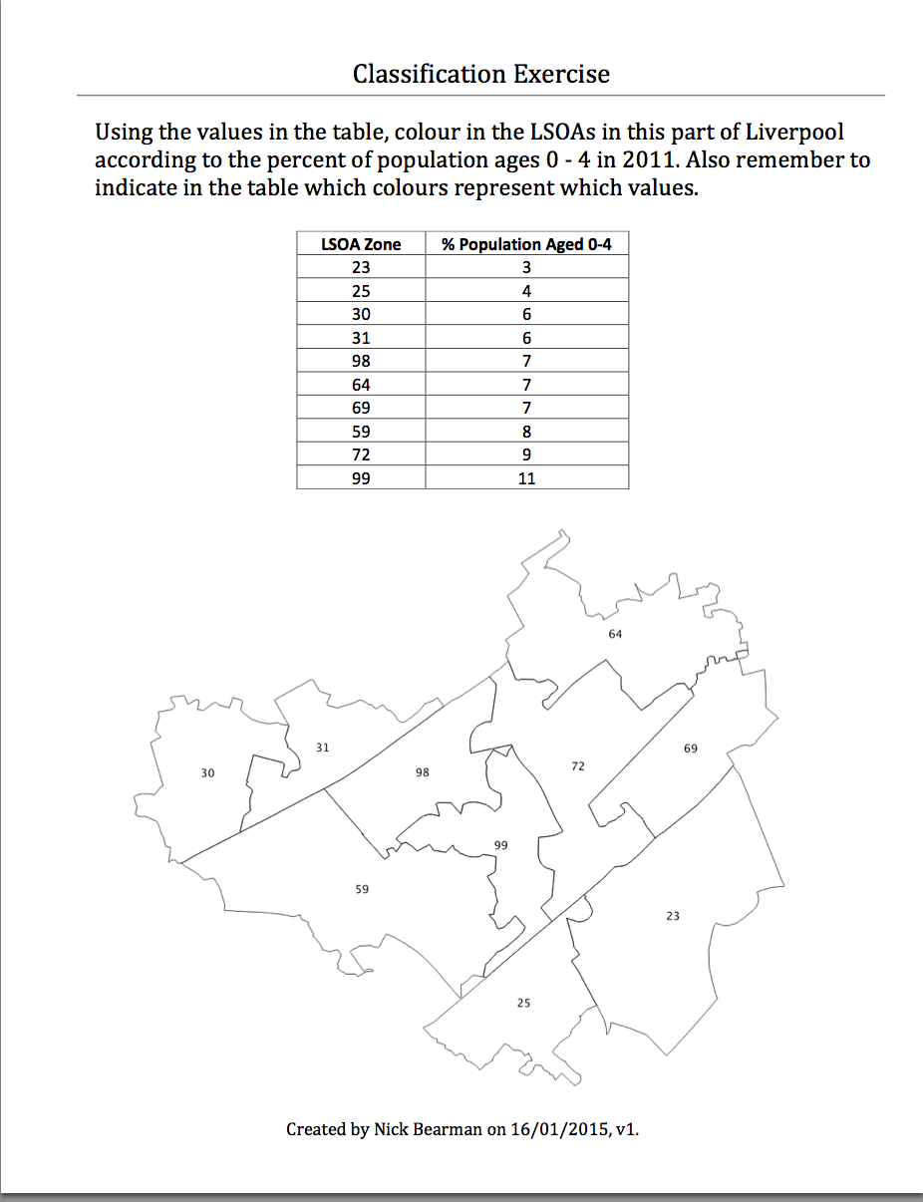
Classification
Colour in the values for Age (10 min)
Discuss your choices

Slide 64
Classification
Colour in the values for Age (10 min)
Discuss your choices
  Colours
  Classes

Slide 65
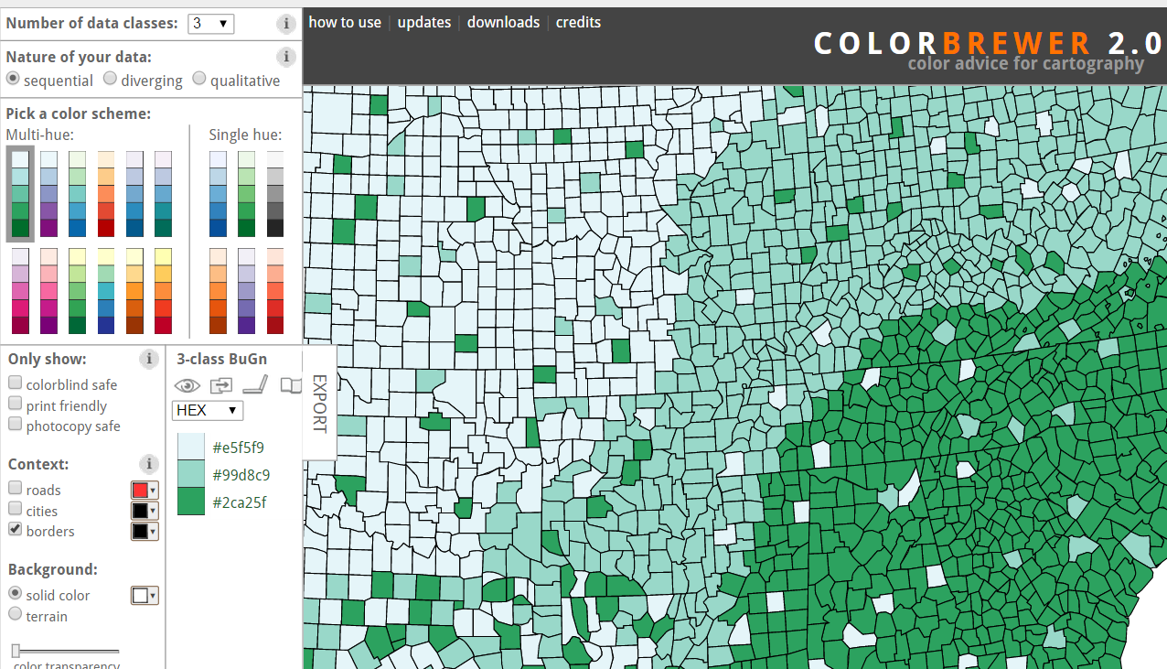
Map Design: Classification
Choropleth maps have colours
How do you choose the colours?
Why is this important?
Output
User
colorbrewer.org

Slide 66
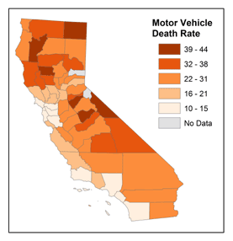
Map Design: Classification
Choropleth maps have classes
How do you choose the classes?
Why is this important?
© 2014 The Pennsylvania State University, https://www.e-education.psu.edu/geog486/l4_p7.html#classification_schemes

Slide 67
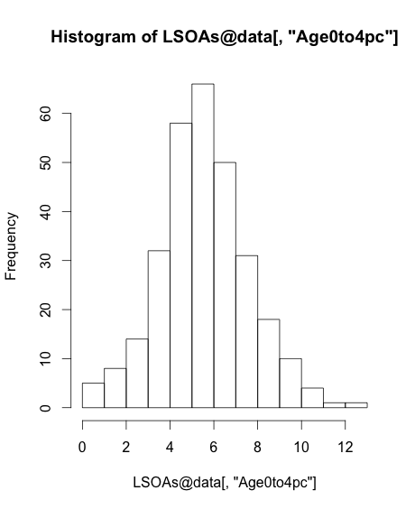
Map Design: Classification
[,"Age0to4pc"]

Slide 68
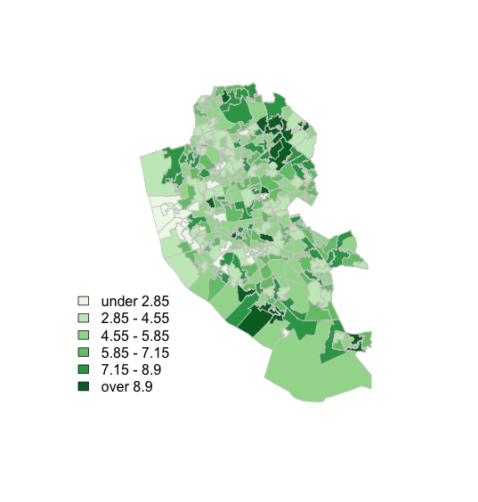
Map Design: Classification

Slide 69
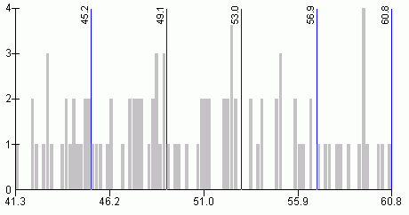
Map Design: Classification
s
http://www.directionsmag.com/entry/choropleth-mapping-with-exploratory-data-analysis/123579

Slide 70
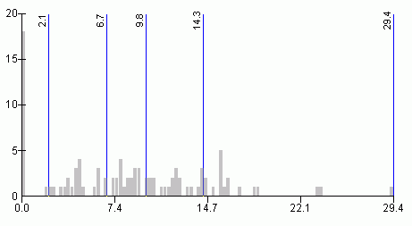
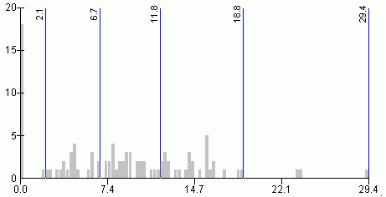
Quantiles
- “equal sized data subsets”
sN
Natural Breaks
reduce variance
within class
increase variance
between classes
http://www.directionsmag.com/entry/choropleth-mapping-with-exploratory-data-analysis/123579

Slide 71
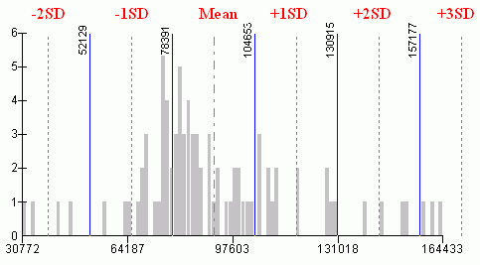
sN
Standard Deviation
R has:
fixed
sd
equal
pretty
quantile
fisher
jenks
….
(from ?classIntervals)
http://www.directionsmag.com/entry/choropleth-mapping-with-exploratory-data-analysis/123579

Slide 72
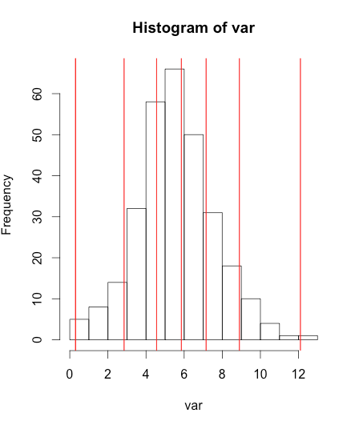
Can do this in R
var <- LSOA@data[,"Age0to4pc"]
breaks <- classIntervals(var, n = 6, style = "fisher")
hist(var)
abline(v = breaks$brks, col = "red")

Slide 73

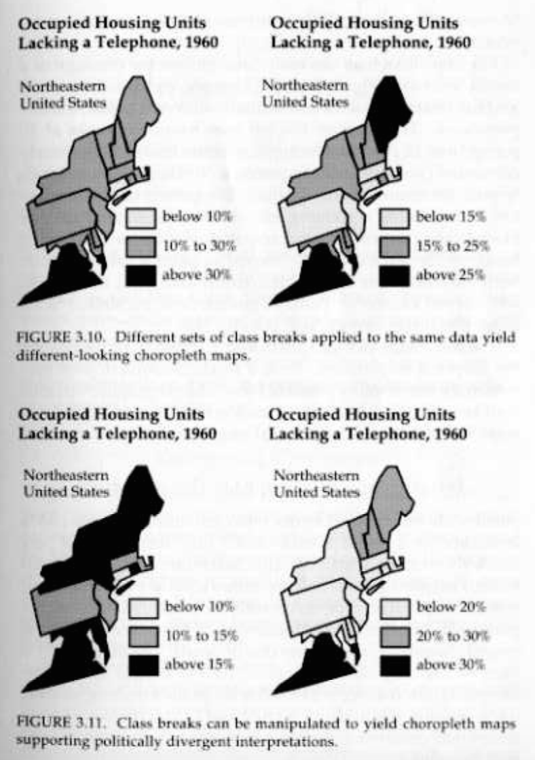
Why is it important?

Slide 74
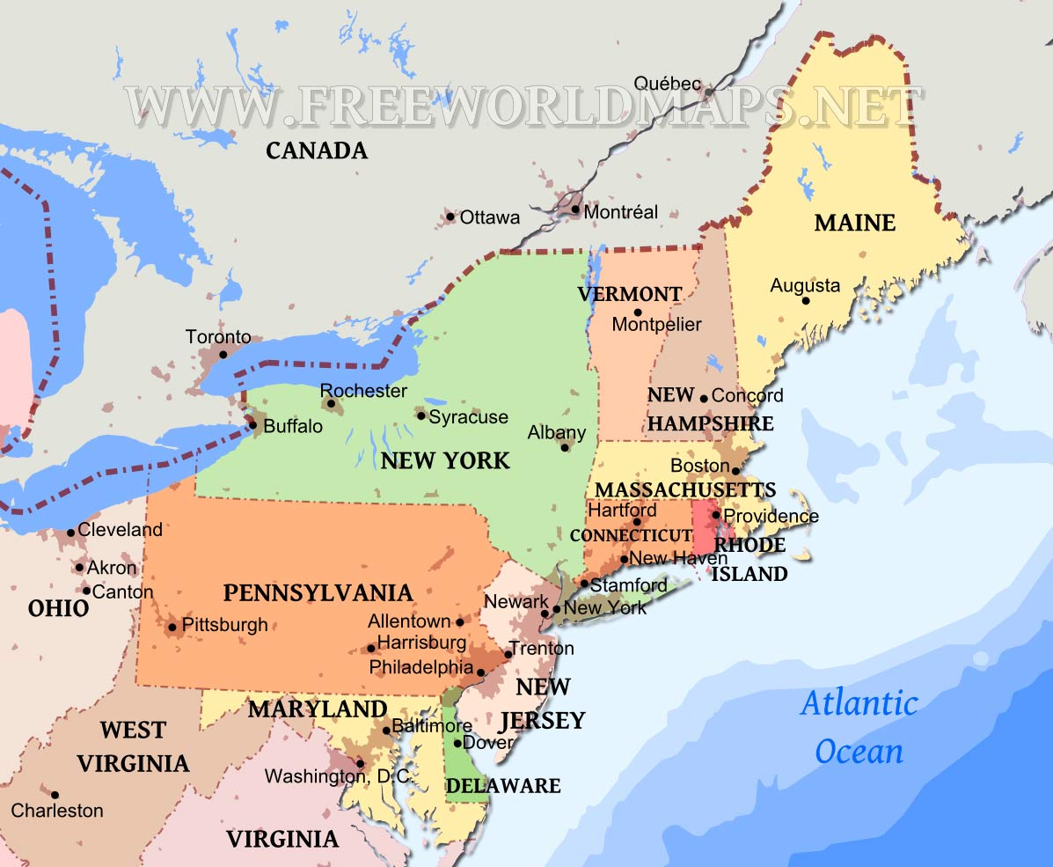
Why is it important?
http://www.markmonmonier.com/how_to_lie_with_maps_14880.htm
https://www.researchgate.net/publication/37420071_How_to_Lie_with_Maps
http://www.freeworldmaps.net/united-states/northeast/

Slide 75
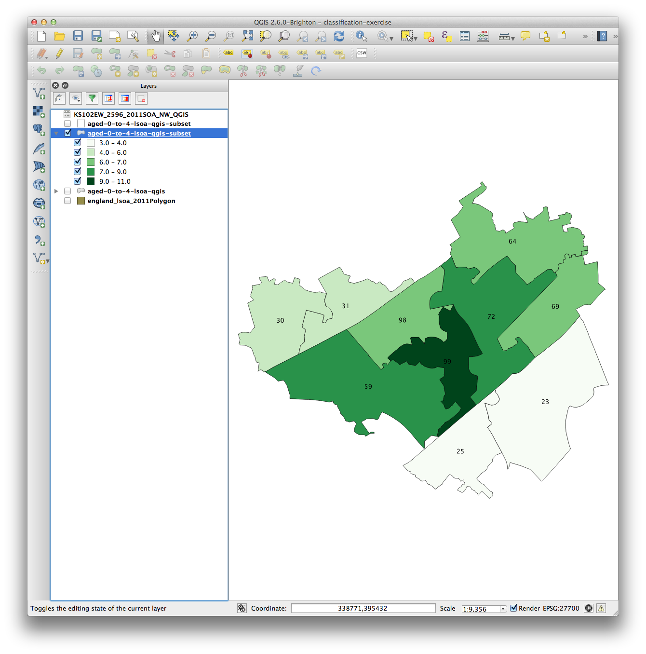
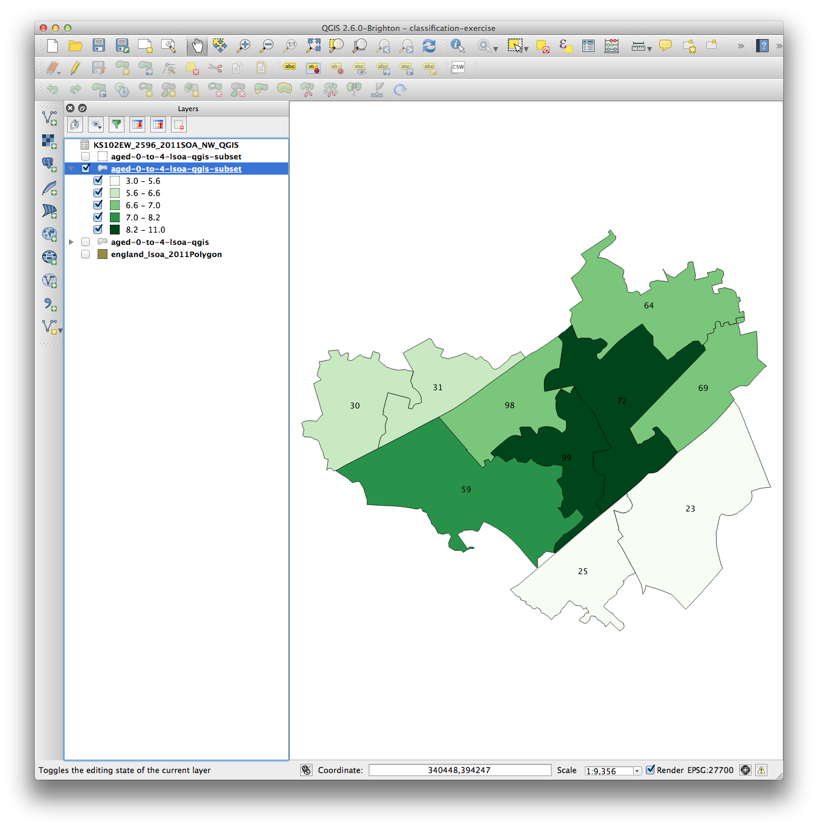
Why is it important?
Age 0-4
Natural Breaks
Quantile

Slide 76
Why is it important?
Age 0-4
Natural Breaks
Quantile

Slide 77
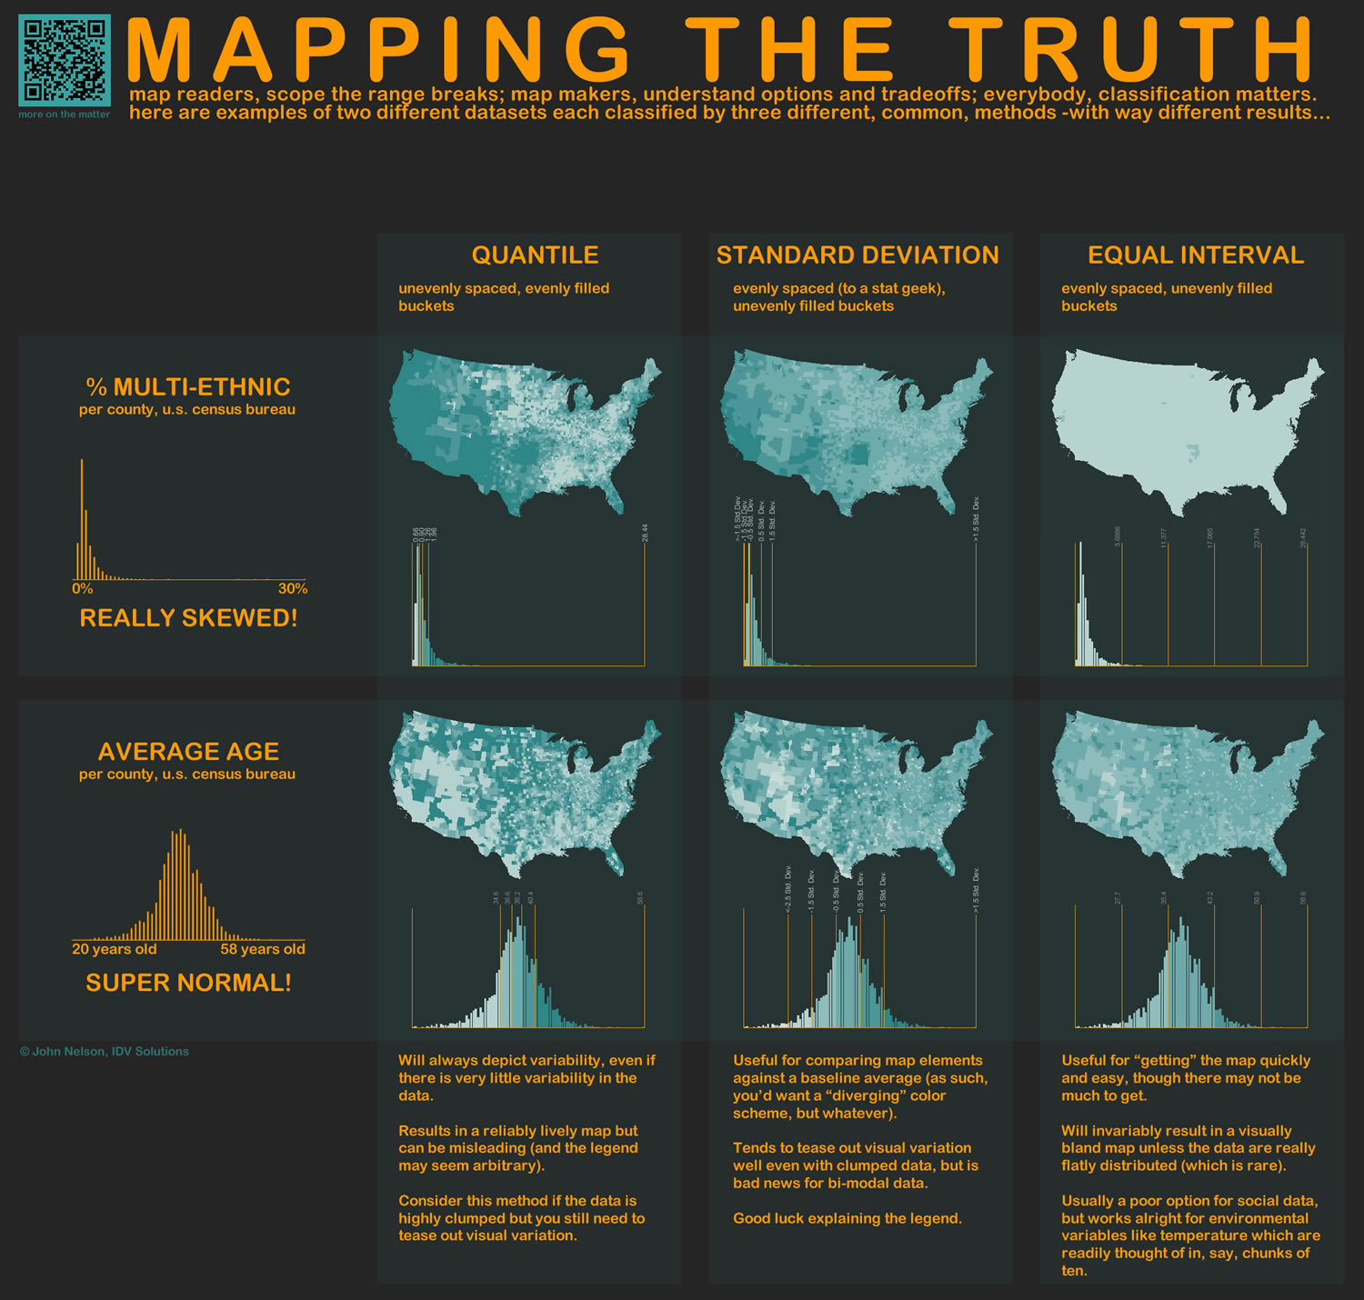
http://www.flickr.com/photos/idvsolutions/6691496421/in/photostream/
http://www.flickr.com/photos/idvsolutions/6691496421/in/photostream/
http://uxblog.idvsolutions.com/2011/10/telling-truth.html

Slide 79
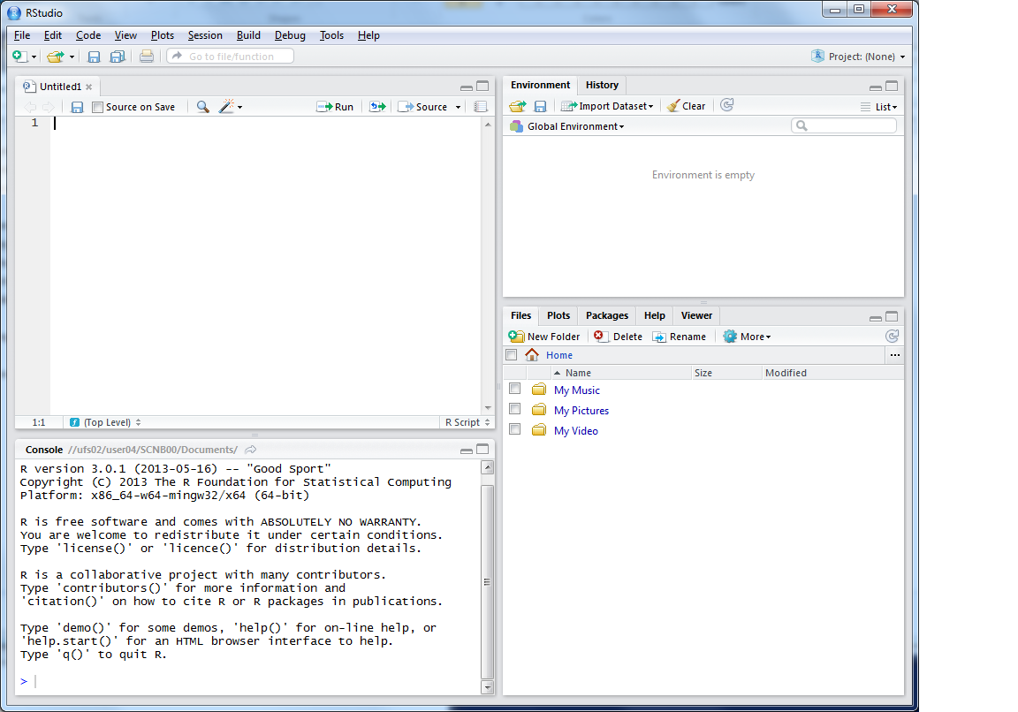
R Scripts
Why use scripts?
  Easier to correct code
  Can easily re run sections of code, or all code if you need to start again
  Good to enable you to reload data etc. if you move machines, or don’t
  have your workspace
  saved

Slide 80
This is where you can write scripts
This lists the variables you have
Link to survey:
Here will show either your files (the files tab) or your plots (the plots tab)
This is the console where you can type in commands

Slide 81
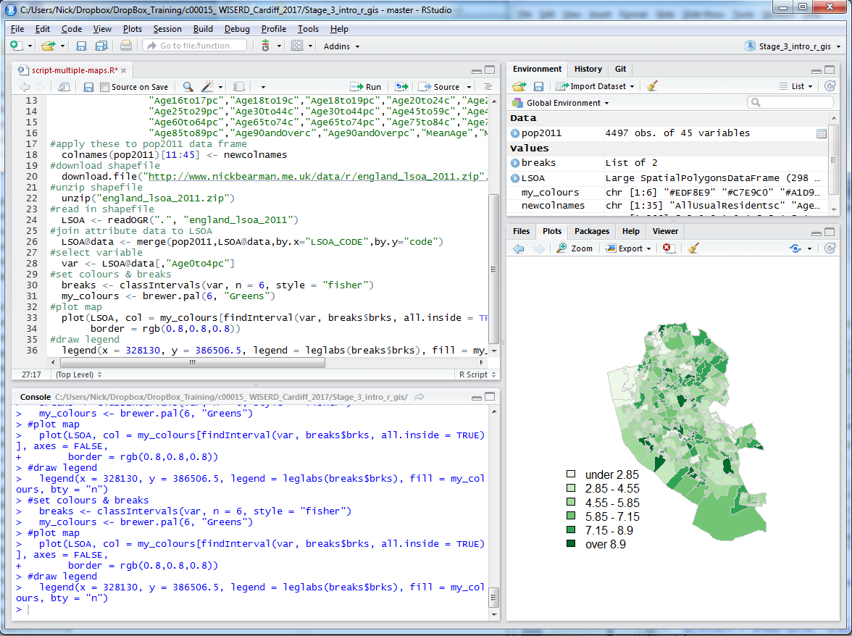

Slide 82

To run script, select lines

Slide 83
Click Run, or Ctrl-Enter

Slide 84
Working directory:

Slide 85
Untitled = you haven’t saved the file at all!
Red = changes have been made since you last saved
Ctrl-s

Slide 86
Code recap
Useful tips
  Up arrow in the console shows you the previous command
  History contains a history of all commands
  Plot window has a back arrow, and an export option
  Tab completion
  Reload libraries

Slide 87
Code debugging
R error messages can be cryptic
Remember
  case sensitive
  picky about , [ ] ( )
  typos
Error in getinfo.shape(fn) : Error opening SHP file can’t find shapefile
Error: could not find function ”readOGR” can’t find function
See glossary helpsheet – and let me know what to add!

Slide 89
Outline of the day
10:15am – 11:00am – What is GIS & R?
11:00am – 11:30am – Prac. 1 Intro to GIS & R
11:30am – 12:00pm – Classification
12:30pm – 12:30pm – Prac. 1 Intro to GIS & R
12:30pm – 1:30pm – Lunch
1:30pm - 1:45pm – Recap and Making Maps
1:45pm – 3:00pm – Prac. 2 Analysis
3:00pm – 3:15pm – Tea/Coffee
3:15pm – 4pm/4:30pm – Prac. 3 BYOD

Slide 90
Lunch
Save your files!

Slide 91
Outline of the day
10:15am – 11:00am – What is GIS & R?
11:00am – 11:30am – Prac. 1 Intro to GIS & R
11:30am – 12:00pm – Classification
12:30pm – 12:30pm – Prac. 1 Intro to GIS & R
12:30pm – 1:30pm – Lunch
1:30pm - 1:45pm – Recap and Making Maps
1:45pm – 3:00pm – Prac. 2 Analysis
3:00pm – 3:15pm – Tea/Coffee
3:15pm – 4pm/4:30pm – Prac. 3 BYOD

Slide 92



Vector and Raster data
Points, Lines & Polygons
Grid Based
Road networks
Rivers and lakes
Street addresses or postcodes
Administrative areas/boundaries
Elevation
Temperature
Land cover
Population density
Light reflectance (in the form of satellite or aerial imagery)
Notes:
-Raster data is constructed by surveying or sampling at regular intervals on a grid layout.
e.g. soil sample every 500m, or interpolated (estimated) from contours.
-Usually assigned a colour in GIS. Includes images, aerial photos.
-You can convert data between the different formats quite easily in the software for different applications

Slide 93
Data Structure – Slot Names
Slot Names slotNames(LSOA)
  "data"
  "polygons"
  "bbox"
  "proj4string"

Slide 94
Data Structure – Slot Names
Slot Names slotNames(LSOA)
"data” ”polygons” "bbox" "proj4string”
LSOA@data
LSOA@data$LSOA_CODE
@ and $
Try running
LSOA@proj4string

Slide 95
Projects
RStudio supports projects
Ties together the workspace (data) and script files.
Saves as a .RProj file
Use a project when you start the next section

Slide 96
Code recap
Scripts
  Highlight: click Run or Ctrl-Enter
Example scripts are available at
  https://github.com/nickbearman/intro-r-spatial-analysis

Slide 97
Code recap
Plotting Maps
plot(LSOA,
col = my_colours[findInterval (var, breaks, all.inside = TRUE)],
axes = FALSE,
border = rgb(0.8,0.8,0.8))

Slide 98
Code recap
Plotting Maps
plot(LSOA,
col = my_colours[findInterval (var, breaks, all.inside = TRUE)],
axes = FALSE,
border = rgb(0.8,0.8,0.8))

Slide 99
Code recap
Plotting Maps
plot(LSOA,
col = my_colours[findInterval (var, breaks, all.inside = TRUE)],
axes = FALSE,
border = rgb(0.8,0.8,0.8))

Slide 100
Code recap
Plotting Maps
plot(LSOA,
col = my_colours[findInterval (var, breaks, all.inside = TRUE)],
axes = FALSE,
border = rgb(0.8,0.8,0.8))

Slide 101
Code recap
Plotting Maps
plot(LSOA,
col = my_colours[findInterval (var, breaks, all.inside = TRUE)],
axes = FALSE,
border = rgb(0.8,0.8,0.8))

Slide 102
Code recap
Plotting Maps
plot(LSOA,
col = my_colours[findInterval (var, breaks, all.inside = TRUE)],
axes = FALSE,
border = rgb(0.8,0.8,0.8))

Slide 103
Code recap
Plotting Maps
plot(LSOA,
col = my_colours[findInterval (var, breaks$brks, all.inside = TRUE)],
axes = FALSE,
border = rgb(0.8,0.8,0.8))

Slide 104
Code recap
col = my_colours[findInterval (var, breaks, all.inside = TRUE)],

Slide 105
Code recap
col = my_colours[findInterval (var, breaks, all.inside = TRUE)],

Slide 106
Code recap
col = my_colours[findInterval (var, breaks, all.inside = TRUE)],
> my_colours
[1] "#EDF8E9" "#C7E9C0" "#A1D99B" "#74C476" "#31A354" "#006D2C"

Slide 107
Code recap
col = my_colours[findInterval (var, breaks, all.inside = TRUE)],
findInterval(var, breaks$brks, all.inside = TRUE)
[1] 3 1 1 2 3 3 1 2 2 2 1 3 3 3 3 4 3 1 2 2 2 2 2 4 2 2 5 3 3 3 4 5 5 4 5 2
[37] 1 1 6 1 2 5 1 4 3 5 4 3 2 4 2 3 2 2 3 5 4 4 3 3 3 4 4 3 3 3 2 3 3 3 3 2
[73] 4 2 4 2 3 2 4 2 3 4 6 3 2 2 2 3 3 4 4 3 5 3 3 4 5 2 3 2 3 2 2 2 2 4 2 2
[109] 3 2 2 4 4 3 6 5 5 4 6 4 5 4 3 2 4 2 5 4 4 4 4 5 5 2 2 4 4 6 5 5 5 4 3 4
[145] 5 3 3 6 5 6 2 6 6 3 6 2 2 3 2 4 2 2 4 3 3 4 5 5 2 5 3 4 6 6 4 4 3 5 2 5
[181] 3 4 4 3 4 4 5 5 5 3 3 4 5 5 2 2 1 4 3 4 5 6 3 4 6 5 4 3 3 5 5 3 3 4 5 5
[217] 4 2 1 1 3 3 5 4 5 6 6 6 3 2 3 3 4 4 3 6 6 2 3 4 4 2 3 3 3 2 3 4 4 3 4 4
[253] 5 4 3 2 5 5 3 2 3 3 3 3 4 3 2 2 2 3 3 3 4 5 4 3 5 2 1 2 1 1 1 1 1 1 1 1
[289] 5 1 1 1 1 3 4 2 4 2

Slide 108
Code recap
col = my_colours[findInterval (var, breaks$brks, all.inside = TRUE)],
> my_colours
[1] "#EDF8E9" "#C7E9C0" "#A1D99B" "#74C476" "#31A354" "#006D2C"
> findInterval(var, breaks$brks, all.inside = TRUE)
[1] 3 1 1 2 3 3 1 2 2 2 1 3 3 3 3 4 3 1 2 2 2 2 2 4 2 2 5 3 3 3 4 5 5 4 5 2
[37] 1 1 6 1 2 5 1 4 3 5 4 3 2 4 2 3 2 2 3 5 4 4 3 3 3 4 4 3 3 3 2 3 3 3 3 2
[73] 4 2 4 2 3 2 4 2 3 4 6 3 2 2 2 3 3 4 4 3 5 3 3 4 5 2 3 2 3 2 2 2 2 4 2 2
[109] 3 2 2 4 4 3 6 5 5 4 6 4 5 4 3 2 4 2 5 4 4 4 4 5 5 2 2 4 4 6 5 5 5 4 3 4
[145] 5 3 3 6 5 6 2 6 6 3 6 2 2 3 2 4 2 2 4 3 3 4 5 5 2 5 3 4 6 6 4 4 3 5 2 5
[181] 3 4 4 3 4 4 5 5 5 3 3 4 5 5 2 2 1 4 3 4 5 6 3 4 6 5 4 3 3 5 5 3 3 4 5 5
[217] 4 2 1 1 3 3 5 4 5 6 6 6 3 2 3 3 4 4 3 6 6 2 3 4 4 2 3 3 3 2 3 4 4 3 4 4
[253] 5 4 3 2 5 5 3 2 3 3 3 3 4 3 2 2 2 3 3 3 4 5 4 3 5 2 1 2 1 1 1 1 1 1 1 1
[289] 5 1 1 1 1 3 4 2 4 2

Slide 109
Code recap
col = my_colours[findInterval (var, breaks$brks, all.inside = TRUE)],

Slide 110
Code recap
col = my_colours[findInterval (var, breaks$brks, all.inside = TRUE)],

Slide 111
Code recap
col = my_colours[findInterval (var, breaks$brks, all.inside = TRUE)],
> breaks$brks
[1] 0.30 2.85 4.55 5.85 7.15 8.90 12.10

Slide 112
Code recap
col = my_colours[findInterval (var, breaks$brks, all.inside = TRUE)],
> breaks$brks
[1] 0.30 2.85 4.55 5.85 7.15 8.90 12.10
> breaks
style: fisher
one of 36,949,857 possible partitions of this variable into 6 classes
[0.3,2.85) [2.85,4.55) [4.55,5.85) [5.85,7.15) [7.15,8.9) [8.9,12.1]
25 64 81 65 44 19

Slide 113
Code recap
col = my_colours[findInterval (var, breaks$brks, all.inside = TRUE)],

Slide 114
Code recap
col = my_colours[findInterval (var, breaks$brks, all.inside = TRUE)],
“If true, the returned indices are coerced into 1,...,N-1, i.e., 0 is mapped to 1 and N to N-1.”

Slide 115
Code recap
col = my_colours[findInterval (var, breaks$brks, all.inside = TRUE)],
“If true, the returned indices are coerced into 1,...,N-1, i.e., 0 is mapped to 1 and N to N-1.”
the first (0) and last (N) values are moved inside the boundaries of the classification
0 moved to within “0 to 1” (0 > 1)

Slide 116
Code recap
Plotting Maps
plot(LSOA,
col = my_colours[findInterval (var, breaks$brks, all.inside = TRUE)],
axes = FALSE,
border = rgb(0.8,0.8,0.8))

Slide 117
Outline of the day
10:15am – 11:00am – What is GIS & R?
11:00am – 11:30am – Prac. 1 Intro to GIS & R
11:30am – 12:00pm – Classification
12:30pm – 12:30pm – Prac. 1 Intro to GIS & R
12:30pm – 1:30pm – Lunch
1:30pm - 1:45pm – Recap and Making Maps
1:45pm – 3:00pm – Prac. 2 Analysis
3:00pm – 3:15pm – Tea/Coffee
3:15pm – 4pm/4:30pm – Prac. 3 BYOD

Slide 118

Making Maps from Census Data
Same as before

Slide 119

Making Maps from Census Data
Same as before, … but:
  Save as PDF

Slide 120

Making Maps from Census Data
Same as before, … but:
  Save as PDF & Loop

Slide 121
Making Maps from Census Data

Slide 122

Plotting Multiple Maps
plot(crime.pts, pch='.', col='darkred')
plot(LSOA, add = TRUE)

Slide 123

Practical
Reload libraries
It should be at the top of your script
Look at example scripts on
https://github.com/nickbearman/intro-r-spatial-analysis
Feedback is really important for me

Slide 124
Tea & Coffee

Slide 125


Slide 126


http://stackoverflow.com/questions/29190219/r-plot-multiple-maps-in-a-grid-from-a-single-shapefile

Slide 127

par(mfrow=c(1,2))
Plot additional rows,columns

Slide 128
Point in Polygon
Points = Crimes
Polygons = LSOA

Slide 129
Overlays / Intersection
Many types, often depends on data type
gContains – wholly within (pts & polys)
gOverlaps – overlaps (not necessarily completely within) (poly & poly)

Slide 130
Outline of the day
10:15am – 11:00am – What is GIS & R?
11:00am – 11:30am – Prac. 1 Intro to GIS & R
11:30am – 12:00pm – Classification
12:30pm – 12:30pm – Prac. 1 Intro to GIS & R
12:30pm – 1:30pm – Lunch
1:30pm - 1:45pm – Recap and Making Maps
1:45pm – 3:00pm – Prac. 2 Analysis
3:00pm – 3:15pm – Tea/Coffee
3:15pm – 4pm/4:30pm – Prac. 3 BYOD

Slide 131
Using your own data
  Get it in to R
  Join it
  Look at the attribute data head(LSOA@data)
  Map it
Or download and map some data from http://data.cdrc.ac.uk
I will come around on a 1-to-1 basis

Slide 133

An Introduction to R for Spatial Analysis and Mapping
Chris Brunsdon, Lex Comber

Slide 134
Analysis Examples
Interpolation (points to surface)
Distance weighting
Spatial Autocorrelation
Clustering – Getis Ord
Geographically Weighted Regression
  Chris Brunsdon
Clustering – Geodemographics
Multi level modelling – space/distance/zone

Slide 135
ArcGIS, QGIS & R
Which one to use?
All is possible in all software
But is easier in some than others!
Whichever you find easiest
  QGIS/ArcGIS quickly visualizing data
  R large data sets / reproducible & repetitive work
No silver bullet…

Slide 136

Common Problems in Mapping
Data availability
  Google, other work
Losing work
  Saving, backups, testing backups
Specific feature not working
  Restart and try again
  Google, Stack Exchange
  (http://www.stackexchange.com/)
How do I do x in y?
  Google, colleagues

Slide 137
Practical
Feedback is really important for me
Or email / phone / in person
Survey to follow tomorrow

Slide 139
Unused Slides

Slide 140
Data Formats
Spatial data
  Spatial*DataFrame
Using Shapefiles
  SpatiaLite
  Reading Personal & File Geodatabases is possible
  Writing is not (easily) possible
RStudio Server can be useful for very large datasets (> multiple tens GB RAM)

