Slide 1
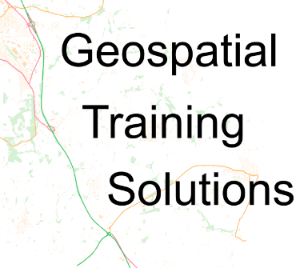
comprehensive training in research methods
Introduction to QGIS: Spatial Data and Spatial Analysis
27th, 28th Feb and 4th , 5th March 2024
10am – 1pm
Dr Nick Bearman
@nickbearmanuk
www.ncrm.ac.uk

Slide 2

Welcome
Please note this lecture is being recorded
If you ask a question or make a comment, your voice/chat may appear on the recording
Please ask me to pause the recording if you do not want your question or comment recorded

