Slide 1
Analysing the Impact of MAUP
on the March of Atopy in England
using Hospital Admission Data
Nick Bearman
Associate Research Fellow in GIS
Nicholas J. Osborne & Clive Sabel

Slide 2
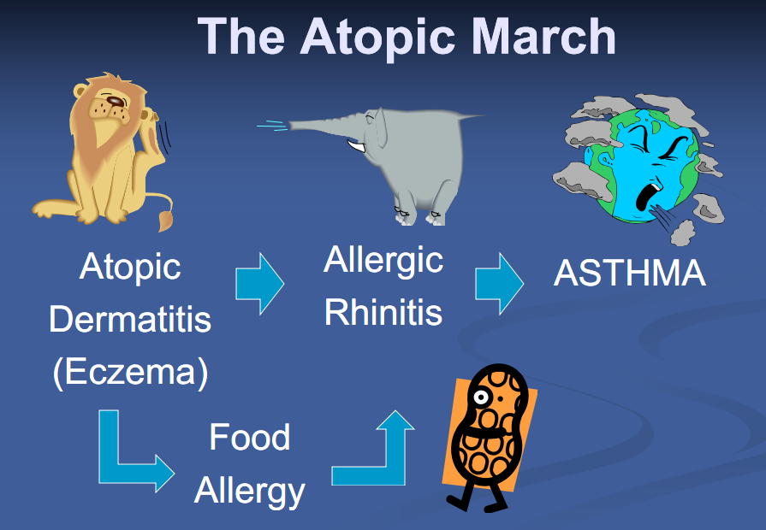
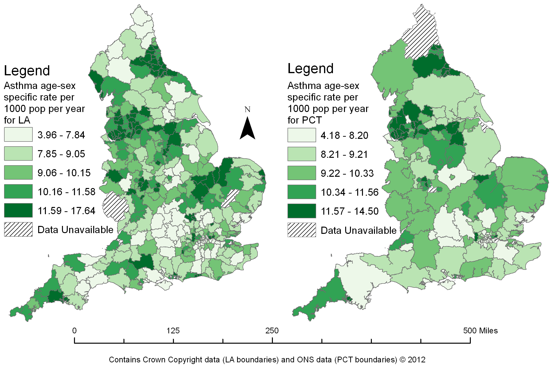
Introduction
Overview
Terms & Literature Review
March of Atopy
MAUP
Hospital Episode Statistics
Results
Conclusions & Future Directions

Slide 3
The March of Atopy
“The atopic march ... describes the progression of atopic disorders, from eczema in young infants ... to allergic rhinitis and ... asthma in older ... children”
Ker and Hartert (2009) p.282
Donell (2011)
Notes:
Concept in Epidemonology
“The atopic march is generally characterized by the progression of atopic dermatitis (eczema) to asthma and allergic rhinitis during the first several years of life.”
Spergel (2010) p.99
Slide from http://www.chicagoasthma.org/site/files/410/114722/390280/545522/CAC_5_10_2010_Atopic_March_presentation_Donnell_[C
http://www.chicagoasthma.org/2011-spring/
THE ATOPIC MARCH: FROM ECZEMA TO ASTHMA Aaron Donnell, MD, Chicago Family Asthma & Allergy, SC

Slide 4
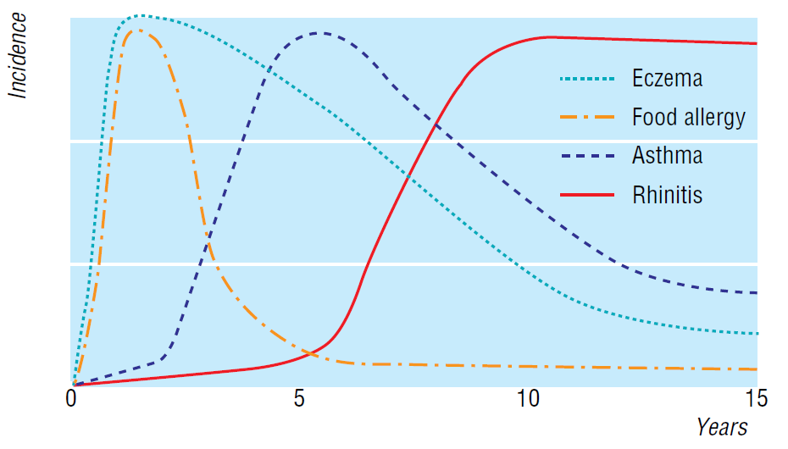
Literature Review
March of Atopy
The March of Atopy is a contested area
Studies show that
childhood eczema / allergies significantly increases the chance of asthma in later life
Barnetson (2002) Fig. 1

Slide 5



Literature Review
Why is this link important?
Managing adult asthma costs the NHS around £1bn per year (Gupta et al., 2004)
If the March of Atopy is correct
Then reducing eczema will have a massive long term cost saving

Slide 6


Literature Review
Issues with using Health Data
Health data are aggregated into larger units, so individuals can’t be identified
GP Practice, PCT (Primary Care Trust)
SHA (Strategic Health Authority)
County, Post Codes, Census Output Areas, Wards
As users of GIS we know this matters…
Notes:
http://topnews.in/health/files/NHS_1.jpg
https://www.census.ac.uk/images/CENSUS%20UK%20WITH%20STRAP%20(RGB)%20297x96.jpg

Slide 7
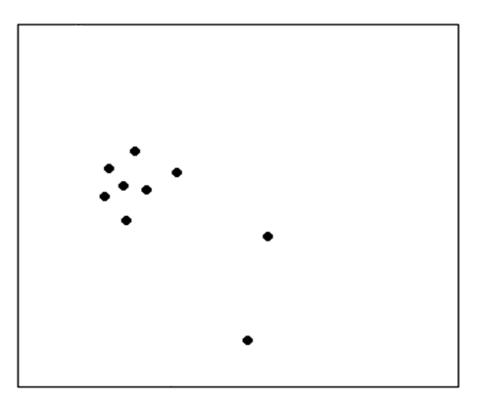
Literature Review
MAUP – Modifiable Areal Unit Problem

Slide 8
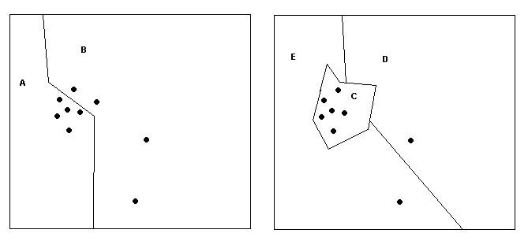
Literature Review
An example....
A | B
5 | 4

Slide 9
Literature Review
A second example
C | D | E
7 | 1 | 1

Slide 10
Literature Review
Same data – different message
A | B
5 | 4
C | D | E
7 | 1 | 1

Slide 11
Literature Review
When point data are aggregated into polygons,
any resulting summary data are influenced by the choice of area boundaries
A | B
5 | 4
≠
C | D | E
7 | 1 | 1

Slide 12
Literature Review
March of Atopy is a contested concept
Many studies do not discuss aggregation of data
Often epidemiological studies ignore MAUP
Is MAUP partly responsible for the contested nature of the March of Atopy?
Compare the relationship between asthma, eczema and allergy data
At different spatial aggregation levels

Slide 13
Methods
Hospital Episode Statistics (HES) data
All admissions of patients to hospital
emergency (e.g. A&E) and referral (e.g. from GP)
Positives
Good spatial coverage for England
Comprehensive
Negatives
Only capture severe cases
Issues with small numbers / confidentiality

Slide 14
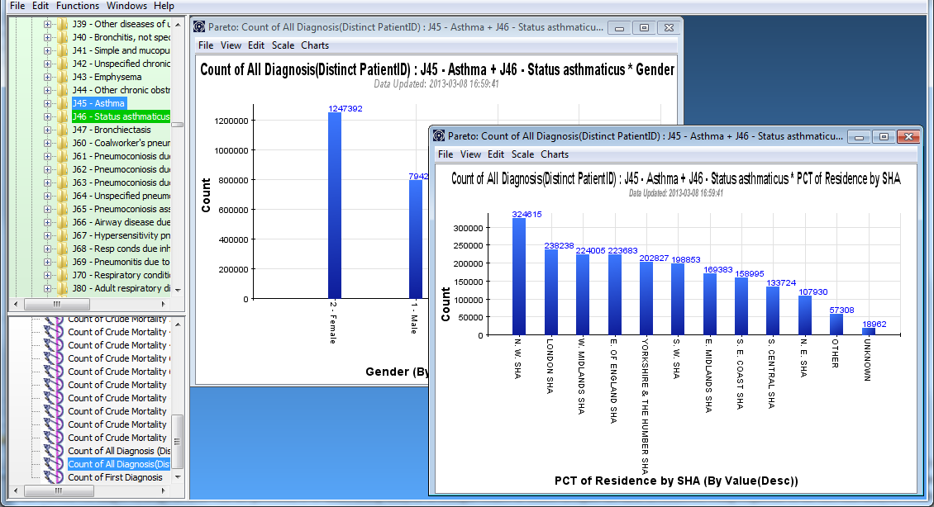
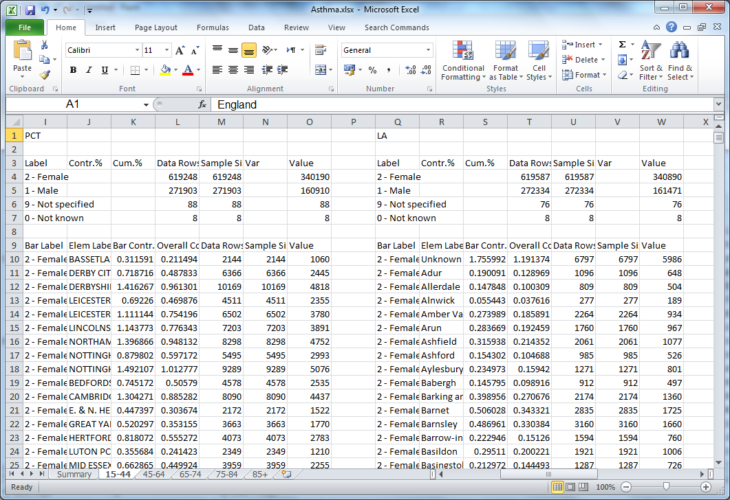
Methods
Lightfoot

Slide 15
Methods
Method
Using ICD-10 codes to define disease (Anandan et al., 2009)
Filtered by PatientID, so per person
Calculate age-sex directly standardised rates for
Eczema 0-14 years, Allergy 0-14 years
Asthma 15+ years
2008/9 to 2010/11 (3 years)
Data for England
PCT (152), LA (354)

Slide 16
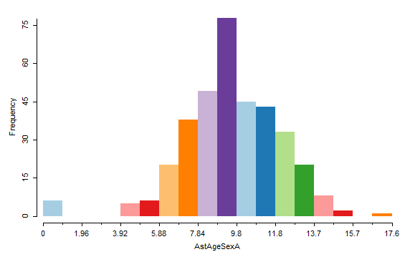
Results
Asthma age-sex directly standardised rates per 1000 by LA

Slide 17
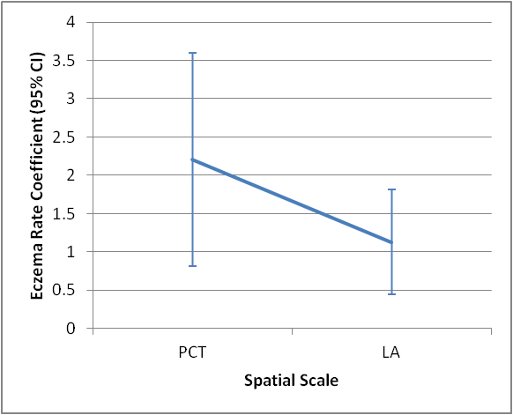
Results
Linear Regression
Impact of presence of Eczema on likelihood of suffering Asthma
Allergy not significant
Also corrected for IMD, which made no difference
No significant difference between PCT & LA
 | N | Eczema |  |  |  | Constant
 |  | Coef. | p | 95% Conf. Int. |  | Coef. | p
PCT | 123 | 2.21 | 0.002 | 0.81 | 3.60 | 7.36 | <0.001
LA | 168 | 1.13 | 0.001 | 0.45 | 1.82 | 6.86 | <0.001

Slide 18
Results
Limitations
Ideally need eczema and asthma data for same individuals
But these are difficult/expensive to access and don’t exist with sufficiently detailed medical reporting
Assuming individuals don’t move around too much / rates in one place don’t change over time

Slide 19
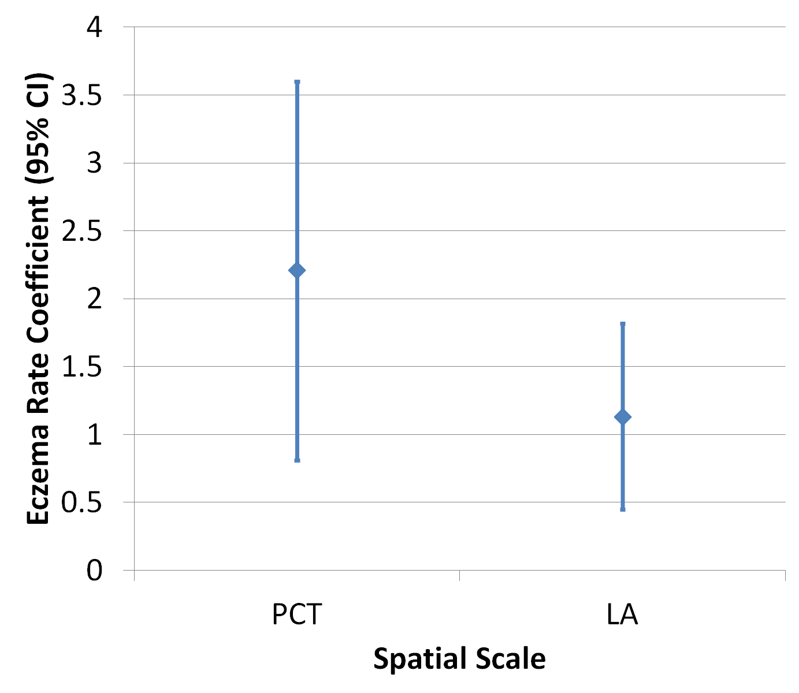
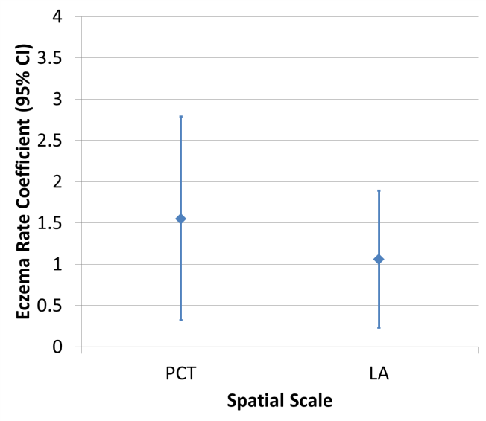
Results
Missing ~20% of cases at LA level because data <6 cases per sex per year are supressed
Did subset comparison of PCT & LA complete data

Slide 20
Results
Results

Slide 21

Results
Clustering
Can look for unusual clusters
Where values are higher (or lower) than expected
Use univariate LISA:
To identify statistically significant clusters
Local Indicators of Spatial Autocorrelation
(Anselin, 1995)
Notes:
Image http://cdn3.hark.com/images/000/002/631/2631/original.gif
http://www.hark.com/collections/dtqzfmzlvm-lisa-simpson

Slide 22
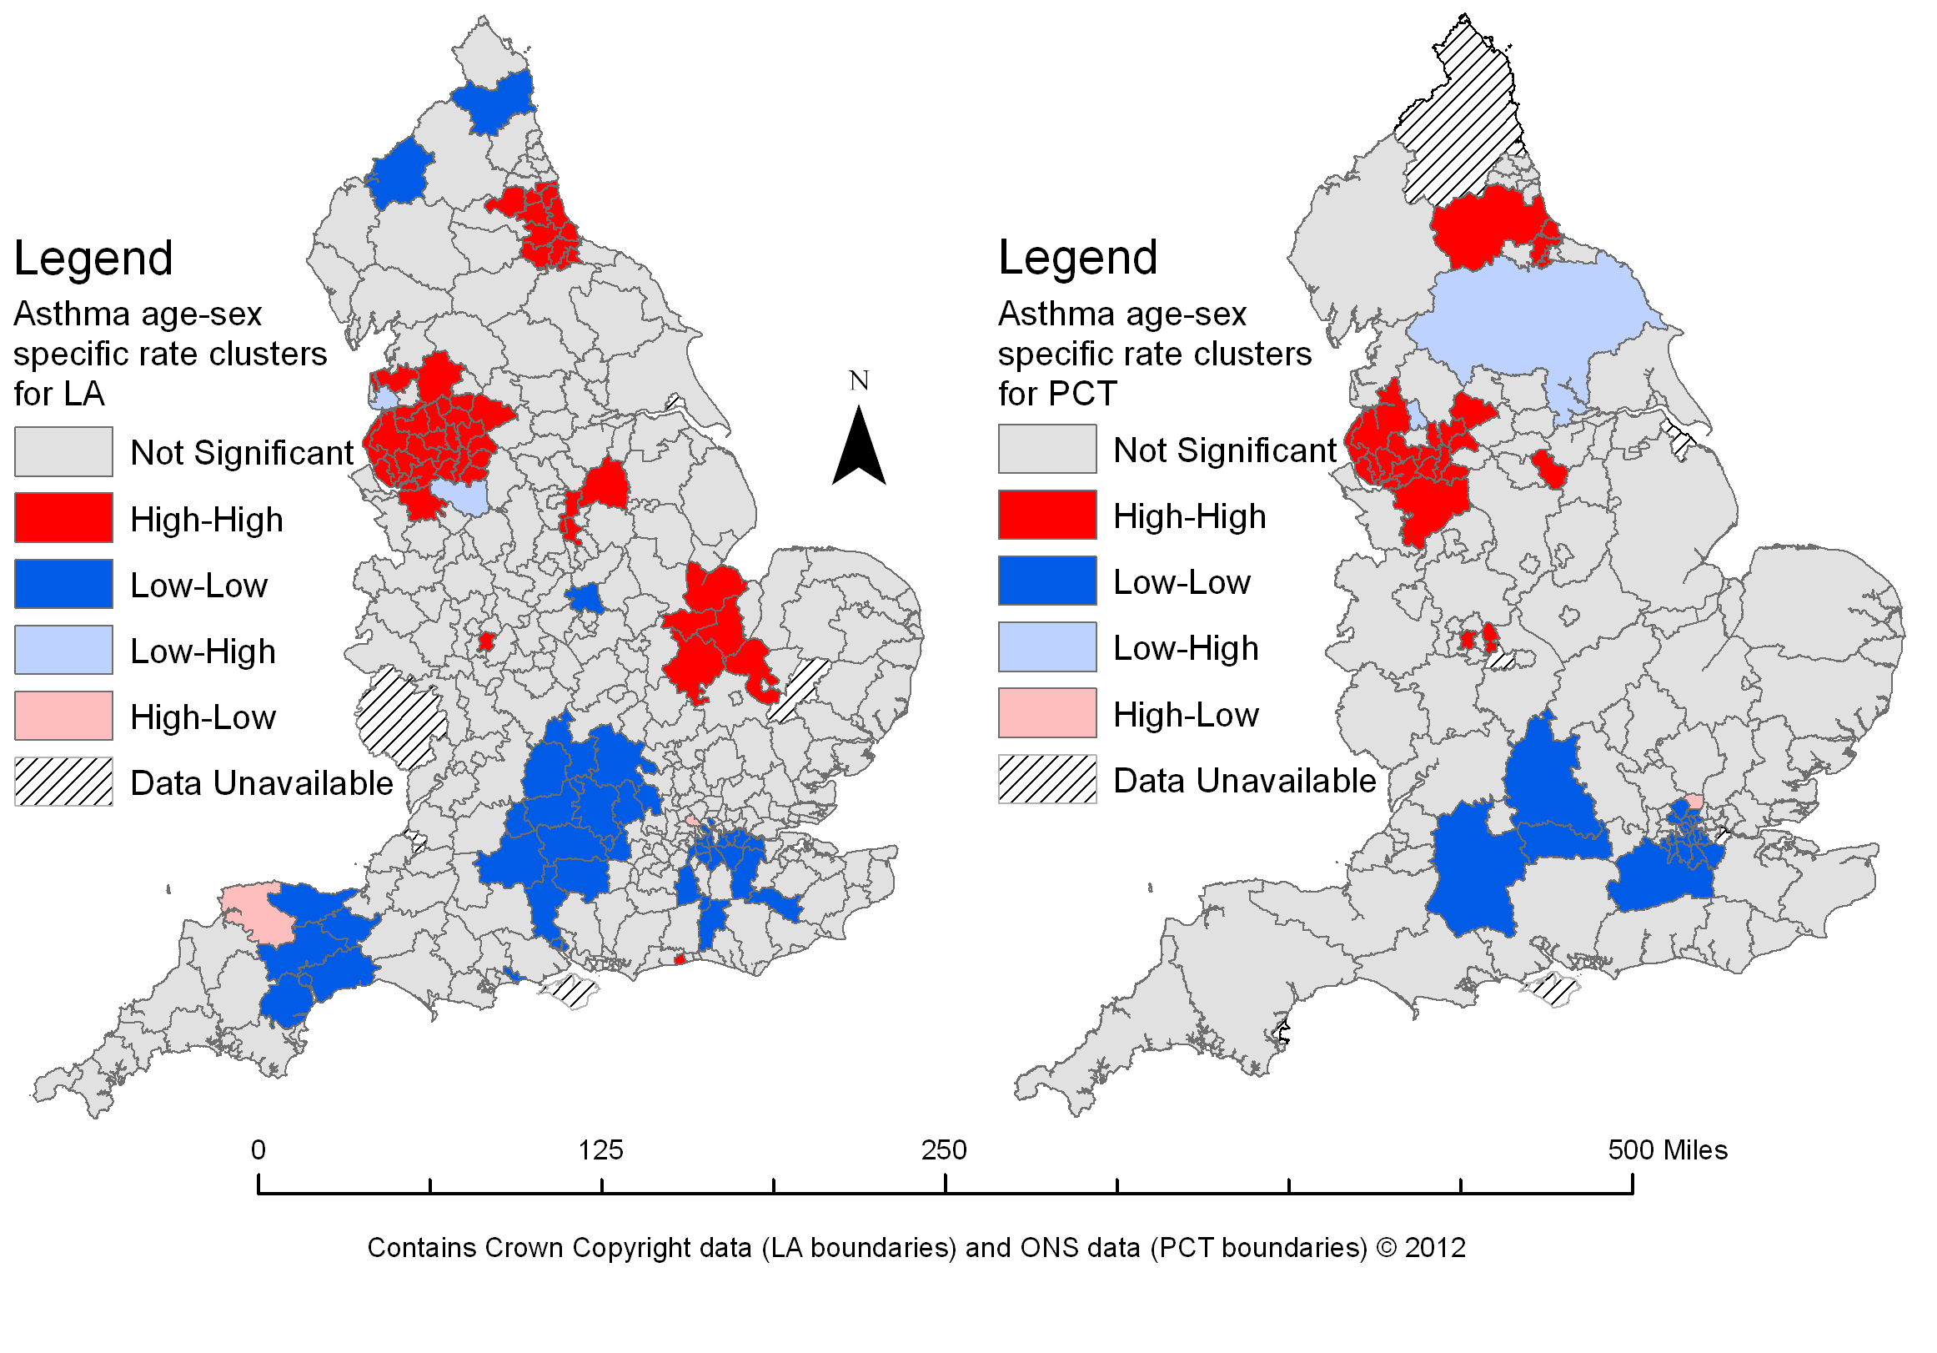
LISA
Also highlights some of the loss of detail moving from LA to PCT
Notes:
SES

Slide 23
Next Stages
PCT -> LA -> GP?
Next stage would be to look at data by GP (n~8000)
But HES data where n < 6 is supressed
Unsupressed data costs too much to access
(~£1500)
(Hopefully) be able to get data by Postcode District (n~2000) from Met Office

Slide 24
Conclusions
Conclusions
For this instance of the March of Atopy, using these data, MAUP is not an issue
Need more data to further explore the issue
Ideally GP, but Postcode District will provide more information
Moving from LA to PCT can result in a loss of data

Slide 25
Questions?
n.bearman@exeter.ac.uk

Slide 26
Regression with Allergy
 | N | Eczema |  |  |  | Allergy |  | Constant
 |  | Coef. | p | 95% Conf. Int. |  | Coef. | p | Coef. | p
PCT | 123 | 2.19 | 0.003 | 0.74 | 3.64 | 0.05 | 0.923 | 7.33 | <0.001
LA | 168 | 1.21 | 0.001 | 0.47 | 1.94 | -0.20 | 0.545 | 7.02 | <0.001
 | N | Eczema |  |  |  | Constant
 |  | Coef. | p | 95% Conf. Int. |  | Coef. | p
PCT | 123 | 2.21 | 0.002 | 0.81 | 3.60 | 7.36 | <0.001
LA | 168 | 1.13 | 0.001 | 0.45 | 1.82 | 6.86 | <0.001

Slide 27
Subset Analysis
Original
Subset

Slide 28
Subset Analysis
Age-sex specific rates per 1000 population per year |  | PCT | LA
Asthma (aged 15+) | Mean | 10.086 | 10.602
 | St Dev | 2.339 | 2.410
Eczema (aged 0-14) | Mean | 0.226 | 0.283
 | St Dev | 0.402 | 0.605
Allergies (aged 0-14) | Mean | 0.961 | 0.913
 | St Dev | 0.346 | 0.340
 | N | Eczema |  |  |  | Allergy |  | Constant
 |  | Coef. | p | 95% Conf. Int. |  | Coef. | p | Coef. | p
PCT | 84 | 1.43 | 0.028 | 0.16 | 2.71 | 0.57 | 0.441 | 9.21 | <0.001
LA | 87 | 0.93 | 0.035 | 0.07 | 1.79 | 0.78 | 0.318 | 9.63 | <0.001
 | N | Eczema |  |  |  | Constant
 |  | Coef. | p | 95% Conf. Int. |  | Coef. | p
PCT | 84 | 1.55 | 0.014 | 0.32 | 2.79 | 9.73 | <0.001
LA | 87 | 1.06 | 0.013 | 0.23 | 1.89 | 10.30 | <0.001

Slide 29
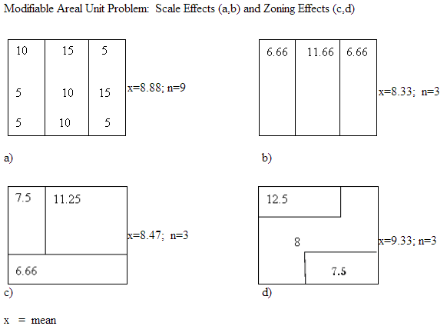
MAUP – Scale and Aggregation/Zoning Effects
From: http://www.geog.ubc.ca/courses/geog570/talks_2001/scale_maup.html

