Slide 1
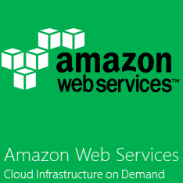


✔
Compute
Cloud Compute & Networking
Storage
Database
Manage
Storage and Content Delivery
SQL and No-SQL
Deployment and Management
Apps
Platforms as a Service

Slide 2
Title text
Subtitle text
text
Text
Text
Text
text

Slide 3
