Slide 1
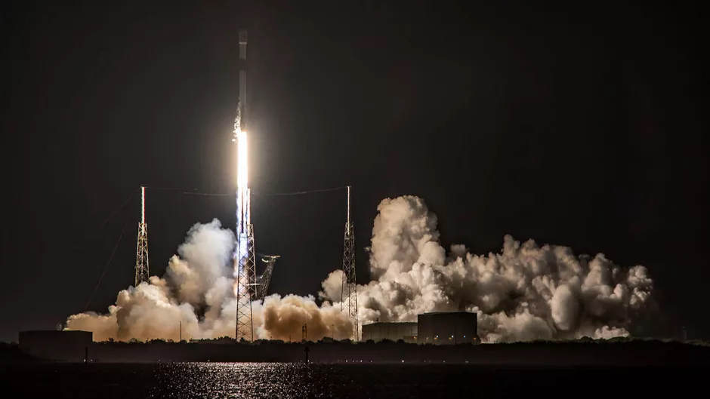


IBM Data Science Capstone
Nick Belgau
9/7/21

Slide 2
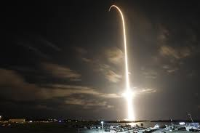
Outline
Executive Summary
Introduction
Methodology
Results
Conclusion
Appendix

Slide 3
Executive Summary
Summary of methodologies
Data collection
Data wrangling
EDA with data visualization
EDA with SQL
Building an interactive map with Folium
Building an interactive dashboard with Plotly Dash
Predictive analysis (classification)
Summary of all results
Exploratory data analysis results
Interactive analytics demo in screenshots
Predictive analysis results
https://github.com/belgau/spacex_capstone

Slide 4
Introduction
Project Background
This project predicts if the Falcon 9 first stage will land successfully. SpaceX advertises the Falcon 9 rocket launches with a cost of $62MM whereas other providers cost upwards to $165MM. If it can be determined that the first stage will land successfully, then the cost of the launch can be determined. This information can be used to keep SpaceX competitive for rocket launches.
Common Problems
What influences if the rocket will land successfully?
What is the relationship with certain rocket variables in determining the success rate of a landing?
What conditions does SpaceX need to have the highest success landing rate?

Slide 5
METHODOLOGY

Slide 6
Methodology
Perform EDA using visualization and SQL
Plotting using Seaborn & Matplotlib
Scatter graphs & bar graphs to show patterns in the data
Interactive visual analytics using Folium and Plotly Dash
Web hosted dashboard
Perform predictive analysis using classification models
How to build, tune, evaluate classification models
Data collection methodology
SpaceX Rest API
Web scrapping launch sites
Perform data wrangling
Data was transformed into a Feature Matrix for Machine Learning
LabelEncoder to transform categorical variables for ML and dropping irrelevant columns

Slide 7
Data Collection Process Overview
Dataset
Web Scrapping
To predict whether a SpaceX rocket will attempt to land a rocket or not, data was compiled from multiple sources to build the dataset.
Launch data was available from the SpaceX REST API
This provided data about launches, rocket use, payload, launch specs, landing specs, and landing outcome
https://api.spacexdata.com/v4/launches/past
Additional data was scrapped from Wikipedia using Beautiful Soup to supplement the launch data
REST API
Request from API
Get HTML Response from Wiki
API returns JSON data
Extract using beautifulsoup
Basic manipulation
Basic manipulation
Convert to CSV
Convert to CSV
https://github.com/belgau/spacex_capstone/tree/main/Dataset

Slide 8

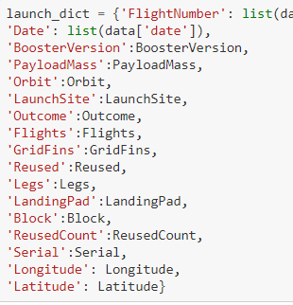
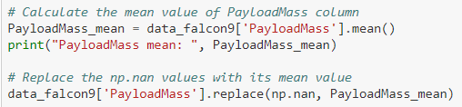
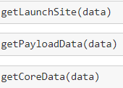
Data Collection – SpaceX REST API
Get response from HTML
Convert response to JSON
Apply custom function to manipulate data
Assign list to dictionary
Convert to dictionary to dataframe
Filter dataframe to only show ‘Falcon 9’
Deal with Missing Values
Export dataframe as .CSV
https://github.com/belgau/spacex_capstone/tree/main/Getting_Data_From_SpaceX_API

Slide 9
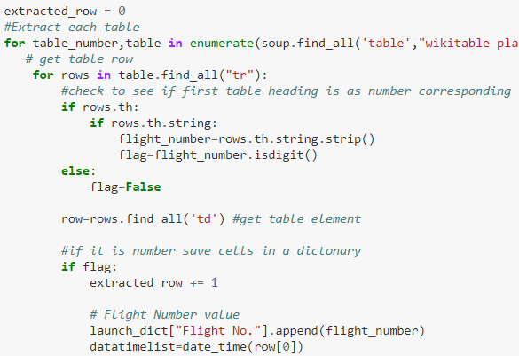
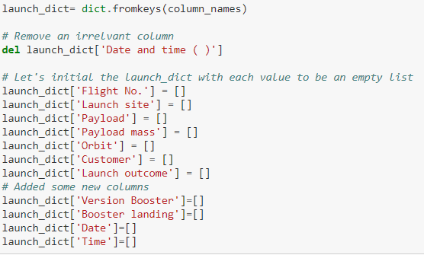
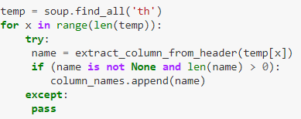
Data Collection – Web Scrapping
Appending data to keys
Convert dictionary to dataframe
Export dataframe as .CSV
Get response from HTML
Create BeautifulSoup object
Finding the HTML web tables
Get column names
Create dictionary
https://github.com/belgau/spacex_capstone/tree/main/Getting_Data_From_Webscraping

Slide 10
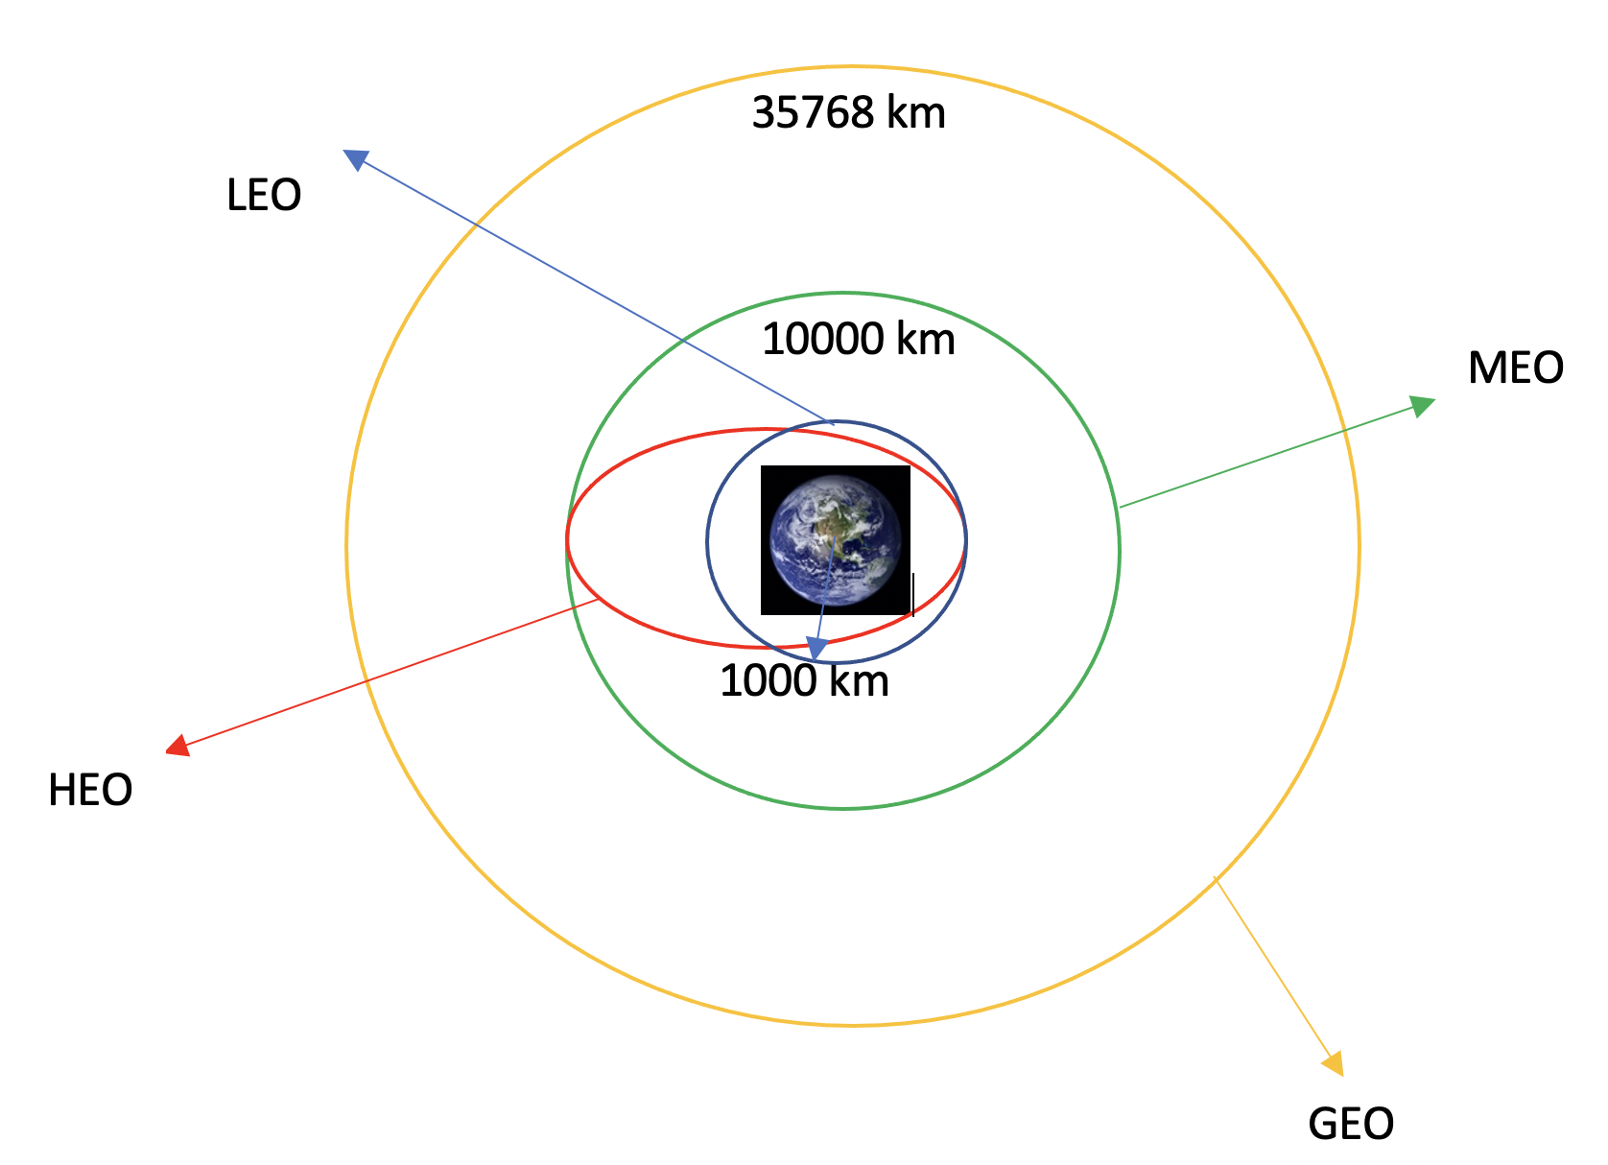
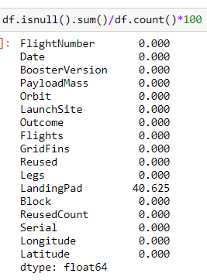
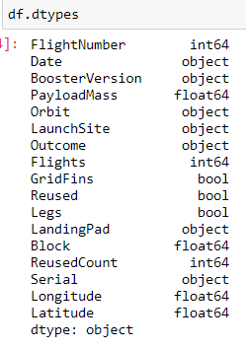
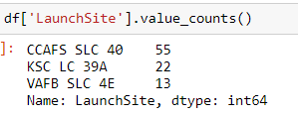
Data Wrangling
Once the CSV dataset was imported and converted to a pandas dataframe, a brief inspection of the following characteristics of the data was conducted
For each column, the data type and percentage of missing values was inspected
Using value_counts, the following was determined
Number of launches on each site
Number of occurrence by orbit
Number of mission
The various outcomes were classified as either success or failure and assigned as a Boolean to a new dataframe column.
Success: 1
Failure: 0
The success rate of the overall dataset could be determined, but will be further dissected in deeper data analyses techniques later
https://github.com/belgau/spacex_capstone/tree/main/Data_Wrangling

Slide 11
EDA with Data Visualization
Seaborn, which is a high-level plotting library on top of matplotlib, was used for statistical figures
Various forms of Scatterplots were used to visually represent relationships of different variables and show how much one variable affects the other
Bar Charts were also used to display numerical stats, delineated by a categorical variable such as orbit type
After EDA, a feature matrix of the best variables was developed
Categorical variables were considered candidates for OneHotEncoding, but were determined to be non-binary.
https://github.com/belgau/spacex_capstone/tree/main/EDA_Data_Visualization

Slide 12

EDA with SQL
Data was uploaded from CSV to SQL database
Various queries were executed to pull specific data and the corresponding landing outcome
More information regarding these queries can be found at my GitHub
https://github.com/belgau/spacex_capstone/tree/main/EDA_SQL

Slide 13
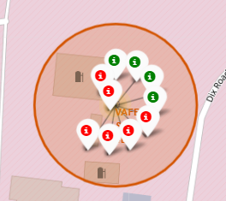
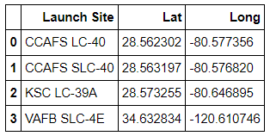
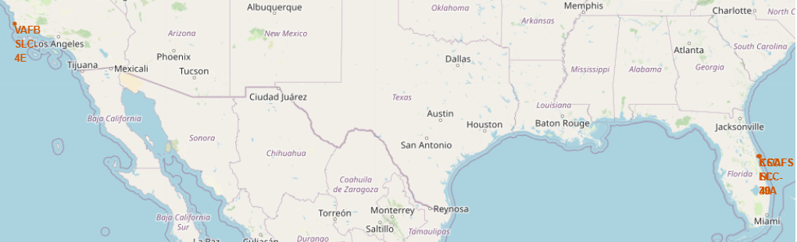
Interactive Map & Launch Site Proximity Analysis
The web scrapped latitudinal and longitudinal coordinates from Wikipedia were used to develop an interactive map using folium.
Interactive Map Generation
The initial map object was defined
All launch sites were pinned on the map
Each launch site was labeled with success or failure markers
Launch Site Proximity Analysis
The data was explored to investigate if there was a relationship between distance to nearby objects and success rate
For example, distance to highway and distance to Orlando was measured
https://github.com/belgau/spacex_capstone/tree/main/Folium_Site_Launch_Locations

Slide 14

Interactive Web Dashboard
Dash was used to develop an interactive dashboard hosted on the web
Features of the dashboard include
Pie Chart
Displays total successful launches by site
Dropdown to filter pie chart by site to show successful launch rate
Scatterplot
Channels all version types by success, plotted against payload
Slider bar to filter payload range
https://github.com/belgau/spacex_capstone/tree/main/Interactive_Web_Dashboard

Slide 15
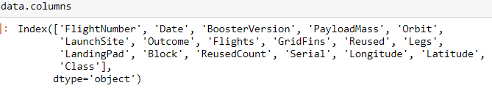

PREDICTIVE ANALYSIS (CLASSIFICATION)
Model Building Process
Load dataset from csv to pandas dataframe
Define feature matrix (X) and response variable (Y)
Preprocessing of the data: standardize the feature matrix
Split data into training and test data sets
Identify ML algorithms to use: Logistic Regression, SVM, Decision Tree, KNN
Train each model type while using GridSearchCV to optimize hyperparameters and solver methods
Feature matrix
Response Variable
1: Success
0: Failure
https://github.com/belgau/spacex_capstone/tree/main/Machine_Learning_Prediction

Slide 16
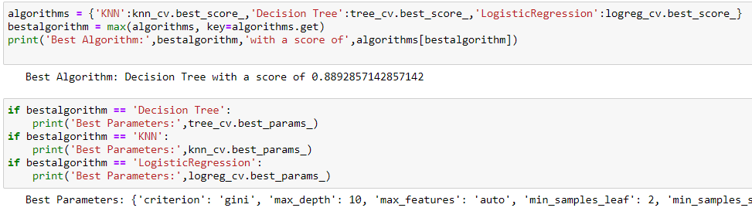
PREDICTIVE ANALYSIS (CLASSIFICATION)
Evaluating Each model
Output the tuned hyperparameters from GridSearchCV using model.best_params_ method
Output the accuracy of each model using model.best_score_ method
Plot the confusion matrix
Finding the Best Model
Best performing model = highest accuracy of training set
A function was developed to automatically rank them
Having this function is helpful for iterative processes where feature matrix improvement and tuning continue
https://github.com/belgau/spacex_capstone/tree/main/Machine_Learning_Prediction

Slide 17
RESULTS

Slide 18
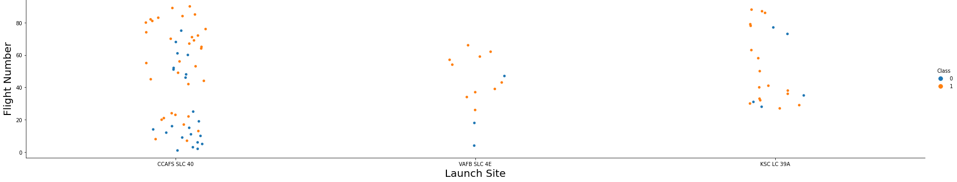
Flight Number Vs. Launch Site EDA with Data Visualization
Flights became more successful with more launches at each site.
CCAFS SLC-40 had mostly unsuccessful launches at the beginning.
https://github.com/belgau/spacex_capstone/tree/main/EDA_Data_Visualization

Slide 19
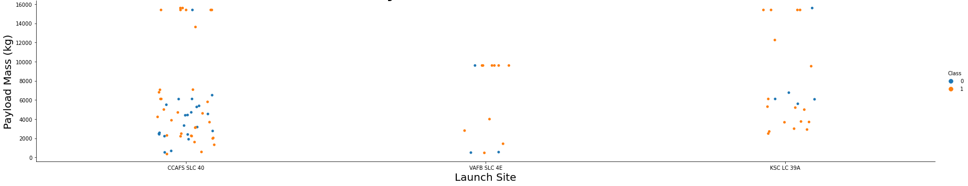
Payload vs. Launch Site EDA with Data Visualization
VAFB SLC-4E typically launched payloads around 10,000 kg and had a few smaller loads as well.
The payload distribution at CCAFS SLC-40 was bimodal split at <8,000 kg and 14,000-15,000 kg
Heavier payloads appears to have fairly high success rate, but this may be a function of another variable like time.
CCAFS SLC-40 appears to have the lowest success rate when considering all payload ranges.
https://github.com/belgau/spacex_capstone/tree/main/EDA_Data_Visualization

Slide 20
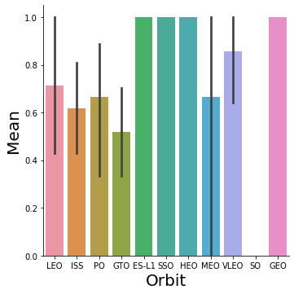
Orbit Success Rate EDA with Data Visualization
Several orbits had 100% success!
ES-L1, SSO, HEO, GEO
However, they lacked clear confidence intervals, so more data may be required to make a concrete conclusion
https://github.com/belgau/spacex_capstone/tree/main/EDA_Data_Visualization

Slide 21
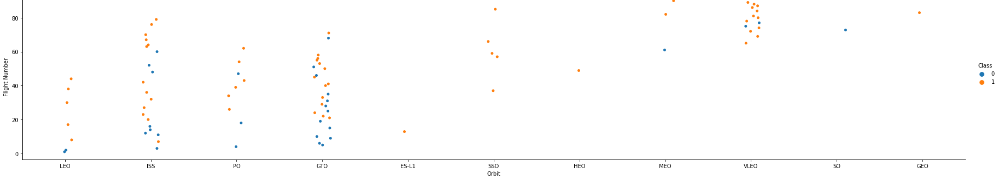
Flight Number vs. Orbit EDA with Data Visualization
LEO appears to be related to flight number since it is evenly spaced on the swarm plot.
The highest orbit, GEO, was a more recent flight.
ISS flights occurred throughout the entire flight number range.
Although, many ISS flights were unsuccessful – it appears to have a lower success rate.
SSO was the only orbit that was conducted more than once (5 total) while maintaining 100% success.
https://github.com/belgau/spacex_capstone/tree/main/EDA_Data_Visualization

Slide 22
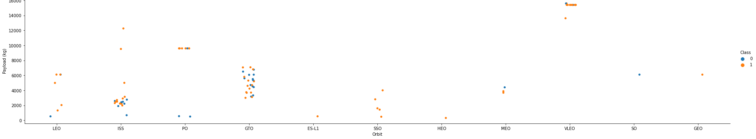
Payload vs. Orbit EDA with Data Visualization
The heaviest payloads were on the VLEO orbit
However, payload has a negative influence on GTO, SSO, MEO, and HEO orbits.
This statement is most conclusive on GTO and SSO orbits since it has significant samples
PO orbits tend to be bimodal, with the most occurring at 10,000 kg (and successful!)
https://github.com/belgau/spacex_capstone/tree/main/EDA_Data_Visualization

Slide 23
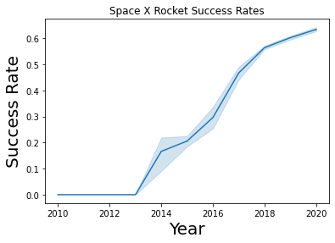
Success Rate vs. Year EDA with Data Visualization
Success rate clearly increases over time!
The variability in the success rate appears to be tightening over time.
This indicates that not only is SpaceX becoming more successful, but they are becoming more consistent!
The success Rate does not appear to be linear which may just be a nature of the compiled metric.

Slide 24
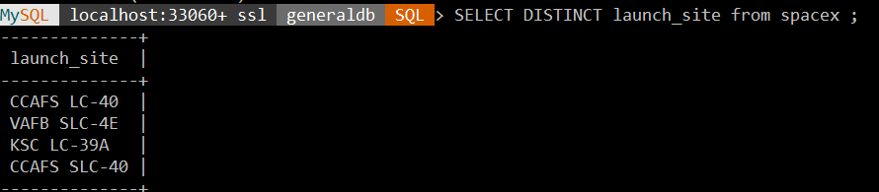
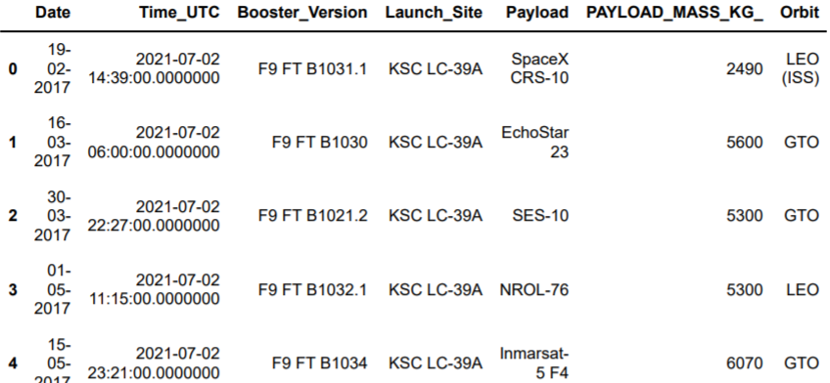
Launch Sites EDA with SQL
Different Launch Sites
Querying the local SQL database for unique launch sites
These launch sites can be paired with the geographical coordinates
Launch Site Names Begin with ‘KSC’
Jupyter Notebook with MySQL plugin was used for further queries to speed up the process
This script finds sites that match the partial name provided
https://github.com/belgau/spacex_capstone/tree/main/EDA_SQL

Slide 25


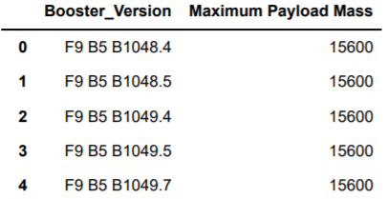
Payload Mass EDA with SQL
Total Payload Mass
This script finds the total payload mass of boosters launched by NASA
Average Payload Mass by F9 v1.1
This script finds the average payload mass of the F9 version 1.1
Boosters Carried Maximum Payload
This script finds the max payload by using a subquery
https://github.com/belgau/spacex_capstone/tree/main/EDA_SQL

Slide 26

Successful Landings EDA with SQL
First Successful Drone Ship Landing Date
Successful Ground Pad Landings of Boosters with Payload Mass Between 4,000 -6,000 kg
Total Number of Successful and Failure Mission Outcomes
https://github.com/belgau/spacex_capstone/tree/main/EDA_SQL

Slide 27
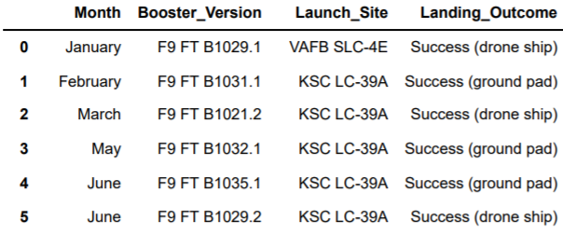

Launch Records EDA with SQL
First Successful Drone Ship Landing Date
Rank Landing Outcomes Between 2010-06-04 and 2017-03-20
https://github.com/belgau/spacex_capstone/tree/main/EDA_SQL

Slide 28
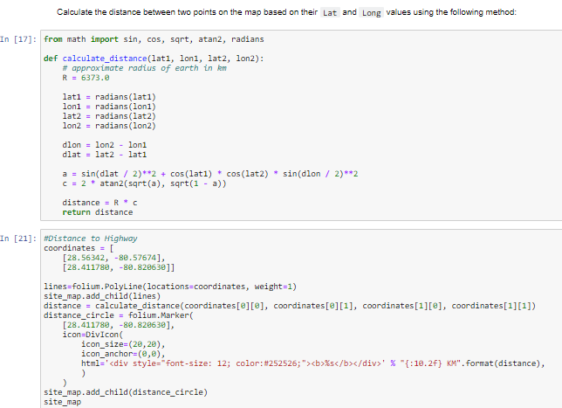
Launch Site Proximity Analysis with Folium
Significant Findings
Are launch sites in close proximity to railways → No
Are launch sites in close proximity to highways → No
Are launch sites in close proximity to coastline → Yes
Do launch sites keep certain distance away from cities → Yes
https://github.com/belgau/spacex_capstone/tree/main/Folium_Site_Launch_Locations

Slide 29
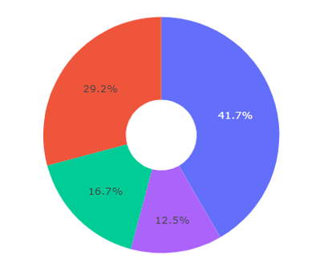
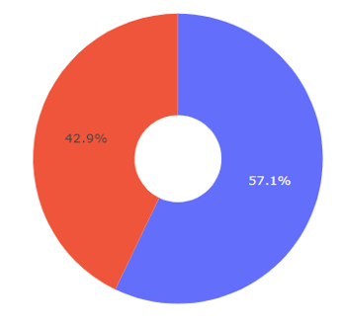

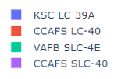
Interactive Dashboard (Plotly & Dash)
Launch Success by Site
KSV LC-39A had the most successful launches, totaling 41.7% of the ‘successful launches’ of the total successful launches.
This is not to be confused with the success rate of the site
CCAFS SLC-40 had the highest successful launch rate at 42.9%
This is insightful data that can only be discovered by zooming in deeper into the data!
https://github.com/belgau/spacex_capstone/tree/main/Interactive_Web_Dashboard

Slide 30
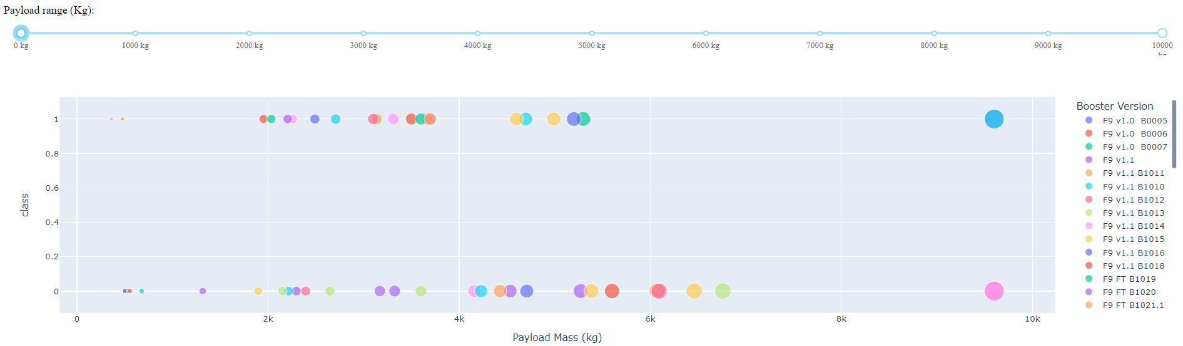
Interactive Dashboard
Launch Rate vs. Payload Overview
This displays an overview of scatterplot
… now when we filter….
https://github.com/belgau/spacex_capstone/tree/main/Interactive_Web_Dashboard

Slide 31
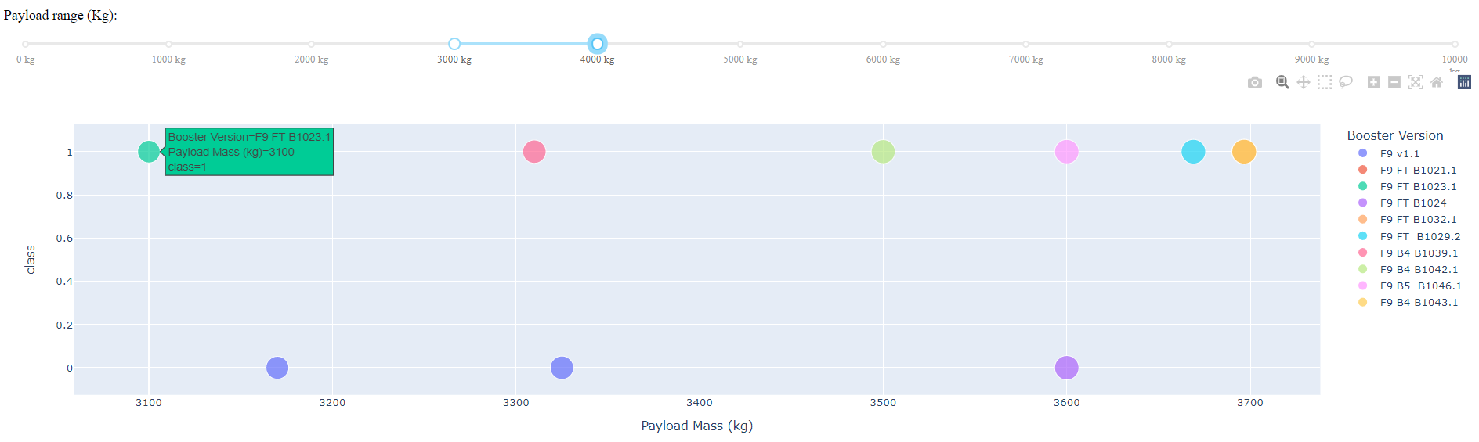
Interactive Dashboard
Launch Rate vs. Payload
The highest successful launch rate was for payloads between 3,000 – 4,000 kg
https://github.com/belgau/spacex_capstone/tree/main/Interactive_Web_Dashboard

Slide 32
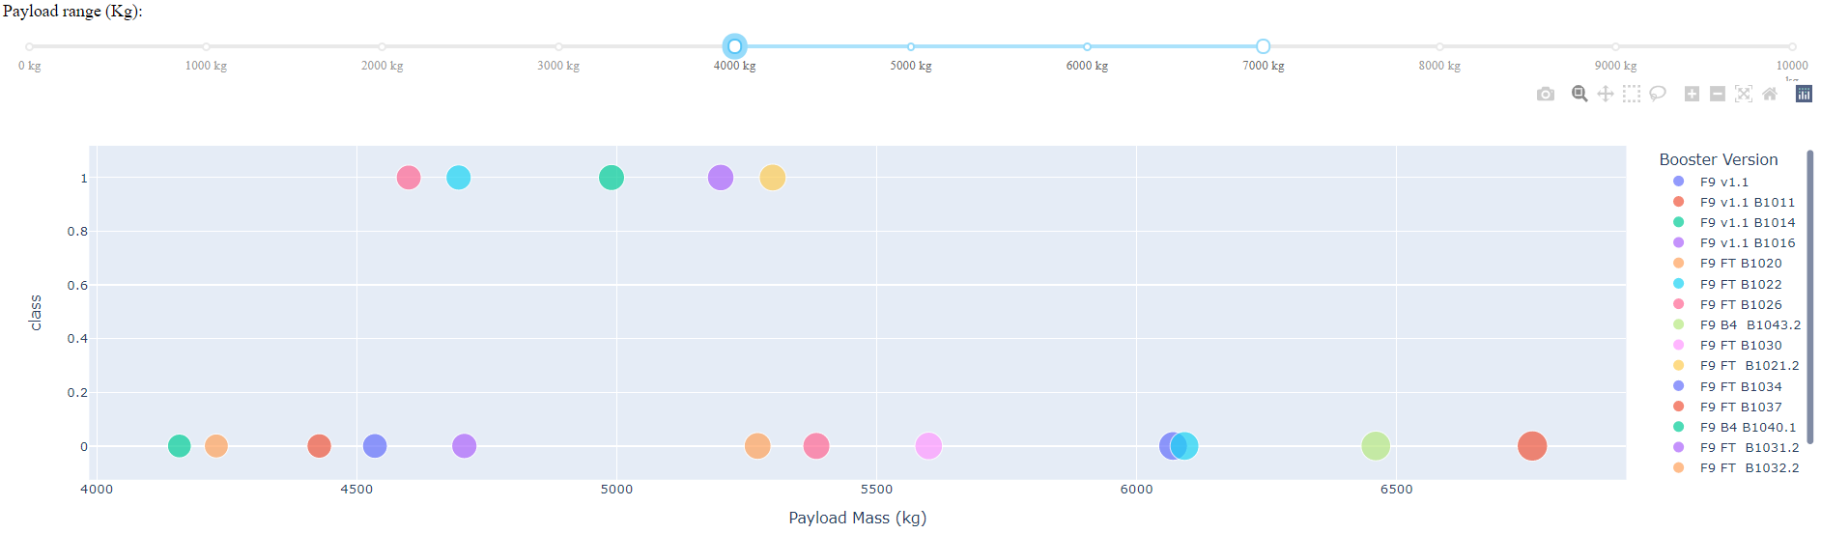
Interactive Dashboard
Launch Rate vs. Payload
The lowest successful launch rate was for payloads between 3,000 – 4,000 kg at 41.67%
However… 0 - 2,000 kg is a close second at 42.86%
https://github.com/belgau/spacex_capstone/tree/main/Interactive_Web_Dashboard

Slide 33
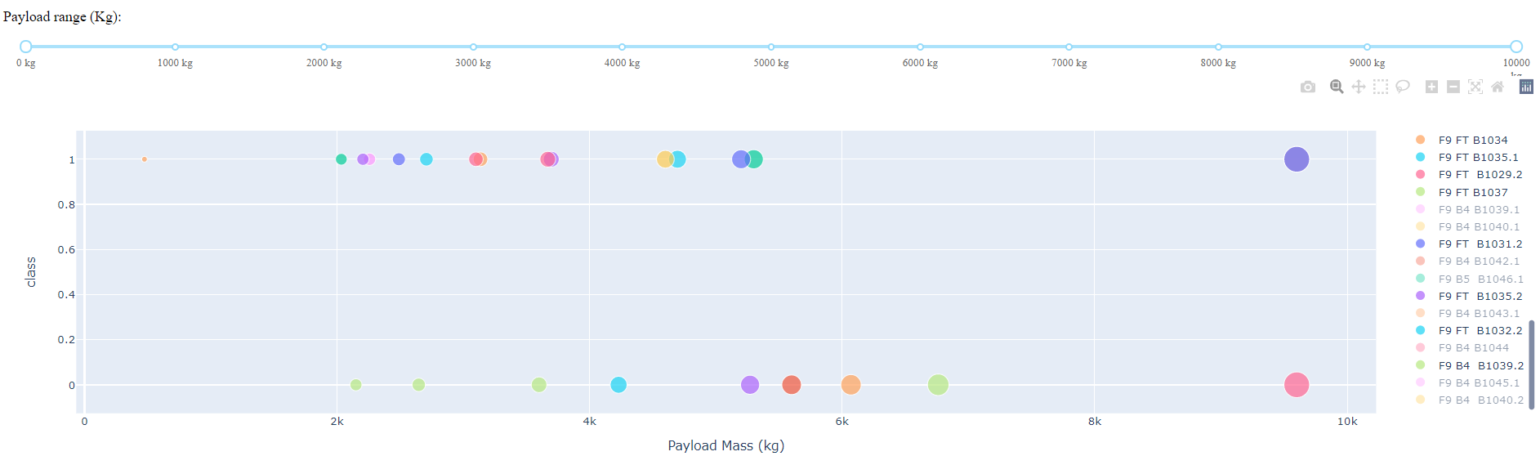
Interactive Dashboard
Launch Rate vs. Booster Type
The F9 Booster Version ‘FT’ had the highest successful launch rate at 62.5%.
https://github.com/belgau/spacex_capstone/tree/main/Interactive_Web_Dashboard

Slide 34
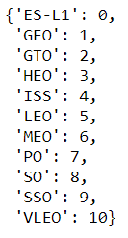
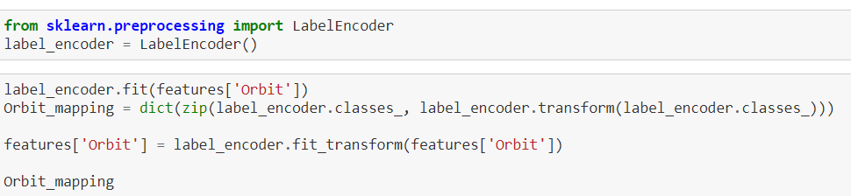
PREDICTIVE ANALYSIS
(CLASSIFICATION)
From EDA, the following feature matrix was developed for model training and success rate prediction
Non-binary categorical variables were converted to numerical values using LabelEncoder
The encodings were saved in dictionaries for later reference
https://github.com/belgau/spacex_capstone/tree/main/Machine_Learning_Prediction

Slide 35
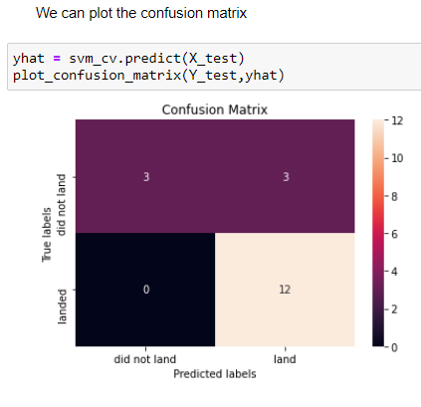
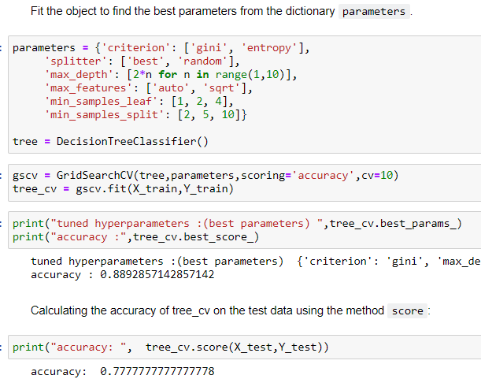
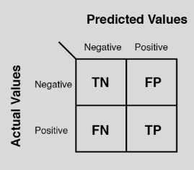
PREDICTIVE ANALYSIS
(CLASSIFICATION)
THE WINNER: Decision Tree Classifier
We see that a major problem is False Positives
https://github.com/belgau/spacex_capstone/tree/main/Machine_Learning_Prediction

Slide 36
CONCLUSIONS

Slide 37
Conclusions
The success rates for SpaceX launches is directly proportional to time since first launch
KSC LC-39A had the most successful launches from all the sites
Orbit GEO, HEO, SSO, ES-L1 had the highest Success Rate
The low weighted payloads perform better than the heavier payloads
The Tree Classifier Algorithm is the best for Machine Learning this dataset

Slide 38
APPENDICES

Slide 39
MySQL Server
The Spacex.csv data was stored on a locally hosted SQL database since the IBM SQL connection was not working.
The setup process was as follows:
Download MySQL executable and launch the shell terminal to connect to root
A database and table with proper labeling was created using a python IDE
The csv was loaded using LOAD DATA INFILE command

Slide 40
Haversine Formula
This was used to calculate the distance between two points for the calculations done on the folium map interface
It uses trigonometry to calculate the distance given the lat and long coordinates
It is critical for navigation as it considers the spherical nature of the earth and the spherical triangles created when drawing straight lines to two points

Slide 41
Thank you!

