Slide 1

Adapting to Withdrawal
from Development Assistance
for Global Health
Midpoint Check-In
October 2026
Notes:
Alina/Vidhi

Slide 2

01
Introduction
5 min
02
OECD Aid Cut Projections
10 min
Agenda
03
Dashboard Presentation
15 min
90 minutes
04
Findings
20 min
05
Looking Ahead
10 min
06
Discussion
30 min
Option 2: navy panel and list
2
Notes:
Alina/Vidhi

Slide 3
01
Recap
Objectives
02
Present New Findings
03
Re-align on Goals
Option 2: navy panel and list
3
Notes:
Alina/Vidhi

Slide 4


Recap
Key Takeaways from Kickoff Meeting
Broadening scope beyond US MOUs to the full donor landscape (Gavi, the Global Fund, OECD bilateral aid)
Shifting from “lives saved” output metric toward how services are actually affected, using a systems-level lens
Examining how countries are responding, including their cofinancing commitments to different donors
Organizing the data into a country-level dashboard, then using it to model coverage metrics
Notes:
Alina/Vidhi

Slide 5
Executive Summary
Finding 1: Cuts were uneven relative to need and capacity
Projected OECD cuts for 2026 averaged about 15% of last reported data, regardless of income or debt burden
Emerging Recommendation: Aid reductions need to be tailored to each country’s need and ability to adapt
Finding 2: Domestic revenue growth is unlikely to resolve shortfalls
Reaching max tax potential covers the decline in 51 of 66 countries. The other 15 also need to raise health’s share of the budget, which may prove to be difficult
Governments may also have reduced domestic health financing in response to aid cuts, which would widen the gap.
Emerging Recommendation: Aid recipients should pursue both tax revenue efficiency and budget reprioritization
Emerging Recommendation: Development banks and other lenders concerned with health should offer concessional loans tied to health expenditure to bridge the gap
Finding 3: Foreign dependency makes some programs and countries especially exposed
Programs like TB, malaria and HIV rely heavily on donor funds, and the US share of HIV treatment aid is 80% or more in 12 of 19 evaluated countries
Emerging Recommendation: Remaining donor funds should target programs unlikely to be adopted by domestic spending

Slide 6
OECD Aid Cut Projections
02

Slide 7
Title
Blurb

Slide 8

How we built the projections
Projected aid = 2023 aid × a multiplier (0.8 means 80% of the money is left, a 20% cut)
1
Split 2023 health aid ($27.6B, IHME) into ~20,500 pieces: one donor, one country, one channel.
e.g. “UK → Kenya via the Global Fund” is one piece.
Baseline
2
Where an announcement exists, it decides the multiplier: US deals, Global Fund, Gavi, UK and Australian budgets, named exits.
e.g. The US–Zambia health deal sets US aid to Zambia.
Announcements
3
In the absence of any announcement, the OECD forecast sets the donor’s total. The remaining is shared evenly over its other pieces.
e.g. Japan: $1.11B target, $0.30B announced → other pieces × 0.88.
Donor budgets
4
Add the pieces up by country, donor, health area and year, 2026–2030, in constant 2023 dollars.
e.g. Kenya’s total = all its pieces from every donor.
Add up
5
Rerun the model with low and high budgets, plus 2,000 simulated ways donors could split unannounced cuts based on historical data.
e.g. All countries, 2030: −25%, range −13% to −39%.
Ranges
54% of the projected cut comes from step 2’s country-specific announcements. The rest comes is accounted for in step 3, where we know the donor’s total cut, but not which countries lose it.
8
Notes:
Every number comes from one formula: projected aid equals 2023 aid times a multiplier. A multiplier of 0.8 means 80% of the money is left. Step 1: IHME tracks who gave health aid to whom; 2023 was $27.6 billion, which we split into about 20,500 pieces, each with one donor, one receiving country and one route. Step 2: if someone has announced what happens to a piece of money, we use it: US country deals, Global Fund country allocations, Gavi pledges, UK and Australian country budgets, and exits by Sweden, Germany and the UK. Step 3: for everything else, the OECD forecast tells us each donor’s total aid budget; we subtract the announced pieces and share what’s left evenly. For Japan, the target is $1.11 billion, $0.30 billion is already announced, so its other pieces keep 88%. Gates grows 2.9% a year and private giving is held flat. Step 4: add everything up by country, donor, health area and year, in 2023 dollars. Step 5: rerun with gloomier and rosier budgets and simulate 2,000 ways donors could split their unannounced cuts, based on 61 past cut episodes. About 54% of the cut comes from step 2’s country-specific evidence.

Slide 9
Main findings: health aid falls about 25% by 2030
−25%
Change by donor, 2030 vs 2023
United States
-66%
Decrease in health aid from all donors, 2023 to 2030
Germany
-41%
Most donors are cutting aid
France
-34%
US health aid falls 66%. Other governments fall 22%, led by Germany, France, UK, Netherlands.
United Kingdom
-32%
Global health funds decrease
Netherlands
-32%
France cut its Global Fund pledge 58%, Japan cut 20%.
Japan
-15%
HIV, malaria and TB
Canada
+2%
Even without the US: malaria −30%, HIV −27%, TB −26%.
Gates Foundation
+22%
US gap
Private philanthropy held flat (0%). Gates grows 2.9% a year by assumption.
US health aid falls 66%, but only Canada and Gates grow.
Range by 2030: −13% to −39%. After inflation, health aid falls about 25% by 2030: around 13% with optimistic assumptions, 39% with pessimistic assumptions (eg: smaller donor budgets, less of the US deals actually delivered).
Source: our model on IHME 1990-2025 health aid, OECD aid outlook and donor announcements; constant 2023 US$.
9
Notes:
Across 97 low- and middle-income countries, health aid falls about 25% in real terms by 2030: −17% in 2026, −22% in 2028, −25% in 2030, with a plausible range of −13% to −39%. The US accounts for most of it: its health aid falls about two-thirds, through the country deals, the end of Gavi and WHO funding, and cuts where there is no deal. Germany, France, the UK and the Netherlands cut by roughly a third, mostly through Global Fund and Gavi pledges and bilateral exits. HIV, malaria and TB lose most because US and Global Fund money is concentrated there. The biggest dollar losses are South Africa, Nigeria and Tanzania; the deepest percentage cuts are in US-reliant countries with no US deal. Non-US government donors alone fall 22% by 2030.

Slide 10
Assumptions and caveats
Key assumptions
Caveats
1
US deals delivered as announced. They are non-binding and need Congressional approval.
Cuts may come faster. IHME estimates 2025 health aid already fell 67% (US) and 64% (UK).
2
Philanthropy: Gates grows 2.9% a year (IHME), other private aid held flat. Together 32% of the baseline.
Maternal and child health cuts in US deal countries are probably understated.
3
US aid with no deal kept at 25% of its old level; no country evidence exists [can change]
2029–2030 rely on inputs held flat after 2028 (OECD outlook, UK, Dutch, Global Fund).
4
Health keeps its share of each donor’s total aid as budgets shrink.
Country budgets = health budgets: UK and Australian budgets cover all aid, and we assume health moves proportionally.
5
Unannounced cuts spread evenly within each donor: about a quarter of the cut.
Gavi country allocations aren’t public; we only apply its stated plan to give fragile countries a bigger share.
6
Judgment calls: South Africa 0.1 and Zimbabwe 0.5 in 2026; exit year 0.5; Germany’s wind-down.
Scope: donor aid only. No recipient co-financing, no non-OECD donors.
Central assumptions: whether US deals are actually delivered, and if countries will cut aid uniformly between recipients
10
Notes:
Assumptions are ranked by how much they could move the results. The biggest is that US deals are delivered as announced: they are non-binding, need appropriations, and let the US cut further if co-financing is missed; the delivery-rate lever (Settings B12) tests this. Philanthropy is a third of the baseline, so the Gates and private growth levers matter a lot for the non-US picture. For US aid to countries without a deal, such as Haiti, India and Namibia, we keep 25%, with no country-specific evidence. We assume health keeps its share of each donor’s budget; IHME’s 2025 estimate for the UK contradicts this, and the anchor switch shows the alternative. About a quarter of the cut is unannounced and spread evenly within each donor; history shows these can’t be predicted, so the ranges carry that uncertainty. On caveats: IHME’s preliminary 2025 numbers suggest cuts may already be deeper than our path; US maternal and child health cuts are likely understated; and 2029–2030 depend on inputs held flat after 2028.

Slide 11
Dashboard
03

Slide 12
The Dashboard Links Aid, Budgets And Health Data To Show Coverage At Risk From Aid Cuts
26 DATASETS | 16 ORGANIZATIONS | 32 PUBLISHED STUDIES | 70 COUNTRIES
AIM 1: AGGREGATE DATA
Government finances
IMF World Economic Outlook; World Bank WDI; IHME GDP
Health spending by source
IHME Health Spending 1995-2050; WHO Global Health Expenditure Database
Health aid by channel
IHME Development Assistance for Health 1990-2026; KFF MOU tracker; OECD 2025 aid; Gavi and Global Fund replenishments
FINANCIAL
Need and current coverage
UNAIDS 2026; WHO TB, GHO and World Malaria Report; Malaria Atlas Project; WHO/UNICEF vaccine coverage; UN population
Cost per person served
GHCC unit costs; Value TB; Rosen 2021; Optima HIV and WHO GHED spending; Global Fund budgets; published cost studies
Effect of losing care
Optima HIV (ten Brink 2025); WHO TB; Lives Saved Tool; Vaccine Impact Modelling Consortium
HEALTH
AIM 2: MODEL HOW CUTS TO DEVELOPMENT AID AFFECT COVERAGE FOR EACH SERVICE
Expected aid retreat
Coverage lost by service
Coverage gap that remains
Can fiscal space fill the gap?
Notes:
Nick/Jiya

Slide 13
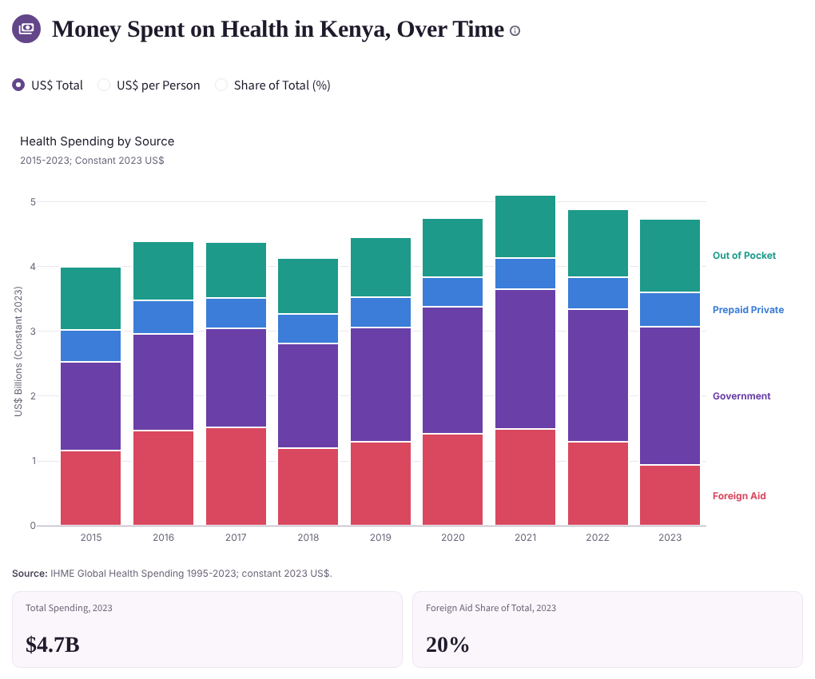
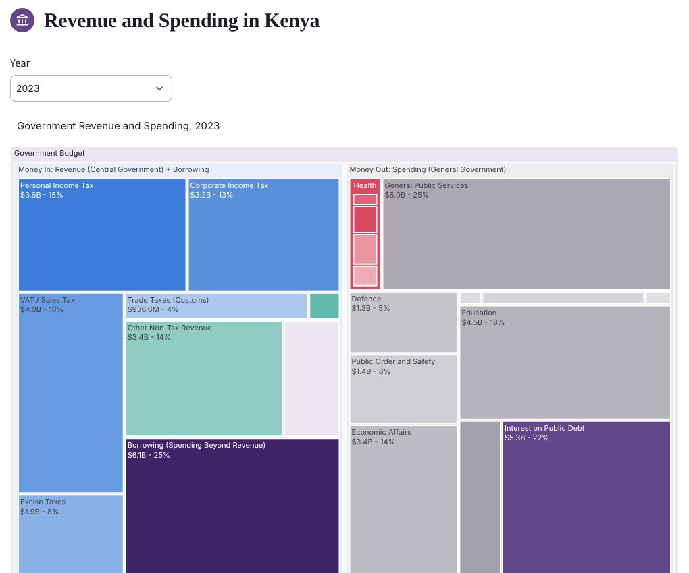
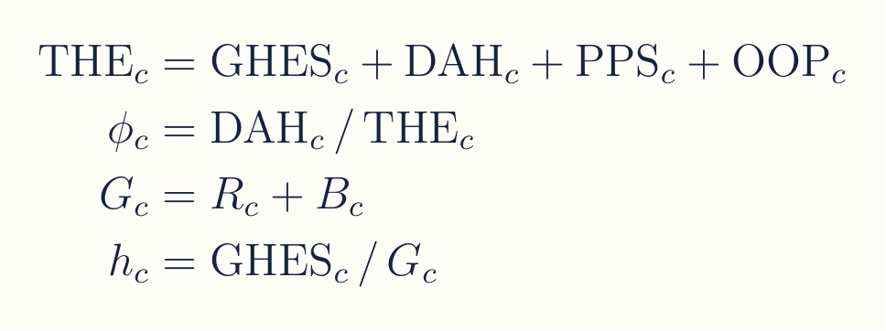
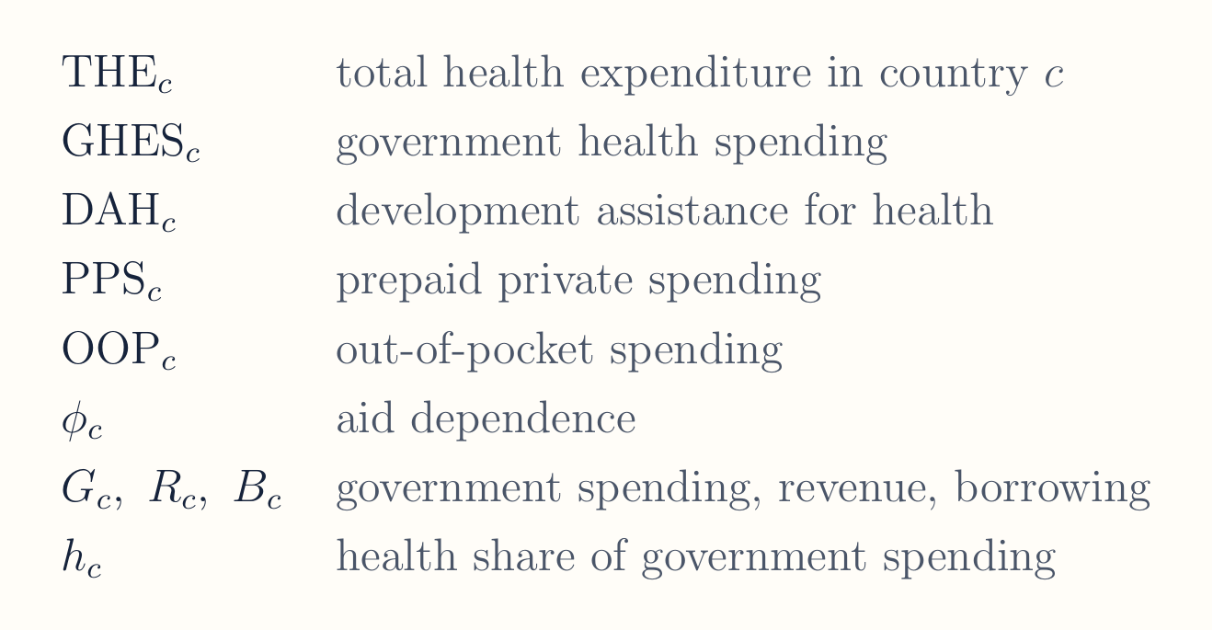
Dashboard – Domestic government and international aid contribute to health spending
13
Notes:
Two accounting identities. On the left, total health spending splits into government, aid, prepaid private and out-of-pocket money, so phi, the aid share, can be read straight off the chart: about 20 percent in Kenya in 2023. On the right, the government budget: spending equals revenue plus borrowing, and health’s share h is what the gradual budget increase option in step 3 raises toward the Abuja 15 percent target.

Slide 14
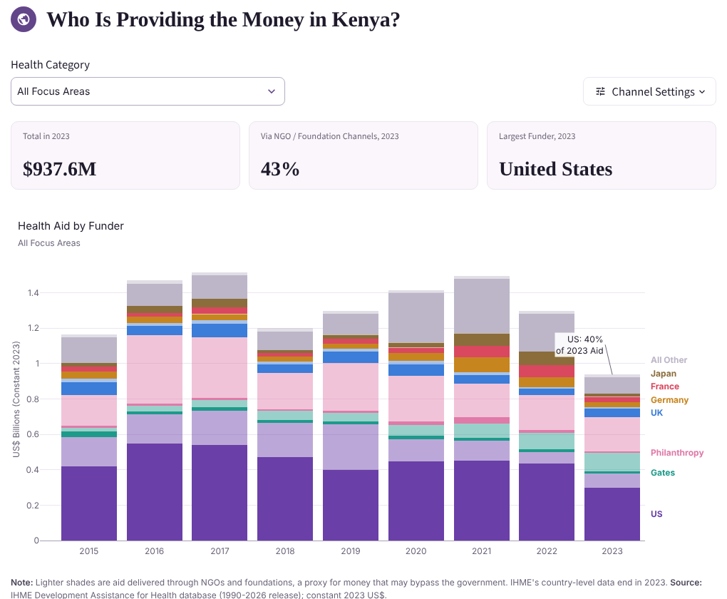
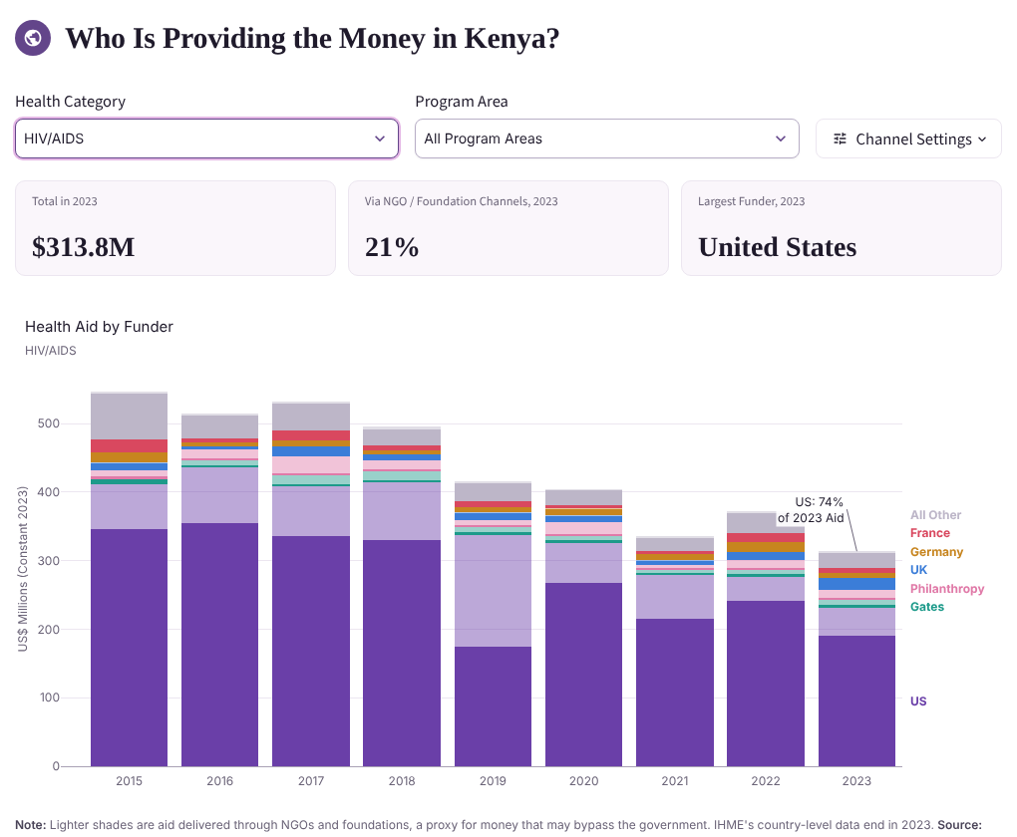
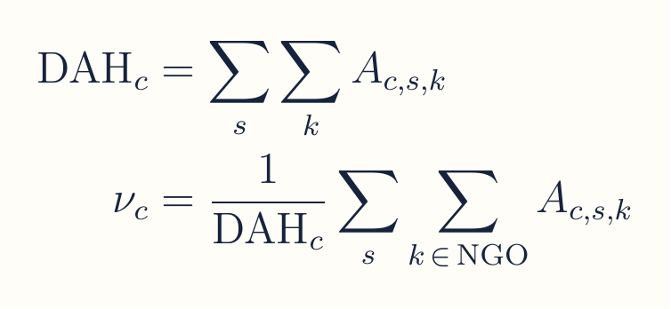
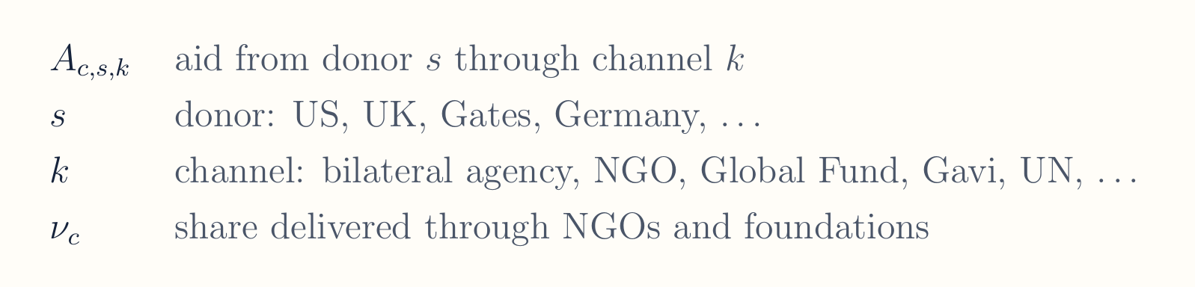
Dashboard – Resolving how development assistance for health funds different services
14
Notes:
This is the donor-by-channel grid the scenarios cut in step 1: every cell is one donor’s money through one channel. Filtering the Health Category to HIV shows why HIV dominates the model results: in Kenya the United States paid about three quarters of 2023 HIV aid, compared with about 40 percent of all health aid. The Program Area dropdown that appears next to it narrows this further, for example to HIV treatment only.

Slide 15
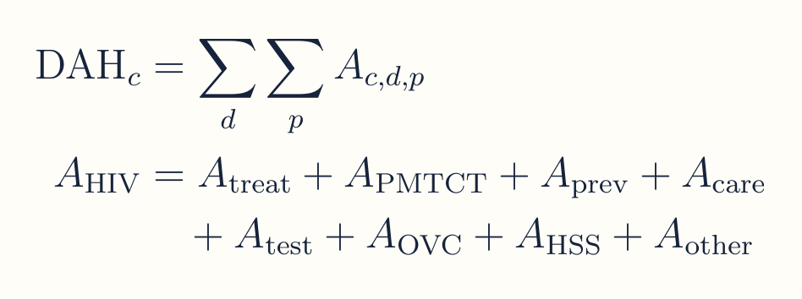
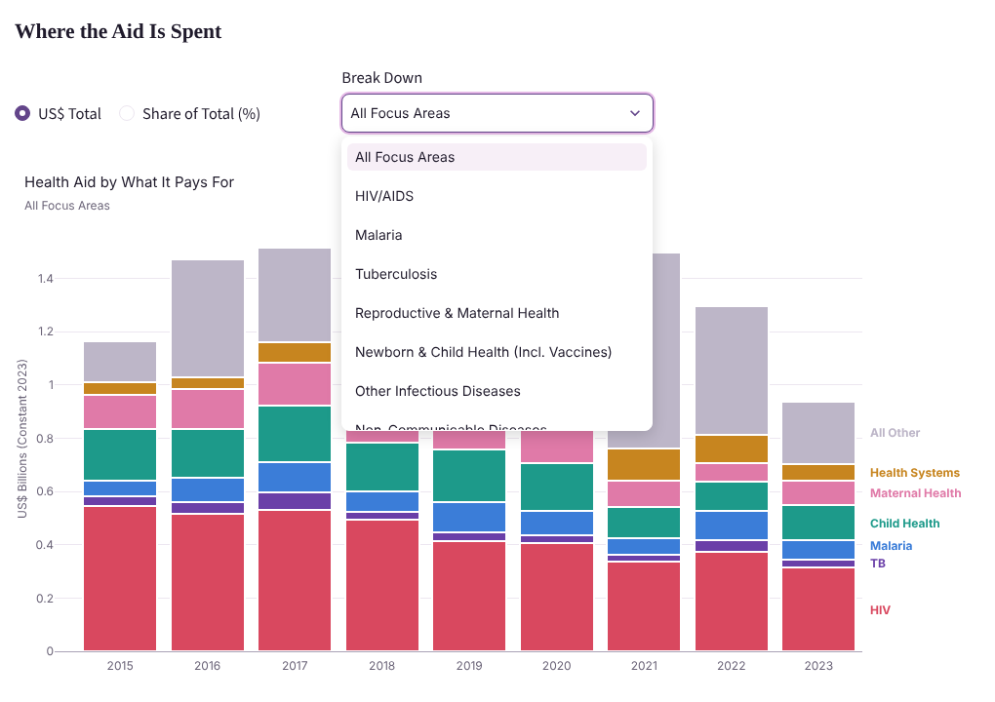
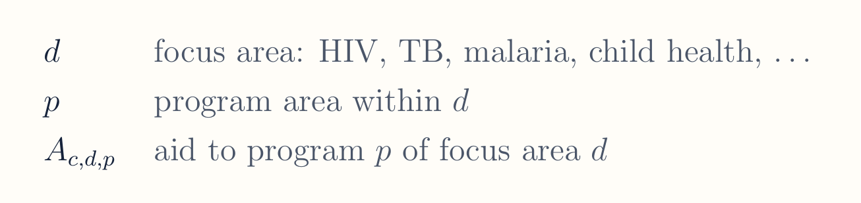
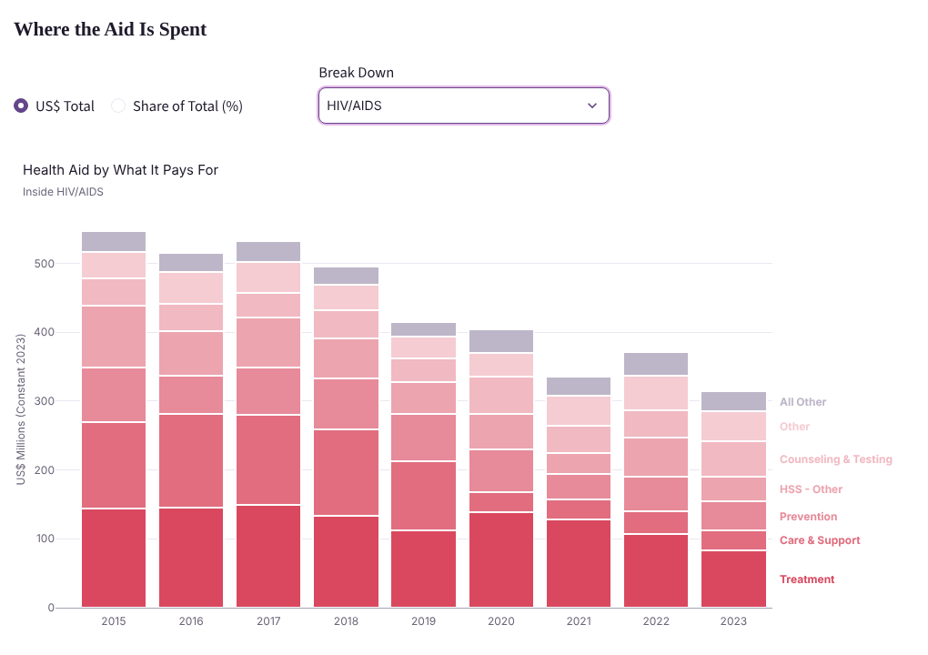
Dashboard – Resolving what program areas are funded by development assistance for each focus area
15
Notes:
The Break Down dropdown switches the chart from focus areas to the program areas inside one of them. For HIV, IHME reports treatment, prevention, care and support, counseling and testing, PMTCT, orphans and vulnerable children, health systems and other. These program areas are the raw material for the model’s service lines: treatment becomes ART, PMTCT stays PMTCT, prevention stays prevention, and testing and care are linked to ART.

Slide 16
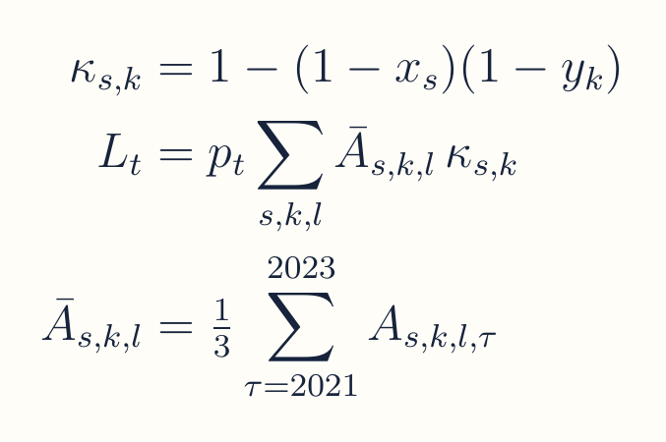
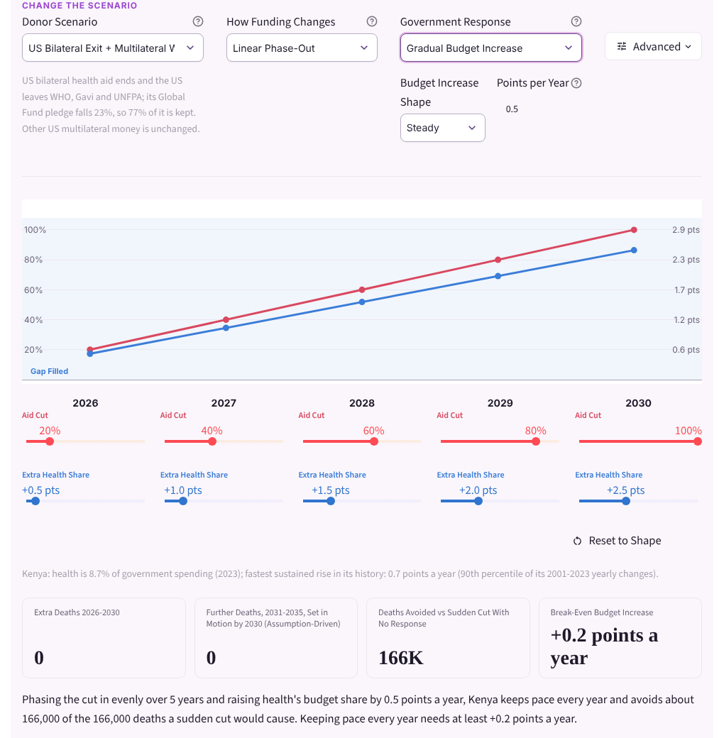
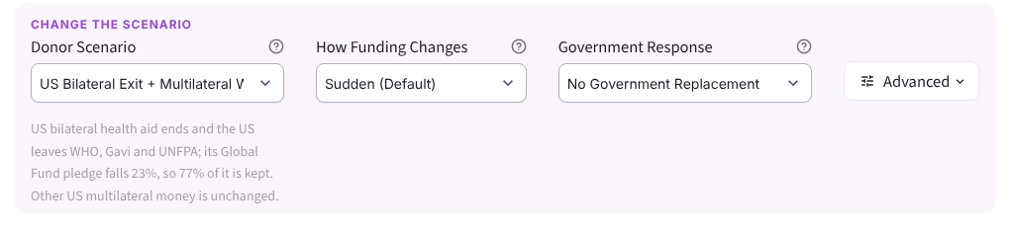
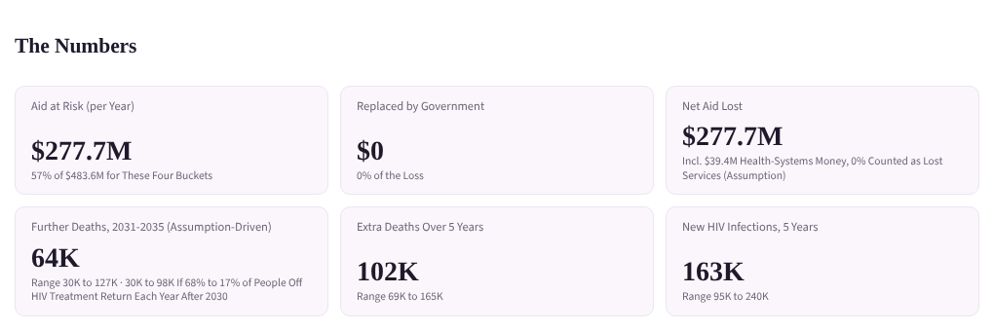
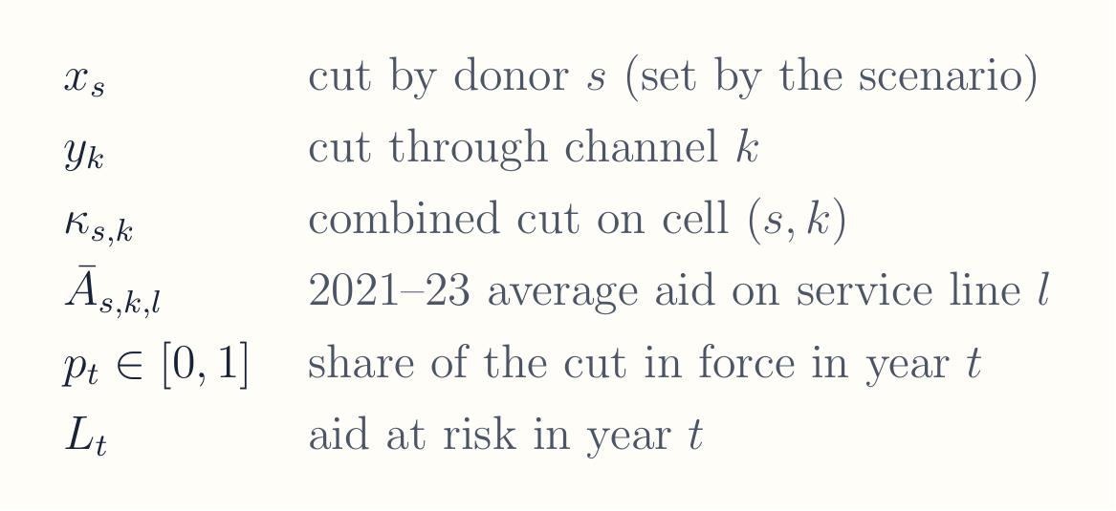
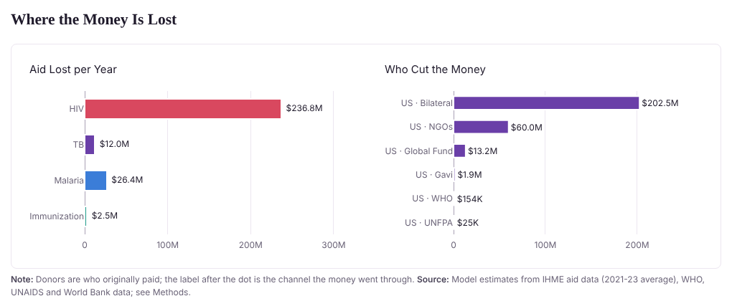
Dashboard – Modeling the aid retreat
Funding path, year by year
Scenario choices
Aid at risk
Where the money is lost
16
Notes:
Step 1 in one line. Each cell of the aid baseline, a donor times a channel times a service line, gets a cut that combines the donor’s cut and the channel’s cut multiplicatively, so a donor that cuts 100 percent removes the cell regardless of channel. The funding path p sub t phases the cut in: 1 every year for a sudden cut, rising to 1 by 2030 for a phase-out. The left panel is the funding path the user can drag year by year; the right panels show the resulting aid at risk and where it falls, by disease and by donor and channel.

Slide 17
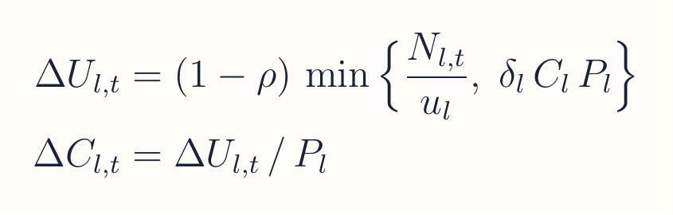
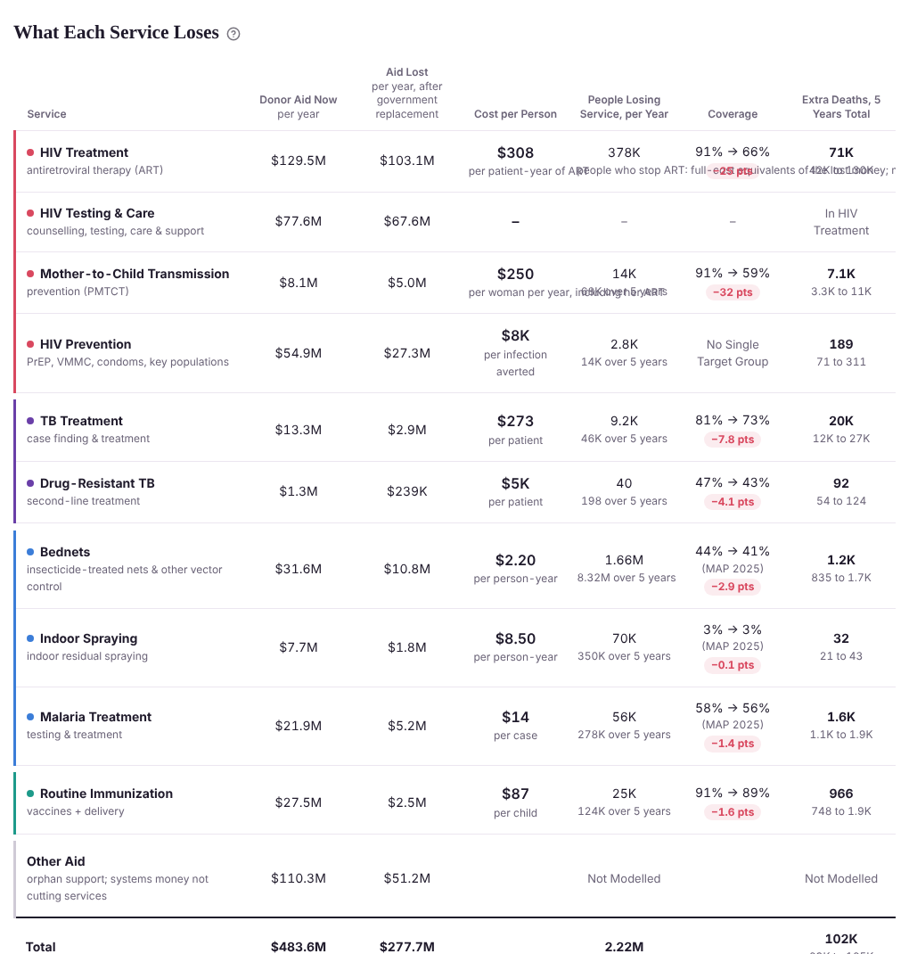
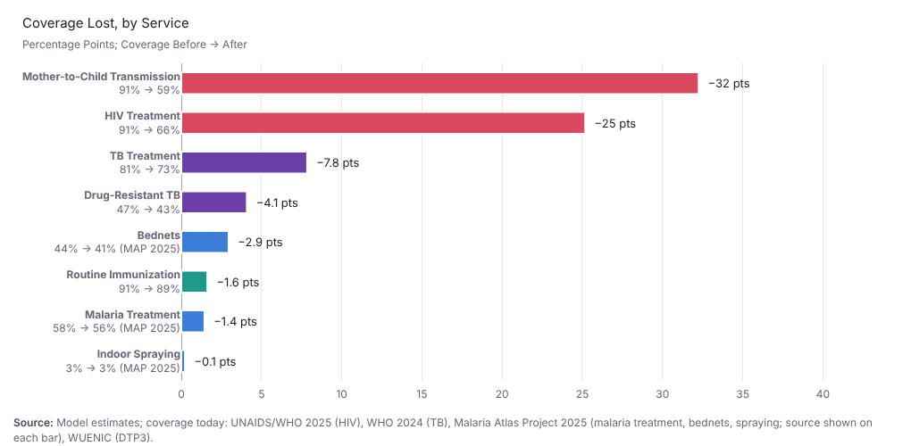
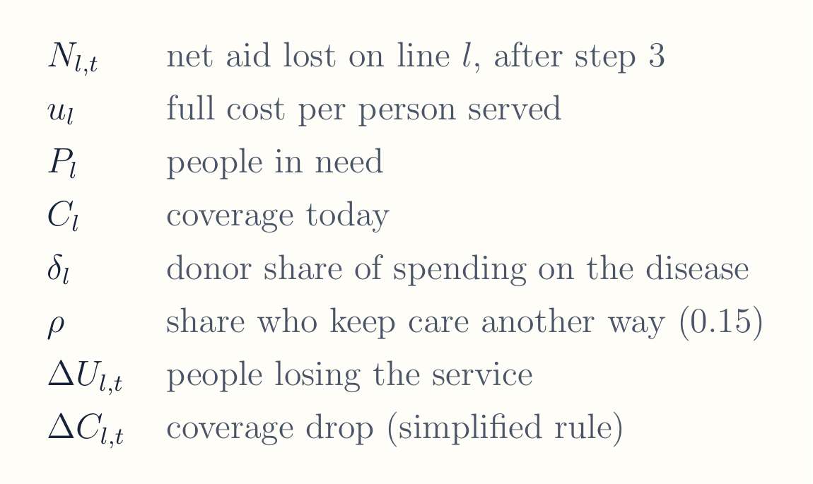
Dashboard – Modeling health coverage loss
What each service loses
Coverage lost, by service
17
Notes:
Step 2 turns dollars into people. The first term in the minimum is the core conversion: net dollars lost divided by the full cost of serving one person for a year. The second term is the cap: you cannot lose more people than donors currently pay for, which is coverage times need times the donor share of that disease’s spending. A fixed 15 percent (range 0 to 30) keep care through another source. Dividing by the people in need gives the coverage drop shown in the bar chart. The form shown is simplified: in the code the cap scales the loss proportionally rather than taking a strict minimum; the Methods page has the full rule.

Slide 18
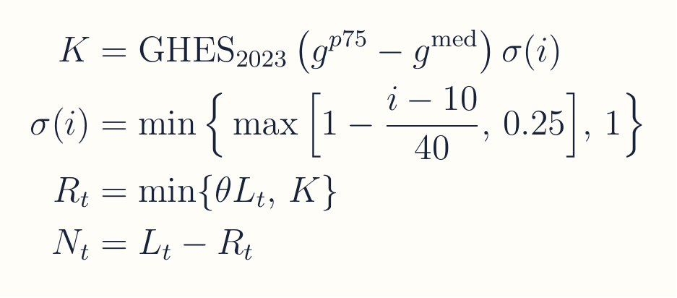
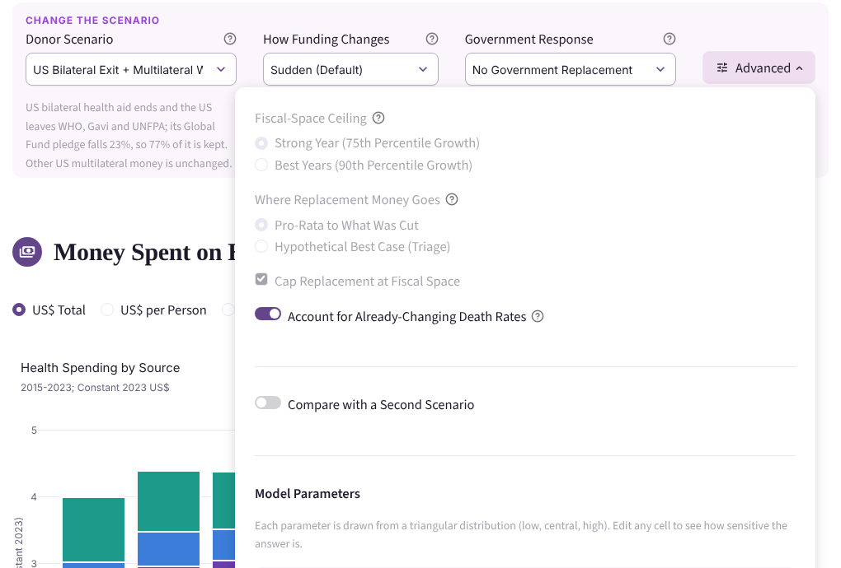
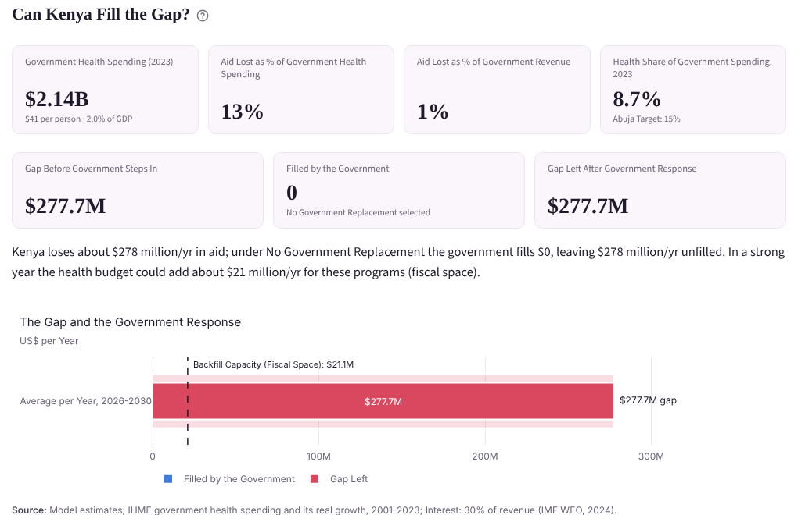
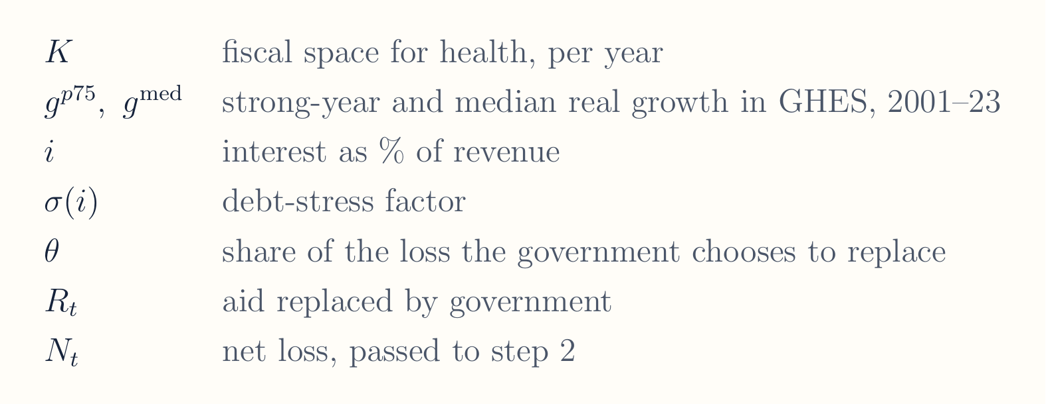
Dashboard – Modeling how fiscal space within country budgets can be used to buffer cuts
Response settings
Can the country fill the gap?
18
Notes:
Step 3 caps what the government can realistically replace. Fiscal space is grounded in the country’s own history: the gap between a strong year and a typical year of real growth in government health spending, applied to 2023 spending. Debt stress shrinks it once interest takes more than 10 percent of revenue, never below a quarter. Replacement is the lower of what the government chooses to replace and that capacity; what is left, N, is what step 2 converts into people. The gradual budget increase option replaces this rule with a set number of budget-share points per year, capped at the Abuja 15 percent target. In Kenya the gap is about 278 million dollars a year against roughly 21 million of fiscal space.

Slide 19
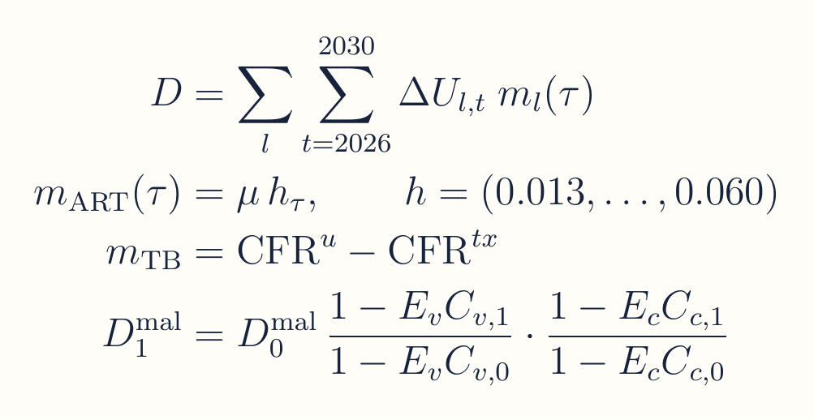
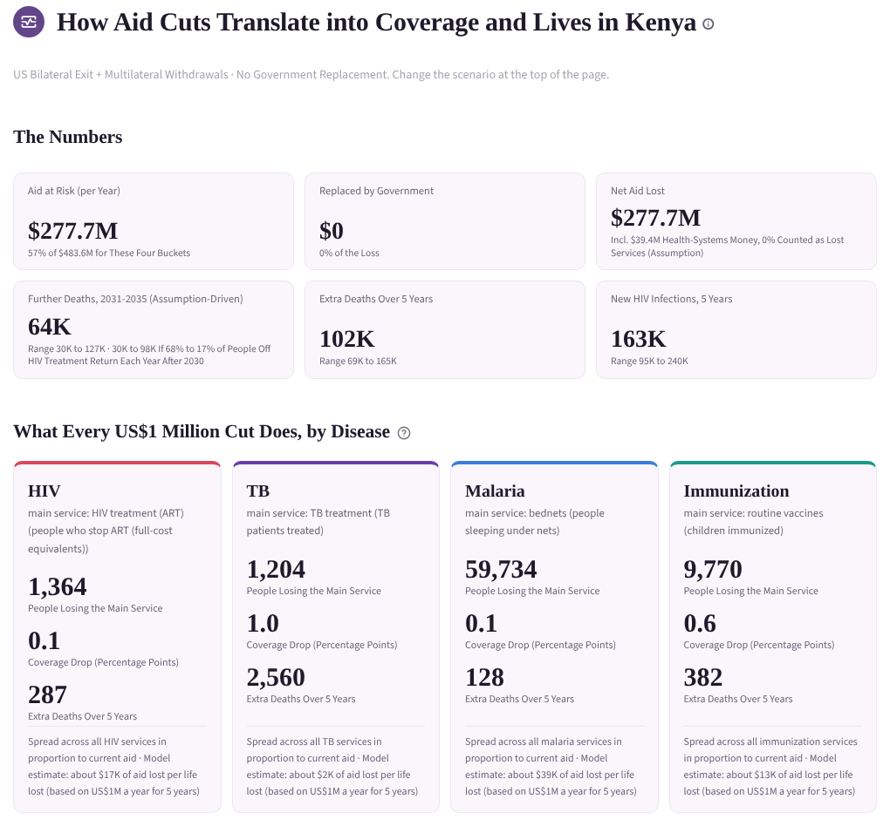
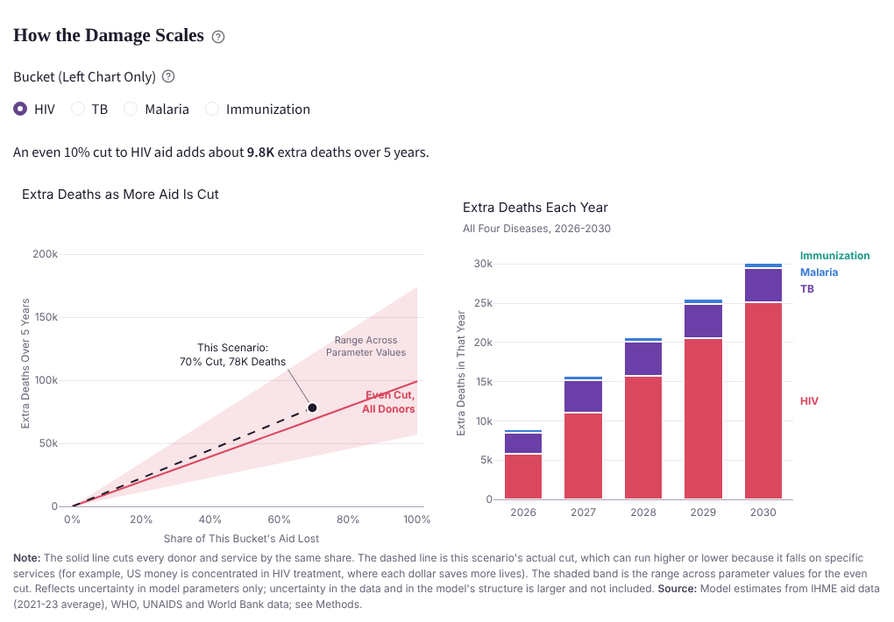
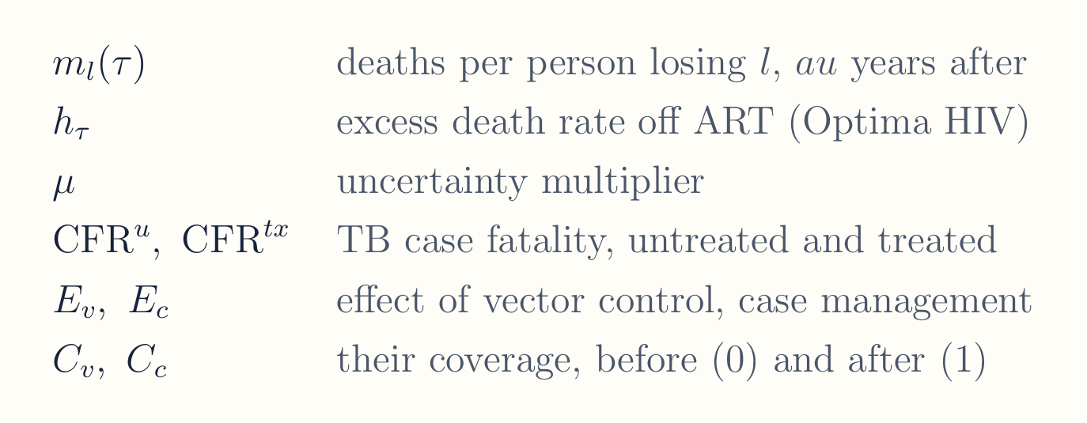
Dashboard – Modeling lives at risk as a result of cuts
Deaths and US$1 million cards
How the damage scales
19
Notes:
Step 4 multiplies people losing each service by a service-specific death rate that depends on how long ago they lost it. For HIV treatment the excess death rate climbs from 1.3 percent in the first year to 6 percent in the fifth, from an Optima-calibrated CD4 cohort, times an uncertainty multiplier. For TB it is the gap in case fatality between untreated and treated patients, weighted by HIV status. Malaria uses the Lives Saved Tool form, where deaths scale with the loss in vector control and case management coverage. Vaccines, PMTCT and HIV transmission follow similar per-person rules, listed on the Methods page. Every parameter is drawn 400 times, which gives the ranges shown in the panels.

Slide 20
Live Demo: Choosing A Country And Scenario Reveals Which Services An Aid Cut Puts At Risk
Open The Live Dashboard ›
1
2
3
4
5
Pick A Country And Scenario
See The Aid At Risk
Set The Government Response
Count People Losing Services
Read The Coverage Change
Notes:
Nick/Jiya

Slide 21
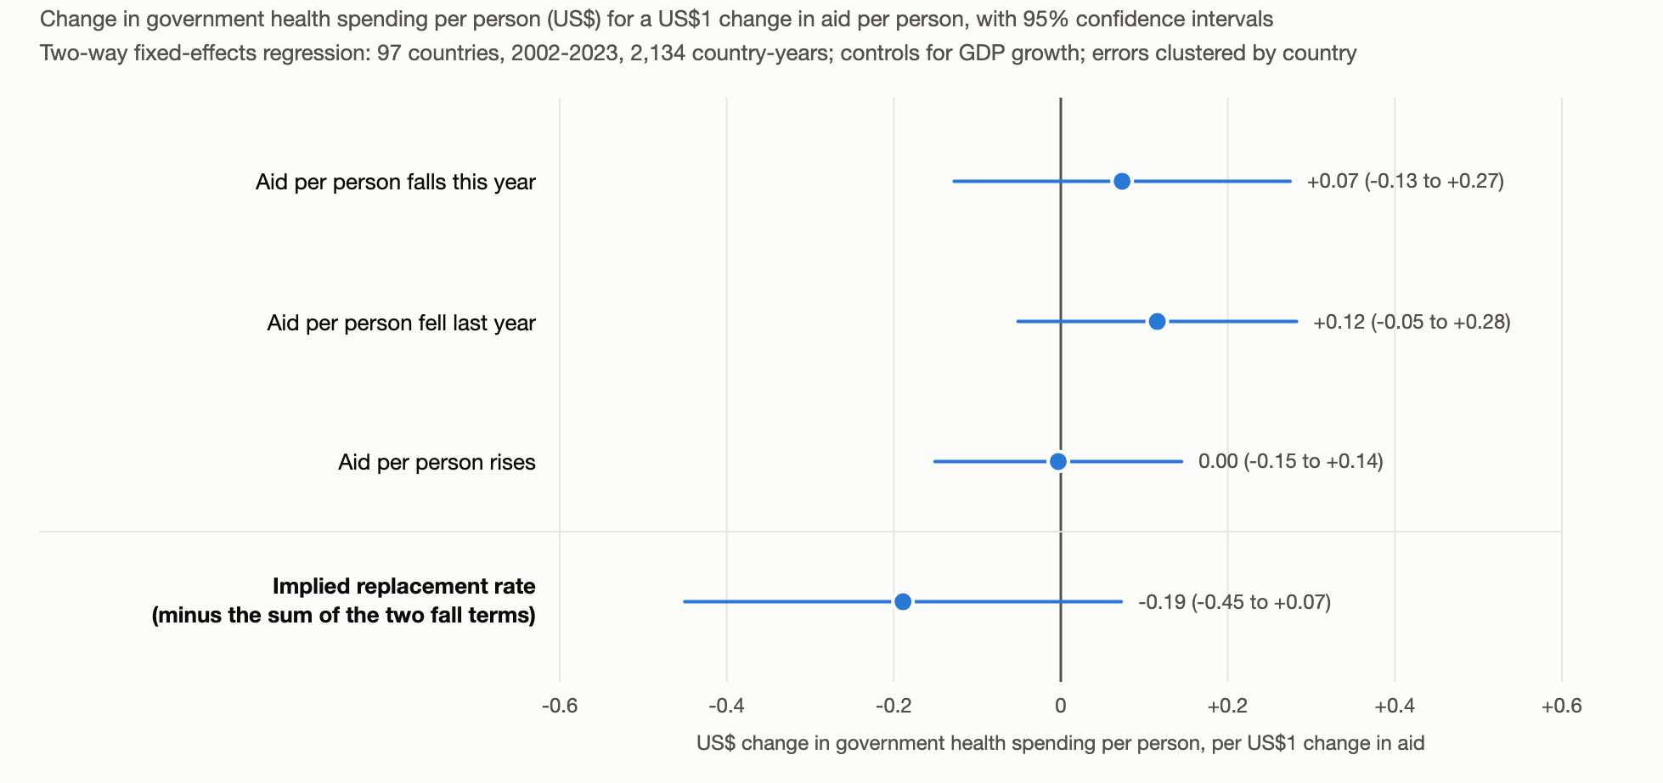
Historical patterns show that when the US decreases aid, countries decreased domestic government health expenditure by 19 cents
Notes:
Nick/Jiya

Slide 22
Findings
04

Slide 23
Domestic resource mobilization capacity – can countries grow their way out of the problem?
04.1

Slide 24
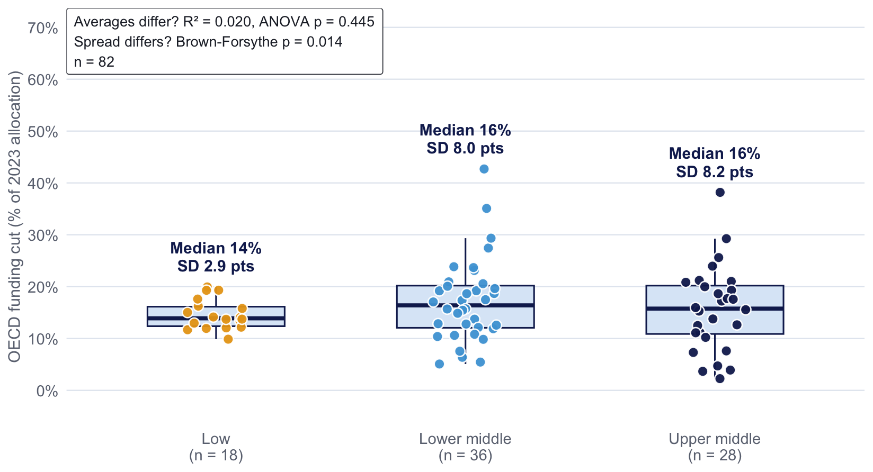
Typical OECD cut averages were similar across income groups
Sources: Income classification from the World Bank. OECD cuts are projections based on OECD data and official country-level communications.
Typical cuts were similar across income groups, at 14% to 16% of 2023 allocations. The spread was not: every low-income country lost 10% to 20%, while middle-income countries ranged from 2% to 43%.
Notes:
Ting – External debt service doesn’t explain variance in cuts in any structural way, which shows us that cuts did not account for countries’ fiscal capacity at least on the debt side.

Slide 25
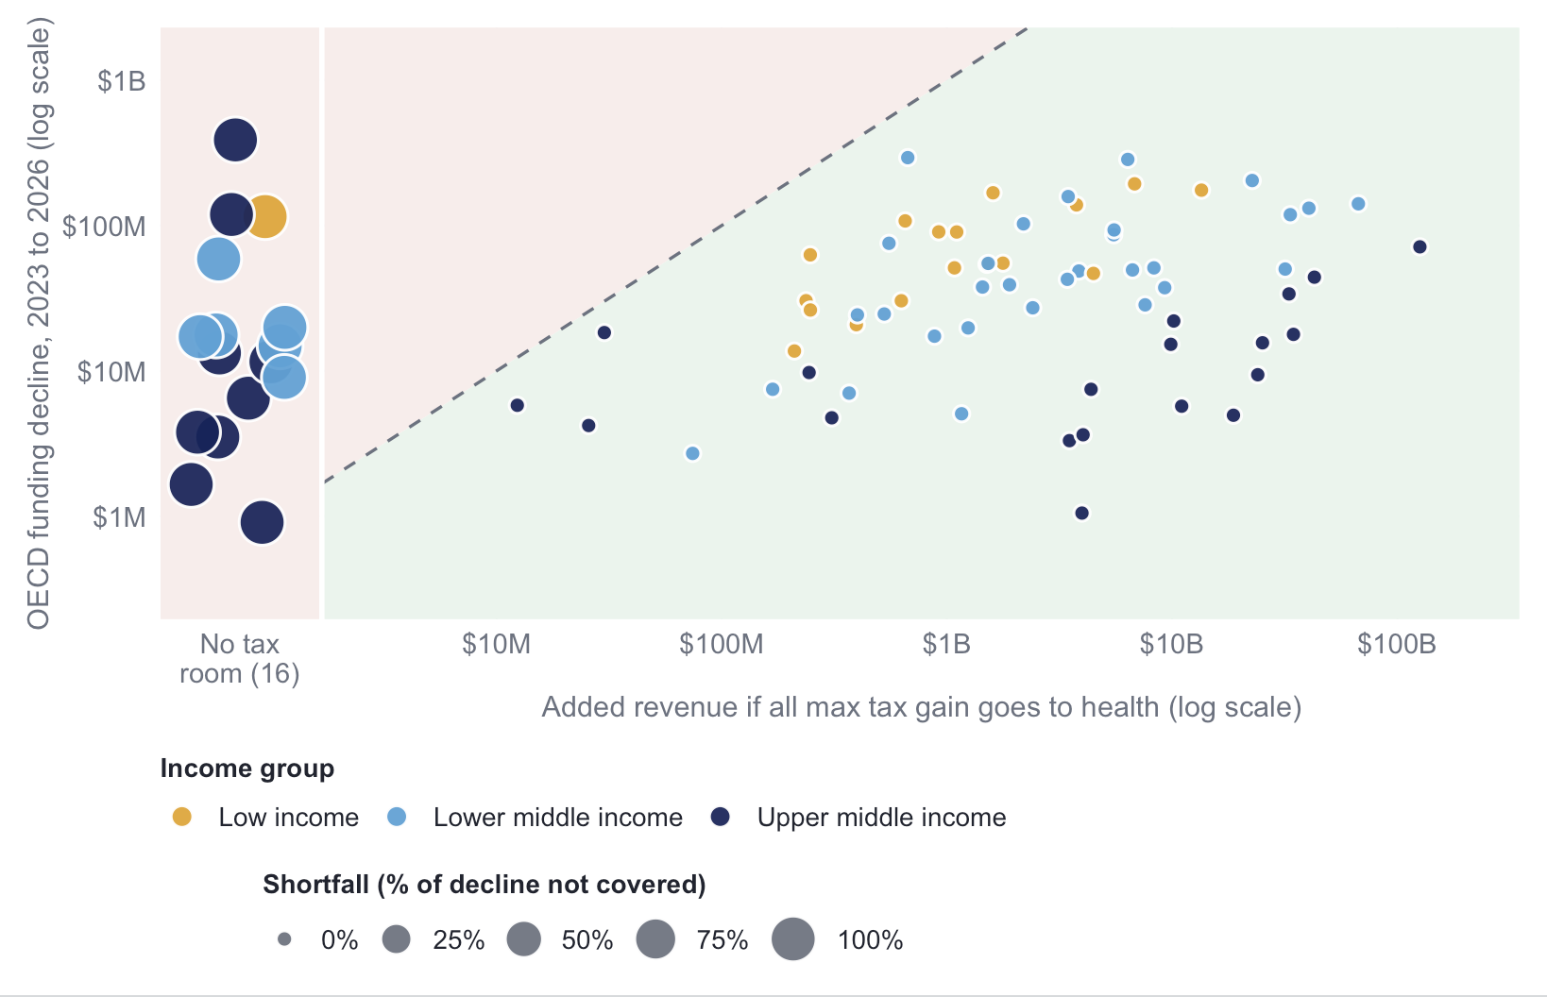
All countries that have tax potential to grow could generate enough revenue to cover the gap
Sources: Tax revenue set to IMF-estimated tax potential (Benitez et al., 2023); OECD funding cuts are projected using OECD cuts are projections based on OECD data and official country-level communications.
Assuming all new funds were allocated to health, revenue potential is not the constraint for the potential for countries to cover the gap. However, it is unlikely that countries would allocate all new funds to health.
Notes:
Kaley

Slide 26
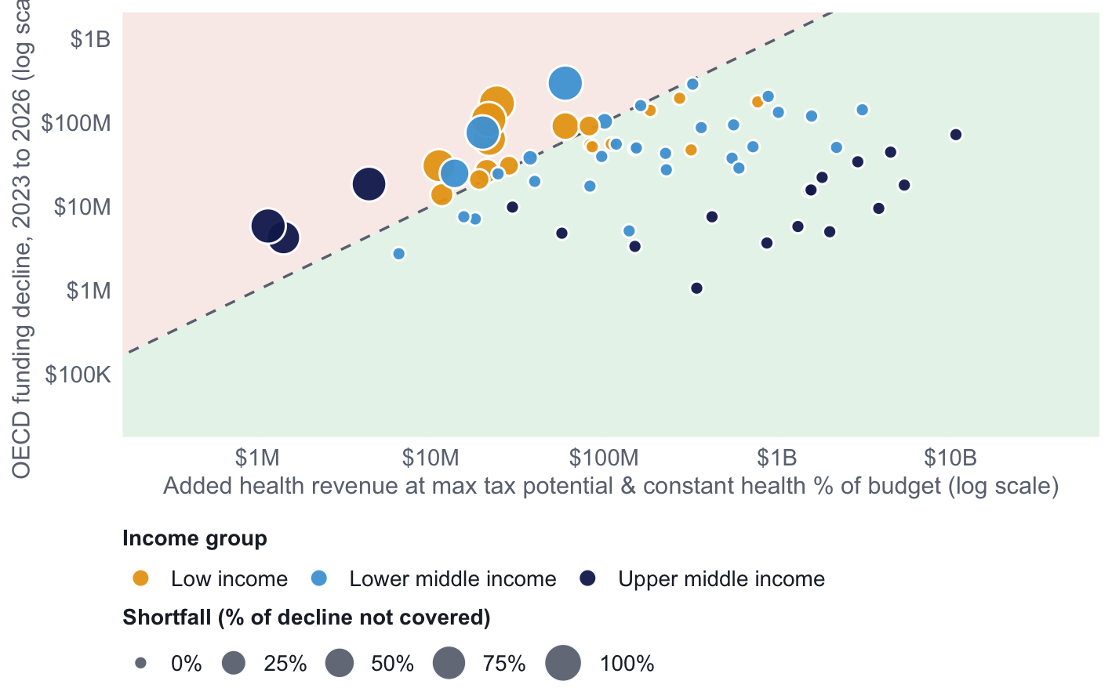
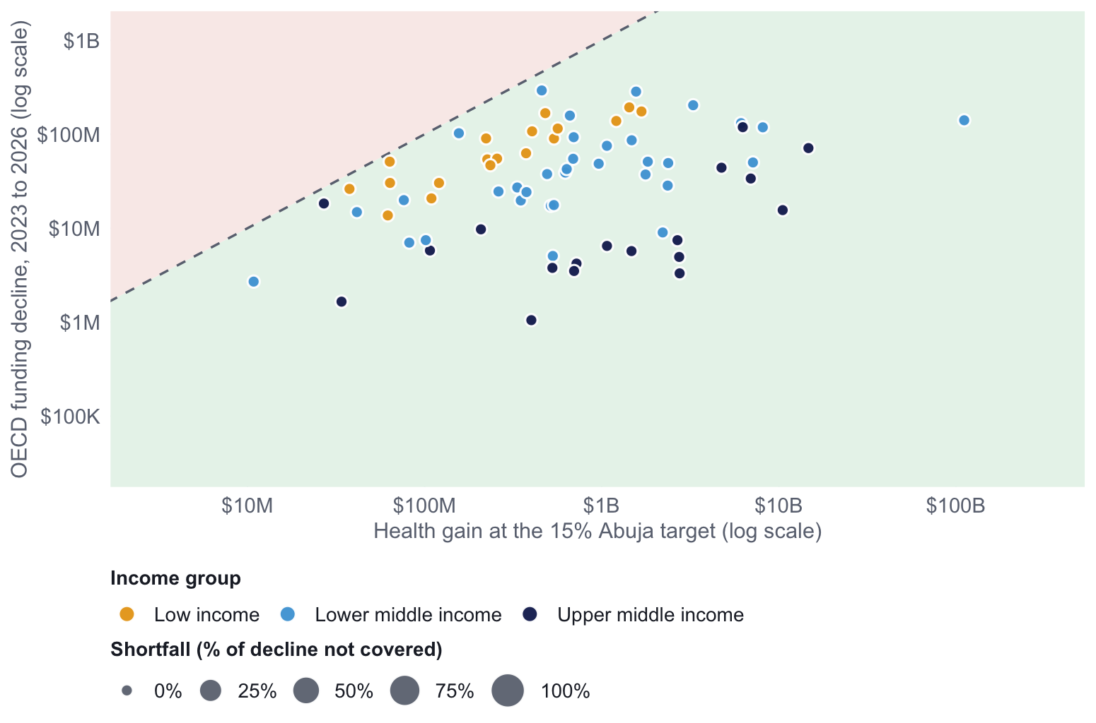
Revenue growth is enough for most, but not for a critical few who additionally require budgetary changes
Sources: Max tax gain = IMF-estimated tax potential (Benitez et al., 2023) minus current tax revenue (IMF), capped at 9% of GDP. Health gain assumes the current health share of the government budget (World Bank) holds on new revenue. 16 countries already at or above their tax potential are not shown. OECD cuts are projections based on OECD data and official country-level communications.
Potential tax revenue growth still covers the decline in 48 of 82 countries if health expenditure as a % of budget is kept constant. Countries with large cuts and low health expenditure % of overall expenditure would need revenue growth beyond what is likely realistic to close the gap through taxes alone.
Notes:
Kaley

Slide 27
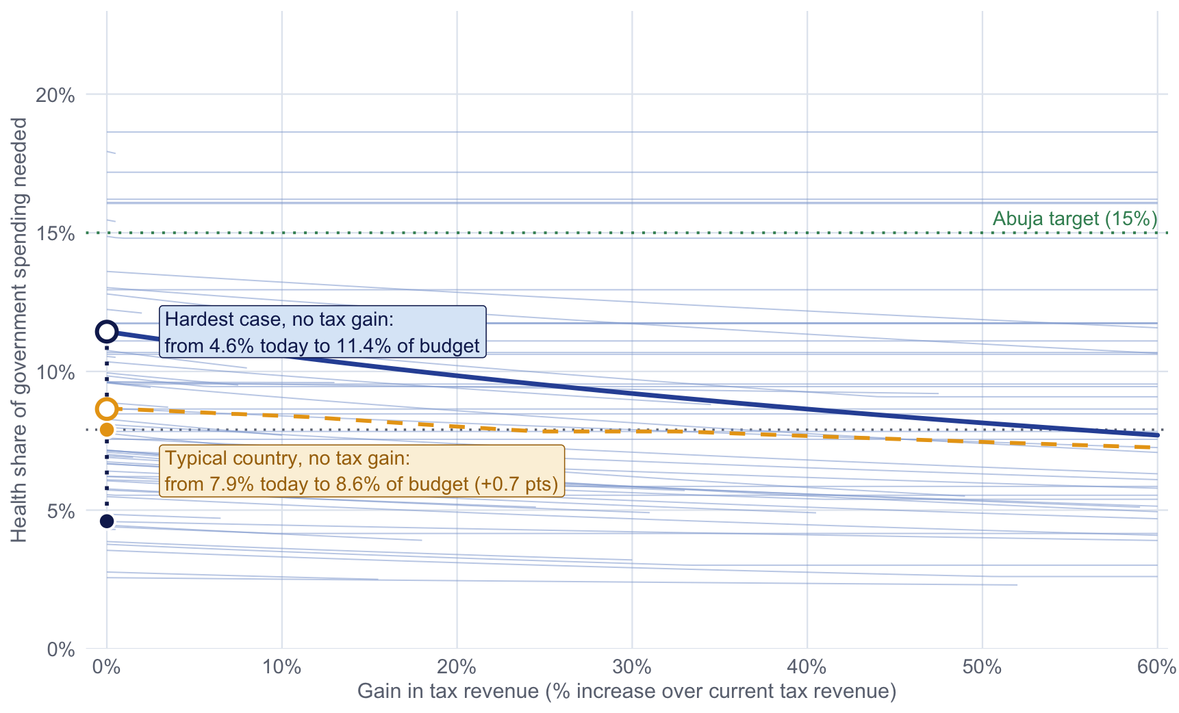
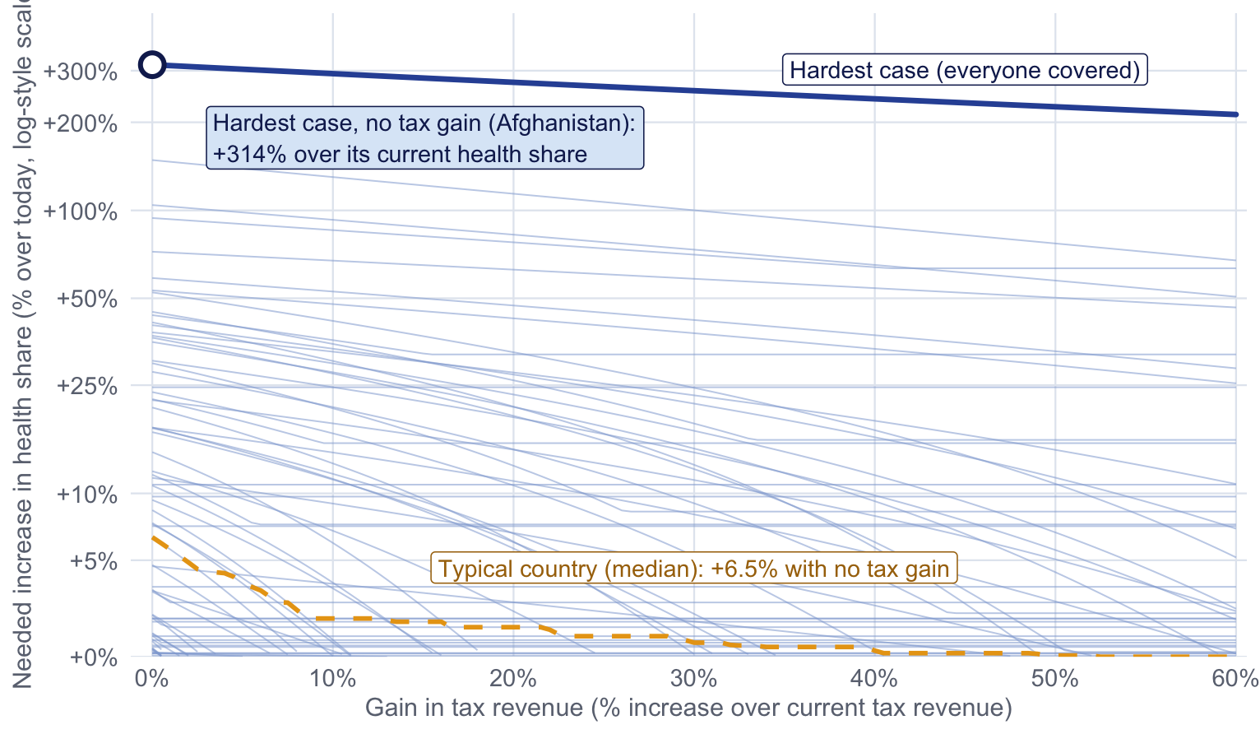
Most countries need only a modest shift in budget priority, but a few would need to at least double their health share
Sources: Health expenditure as a % of government budget is sourced from the World Bank and current tax revenue is sourced from the IMF. OECD cuts are projections based on OECD data and official country-level communications.
Budget reallocation in absolute terms may be a small shift for the typical country (+0.7 points), but 21 countries start below 5% of their budget and would have to raise health’s share sharply.
Notes:
Kaley

Slide 28
Loans tied to health priorities can incentivize new funds to be invested into health
Strategy | Description
Sustainability-Linked Loans | Interest rate or repayment schedule improves when national health targets are met
Matching Domestic Mandates | Low-interest loans are distributed when health investment increases
New revenue on its own competes with other budgetary demands, however, loans tied to health targets provide a potential avenue for circumventing this
Notes:
Ting
There’s a double-sided sword where as the world bank has pointed out it’s tough to raise new tax revenue in a lot of these countries where the informal work sector is large and also a small percentage of spending is going to health, and also there are constraints on reallocation from certain expenditure budgets.

Slide 29
DAH prioritization – where should donors be targeting remaining funds?
04.2

Slide 30
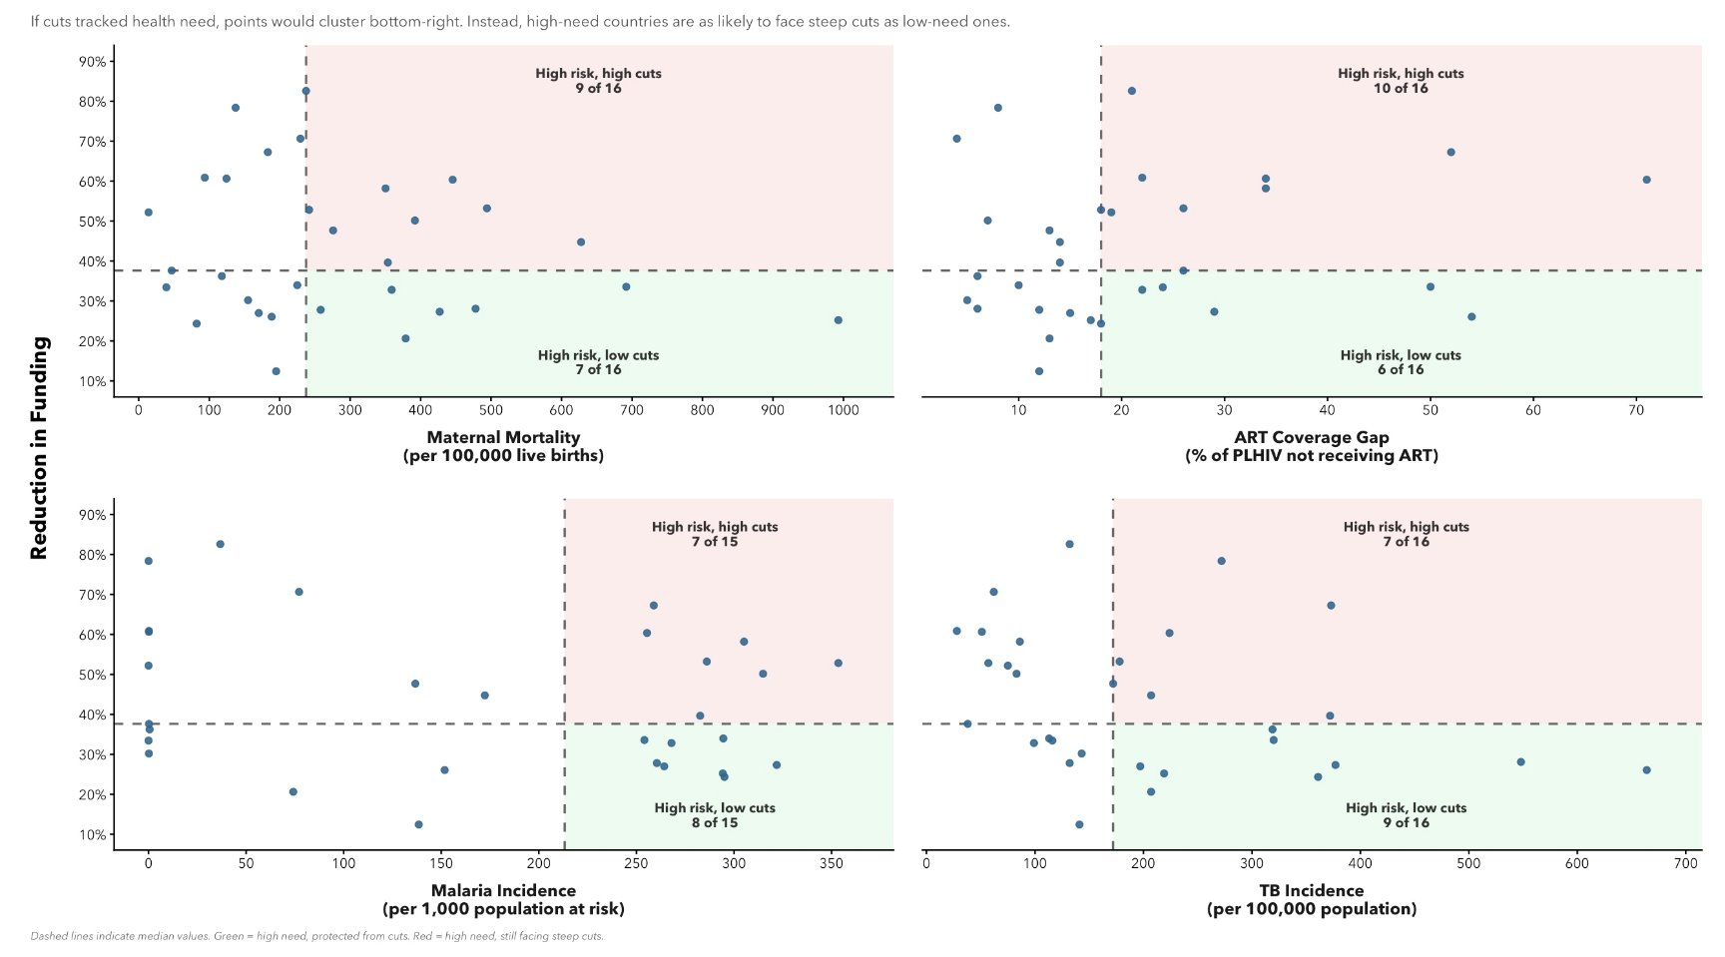
Recall: Funding cuts show no consistent relationship
with health need, leaving high risk countries vulnerable
Cuts also did not follow health need, leaving some high-risk countries heavily exposed and others spared. Uneven exposure requires tailored responses

Slide 31
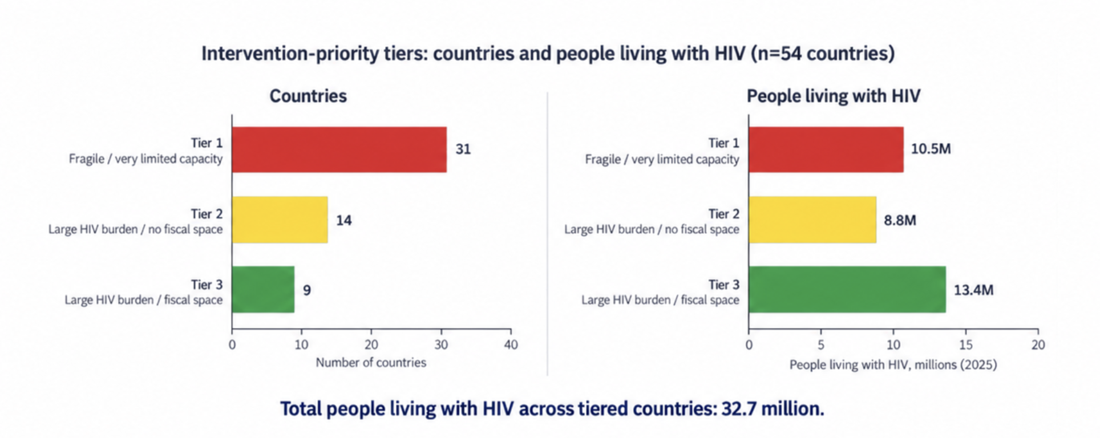
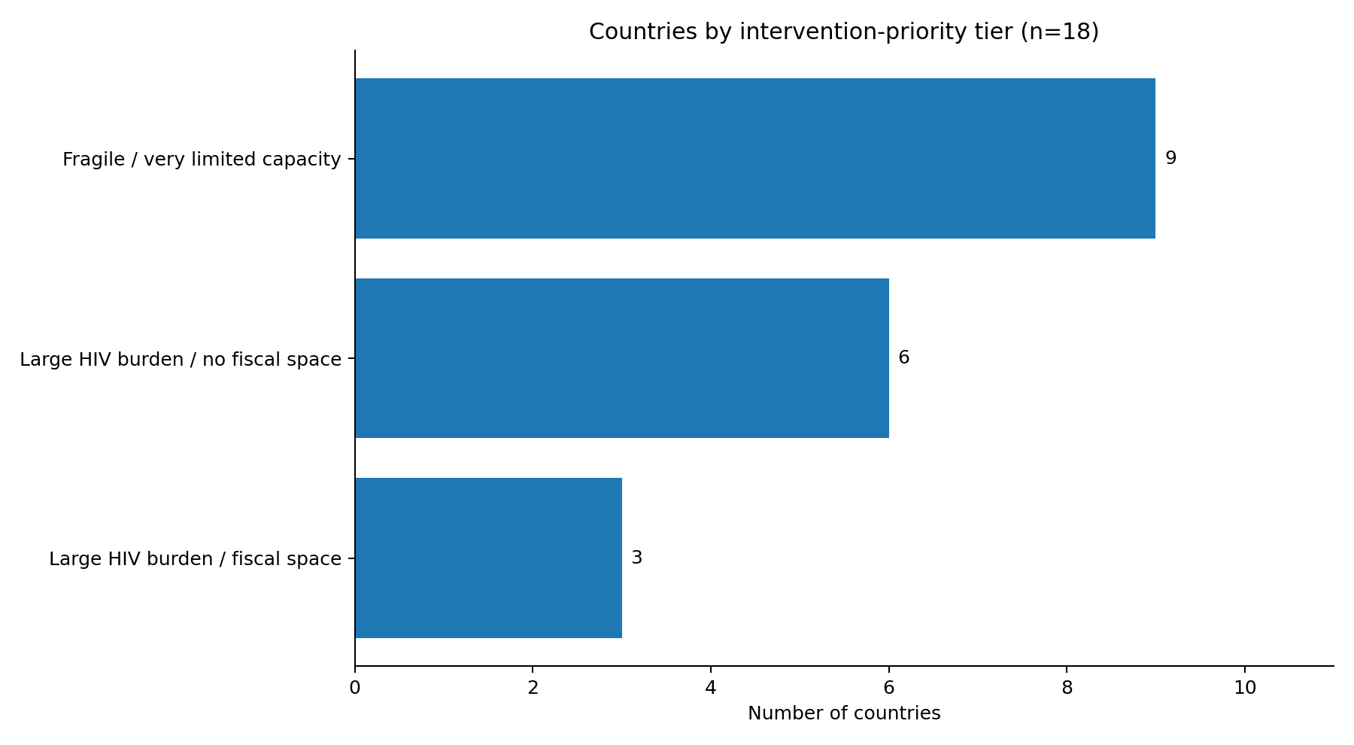
HIV Financing Transition: Country Risk-Tier Analysis
Notes:
Ishnan/Victor

Slide 32
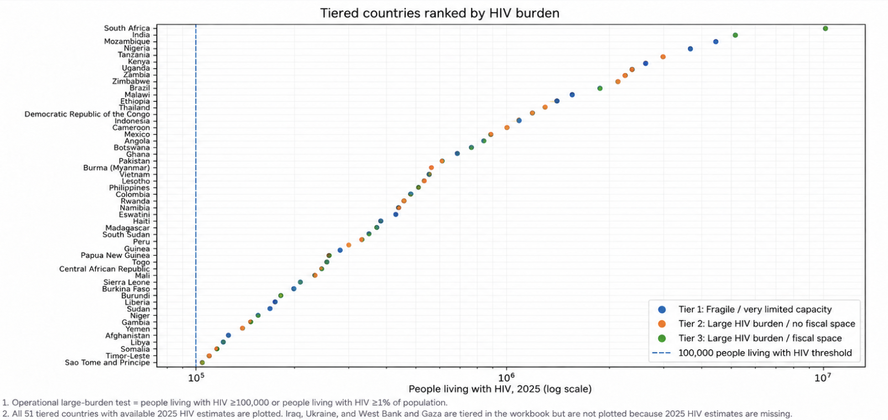
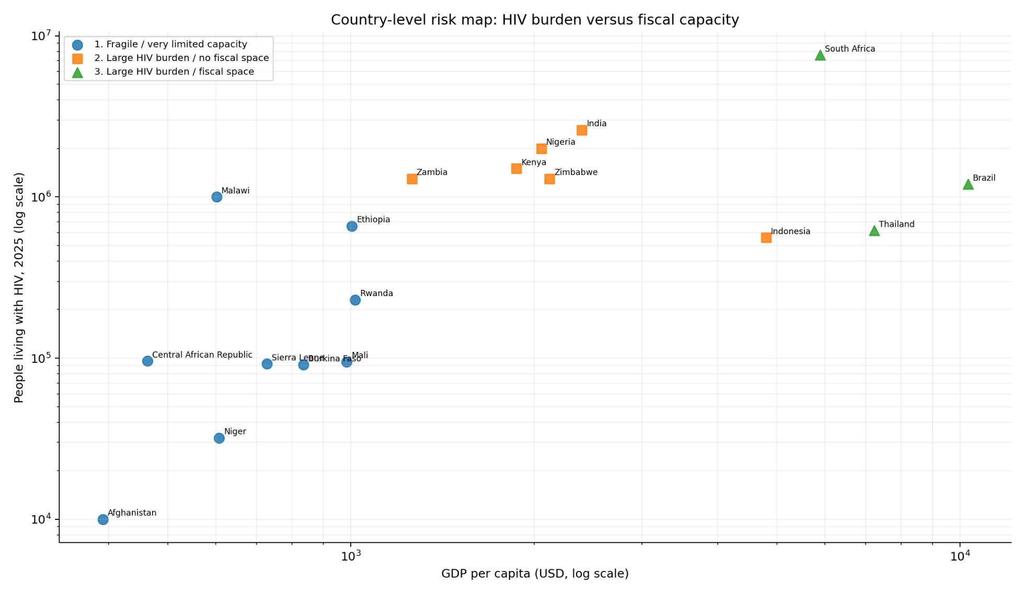
Country risk map
Notes:
Ishnan/Victor

Slide 33
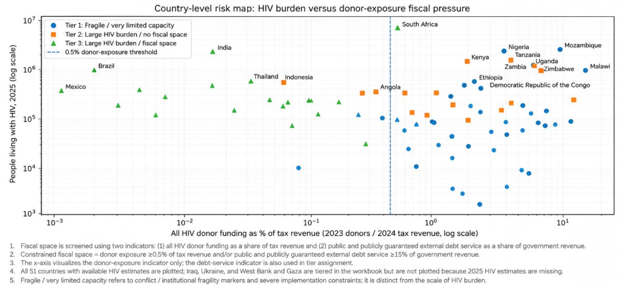
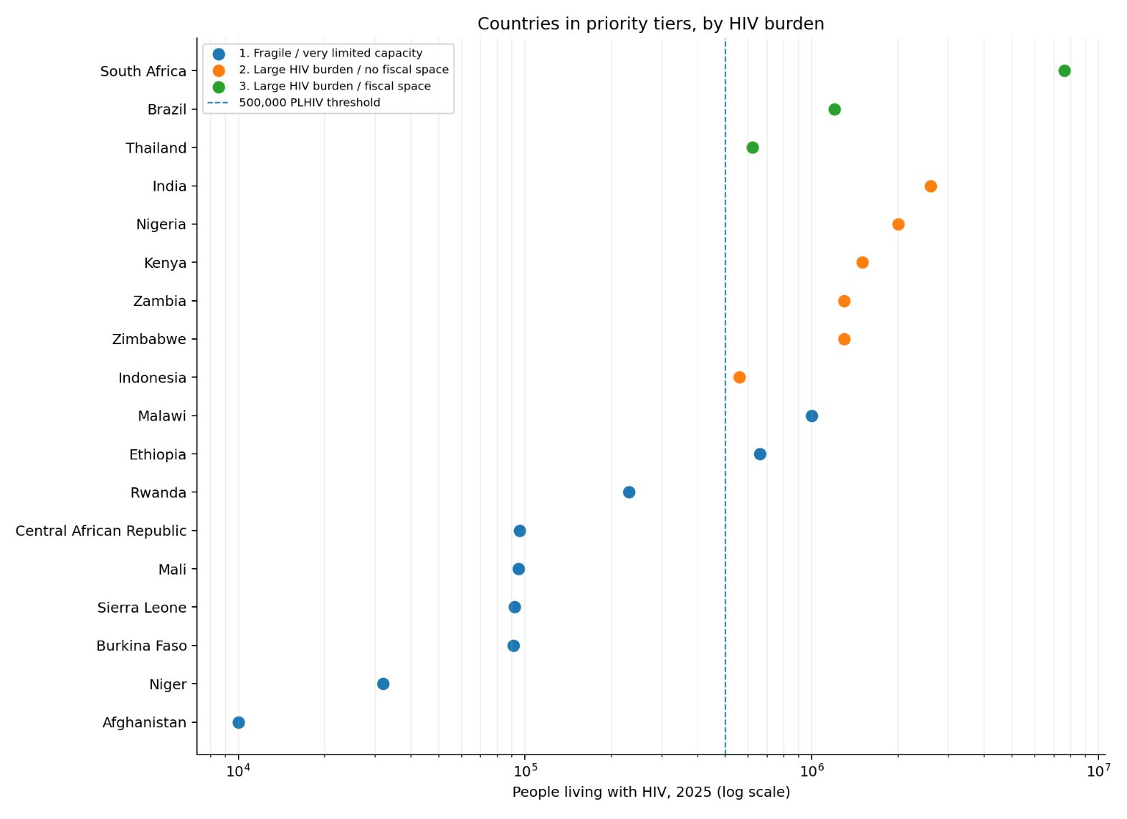
Countries by HIV burden
Notes:
Ishnan/Victor

Slide 34
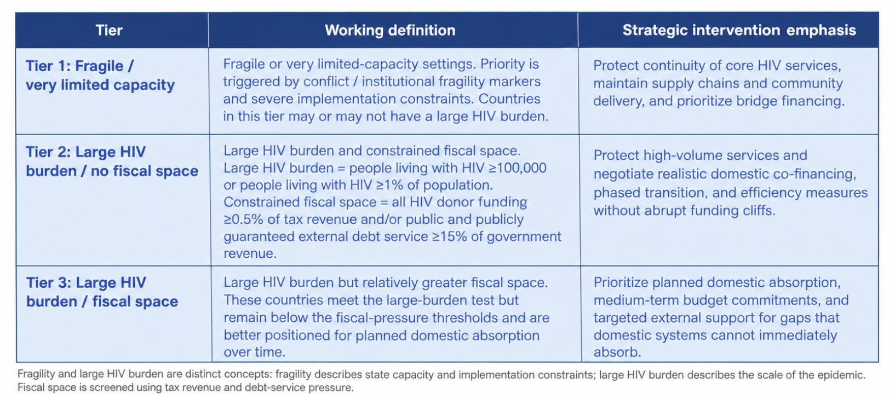
Priority tiers and intervention emphasis
Tier | Strategic intervention emphasis
Tier 1: Fragile / very limited capacity | Protect continuity of core HIV services, maintain supply chains and community delivery, and prioritize bridge financing.
Tier 2: Large HIV burden / no fiscal space | Protect high-volume services and negotiate realistic domestic co-financing, phased transition, and efficiency measures without abrupt funding cliffs.
Tier 3: Large HIV burden / fiscal space | Prioritize planned domestic absorption, medium-term budget commitments, and targeted external support for gaps that domestic systems cannot immediately absorb.
Notes:
Ishnan/Victor

Slide 35
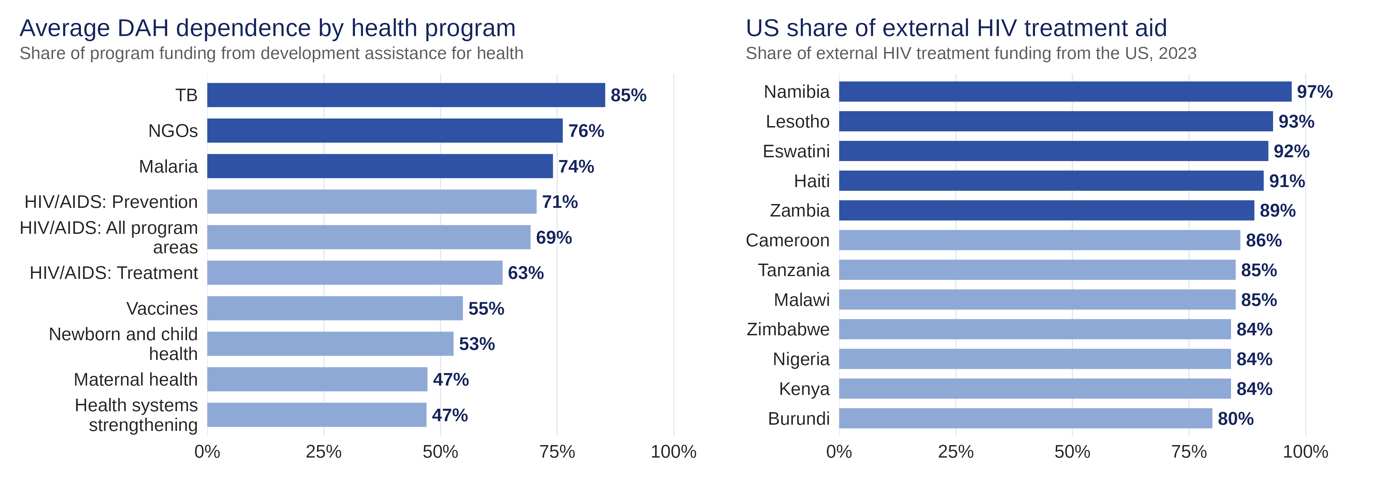
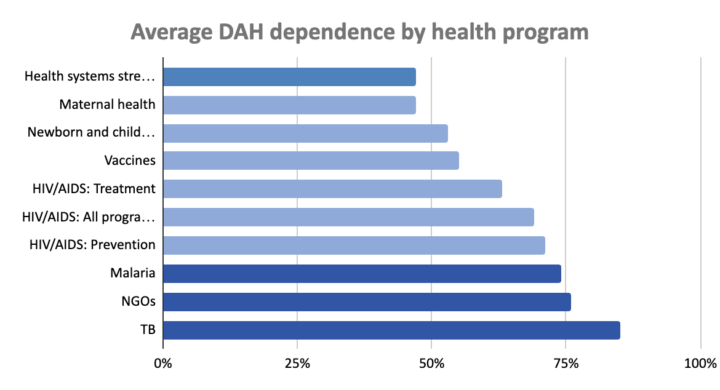
High-dependency programs are where remaining donor funds matter most
Sources: IHME Development Assistance for Health Database 1990-2023; United Nations Programme on HIV/AIDS (UNAIDS) 2026 Estimates
Sudden disruption in aid threatens to halt care delivery without targeted donor response

Slide 36
Looking Ahead
05

Slide 37
Calendar
Event | Date
Current Meeting | October 13, 2026
Final Readout | TBD
Report Finalized | TBD
Final Presentation Competition | December 14, 2026
Notes:
Kaley

Slide 38




Discussion
Next Steps and Discussion
Estimate how long it might take for fiscal space to grow
Model various concessional loan terms and their impact
Work on the written report and final presentation
Anything else?
Notes:
Kaley

Slide 39
Executive Summary
Finding 1: Cuts were uneven relative to need and capacity
  Projected OECD cuts for 2026 averaged about 15% of last reported data, regardless of income or debt burden
  Recommendation: Resolutions need to be intentional to provide tailored responses based on a countries' current need and ability to adapt
Finding 2: Domestic revenue growth is unlikely to resolve shortfalls
  Max tax potential covers the decline in 51 of 66 countries. The other 15 also need to raise health’s share of the budget, which is hard for countries starting at 1 to 2%.
  Recommendation: Aid recipients should pursue both revenue growth and budget reprioritization
Finding 3: Foreign dependency makes some programs and countries especially exposed
  Programs like TB, malaria and HIV rely heavily on donor funds, and the US share of HIV treatment aid is 80% or more in 12 of 19 countries.
  Recommendation: Remaining donor funds should be intentional to target health programs unlikely to be adapted by domestic spending

Slide 40
Dashboard-nModeling the cuts
Nick/Jiya
(1) Full US Exit
  If US funding through all multilaterals, and through bilateral agreements was cut
  Modeled using IHME Data, averaged over 2021-2025 funding levels, inflation-adjusted over time
(2) America First MOUs
  Modeling the changes to US funding through bilateral agreements based on deductions to MOUs
Notes:
Nick/Jiya

Slide 41
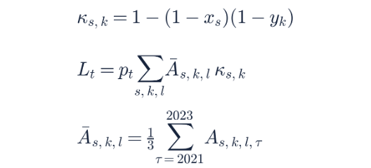
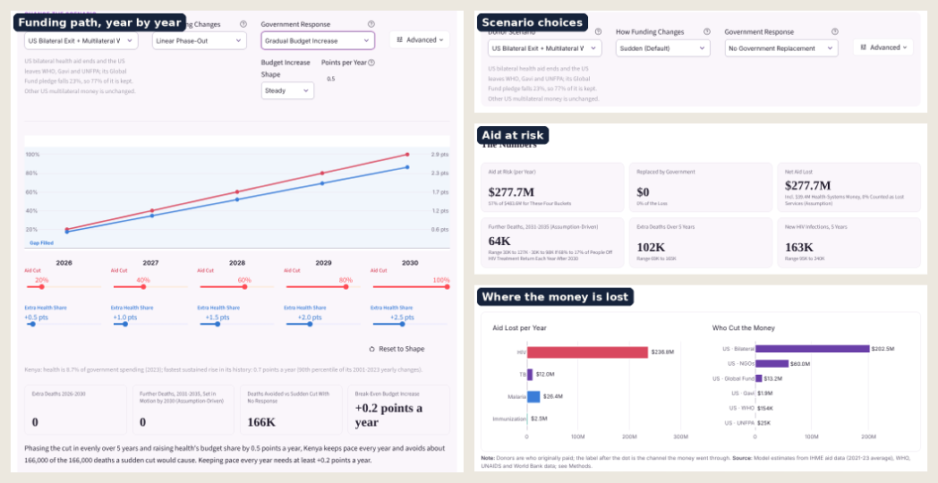
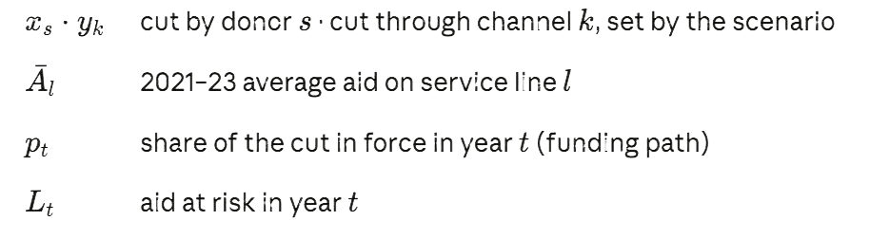
Dashboard – Modeling the aid retreat
Notes:
Nick/Jiya

Slide 42





Malaria, TB and vaccines, by program
Break Down: Malaria
Break Down: Tuberculosis
Break Down: Newborn & child health (vaccines)
Notes:
The same dropdown for the other three diseases the model covers. Malaria aid splits into bednets, indoor spraying, treatment and other; TB into treatment and drug resistance; newborn and child health includes vaccines, nutrition and health systems. A large share of aid in every disease is labeled other or health systems. The model does not drop it: it splits that unlabeled money across treatment, prevention, testing and systems using the shares in the Global Fund’s own grant budgets, so every service line carries its fair share of the loss.

