Slide 1
FEM Stuff
Nick Horton

Slide 2

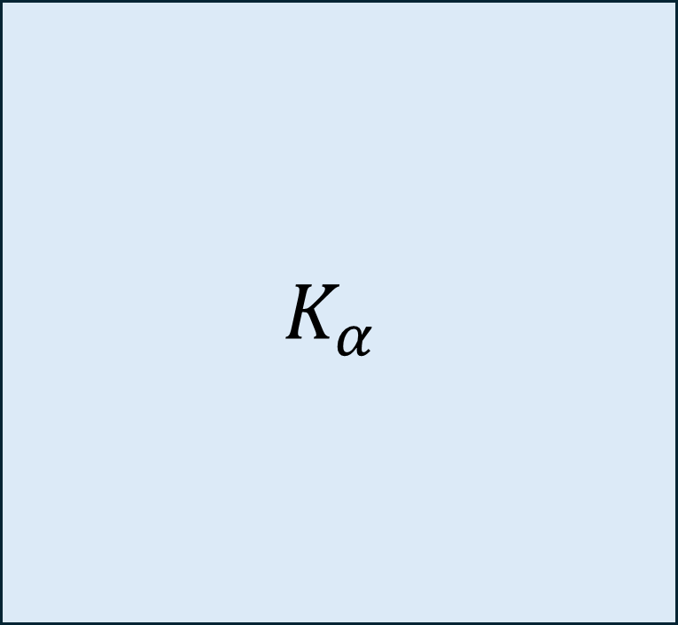
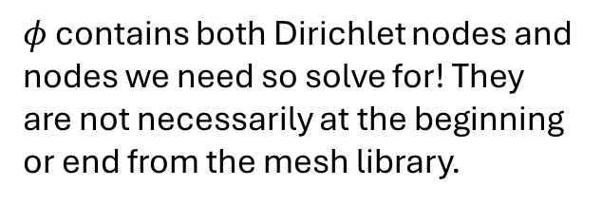


$$K_{α}$$
$$φ$$
$$b$$
$φ$ contains both Dirichlet nodes and nodes we need so solve for! They are not necessarily at the beginning or end from the mesh library.
$$=$$

Slide 3


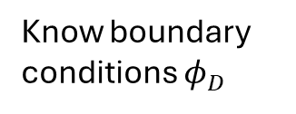
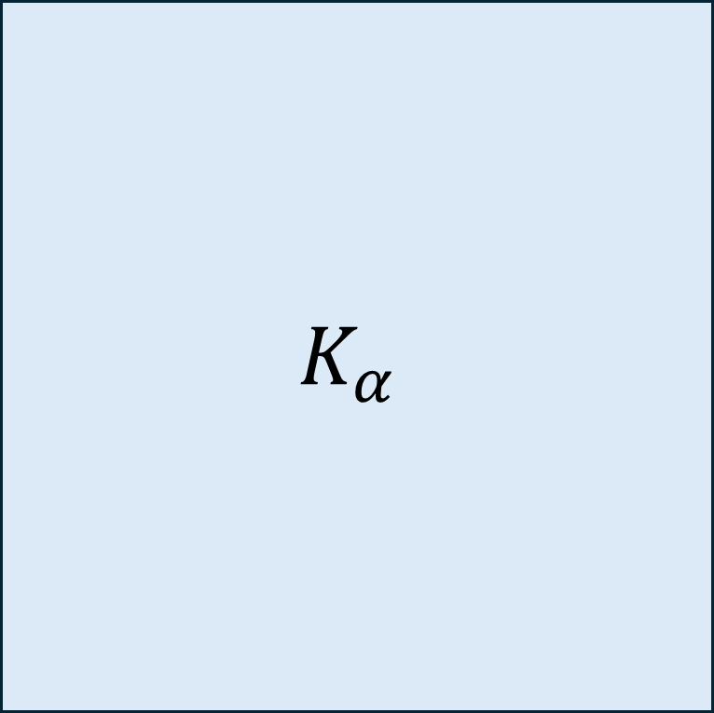





Know boundary conditions $φ_{D}$
$$j$$
$$j_{D}$$
$$K_{α}$$
$$φ$$
$$b$$
$$b_{D}$$
$$=$$
$$=$$
$$i$$
$$j_{\sim D}$$

