Slide 1
Getting and Cleaning Data
CIHR Course Week 4
Bethany Hedt-Gauthier
Izzie Fulcher

Slide 2
Syndromic Surveillance Review
By yourself, write out the answers to the following questions.
When done, discuss with the people around you
Questions:
What are the steps taken to conduct syndromic surveillance?
What are the pros and cons of syndromic surveillance?
What is the difference between a confidence and a prediction interval? Which do we use for syndromic surveillance?

Slide 3
How to conduct syndromic surveillance
Step 1. Choose relevant indicators to follow over time (Session 1) and format data for analysis (Session 4)
Step 2. Determine baseline and evaluation periods
Step 3. Fit time series model to baseline period (Sessions 2 & 3)
Step 4. Using the model from Step 3, calculate deviations from expected in the evaluation period (Session 3)
Step 5. Produce interpretable visualizations (Session 4)

Slide 4
Detecting deviations from expected
Syndromic surveillance: is the process of monitoring data on symptoms or outcomes related to a disease as a way to detect areas that might be affected by the disease.
Pros:
Provide “warnings” for local areas.
Uses existing data.
Process can be automated.
Cons:
Not as good as monitoring the disease directly.
Changes could be explained by other factors that should be considered.
Notes:
QUESTION: What are some “Other factors” that should be considered?

Slide 5
Teaching Objectives
Overview
Outliers
Missing data
Data Visualization

Slide 6
Outliers

Slide 7
A note
In this session, we will discuss outliers and missing data in the context of fitting a time series model for a single facility and indicator
Notes:
Misentered;
Nearby clinic shut down so individuals came to this clinic for one month

Slide 8
Types of outliers
Outliers are data points that are very different from the majority of observations in the time series
There are various types of outliers:
Errors in data entry
Unusual cases
Global outlier: raw values are significantly larger or smaller than the rest of the values.
Contextual outlier: higher or lower value than you would expect based on the patterns and trends of the time series
Notes:
Misentered;
Nearby clinic shut down so individuals came to this clinic for one month

Slide 9
How do we detect outliers?
Method 1: Visual inspection
Hard to detect outliers with time series data due to seasonality
Method 2: Tukey’s rule (larger than 1.5*IQR values)
Does not capture the seasonal nature
Boxplots by month – but would not capture trend & need many years of data
Boxplots by year – but would not capture seasonality
Method 3: Fit time series model and apply statistical test
Captures trend & seasonality, but it is model dependent

Slide 10
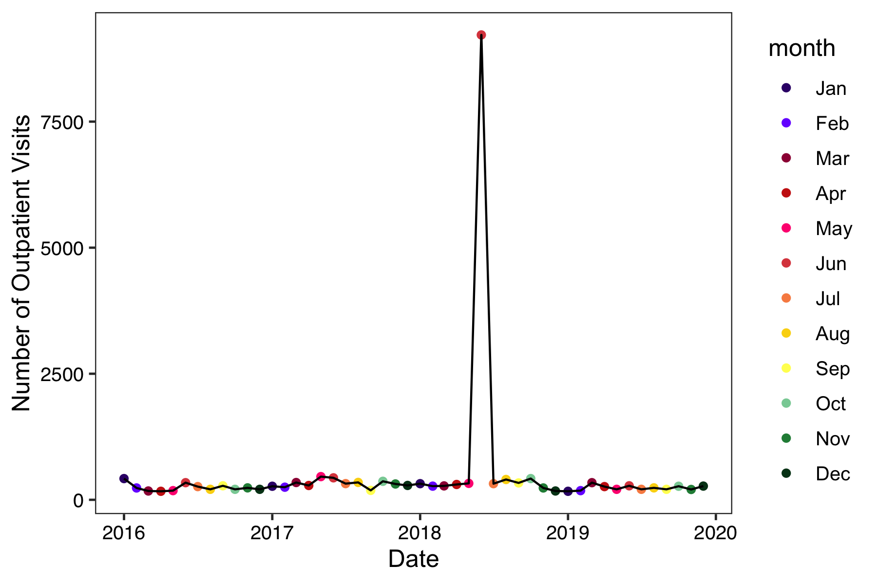
Method 1: Visual inspection
Error?
Global outlier?
Contextual outlier?
Jayproken Clinic in Liberia
Notes:
ACTIVITY: POLL FOR ALL VISUAL INSPECTION SLIDES

Slide 11
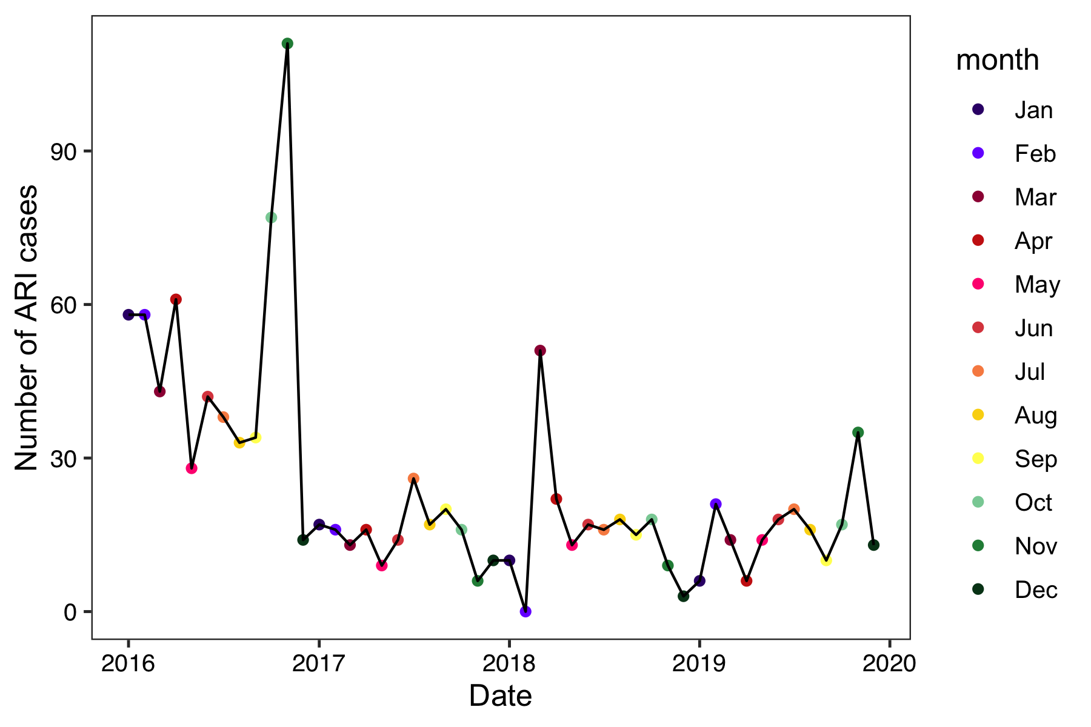
Method 1: Visual inspection
Error?
Global outlier?
Contextual outlier?
St. Francis Clinic in Liberia
Notes:
ACTIVITY: POLL FOR ALL VISUAL INSPECTION SLIDES

Slide 12
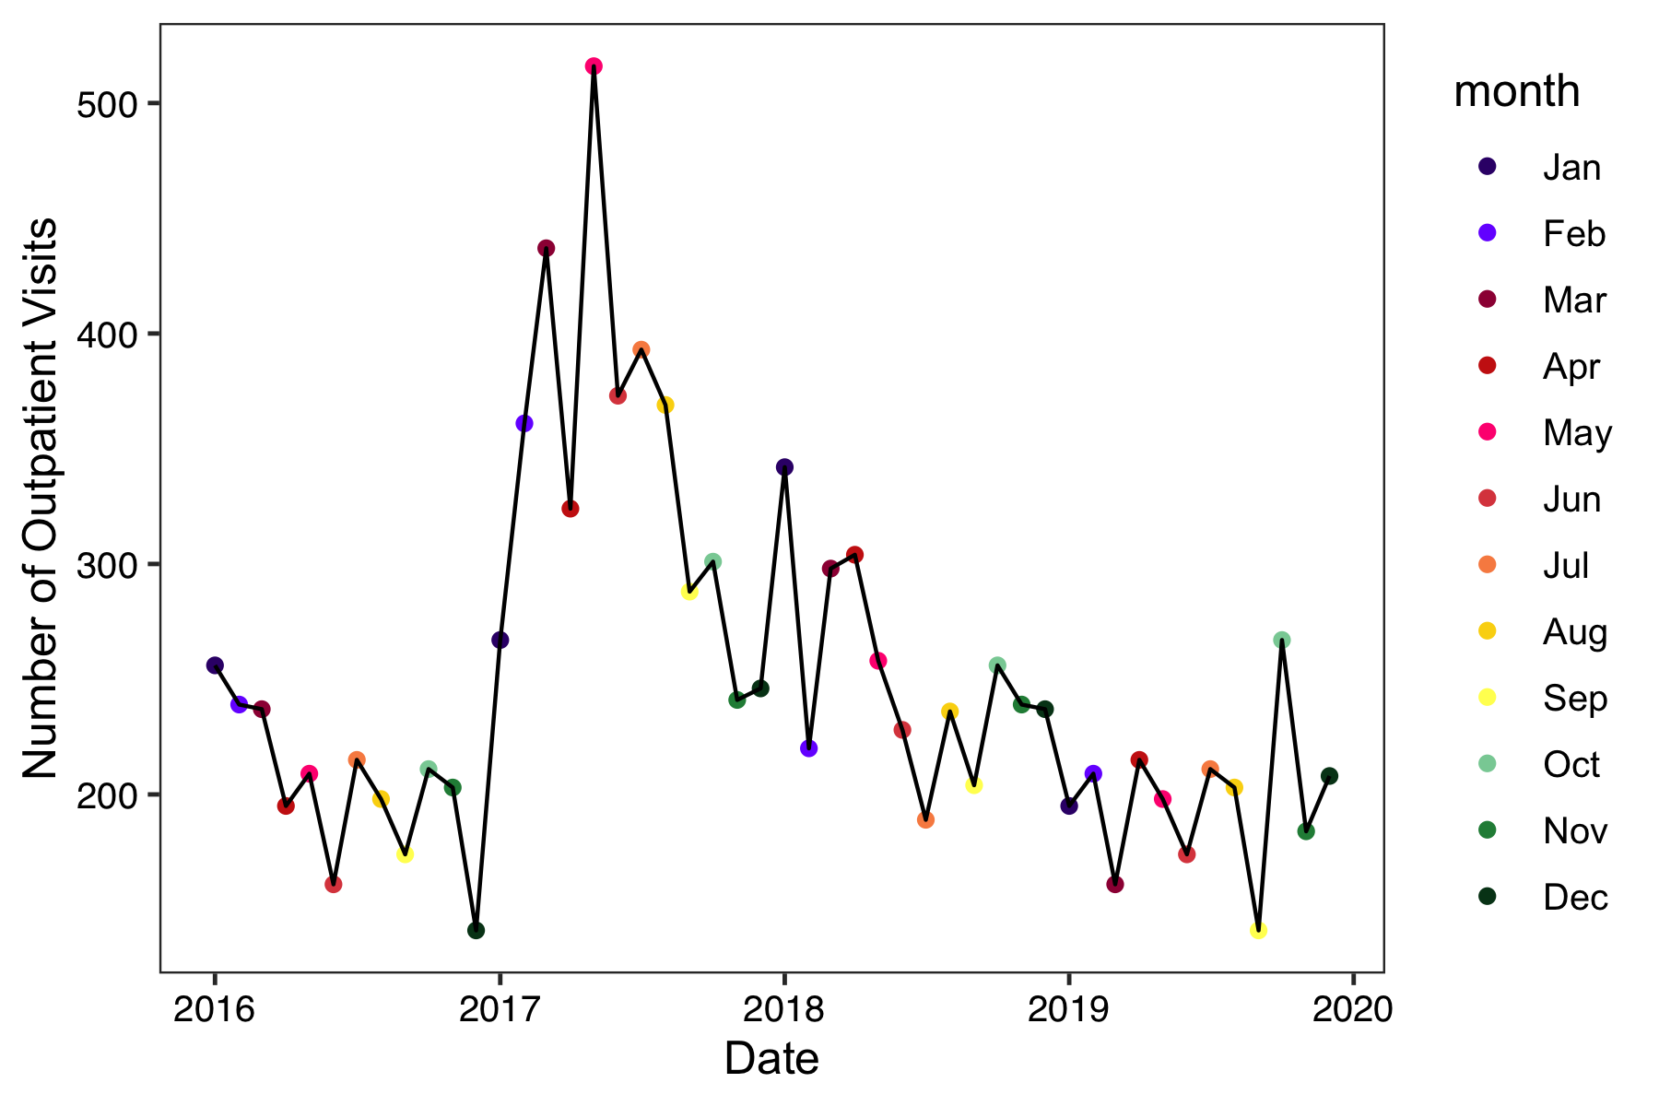
Method 1: Visual inspection
Error?
Global outlier?
Contextual outlier?
Yangaya Clinic in Liberia
Notes:
ACTIVITY: POLL FOR ALL VISUAL INSPECTION SLIDES

Slide 13
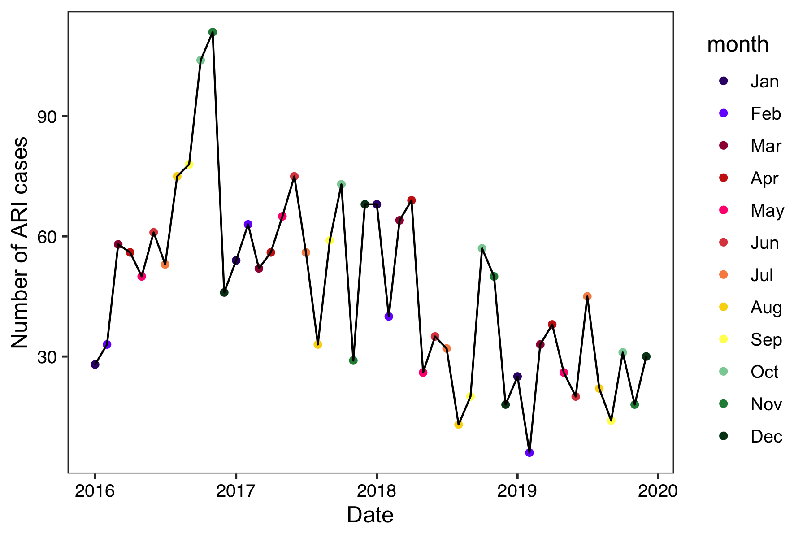
Method 1: Visual inspection
Error?
Global outlier?
Contextual outlier?
Boniken Clinic in Liberia
Notes:
ACTIVITY: POLL FOR ALL VISUAL INSPECTION SLIDES

Slide 14
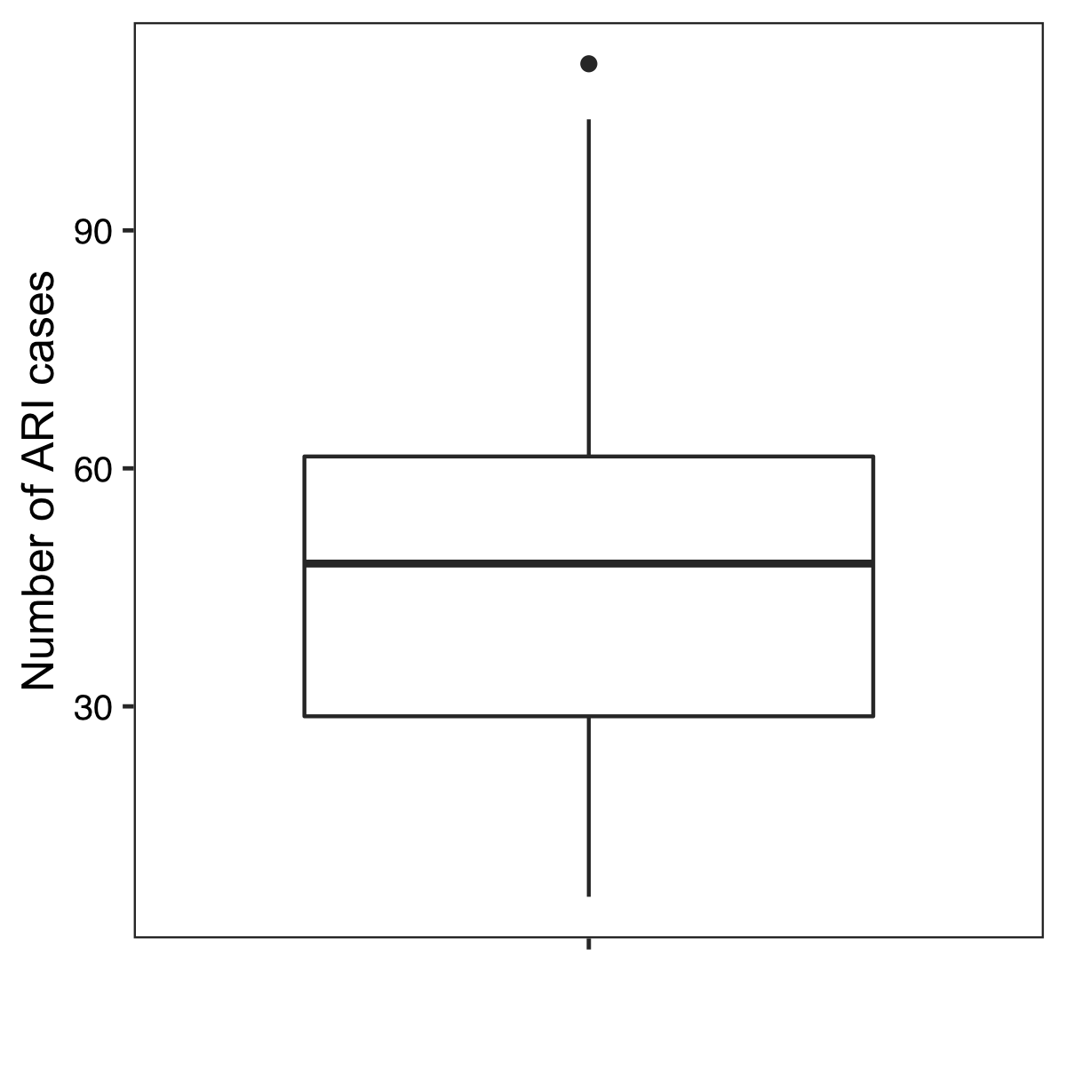
Method 2: Tukey’s rule
Boniken Clinic in Liberia

Slide 15
Method 2: Tukey’s rule
Q75 + 1.5*IQR
75th percentile
median
25th percentile
Q25 – 1.5*IQR
Boniken Clinic in Liberia

Slide 16
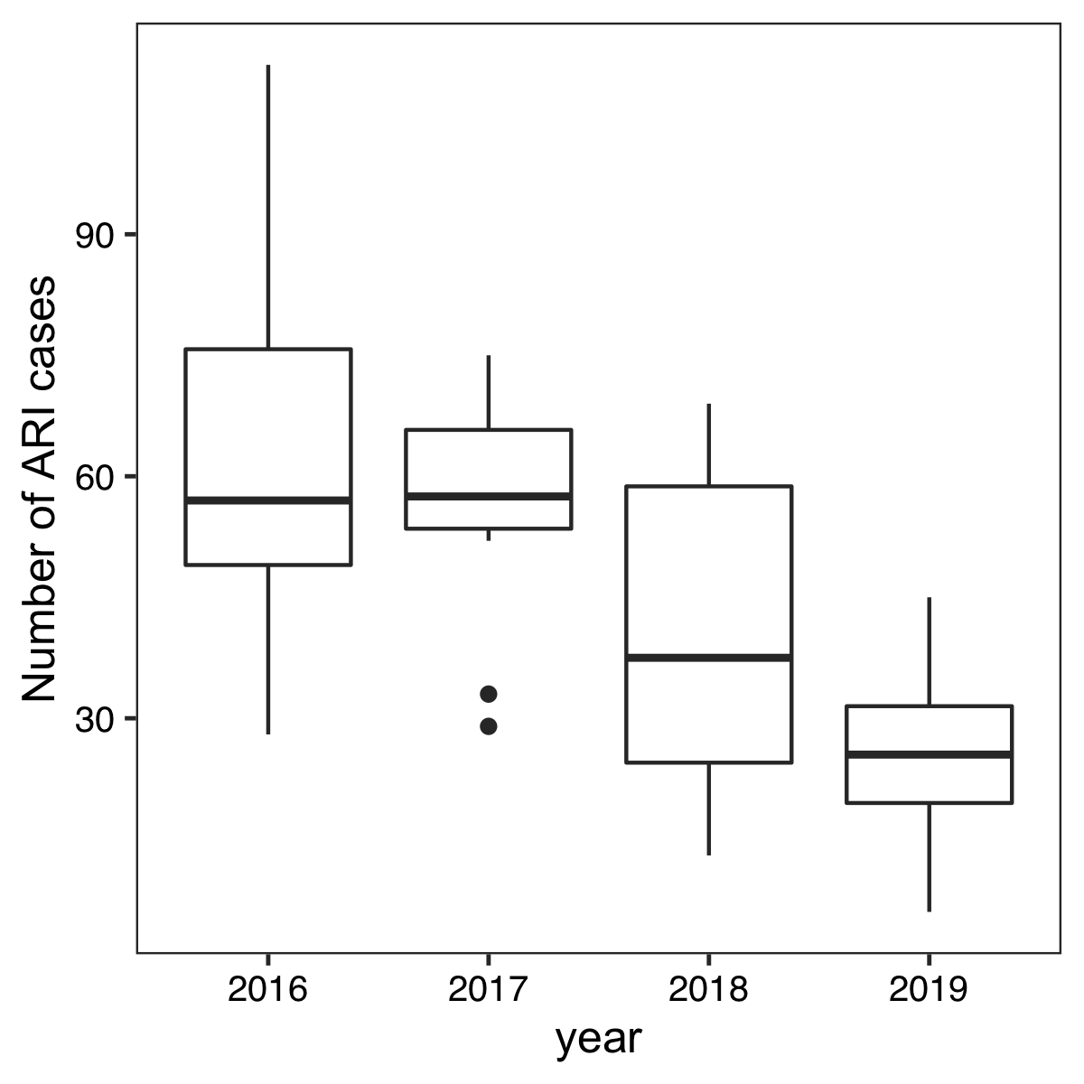
Method 2: Tukey’s rule
Boniken Clinic in Liberia

Slide 17
Method 2: Tukey’s rule
Boniken Clinic in Liberia

Slide 18



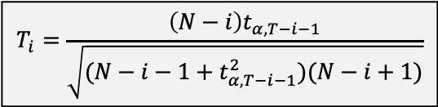
Method 3: Apply statistical test
Fit time series model (Sessions 2 & 3)
Calculate residuals (observed - predicted)
Calculate test statistic (Grubb’s test)
Calculate critical value
Compare test statistic to critical value
If larger, then remove the largest residual and repeat steps
If smaller, then no outliers identified
The residuals removed are the outliers
$$r_{t}=y_{t}−\hat{y_{t}}$$
$$R_{i}=\max{\frac{\left|r_{t}−\overline{r}\right|}{σ_{r}}}$$
$$T_{i}=\frac{\left(N−i\right)t_{α,T−i−1}}{\sqrt{(N−i−1+t_{α,T−i−1}^{2})(N−i+1)}}$$
$$R_{i}>T_{i}$$

Slide 19
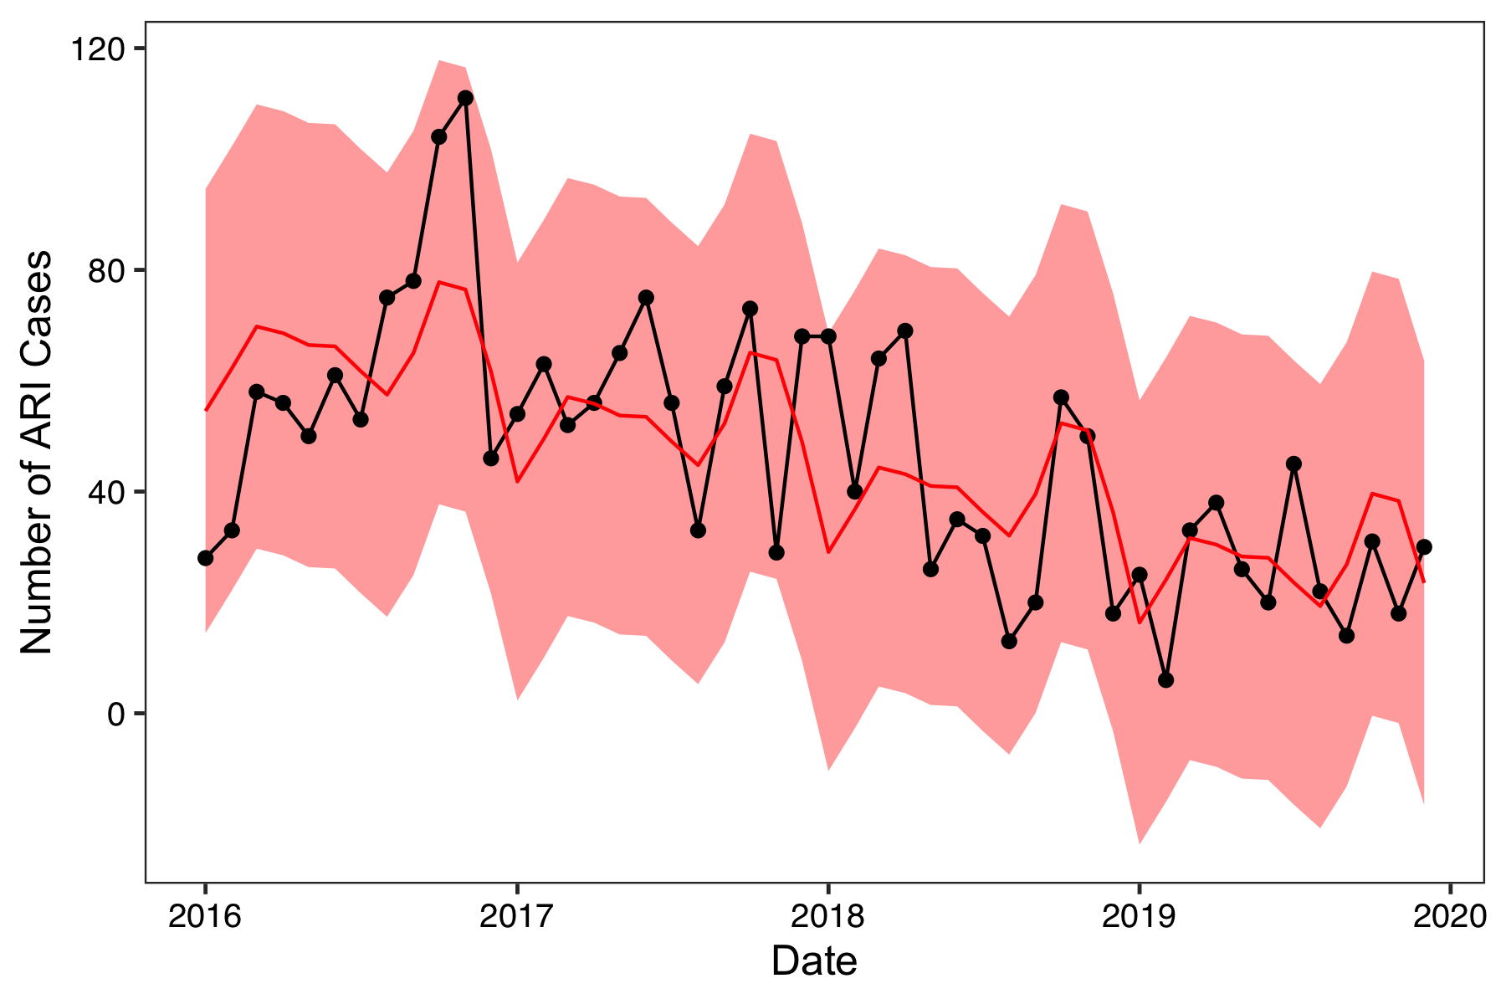
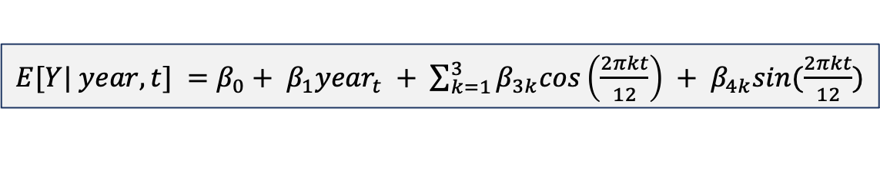
Method 3: Apply statistical test
$E[Y| year, t] =β_{0}+ β_{1}{year}_{t} + \sum_{k=1}^{3}{β_{3k}cos\left(\frac{2πkt}{12}\right)} + β_{4k}sin(\frac{2πkt}{12})$

Slide 20
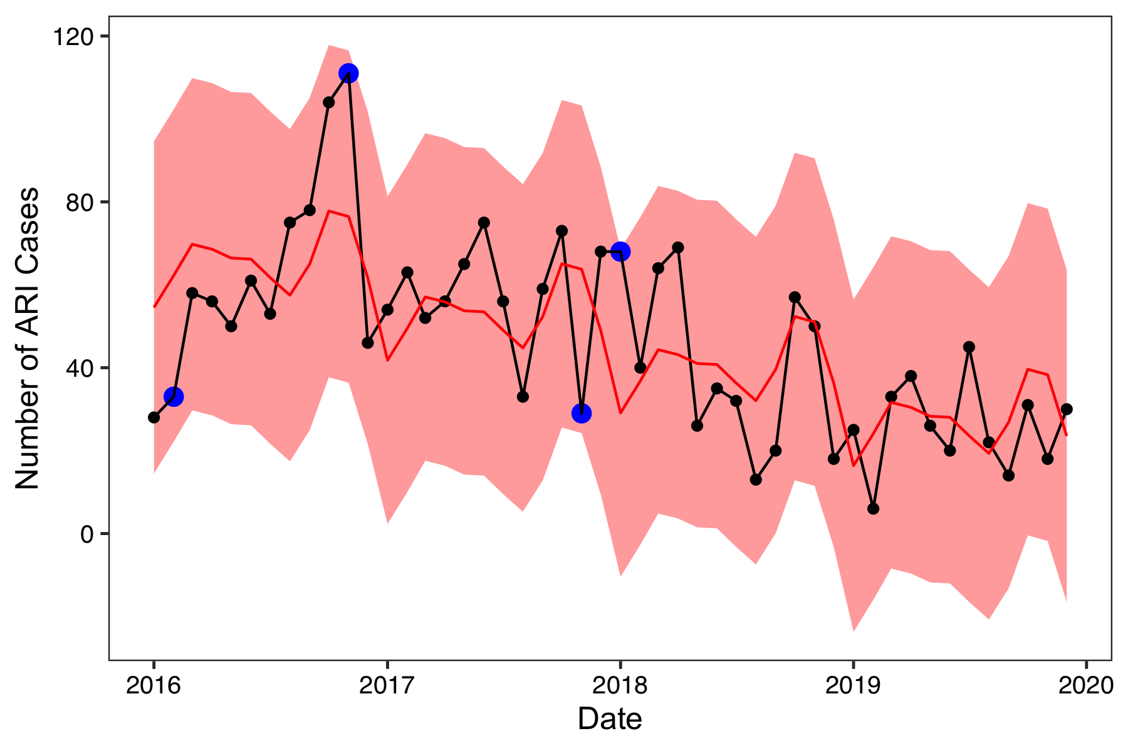
Method 3: Apply statistical test
Not previously identified
Not previously identified

Slide 21
Solutions: Outliers
If an outlier is suspected, it is important to investigate why the data point may be an outlier
Was it an anomaly?
If concerned about model fit, include a dummy variable for the time point(s)
Was it a data entry error?
Can it be replaced with the correct/true value?
If not, then code as missing value

Slide 22
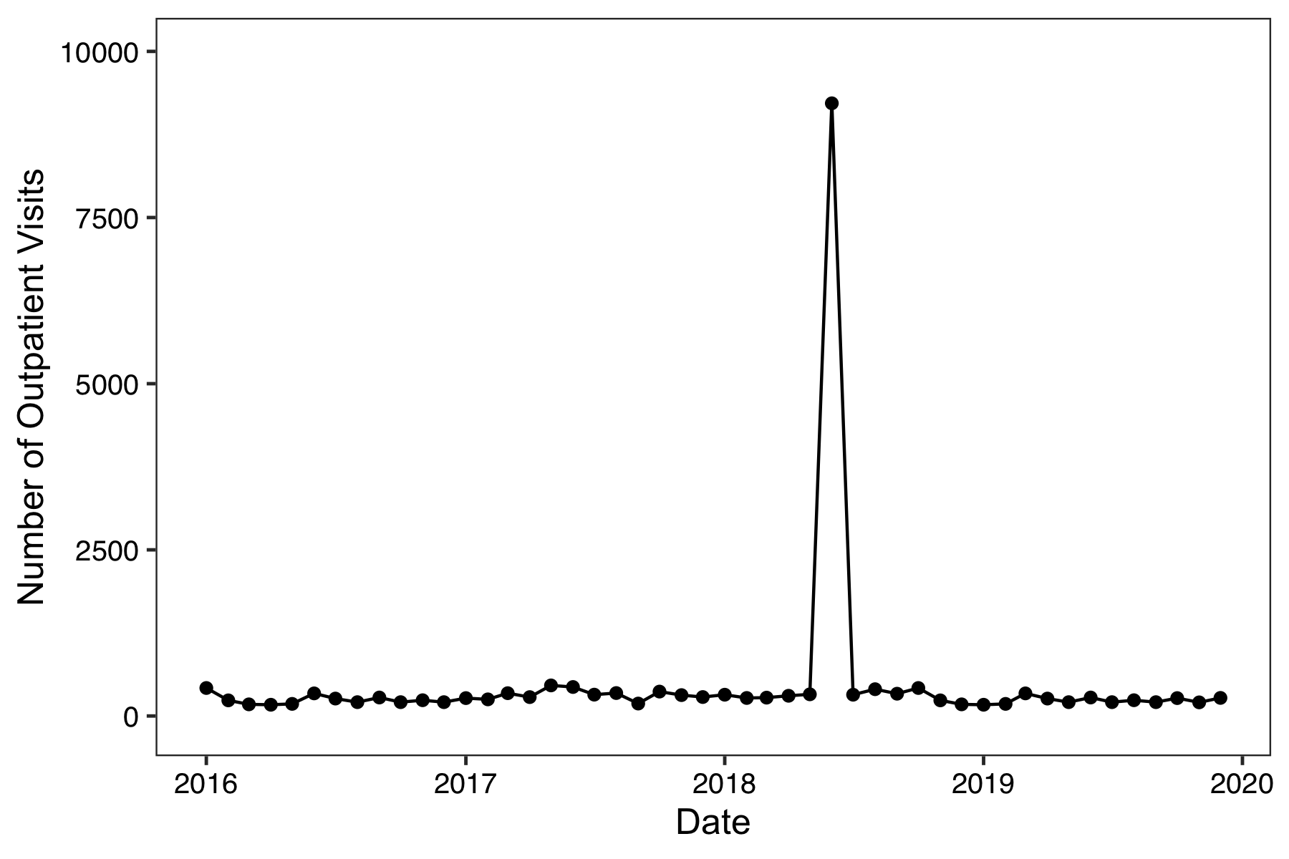
Solutions: Data entry error
Jayproken Clinic in Liberia

Slide 23
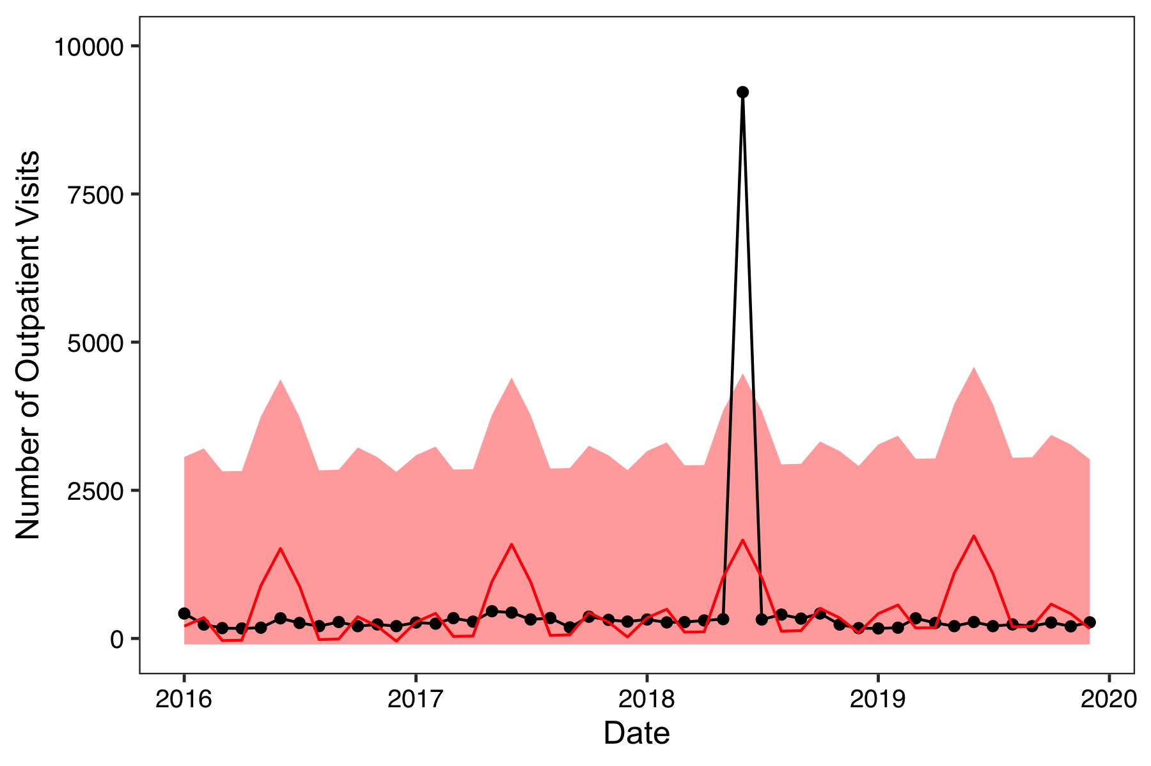
Solutions: Data entry error
Jayproken Clinic in Liberia

Slide 24
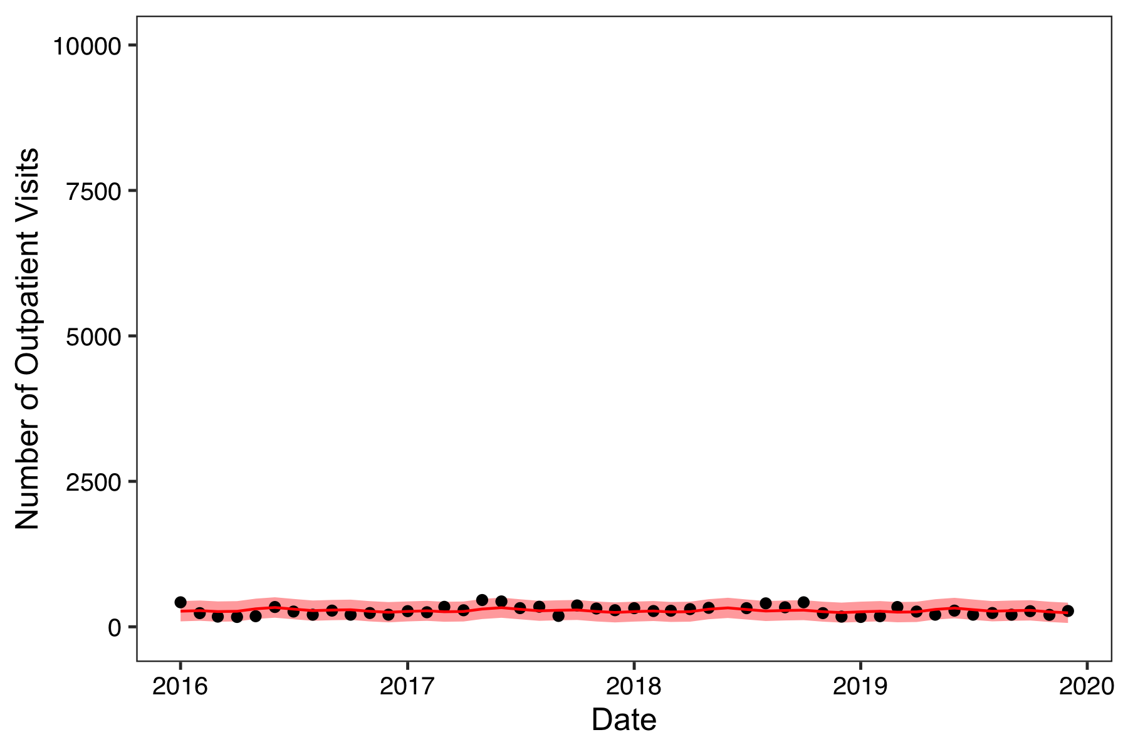
Solutions: Data entry error
Jayproken Clinic in Liberia

Slide 25
Missing data

Slide 26
Considerations for missing data
To help determine if and how missing data should be addressed:
What is the research question?
Why is the data missing?
Is there enough information to address missing data?
How much data is missing?
Is there additional information available to “fill in” missing values?

Slide 27
1. What is the research question?
Describe the behavior of an indicator over time
May be of interest to describe missing data pattern
May want to “fill in” a reasonable value for missing month in figures

Slide 28
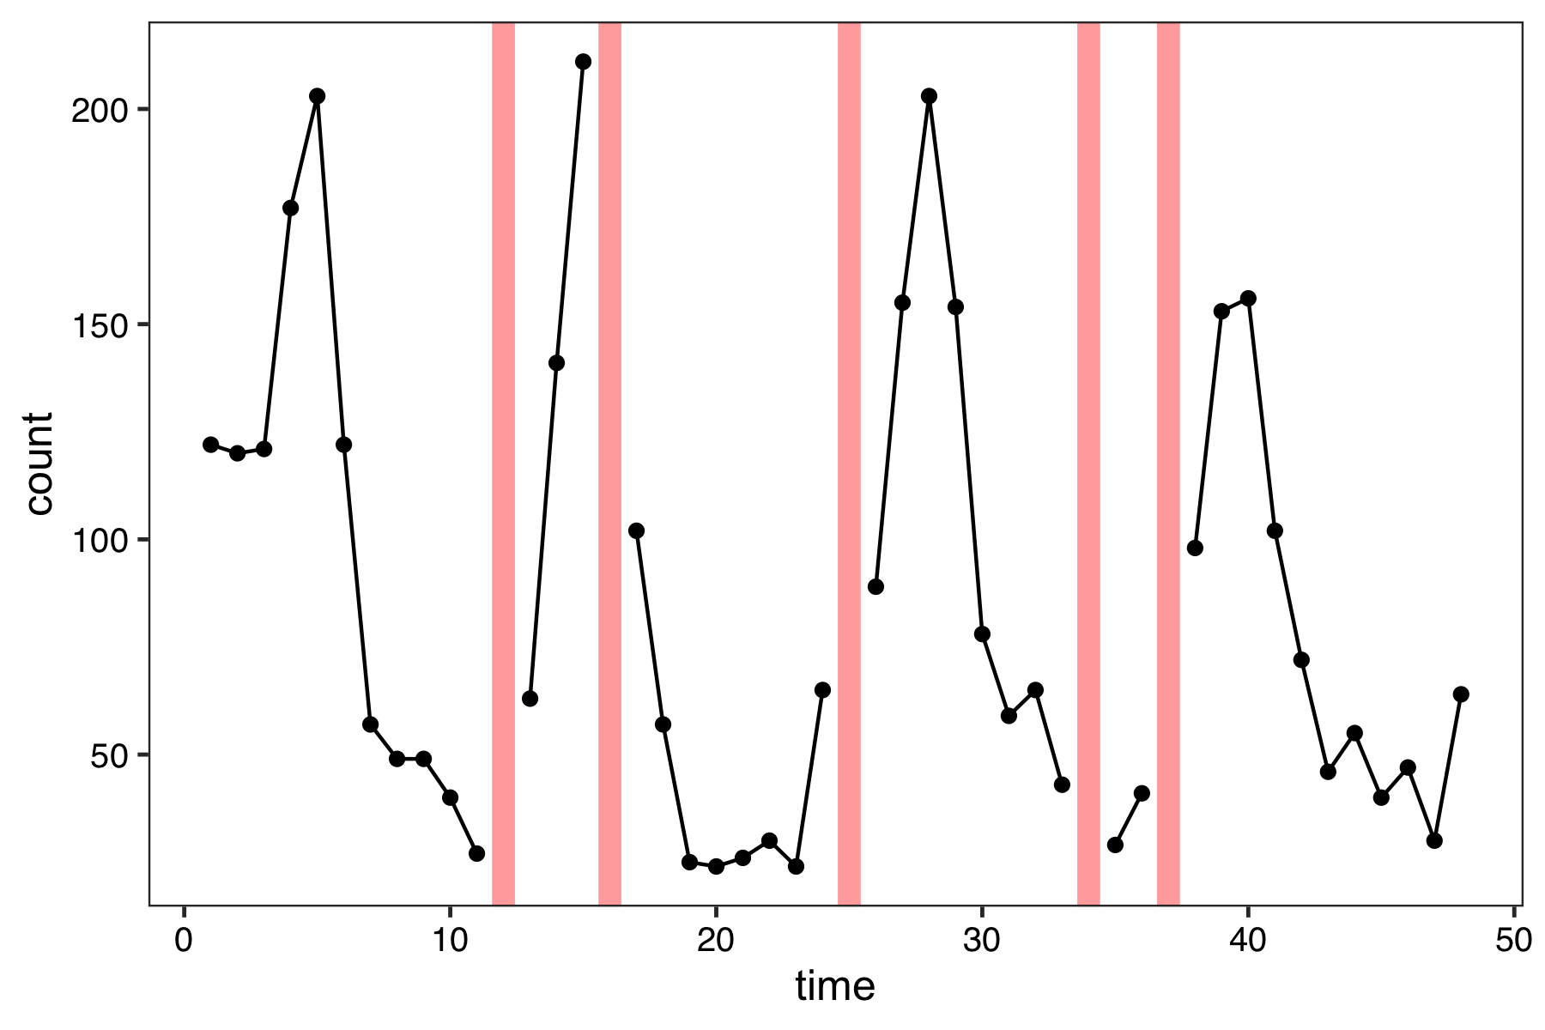
1. What is the research question?
Describe the behavior of an indicator over time
Can perform single imputation based on:
Mean
Interpolation
Model-based

Slide 29
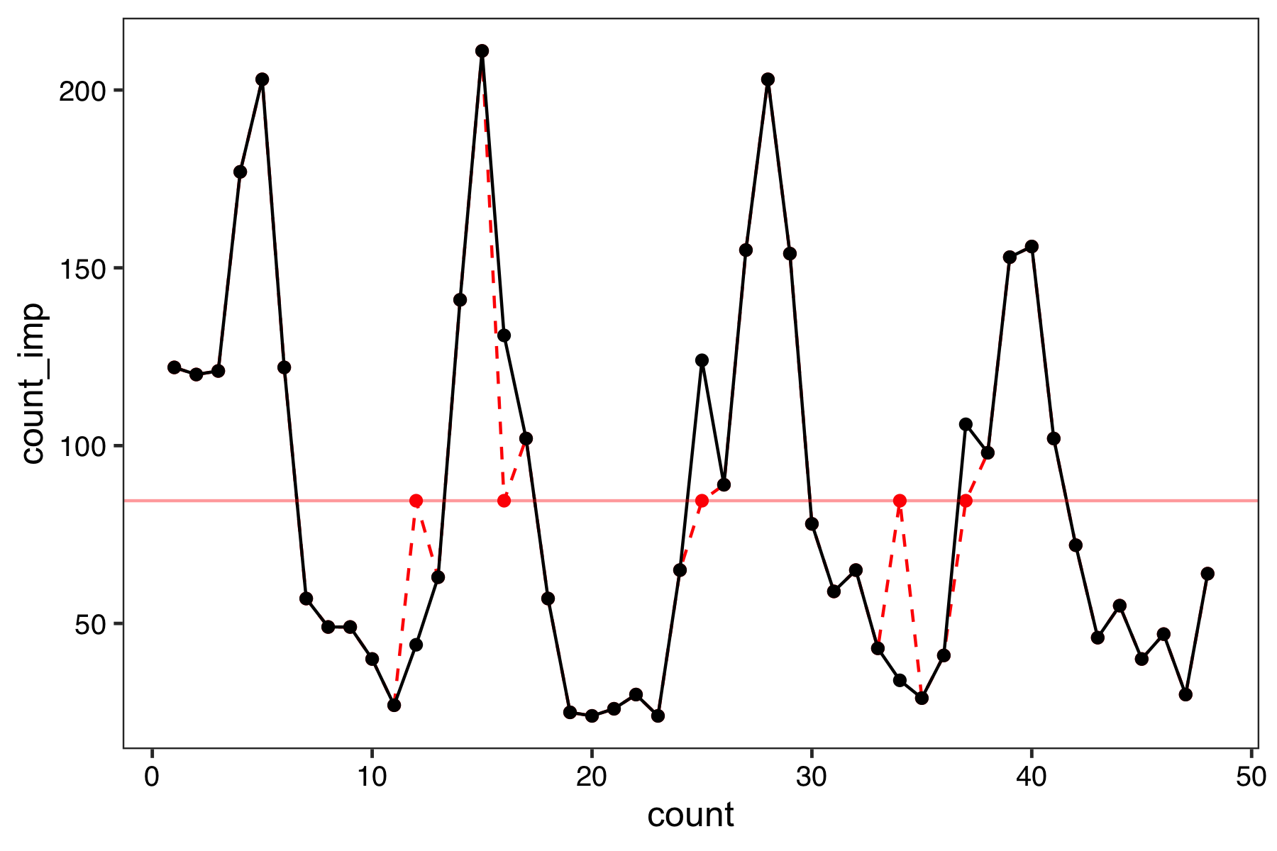
1. What is the research question?
Describe the behavior of an indicator over time
Can perform single imputation based on:
Mean
Interpolation
Model-based
number of malaria cases

Slide 30
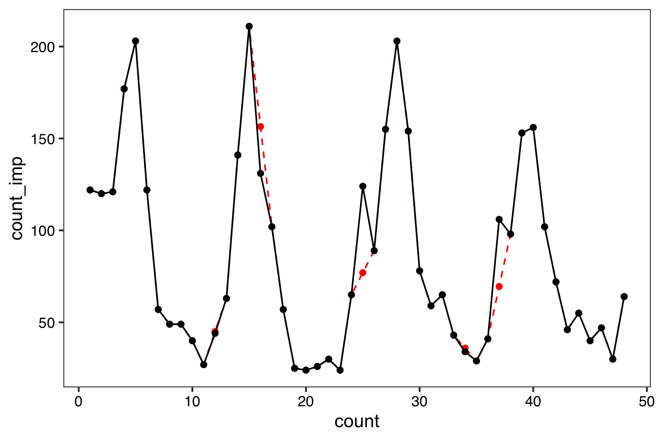
1. What is the research question?
Describe the behavior of an indicator over time
Can perform single imputation based on:
Mean
Interpolation
Model-based
number of malaria cases

Slide 31
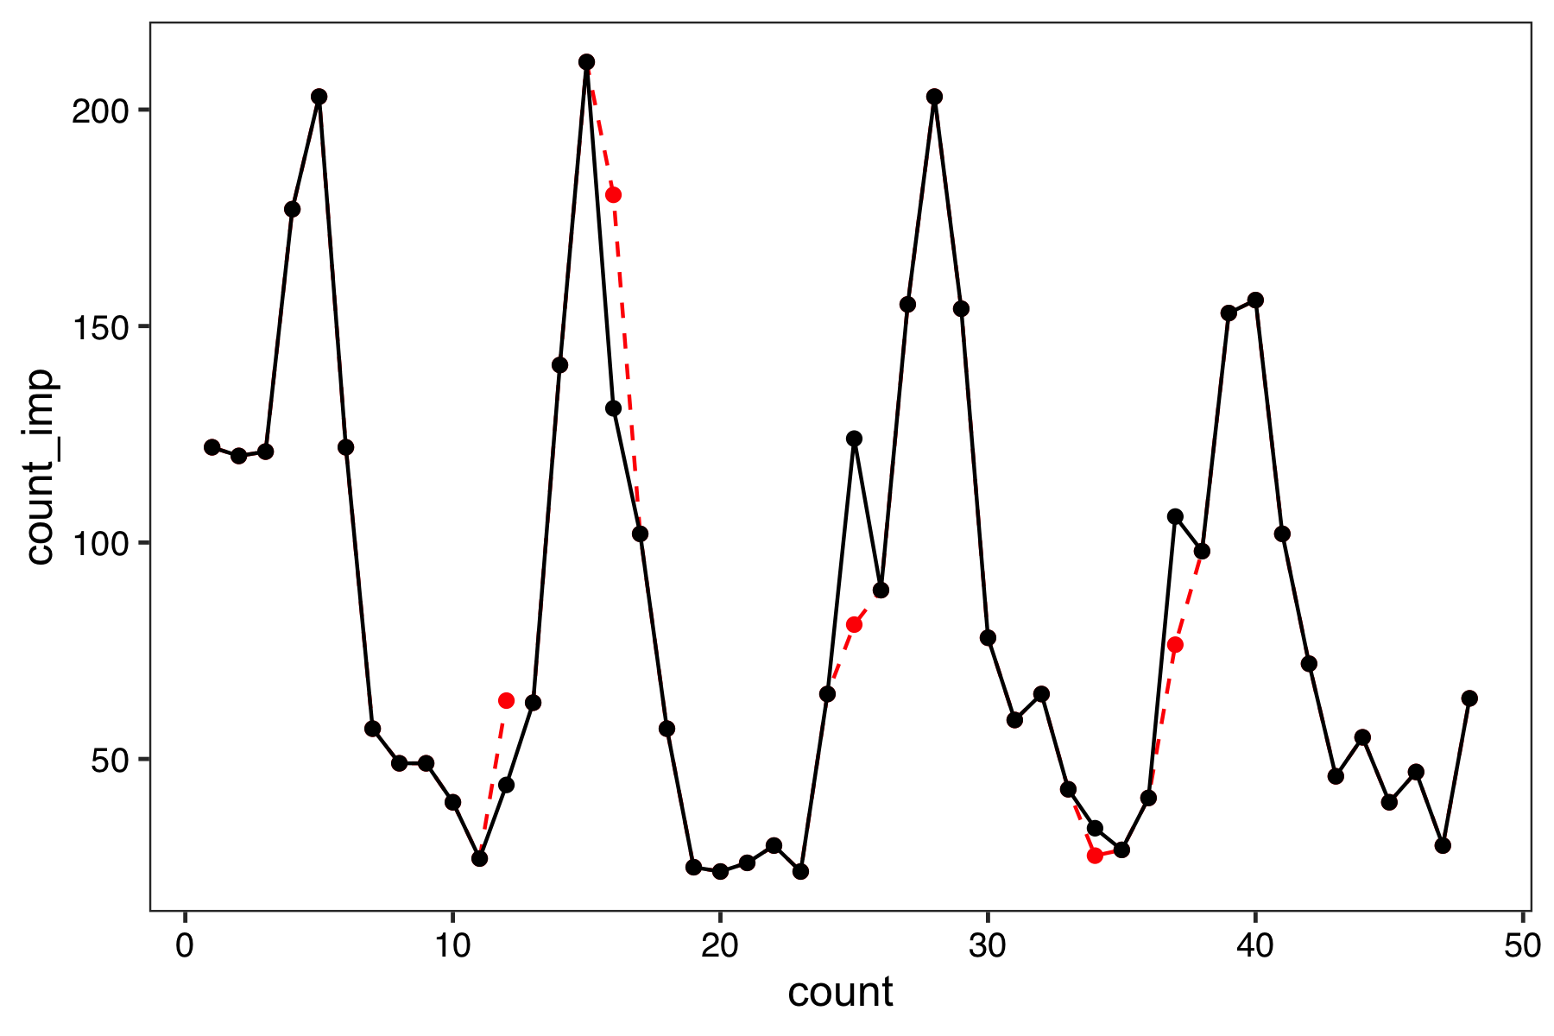
1. What is the research question?
Describe the behavior of an indicator over time
Can perform single imputation based on:
Mean
Interpolation
Model-based
number of malaria cases

Slide 32
1. What is the research question?
Describe the behavior of an indicator over time
May be of interest to describe missing data pattern
May want to “fill in” a reasonable value for missing month in figures
Detect deviations from expected in an indicator (syndromic surveillance)
Want to build a valid baseline model for each facility, which can be biased if data is missing
Want to aggregate data across multiple facilities
Need to be careful about “borrowing” information from the baseline period for missing values in evaluation period
Measure the impact of an intervention on an indicator
Want to construct valid estimates, which can be biased if data is missing

Slide 33
2. Why is the data missing?
Missing completely at random
Missing pattern is random (can ignore: “complete case”)
Missing at random
Missing pattern can be fully identified using observed data (e.g. other facilities or external data sources)
Missing not at random
Missing pattern cannot be identified from the observed data
Very challenging and often results in calculating reasonable “bounds” for predicted values
Notes:
MCAR means there is no relationship between the missingness of the data and any values, observed or missing.
Missing at Random, MAR, means there is a systematic relationship between the propensity of missing values and the observed data, but not the missing data.
Missing Not at Random, MNAR, means there is a relationship between the propensity of a value to be missing and its values.
GROUP ACTIVITY: https://docs.google.com/presentation/d/1QhRqyj0UJUtVCmGAoEmXCcHZQfCVg-Jbge03o8Yc7v8/edit?usp=sharing

Slide 34
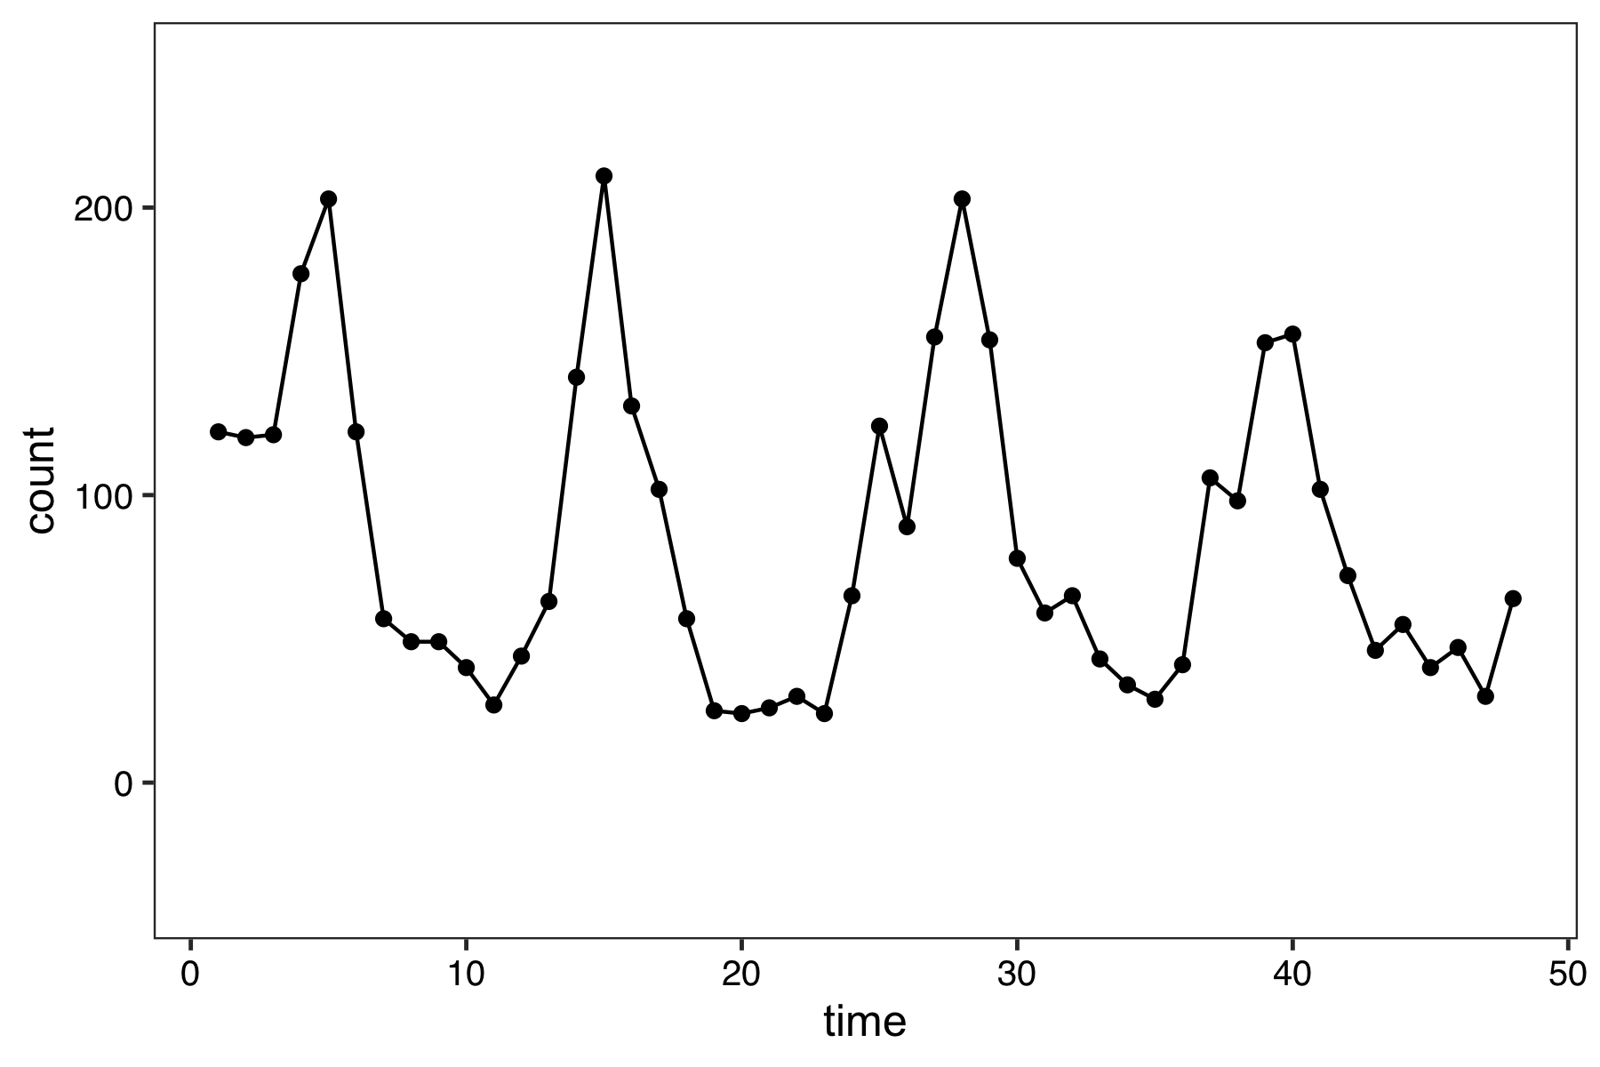
Missing data patterns in time series data
No missing data
MCAR
Not MCAR

Slide 35
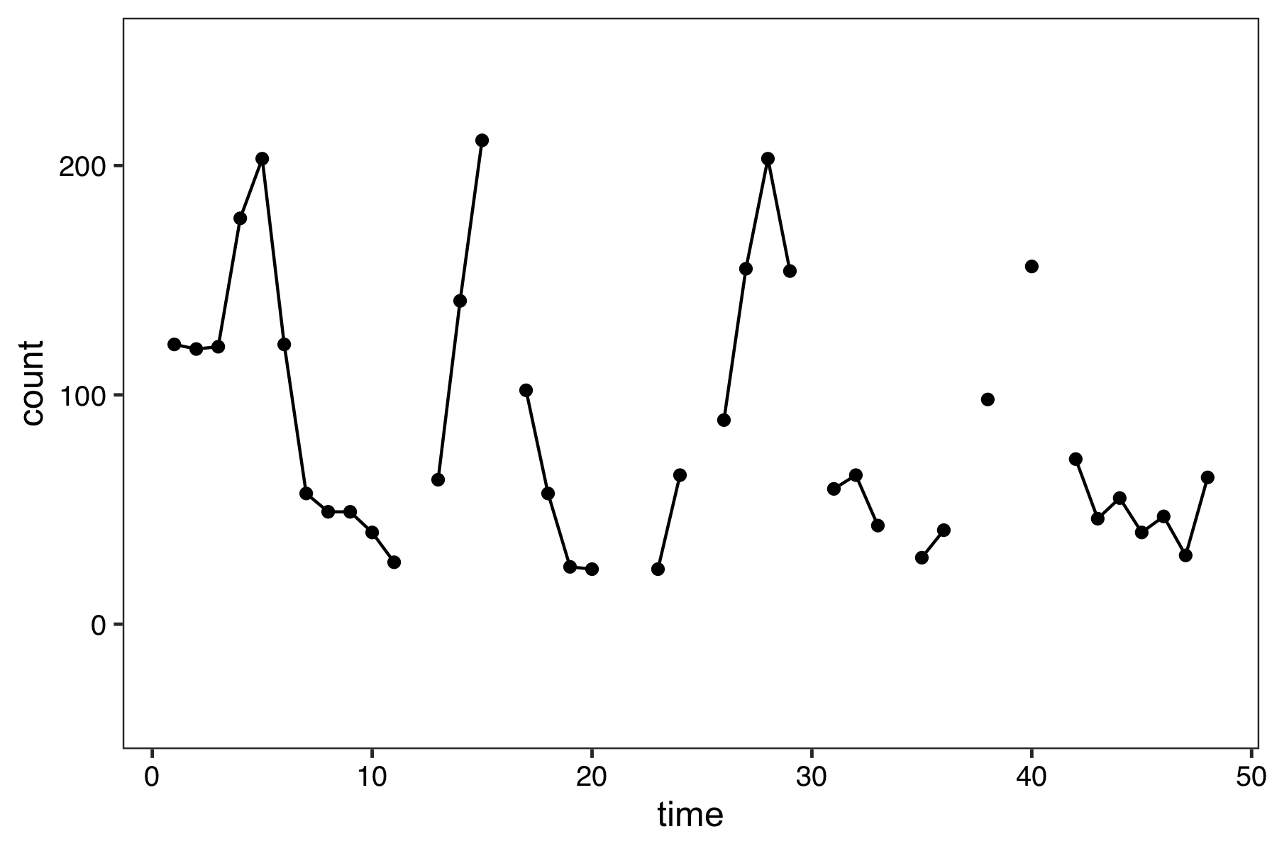
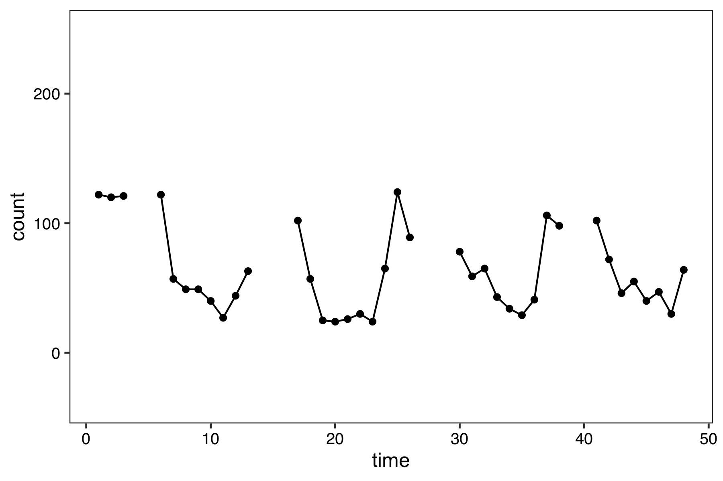
Missing data patterns in time series data
No missing data
MCAR
Not MCAR
remove 10 random points
remove the 10 largest points

Slide 36
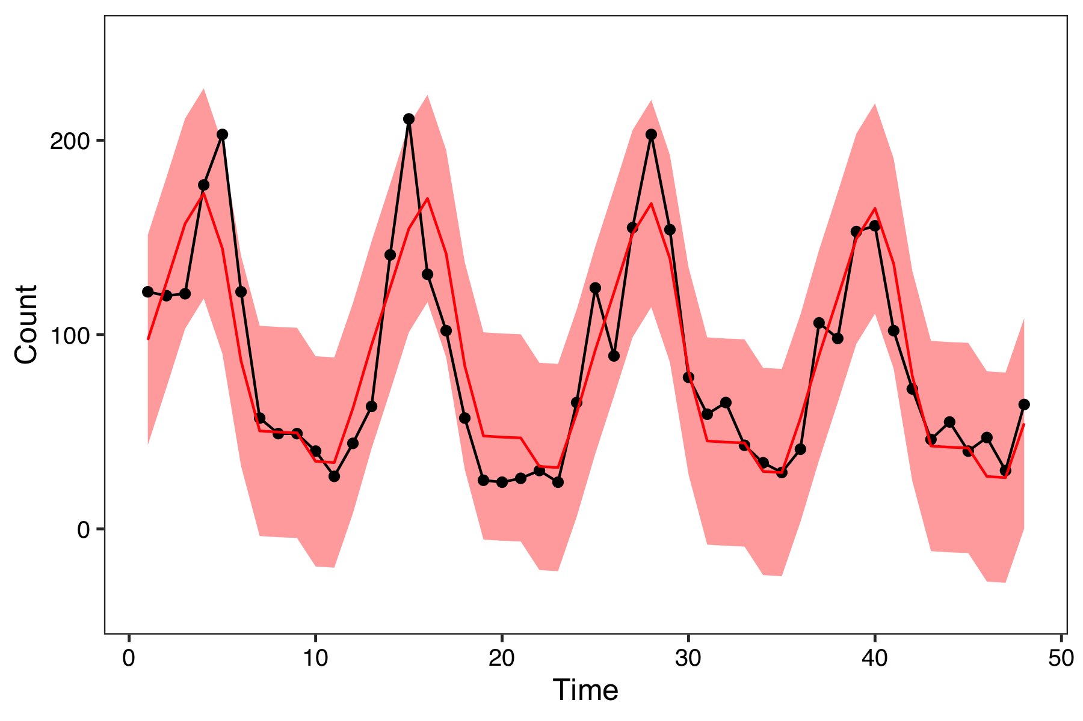
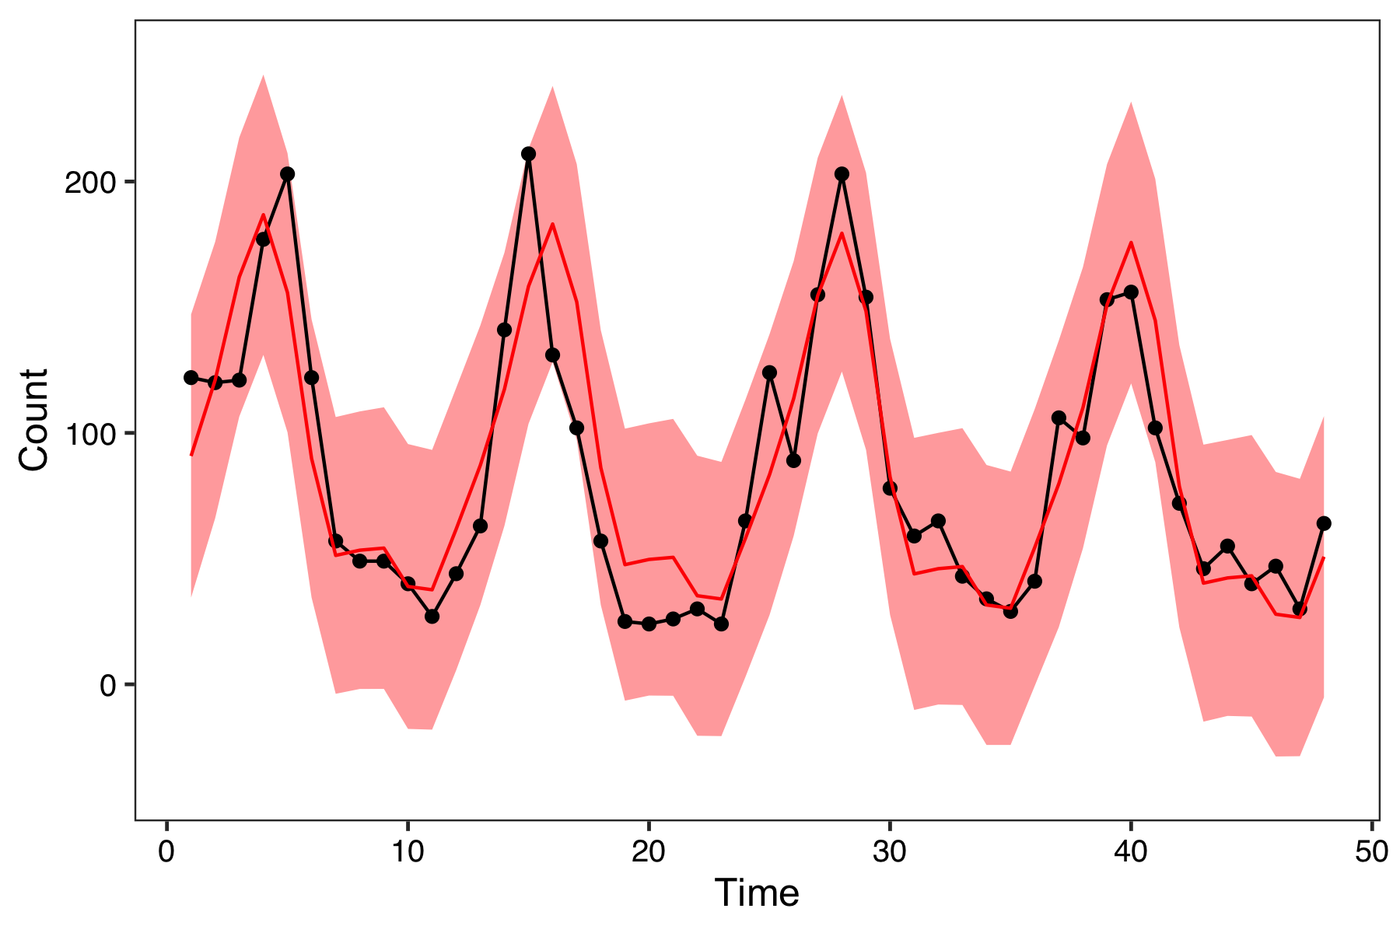
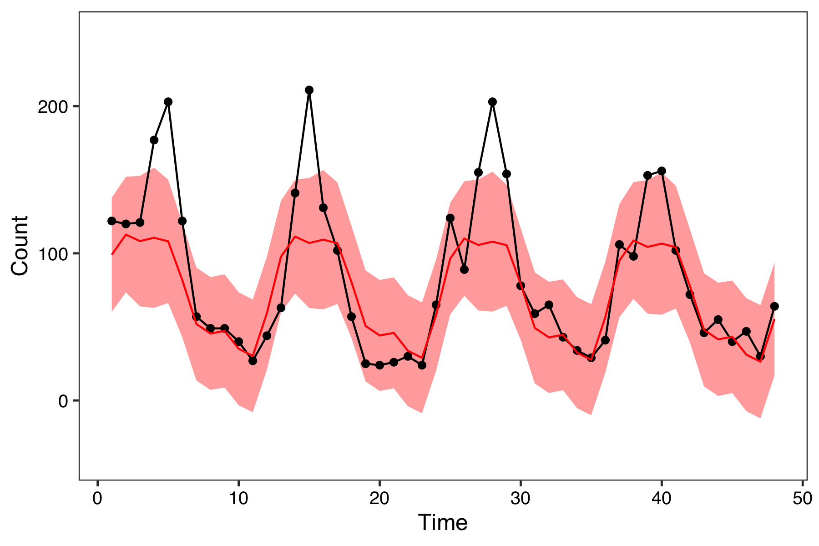
Missing data patterns in time series data
No missing data
MCAR
Not MCAR
Notes:
If missing completely at random, can ignore

Slide 37
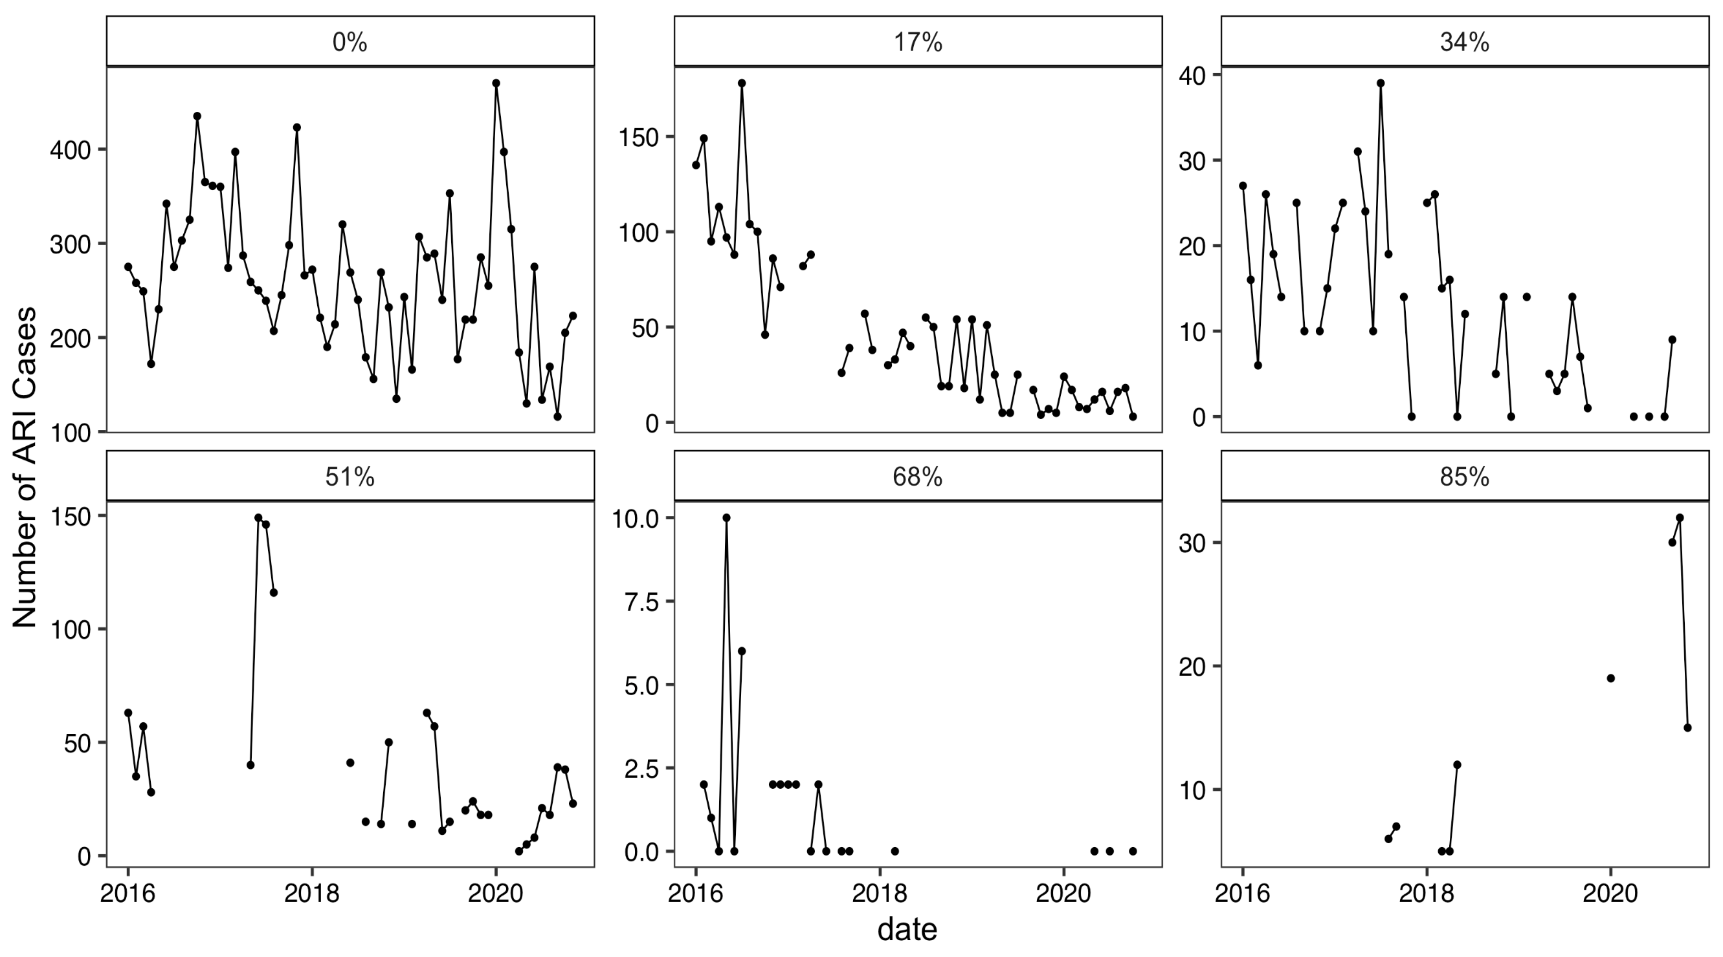
3. Is there enough information?
How much data is missing?

Slide 38
3. Is there enough information?
Is there additional information available to “fill in” missing values?
Data from other facilities
Can use “similar” facilities (neighboring, same size or type, or correlated seasonal patterns) to impute missing values
Other indicators
Health service utilization indicators that are correlated with indicator could be used to impute missing values in a given facility
Need to make sure they do not have similar missingness patterns
External (non-DHIS2) sources
Weather of rainfall data
Mobility data
Many statistical methods to incorporate these data sources!

Slide 39
Solution: Syndromic Surveillance
Goal 1: Create baseline facility-level models for prediction
Chose not to model facilities with >20% of months missing
This was “not enough information to draw conclusions”
Fit facility-level models on complete case data
Goal 2: Create baseline aggregate-level models for prediction
To calculate aggregate-level monthly predictions, sum predicted monthly counts across facilities by “drawing” from facility-level complete case models
Future direction: Utilize information from “similar” facilities and indicators to fill in missing values (previous slide)
Notes:
What is the research question?
Why is data missing?
Is there enough information to address missing data?
This assumes data is missing at random

Slide 40
Final lecture: Data visualization for syndromic surveillance

