Slide 1
ENGI 301 Boil Buddy PCB Proposal
9 December 2020
Nicolas Escobar

Slide 2
Background Information
The goal of this project is to create a system to notify an absentminded cook when their pot of water is boiling.
Current methods are invasive – reliant on submerged sensors.
Boil Buddy will sense pot vibrations and humidity/temperature above the pot to determine boiling.
Simpler options (e.g. kettle whistle, rattling boil alert) have limited reach/effect if the user is in another room, outside, or wearing headphones.
Boil Buddy will send a push notification to the user’s phone/device to alert them

Slide 3
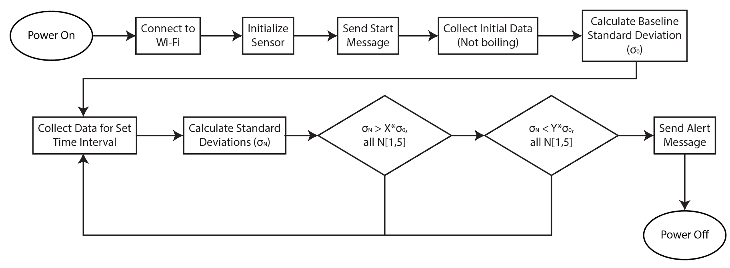
Function Block Diagram

Slide 4
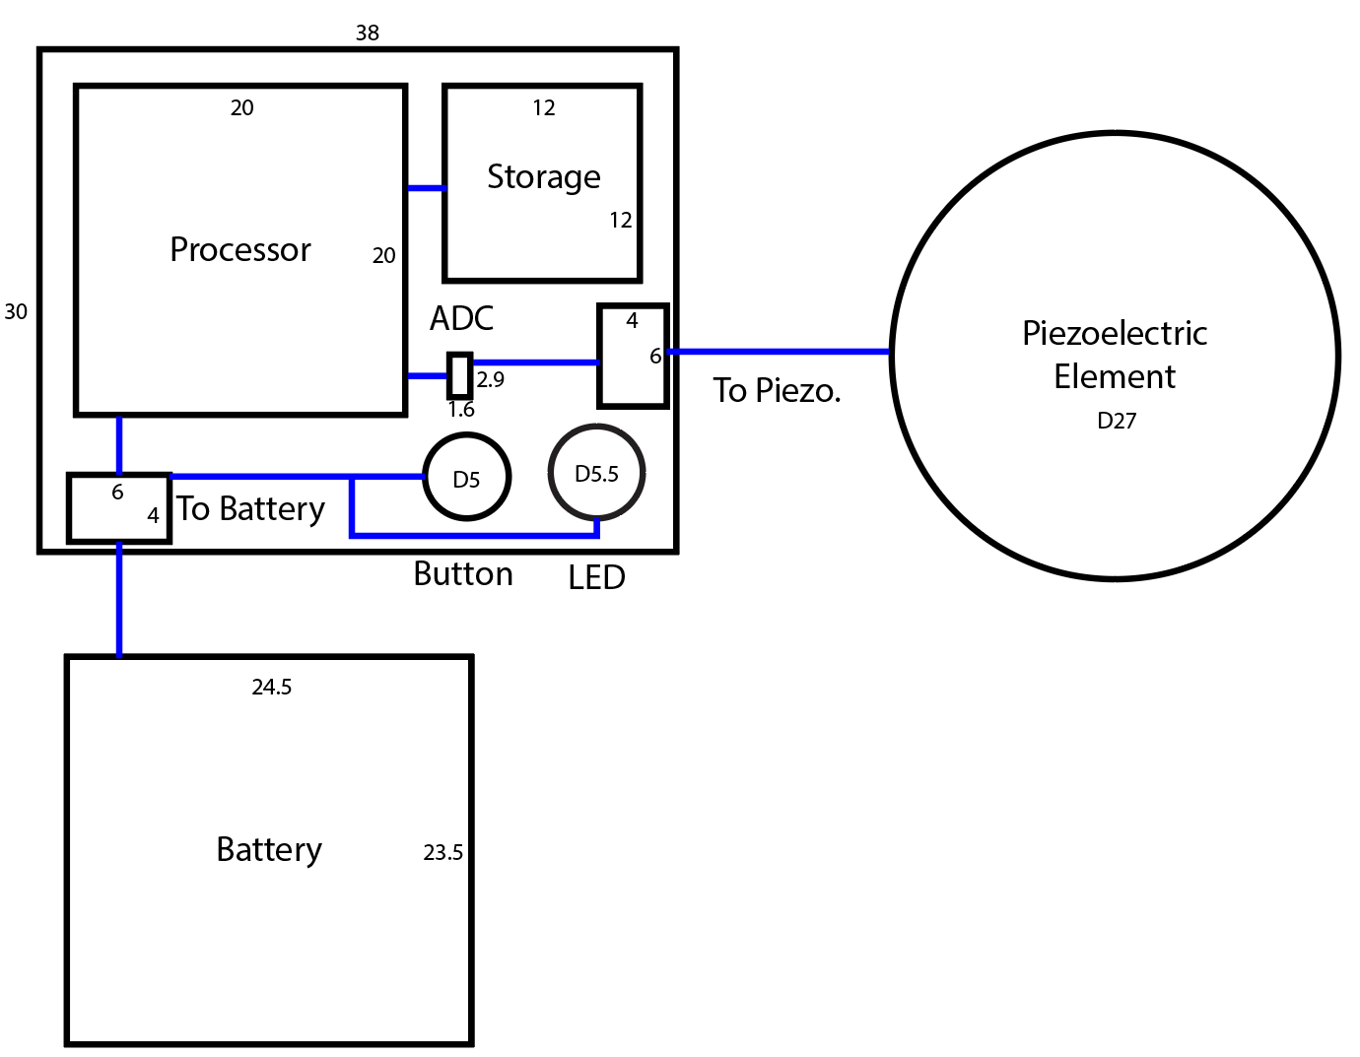
Mechanical/Connection Block Diagram

