Slide 1
Peer-to-Peer Wikipedia
A Chord overlay peer-to-peer network hosting Treedoc CDRTs

Slide 2
Overview
Notes:
Maybe have a picture showing the 4 nodes and the movement of the article between client nodes and the server node

Slide 3
Chord

Slide 4
Treedoc
Commutative replicated data type based on extended binary trees
Allows for offline/local editing of replica articles
If operations replay in happened-before order, replicas converge automatically
Edit history for free
Represent article as a shared, replicated document, consisting of a sequence of paragraphs
Notes:
Recall CRDTs are data structures that allow all concurrent operations to commute.
This means fewer assumptions about the network. Happened-before is the same as Lamport’s

Slide 5
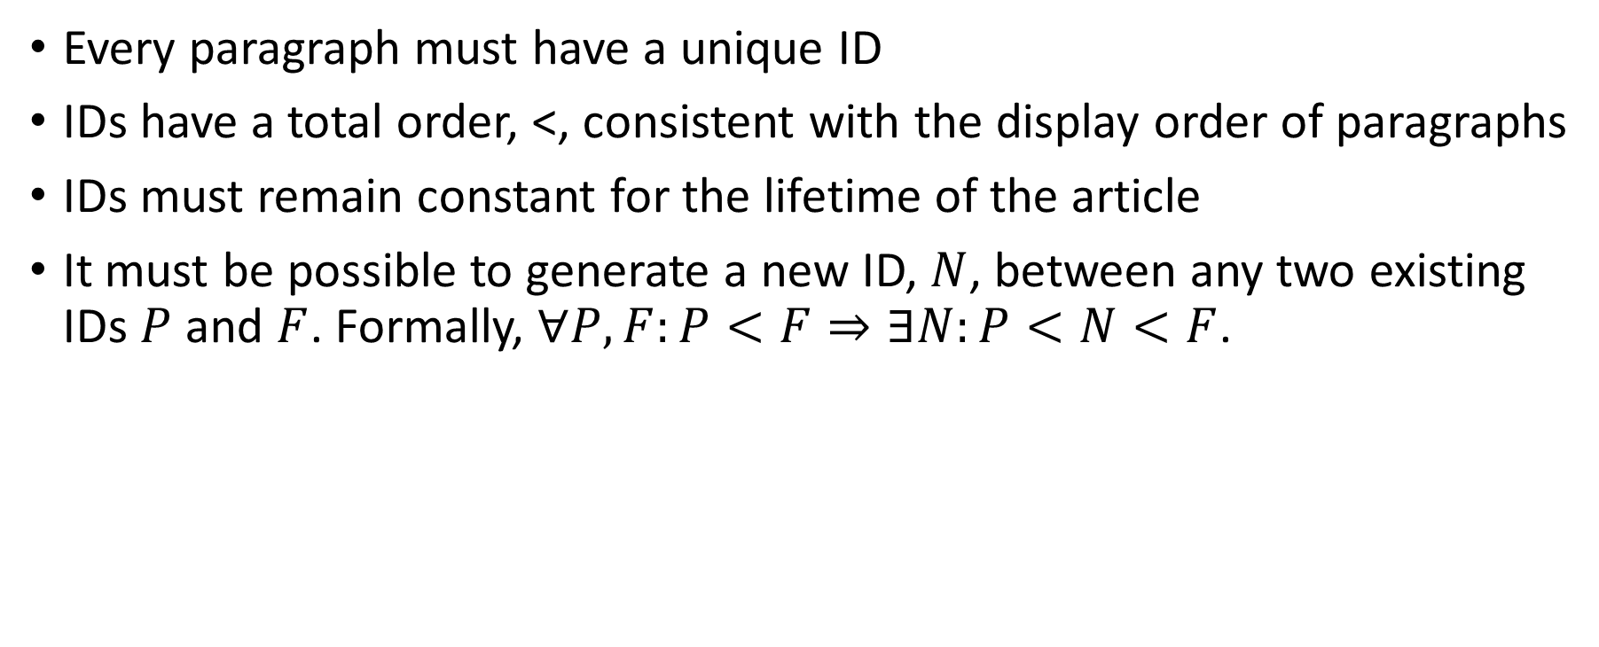
Treedoc – Requirements
Every paragraph must have a unique ID
IDs have a total order, <, consistent with the display order of paragraphs
IDs must remain constant for the lifetime of the article
It must be possible to generate a new ID, $N$, between any two existing IDs $P$ and $F$. Formally, $∀P,F:P<F⇒∃N:P<N<F$.

Slide 6
Treedoc – Data Structure
Extended Binary Tree
Operations
insert(path, paragraph) – create a new node and insert it at the new path
delete(path) – make the node at path invisible
Notes:
One data type that fulfills the identifier requirements is an extended binary tree where a paragraph’s ID is its path in the tree.
…Explain how it meets the requirements…

Slide 7
Treedoc - Example
Client 1
Client 2

Slide 8
Treedoc - Example
Client 1
Client 2
insert([(0:dC1)], “A”)
insert([(0:dC2)], “X”)

Slide 9
Treedoc - Example
Client 1
Client 2
insert([1(0:dC1)], “C”)
delete([(1:dS)])

Slide 10
Treedoc – Example
Server displays: AXBC

Slide 11
Evaluation (of design??)

