Slide 1
Peer-to-Peer Wikipedia
A Chord overlay peer-to-peer network hosting Treedoc CDRTs

Slide 2
Overview
Motivation
P2P decentralization helps eliminate proprietary interest in content and infrastructure
Reduce administration costs
Design considerations
Retrieving articles should be fast
Articles should be (eventually) consistent without expensive concurrency control
Articles should allow for disconnected, non-blocking editing
Components
Shared data structure for managing article content (Treedoc CRDT)
Article hosting and discovery (Chord)
Notes:
Motivation
So, why peer-to-peer Wikipedia?
Well, it’s possible Wikipedia could just disappear if they run out of money or they could choose to remove or alter certain articles. Essentially, we want to remove proprietary interests in the system’s infrastructure by diffusing trust over all peers.
Design considerations
In terms of the design considerations for our system
We want article retrieval to be fast – in our case the bottleneck is the lookup since the articles themselves are relatively small (for instance, Wikipedia recommends they not exceed 50kB).
Articles should not require expensive protocols like Paxos for consistency since they don’t scale well
Articles should be fault-tolerant and allow for disconnected editing since we expect nodes to be frequently offline.
And, Editing should be non-blocking to increase availability
Components
Our system is based on two main components.
We will talk about the treedoc commutative replicated data structure that we used for our articles
And we will review the Chord protocol which is the network structure overlay we chose to facilitate article lookups since it is simple and provides log(n) lookup times.

Slide 3
Overview
x
Clients:
Lookup article
Copy the article from the host node and view/edit. Edits are logged locally.
Push the log to the host node where the logs are replayed.
Articles are periodically sent to replica node
v
w
w
u
u
Notes:
In our system:
Clients request the address of the node hosting the article by hashing the article title and doing a Chord lookup.
Once the client has the host address, it copies the article to its local cache. If the client edits the article, the edit operations are logged locally.
At some later time, the client will want to make its changes available to other nodes. To do so, it sends its log to the host node where it is replayed to include the client’s changes.
Periodically, the host’s articles are replicated to its successor nodes.

Slide 4
Heart of Chord:
Consistent Hashing: Map a KEY To a Fixed LOCATION.
KEY: Title of the Article
LOCATION: Peer’s IP address
P3
10?
P55
10?
m = 6 (64 peers max)
P12
Hash(peer1’s IP) = 12
Hash(peer3’s IP) = 3
Hash(peer2’s IP) = 55
Hash(peer4’s IP) = 36
10?
A10
Hash
“Distributed System”
10
10?
P36

Slide 5
Chord-With-Replication
KEYS: 2, 6, 7, 12, 30, 33, 60
60
2,6,7
60
2,6,7,60
P60
P7
P60
P7
P15
P15
Original Chord
12
Chord-With-Replication
2,6,7,12
NONE
30,33
P45
P19
P45
P19
NONE
12
P38
P38
30,33
30,33

Slide 6
Why Chord?
Scalability!
Load Balance!
Simple & Efficient!

Slide 7
Treedoc CRDT
Commutative replicated data type based on extended binary trees
Allows for offline/local editing of replica articles
No network latency
Fault-tolerant
If operations replay in happened-before order, replicas converge automatically
Get revision history “for free”
Notes:
Treedoc is a CRDT based on binary trees
It allows for disconnected editing so we don’t need to worry about network latency or host node failures once we have a local copy of the article.
Copies of the article converge automatically so we don’t need any protocol for managing concurrent edits. This would make it very easy to, for example, host the same article on multiple nodes which would increase its availability.
And, because every operation is appended to the data structure, we get the revision history for free

Slide 8
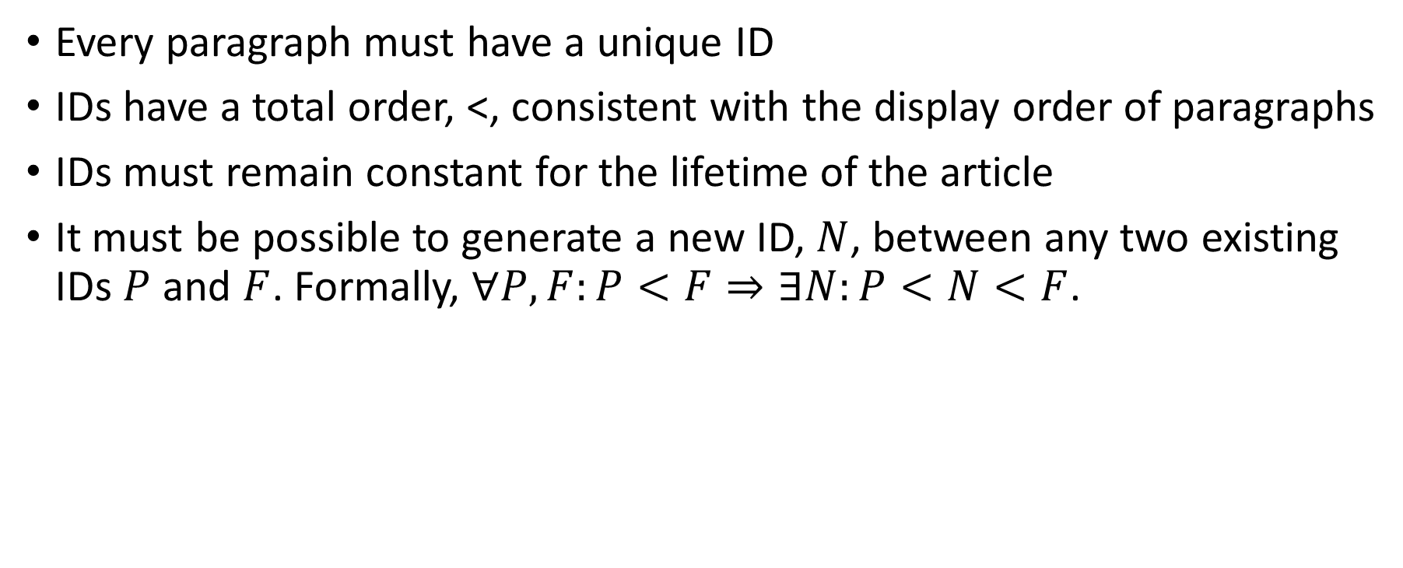
Treedoc – Requirements
Every paragraph must have a unique ID
IDs have a total order, <, consistent with the display order of paragraphs
IDs must remain constant for the lifetime of the article
It must be possible to generate a new ID, $N$, between any two existing IDs $P$ and $F$. Formally, $∀P,F:P<F⇒∃N:P<N<F$.
Notes:
Treedoc requires that
Every paragraph have a unique ID
IDs must give us a consistent display order for the paragraphs.
IDs must not change
And, It must be possible to generate a new ID between any two existing IDs.

Slide 9
Treedoc – Data Structure
Extended Binary Tree
IDs are paths in the tree
Examples IDs:
Node A: [0(0:dC1)]
Node Z: [100(1:dC3)]
Node X: [10(0:dC1)(1:dC3)]
Display: [A B C W X Y Z D E F]
Operations
insert(path, paragraph) – create a new node and insert it at the new path
delete(path) – make the node at path invisible
Notes:
The treedoc data structure is an extended binary tree where
The 0’s and 1’s indicate the branch
The letters in the circles represent the paragraphs
The letters above the circles are disambiguators and represent the ID of the peer who inserted the paragraph. In our case, they are IP addresses but could be any unique identifier.
Concurrent inserts are represented as “mini-nodes” which are contained within a “major node”.
A paragraph’s ID is its path in the tree. Disambiguators are included when necessary: either to mark the end of the path or to disambiguate a branch coming from a mini-node.
Total ordering of paragraphs is achieved by walking the tree in infix order and ordering mini-nodes by their disambiguators. We would display the tree as shown.
The data structure supports two operations
Insert which adds the node to the tree
Delete which marks the node as invisible

Slide 10
Treedoc – Example
Server
Clients
Sees: [B D]
Client 1 sees:
[B D]
Client 2 sees:
[B D]
Clients Pull
Notes:
A quick example. We have two clients that copy an article from the server so that they each have a local version.
After the copy, everyone sees the same output: BD.

Slide 11
Treedoc – Example
Client 1
Client 2
insert([(0:dC1)], “A”)
Sees: [A B D]
insert([(0:dC2)], “X”)
Sees: [X B D]
Notes:
Then, Client 1 inserts “A” at the beginning of its copy of the article and sees ABD. Similarly, client 2 inserts “X” at the beginning of its copy of the article and sees XBD. We notice that the inserted nodes have different disambiguators, dC1 and dC2 – which will be important when we go to merge the article.
At this point, the insert commands are being logged locally so the server hasn’t seen any changes.

Slide 12
Treedoc – Example
Client 1
Client 2
insert([1(0:dC1)], “C”)
Sees: [A B C D]
delete([(1:dS)])
Sees: [X B]
Notes:
Again, client 1 inserts but this time in the middle of the article while client 2 hides node D by doing a delete.
It is important that we don’t actually remove the node since other clients may assume it exists, as is the case with client 1.

Slide 13
Treedoc – Example
Clients
Server
Client 1 sees:
[A B C D]
Client 2 sees:
[X B]
Sees: [A X B C]
Clients Push
Notes:
Finally, the clients push their logs to the server. It replays the commands in log order to maintain the local “happens-before” relation (for example, with client 2, we want to execute the insert before the delete). However, it can arbitrarily choose to replay client 1 or client 2’s log first.
Since both clients inserted “A” and “X” in the same position, their changes are merged and ordered by their IP address as the left node shows.
Regardless of whose log is replayed first, we would see AXBC.

Slide 14
Peer-to-Peer Wikipedia
Demo & Questions

