Slide 1
Peer-to-Peer Wikipedia
A Chord overlay peer-to-peer network hosting Treedoc CDRTs

Slide 2
Overview
Motivation
P2P decentralization helps eliminate proprietary interest in content and infrastructure
Reduce administration costs
Design considerations
Retrieving articles should be fast
Articles should be (eventually) consistent without expensive concurrency control
Articles should allow for disconnected, non-blocking editing
Components
Shared data structure for managing article content (Treedoc CRDT)
Article hosting and discovery (Chord)
Notes:
Motivation
Why peer-to-peer Wikipedia?
The biggest reason is that Wikipedia could just disappear one day if it can no longer fund its infrastructure costs.
Also, since is a legal entity, It could be banned in certain countries
Or Wikipedia could simple choose not to host certain articles or parts of articles or otherwise manipulate the content.
Design considerations
In our system
We want article retrieval to be fast
And, in our case, searching the network for an article is the bottleneck since the articles themselves are relatively small files (Wikipedia recommends keeping them between 30 and 50 kB).
Also, once we identify the host, we can retrieve the article directly.
Articles should not require expensive protocols like Paxos for consistency since they don’t scale well
Articles should be fault-tolerant and allow for disconnected editing since we expect nodes to be offline frequently.
Editing should be non-blocking to increase availability
Components
Our system is based on two main components.
We will talk about the treedoc commutative replicated data structure that we used for our articles
And we will review the Chord protocol which is the network structure overlay we chose to facilitate article lookups since it is simple and provides O(log(n)) lookup times.

Slide 3
Overview
x
Clients:
Lookup article
Copy the article from the host node and view/edit. Edits are logged locally.
Push the log to the host node where the logs are replayed.
Articles are periodically sent to replica node
v
w
w
u
u
Notes:
So, to view and edit articles:
Clients request the address of the node hosting the article by hashing the article title and doing a Chord lookup.
Once the client has the host address, it copies the article to its local cache. If the client edits the article, the edit operations are logged locally.
At some later time, the client will want to make its changes available to other nodes. To do so, it sends its log to the host node (which it must determine again by performing another lookup since the host could have changed). The log is replayed on the host to include the client’s changes.
Periodically, the host’s articles are replicated to its successor nodes.

Slide 4
Chord

Slide 5
Treedoc
Commutative replicated data type based on extended binary trees
Allows for offline/local editing of replica articles
No network latency
Fault-tolerant
If operations replay in happened-before order, replicas converge automatically
Get revision history “for free”
Notes:
Treedoc is a CRDT based on binary trees
It allows for disconnected editing so we don’t need to worry about network latency or host node failures once we have a local copy of the article. This is great feature since we are working on a peer-to-peer network that typically experiences high node unavailability.
Copies of the article converge automatically so we don’t need any protocol for managing concurrent edits. This would make it very easy to, for example, host the same article on multiple nodes which would increase its availability.
And, because every operation is appended to the data structure, we get the revision history for free

Slide 6
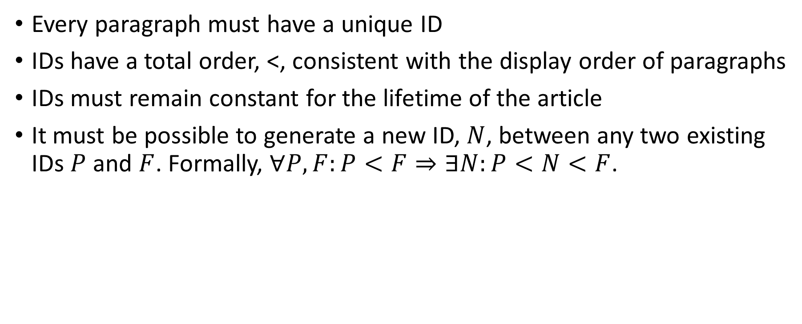
Treedoc – Requirements
Every paragraph must have a unique ID
IDs have a total order, <, consistent with the display order of paragraphs
IDs must remain constant for the lifetime of the article
It must be possible to generate a new ID, $N$, between any two existing IDs $P$ and $F$. Formally, $∀P,F:P<F⇒∃N:P<N<F$.
Notes:
Treedoc requires that
Every paragraph have a unique ID
IDs must give us a consistent display order for the paragraphs.
IDs must not change
And, It must be possible to generate a new ID between any two existing IDs.

Slide 7
Treedoc – Data Structure
Extended Binary Tree
IDs are paths in the tree
Examples:
Node A: [0(0:dC1)]
Node X: [10(0:dC1)(1:dC3)]
Node Z: [100(1:dC3)]
See: [A B C W X Y Z D E F]
Operations
insert(path, paragraph) – create a new node and insert it at the new path
delete(path) – make the node at path invisible
Notes:
One data type that fulfills the identifier requirements is an extended binary tree where a paragraph’s ID is its path in the tree.
…Explain how it meets the requirements…
Explain the diagram
0’s and 1’s indicate the direction
The letters in the circles represent the paragraphs
The letters above the circles represent the ID of the peer who inserted the paragraph. In our case, they are IP addresses but could be any unique identifier.
Concurrent inserts are represented as “mini-nodes” within a “major node” (e.g. W and Y are mini-nodes inside of the major node located at 100).
Paragraph IDs are formed by the path in the tree, including Node IDs when necessary (which is either to mark the end of the path or to disambiguate a branch from a mini-node and a major node).
Nodes attached to the mini-nodes came after concurrent edit (i.e. article pushed, then pulled and modified so that the client sees the concurrent edit)
Total ordering of node IDs is achieved by walking the tree in infix order and ordering mini-nodes by the disambiguator.
Operations
Delete will make the node invisible but does not actually remove it. If nodes were actually removed then the operations would no longer commute.

Slide 8
Treedoc – Example
Server
Clients
Sees: [B D]
Client 1 sees:
[B D]
Client 2 sees:
[B D]
Clients Pull
Notes:
A quick example. We have two clients that copy an article from the server so that they each have a local version.
After the copy, everyone sees the same output: BD.

Slide 9
Treedoc - Example
Client 1
Client 2
insert([(0:dC1)], “A”)
Sees: [A B D]
insert([(0:dC2)], “X”)
Sees: [X B D]
Notes:
Then, Client 1 inserts “A” at the beginning of its copy of the article and sees ABD. Similarly, client 2 inserts “X” at the beginning of its copy of the article and sees XBD. We notice that the inserted nodes have different IDs, dC1 and dC2 – which will be important when we go to merge the article.
At this point, the insert commands are being logged locally so the server hasn’t seen any changes.

Slide 10
Treedoc - Example
Client 1
Client 2
insert([1(0:dC1)], “C”)
Sees: [A B C D]
delete([(1:dS)])
Sees: [X B]
Notes:
Again, client 1 inserts but this time in the middle of the document while client 2 sets node D’s visibility flag to hidden.
It is important that we don’t actually remove the node since other clients may assume it exists, as is the case with client 1.

Slide 11
Treedoc - Example
Clients
Server
Client 1 sees:
[A B C D]
Client 2 sees:
[X B]
Sees: [A X B C]
Clients Push
Notes:
Finally, the clients push their logs to the server. It replays the commands in log order to maintain the local “happens-before” relation but can arbitrarily choose to replay client 1 or client 2’s log first.
In either case, we see AXBC.

Slide 12
Evaluation (of design??)

