Slide 1
CodeStory: Capturing Rationale for Program Comprehension
Felix Grund and Nick Bradley
CPSC 507 Course Project
March 28, 2017

Slide 2
Introduction
Idea: capture developer rationale
Reason for code not always obvious
Requires understanding of existing code
Minimize amount and frequency of understanding tasks
Previous work
Required separate system
Very structured and formalized approach
Hard to link to code: good for general program understanding
Our tool: CodeStory
Integrates into existing workflow
Hooks into copy/paste operation capturing extra information from source program
Possible sources: email clients, instant messaging, websites – we focus on StackOverflow
Supplements other info management systems: issue trackers, wikis, etc.
Notes:
What do we mean by “capturing rationale”?
In order to modify code, developers need to understand how the code works:
Exploring the existing code to figure out how it is structured and what it does
If unclear, talk to other team members to get clarification
And, during implementation, maybe copy code from StackOverflow
Developers are always reasoning about their code but code can be a hard medium to infer reasoning from.
Want to avoid having people rediscover this information when they go to make changes.
Record it + make it available.
CodeStory:
Integrate into existing workflow:
minimize task switching
Aren’t going to use:
don’t know what to enter: as become more familiar decisions may seem more trivial
extra work
Stackoverflow => already structured so can focus on idea, not how to extract info from app

Slide 3
Pilot Survey
Sent 17 surveys to developers
All in industry
All responded
Scenario:
A developer has to choose a sort algorithm for a particular task. She googles "sort array in JavaScript" and finds a code snippet on StackOverflow. She copies the snippet as a scaffold into her code.
13 questions ranking usefulness of information during a code review
Used Likert Scale: 1 (not useful) to 5 (very useful)
Q0: overall usefulness of extra info about copied snippets of code
Q1-12: usefulness of specific SO fields
Notes:
Convenience sample but all qualified
We described a situation where a developer copied a snippet of code from StackOverflow as a starting point for extending it. Then we asked, in general,how useful having extra information about that snippet would be during a code review.

Slide 4
Pilot Survey – Results
% Responses Rated Maybe Useful, Somewhat Useful or Very Useful
Q0 | Usefulness of extra info during code review
Q2 | SO question URL
Q4 | SO question content
Q5 | SO answer URL
Q11 | SO answer comments
Q6 | Time of access of SO page
Q9 | SO answer rating
Q10 | SO answer acceptance status
Q7 | SO answer code snippet
Q12 | Other SO answers
Q3 | SO question heading
Q8 | Entire SO answer
Q1 | Google search query leading to SO
Notes:
Briefly discuss results
We felt very confident about implementing a prototype after we received a strong positive response to the general idea
We ended up capturing all the fields listed except Q1 even though some of them were considered less useful because they were all easy. Q1 was also hard to capture.
We instead used this feedback to prune what was shown to the reviewer.

Slide 5
Pilot Survey – Interpretation
Our approach makes sense!
88% found the idea our extra information during code review useful
Overall positive results in questions on potentially useful elements
But quite some variance in results
Weakest field “Google search query leading to SO” was abandoned

Slide 6
Implementation
Captures SO metadata during copy operation
Creates id by hashing fields with timestamp
Sends data to backend
Inserts link to captured metadata as comment during paste operation
Atom
Package
Chrome
Extension
linked by hash X in clipboard
take story X
Backend
Node.js + Redis
RESTful service
Receives requests from Chrome extension
Serves code story
give me story X
Browser
take story X
Notes:
Chrome extension
Uses DOM to capture the required fields. Always captures question heading and question text and will capture the full answer containing the selected text.
We create a unique ID by hashing these fields with a timestamp then POST the information to the backend
Atom package
We wrote a simple Atom package that inserts a comment above any text pasted from the Chrome extension
The package strips the hash from the clipboard and uses it to construct a hyperlink to the corresponding information on the backend
Important note: the only changes we made were to include the hash on the clipboard and the extra one-line comment above the pasted text.

Slide 7
Evaluation – Study (1)
2 scenarios based on 2 StackOverflow questions
2 versions for each scenario => 4 treatments
T1: Scenario 1 without annotation
T2: Scenario 2 without annotation
T3: Scenario 1 with annotation
T4: Scenario 2 with annotation
8 participants (4 students, 4 industry developers)
2 code reviews each: one with annotation, one without
4 start with annotation, 4 start without annotation
Avoiding learning bias!

Slide 8
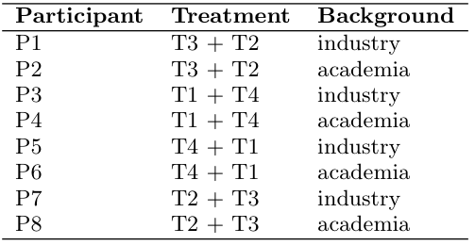
Evaluation – Study (2)
One repository for each participant
Two pull requests for two code reviews (with ensured order)
Participant added as reviewer
Questions:
Q1: What is the purpose of the method with the change?
Q2: How did the method change?
Q3: Why was this change made?
Participants answered questions as comment on pull request

Slide 9
Evaluation – Exit Survey
Rank experience each pull request
1 (very challenging) to 5 (very easy)
Was the information provided by CodeStory useful?
1 (not useful) to 5 (very useful)
Additional comments

Slide 10
Demo

Slide 11
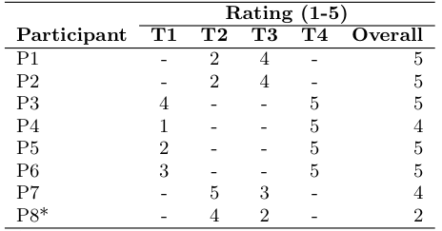
Evaluation – Study Results
Results Study: Qualitative analysis of code reviews
Strong increase in quality using our tool
Without our tool: great amounts of guessing
“presumably”, ”it appears to be”, ”it seems to me”, “I believe”
Decrease in quality from Q1 to Q3
With our tool: precise answers
Reviewers understood what “really happened”
Results Survey: Average ratings
PRs without CodeStory: 2.71
PRs with CodeStory: 4.43
General usefulness: 4.71

Slide 12
Future Work
Evaluate CodeStory tool
Would developers adopt it?
Show more info in comment?
Evaluate effectiveness for different comprehension tasks
Code reviews vs. Bug fixes vs. Adding features...
Evaluate presentation of captured information
Support more sources and IDEs
Notes:
Different comprehension tasks => don’t necessarily see the specific code interested in
Sources could be email clients or instant messaging apps
these are harder because source is less structured
how much do you need to capture, what is important, etc.
Privacy concerns

Slide 13
Summary
Implemented tool to capture developer rationale
Consists of three components that capture-on-copy and link-on-paste
Evaluated utility of captured information for code review tasks
Patches with links => Higher quality reviews
Patches with links => Reviews were easier
CodeStory is a valid approach to capturing developer rationale

Slide 14
Questions

