Slide 1
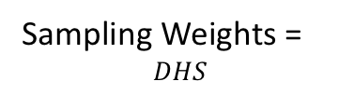
OPTION 1 – Easy SRS
True DRC Population
-Based on sampling weights from DHS
SRS
Sampling Weights =
$$DHS$$
PROS | CONS
Easy Math | Data wasted
Easy Explain
Simple random sample blinded to case status. Will only get ~3% of the vivax cases (since pv prevalence is 3%) even though we will have data on all ~500 cases.

Slide 2
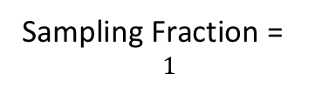
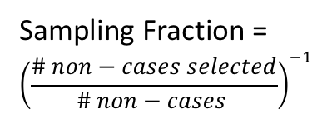
OPTION 2 – Sampling Fractions
All Cases
Sampling Fraction =
$$1$$
True DRC Population
-Based on sampling weights from DHS
SRS of
Non-Cases
PROS | CONS
All data used | Harder Math
 | Harder to explain to non-epidemiologists
Sampling Fraction =
$${\left(\frac{\# non−cases selected}{\# non−cases }\right)}^{−1}$$

