Slide 1
SIMULATION MODEL FRAMEWORKS

Slide 2
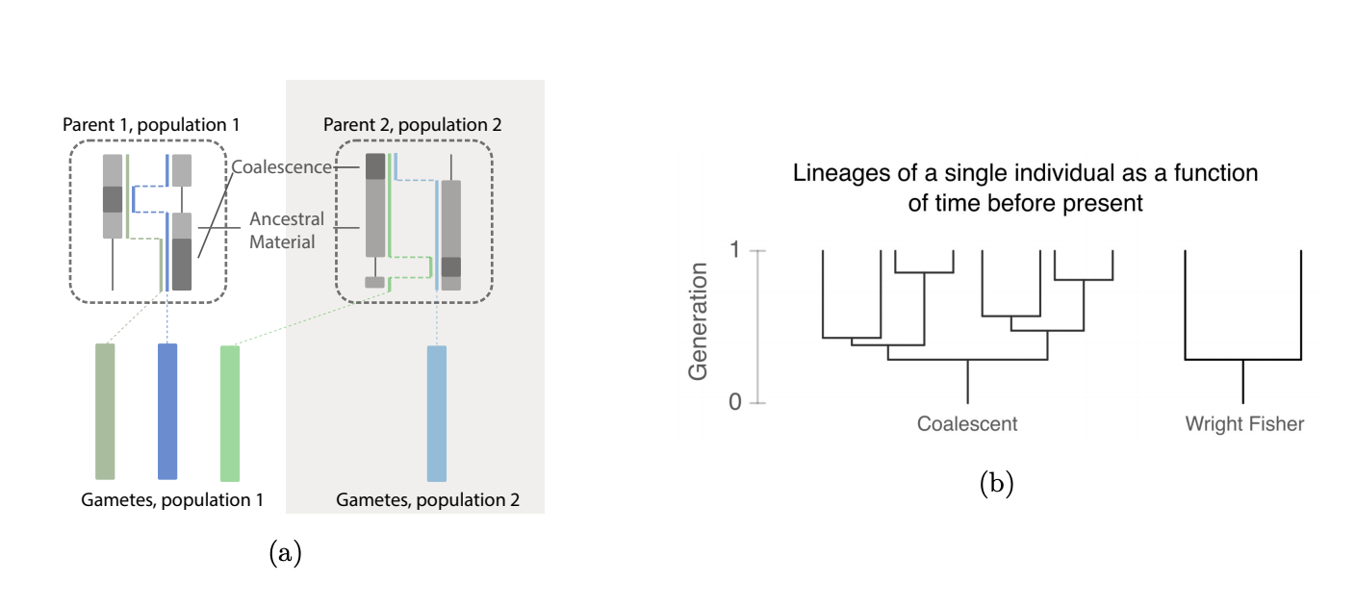
Jerome Kelleher recombination note https://www.biorxiv.org/content/biorxiv/early/2019/06/18/674440.full.pdf

Slide 3
OLD

Slide 4
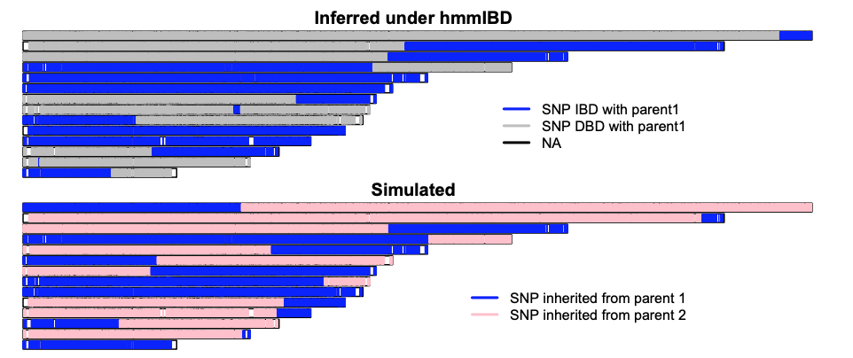
hmmIBD
hmmIBD approach assumes:
Simulate 2 parental genotypes based on PLAF
Make child from Parent
Always comparing child with parent…
Based on k and f (rho/d)
Now compare
OR

Slide 5
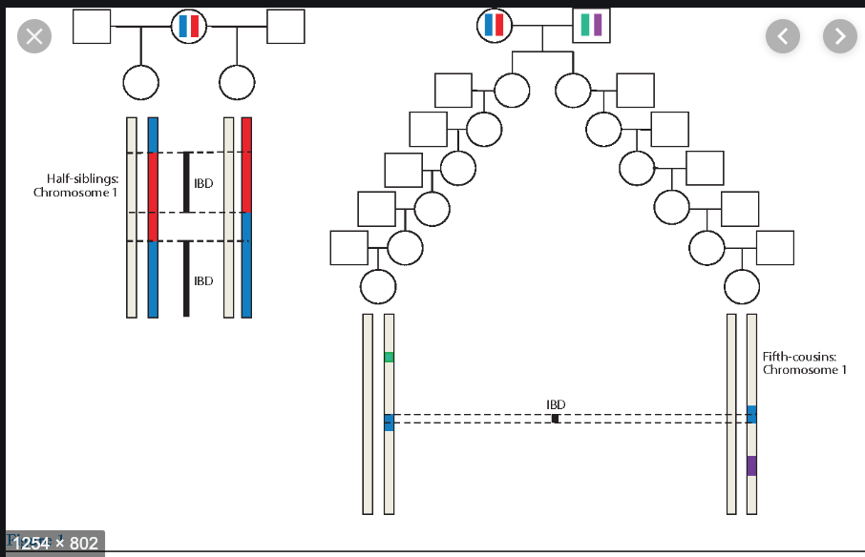
PEDIGREE – No Inbreeding
Pedigree approach assumes:
Always an outgroup crossing in
Thoughts:
Here “K” is constant?
E.g. loci don’t have differing recombination history based on the pairwise comparison

Slide 6
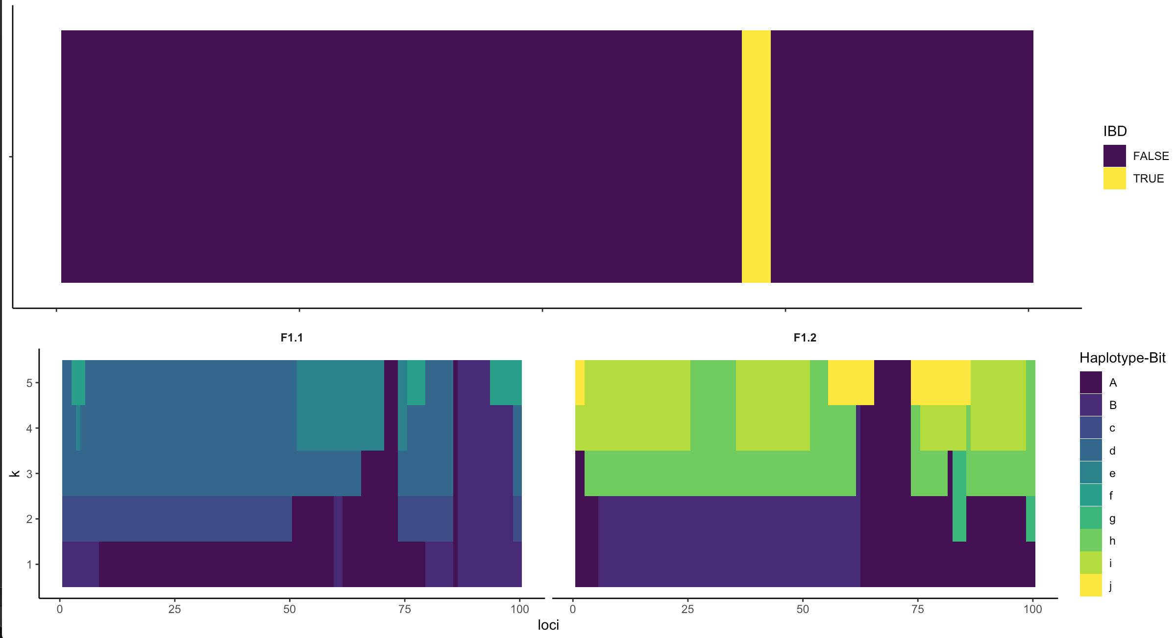
PEDIGREE – No Inbreeding
Pedigree approach assumes:
Always an outgroup crossing in
Thoughts:
Here K is constant?
This is the model framework that polyIBD is almost valid under b/c there is never overlapping haplotypes from previous generations
E.g. loci don’t have differing recombination history based on the pairwise comparison

Slide 7
PEDIGREE –Inbreeding
Pedigree approach assumes:
Flip coin (user specifies prob of inbreeding) for whether you breed with an outgroup or you breed with one of your K \in {k_0, … k_i-1} relatives
Coin

Slide 8
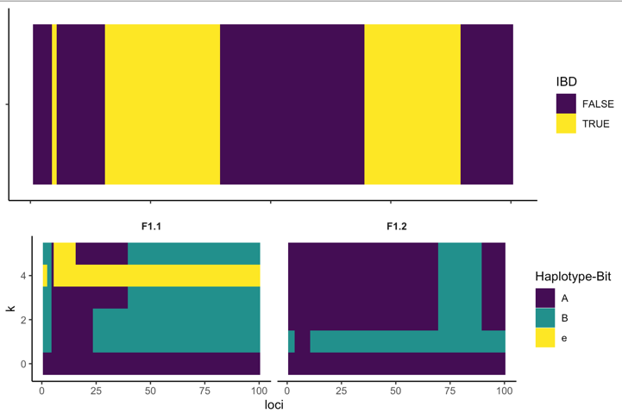
PEDIGREE – Inbreeding
Pedigree approach assumes:
Outgroup in relative
Thoughts:
This sort of gets at the “f” in our hmmIBD/polyIBD switch rate?
More valid?

Slide 9
“Wright Fisher”
“WF” approach assumes:
We start with a population of size Ne
Choose two individuals (could be same haplotype)
Mating happens (i.e. zygote is formed)
One of the haploid meiotic products (from the tetraploid) is randomly selected*
Thoughts:
This is the model framework for the (neutral) ARG?
*Might be nice to keep all tetraploids around – results in a geometric series

Slide 10
“Not really Wright Fisher”
Seed Initial Infections
Ne = parasite haplotype size
Nc = parasite consensus size
COI = mean number of infections per case
Lamba ~ EIR (for cases)
Note, when MOI is 2, only 4 Haplotype Meiotic Products
λ
λ
λ
λ
λ
.
.
.

Slide 11
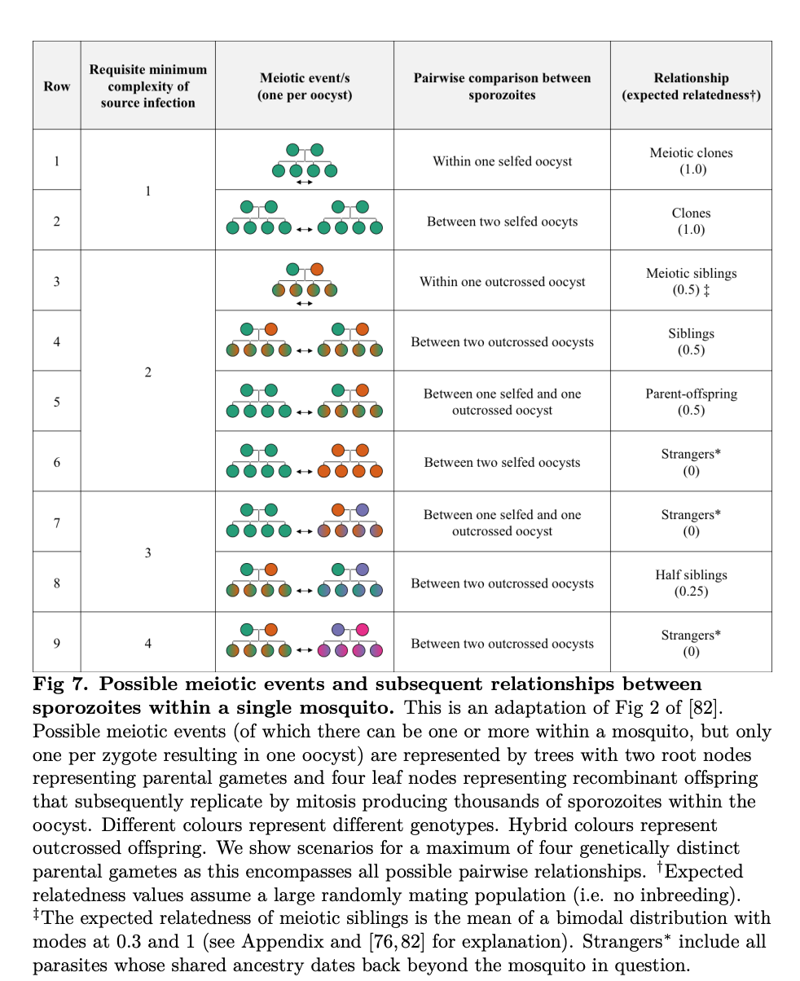
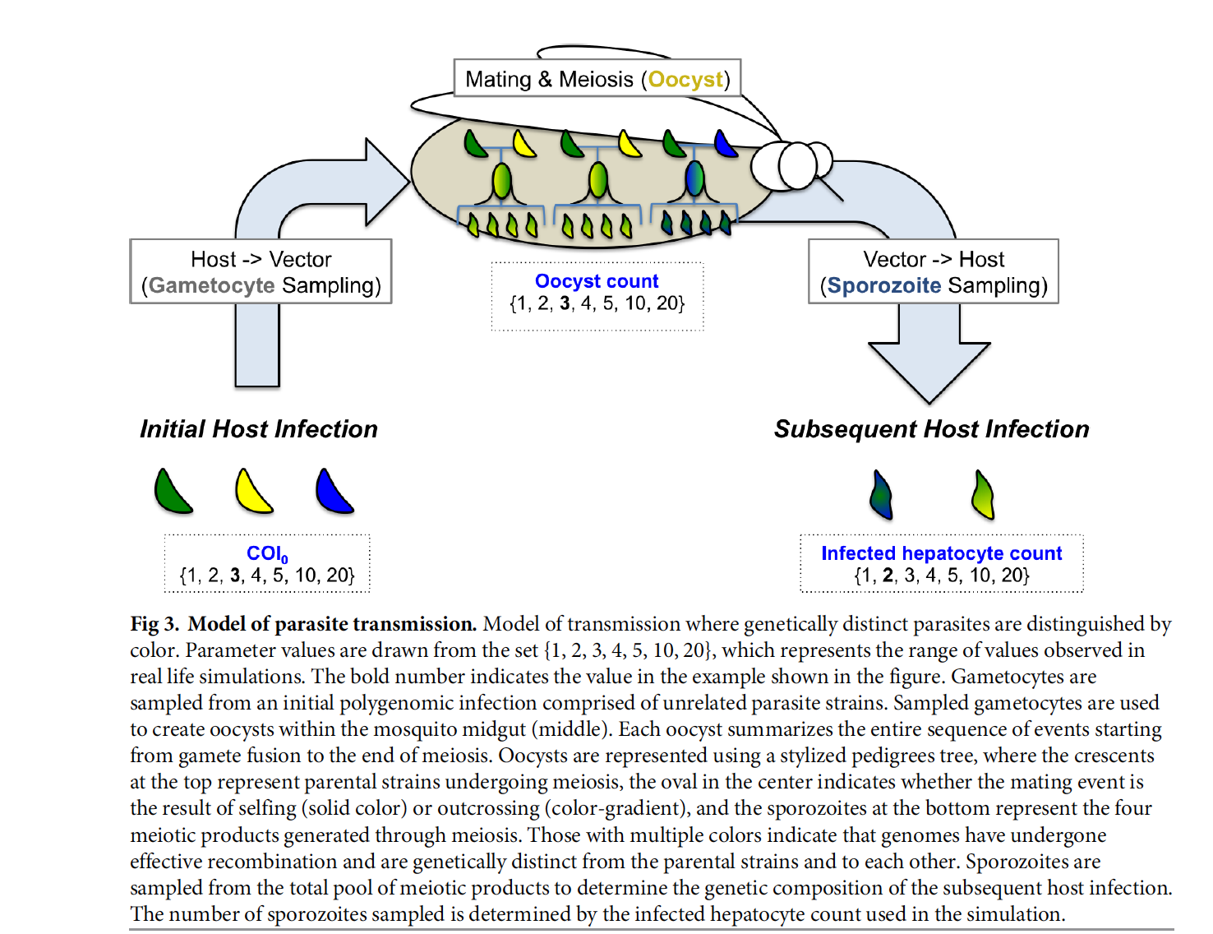
When MOI > 2, oocyst count matters…

Slide 12
H
Seed Initial Infections
Ne = parasite haplotype size
Nc = parasite consensus size
COI = mean number of infections per case
Lamba ~ EIR (for cases)
λ
λ
*
M
P.superinxn
* Here Ѡ, zygote count, is not relevant because the same 4 HMP are always produced

Slide 13
H
Note, MOI = 3, but strain prop not 3 (based on previous infxn)
In mosquito phase, our HMP != 4 anymore… they are 9
Ѡ = zygote count
M
Mating event can produce 4 haplotypes --> endomitosis, thousands of sporozoites

Slide 14
H
M
CAN ALSO IMAGINE THIS HAPPENING IN A SETTING OF HIGH EIR…

Slide 15
H
M
I am missing this….

Slide 16
Simulating
Recombination

Slide 17
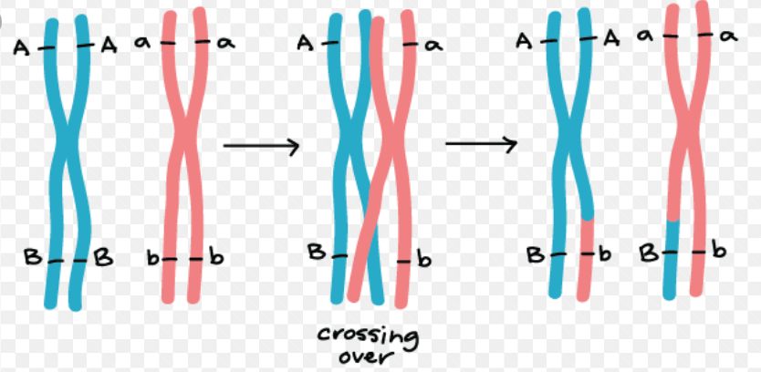
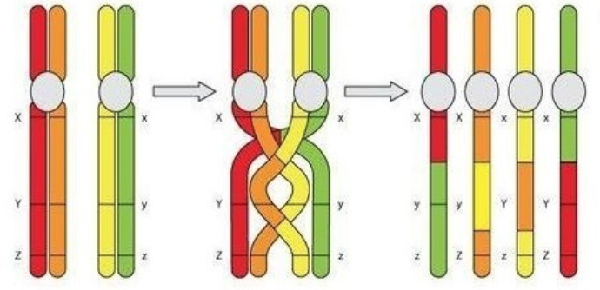
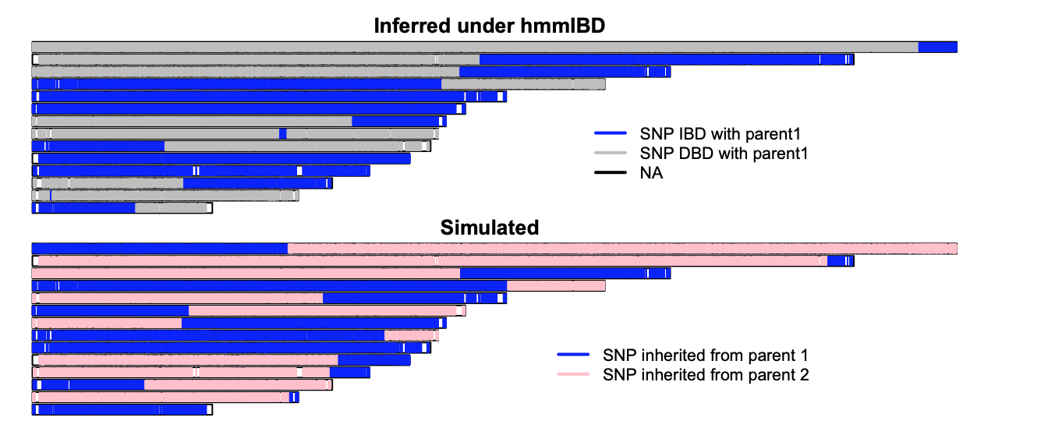
hmmIBD | Nick
Breakpoint <- rexp(1, rho) Where breakpoint < chrom make recombination Return 1 child chimeric progeny | Breakpoint <- rexp(1, rho) Where breakpoint < chrom make recombination If new breakpoint < POS, then cross back over (e.g. “re-start”
No back Cross Over!

Slide 18
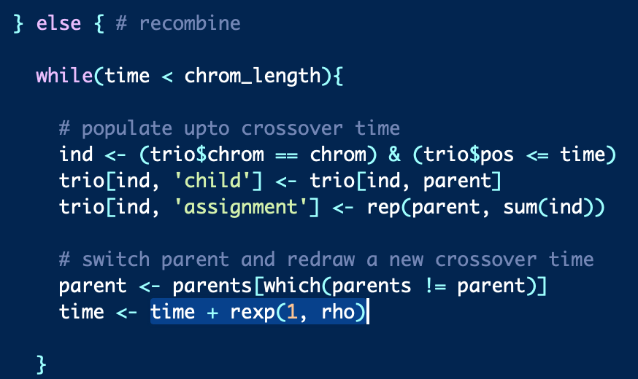
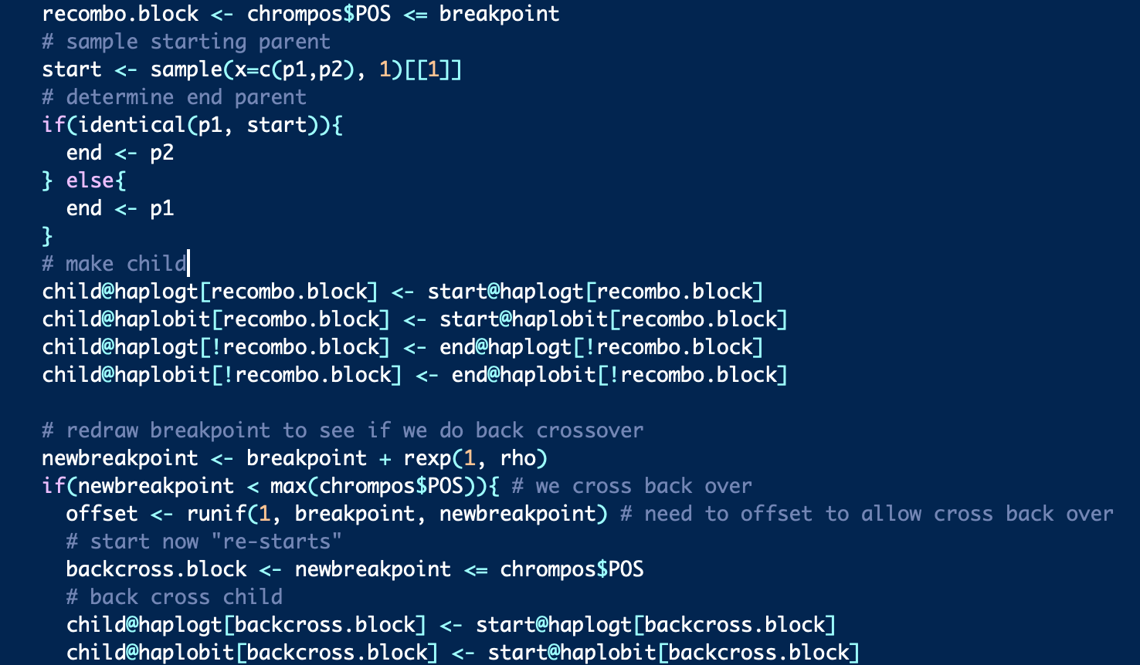
hmmIBD | Nick
Breakpoint <- rexp(1, rho) Where breakpoint < chrom make recombination Return 1 child chimeric progeny | Breakpoint <- rexp(1, rho) Where breakpoint < chrom make recombination If new breakpoint < POS, then cross back over (e.g. “re-start”
Both only allow one recombination event per generation

