Slide 1
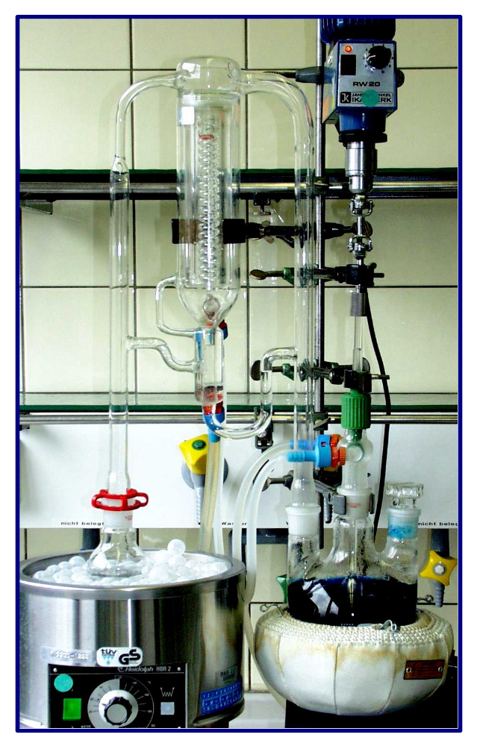
SDE Apparatus
Stirrer
Jacketed coil condenser
Flask with extraction agent
Extraction flask with aqueous sample
Water bath
Heater

