Slide 1
pH and Buffers

Slide 2
pH
pH is commonly expressed as –log[H⁺]
It approximates the negative log (base 10) of the molar concentrations of hydrogen ions H+ (really hydronium ions H₃0+) in solution
So a solution of HCl with a pH of 2.0 has a concentration of hydronium ions of 1x 10⁻² (1/100!!)
Compared to a more dilute solution of HCl with a pH of 5.0, which has a hydronium ions concentration of 1 x 10⁻⁵ (1/100,000).

Slide 3
pH
pH is commonly expressed as –log[H⁺]
Pure water has [H⁺]=10⁻⁷ and thus pH=7.

Slide 4
pH
pH is commonly expressed as –log[H⁺]
Pure water has [H⁺]=10⁻⁷ and thus pH=7.
Acids have a high [H⁺] and thus a low pH.
Bases have a low [H⁺] and thus a high pH.
Bases contribute –OH ions when they dissociate. These bind to the H+ ions produced when water dissociates. Thus, these OH ions “suck up” the H+ ions in solution, reducing their concentration.
NaOH with a pH of 12.0 contributes so many –OH ions that almost all the H+ ions are bound into water molecules, reducing the free H+ (and hydronium) ion concentration to 1 x 10⁻¹² (1,000,000,000,000 = 1/trillion)

Slide 5

pH
Acid | Normality | pH
Acetic | N | 2.4
Acetic | 0.1 N | 2.9
Acetic | 0.01 N | 3.4
Hydrochloric | N | 0.1
Hydrochloric | 0.1 N | 1.1
Hydrochloric | 0.01 N | 2.0
Sulfuric | N | 0.3
Sulfuric | 0.1 N | 1.2
Sulfuric | 0.01 N | 2.1
How do normality and molarity relate to pH??
Molarity is the fractions of a mole in solution; normality is a measure of the concentration of reactive groups which may affect pH.

Slide 6
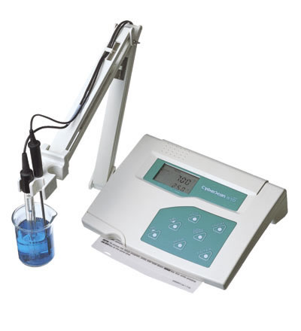
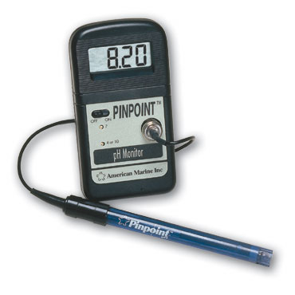
Ways to measure pH
pH meter
    Electrode measures H⁺ concentration
    Must standardize (calibrate) before using.

Slide 7
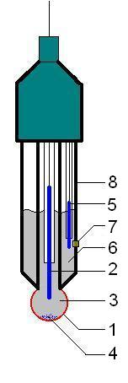
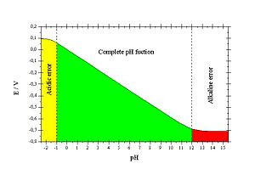
Actually measuring a voltage – a charge differential – between a control solution and the external fluid.

Slide 8
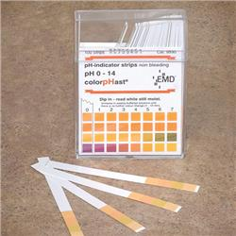
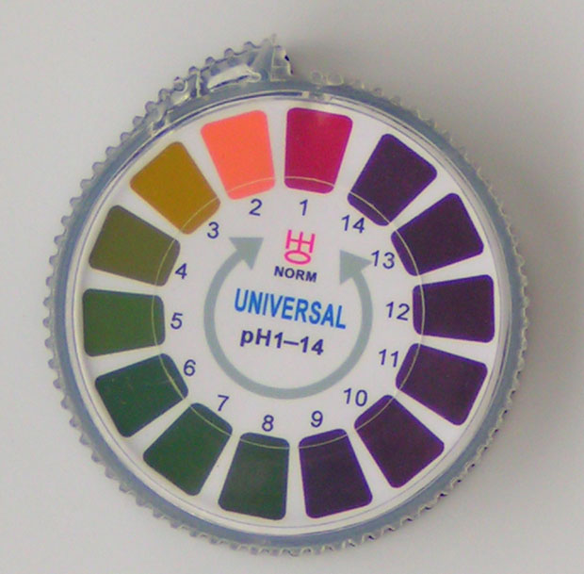
Ways to measure pH
Indicator dyes and test strips
    Less precise
    Each indicator is only good for a small pH range (1-2 pH units)
    But may be good for field usage, or measuring small volumes, or dealing with noxious samples.

Slide 9
Why is pH important in biology?
pH affects solubility of many substances.
[A] (mol/L) | 1 | 10⁻¹ | 10⁻² | 10⁻³ | 10⁻⁴ | 10⁻⁵ | 10⁻⁶ | 10⁻⁷ | 10⁻¹⁰
Initial pH | 0.00 | 1.00 | 2.00 | 3.00 | 4.00 | 5.00 | 6.00 | 6.79 | 7.00
Final pH | 6.75 | 7.25 | 7.75 | 8.14 | 8.25 | 8.26 | 8.26 | 8.26 | 8.27
Dissolved CaCO₃ (g per liter of acid) | 50.0 | 5.00 | 0.514 | 0.0849 | 0.0504 | 0.0474 | 0.0471 | 0.0470 | 0.0470
More calcium carbonate dissolves as pH drops

Slide 10
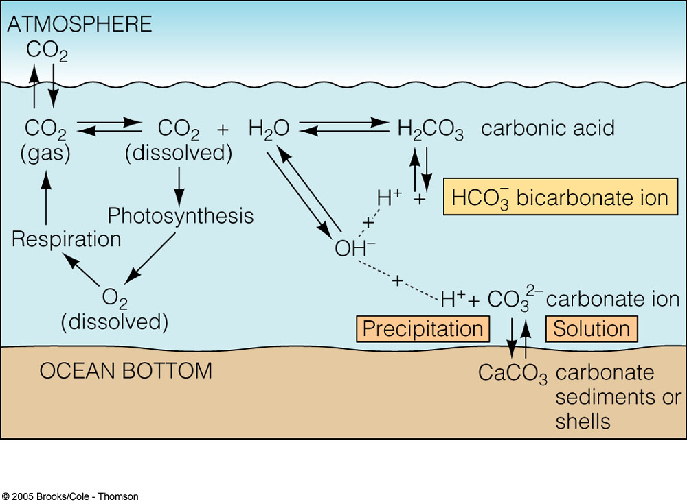
Increased CO₂ increases the ocean’s acidity
Increases in H+ causes cation displacement and the dissolution of Calcium Carbonate (shell, limestone, etc.)

Slide 11
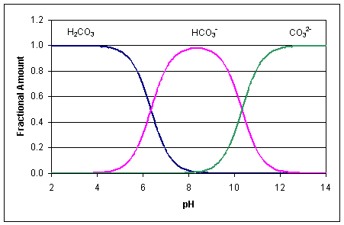
Drives equilibria and reversible states of compounds
Carbonic Acid Bicarbonate Carbonate

Slide 12
Why is pH important in biology?
pH affects solubility of many substances.
pH affects structure and function of most proteins - including enzymes.

Slide 13
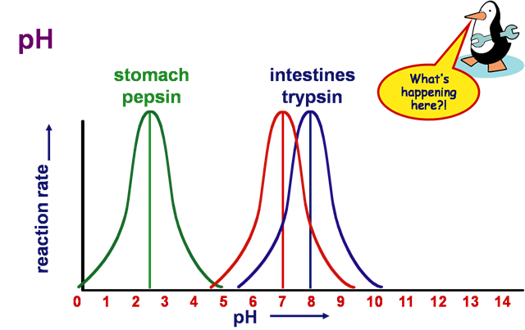

Slide 14
Why is pH important in biology?
pH affects solubility of many substances.
pH affects structure and function of most proteins - including enzymes.
Many cells and organisms (esp. plants and aquatic animals) can only survive in a specific pH environment.

Slide 15
Why is pH important in biology?
pH affects solubility of many substances.
pH affects structure and function of most proteins - including enzymes.
Many cells and organisms (esp. plants and aquatic animals) can only survive in a specific pH environment.
Important point -
  pH is dependent upon temperature

Slide 16
Buffers
Definition: a solution that resists change in pH
  Typically a mixture of the acid and base form of a chemical
  Can be adjusted to a particular pH value
Blood: pH = 7.35-7.45
Too acidic? Increase respiration rate expelling CO2, driving reaction to the left and reducing H+ concentration.
Excretory system – excrete more or less bicarbonate

Slide 17
Buffers
Definition: a solution that resists change in pH
  Typically a mixture of the acid and base form of a chemical
  Can be adjusted to a particular pH value
pH below 7.4 in rats – CaCO₃ in BONE dissociates, carbonates soak up extra H+ to buffer blood. But bones weakened.

Slide 18
Buffers
Definition: a solution that resists change in pH
  Typically a mixture of the acid and base form of a chemical
  Can be adjusted to a particular pH value
Why use them?
  Enzyme reactions and cell functions have optimum pH’s for performance
  Important anytime the structure and/or activity of a biological material must be maintained

Slide 19
How buffers work
Equilibrium between acid and base.
Example: Acetate buffer
  CH₃COOH ↔ CH₃COO⁻ + H⁺
If more H⁺ is added to this solution, it simply shifts the equilibrium to the left, absorbing H⁺, so the [H⁺] remains unchanged.
If H⁺ is removed (e.g. by adding OH-) then the equilibrium shifts to the right, releasing H⁺ to keep the pH constant

Slide 20
Limits to the working range of a buffer
Consider the previous example:
  CH₃COOH ↔ CH₃COO⁻ + H⁺
If too much H⁺ is added, the equilibrium is shifted all the way to the left, and there is no longer any more CH₃COO⁻ to “absorb” H⁺.
At that point the solution no longer resists change in pH; it is useless as a buffer.
A similar argument applies to the upper end of the working range.

Slide 21
Chemistry of buffers
Lets look at a titration curve

Slide 22
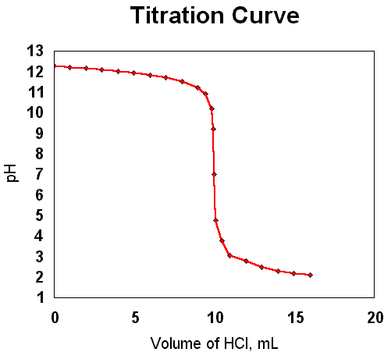
Titration is used to determine the concentration of an acid or base by adding the OTHER and finding an equivalency point…

Slide 23
Titration is used to determine the concentration of an acid or base by adding the OTHER and finding an equivalency point…
Suppose you have a KOH solution, and you want to know its concentration (molarity).
Slowly add an acid (HCl) with a known concentration (0.1 M) and find the equivalency point…in this case it will be at pH = 7… and we use an indicator that changes color at that pH determine when that point has been reached.
So, suppose it takes 10ml of 0.1 M HCl to buffer 50 ml of the KOH.

Slide 24
Titration is used to determine the concentration of an acid or base by adding the OTHER and finding an equivalency point…
So, suppose it takes 10ml of 0.1 M HCl to buffer 50 ml of the KOH.
The original concentration of the base =
Vol Acid x conc. Of acid
Volume of Base
10 ml x 0.1 M
50 ml = 0.02 M

Slide 25
Chemistry of buffers
K_{a} = equilibrium constant for H+ transfer… also described as the dissociation constant…the tendancy of an acid to dissociate. AH → A- (base conjugant) + H+
K_{a} = [A-] [H+]/ [AH] = [base] [H+] / [acid]
Weak acids have low values… contribute few H+ ions…
Because we are usually dealing with very small concentrations, log values are used…
The log constant =

Slide 26
Chemistry of buffers
K_{a} = [A-] [H+]/ [AH] = [base] [H+] / [acid]
Weak acids have low values… contribute few H+ ions…
Because we are usually dealing with very small concentrations, log values are used…
The log constant =
SO! Since pK is the negative log of K, weak acids have high values … (-2 – 12).
HCl = -9.3 – very low ~complete dissociation

Slide 27
Chemistry of buffers
First rearrange the first equation and solve for [H+]
  [H+] = K_{a} x [acid]/[base]
Then take the log of both sides
  log₁₀[H+] = log₁₀K_{a} + log₁₀ [acid]/[base]
-pH
-pK_{a}

Slide 28
Chemistry of buffers
-pH = -pKa + log₁₀ [acid]/[base]
Multiply both sides by –1 to get the Henderson-Hasselbach equation
  pH = pKa - log₁₀ [acid]/[base]

Slide 29
Chemistry of buffers
What happens when the concentration of the acid and base are equal?
  Example: Prepare a buffer with 0.10M acetic acid and 0.10M acetate
    pH = pKa - log₁₀ [acid]/[base]
    pH = pKa - log₁₀ [0.10]/[0.10]
    pH=pKa
    Thus, the pH where equal concentrations of acid and base are present is defined as the pKa
A buffer works most effectively at pH values that are + 1 pH unit from the pKa (the buffer range)

Slide 30
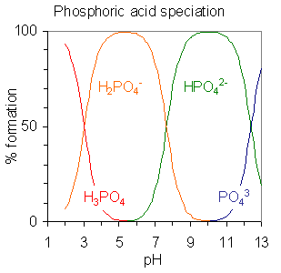
equilibrium | pK_{a} value
H₃PO₄ H₂PO₄⁻ + H⁺ | pK_{a1} = 2.15
H₂PO₄⁻ HPO₄²⁻ + H⁺ | pK_{a2} = 7.20
HPO₄²⁻ PO₄³⁻ + H⁺ | pK_{a3} = 12.37

Slide 31
Drives equilibria and reversible states of compounds
Carbonic Acid Bicarbonate Carbonate

Slide 32
Factors in choosing a buffer
Be sure it covers the pH range you need
  Generally: pK_{a} of acid ± 1 pH unit
  Consult tables for ranges or pK_{a} values
Be sure it is not toxic to the cells or organisms you are working with.
Be sure it would not confound the experiment (e.g. avoid phosphate buffers in experiments on plant mineral nutrition).

Slide 33
What to report when writing about a buffer:
The identity of the buffer (name or chemicals)
The molarity of the buffer
The pH of the buffer
Examples:
  “We used a 0.5M Tris buffer, pH 8.0.”
  “The reaction was carried out in a 0.1M boric acid – sodium hydroxide buffer adjusted to pH 9.2.”

Slide 34
Three basic strategies for making a buffer
1. Guesswork – mix acid and base at the pH meter until you get the desired pH.
  Wasteful on its own, but should be used for final adjustments after (2) or (3).
2. Calculation using the Henderson-Hasselbach equation.
3. Looking up recipe in a published table.

Slide 35
Calculating buffer recipes
Henderson-Hasselbach equation
  pH = pKa - log₁₀ [acid]/[base]
Rearrange the equation to get
  10^{(pKa-pH)} = [acid]/[base]
Look up pKa for acid in a table. Substitute this and the desired pH into equation above, and calculate the approximate ratio of acid to base.
Because of the log, you want to pick a buffer with a pKa close to the pH you want.

Slide 36
Example
You want to make about 500 mL of 0.2 M acetate buffer (acetic acid + sodium acetate), pH 4.0.
Look up pKa and find it is 4.8.
10^{(4.8 - 4.0)} = 10^{0.8} = 6.3 = [acid]/[base]
If you use 70 mL of base, you will need 6.3X that amount of acid, or 441 mL. Mix those together and you have 511 mL (close enough).

Slide 37
Tables
Tables are available to avoid doing this calculation for most buffers.
tables

Slide 38
Titration
Whether you use the formula or the tables, you will have to make fine adjustments to the final solution at the pH meter.
This is unavoidable; therefore, you can be rather approximate about the amounts of acid and base that you mix. It’s a waste of time to try to be super-precise in mixing, because you will need to make adjustments anyway.

