Slide 1
Weather App
A simple weather forecasting application using OpenWeatherMap API
By: Nikhil Chougule

Slide 2
Introduction
• Weather applications provide real-time weather updates.
• Useful for daily planning and travel.
• This project is a simple Weather App that shows temperature, humidity, wind speed, and weather condition.

Slide 3
Problem Statement
• People need quick and real-time weather information.
• Existing apps can be heavy or complex.
• Goal: Create a simple weather app that displays real-time weather in a clean interface.

Slide 4
Objectives
• Fetch weather data using OpenWeatherMap API.
• Display temperature, humidity, wind speed, and weather condition.
• Show weather icons for better user experience.

Slide 5
Technology Stack
• Frontend: HTML, CSS, JavaScript
• API: OpenWeatherMap API
• IDE: Visual Studio Code

Slide 6
System Design
User → Search City → Fetch API Data → Display Results

Slide 7
Implementation
• HTML: Structure of the app
• CSS: Styling and layout
• JavaScript: API integration and dynamic updates

Slide 8
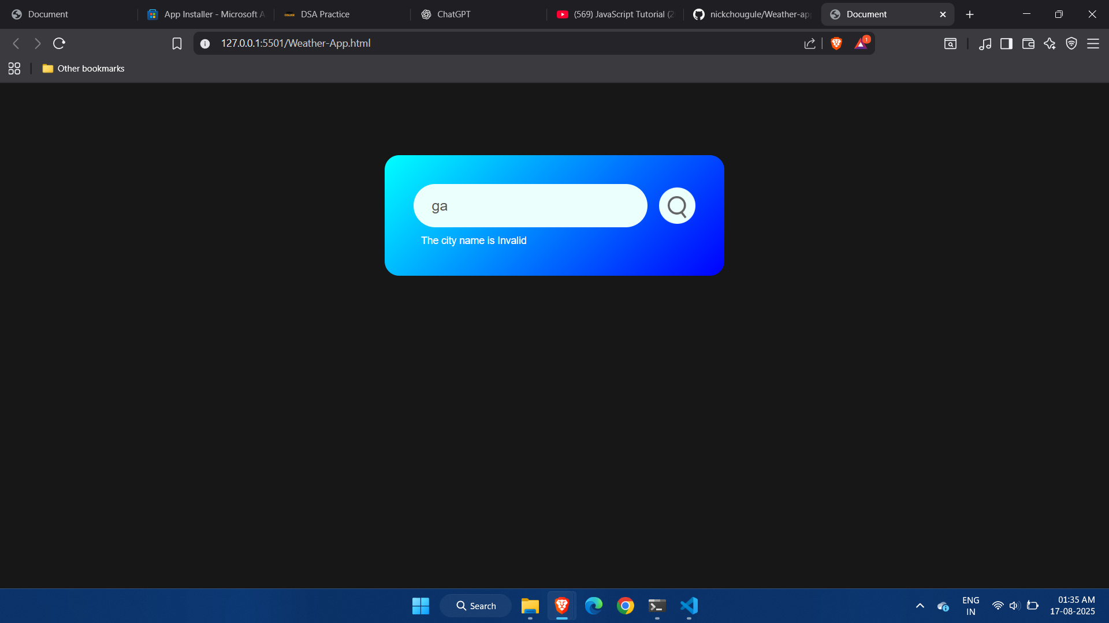
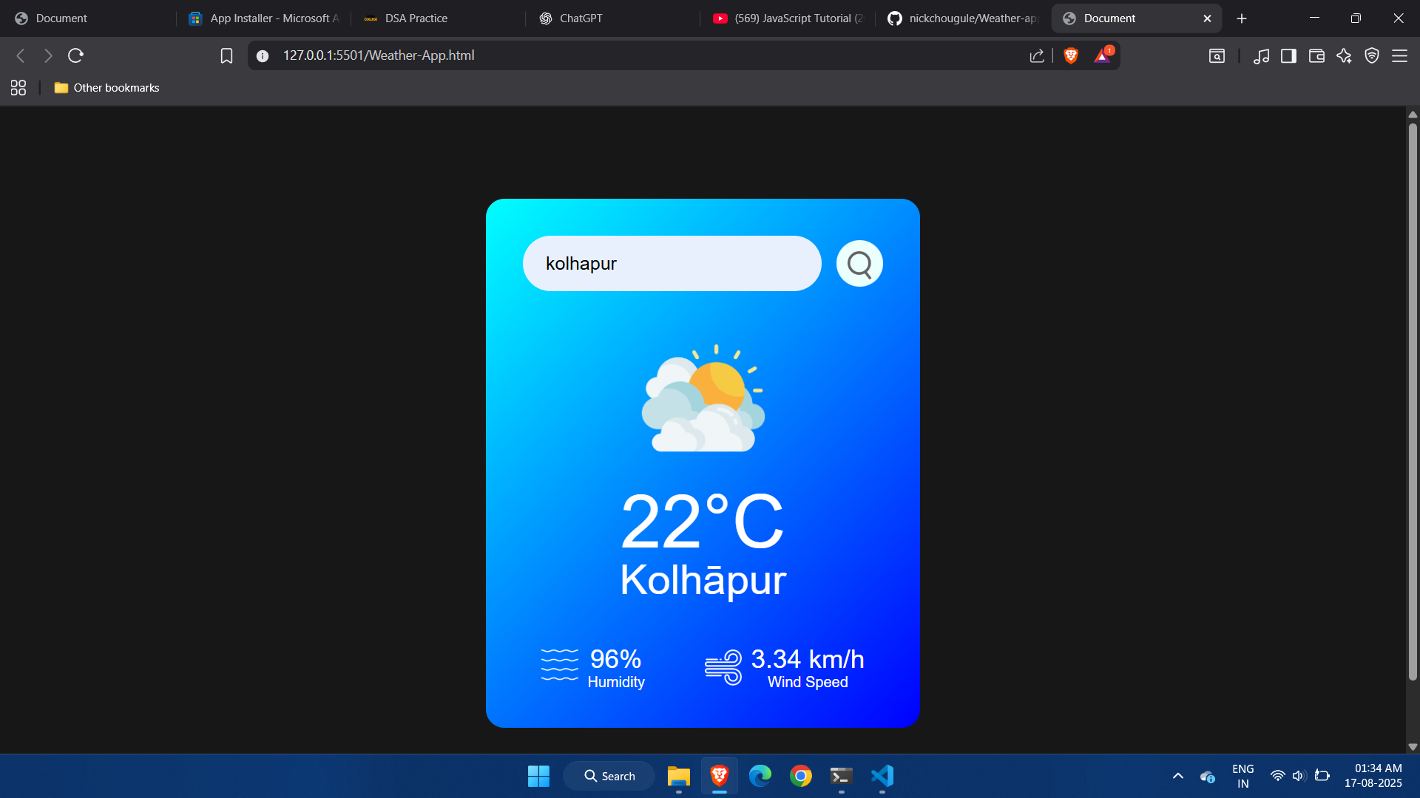
Screenshots / Output
• Example 1: Invalid city (error message)
• Example 2: Weather info displayed (Kolhapur example)

Slide 9
Conclusion & Future Scope
• Achieved real-time weather display using OpenWeatherMap API.
• Simple, lightweight, and easy-to-use interface.
• Future Scope:
- Add multi-day forecast.
- Add location-based automatic weather detection.
- Enhance UI design.

Slide 10
Thank You
Questions & Discussion

