Slide 1
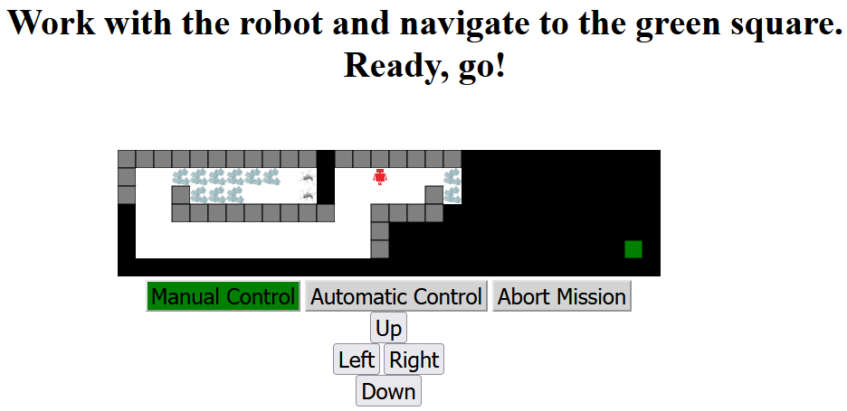
Broken Glass
Holes
Robot
Unexplored
area
Walls
Finish
Explored
area
End the mission
Choose robot control
Movement

Slide 2
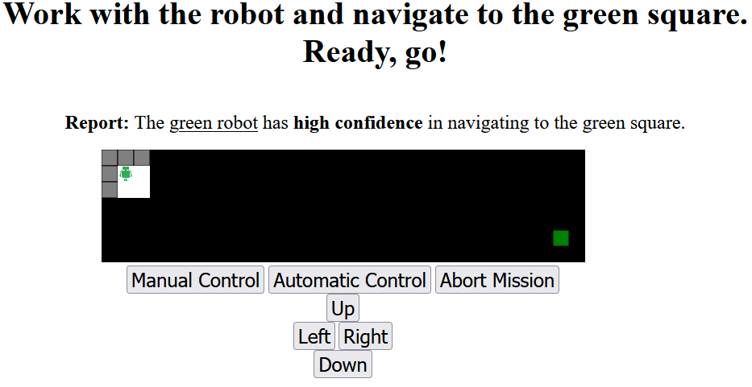

Slide 3
Robot self-confidence report
Good confidence
Robot starting location

Slide 4
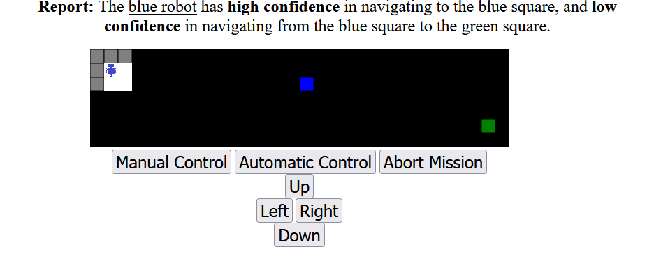
Robot self-confidence report
self-confidence to blue square
Good confidence
fair
self-confidence to green square
Robot starting location

Slide 5
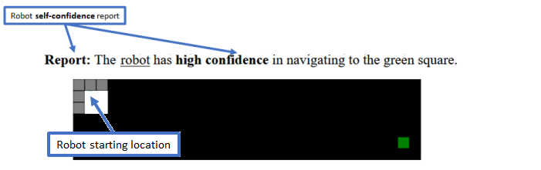
good

Slide 6
Maze Set i maze 1
Maze Set i maze 2
Thank you screen
Maze Set i maze 3
No
No
Start
Consent?
Pass Pre-screen?
Base Tutorial + quiz
Maze Set i tutorial + quiz
Yes
Yes
Maze Set i maze 4
Maze Set i trust questionnaire
3 Maze Sets complete?
No
Yes
Demographic questionnaire
Turk completion code (study complete)

