Slide 1
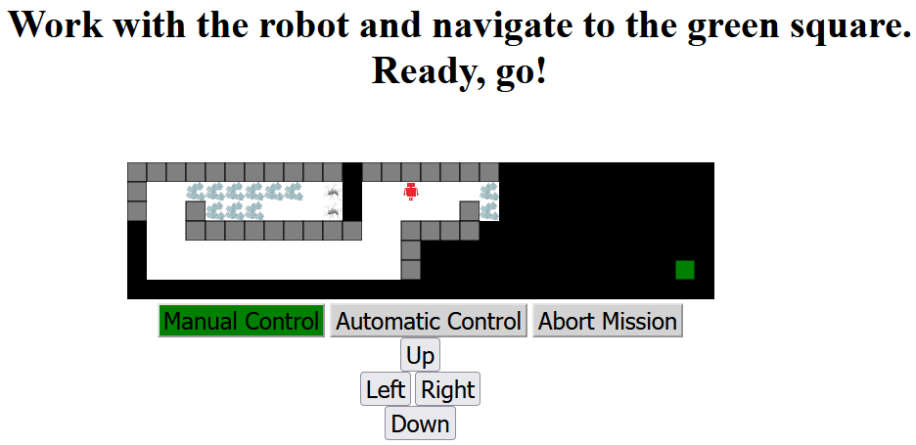
Broken Glass
Holes
Robot
Unexplored
area
Walls
Finish
Explored
area
End the mission
Choose robot control
Movement

Slide 2
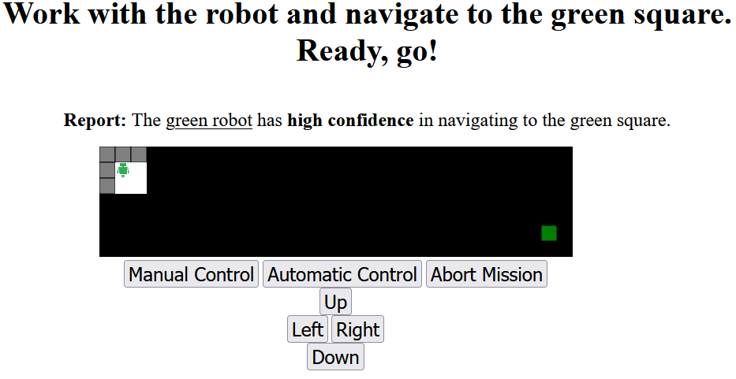

Slide 3
Robot self-confidence report
Good confidence
Robot starting location

Slide 4
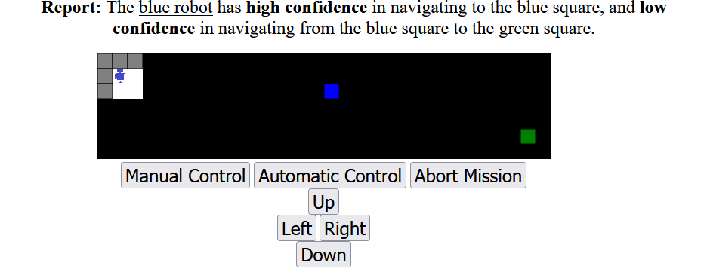
Robot self-confidence report
self-confidence to blue square
Good confidence
fair
self-confidence to green square
Robot starting location

Slide 5
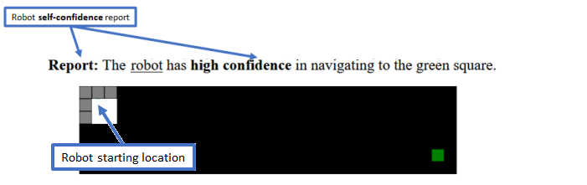
good

