Slide 1
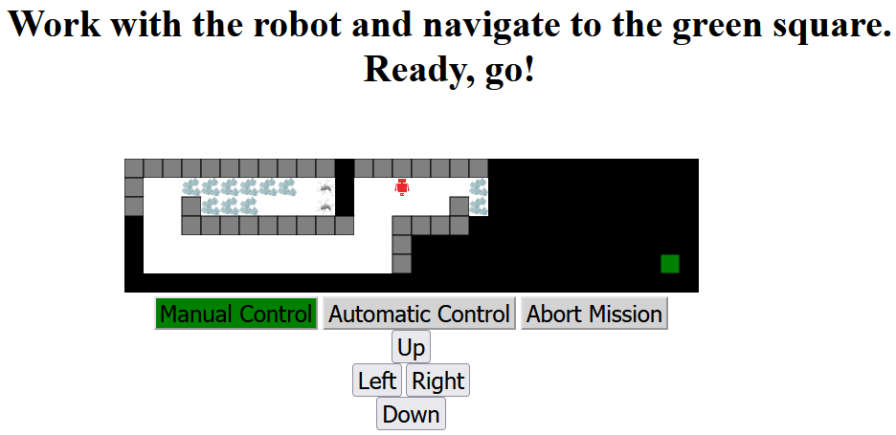
Broken Glass
Holes
Robot
Unexplored
area
Walls
Finish
Explored
area
End the mission
Choose robot control
Movement

Slide 2
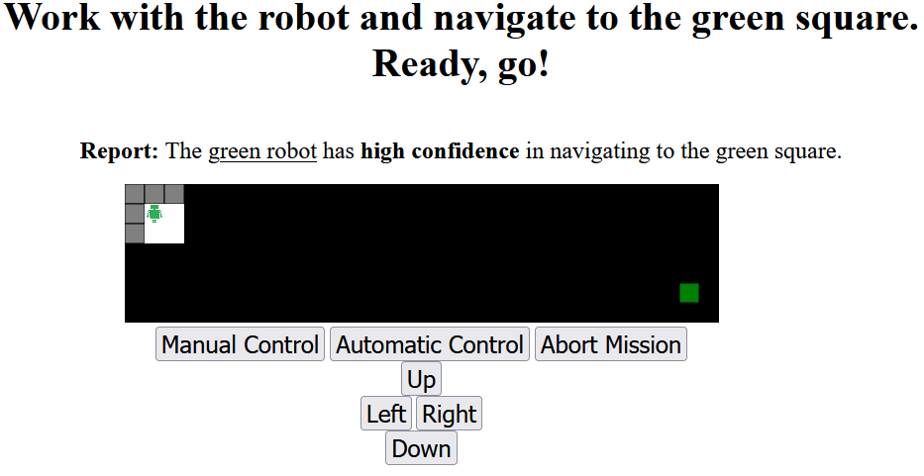

Slide 3
Robot self-confidence report

Slide 4
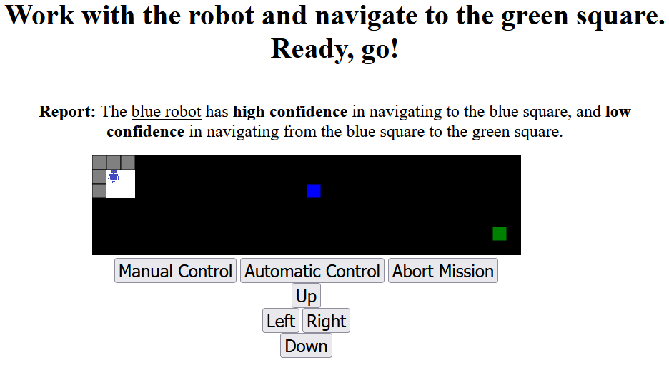
Robot self-confidence report
self-confidence to blue square
self-confidence to green square

