Slide 1
No. of Sales by month

Slide 2
Sales by Category

Slide 3
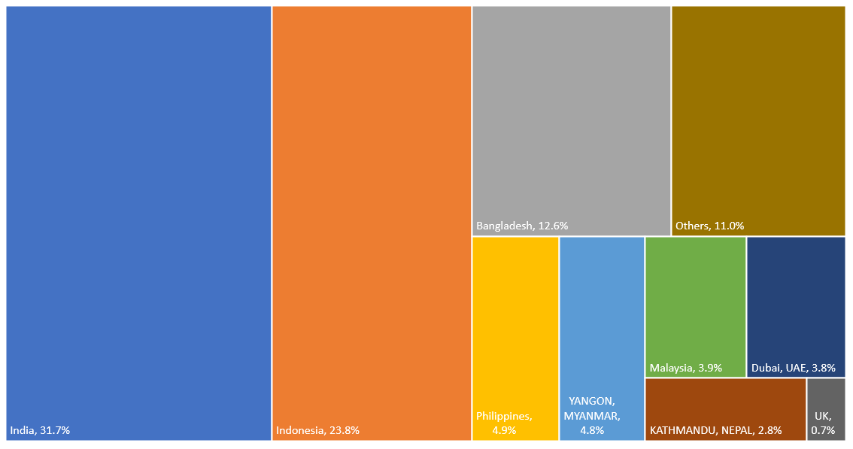

Sales by Country

Slide 4
Sales by Nationality

Slide 5
Sales by Pass type

Slide 6
Customer by Age group

Slide 7
Customer by Average age

Slide 8
Customer refund requests by days

