Slide 1
Ayllu Big Data Learning Framework
Uday Kamath
And
Horacio Blanco

Slide 2
Agenda
Team (So far)
Problem
Issues
Related Work
Approach – Ayllu framework
Current Status
Potential Paths

Slide 3
Team, Expertise and Roles
Uday Kamath
(Machine Learning , Evolutionary and Parallel algorithm expert)
Horacio Blanco
(Software Engineering, High Scale Distributed Framework expert)
Carlotta Domeniconi
(Research Advisor, Academic front, Machine Learning expert)
Raj Pai
(Evangelist, Serial Entrepreneur, Marketing/Sales expert)

Slide 4
Learning
Learning
Machine Learning
Supervised (Classification, Regression)
Unsupervised
Clustering (Density, Centroid, Distribution,..)
Outlier (Density,..)
Semi Supervised
Stream Learning
Optimization
Non-Linear NP Hard
Genetic Algorithms
Ant Colony
Particle Swarm
Genetic Programming
..

Slide 5
Issues (Big Data Learning)
Big Data Learning Issues of Interest
Volume
Variety
Value
Veracity
Velocity
Variability
Classic Machine Learner Issues and Solutions
Training time and memory requirements on basic learner
E.g. SVMs: O(n³) time - O(n²) space
Sampling (various sampling based frameworks..)
Approximations (online, transform algorithms for scaling..)
Lack of Generic Scalable Algorithms which work on entire data without customization and choice of wide variety of algorithms !

Slide 6
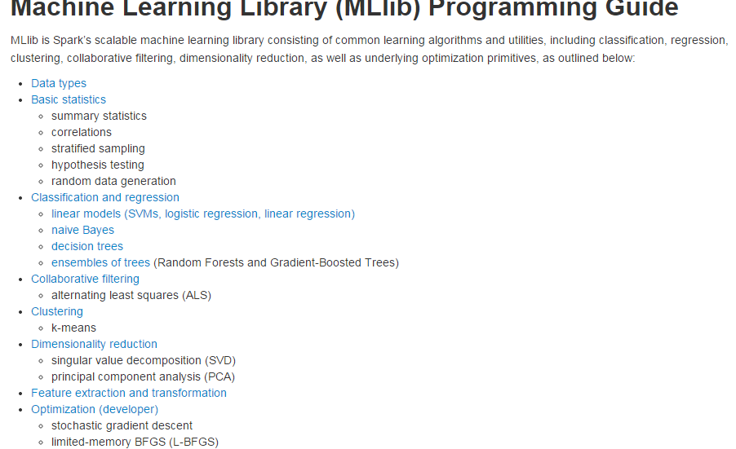
RELATED WORK
Apache SPARK-2 MLib

Slide 7
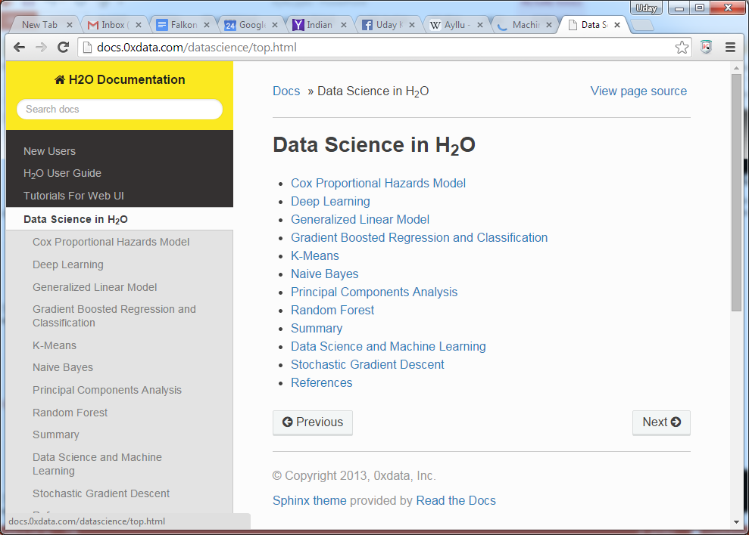
RELATED WORK
H20 Data Science

Slide 8
RELATED WORK

Slide 11
Choices in non Big data learning
There are so many Learning Libraries but not Big Data!
Weka
300 + Algorithms in Supervised, Unsupervised…
JSAT
100+ Algorithms in Supervised, Unsupervised…
RapidMinder
300 + Algorithms in Supervised, Unsupervised…
ECJ
25+ Optimization techniques in Evolutionary Algorithms
MOA
200+ Online Learning for Supervised, Unsupervised…

Slide 12
Choices in Big Data Storage and Processing
Tons of Big Data Storage
HDFS
NoSQL
New SQL
In Memory
…
Tons of Big Data Processing in Nodes
MapReduce
Apache Spark
GraphX
Jpregel
….

Slide 13
Million Dollar Question!
Is there a “generic” way to take any “Learner”, across “all learning” using “any storage”and scale it for Big Data?

Slide 14
Ayllu Big Data Learning Framework
Ayllu – Divide, Conquer and Collaborate!
http://en.wikipedia.org/wiki/Ayllu
Ayllu (pronounced I-LL-YOU) is at the core a social unit where every member engages in shared collective labor

Slide 15
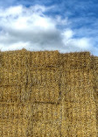


Ayllu Concept
Puzzle – Metaphorical Needle in Haystack
9 Needles in Haystack with 9 workers, each can talk to 4 others!
Quickest way to get location of 9
Divide (9 areas and 9 workers)
Conquer (Each worker searches his pile for needle)
Collaborate (Shares with 4 neighbors)

Slide 16
Ayllu Big Data Framework
Logical Grid, Nodes with Learner and Data
Nodes interact with “neighbors” to exchange message
Wraparound Grid, even local interaction-> Global behavior!
Node
Node
Node
Node
Node
Node
Node
Node
Learner
Data Sample
Node
Node
Node
Node
Node
Node
Node

Slide 17
Distributed Grid with Learners

Slide 18
Ayllu Big Data Learning Engine
Financial
Healthcare
Energy
Government
Language API (Java/Scala/Python)
Ayllu Big Data Framework
Vendors
Storage
Learning
Distributed
Weka
JSAT
RapidMinder
File
Database
HDFS
NoSQL
Supervised
Unsupervised
Outlier
Online
Evolutionary
Apache Spark
STORM
Hazlecast

Slide 19
AYLLU PSBML Algorithm
Distribute Data and Classifiers in GRID
Neighborhood Ensemble
Keep a Validation Set
for (epoch 1 to N) {
for each Node (1 to M){
Train Classifier from Node Data
Test with Node + Neighbor Data
Assign Fitness to each Data
Harder Data = Higher Fitness
Select using Fitness Proportion Selection
New Data = FPS(Node + Neighbor)
Grid Data = Grid Data + New Data
}
error= Classifier(Validation Set , Grid Data)
}
3X3 Grid, SSEA
Classifiers C1,C2…C9
Data D1, D2..D9
C1
D1
Easy
Hard
C1
D1
Testing
N
C2
D2
C2
D2
C3
D3
C3
D3
Testing
N
C4
D4
C4
D4
Training
Data
Testing
N
C5
D5
C5
D5
Testing
N
C6
D6
New Training
N
C6
D6
C7
D7
C7
D7
Testing
N
C8
D8
C8
D8
C9
D9
C9
D9

Slide 20
AYLLU PSBML Theory and Analysis
Theorem: PSBML is a Large Margin Classifier [GECCO’13, SDM’14*]
Modeling Distribution Gaussian Mixture Model (GMM)
Modeling Distribution Change using Mean-Shift
Induction from Node to Grid
Empirically shown connection to Theory
PSBML is a Meta Learner [PPSN’12,GECCO’13, SDM’14*]
Statistically Significant improvement across 5 datasets on accuracy with different classifiers (Naïve Bayes, C4.5, SVM..)
PSBML Scalability [GECCO’13, SDM’14*]
Best speed-accuracy trade-off (10 algorithms, 5 real/synthetic dataset)
Training time (Linear)
Memory (Linear)
Threads (Linear)
PSBML noise resilient [SDM’14*]
Compare 5 datasets with AdaBoosting
Statistically Significant improvement in accuracy when noisy

Slide 21
AYLLU PSBML : Empirical Analysis
Speed – Accuracy Tradeoff
1 Million Training Samples
Speed in msecs , Acc as mean auROC
Sine wave
Checkerboard

Slide 22
AYLLU PSBML : Empirical Analysis
Real World Dataset: KDD Cup 5 Million

Slide 23
AYLLU PSBML : Empirical Analysis
Scalability (KDD, 5 Million)
Training Time ?
Linear O(n)
Memory ?
Linear O(n)
Threads ?
Linear O(n)

Slide 24
AYLLU CLUSTERING

Slide 25
AYLLU BSMC UNSUPERVISED CLUSTERING
Boosted Mean Shift Clustering

Slide 26
AYLLU-BMSC REAL WORLD COMPARISON
Boosted Mean Shift Clustering

Slide 27
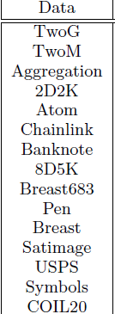
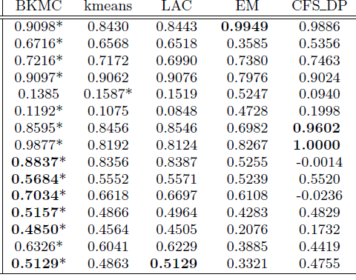
AYLLU BCC UNSUPERVISED LEARNING
Boosted Centroid Clustering

Slide 28
AYLLU Publications

Slide 29
Current Status
Generic Framework
Classification
Regression
Clustering
Generic Vendor Support
Weka
JSAT
RapidMinder
Generic Storage
File
HDFS (in process)
Generic Distributed Framework
Apache Spark (in process)

Slide 30
Monetization and Future
Open Source Research/Community Edition?
GPL
Data Scientist, Universities
Growing Model, Contributions rolled in, Wide spread adoption…
Vertical Enterprise/Cloud Solution
Cloud Deployment
Any Verticals
Patents and Trademarks
Help

