Slide 1
Tradedate - LETS CMS
CMP 3 2016-2017
Nicky De Knibber
3 MMP proDUCE

Slide 2
Concept

Slide 3
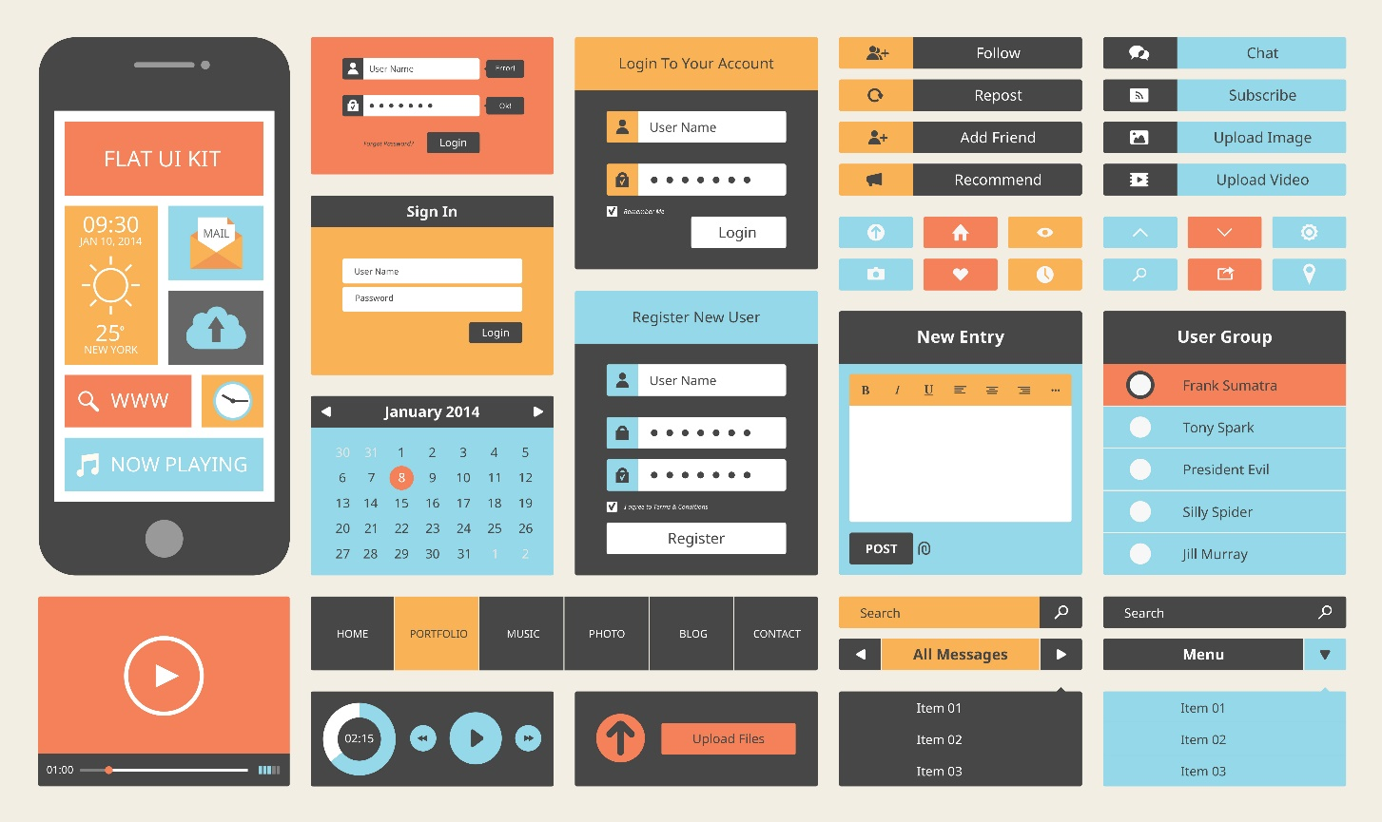


Inspiratie

Slide 4
Design

Slide 5
Development

Slide 6
Screenshots

