Slide 1
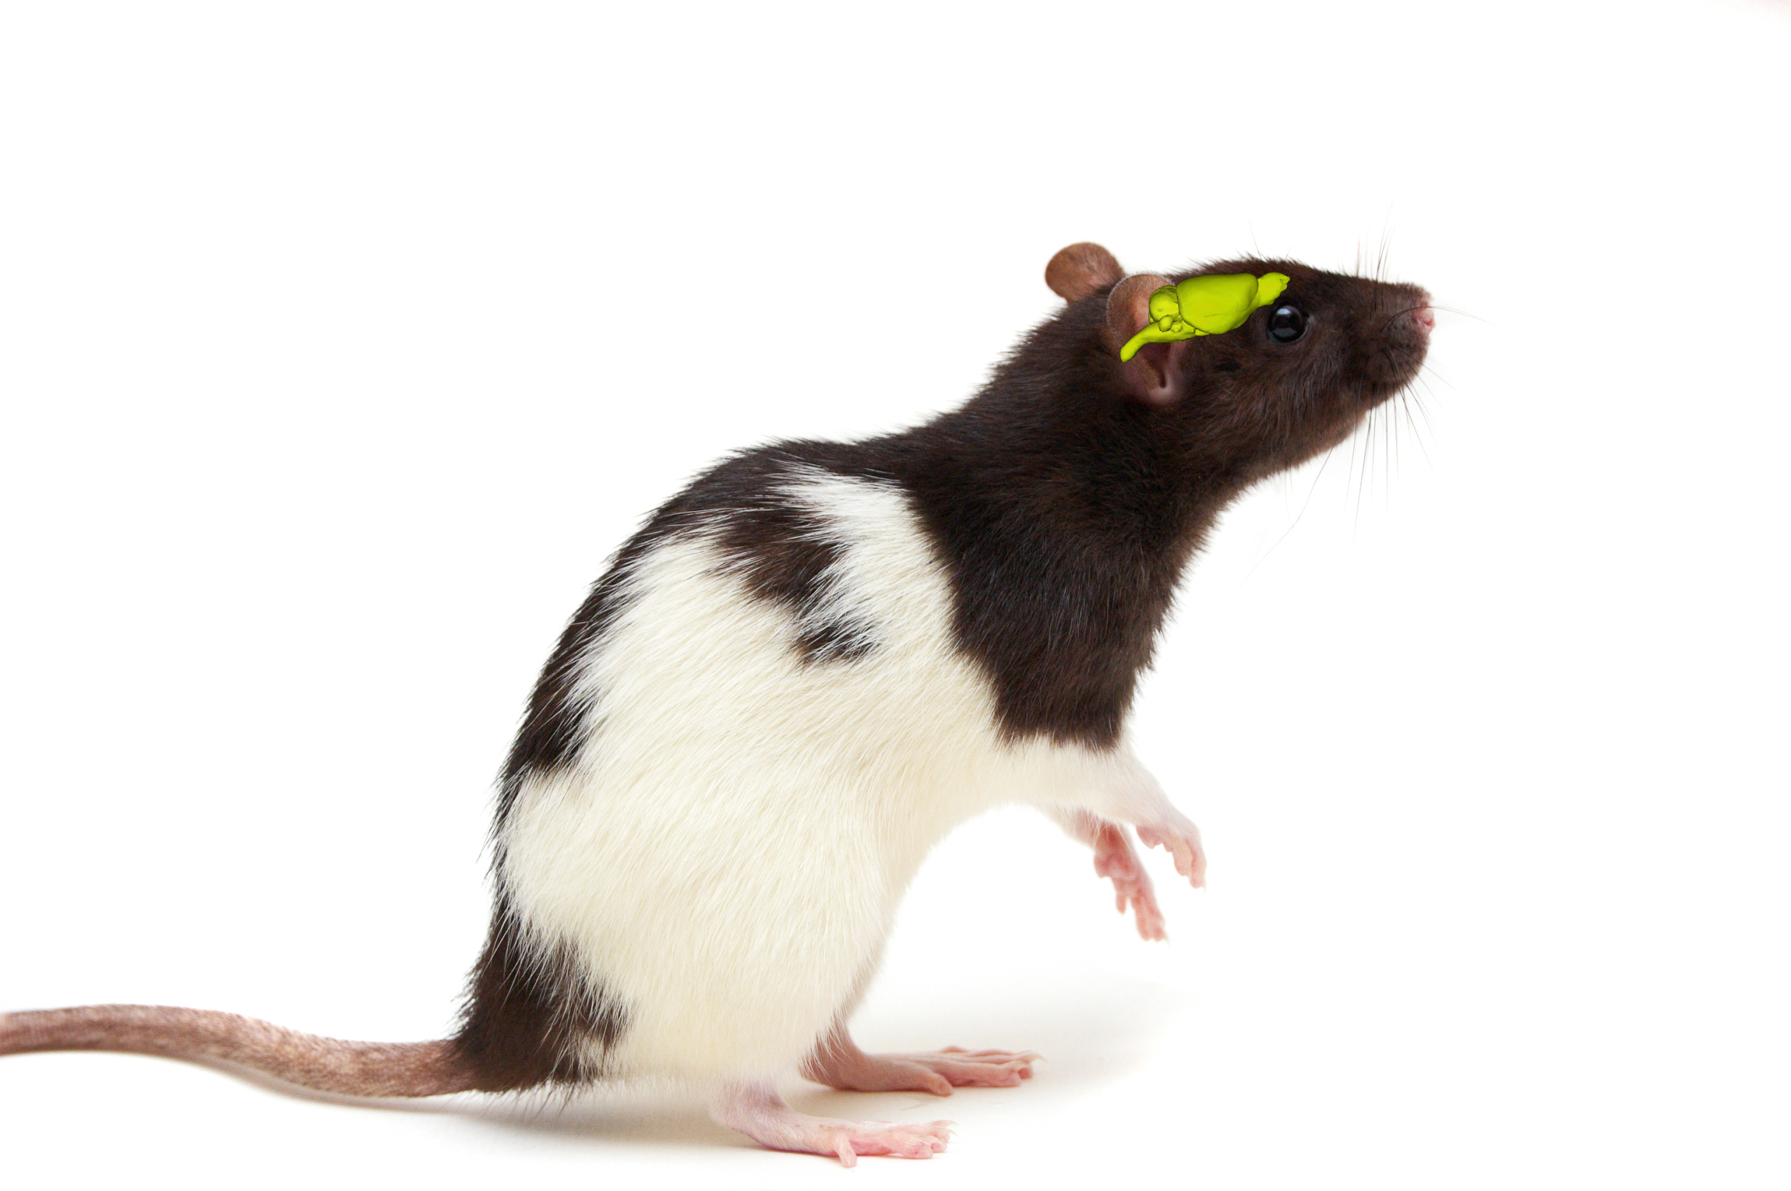
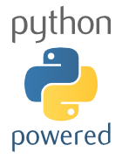
The Neuroscience Lab
A Tour Through the Eyes
of a Pythonista
Nicholas A. Del Grosso
Javier Martinez Alcantara

Slide 2
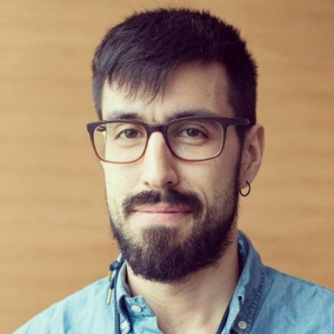
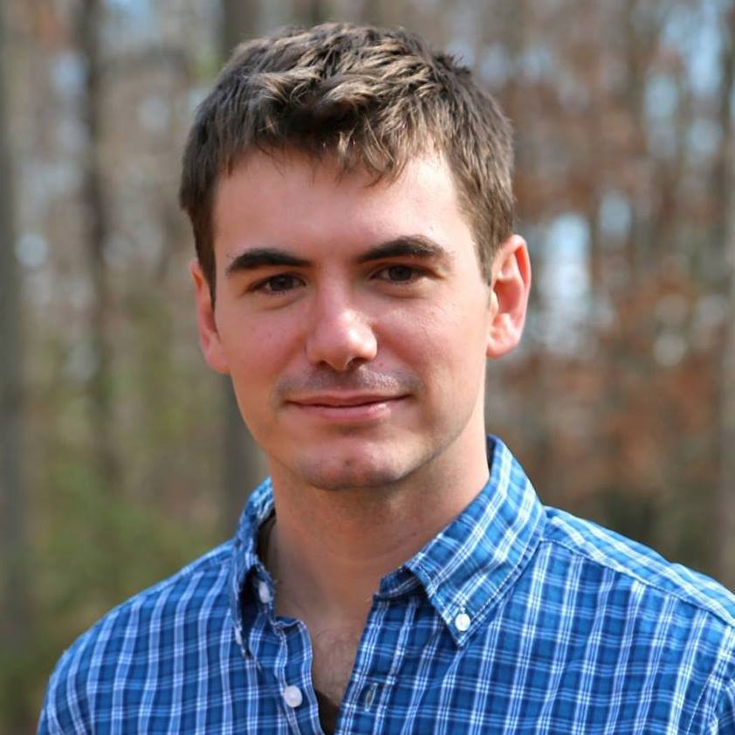
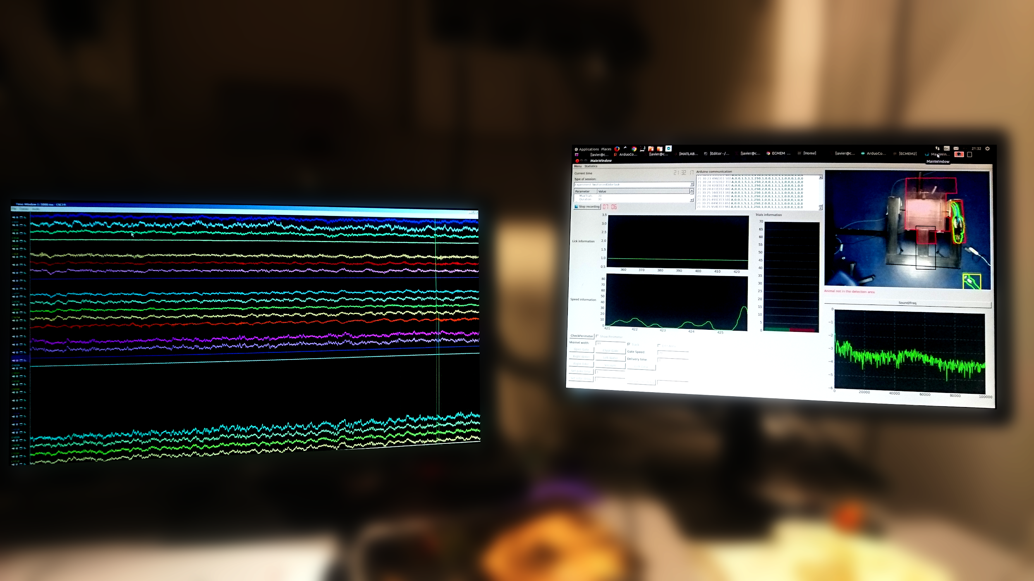
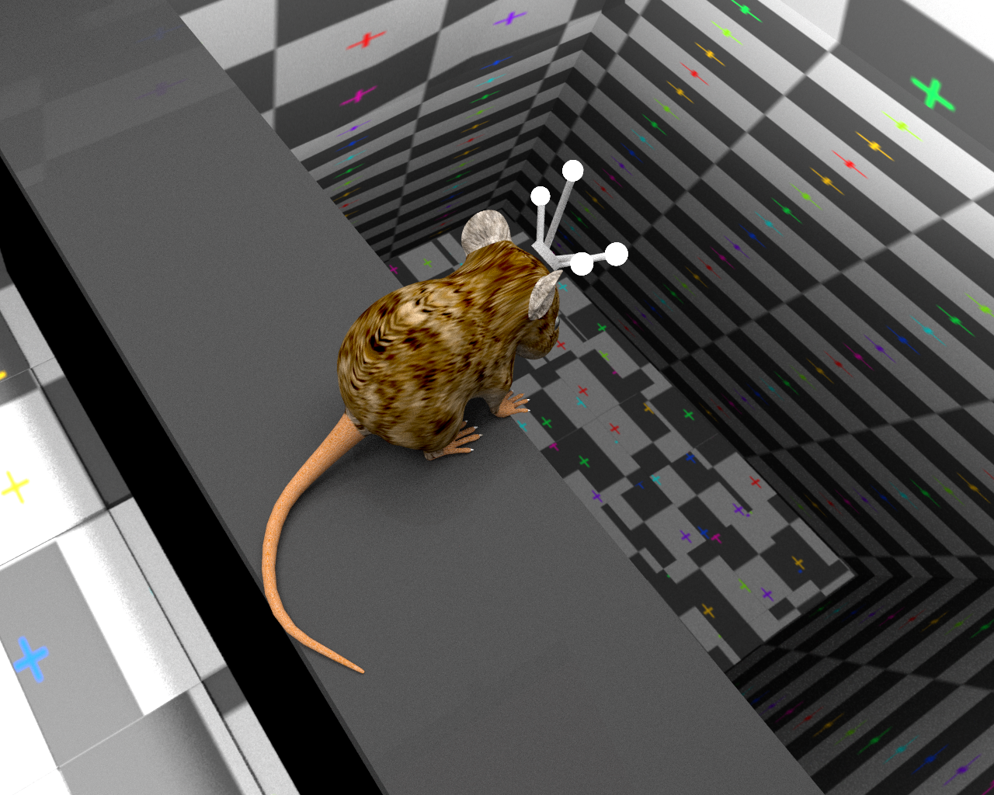

Javier and Nick: Labmates, Neuroscientists, Pythonistas.
Javier Martinez Alcantara
@jmaralc
Nicholas Del Grosso
@neuroneuro15

Slide 3
Python is Everywhere in Our Lab
Presenting Visual Stimuli
Virtual Reality
Animal Training
Networking Together Our Devices
Refine Control of Hardware
Motion Tracking
Graphic User Interfaces (GUIs)
Data Analysis
Notes:
End of Introduction:
Thesis Statement (Neuroscience research involves lots of types of tasks, most of which contain a programming element. Python has been a great tool for fulfilling our projects’ requirements)
Declaration of Approach: (Explain the Tour Metaphor)

Slide 4
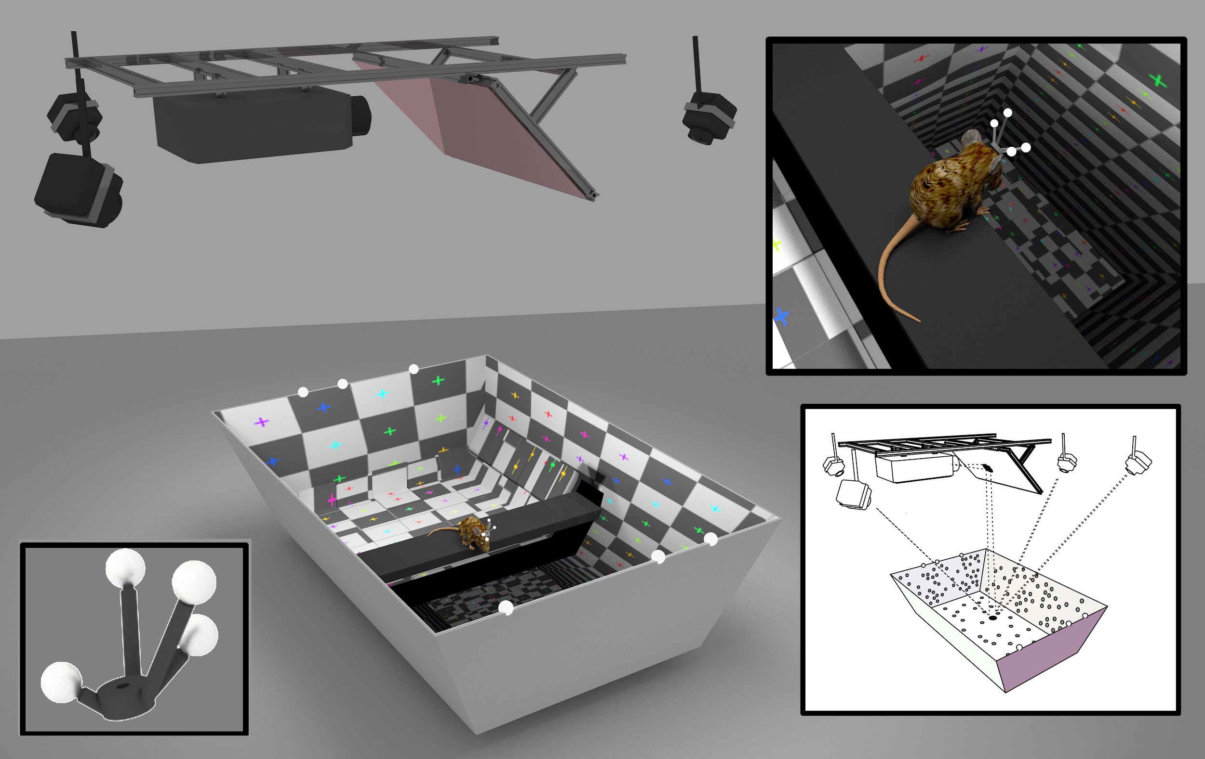
Collecting Data

Slide 5
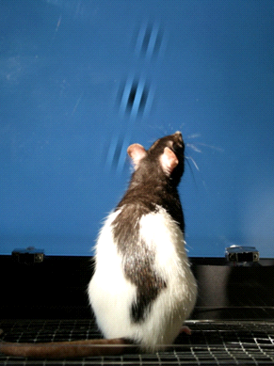
Sending Info to the Brain
We need to link events that occur in the world with the brain’s activity.
The means delivering sensory (visual, auditory, etc) stimuli to our subjects.
PsychoPy for Sensory Stimuli
from psychopy import visual, event
window = visual.Window()
gabor = visual.GratingStim(pos=(0.5, 0.5))
while ‘escape’ not in event.getKeys():
gabor.draw(window)
window.flip()
(Meier et al, 2011)

Slide 6
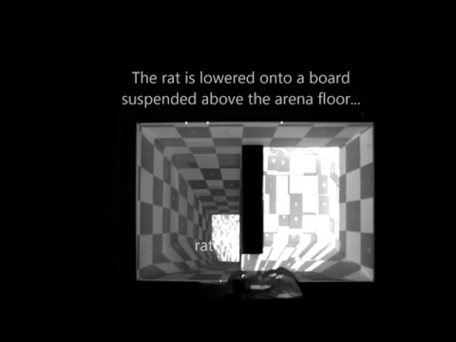
3D Visual Stimuli
Pyglet and ratCAVE
import pyglet
import ratcave as rc
reader = rc.WavefrontReader(‘exp.obj’)
sphere = reader.get_mesh(‘Sphere’)
cam = rc.Camera(position=(1, 0, 0))
scene = rc.Scene([sphere], camera=cam)
win = pyglet.window.Window()
@win.event
def on_draw():
win.clear()
scene.draw()
pyglet.app.run()
Virtual Reality Research requires low-latency graphics.
OpenGL-powered game engines like Pyglet make this possible in Python.
http://github.com/neuroneuro15/ratcave

Slide 7
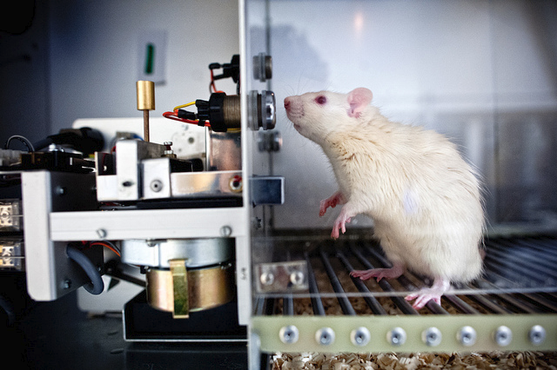
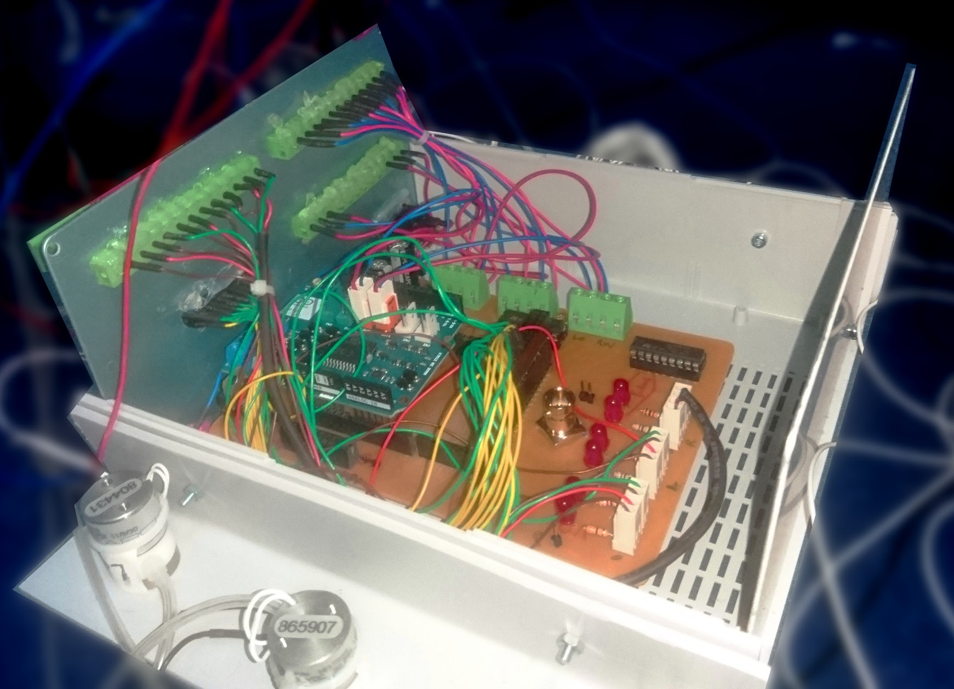
Animal Training
We teach our rats to perform various tasks.
The rats are rewarded.
http://farm8.staticflickr.com/7182/7093991205_700c7fb58f_z.jpg
Python-Controlled Arduinos
from serial import Serial
arduino = Serial('/dev/ttyACM0')
arduino.write(‘RightWater,3’)
data = arduino.readline()

Slide 8
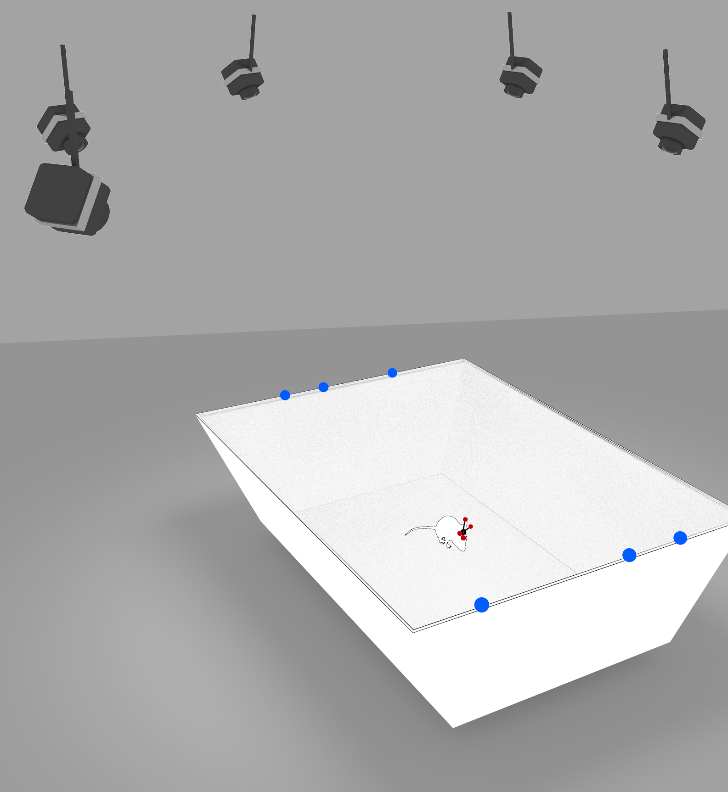
Networking Together Our Devices
We need to synchronize many devices together during our experiments.
Let’s connect to it over the network!
Socket for network connections,
struct for splitting bytestrings into variables
from socket import socket, AF_INET, SOCK_DGRAM
import struct
sock = socket(AF_INET, SOCK_DGRAM, 0)
sock.bind(‘192.12.0.0’)
message = sock.recv(128)
x, y, z = struct.unpack(‘3f’, message)

Slide 9

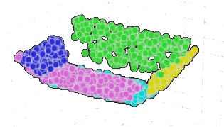
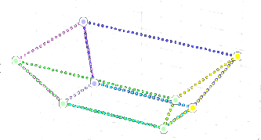
Refine Control of Hardware
We need to connect to commercial hardware
from vpixxlib import ProPixx
projector = ProPixx()
projector.setSleepMode(False)
projector.setLedIntensity(‘100.0’)
Cython for Interfacing to C Libraries
cdef extern from “NPTrackingTools.h”:
TT_Initialize()
def initialize():
“””Initializes camera connection.”””
return TT_Initialize()

Slide 10
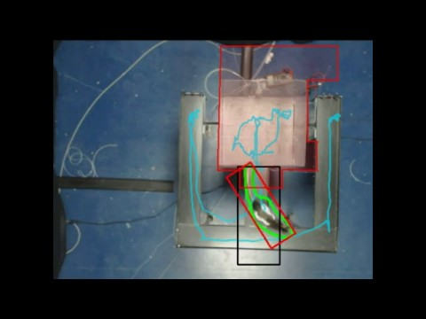
Motion Tracking
We need to link brain activity with the location of the subjects in the maze.
We use a webcam-based tracking system
OpenCV for Computer Vision
import cv2 as cv
webcam = cv.VideoCapture(0)
_ ,img = webcam.read()
img = cv.createBackgroundSubtractorKNN(50000,400.0,True).apply(img)
img = cv.GaussianBlur(img, (11, 11), 0)
img = cv.threshold(img, 100, 255, cvv.THRESH_BINARY)[-1]
contours = cv.findContours(img, cv.RETR_EXTERNAL, cv.CHAIN_APPROX_SIMPLE)[-2]

Slide 11
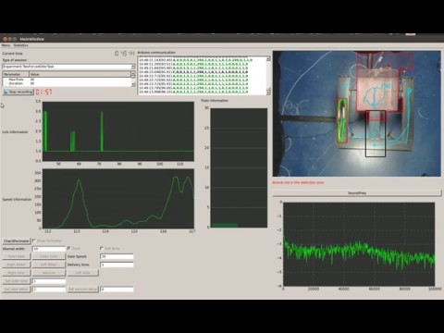
Graphic User Interfaces
We can make user-friendly graphics interfaces
Flexible way to standardize procedures
PyQt provide wide range of visual interfaces
from PyQt5.QtWidgets import QApplication,
QMainWindow, QPushButton
app = QApplication([])
win = QMainWindow()
button1 = QPushButton('Run Exp.', win)
button2 = QPushButton('Stop Exp.', win)
button2.move(0, 30)
win.show()
app.exec_()

Slide 12
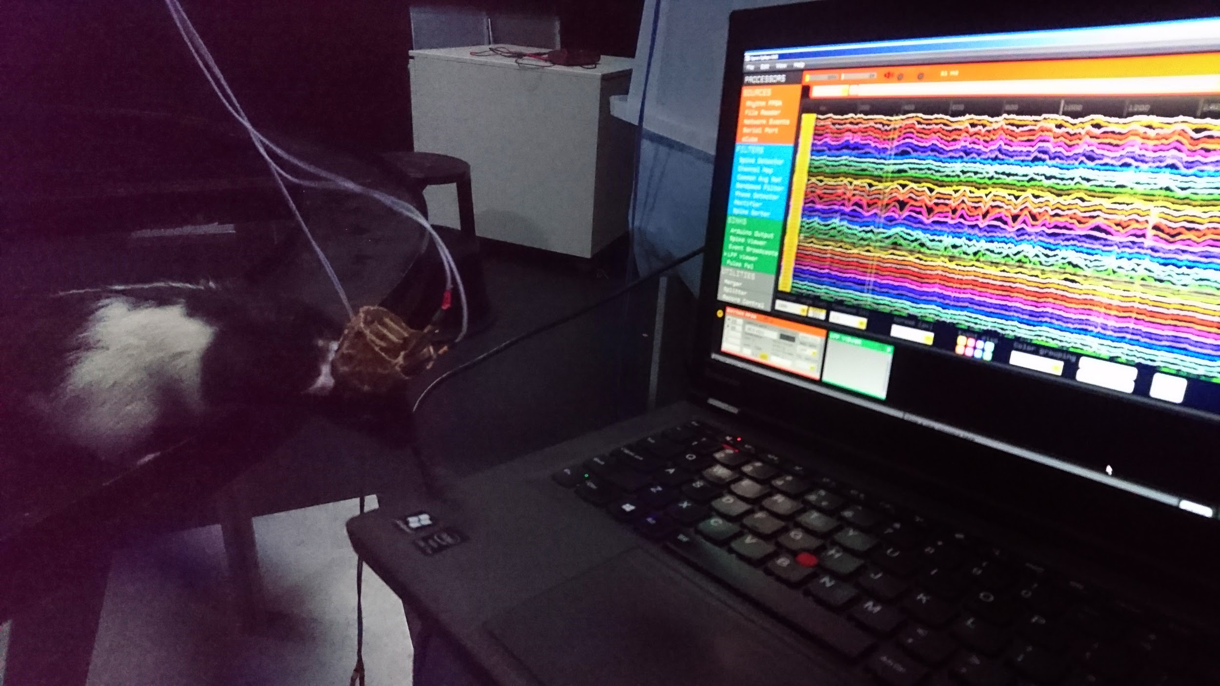
We have our setup ready!

Slide 13
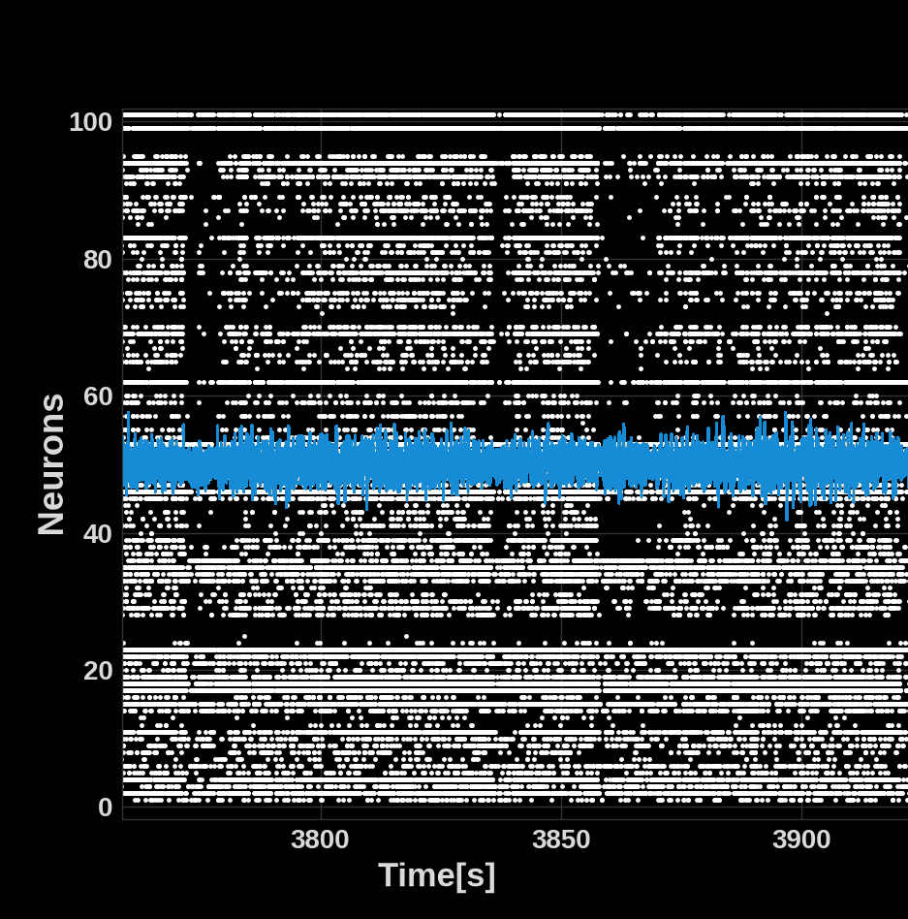
Analyzing Data
Notes:
We need a powerful data framework to perform our analysis
Mainly exploratory data analysis
Learning curve
Developing environment
Evolving ecosystem of functions

Slide 14
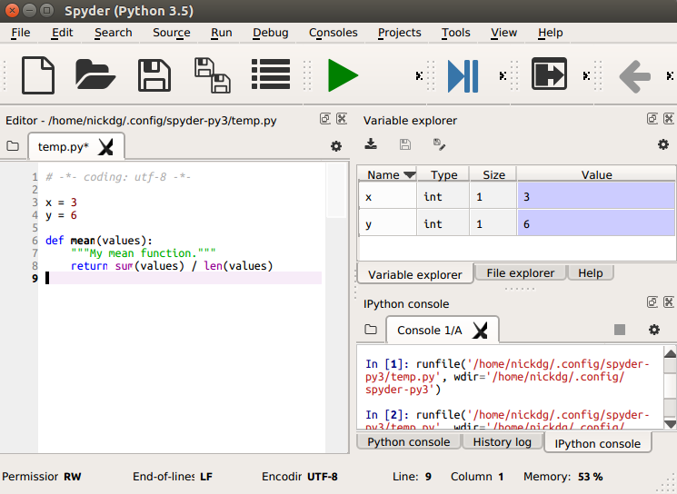
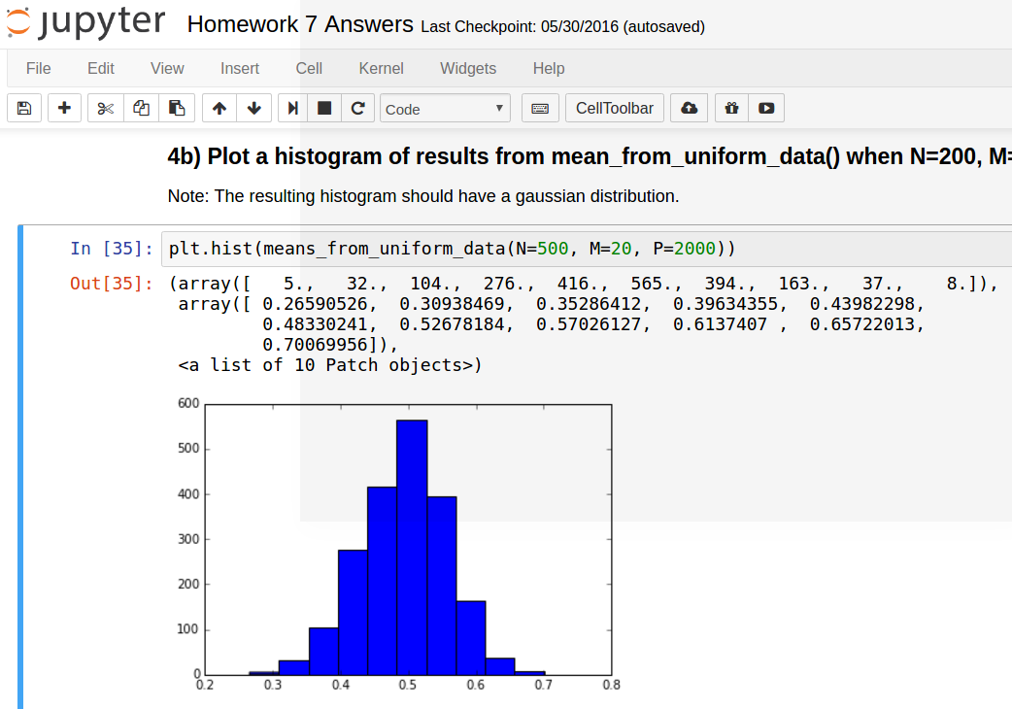
Interactive Data Analysis
While programming, we want to continuously explore our data, view plots, and share our analyses with colleagues. Editors with IPython make these workflows possible.
Spyder
Jupyter

Slide 15
Reading Data from Files
Pandas for reading Tables in many formats
Open Ephys Electrophysiology Data
import pandas as pd
df = pd.read_csv(‘mydata.csv’)
df = pd.read_html(‘mydata.html’)
df = pd.read_hdf(‘mydata.h5’, ‘spikes’)
import OpenEphys as oe
chan1 = oe.loadContinuous('CH1.continuous')
data = oe.loadFolderToArray(‘myDataFolder’)
Pickle for Python objects
Pandas and SQLAlchemy for databases
import pickle
with open(‘data.pkl’) as f:
data = pickle.load(f)
import pandas as pd
from sqlalchemy import create_engine
eng = create_engine(‘sqlite:///data.db’)
conn = eng.connect()
df = pd.read_sql_table(‘spikes’, conn)

Slide 16
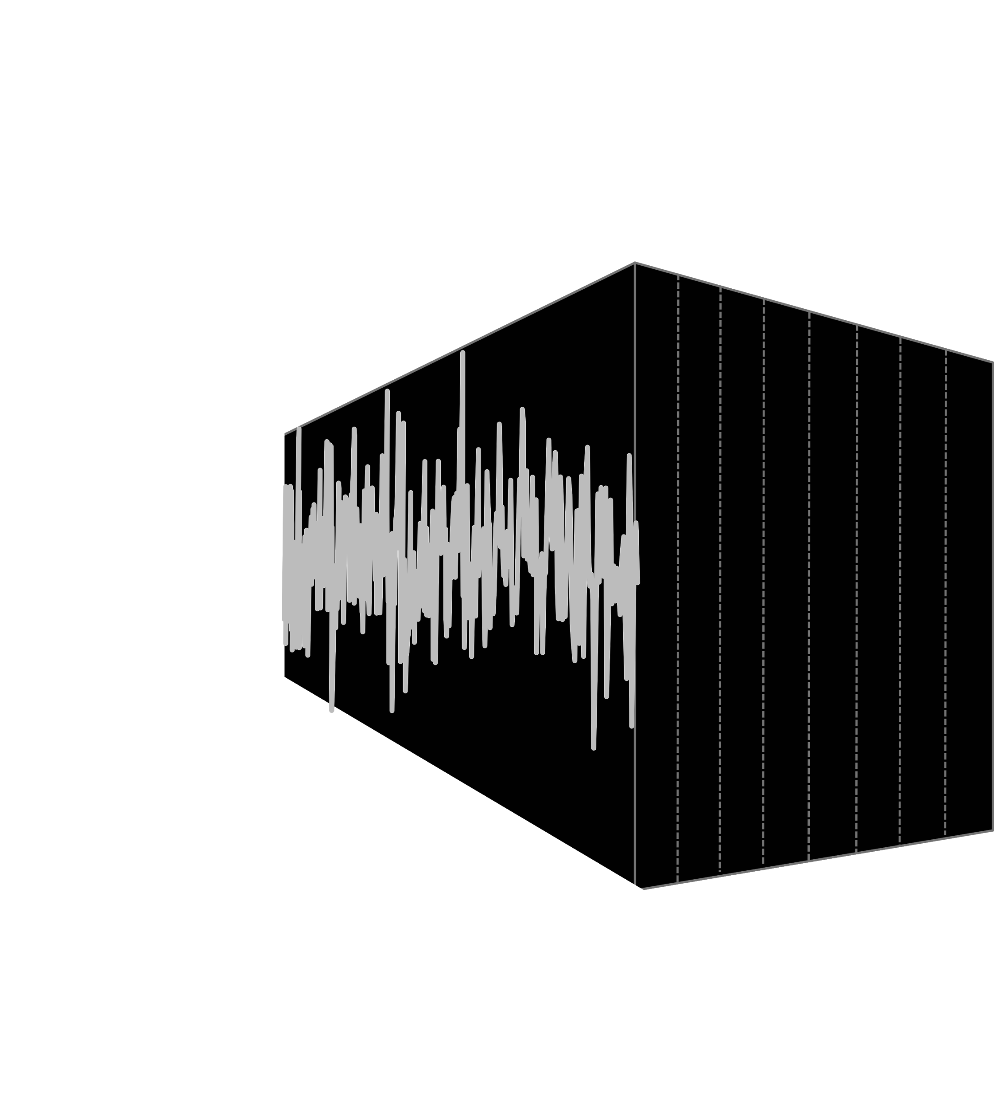
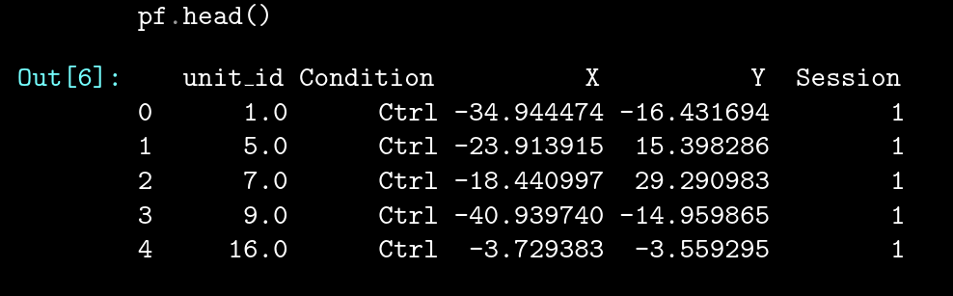
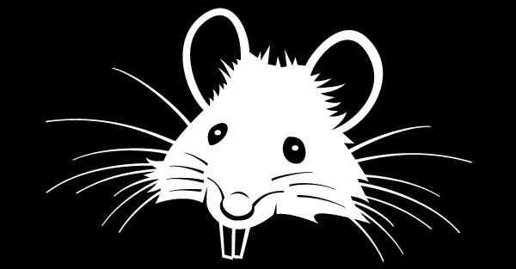
Powerful Computation and Data Manipulation
Numpy for arrays and N-dimensional matrices
Pandas for tables and time series
import numpy as np
dat = np.random.random(200000)
dat_squared = dat ** 2
dat_matrix = dat.reshape(200, 1000)
dat_mean = dat.mean(axis=1)
[U,D,V]=np.linalg.svd(np.cov(feat_spk))
import pandas as pd
df = pd.read_csv(‘ratdata1.csv’)
x_pos = df[‘x’]
df_smoothed = df.rolling.mean()
df.head()

Slide 17
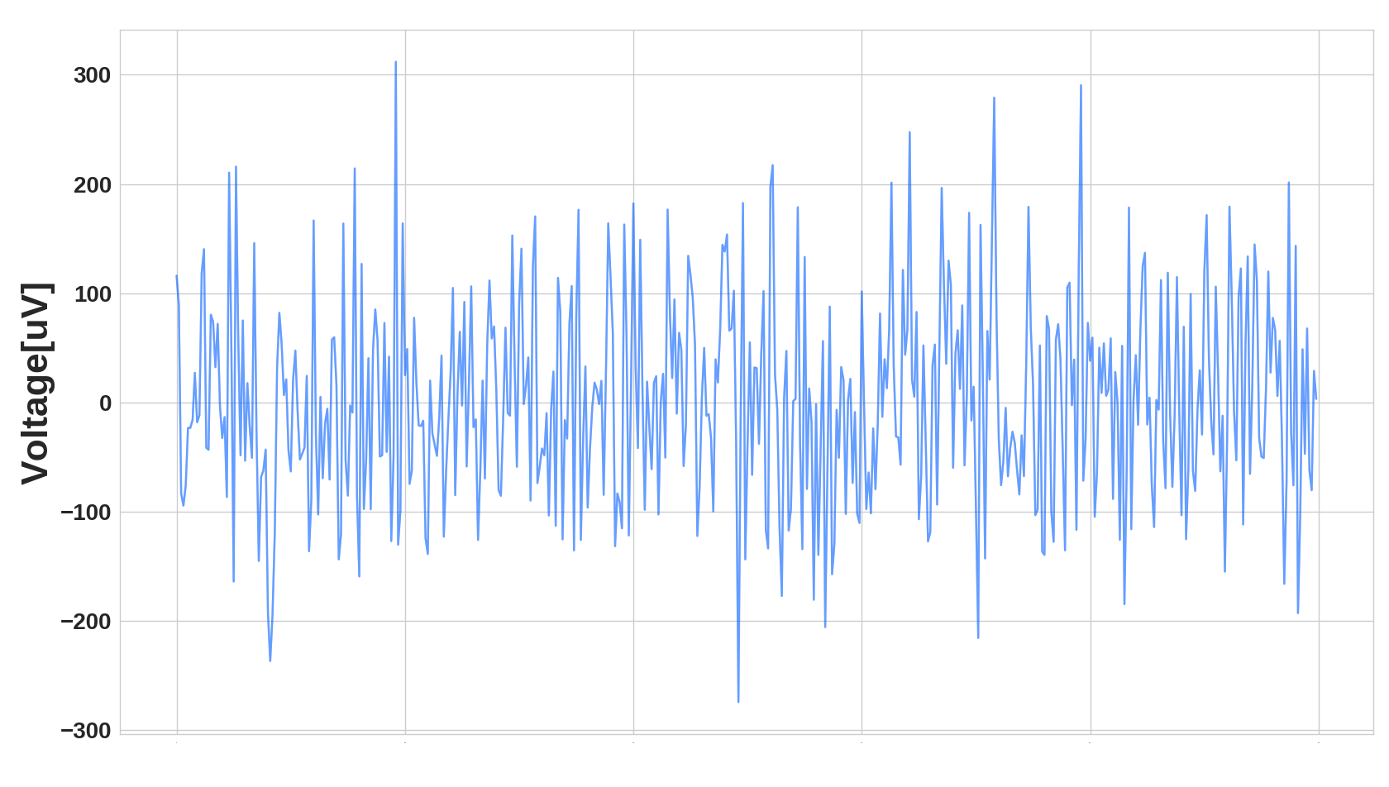
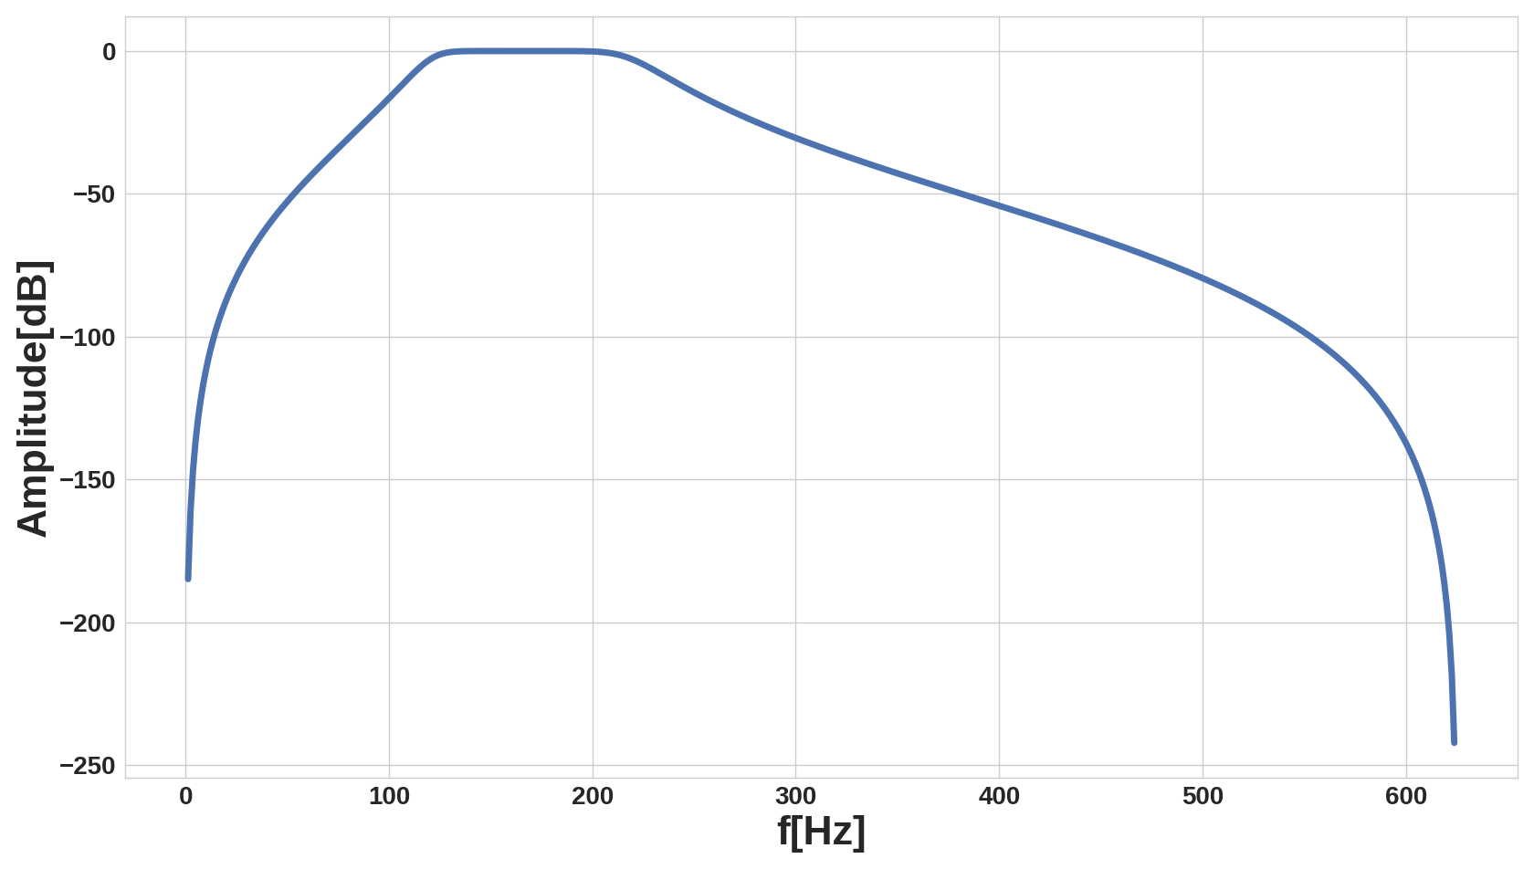
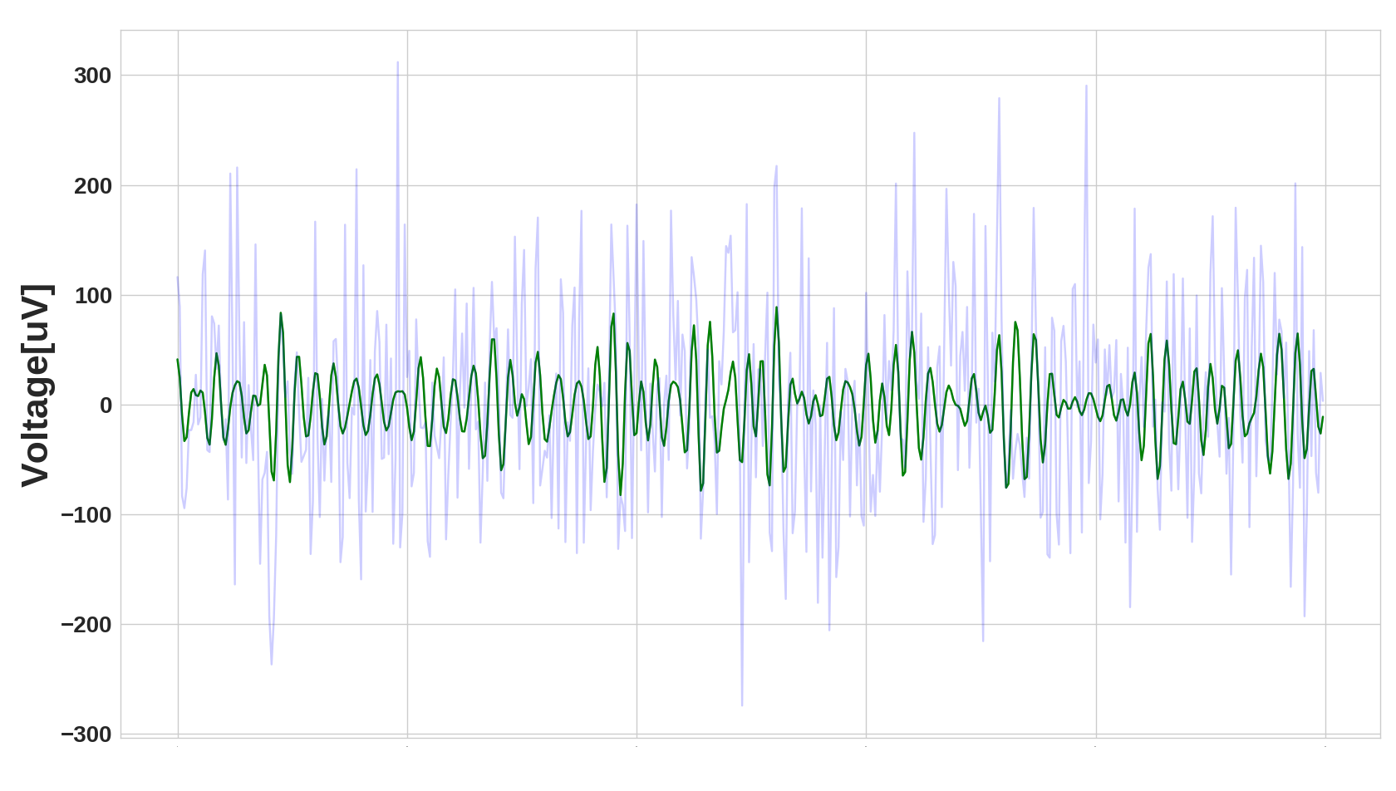
Signal Processing
Analysis of the spectral content reveals essential features of the neural code
Scipy-Signal for signal processing
from scipy import signal
import numpy as np
freqs = np.array([120., 220.])
filter = signal.butter(N=4,
Wn=freqs / samp_rate * 2,
btype='bandpass')
filtered_signal = signal.filtfilt(filter[0],
filter[1], x=signal)

Slide 18
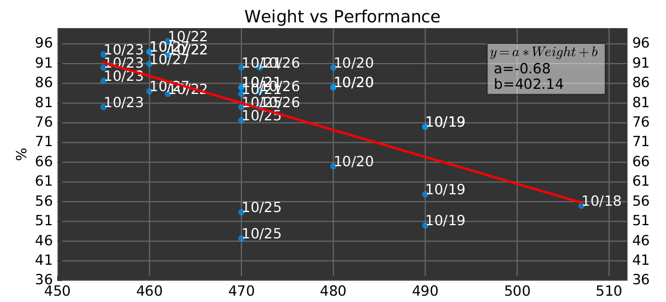
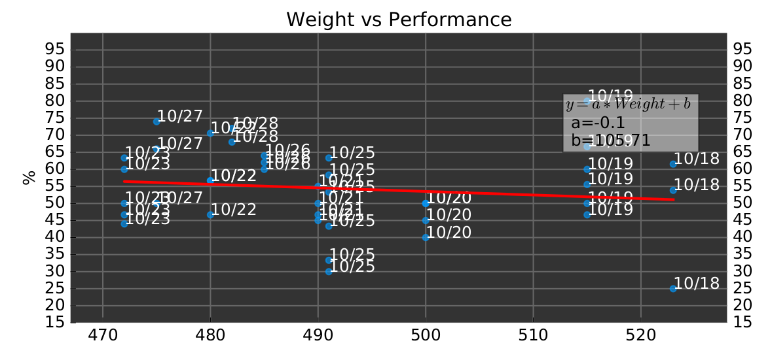
Machine Learning
Supervised and unsupervised machine learning algorithms
Scikit-learn for extracting more features
from sklearn import linear_model
weight_train = dat[:-25,0]
weight_test = dat[-25:]
performance_train = dat[:-25]
performance_test = dat[-25:]
regr = linear_model.LinearRegression()
regr.fit(weight_train, performance_train)
performance_regr = regr.predict(weight_test)
Weight [g]
Weight [g]

Slide 19

Statistics
StatsModels for building and testing linear models
Do our experimental observations fit a pattern?
Could it have simply arisen from chance?
import statsmodels.api as sm
formula = ‘is_shifted ~ dX * dY * Session’
fit = sm.Probit.from_formula(formula, data=df)
print(fit.summary2())
Scipy-Stats for hypothesis testing and distributions
from scipy import stats
gaussian_dist = stats.normal(0, 1)
rand_dat = gaussian_dist.rvs(200)
c1 = [1, 2, 1, 2, 1]
c2 = [5, 6, 7, 5, 6]
res, p = stats.ttest_ind(c1, c2)

Slide 20
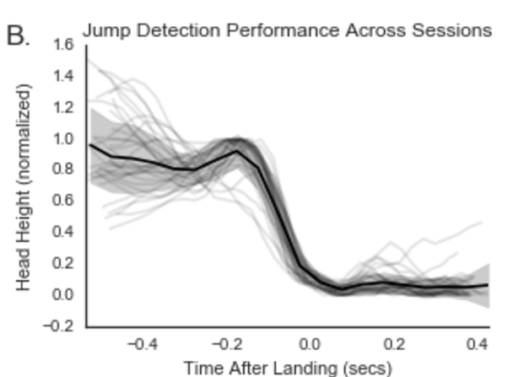
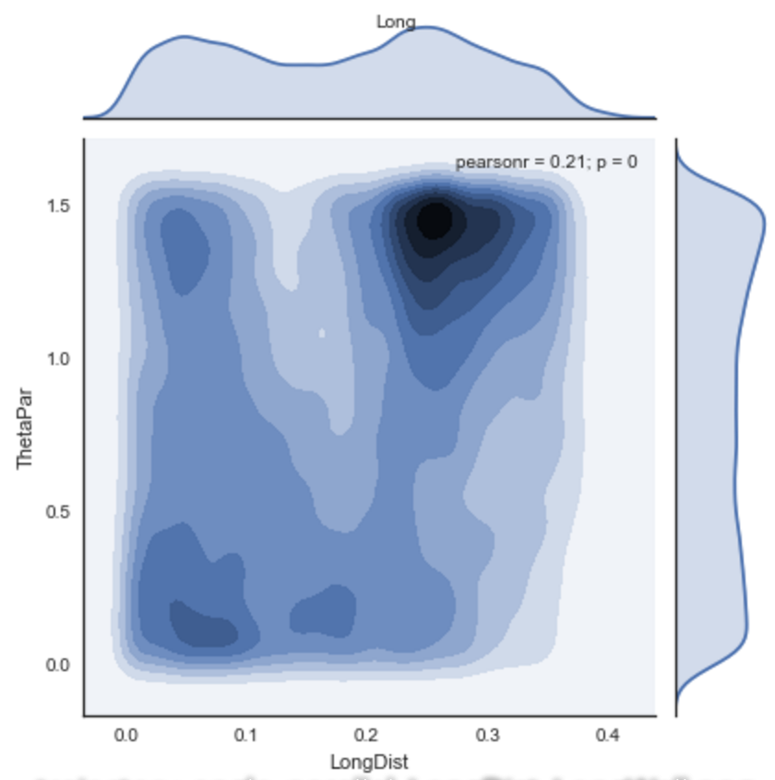
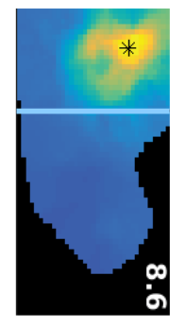
Data Visualization
Matplotlib for fully-customizable charts
import matplotlib.pyplot as plt
plt.plot([1, 2, 3], [8, 10, 2], ‘r’)
plt.xlabel(‘My X Axis’)
plt.show()
Seaborn for quickly building matplotlib charts
import seaborn as sns
sns.jointplot(x=’Size’, y=’Speed’, data=df)

Slide 21
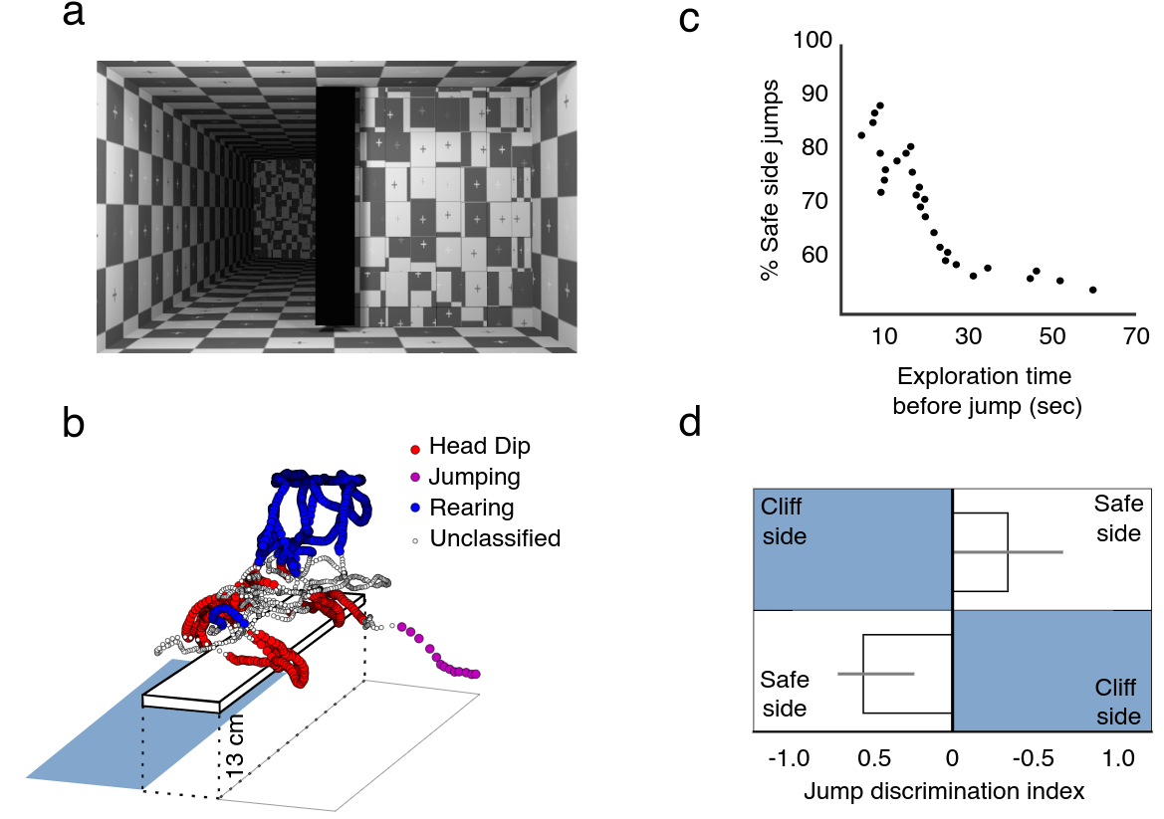

… in order to discover things about the brain (and publish!)

Slide 22
Python has rich ecosystem of packages for neuroscientists.

Slide 23


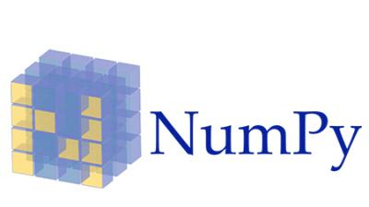
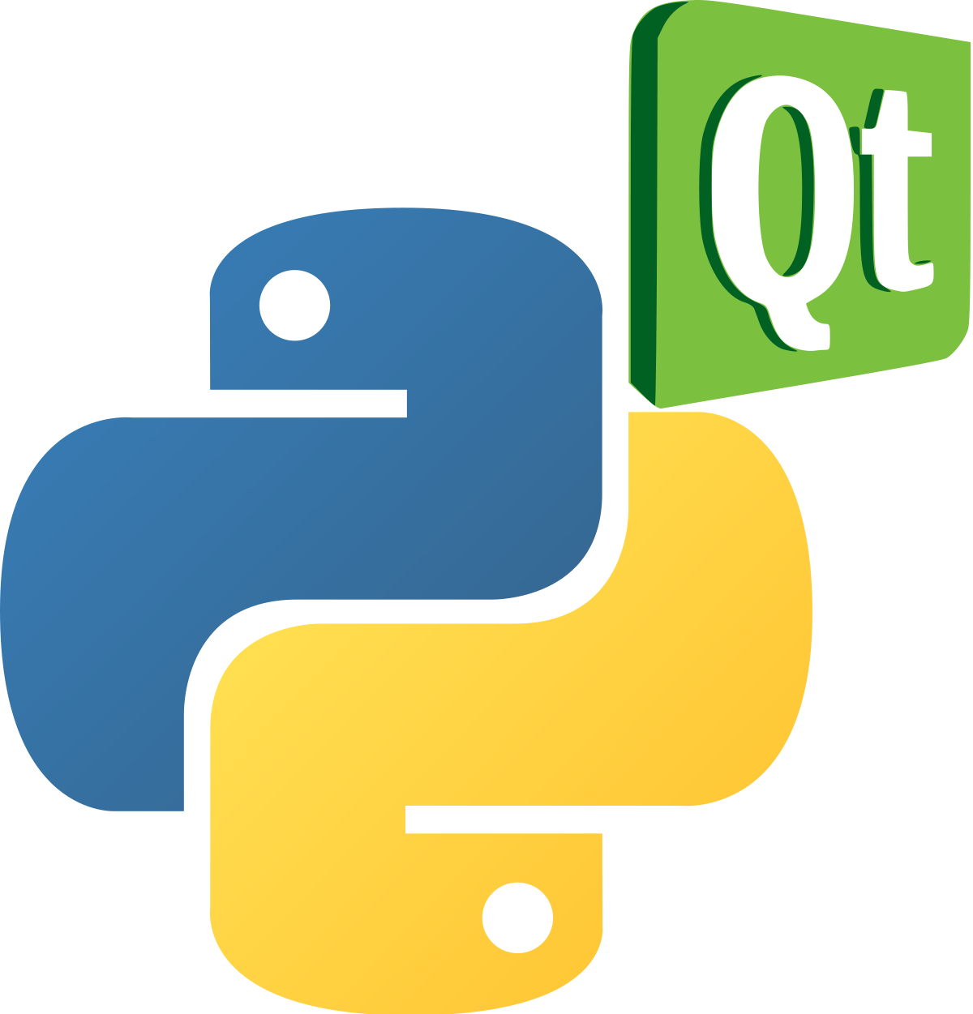


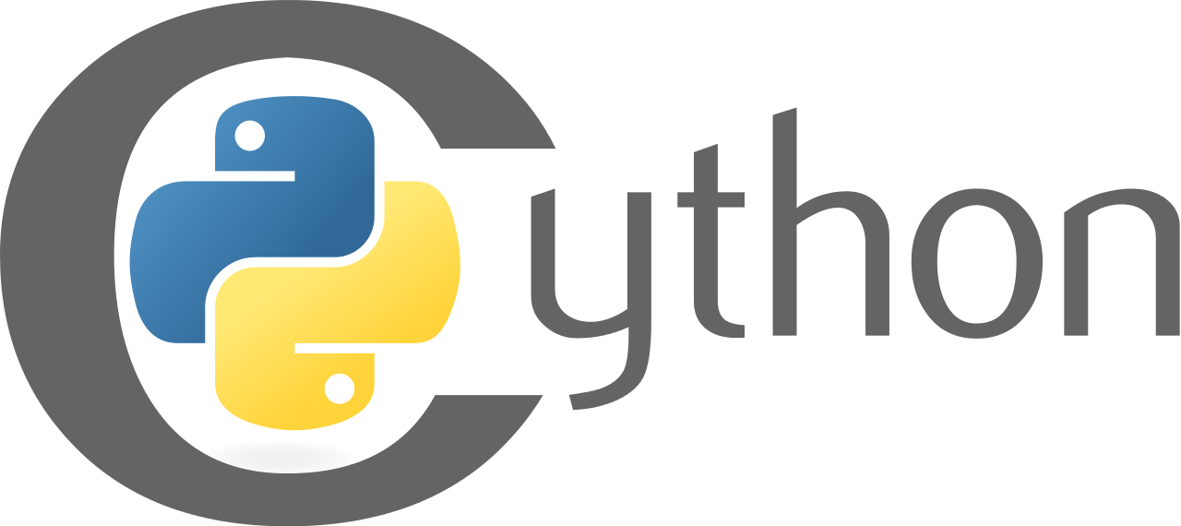
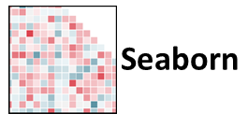
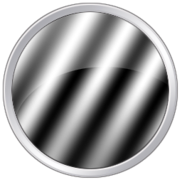
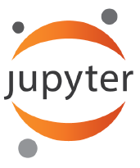
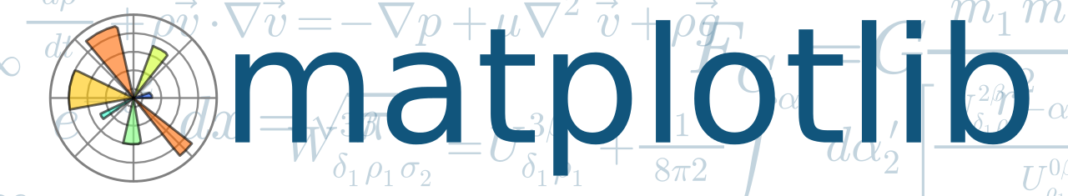




Slide 24
Why does Python have so many resources for scientists?

Slide 25
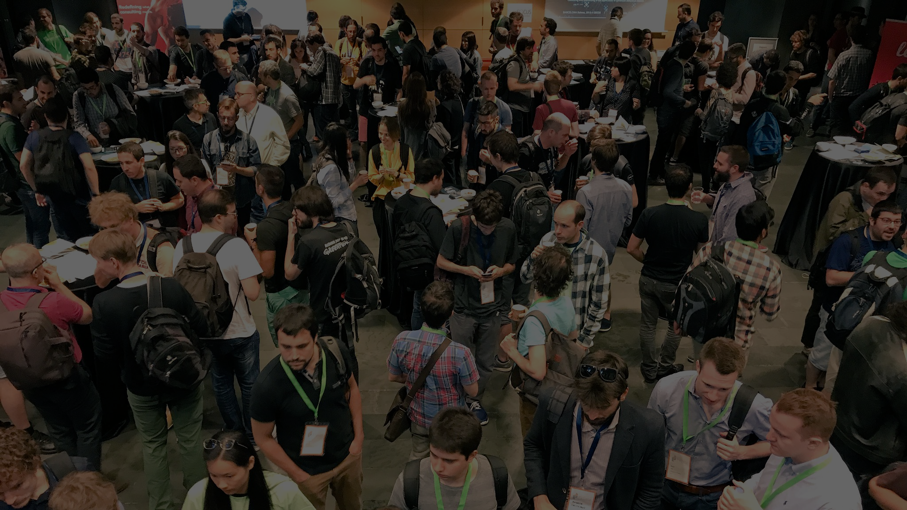
It’s the community.

Slide 26
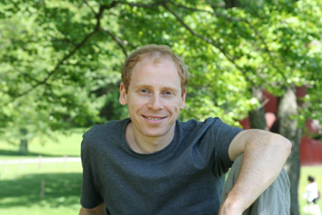
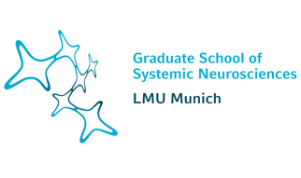


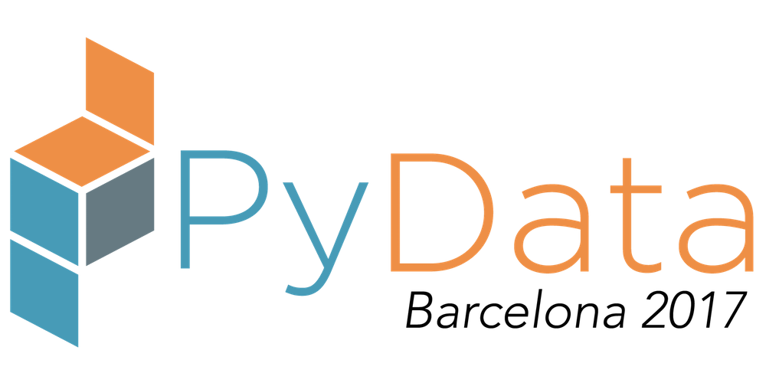
Acknowledgments
Prof. Anton Sirota
CNS Department
RTG, Synergy
LMU Munich
PyData

Slide 27
Reference List and Request for Questions
RatCave. http://github.com/neuroneuro15/ratcave
Open Ephys. https://github.com/open-ephys. Accepted manuscript ‘Open Ephys: An open-source, plugin-based platform for multichannel electrophysiology’, Joshua Handman Siegle, Aarón Cuevas López, Yogi Patel, Kirill Abramov, Shay Ohayon and Jakob Voigts
OpenCV.
  Here the documentation for background substraction. http://docs.opencv.org/trunk/de/de1/group__video__motion.html
  Here tutorials covering different aspects of OpenCV https://opencv-python-tutroals.readthedocs.io/en/latest/index.html
  Here a great professional of image processing http://www.pyimagesearch.com/
PySerial. Complete documentation of the project. https://pythonhosted.org/pyserial/
PyQt.
  Documentation for PyQt4 http://pyqt.sourceforge.net/Docs/PyQt4/
  Documentation for the original Qt project in C++. Despite of that it is a great source of information of the properties of the objects that the python bindings can provide. http://doc.qt.io/qt-4.8/
  A recommended book. “Rapid GUI Programming with Python and Qt: The Definitive Guide to PyQt Programming”,Mark Summerfield
Javier Martinez Alcantara
@jmaralc
Nicholas Del Grosso
@neuroneuro15

Slide 28
Spare Slides

Slide 29
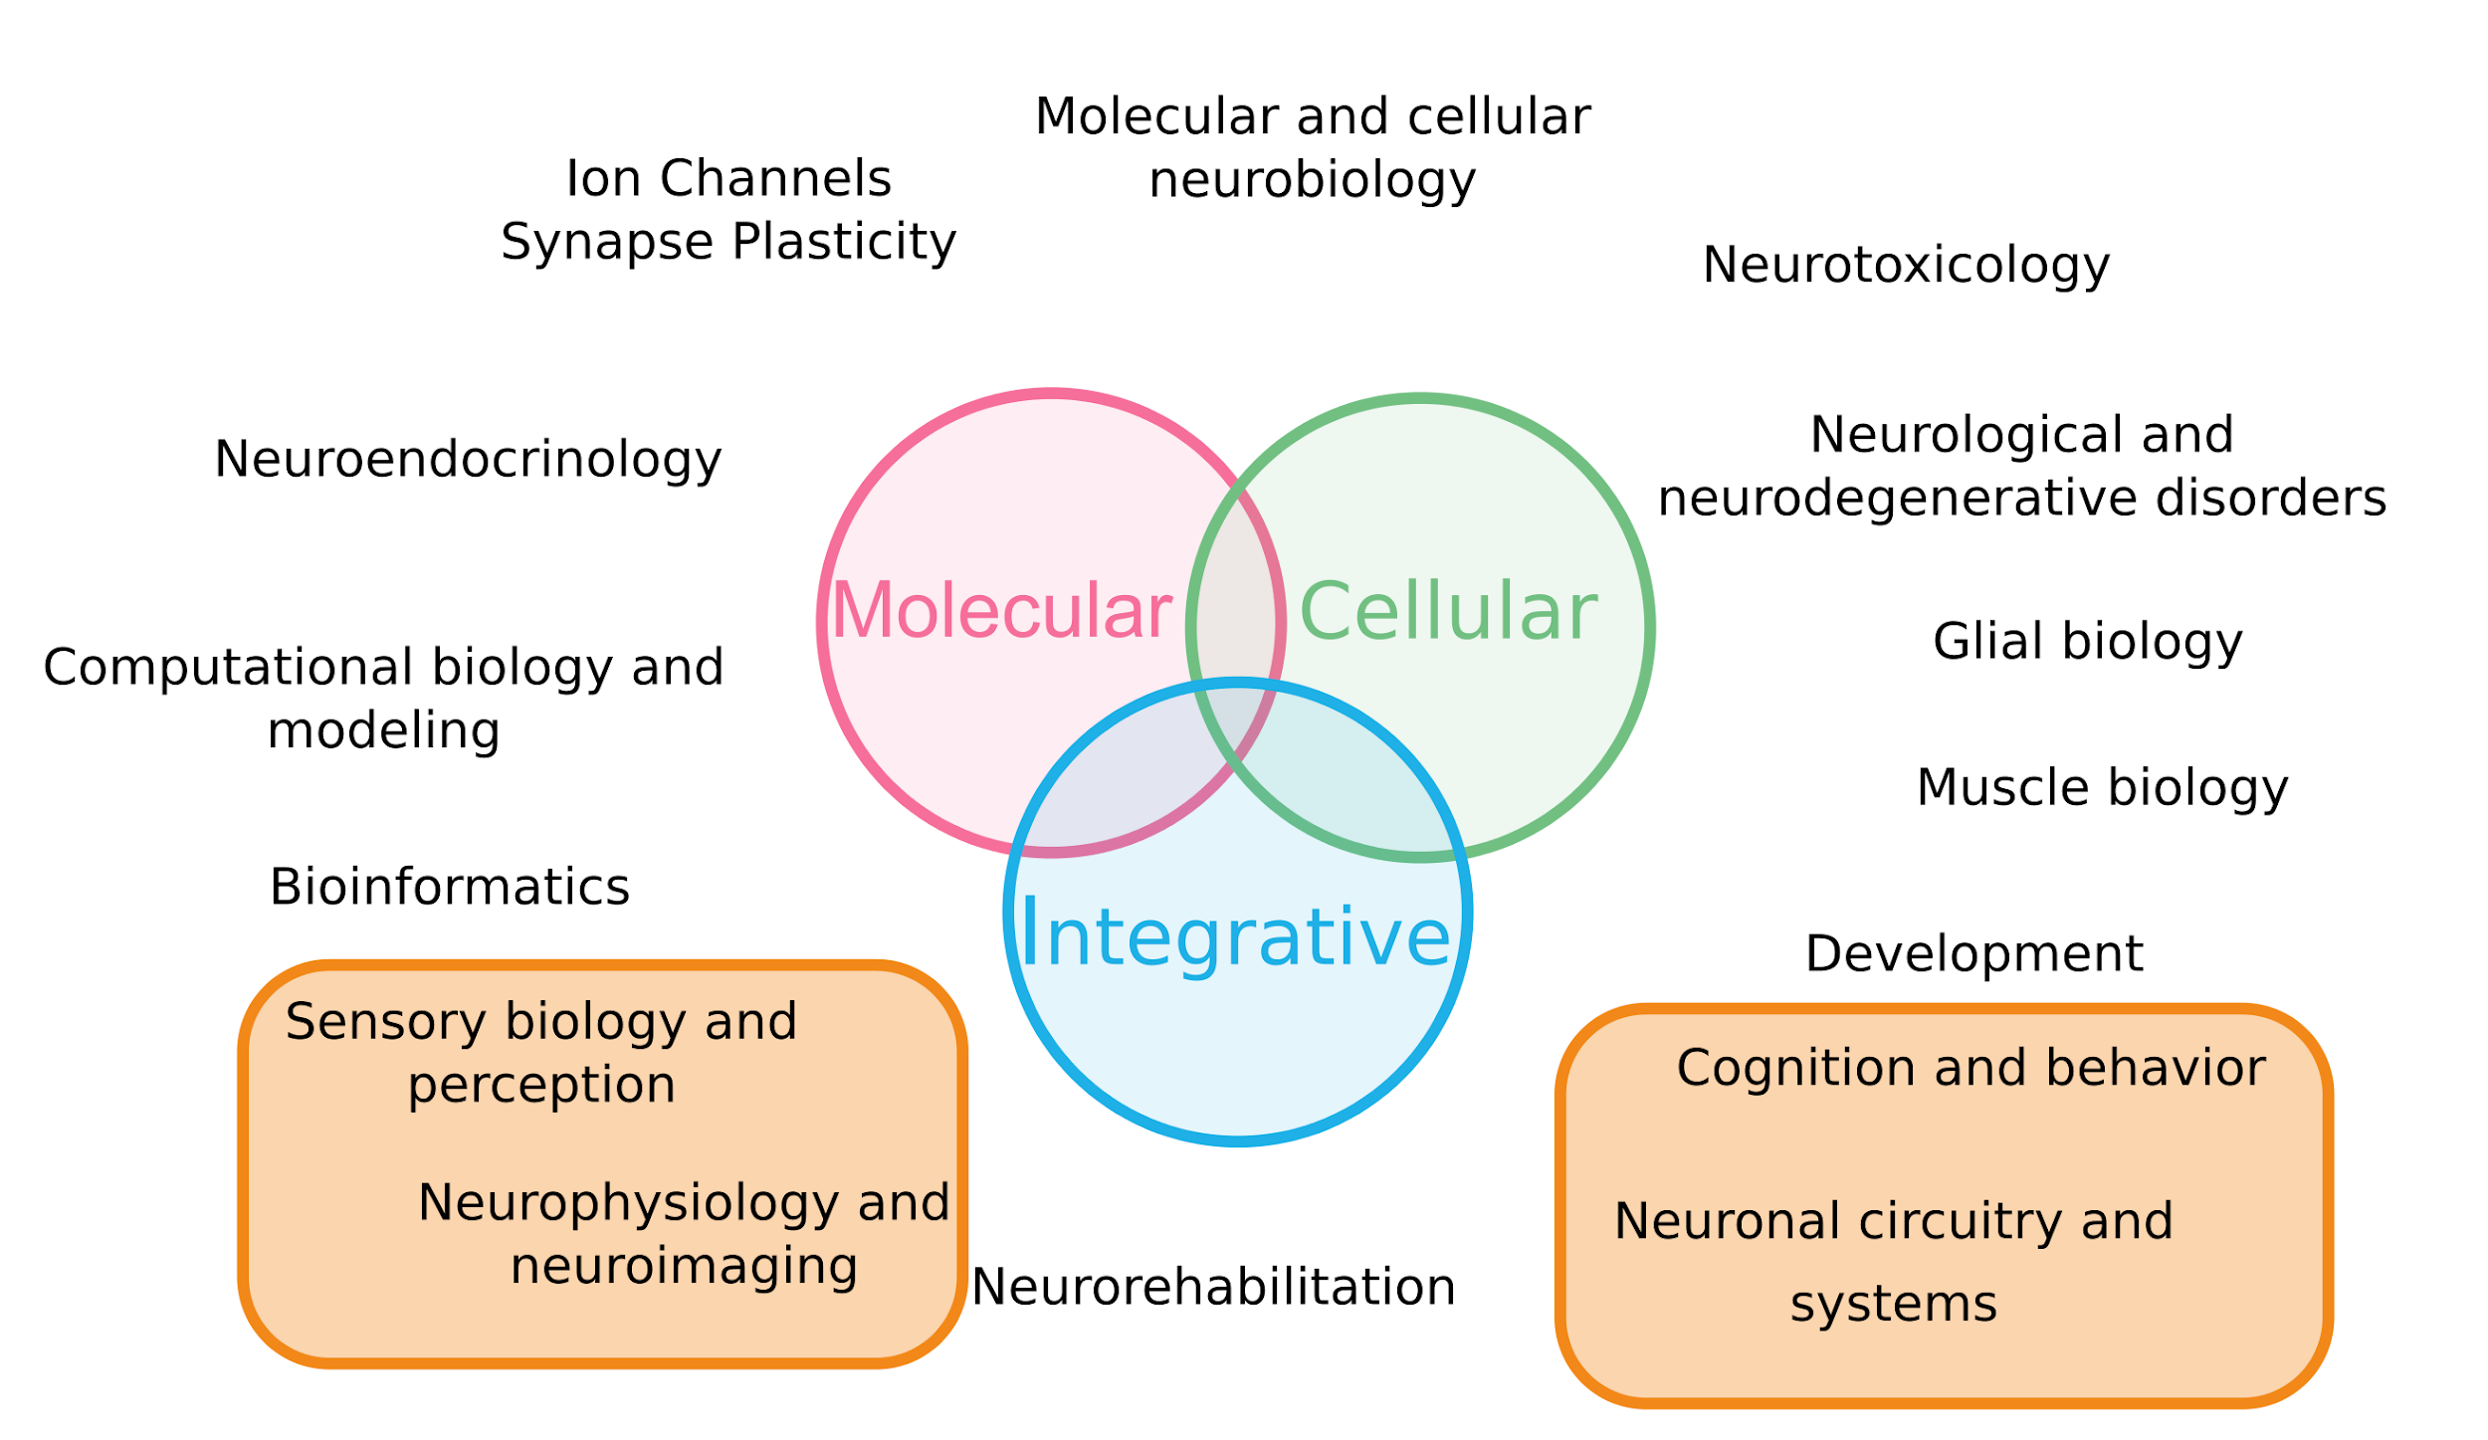
Neuroscience is a Broad Field Containing Many Disciplines

Slide 30


