Slide 1
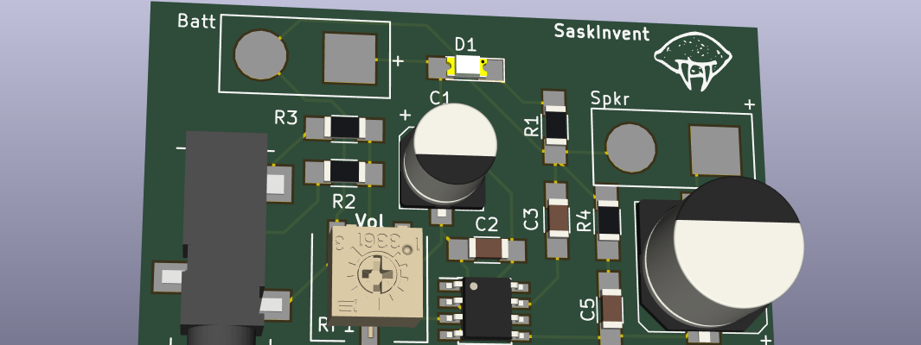
Pcb design with kicad
Because otherwise you’re stuck breadboarding
Notes:
Introductions

Slide 2
Topics
Introduction
Schematic Capture
Symbol and Footprint Libraries
PCB Layout
Getting Boards Made

Slide 3

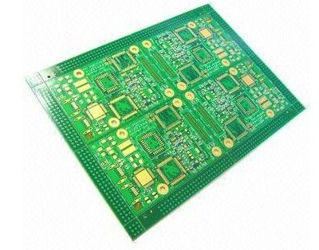
Introduction
Circuit boards are flat interconnected copper layers sandwiched between fibreglass
We design them with Electrical Design Automation or EDA tools
KiCad is a free, open source, cross platform EDA tool
Hopefully you’ve already installed it on your laptop

Slide 4
Practice Project
The best way to learn KiCad is to make something with it
We’re going to work on an audio amplifier so we can listen to our music and share it with as many people as possible!
Final design files are on Github: https://github.com/saberToothedLime/kicad_tutorial

Slide 5

Starting a new project
Before you open KiCad, pick a place for your project
Mac/Linux – I’d recommend the following structure: ~/hw/amp_project/
Windows – Either C:\User\Nick\hw\amp_tutorial or C:\hw\amp_tutorial
Or anything else! But pick short names. It’ll make your life easier
Keep an Explorer/Finder window open in this directory to save time later
Click the New Project button
Save the .pro file to your amp project folder

Slide 6
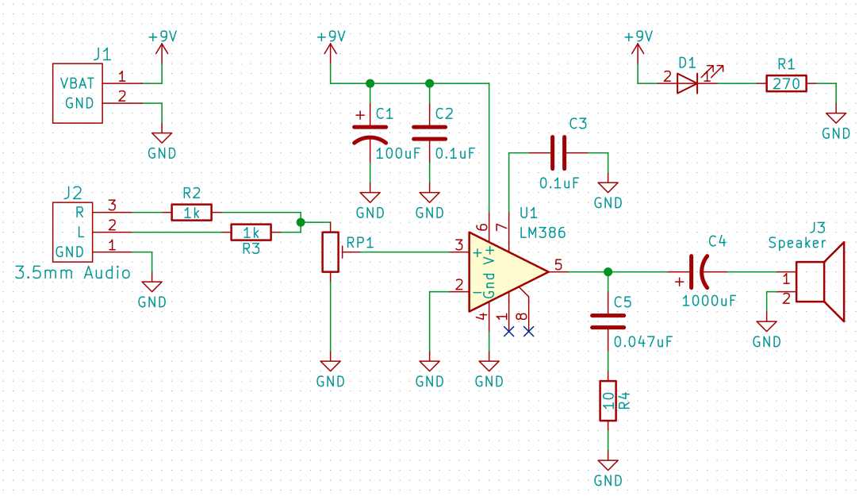
Schematic Capture
Notes:
This is the circuit we’re building
Download your own copy off Github
Don’t freak out if you don’t understand it. The simple version: L & R audio signals come in from a headphone jack. But we need a mono signal, so we take the average of the two and feed it into our amp chip. We feed our output through a big capacitor before sending it out to our speaker.
Navigation
Zoom in and out with mouse wheel
Middle click and drag to navigate around
Kicad uses a lot of hotkeys, I’ll display my keystrokes on the screen for you to copy. Type a “?” to see the hotkeys for yourself.

