Slide 1
Omicron
A 16-Bit Pipelined CPU
By Cody Cziesler and Nick Desaulniers

Slide 2
Overview
General Purpose Pipelined CPU written in Verilog HDL
Five Stages
Instruction Fetch
Instruction Decode
Execute
Memory
Write Back
RISC Architecture
Based off of 32-bit MIPS
Omicron is a 16-bit processor

Slide 3
Instruction Set Architecture (ISA)
Three Opcode Types:
Math Type (ADD, SUB, AND, OR, etc.)
Load/Store and Branch Type (LD, STR, BEQ, BNE)
Jump Type (JMP)
OpCode [15-12] | Source 1 [11-9] | Destination [8-6] | Source 2 [5-3] | Not Used [2-0]
OpCode [15-12] | Source 1 [11-9] | Destination [8-6] | Immediate [5-0]
OpCode [15-12] | Address [11-0]

Slide 4
Registers
Eight Registers ($A – $G and $0)
Each register is 16 bits wide, allowing 2¹⁶ bytes (64 KB) to be accessed in memory
The zero register has a constant value of “0x0000”, it cannot be overwritten
Register Name | Register Number
$0 | 000
$A | 001
$B | 010
$C | 011
$D | 100
$E | 101
$F | 110
$G | 111

Slide 5
Control unit
The Control Unit is in charge of sending the correct control signals across the data path
Instruction | Type | opcode [15:12] | cu_alu_opcode [10:0] | cu_reg_load | cu_reg_data_loc | cu_branch [1:0] | cu_dm_wea | cu_alu_sel_b | cu_reg_dest
NOOP | Math | 0000 | 00000000001 | 0 | 0 | 00 | 0 | 0 | 1
CPY | Math | 0001 | 00000000010 | 1 | 0 | 00 | 0 | 0 | 1
ADD | Math | 0010 | 00000000100 | 1 | 0 | 00 | 0 | 0 | 1
SUB | Math | 0011 | 00000001000 | 1 | 0 | 00 | 0 | 0 | 1
MUL | Math | 1000 | 00000010000 | 1 | 0 | 00 | 0 | 0 | 1
AND | Math | 0100 | 00000100000 | 1 | 0 | 00 | 0 | 0 | 1
OR | Math | 0101 | 00001000000 | 1 | 0 | 00 | 0 | 0 | 1
NOT | Math | 0110 | 00010000000 | 1 | 0 | 00 | 0 | 0 | 1
XOR | Math | 0111 | 00100000000 | 1 | 0 | 00 | 0 | 0 | 1
LS | Math | 1001 | 01000000000 | 1 | 0 | 00 | 0 | 0 | 1
RS | Math | 1010 | 10000000000 | 1 | 0 | 00 | 0 | 0 | 1
BEQ | Ld/St/Br | 1011 | 00000001000 | 0 | 0 | 01 | 0 | 0 | 1
BNE | Ld/St/Br | 1100 | 00000001000 | 0 | 0 | 10 | 0 | 0 | 1
LD | Ld/St/Br | 1101 | 00000000010 | 1 | 1 | 00 | 0 | 1 | 1
STR | Ld/St/Br | 1110 | 00000000010 | 0 | 0 | 00 | 1 | 1 | 1
JMP | Jump | 1111 | XXXXXXXXXXX | 0 | 0 | 11 | 0 | 0 | 1

Slide 6
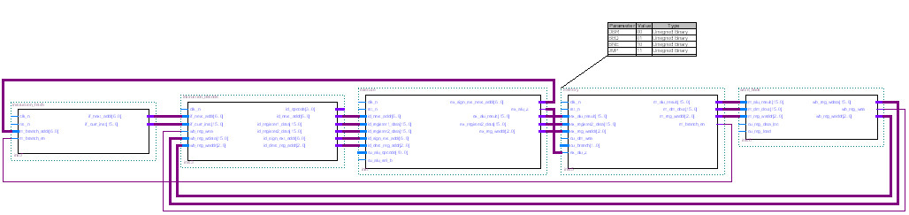
Data Path

Slide 7
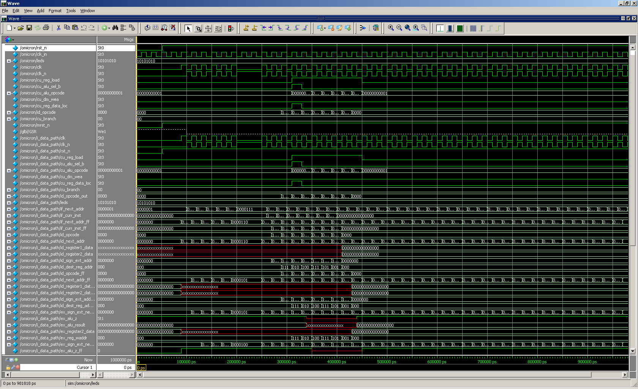
Simulation

Slide 8
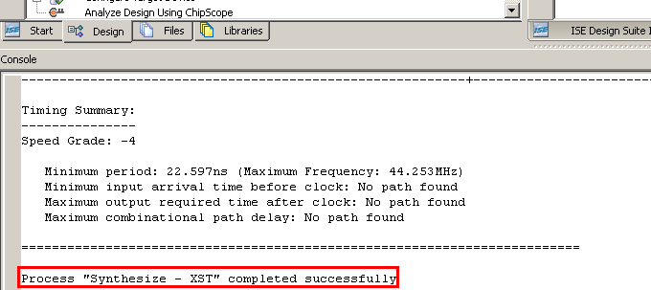
Synthesizing
### omicron.ucf ###
# ==== Clock Source ====
NET "clk_in" LOC = "C9" | IOSTANDARD = LVCMOS33;
NET "clk_in" PERIOD = 5ns HIGH 40%;
NET "clk_in" CLOCK_DEDICATED_ROUTE = FALSE;
# ==== Discrete LEDs (LED) ====
NET "leds<0>" LOC = "F12" | IOSTANDARD = LVTTL | SLEW = SLOW | DRIVE = 8 ;
NET "leds<1>" LOC = "E12" | IOSTANDARD = LVTTL | SLEW = SLOW | DRIVE = 8 ;
NET "leds<2>" LOC = "E11" | IOSTANDARD = LVTTL | SLEW = SLOW | DRIVE = 8 ;
NET "leds<3>" LOC = "F11" | IOSTANDARD = LVTTL | SLEW = SLOW | DRIVE = 8 ;
NET "leds<4>" LOC = "C11" | IOSTANDARD = LVTTL | SLEW = SLOW | DRIVE = 8 ;
NET "leds<5>" LOC = "D11" | IOSTANDARD = LVTTL | SLEW = SLOW | DRIVE = 8 ;
NET "leds<6>" LOC = "E9" | IOSTANDARD = LVTTL | SLEW = SLOW | DRIVE = 8 ;
NET "leds<7>" LOC = "F9" | IOSTANDARD = LVTTL | SLEW = SLOW | DRIVE = 8 ;
# ==== Slide Switches (SW) ====
NET "rst_n" LOC = "L13" | IOSTANDARD = LVTTL | PULLUP ; # SW

