Slide 1
Making a mockery of web services
Manchester Java Community – 20th October 2016
Nick Ebbitt
@nickebbitt
Notes:
Good evening,
So I’m Nick Ebbitt and I work for a software house called Tracsis providing services to the UK rail industry.
Over the past couple of years I’ve been involved in the delivery of a cloud based mobile platform to provide rail staff with context sensitive "real time" train information.
The mobile platform is hosted in AWS and integrates with a self-hosted "backend" system exposed via a HTTP based API. As part of a fully automated CD pipeline we implemented a suite of automated tests to allow us to verify the behaviour of the mobile platform in the cloud.
This talk explores some of the tools and techniques used to assist with the creation and execution of the test suite.

Slide 2
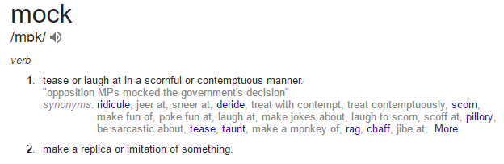
Define: mock
Notes:
So let’s begin by defining the term “mock”.
A quick Google search gives us a good starting point.
So the first description isn’t quite what we’re talking about here but the second…
“make a replica or imitation of something” – is more like what we’re talking about

Slide 3
Define: mock
In software engineering mocks are…
"…special case objects that mimic real objects for testing."
http://martinfowler.com/articles/mocksArentStubs.html?
Notes:
Applying this to the domain of software engineering, mocks are…
“…special case objects that mimic real objects for testing.”
Now this description sounds quite low-level in that it refers to objects.
In more general terms, an object could refer to any internal or external component related to a software application.

Slide 4
Why use mocks?
Deterministic & repeatable tests
Control interactions
Model scenarios
Acceptance criteria
Notes:
So why do we use mocks when testing our code or applications?
Well, to allow us to write tests that are deterministic and repeatable, we have to be in control of how our objects or systems interact with other objects or systems.
This control allows us to model the various scenarios necessary to prove that the software meets any acceptance criteria.

Slide 5
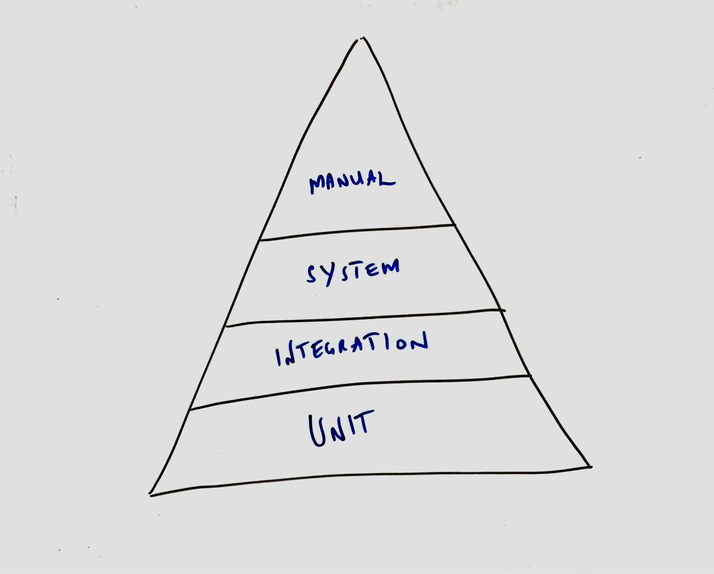
When to mock?
Notes:
It is likely that during the development of an application you’ll be writing different types of tests to increase the confidence that what you are producing is correct.
This will usually start with unit tests in which you’ll be aiming to test a single unit of your application which will likely be single class.
If the object you are testing interacts with another object then using a design pattern such as dependency injection, to implement inversion of control, and a framework such as Mockito you will be able to provide the unit you are testing with a mock collaborator.
Similarly, if you are testing at a higher level and looking to prove the correctness of a subsystem or the application as a whole then it may be necessary to mock the application’s external dependencies such as the database, a queue, or a web service.
It’s important to note, mocks are useful but are not a replacement for testing against the “real” thing. This is necessary and should definitely be part of your testing strategy.

Slide 6
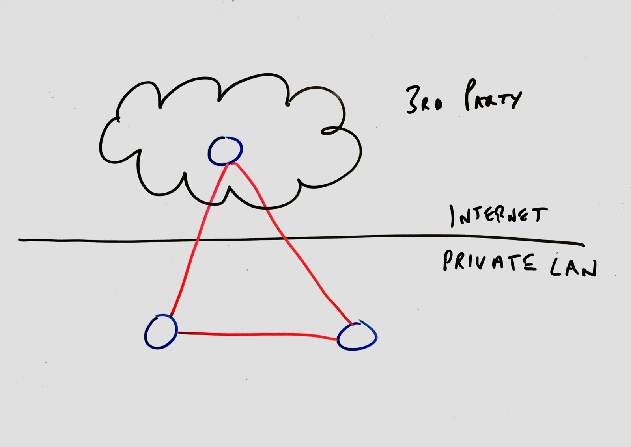
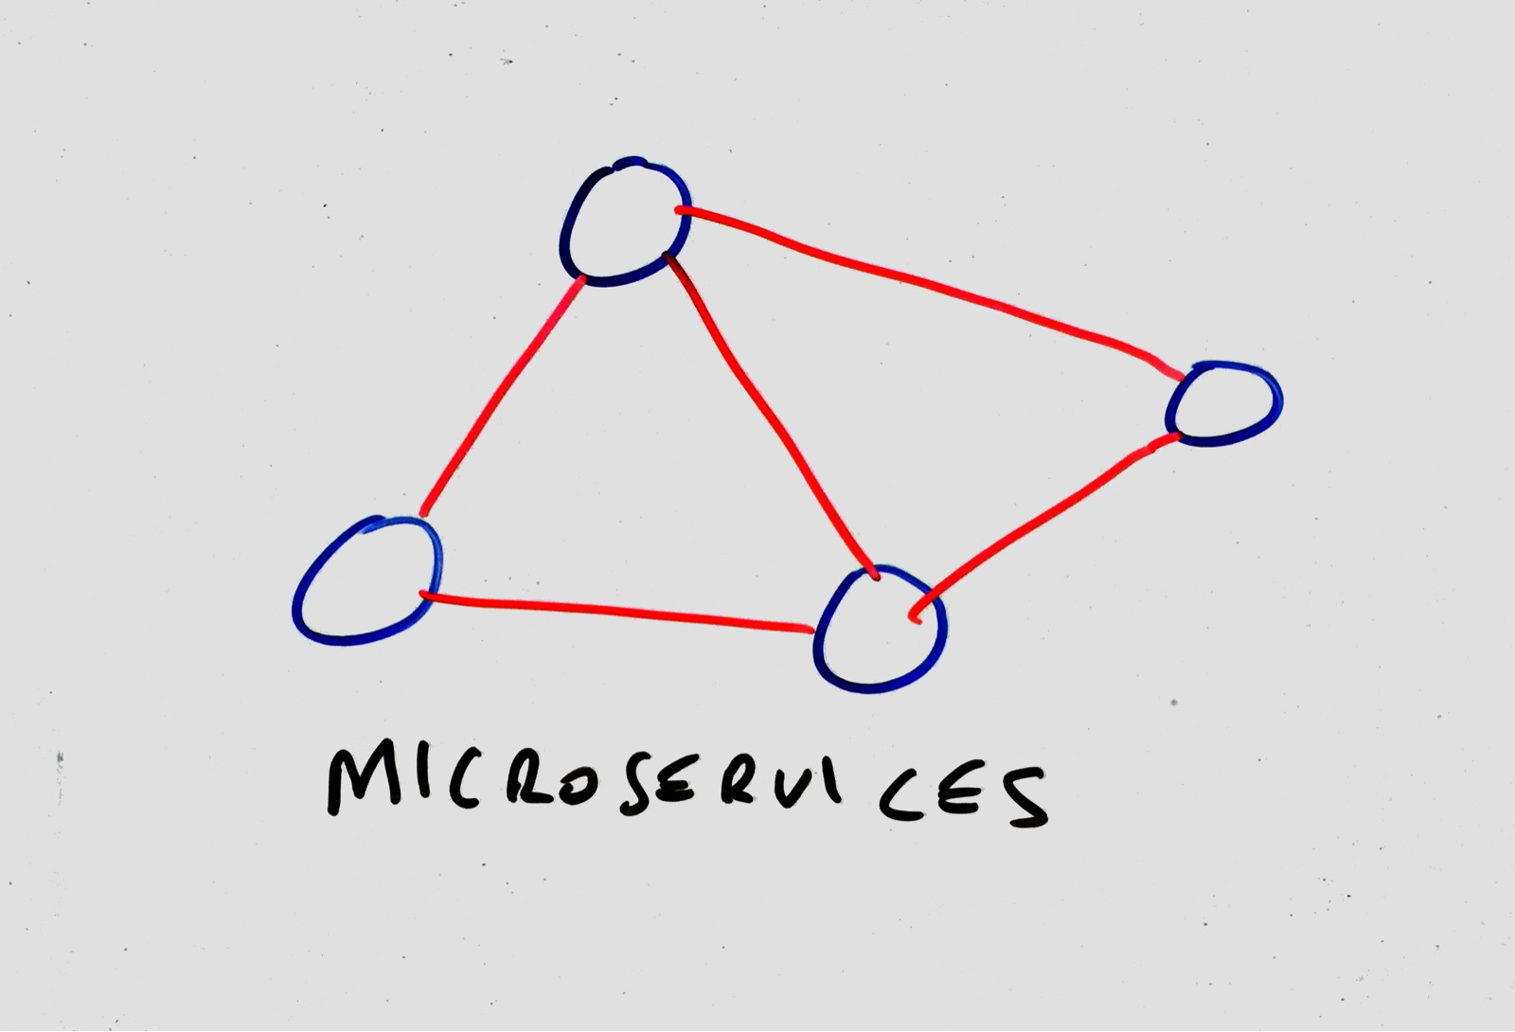
Mocking web services
Notes:
It’s quite common for an application to depend on an external web service.
The external service could be external to the company and controlled by a 3rd party e.g. Twitter.
It could be a service within the company but controlled by a different team. It is quite common for micro-service architectures to communication over HTTP.

Slide 7

Introducing WIREMOCK…
Created by Tom Akehurst in 2011
Version 2.1.12
http://wiremock.org/
Notes:
There are various tools or frameworks available that support the mocking of HTTP based APIs or web services however I’m going to focus on WireMock that we have used to good effect to support our development and automated integration testing processes within Tracsis.
WireMock was created by Tom Akehurst a few years ago now so is quite mature as a product.
The documentation on the website is pretty good, contains lots of useful info and examples.

Slide 8


deployment
Notes:
In it’s simplest form, WireMock comes as a runnable JAR that can be started from the command line. This mode proves to be very useful during development to provide a reliable web service running on your local machine to develop against.
WireMock can also be deployed to a servlet container if that’s your preference.
There is a comprehensive Java API from which you can created an embedded WireMock server and configure as required.
Finally, and more interesting from a Java testing perspective, WireMock provides Junit integration using @Rules.

Slide 9
KEY features
Stubbing
Verifying
Proxy
Record and Playback
Simulating faults
Stateful behaviour
Notes:
In regards to the feature set of WireMock…
Stubbing allows you to pre-define a canned response that will be served when a request is made matching a specific URL pattern.
Verifying allows you to prove that your application interacts with the external service in the way that you require it to.
WireMock can be used as a proxy.
The ability to record and playback interactions with the external service is pretty cool. It is a great way to create a base set of request mappings for use in development or with your tests.
The ability to simulate faults is very useful, particularly when it comes to testing the resilience of your application. One example would be to add a delay to the interaction with the external service to prove that your app behaves as expected.
Finally

Slide 10
conclusion
Reduce dependency on “real” service
Increase developer productivity
Improve testability
Improve quality
Notes:
In conclusion, through my experience of using WireMock we’ve been able to…
reduce dependency on the real service being available - it’s important to mention however that while tools like this are great, they don’t completely replace the need to test against the real thing.
realise an increase in developer productivity through removing the hard dependency on a version of the actual external service being available
improve the testability of the application, allowing us to create new tests for new features with less effort
and therefore ultimately we have been able to improve the quality of product we are delivering.
Thanks you very much.

Slide 11
Thank you
@nickebbitt
https://github.com/nickebbitt/wiremock-examples

