Slide 1
Making a mockery of web services
Manchester Java Community – 20th October 2016
Nick Ebbitt
@nickebbitt

Slide 2
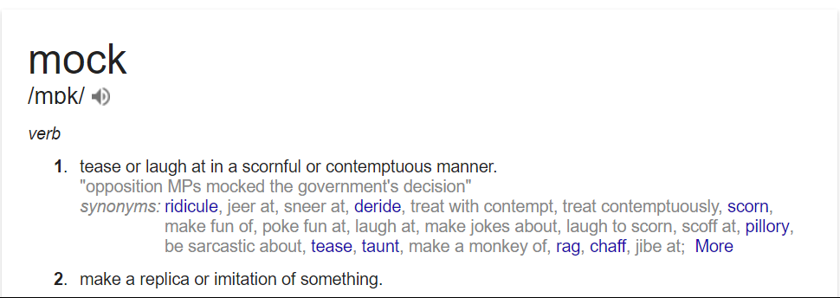
Define: mock

Slide 3
Define: mock
Software engineering:
"…special case objects that mimic real objects for testing." - Martin Fowler
http://martinfowler.com/articles/mocksArentStubs.html?

Slide 4
Why do we use mocks?
To be in control of interactions that our code or application makes with other objects or services
To write tests that are deterministic and repeatable
To enable the modelling of different scenarios to prove your code works as expected

Slide 5
When to mock?
Unit tests
Testing a specific class that collaborates with other classes
Using dependency injection design pattern you would inject a mock of an object
Integration/system tests
Testing an application as a whole to ensure the objects/components/classes work together as a cohesive unit
Mock any external collaborators with the application e.g. database, RESTful web service, etc.

Slide 6
Mocking web services
Many modern applications dependent on external web services
3rd party
Internal
Micro-services architecture
Testing against a live version of the an external web service doesn't make sense!
No control over its availability
No control over its state
Unpredictable responses, if they respond at all…

Slide 7
WireMock
http://wiremock.org/
Features
Mocking of request / response
Stubbing
Verifying interactions
Proxy
Usage modes
Standalone
Servlet container
Java APIs
JUnit integration

Slide 8
Demo
SpringBoot
@SpringBootTest
WebEnvironment
TestRestTemplate
Integration Tests
mvn verify
Or, run via IntelliJ for user friendly test results
WireMock JUnit API
JUnit @Rule

Slide 9
Demo
Language Service
GET ../languageService/random
{
"name": "Erlang",
"type": "Functional",
"yearCreated": 1986
}

Slide 10
demo
Language Processor
GET: ../languageProcessor/describe
Year created < 2000
“This is old school...”
Else
“Down with the kids!”

