Slide 1
Making a mockery of web services
Manchester Java Community – 20th October 2016
Nick Ebbitt
@nickebbitt
Notes:
Good evening,
My names Nick Ebbitt and I work for a software house called Tracsis based on Piccadilly Gardens. We provide software solutions to the UK rail industry, particularly TOCs such as Virgin, Trans Pennine Express, Northern, etc.

Slide 2
The problem
Cloud based mobile platform
Continuous Delivery pipeline
Dependency on “backend” web service
Automated tests…?
Notes:
For the past couple of years I’ve been leading the technical delivery of a cloud based mobile platform designed to provide rail staff with context sensitive information on their mobile devices.
We architected the platform to be delivered via a fully automated CD pipeline using blue/green deployments with the aim of being able to regularly deliver value with minimal downtime.
The platform is hosted in AWS and integrates with a self-hosted "backend" system exposed via a HTTP based API.
Central to the delivery pipeline is a suite of automated acceptance tests that allow us to verify the behaviour of the mobile platform and give us the confidence to deliver changes the way we do.
We realised quite early that we would have to manage the dependency with the “backend” service to allow us to fully test the platform.
Over the next quarter of an hour we’ll explore how we tackled this problem.

Slide 3
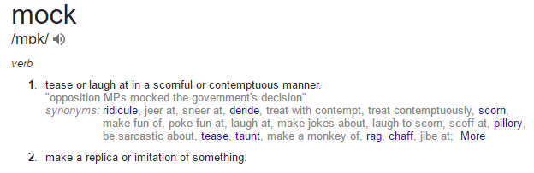
Define: mock
Notes:
So let’s begin by defining the term “mock”.
A quick Google search gives us a good starting point.
So the first description isn’t quite what we’re talking about here but the second…
“make a replica or imitation of something” – is more like what we’re talking about

Slide 4
Define: mock
In software engineering mocks are…
"…special case objects that mimic real objects for testing."
http://martinfowler.com/articles/mocksArentStubs.html?
Notes:
Applying this to the domain of software engineering, mocks are…
“…special case objects that mimic real objects for testing.”
Now this description sounds quite low-level in that it refers to objects.
In more general terms, an object could refer to any internal or external component related to a software application.

Slide 5
Why use mocks?
Control interactions
Deterministic & repeatable tests
Model scenarios
Acceptance criteria
Notes:
So why do we use mocks when testing our code or applications?
Well, to allow us to write tests that are deterministic and repeatable, we have to be in control of how our objects or systems interact with other objects or systems.
This control allows us to model the various scenarios necessary to prove that the software meets any acceptance criteria.

Slide 6
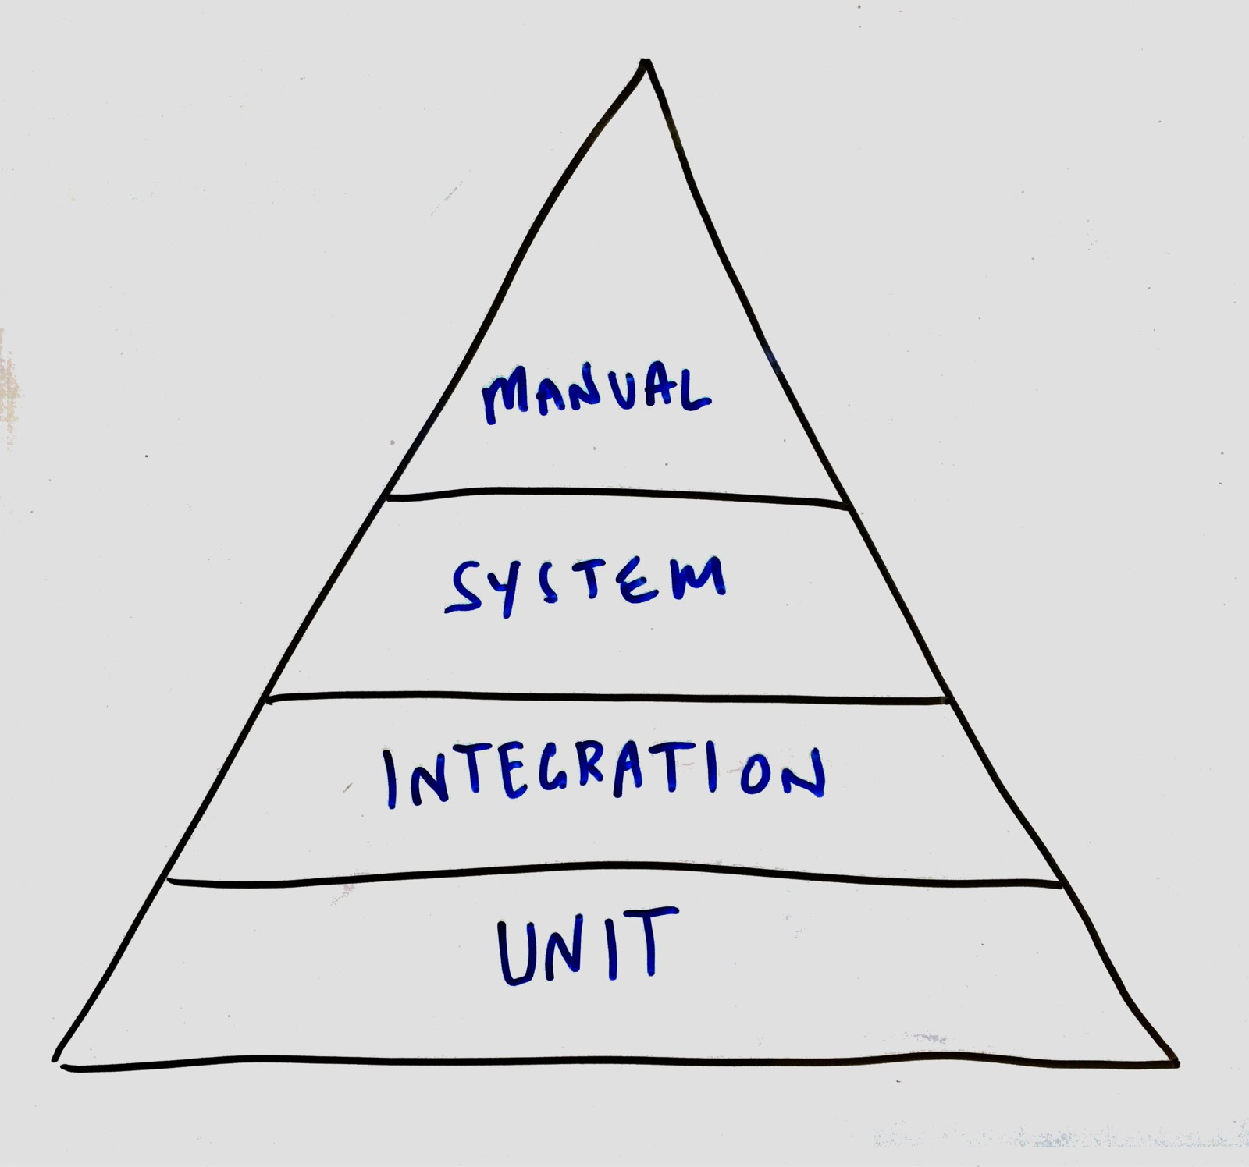
When to mock?
Notes:
It is likely that during the development of an application you’ll be writing different types of tests to increase the confidence that what you are producing is correct.
This will usually start with unit tests in which you’ll be aiming to test a single unit of your application which will likely be single class.
If the object you are testing interacts with another object then using a design pattern such as dependency injection, to implement inversion of control, and a framework such as Mockito you will be able to provide the unit you are testing with a mock collaborator.
Similarly, if you are testing at a higher level and looking to prove the correctness of a subsystem or the application as a whole then it may be necessary to mock the application’s external dependencies such as the database, a queue, or a web service.
It’s important to note, mocks are useful but are not a replacement for testing against the “real” thing. This is necessary and should definitely be part of your testing strategy.

Slide 7
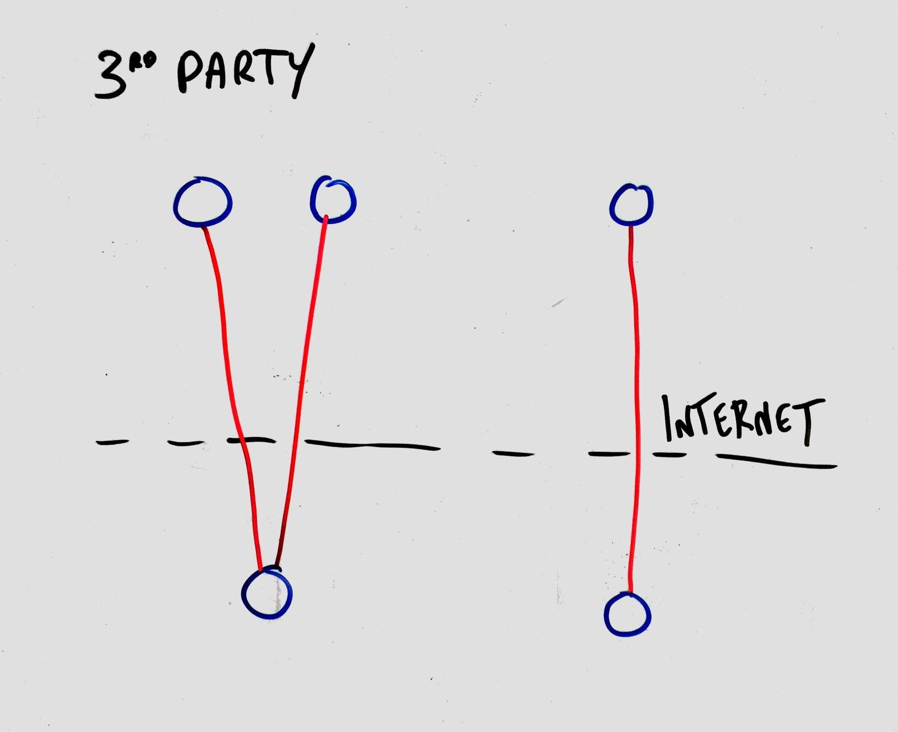
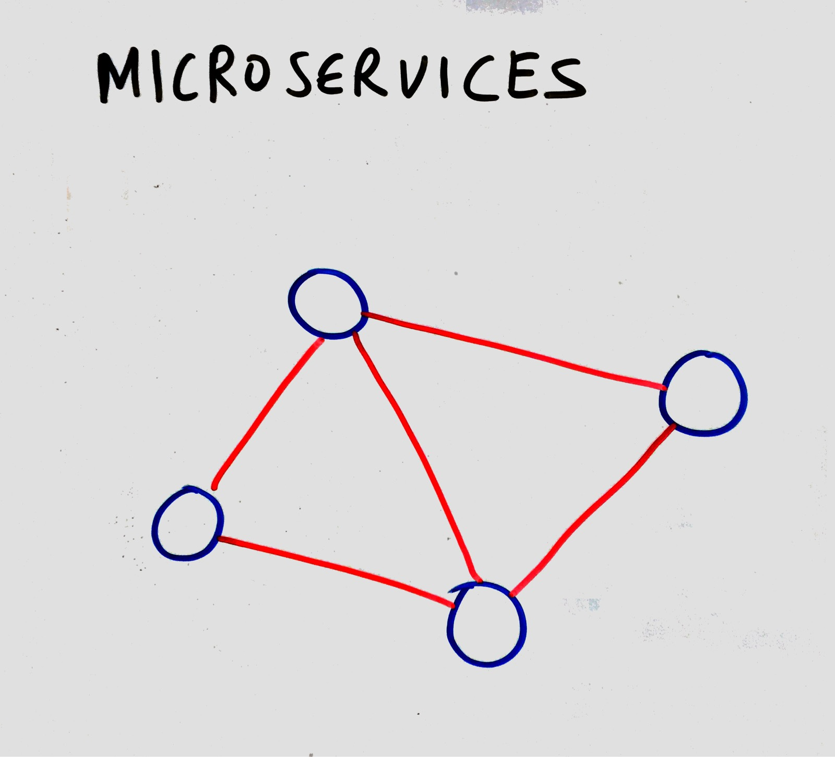
Mocking web services
Notes:
It’s quite common for an application to depend on an external web service.
The external service could be external to the company and controlled by a 3rd party e.g. Twitter.
It could be a service within the company but controlled by a different team. It is quite common for micro-service architectures to communication over HTTP.

Slide 8

Introducing WIREMOCK…
Created by Tom Akehurst in 2011
Version 2.1.12
http://wiremock.org/
https://github.com/tomakehurst/wiremock
Notes:
There are various tools or frameworks available that support the mocking of HTTP based APIs or web services however I’m going to focus on WireMock that we have used to good effect to support our development and automated integration testing processes within Tracsis.
WireMock was created a few years ago by Tom Akehurst, a London based developer.
The framework is open source which appealed to us as development team and is quite mature at version 2.
The documentation on the website is pretty good, contains lots of useful info and examples.

Slide 9


deployment
Notes:
In it’s simplest form, WireMock comes as a runnable JAR that can be started from the command line. This mode proves to be very useful during development to provide a reliable web service running on your local machine to develop against.
WireMock can also be deployed to a servlet container if that’s your preference.
There is a comprehensive Java API from which you can created an embedded WireMock server and configure as required.
Finally, and more interesting from a Java testing perspective, WireMock provides Junit integration using @Rules.

Slide 10
KEY features
Stubbing
Verifying
Proxy
Record and Playback
Simulating faults
Stateful behaviour
Notes:
In regards to the feature set of WireMock…
Stubbing allows you to pre-define a canned response that will be served when a request is made matching a specific URL pattern.
Verifying allows you to prove that your application interacts with the external service in the way that you require it to.
WireMock can be used as a proxy.
The ability to record and playback interactions with the external service is pretty cool. It is a great way to create a base set of request mappings for use in development or with your tests.
The ability to simulate faults is very useful, particularly when it comes to testing the resilience of your application. One example would be to add a delay to the interaction with the external service to prove that your app behaves as expected.
Stateful behaviour provide a way to interact with the mock service and have it alter it’s state based on the interactions made. It acts as a state machine that can move through various states during a test to allow you to model more complex scenarios.

Slide 11
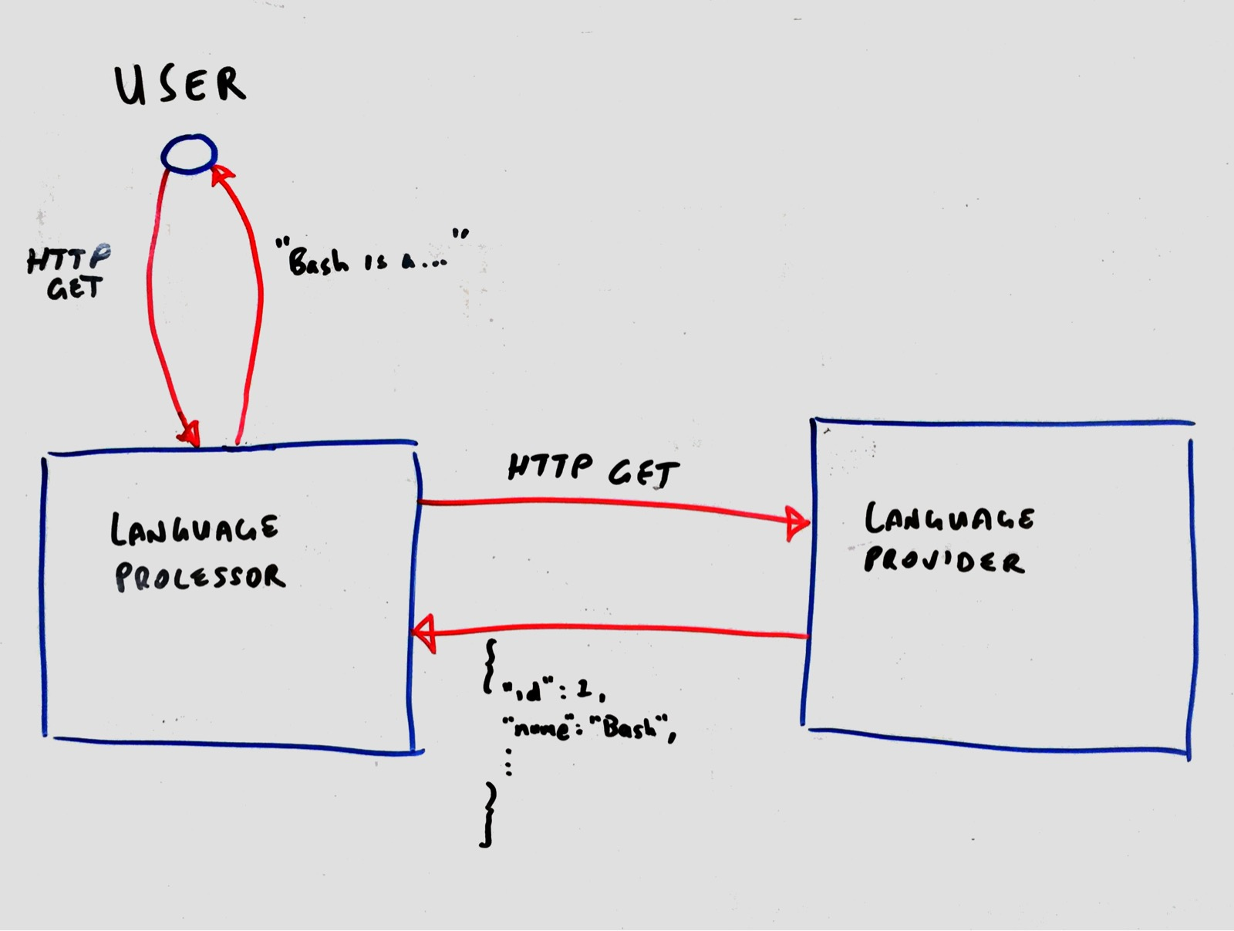
demo

Slide 12
conclusion
Reduce dependency on “backend” service
Improve testability
Improve quality
Increase productivity
Notes:
In conclusion, through my experience of using WireMock we’ve been able to…
reduce dependency on the real service being available - it’s important to mention however that while tools like this are great, they don’t completely replace the need to test against the real thing.
improve the testability of the application, allowing us to create new tests for new features with less effort
and therefore ultimately we have been able to improve the quality of product we are delivering.
An additional benefit has been an increase in developer productivity due to not being reliant on the “real” service being available and working as expected.

Slide 13
Thank you
@nickebbitt
https://github.com/nickebbitt/wiremock-examples

