Slide 1
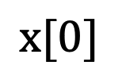



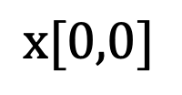
Arrays
$$\text{x}[0,0,0,0]$$
The fourth dimension selects between 3D matrices
Axis 2
With their dimensions (axes) and sample indexing
Axis 0
Axis 3
Axis 1
$$\text{x}[0,0,0]$$
$$\text{x}[0]$$
$$\text{x}[0,0]$$
Axis 2
Axis 2
$$\text{x}$$
Axis 0
Axis 0
Axis 0
Axis 0
Axis 1
Axis 1
0-D
Scalar
1-D
Vector
2-D
Matrix
3-D
Matrix
4-D
Matrix

Slide 2
Arrays
The fourth dimension selects between 3D matrices
Axis 2
With their dimensions (axes)
Axis 0
Axis 3
Axis 1
Axis 2
Axis 2
Axis 0
Axis 0
Axis 0
Axis 0
Axis 1
Axis 1
0-D
Scalar
1-D
Vector
2-D
Matrix
3-D
Matrix
4-D
Matrix

Slide 3
Arrays
With their dimensions (axes)
Axis 2
Axis 0
Axis 0
Axis 0
Axis 1
0-D
Scalar
1-D
Vector
2-D
Matrix
3-D
Matrix

