Slide 1
WITH SCALAR MENTIOED

Slide 2
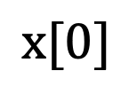



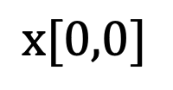
R
Arrays
$$\text{x}[0,0,0,0]$$
The fourth dimension selects between 3D arrays
Axis 3
With their dimensions (axes) and sample indexing
Axis 1
Axis 4
Axis 2
$$\text{x}[0,0,0]$$
$$\text{x}[0]$$
$$\text{x}[0,0]$$
Axis 3
Axis 3
$$\text{x}$$
Axis 1
Axis 1
Axis 1
Axis 1
Axis 2
Axis 2
Axis 2
0-D
Scalar
1-D
Array
(Vector)
2-D
Array
(Matrix)
3-D
Array
4-D
Array

Slide 3
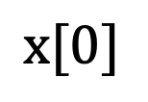



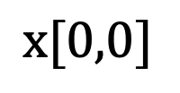
Arrays
$$\text{x}[0,0,0,0]$$
The fourth dimension selects between 3D arrays
Axis 2
With their dimensions (axes) and sample indexing
Axis 0
Axis 3
Axis 1
$$\text{x}[0,0,0]$$
$$\text{x}[0]$$
$$\text{x}[0,0]$$
Axis 2
Axis 2
$$\text{x}$$
Axis 0
Axis 0
Axis 0
Axis 0
Axis 1
Axis 1
Axis 1
0-D
Scalar
1-D
Array
(Vector)
2-D
Array
(Matrix)
3-D
Array
4-D
Array

Slide 4
Arrays
The fourth dimension selects between 3D arrays
Axis 2
With their dimensions (axes)
Axis 0
Axis 3
Axis 1
Axis 2
Axis 2
Axis 0
Axis 0
Axis 0
Axis 0
Axis 1
Axis 1
Axis 1
0-D
Scalar
1-D
Array
(Vector)
2-D
Array
(Matrix)
3-D
Array
4-D
Array

Slide 5
Arrays
With their dimensions (axes)
Axis 2
Axis 0
Axis 0
Axis 0
Axis 1
Axis 1
0-D
Scalar
1-D
Array
(Vector)
2-D
Array
(Matrix)
3-D
Array
(Matrix)

Slide 6
Arrays
With their dimensions (axes)
Axis 2
Axis 0
Axis 0
Axis 0
Axis 1
Axis 1
0-D
Scalar
1-D
Array
(Vector)
2-D
Array
(Matrix)
3-D
Array
(Matrix)

Slide 7
WITHOUT SCALAR MENTIOED

Slide 8




R
Arrays
$$\text{x}[0,0,0,0]$$
The fourth dimension selects between 3D arrays
Axis 3
With their dimensions (axes) and sample indexing
Axis 1
Axis 4
Axis 2
$$\text{x}[0,0,0]$$
$$\text{x}[0]$$
$$\text{x}[0,0]$$
Axis 3
Axis 3
Axis 1
Axis 1
Axis 1
Axis 1
Axis 2
Axis 2
Axis 2
1-D
Array
(Vector)
2-D
Array
(Matrix)
3-D
Array
4-D
Array

Slide 9




Arrays
$$\text{x}[0,0,0,0]$$
The fourth dimension selects between 3D arrays
Axis 2
With their dimensions (axes) and sample indexing
Axis 0
Axis 3
Axis 1
$$\text{x}[0,0,0]$$
$$\text{x}[0]$$
$$\text{x}[0,0]$$
Axis 2
Axis 2
Axis 0
Axis 0
Axis 0
Axis 0
Axis 1
Axis 1
Axis 1
1-D
Array
(Vector)
2-D
Array
(Matrix)
3-D
Array
4-D
Array

Slide 10
Arrays
The fourth dimension selects between 3D arrays
Axis 2
With their dimensions (axes)
Axis 0
Axis 3
Axis 1
Axis 2
Axis 2
Axis 0
Axis 0
Axis 0
Axis 0
Axis 1
Axis 1
Axis 1
1-D
Array
(Vector)
2-D
Array
(Matrix)
3-D
Array
4-D
Array

Slide 11
Arrays
With their dimensions (axes)
Axis 2
Axis 0
Axis 0
Axis 0
Axis 1
Axis 1
1-D
Array
(Vector)
2-D
Array
(Matrix)
3-D
Array
(Matrix)

Slide 12
Arrays
With their dimensions (axes)
Axis 2
Axis 0
Axis 0
Axis 0
Axis 1
Axis 1
1-D
Array
(Vector)
2-D
Array
(Matrix)
3-D
Array
(Matrix)

Slide 13
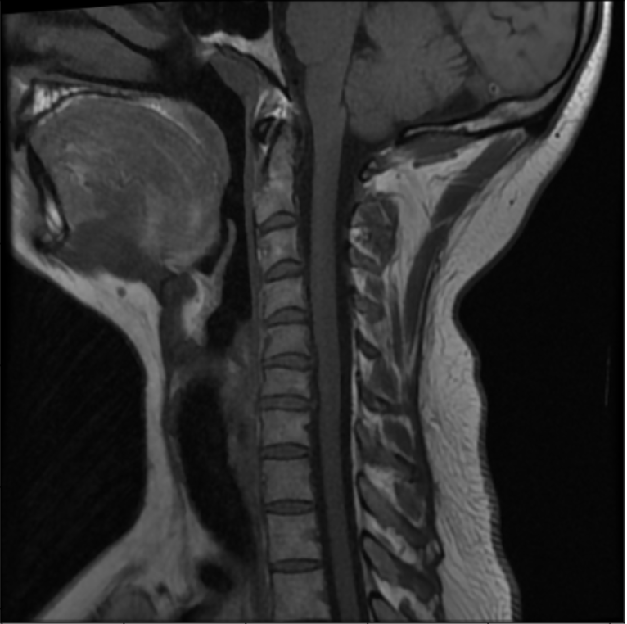
mri[:,0,:]
mri[14,:,:]
mri[:,300,:]
mri[:,512,:]

Slide 14
our_matrix
column index
(axis 1)
0
1
2
3
0 | 1 | 2 | 3
4 | 5 | 6 | 7
8 | 9 | 10 | 11
0
1
2
row index
(axis 0)

Slide 15
row index
(axis 0)
our_matrix
column index
(axis 1)
0
1
2
3
0 | 1 | 2 | 3
4 | 5 | 6 | 7
8 | 9 | 10 | 11
0
1
2

Slide 16
our_matrix
our_matrix[1,2]
0
1
2
3
0 | 1 | 2 | 3
4 | 5 | 6 | 7
8 | 9 | 10 | 11
0
1
2

Slide 17
our_matrix
our_matrix[0:2,0:2]
0
1
2
3
0 | 1 | 2 | 3
4 | 5 | 6 | 7
8 | 9 | 10 | 11
0
1
2

Slide 18
our_matrix
our_matrix[1,:]
0
1
2
3
0 | 1 | 2 | 3
4 | 5 | 6 | 7
8 | 9 | 10 | 11
0
1
2

Slide 19
our_matrix
our_matrix[:,2]
0
1
2
3
0 | 1 | 2 | 3
4 | 5 | 6 | 7
8 | 9 | 10 | 11
0
1
2

Slide 20
our_matrix
Output array
our_matrix[[0,1,2],[0,1,2]
0
1
2
3
0 | 1 | 2 | 3
4 | 5 | 6 | 7
8 | 9 | 10 | 11
0
(walking through how it is populated one step at a time)
0
0
1
1
2
2
our_matrix
our_matrix[[0,1,2],[0,1,2]
0
1
2
3
0 | 1 | 2 | 3
4 | 5 | 6 | 7
8 | 9 | 10 | 11
0
5
0
0
1
1
2
2
our_matrix
our_matrix[[0,1,2],[0,1,2]
0
1
2
3
0 | 1 | 2 | 3
4 | 5 | 6 | 7
8 | 9 | 10 | 11
0
5
10
0
0
1
1
2
2

