Slide 1

Number of Penguins
Zoo A
Zoo B
Zoo C
Zoo D
Zoo E

Slide 2
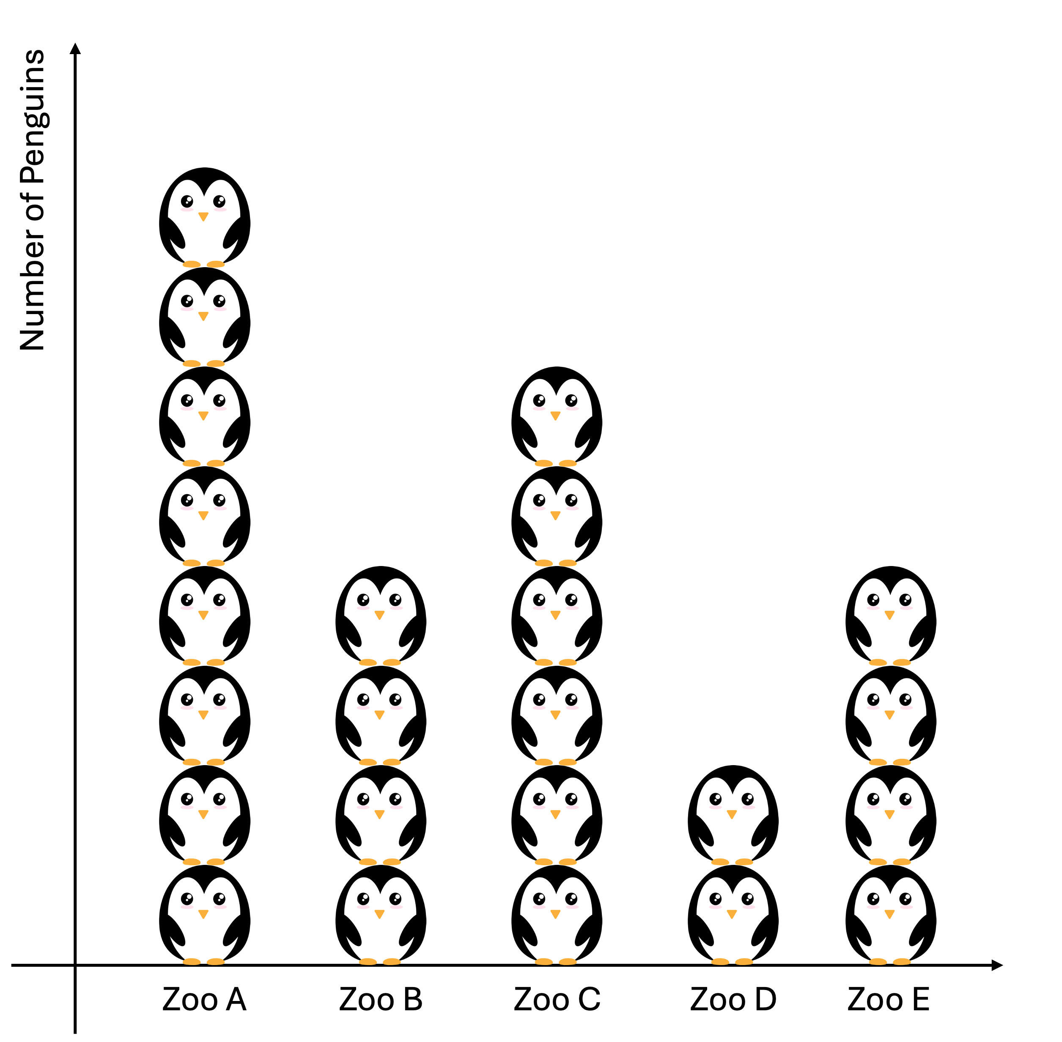
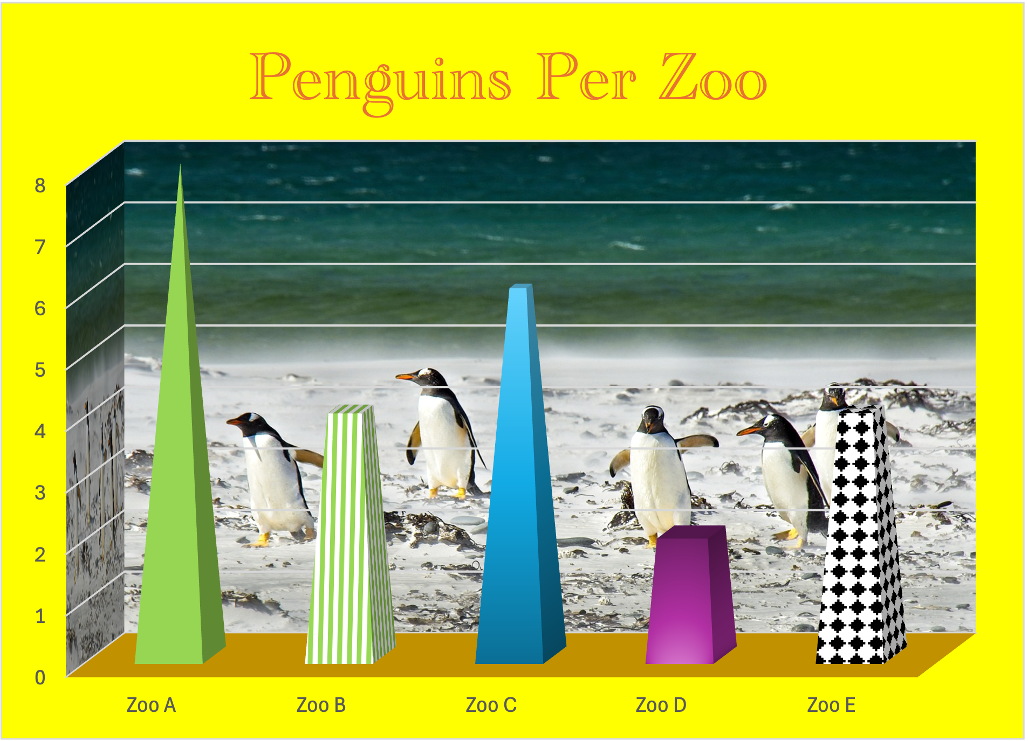
A
B

Slide 3
Perceptual ranking of visual differences
1. Position along a
common scale
Easier to accurately distinguish differences
2. Length
3. Angle
4. Area
5. Volume
6. Color Saturation
Harder to accurately distinguish differences
7. Color Hue

Slide 4
Baselines matter in bar plots
A
B
37
Percent of Voters
32
31
For
Against
Unsure
0
For
Against
Unsure

Slide 5
Tips for how to use color effectively
Needless color
Clearer
Use color to encode information not just decoration
If there are perceptually easier ways to communicate your data, do it
Harder to read
Easier to read
Harder to read
Easier to read
Penguins
Penguins
Be consistent with color encodings
Dolphins
Dolphins
Penguins
Penguins
Dolphins
Dolphins
Use categorical color palettes for categorical data and sequential maps for sequential data
Implies ordering 1→2→3
No ordering suggested
1
2
3
1
2
3
A
B
C
A
B
C
Rank
Zoo

