Slide 1
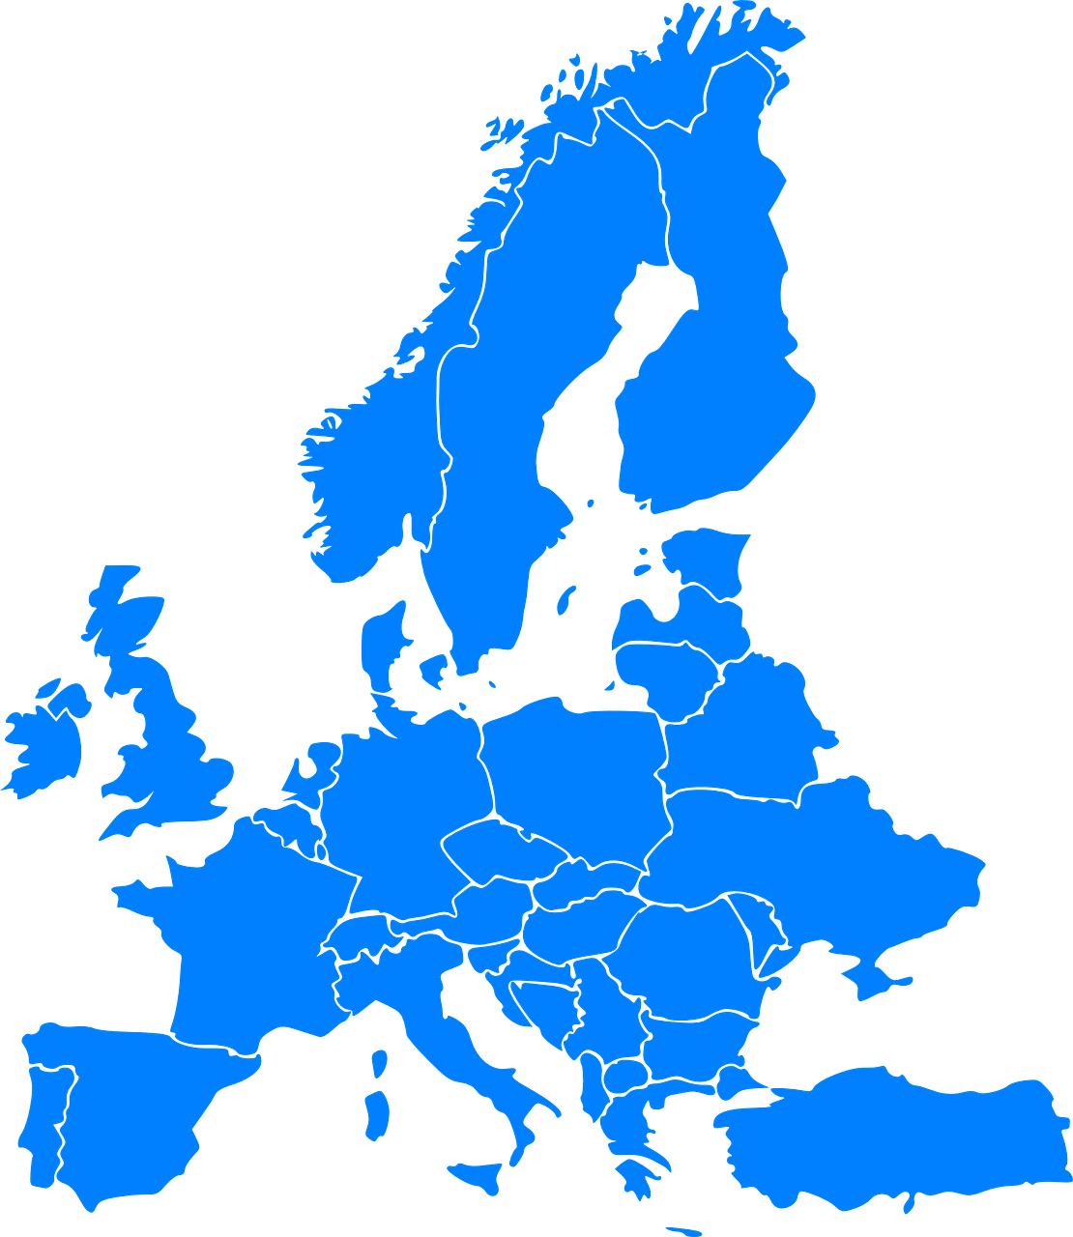
Examples of Object Series
 | name
0 | "Albania"
1 | "Austria"
2 | "Belgium"
3 | "Croatia"
4 | "Denmark"
5 | "Finland"
6 | "France"
 | population
0 | 2994667
1 | 8217280
2 | 10431477
3 | 4290612
4 | 5529888
5 | 5259250
6 | 63248000
 | geometry
0 | <Plotly Polygon Object>
1 | <Plotly Polygon Object>
2 | <Plotly Polygon Object>
3 | <Plotly Polygon Object>
4 | <Plotly Polygon Object>
5 | <Plotly Polygon Object>
6 | <Plotly Polygon Object>
Object series
with text data
Object series
with integer data
Object series
with geospatial data
 | country_traits
0 | "Albania"
1 | 2994667
2 | <Plotly Polygon Object>
Object series
with mixed data types

Slide 2
1
3
customers DataFrame
categorical codes
 | customer | state
0 | Bob | Colorado
1 | Aditya | Tennessee
2 | Francisco | Colorado
3 | Shufan | Virginia
0 | 0
1 | 1
2 | 0
3 | 2
"Colorado"
"Tennessee"
"Colorado"
"Virginia"
customers
customers["state"].cat.codes
2
Create categories from the column "state"
customers["state"] = customers["state"].astype("category")

Slide 3
Categoricals are useful when the object Series has a relatively small number of unique values
Categoricals are NOT useful when the object Series has a relatively large number of unique values
 | state
0 | Colorado
1 | Tennessee
2 | Colorado
3 | Virginia
4 | Virginia
5 | Tennessee
6 | Tennessee
7 | Ohio
8 | Colorado
9 | Virginia
0 | 0
1 | 1
2 | 0
3 | 2
4 | 2
5 | 1
6 | 1
7 | 3
8 | 0
9 | 2
 | state
0 | Colorado
1 | Tennessee
2 | Colorado
3 | Virginia
4 | Texas
5 | Vermont
6 | Georgia
7 | Ohio
8 | New York
9 | Wyoming
0 | 0
1 | 1
2 | 0
3 | 2
4 | 3
5 | 4
6 | 5
7 | 6
8 | 7
9 | 8
customers["state"]
customers["state"].cat.codes
customers["state"]
customers["state"].cat.codes
customers["state"] = customers["state"].astype("category")
customers["state"] = customers["state"].astype("category")

Slide 4
 | country | area | geometry
0 | Albania | 28748 | <Plotly Polygon Object>
1 | Austria | 83858 | <Plotly Polygon Object>
2 | Belgium | 30510 | <Plotly Polygon Object>
3 | Croatia | 56542 | <Plotly Polygon Object>
4 | Denmark | 43094 | <Plotly Polygon Object>
5 | Finland | 336593 | <Plotly Polygon Object>
6 | France | 547030 | <Plotly Polygon Object>

