Slide 1
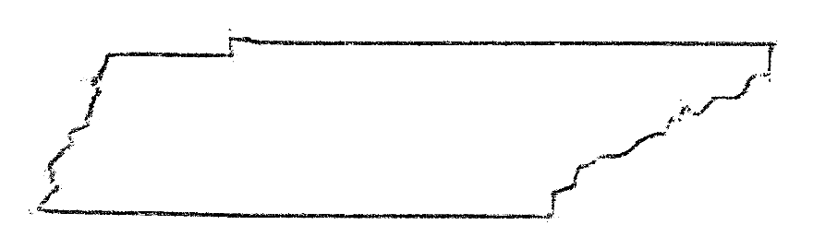
Analysis of Split Ticket Voting in Tennessee Elections
(1980-2020)
Nick Forte | Nashville Software School | DDA6

Slide 2
What is Ticket Splitting?
And how can we measure it?

Slide 3
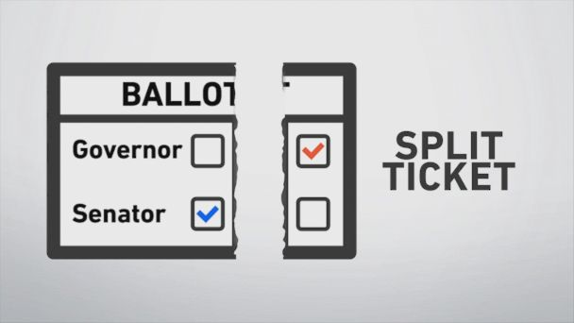
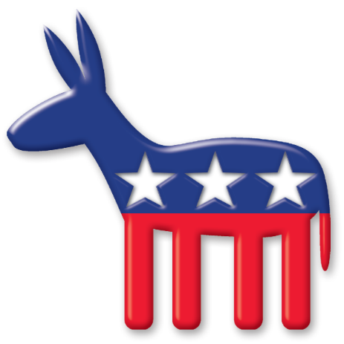
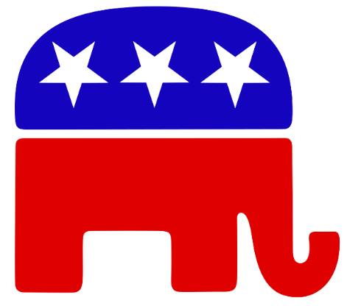
Split-ticket voting, or “ticket splitting,” is when, in a single election, citizens vote for candidates of opposing political parties…instead of voting for a straight one-party ticket.

Slide 4
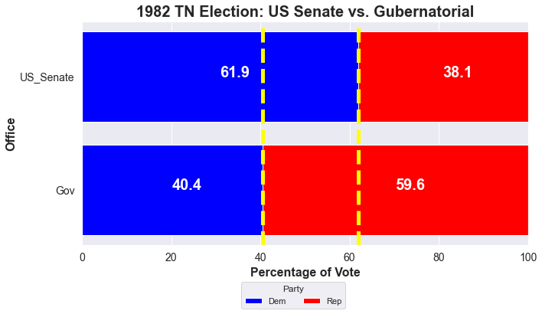
D + 23.8%
1982
R + 19.2%
Max Margin (23.8) – Min Margin (-19.2) = Margin Range (43.0)

Slide 5
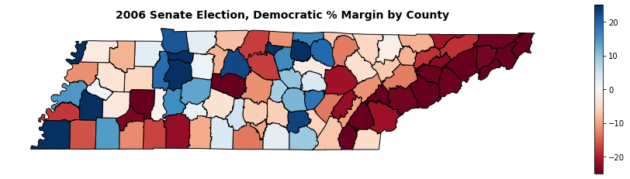
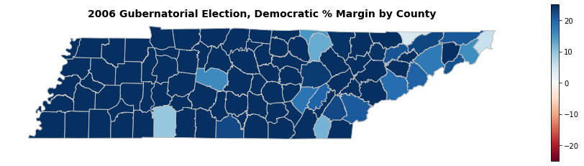
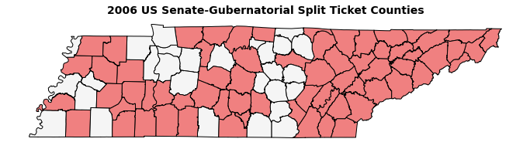
2006
R +2.7%
D +39%
Max Margin (39.0)
– Min Margin (-2.7)
Margin Range (41.7)

Slide 6
What are the statewide trends in Ticket Splitting in Tennessee elections over the past 40 years?

Slide 7
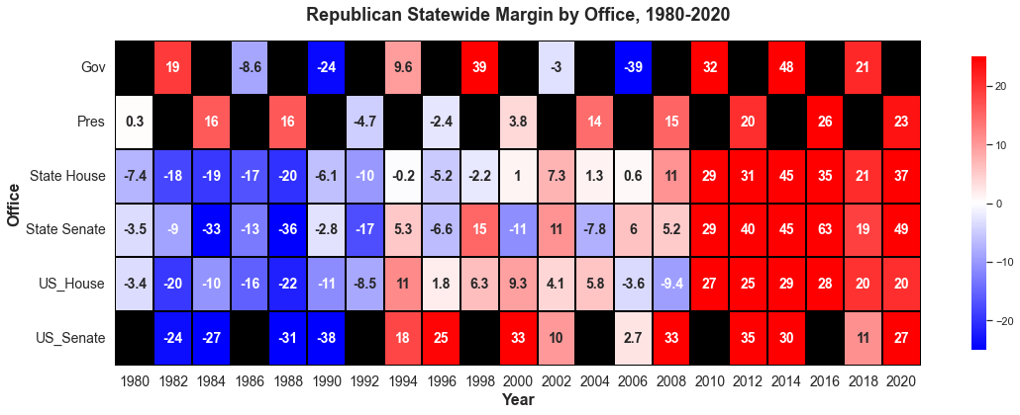
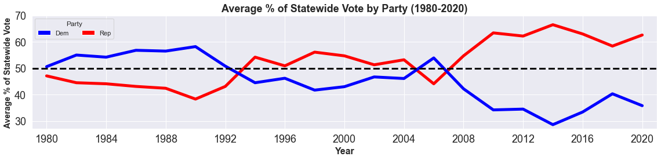
1980-2020

Slide 8
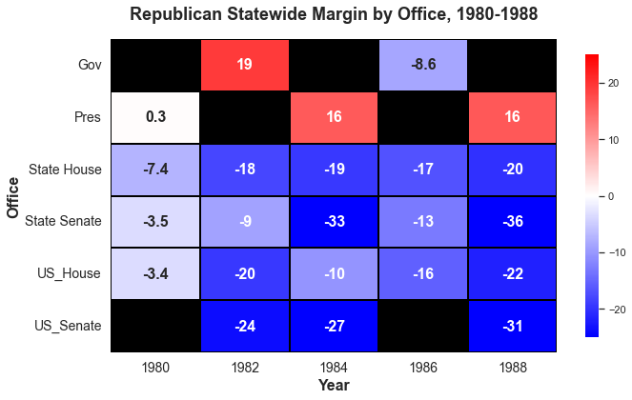
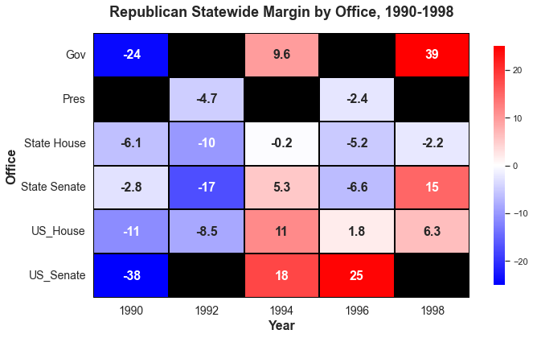
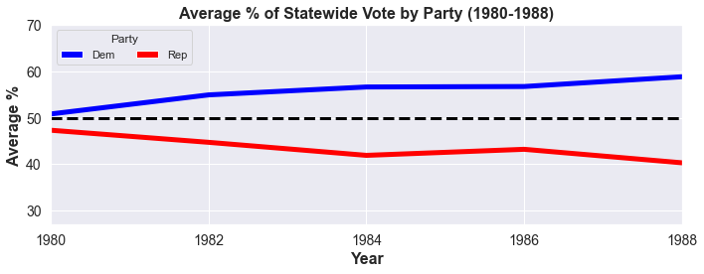
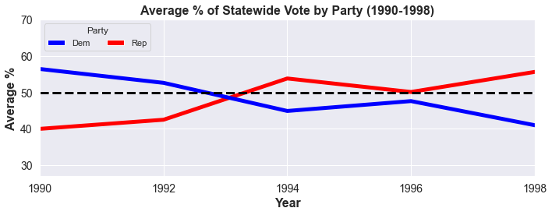
1980-1988
1990-1998

Slide 9
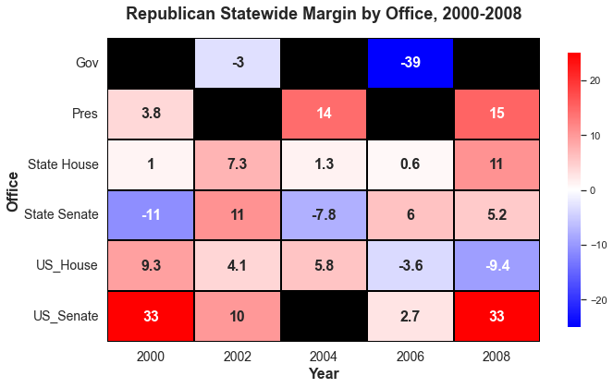
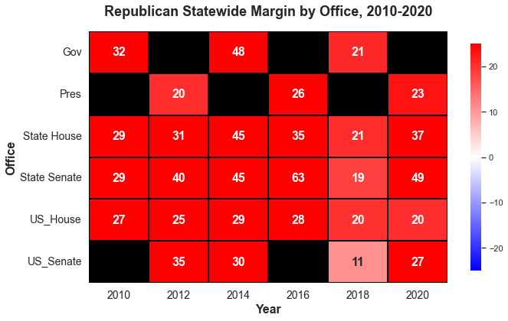
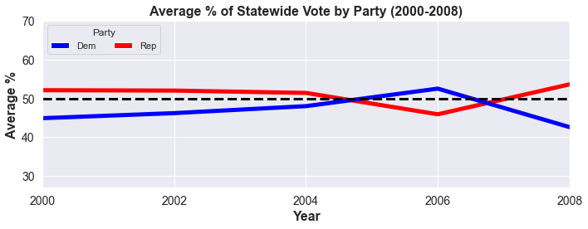
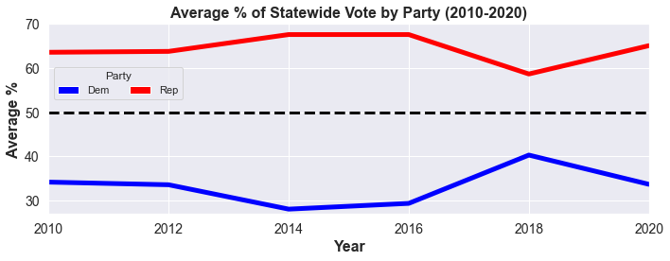
2000-2008
2010-2010

Slide 10
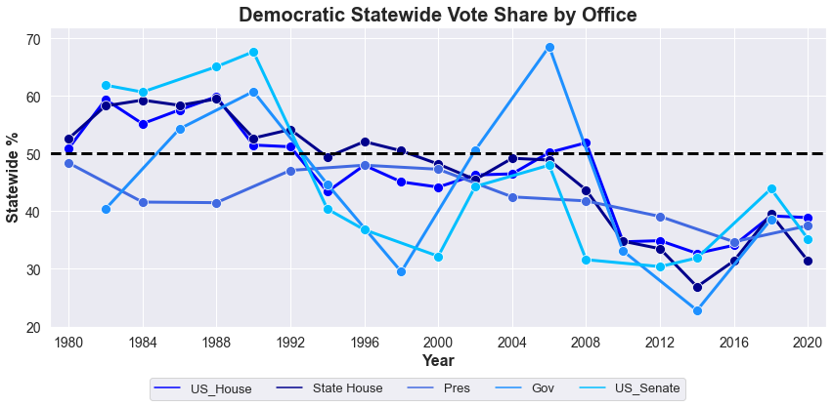
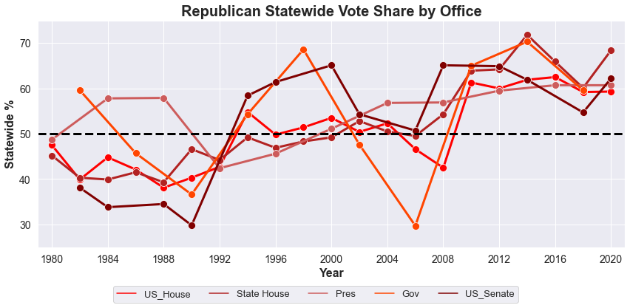
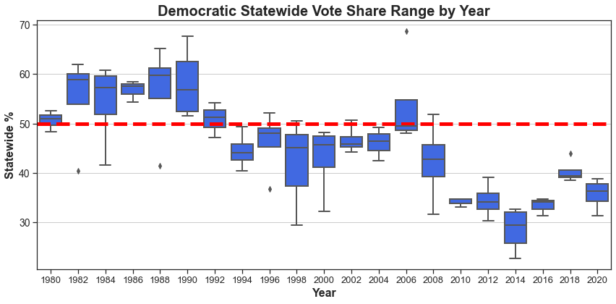
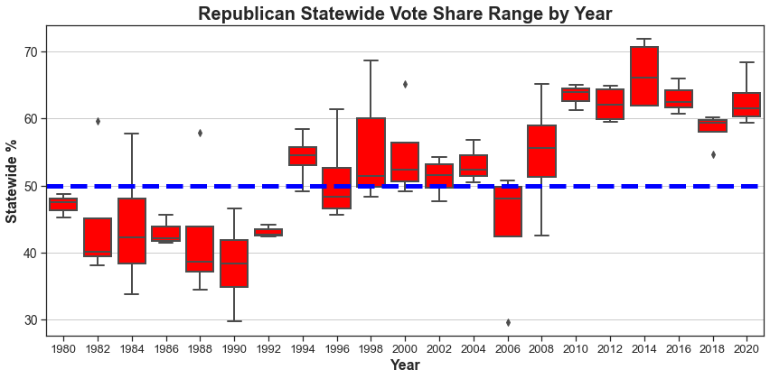
Statewide Trends

Slide 11
What about on a County level?

Slide 12
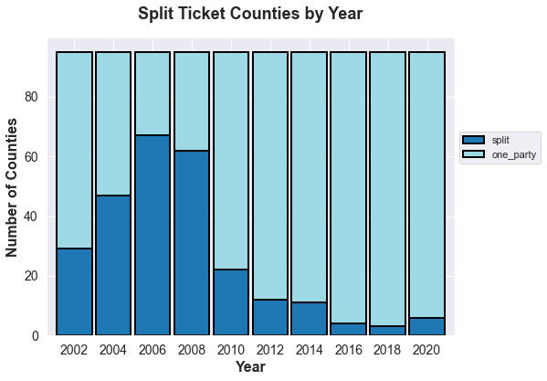
67
62
Analysis by County
47
29
22
12
11
4
6
3

Slide 13
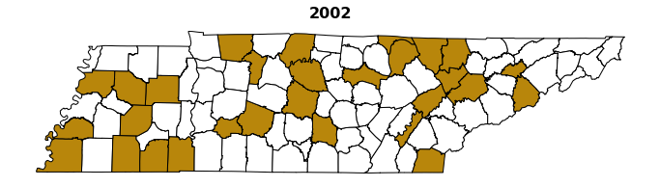
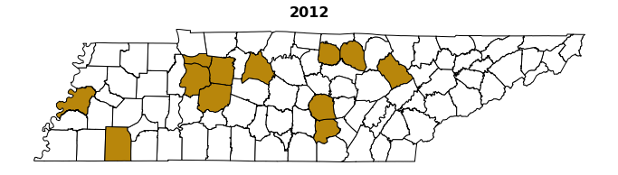
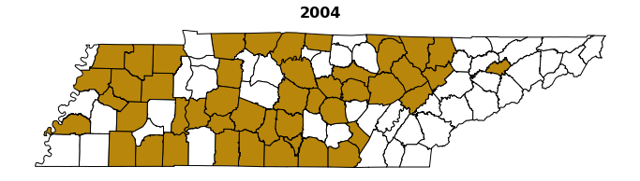
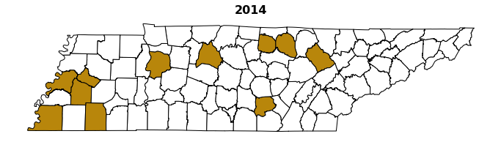
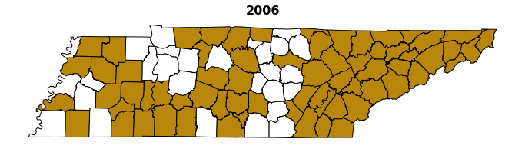
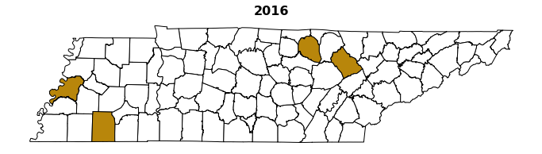
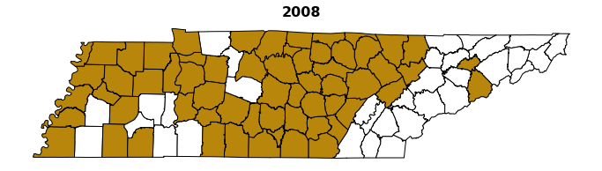
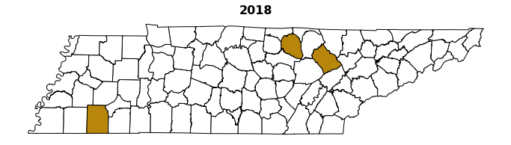
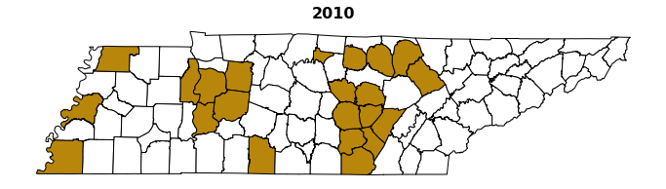
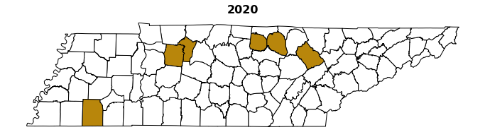
Split Ticket Counties by Year

Slide 14
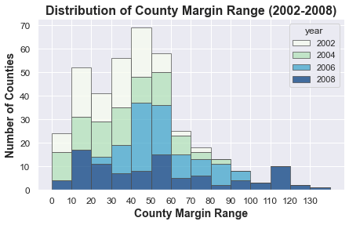
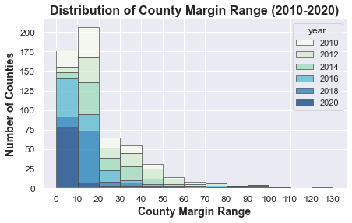
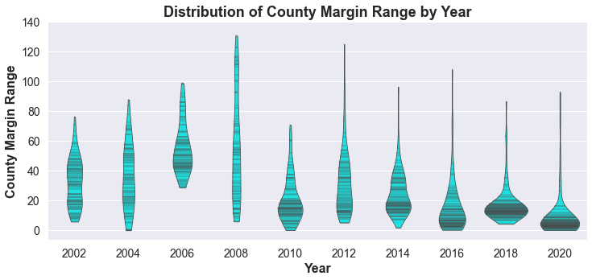

Slide 15
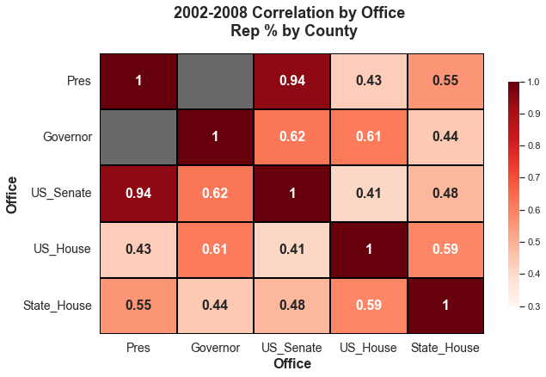
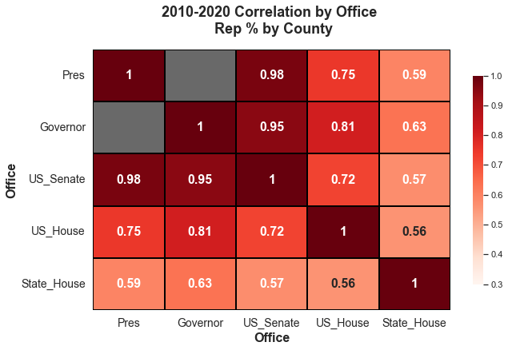
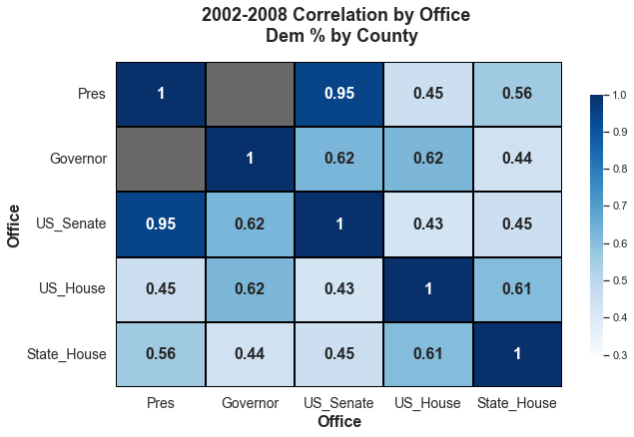
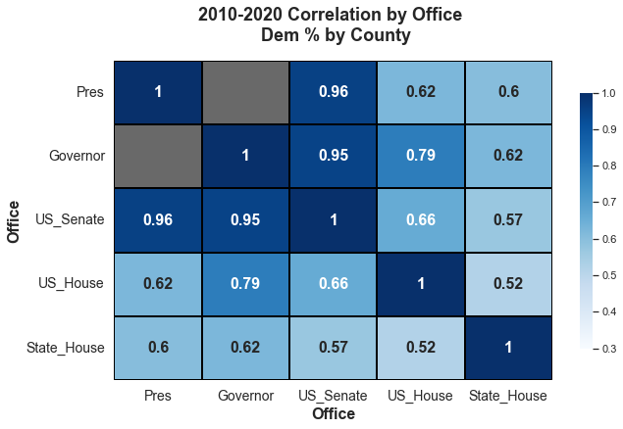
Correlation by Office

Slide 16
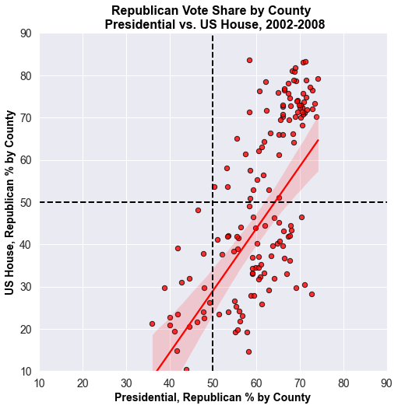
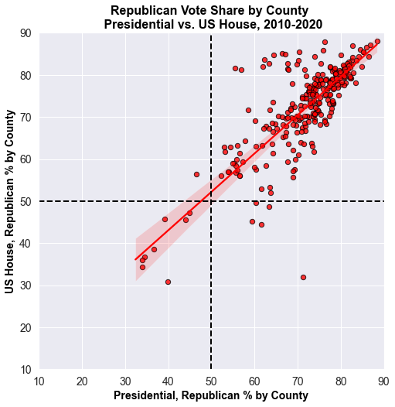
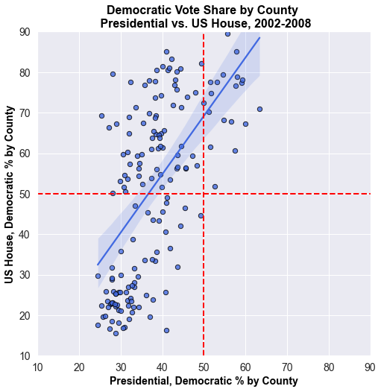
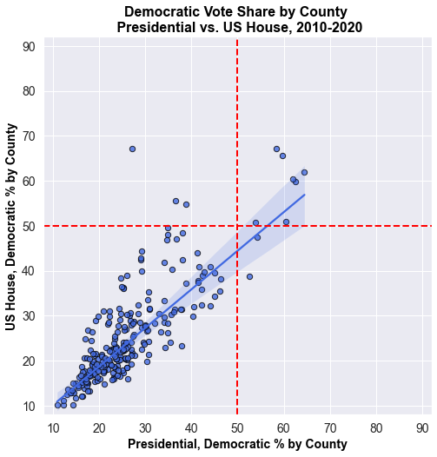
Correlation: 0.43
Correlation: 0.75
Change in Correlation: President vs.
US House
Correlation: 0.45
Correlation: 0.62

Slide 17
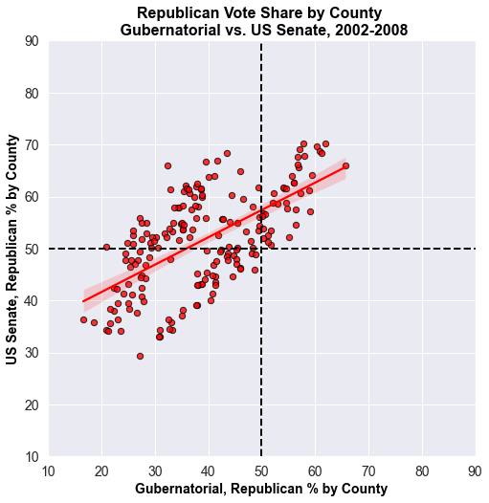
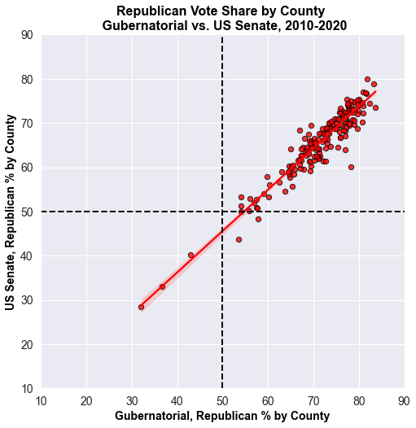
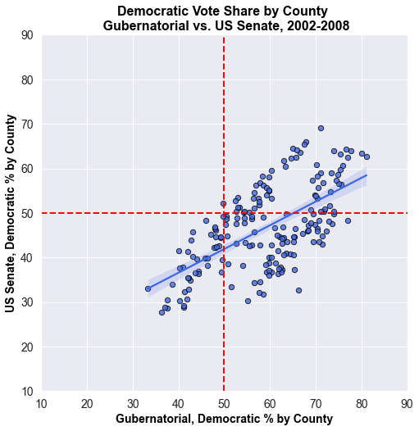
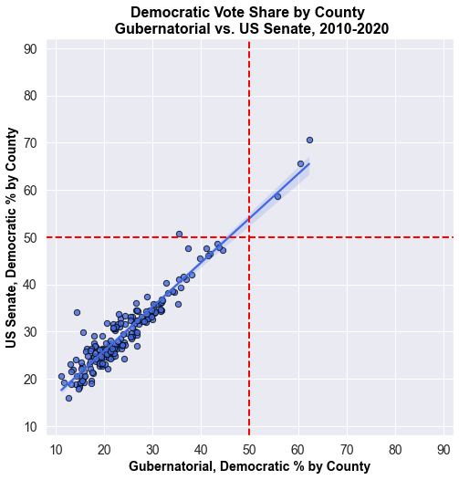
Change in Correlation: Governor vs.
US Senate
Correlation: 0.62
Correlation: 0.95
Correlation: 0.62
Correlation: 0.95

Slide 18
Are certain demographics more likely to split their ticket?

Slide 19
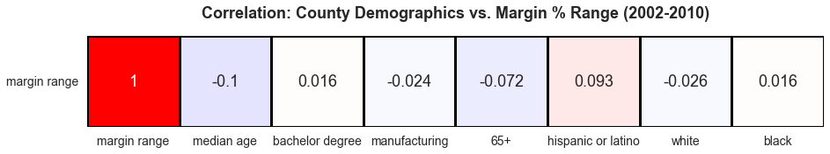
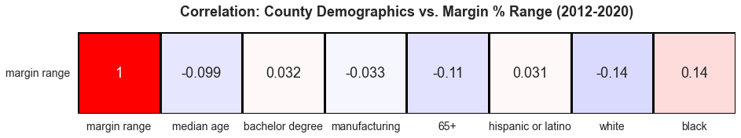

Slide 20
Conclusions
Tennessee hasn’t split its statewide vote in any way since 2008, and based on recent trends it appears unlikely that it will anytime soon; Margin Range is decreasing as voters increasingly appear to be voting straight one-party tickets
The number of split ticket Counties has drastically decreased since the mid-2000’s when a majority of Counties were splitting their tickets; over the past few election cycles only a handful of Tennessee’s 95 Counties have split their ticket in any way, and with few exceptions County Margin Ranges have steadily decreased
How a County votes for one office is an increasingly strong indicator of how they will vote for other offices; Tennessee State House Elections are the most likely office to see split ticket voting
There doesn’t appear to be any strong correlation between the specific demographic groups I analyzed and their propensity to split their ticket; across the board, Tennessee voters appear to have become significantly more polarized and less likely to split their tickets in any form or fashion

Slide 21
Data Sources
Tennessee Secretary of State:
Tennessee Election Results 2008-2020
Harvard Dataverse:
Tennessee Election Results 2002
Tennessee Election Results 2004-2006
US Presidential Election Results 1980-2020
US Senate Election Results 1980-2020
US House Election Results 1980-2020
All US State Legislature Election Results 1967-2016
US Election Atlas:
TN Gubernatorial Election Results 1974-2018
Census Reporter:
US Census Demographics Data

