Slide 1

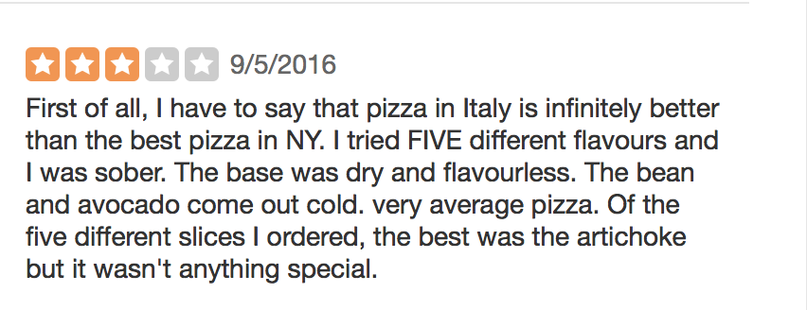
Predicting the quality of different aspects of a restaurant based on it’s 3-star Yelp reviews.
Nikhil Garg, Shivangi Singh
CS 585- Natural Language Processing, UMass Amherst
Problem
Usually, people who give 3 star reviews are both satisfied and dissatisfied with certain services provided by a business.
It can be assumed that people who give 3 star reviews are the ones who usually suggest improvements for a business identity.
So, we can use these 3 star reviews to help restaurants convince the average rater to like the restaurant.
Methodology
From this example review, the business owners could learn that their pizza base was dry and flavorless. So we can ask the business for their business ID and also the aspect for which they want our recommendation/ review. So accordingly we query their reviews and run TextBlob’s Sentiment Analyzer, Naïve Bayes and Turney’s method to classify the restaurant aspect as either positive or negative, an the adjective describing the business aspect can be predicted by querying the five most frequent word related to the aspect.
Results
The customized Naive Bayes Classifier which was trained on restaurant reviews (similar model) worked much better than the baseline model trained on movie reviews. This is probably due to the fact that movie reviews and food/restaurant reviews have different characteristics and sense in how they are worded. It also worked much better than the TextBlob's pattern analyzer, which only had an accuracy of 74.5 as compared to the customized Naive Bayes model's accuracy of 95.4. It is obvious that using a training set related to the item we are classifying works better for the classification of the item. Our Naïve Bayes model also worked better than Turney’s model, which was a bit surprising.
Dataset
The dataset was obtained from the Yelp Data
Challenge which contains information about local businesses in 12 metropolitan areas across 4 countries.
Example
Graph
Three stars

