Slide 1

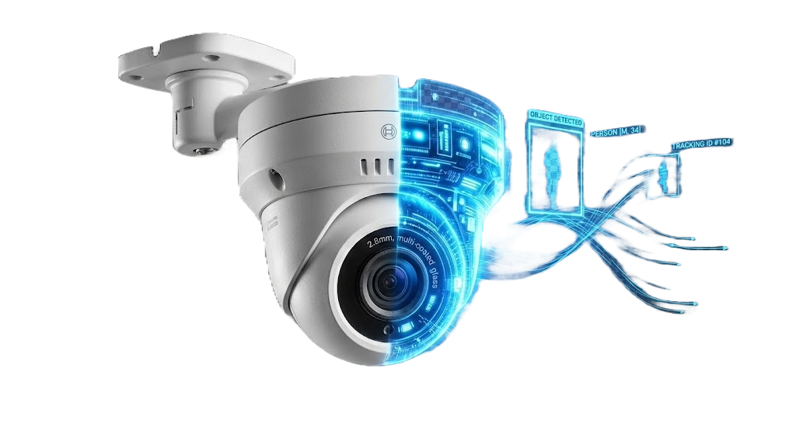
Eyenet-vision Platform
"Turning ordinary cameras into an intelligent, always-on assistant for safer, smarter, more efficient operations."
Counts visitors, detects unusual events, and drives automated responses in real time.
Runs locally on owner-controlled hardware with privacy-first, offline-capable operation.
Scales from a single camera to multi-site estates without per-camera licensing ceilings.
Core Functionalities & Features
Version 2.23.1 | January 15, 2026 | Confidential
The Eyenet-vision Platform — Turning Every Camera into an Intelligent Sensor
Eyenet Vision | Functionalities Presentation

Slide 2
How Eyenet Multiplies Human Operation Capacity
Boost Moderate Cameras to Powerful Machine Vision Nodes
"Turn any camera into an intelligent sensor with real-time analytics and no specialized hardware burden."
Turn IP, WiFi, and mobile cameras into intelligent machine-vision nodes.
Run face detection, people counting, demographics, and route tracking on-device.
Scale from a single lens to a facility-wide mesh without changing platform logic.
The Eyenet-vision Platform — Turning Every Camera into an Intelligent Sensor
Eyenet Vision | Functionalities Presentation

Slide 3
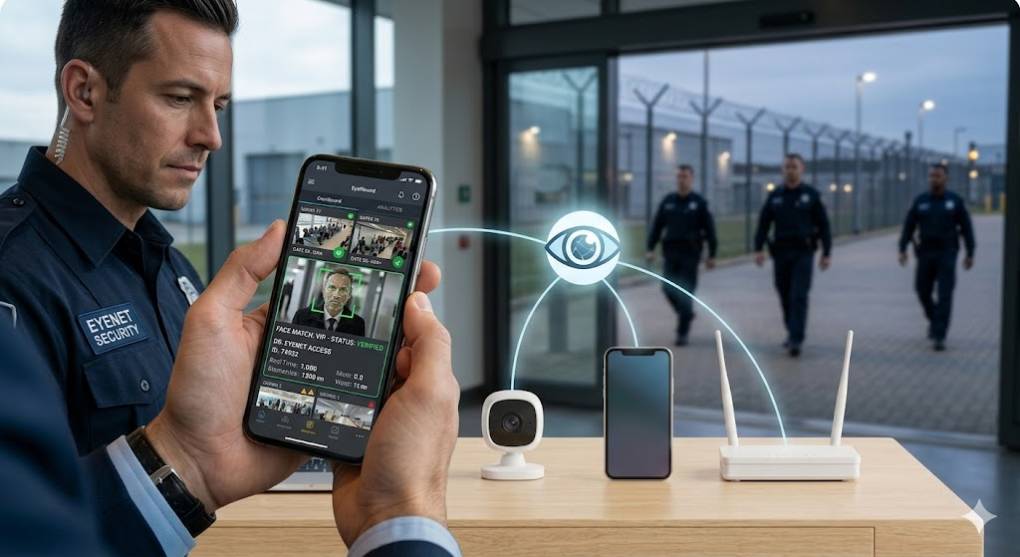
Operational Coverage and Safety
Track human activity, regulate access, and protect restricted zones
"Replace manual checks with always-on monitoring that counts, alerts, and documents events automatically."
Real-time people tracking, attendance, route analysis, and dwell-time mapping.
Automatic headcount, checkpoint oversight, and unauthorized-access alerts.
Virtual perimeters, lone-worker monitoring, PPE checks, and incident documentation.
Advanced Security — Real-Time Monitoring and Intelligent Threat Detection
Eyenet Vision | Functionalities Presentation

Slide 4
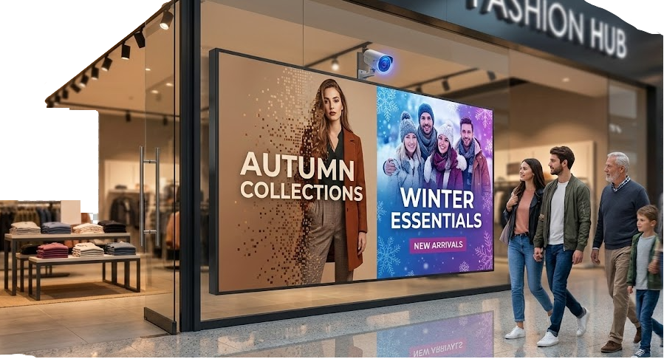
Audience-Aware Automation
Drive digital signage and workflows from live vision events
"Cameras read the room and trigger content, notifications, and third-party actions in milliseconds."
Switch playlists, promotions, and emergency messages based on age, gender, group size, and behavior.
Configure per-camera triggers with configurable conditions and AND/OR logic.
Measure impressions, dwell time, and engagement to prove signage ROI.
Dynamic Digital Signage — Audience-Aware Content That Adapts in Real Time
Eyenet Vision | Functionalities Presentation

Slide 5
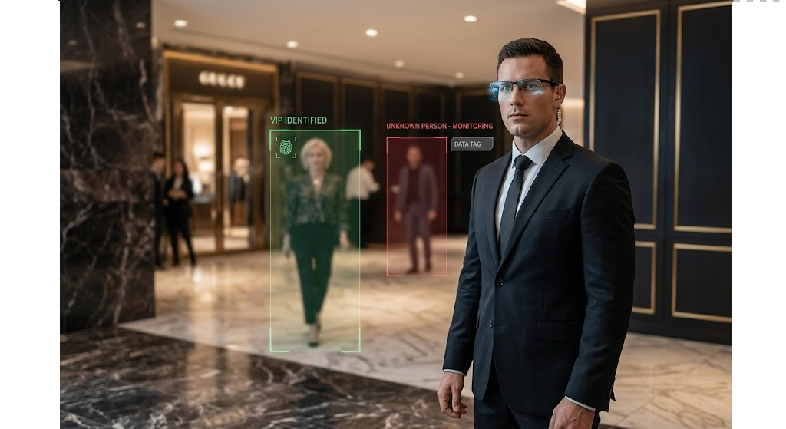
Advanced Protection Use Cases
Control entry points, restricted areas, VIP coverage, and remote operations
"One platform coordinates access control, perimeter alerts, VIP recognition, and remote supervision."
Protect entrances, gates, and checkpoints with identity awareness and audit trails.
Stream person-of-interest alerts to security eyewear and mobile devices.
Manage every camera, trigger, and dashboard remotely from web or mobile with no cloud video dependency.
VIP Protection — Discreet Recognition and Priority Alert Systems
Eyenet Vision | Functionalities Presentation

Slide 6
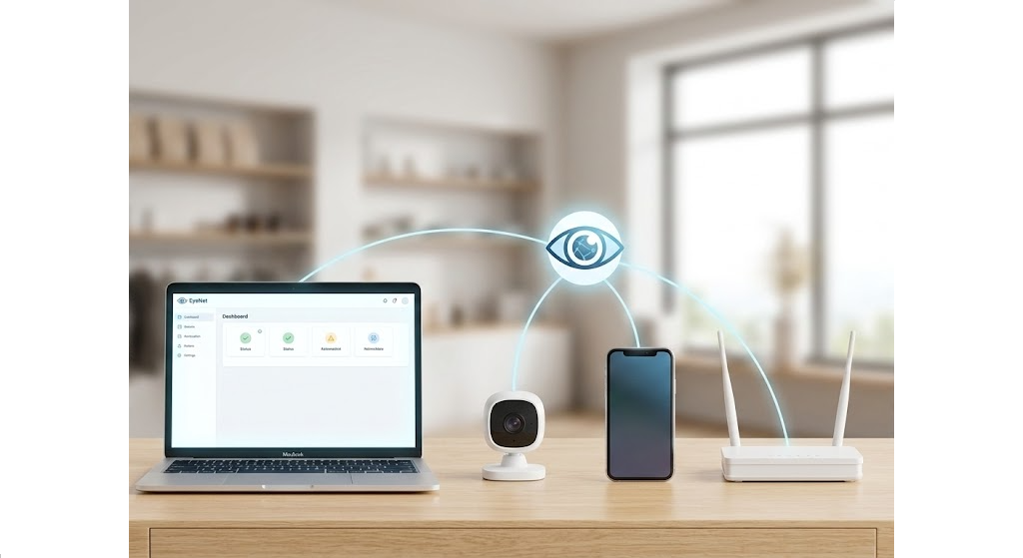
Instant Deployment
Get started quickly on everyday hardware
"Deploy with standard compute, no forced GPU servers, and no per-camera licensing ceiling."
Start with 16 GB RAM and a modern CPU using cameras you already own.
Bring the first detection online in minutes from IP, WiFi, or phone-based cameras.
Expand from one room to multi-site estates without redesigning the architecture.
Instant Deployment — Up and Running in Minutes, Not Months
Eyenet Vision | Functionalities Presentation

Slide 7

Key Differentiators
"A privacy-first machine-vision platform designed for owner control, flexible automation, and practical scale."
✓
Privacy-first on-premises processing and storage.
✓
Offline-capable operation without internet dependency.
✓
Scales from one camera to enterprise-wide deployments.
✓
Secure by design with encryption, access control, and VPN-ready connectivity.
✓
Integration-ready with REST APIs, webhooks, and third-party connectors.
✓
Event-driven intelligence with per-camera automation and multi-action orchestration.
Intelligent Access Control — Seamless Entry Management Powered by Vision AI
Eyenet Vision | Functionalities Presentation

Slide 8
Core Platform Functionalities
"The platform combines computer vision, hardware integration, triggers, media handling, and communications into one operating layer."
Computer Vision, Cameras, Triggers
Video, Data, and Communications
People analytics: tracking, counting, attendance, route analysis, and demographics.
Multi-source camera support across IP, WiFi, and mobile soft cameras.
Per-camera trigger configuration with real-time event detection and complex condition logic.
Automated actions across push, in-app, email, SMS, signage, and webhooks.
Local video storage and processing with no mandatory cloud services.
Intelligent communications with audit logging and delivery tracking.
Real-time dashboards, historical analytics, behavioral patterns, and reporting.
Operational resilience with internet optional except for selected remote notifications.
Eyenet Vision | Functionalities Presentation

Slide 9
Architecture, Security, and Scale
"Eyenet is engineered as an edge-capable microservices platform that preserves control while scaling across sites and stakeholders."
Deployment and Governance
Scalability and Extensibility
On-premises and edge deployment with modular microservices and automatic service discovery.
Role-based access, file-level encryption, private VPN support, and full data sovereignty.
Remote diagnostics, centralized logging, audit trails, and trigger execution debugging.
Flexible scaling from homes to industrial sites with hardware-based performance growth.
Unlimited camera support subject to available hardware capacity.
Extensible integrations through REST APIs, webhooks, custom connectors, and signage modules.
Eyenet Vision | Functionalities Presentation

Slide 10
Technical Architecture Highlights
"Trigger evaluation, orchestration, and context awareness are first-class capabilities rather than bolt-on automation."
Trigger and Action System
Context and Signage Intelligence
Granular per-camera rule configuration.
Instant event evaluation against configured conditions.
Reliable action delivery with retry logic and failure tracking.
Complete audit trail for activations and executions.
Time, day, occupancy, demographics, velocity, direction, and trajectory-aware triggers.
Historical comparison and multi-camera correlation across zones.
Dynamic signage content switching, demographic targeting, and playlist automation.
Eyenet Vision | Functionalities Presentation

Slide 11
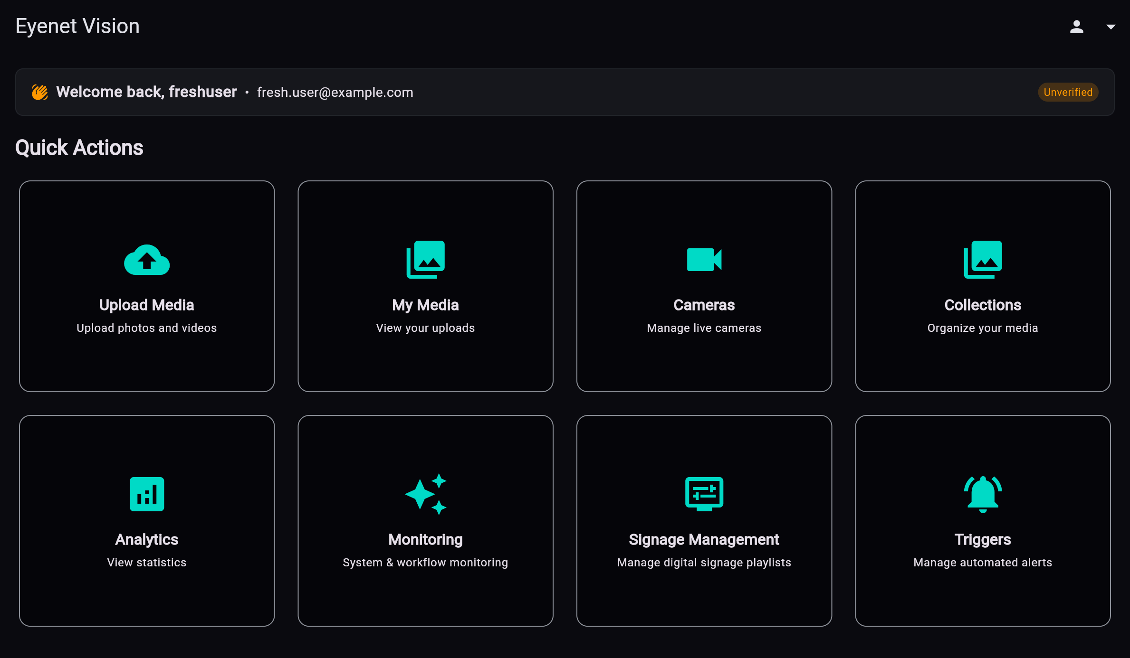
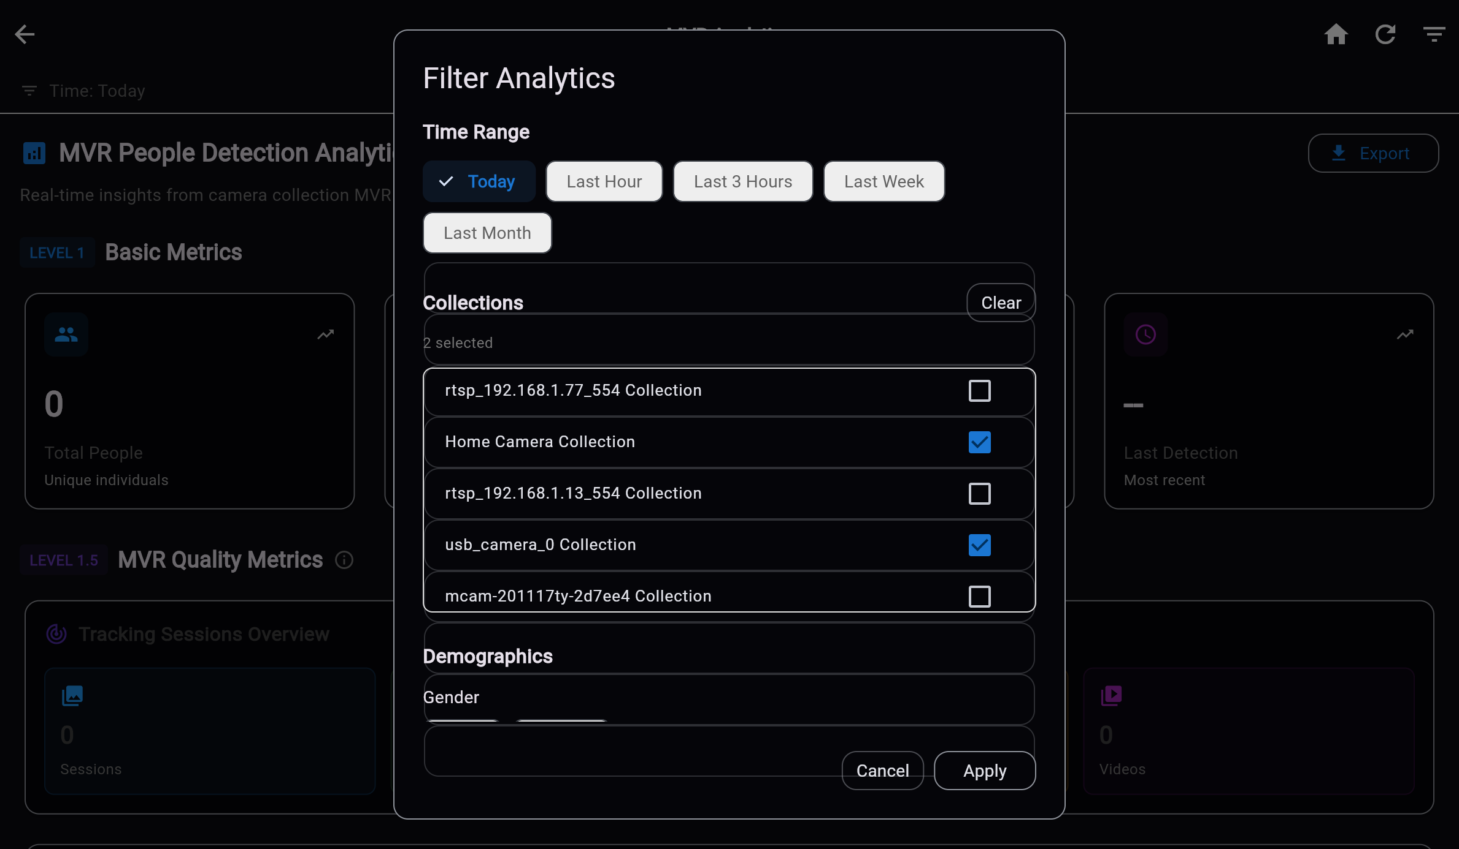
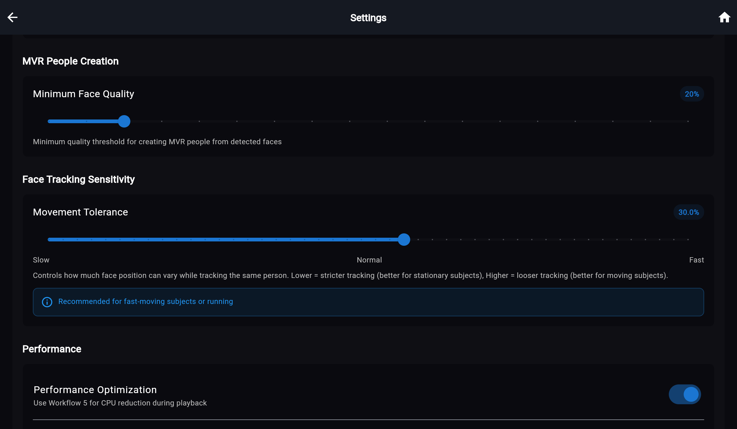
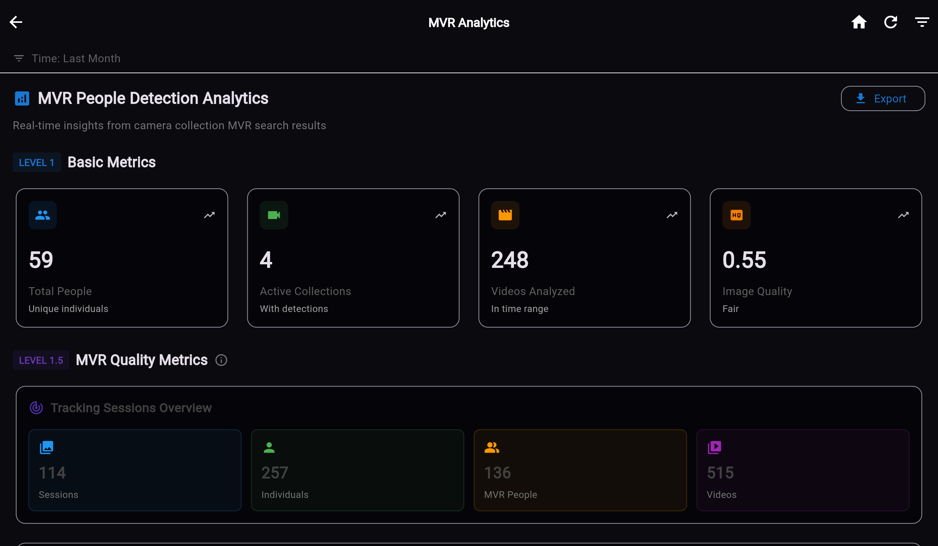
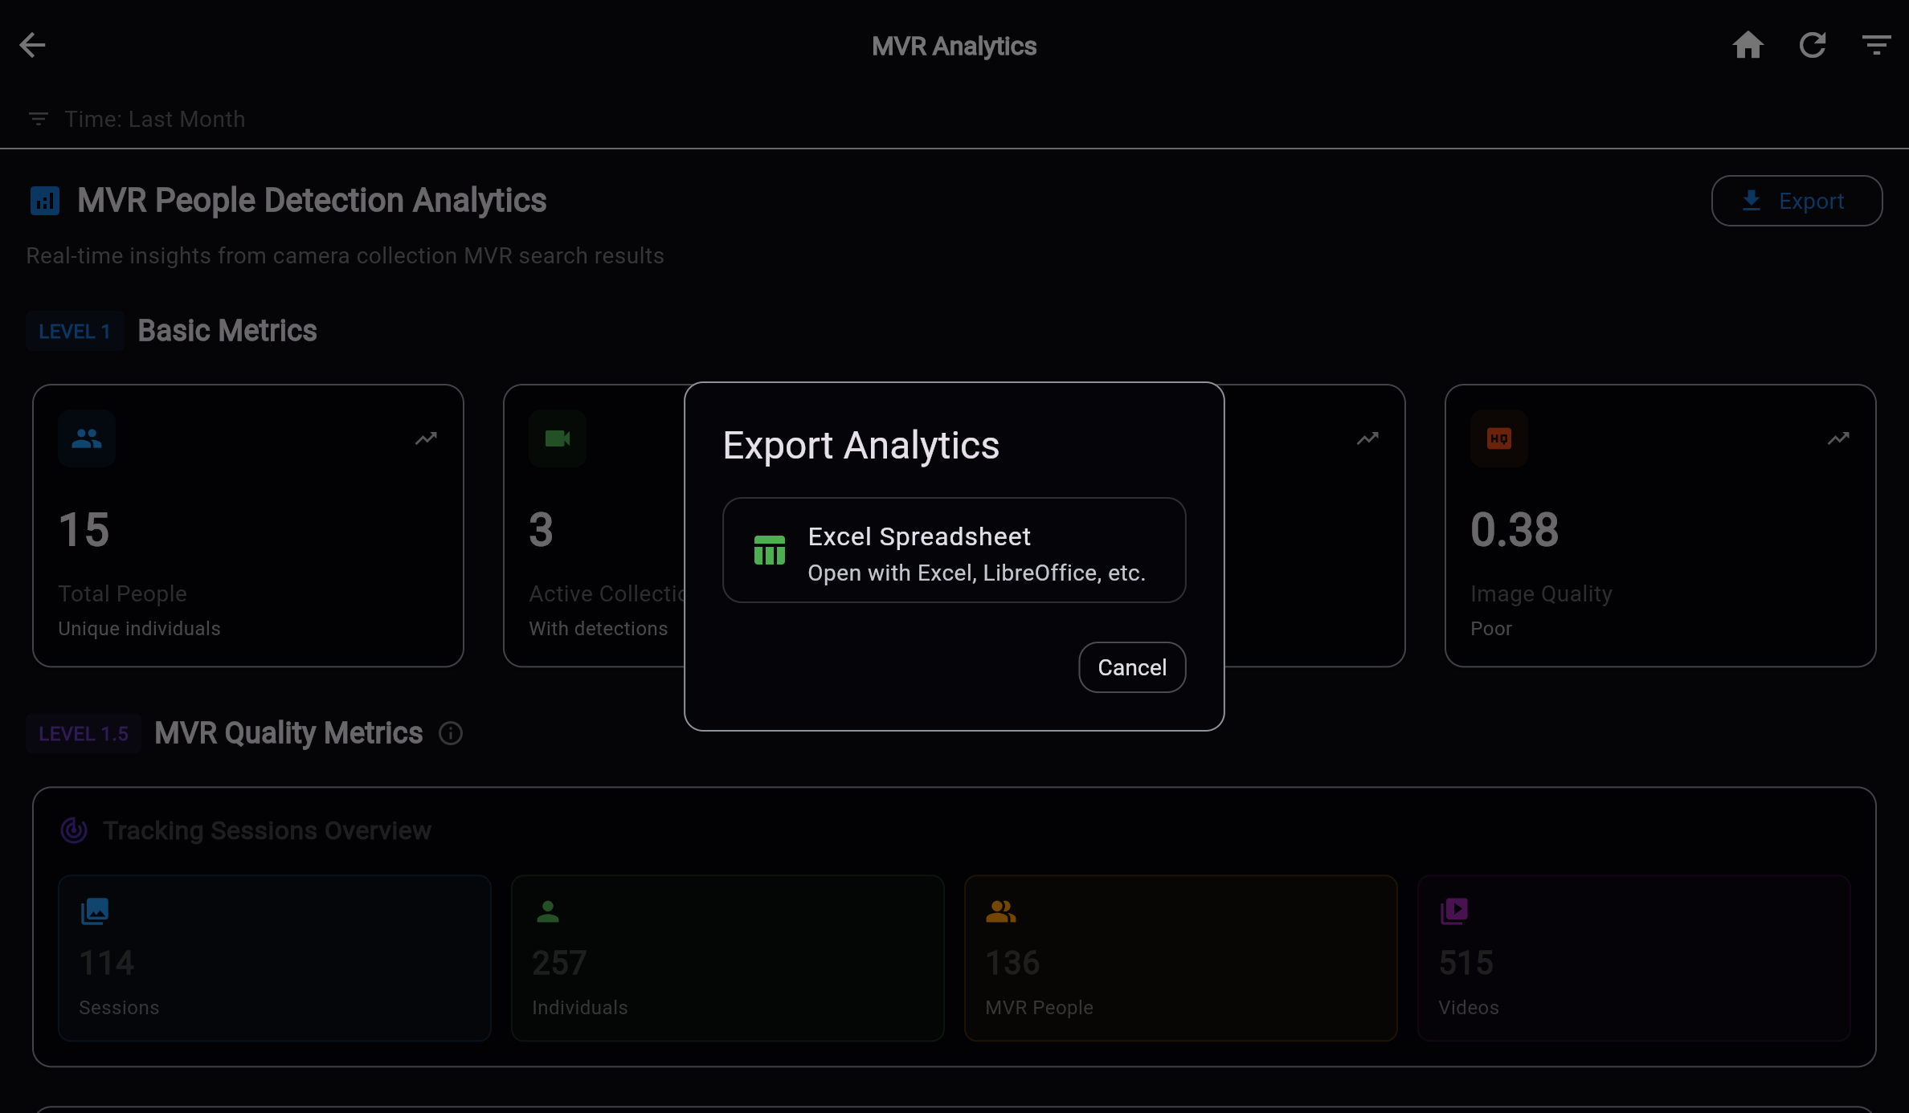
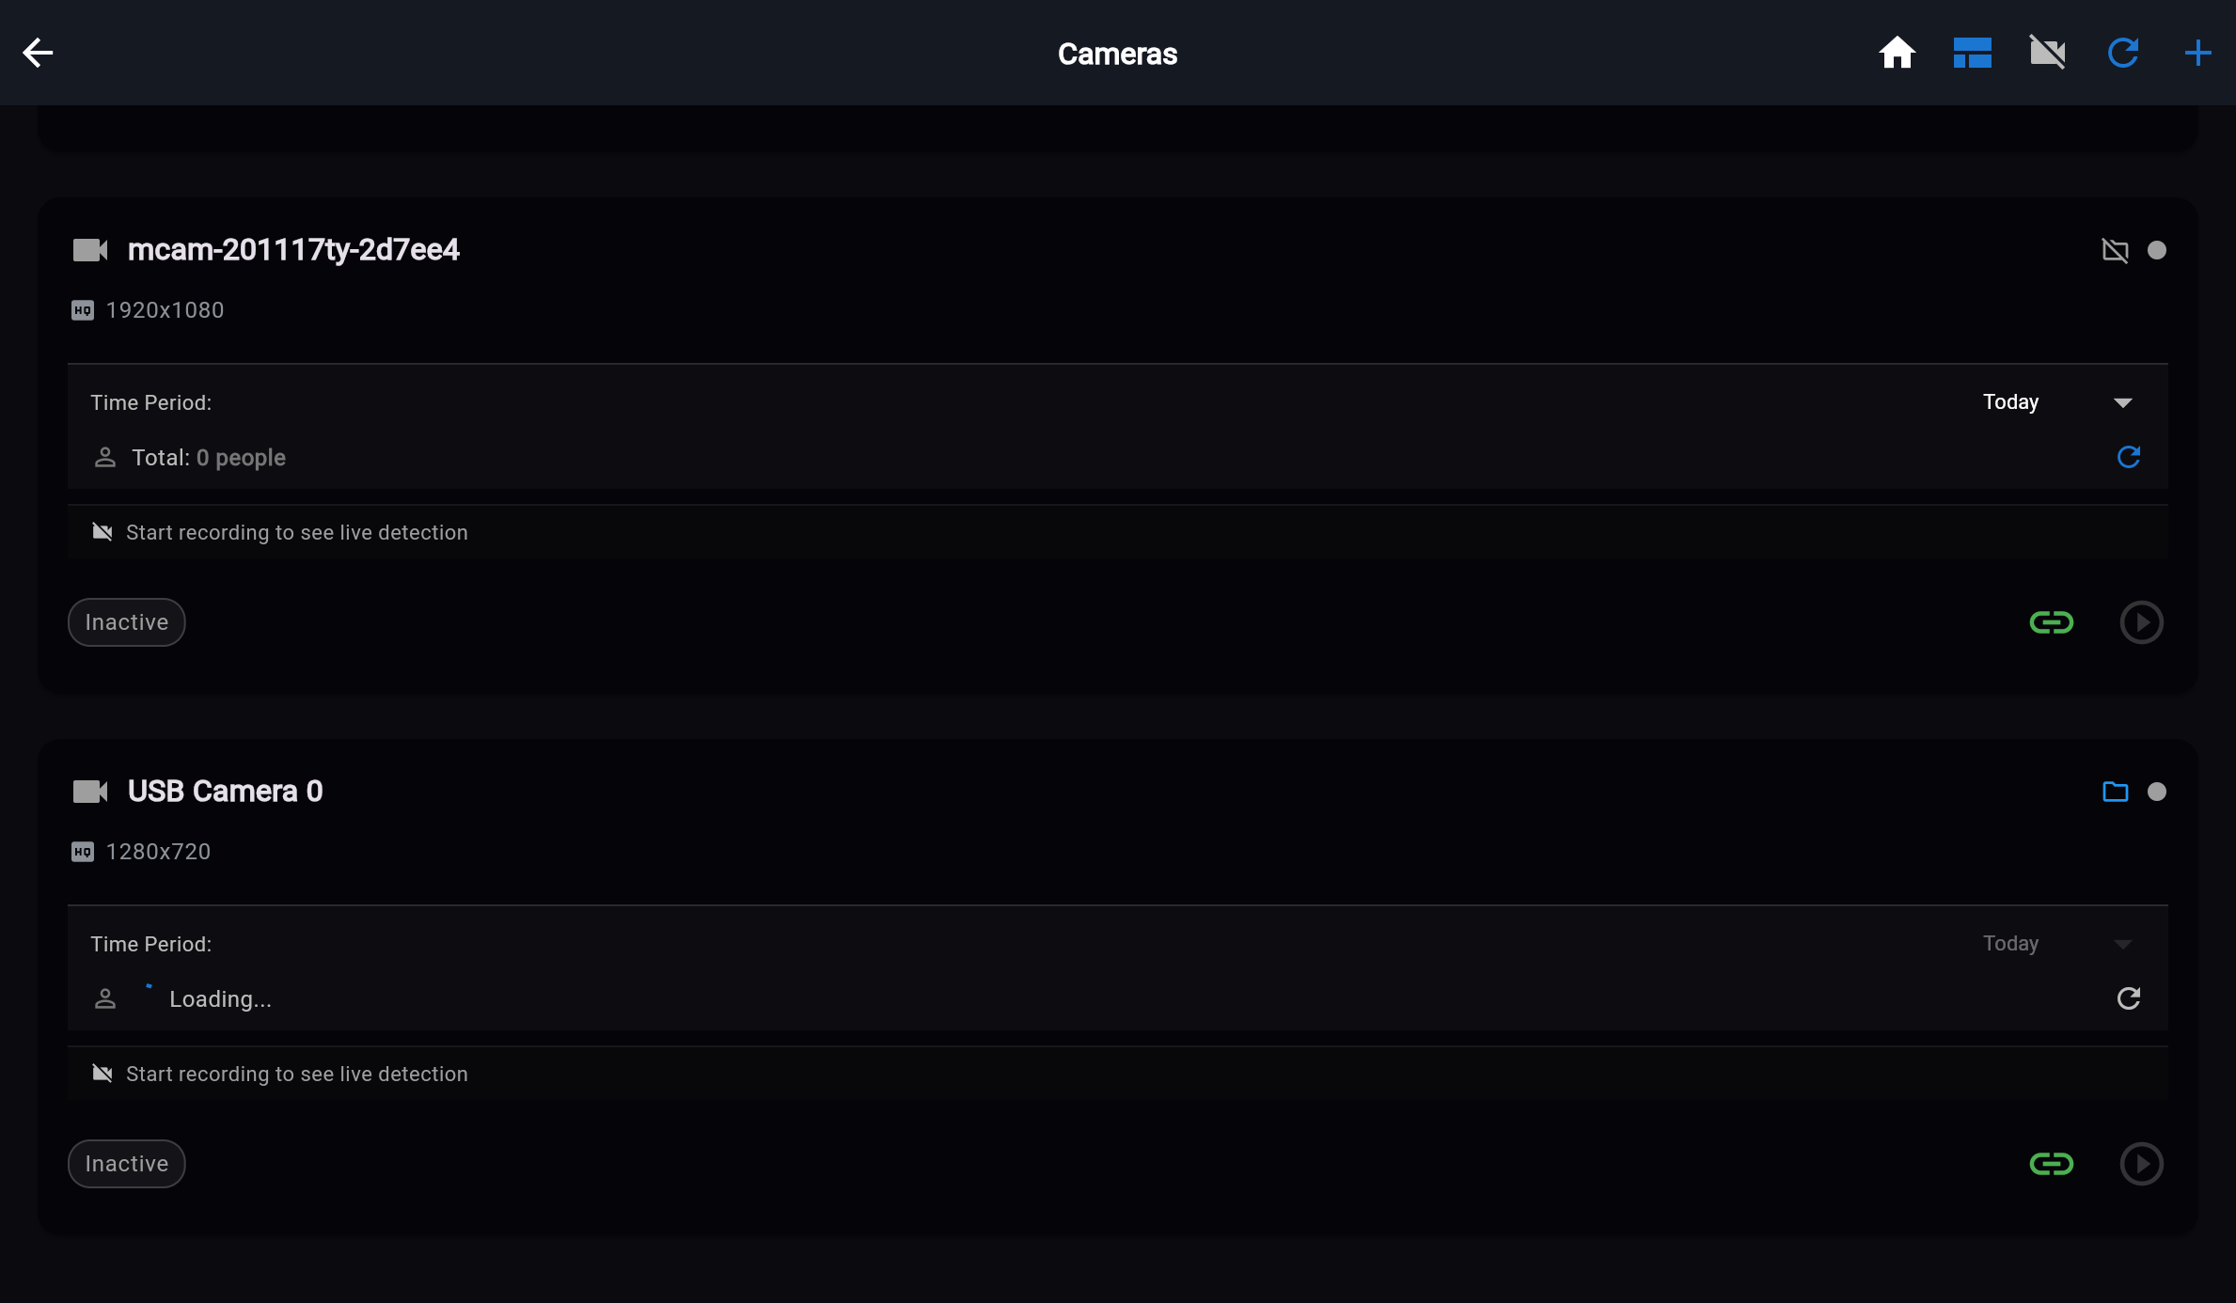
Eyenet in Action — Operations and Analytics
"Representative screenshots from the live platform UX included in the functionalities document."
Main Dashboard
Analytics Filters
System Settings
Analytics Dashboard
Detection Analytics
Camera Management
Eyenet Vision | Functionalities Presentation

Slide 12
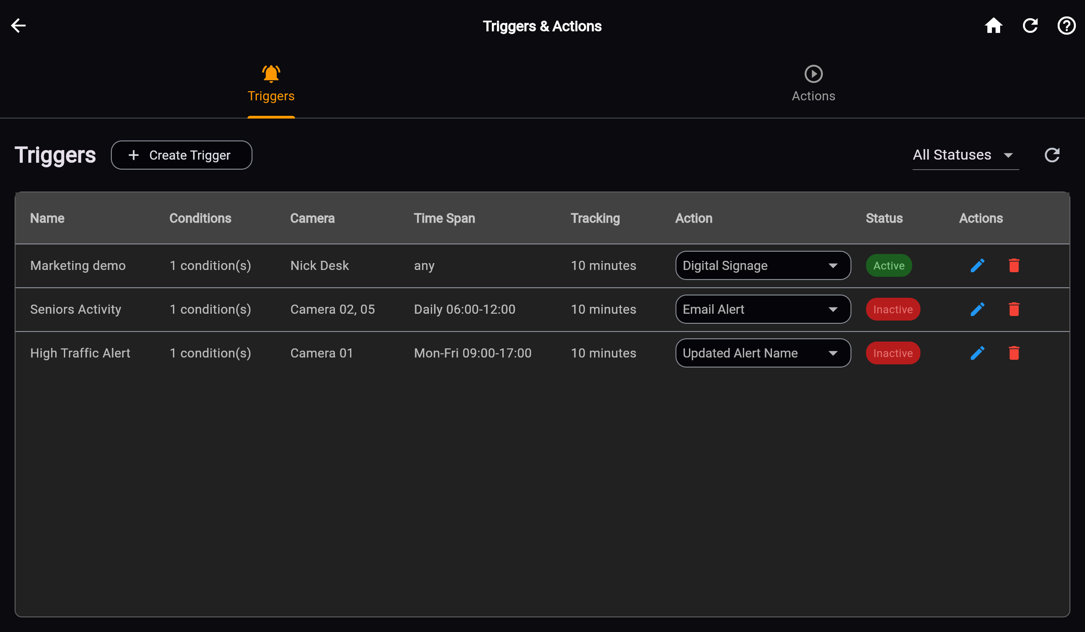
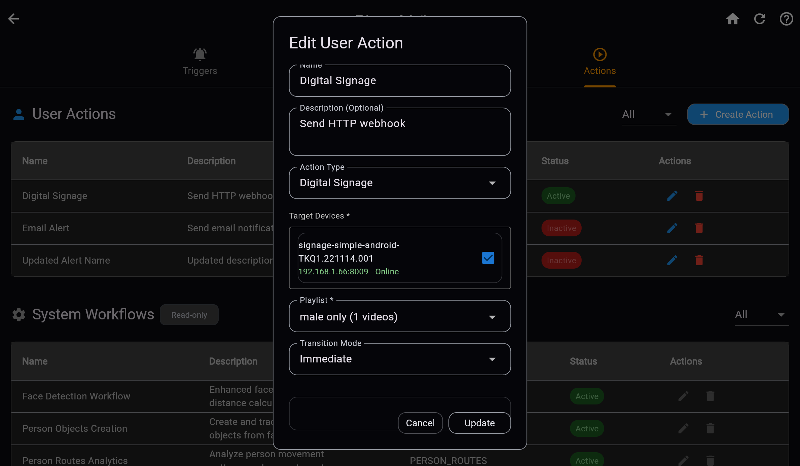
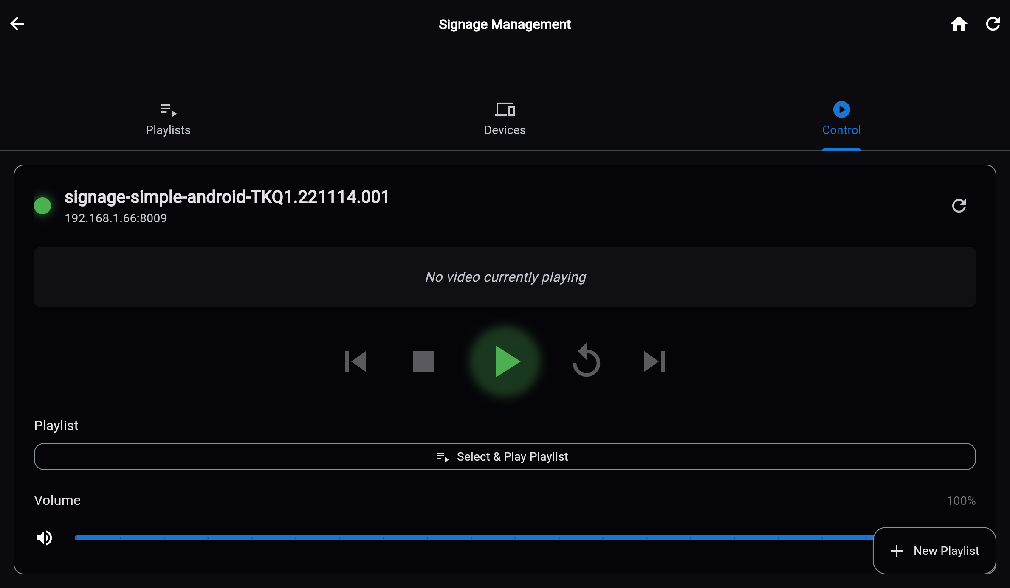
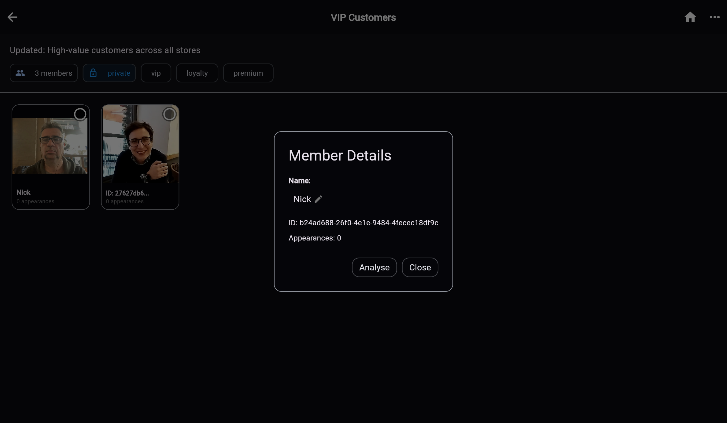
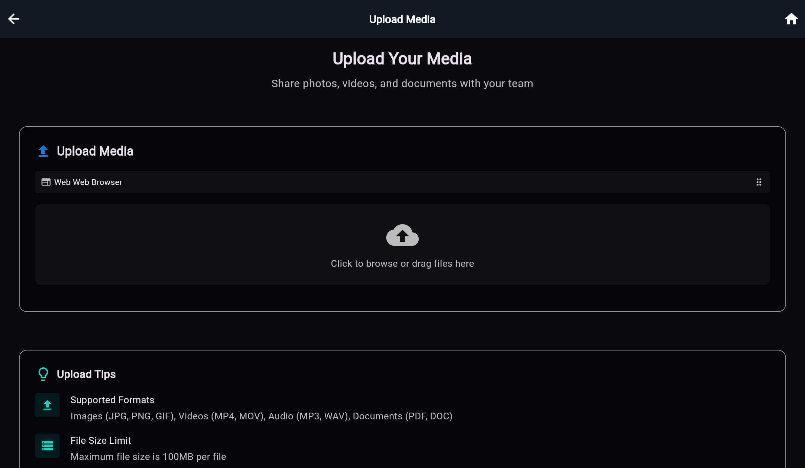
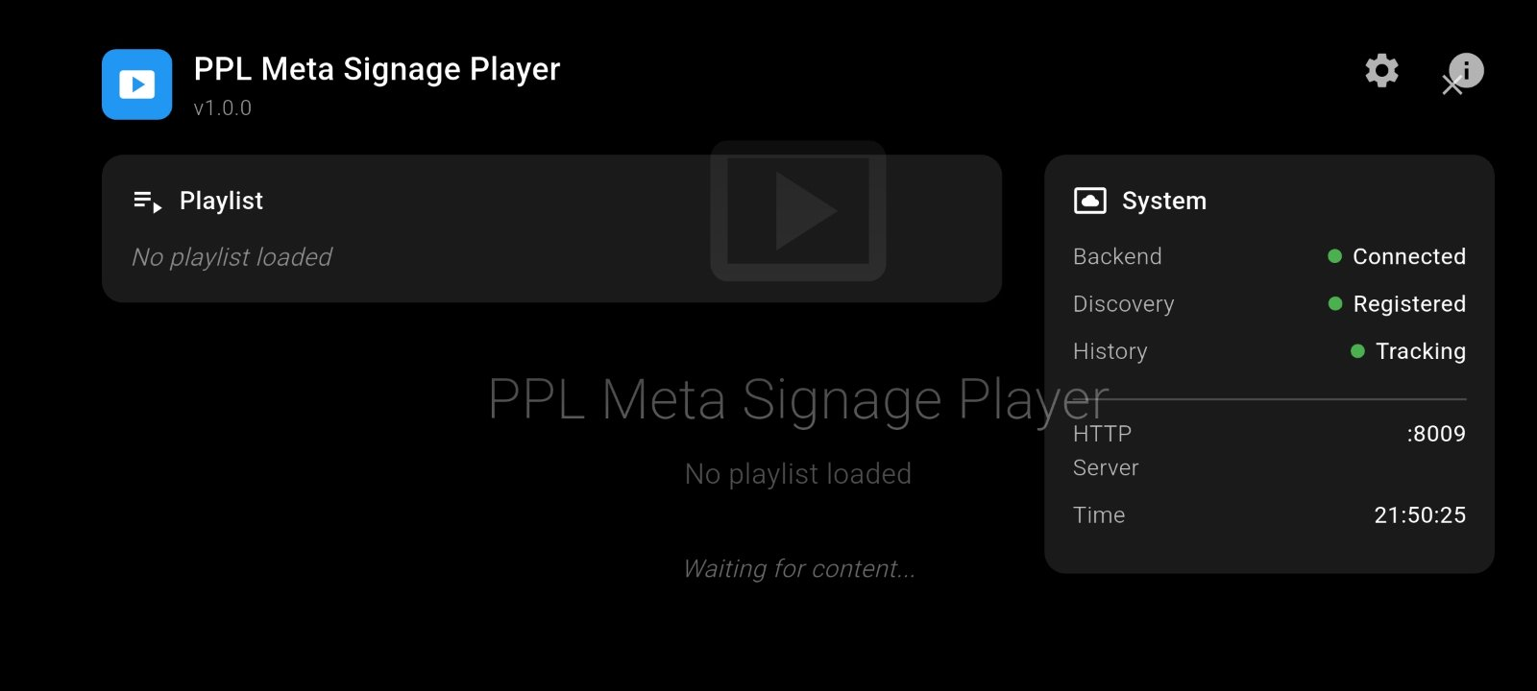
Eyenet in Action — Automation and Media
"Workflow and endpoint views covering trigger orchestration, signage, media, and playback operations."
Triggers Management
Actions Editor
Digital Signage
MVR Group Details
Media Upload
Signage Android App
Eyenet Vision | Functionalities Presentation

