Slide 1
• Counts visitors, detects unusual events, and drives automated responses in real time. Runs locally on owner-controlled hardware with privacy-first, offline-capable operation. Scales from a single camera to multi-site estates without per-camera licensing ceilings.
Eyenet Vision Platform
Core Functionalities & Features
Turning ordinary cameras into an intelligent, always-on assistant for safer, smarter, more efficient operations.
Version 2.23.1 | January 15, 2026 | Confidential

Slide 2
How Eyenet Multiplies Human Operation Capacity
Boost Moderate Cameras to Powerful Machine Vision Nodes
"Turn any camera into an intelligent sensor with real-time analytics and no specialized hardware burden."
• Turn IP, WiFi, and mobile cameras into intelligent machine-vision nodes. Run face detection, people counting, demographics, and route tracking on-device. Scale from a single lens to a facility-wide mesh without changing platform logic.
Eyenet Vision | Functionalities Presentation
"deploy faster with no complex multi-sensor setup burden, run on everyday open hardware instead of locked camera ecosystems"
• Works with everyday cameras and standard compute hardware
• Supports mixed hardware generations across store estates
• Avoids lock-in to closed camera vendors and proprietary appliance chains
• Simplifies deployment architecture for demographic-aware signage
• Enables staged rollout instead of full-store replacement
• Lower replacement risk when device vendors change strategy
Eyenet Vision | Technology Retail Pitch

Slide 3
Operational Coverage and Safety
Track human activity, regulate access, and protect restricted zones
"Replace manual checks with always-on monitoring that counts, alerts, and documents events automatically."
• Real-time people tracking, attendance, route analysis, and dwell-time mapping. Automatic headcount, checkpoint oversight, and unauthorized-access alerts. Virtual perimeters, lone-worker monitoring, PPE checks, and incident documentation.
Eyenet Vision | Functionalities Presentation
"operate signage from big wall screens and entrance LED panels down to single tabletop laptops"
• Big wall displays — hero product narratives and brand campaigns
• Entrance LED panels — dynamic campaign hooks at the door
• Mid-store digital screens — zone-specific promotions
• Counter displays — assisted selling and targeted offers
• Single tabletop laptops — zero-infrastructure endpoint option
• Same campaign logic delivered across all endpoint types
Eyenet Vision | Technology Retail Pitch

Slide 4
Audience-Aware Automation
Drive digital signage and workflows from live vision events
"Cameras read the room and trigger content, notifications, and third-party actions in milliseconds."
• Switch playlists, promotions, and emergency messages based on age, gender, group size, and behavior. Configure per-camera triggers with configurable conditions and AND/OR logic. Measure impressions, dwell time, and engagement to prove signage ROI.
Eyenet Vision | Functionalities Presentation
"remove the operational burden of bulky, rigid booth models"
• Marketing teams no longer trapped in fixed kiosk/booth models
• Campaigns can be changed without infrastructure redesign
• Faster campaign updates without rebuilding physical layouts
• Less physical reconfiguration for new promotions or launches
• Better support for seasonal and launch-driven retail cadence
• Lower capex pressure when scaling to new store zones
Eyenet Vision | Technology Retail Pitch

Slide 5
Advanced Protection Use Cases
Control entry points, restricted areas, VIP coverage, and remote operations
"One platform coordinates access control, perimeter alerts, VIP recognition, and remote supervision."
• Protect entrances, gates, and checkpoints with identity awareness and audit trails. Stream person-of-interest alerts to security eyewear and mobile devices. Manage every camera, trigger, and dashboard remotely from web or mobile with no cloud video dependency.
Eyenet Vision | Functionalities Presentation
"manage campaigns from anywhere using any device via web dashboard and mobile apps"
• Owners, marketing teams, and managers access operations remotely
• Any device supported: desktop, tablet, or smartphone
• Teams stay operational without being tied to in-store control stations
• Campaign uploads, endpoint assignments, and scheduling from any location
• Faster response to floor-level changes or urgent campaign needs
Eyenet Vision | Technology Retail Pitch

Slide 6
Instant Deployment
Get started quickly on everyday hardware
"Deploy with standard compute, no forced GPU servers, and no per-camera licensing ceiling."
• Start with 16 GB RAM and a modern CPU using cameras you already own. Bring the first detection online in minutes from IP, WiFi, or phone-based cameras. Expand from one room to multi-site estates without redesigning the architecture.
Eyenet Vision | Functionalities Presentation
"monitor guest engagement in real time and adjust content on the fly"
• Live monitoring of guest engagement while campaigns are running
• Real-time campaign adjustments without physical intervention
• Faster campaign launch cycles — upload video, assign endpoint, go live
• Central reporting accessible from any device by managers and decision makers
• Unified performance visibility across all stores and zones
• Faster decision cycles for budget and campaign optimization
Eyenet Vision | Technology Retail Pitch

Slide 7
Key Differentiators
"A privacy-first machine-vision platform designed for owner control, flexible automation, and practical scale."
• ✓
• Offline-capable operation without internet dependency.
• ✓
• Scales from one camera to enterprise-wide deployments.
• ✓
• Secure by design with encryption, access control, and VPN-ready connectivity.
Eyenet Vision | Functionalities Presentation
"give every stakeholder — owner, manager, marketer, IT — their own role-based view"
• Owners: business KPIs and strategic performance summaries
• Marketing teams: campaign metrics and engagement analytics
• Technical teams: system health and operational status
• Regional managers: cross-store performance comparisons
• Sales associates: context-ready display support for consultative selling
• Custom dashboard configuration per enterprise client
Eyenet Vision | Technology Retail Pitch

Slide 8
Core Platform Functionalities
"The platform combines computer vision, hardware integration, triggers, media handling, and communications into one operating layer."
• Computer Vision, Cameras, Triggers:
• People analytics: tracking, counting, attendance, route analysis, and demographics. Multi-source camera support across IP, WiFi, and mobile soft cameras. Per-camera trigger configuration with real-time event detection and complex condition logic. Automated actions across push, in-app, email, SMS, signage, and webhooks.
• Video, Data, and Communications:
• Local video storage and processing with no mandatory cloud services. Intelligent communications with audit logging and delivery tracking. Real-time dashboards, historical analytics, behavioral patterns, and reporting. Operational resilience with internet optional except for selected remote notifications.
Eyenet Vision | Functionalities Presentation
"run multi-camera analytics decoupled from signage points for full store intelligence"
• Multiple camera points per installation, independent of signage cameras
• Analytics coverage and signage coverage designed separately
• Better flexibility in store layout and camera planning
• Scalable expansion without redesigning signage hardware
• Edge-capable: local processing options for resilience and privacy
• Modular scaling: start with one zone, expand store-wide
Eyenet Vision | Technology Retail Pitch

Slide 9
Architecture, Security, and Scale
"Eyenet is engineered as an edge-capable microservices platform that preserves control while scaling across sites and stakeholders."
• Deployment and Governance:
• On-premises and edge deployment with modular microservices and automatic service discovery. Role-based access, file-level encryption, private VPN support, and full data sovereignty. Remote diagnostics, centralized logging, audit trails, and trigger execution debugging.
• Scalability and Extensibility:
• Flexible scaling from homes to industrial sites with hardware-based performance growth. Unlimited camera support subject to available hardware capacity. Extensible integrations through REST APIs, webhooks, custom connectors, and signage modules.
Eyenet Vision | Functionalities Presentation
"understand audiences through age and gender distributions, proximity heatmaps, and individual-level engagement data"
• Age and gender distribution analytics across store zones
• Proximity heatmaps showing customer movement and dwell concentration
• Granular engagement insights down to individual-level events*
• Combined analytics from both signage and analytics camera types
• More accurate audience understanding for campaign targeting
• Stronger evidence for ROI and merchandising decisions
• * Subject to local legal and privacy requirements
Eyenet Vision | Technology Retail Pitch

Slide 10
Technical Architecture Highlights
"Trigger evaluation, orchestration, and context awareness are first-class capabilities rather than bolt-on automation."
• Trigger and Action System:
• Granular per-camera rule configuration. Instant event evaluation against configured conditions. Reliable action delivery with retry logic and failure tracking. Complete audit trail for activations and executions.
• Context and Signage Intelligence:
• Time, day, occupancy, demographics, velocity, direction, and trajectory-aware triggers. Historical comparison and multi-camera correlation across zones. Dynamic signage content switching, demographic targeting, and playlist automation.
Eyenet Vision | Functionalities Presentation
"deploy faster with no complex multi-sensor setup burden, run on everyday open hardware instead of locked camera ecosystems"
• Works with everyday cameras and standard compute hardware
• Supports mixed hardware generations across store estates
• Avoids lock-in to closed camera vendors and proprietary appliance chains
• Simplifies deployment architecture for demographic-aware signage
• Enables staged rollout instead of full-store replacement
• Lower replacement risk when device vendors change strategy
Eyenet Vision | Technology Retail Pitch

Slide 11
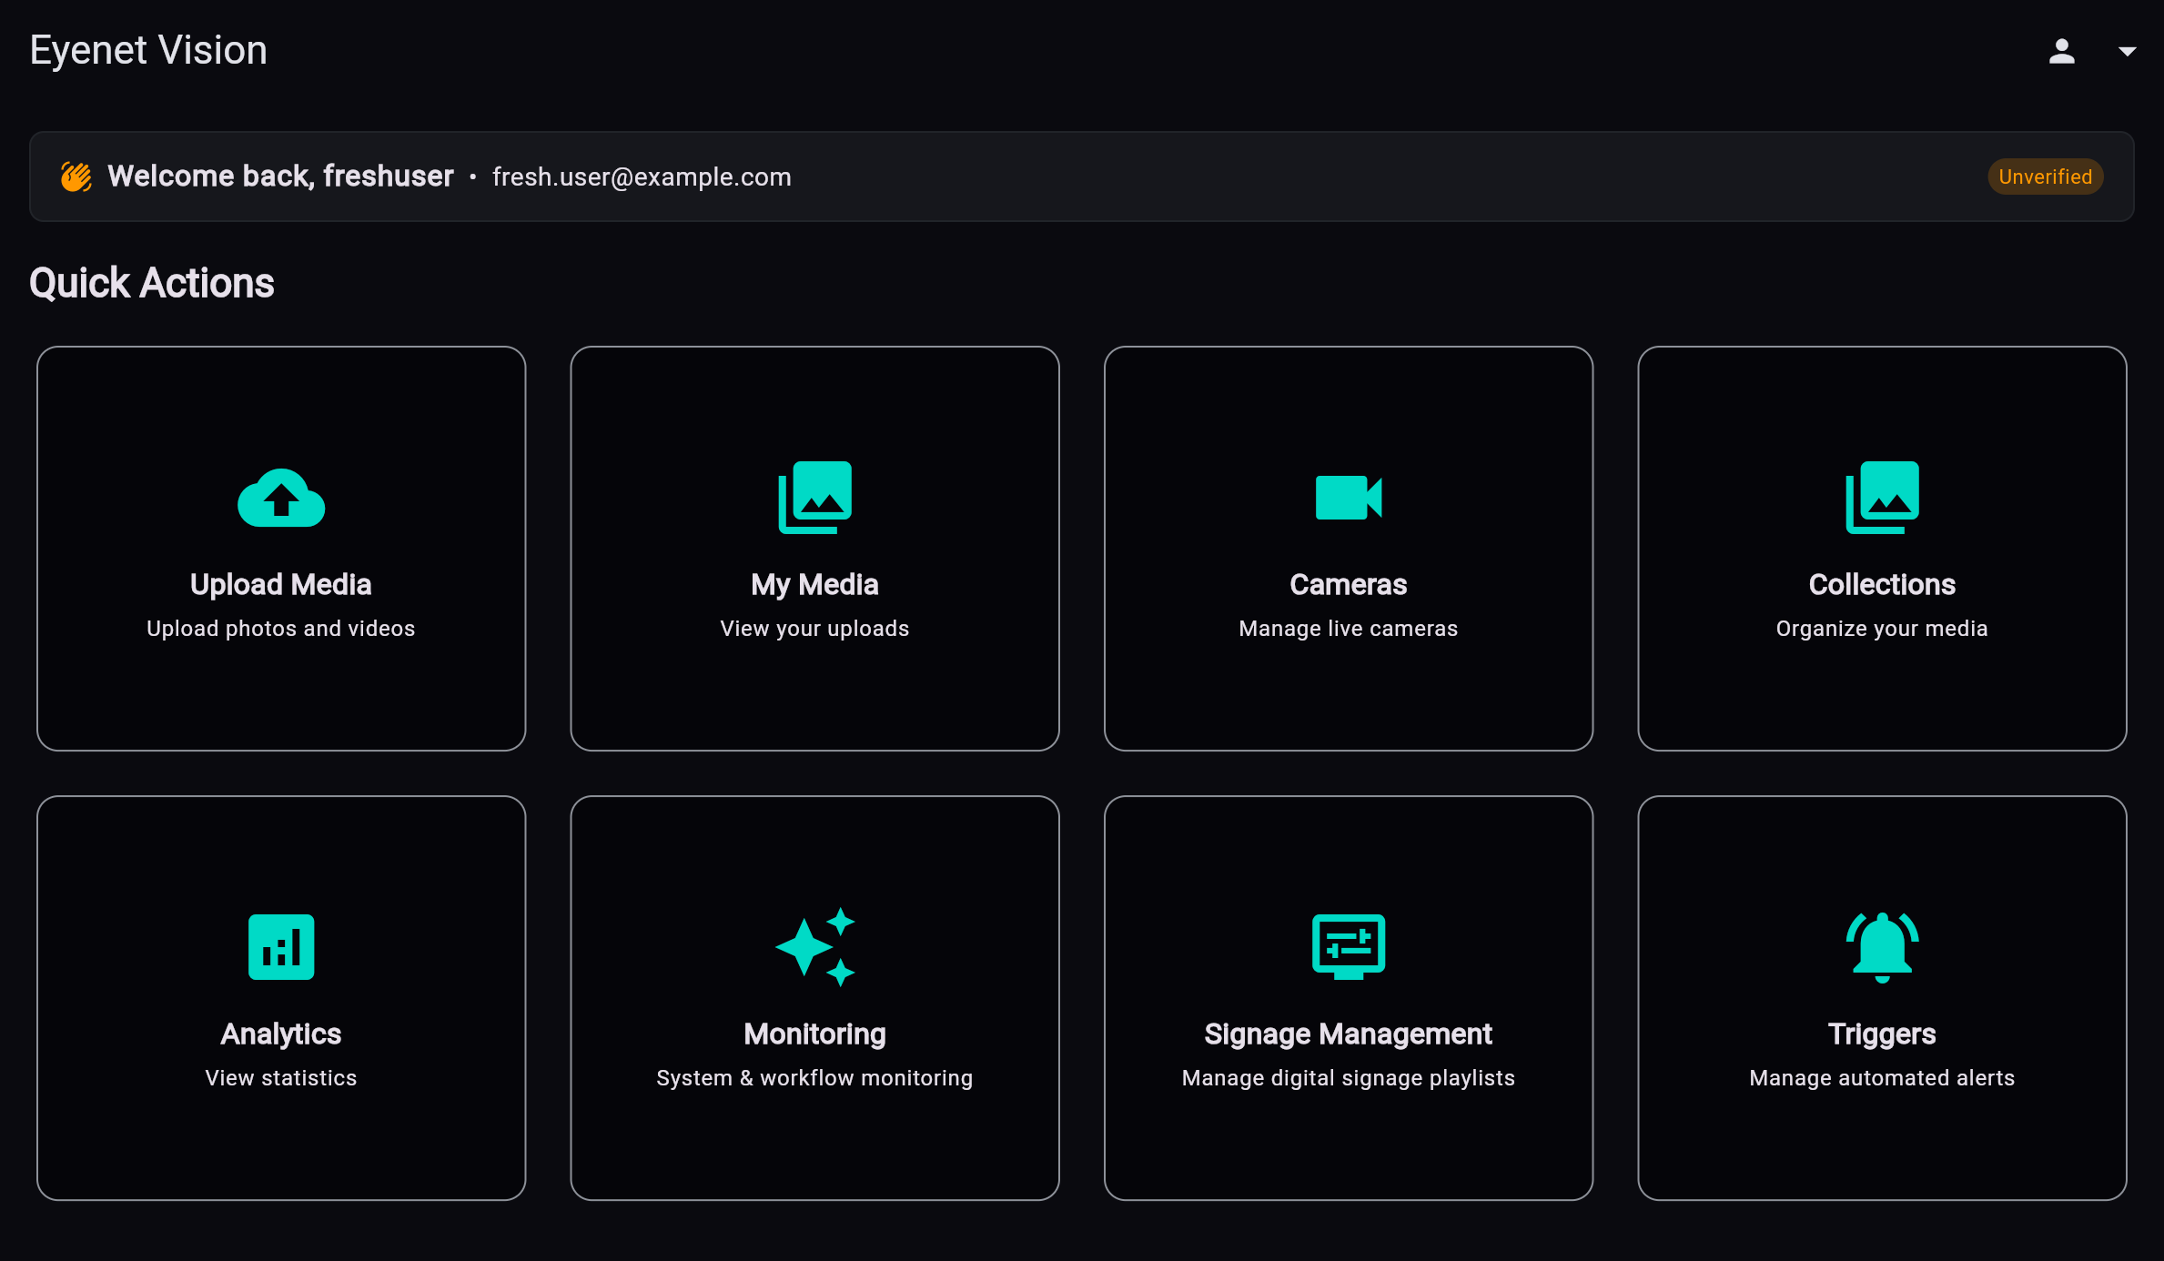
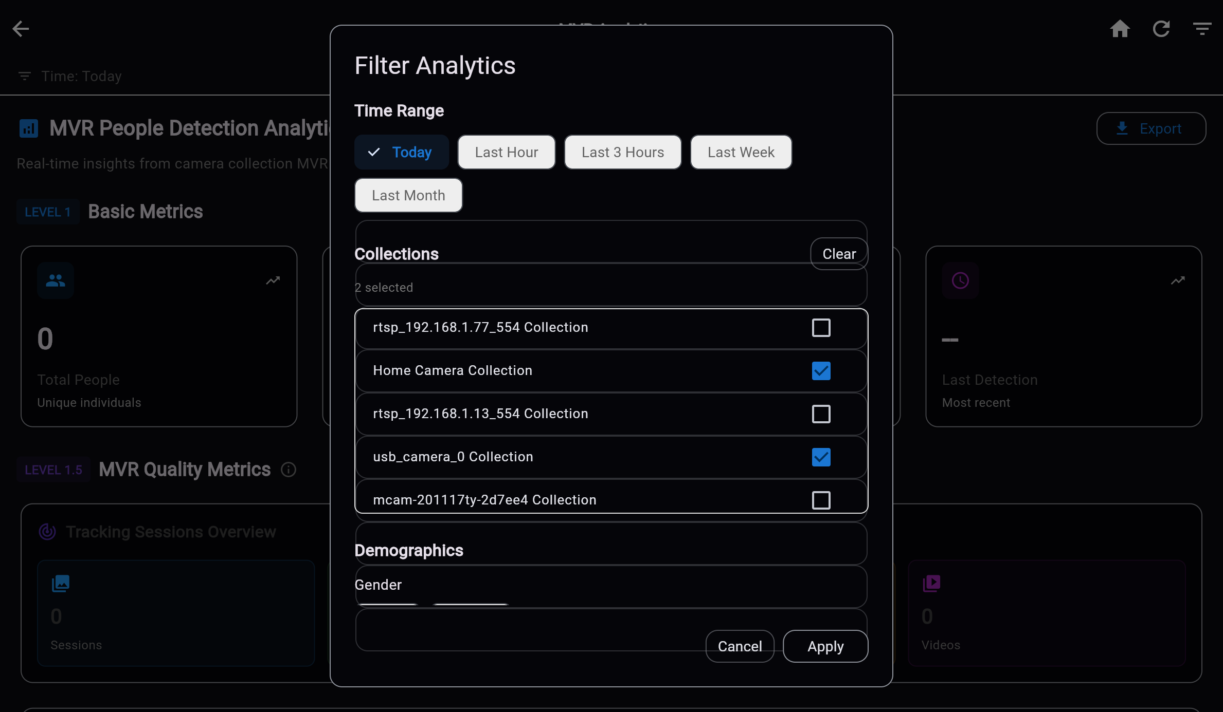
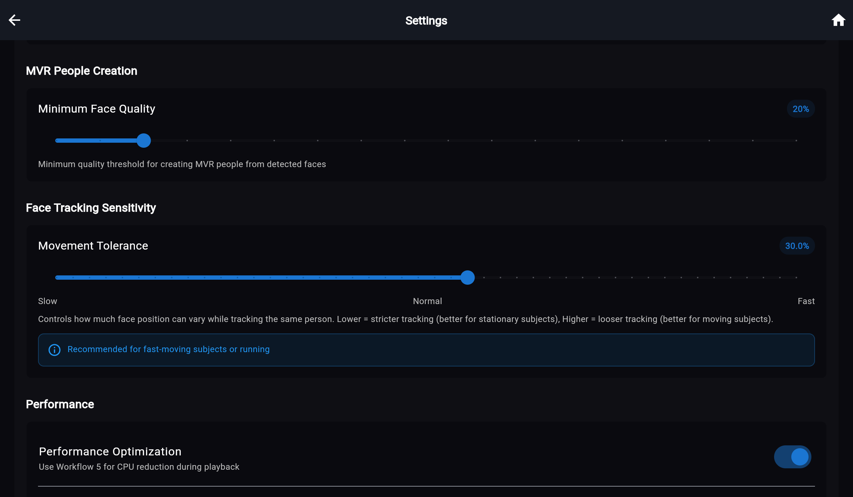
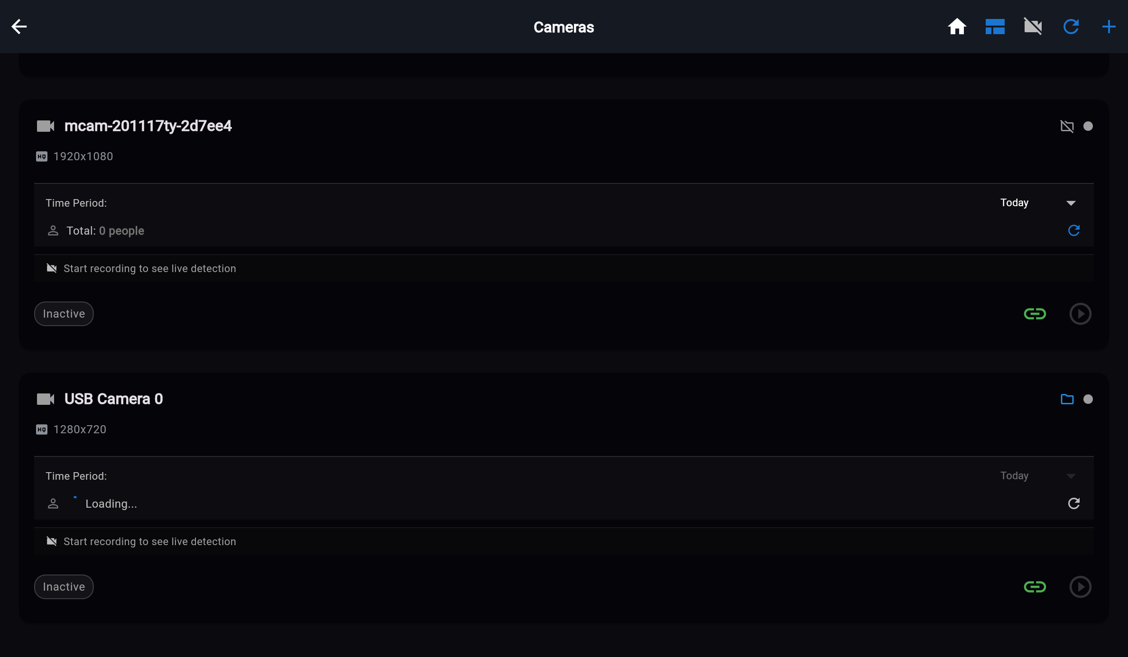
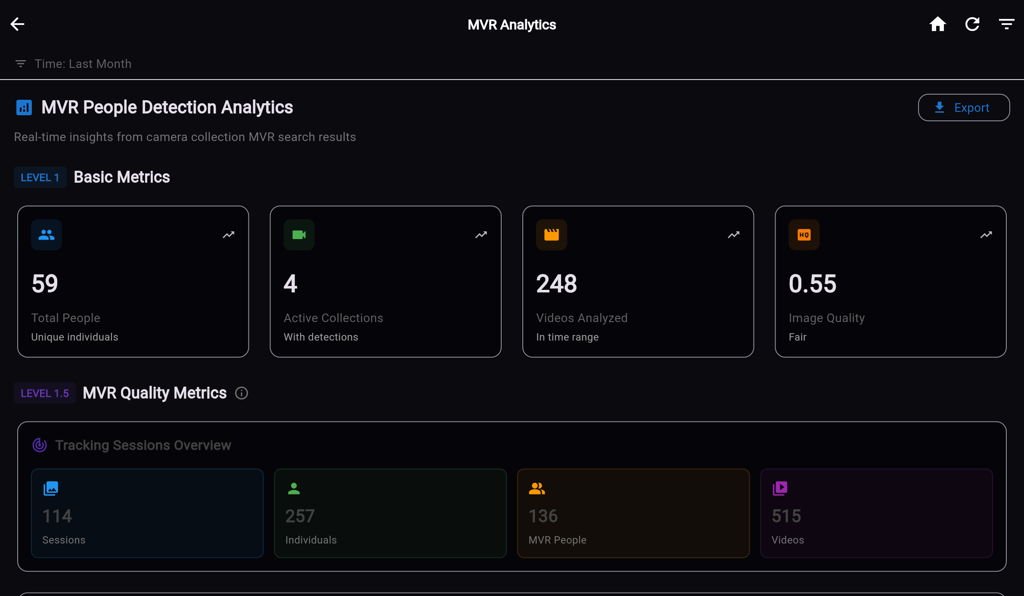
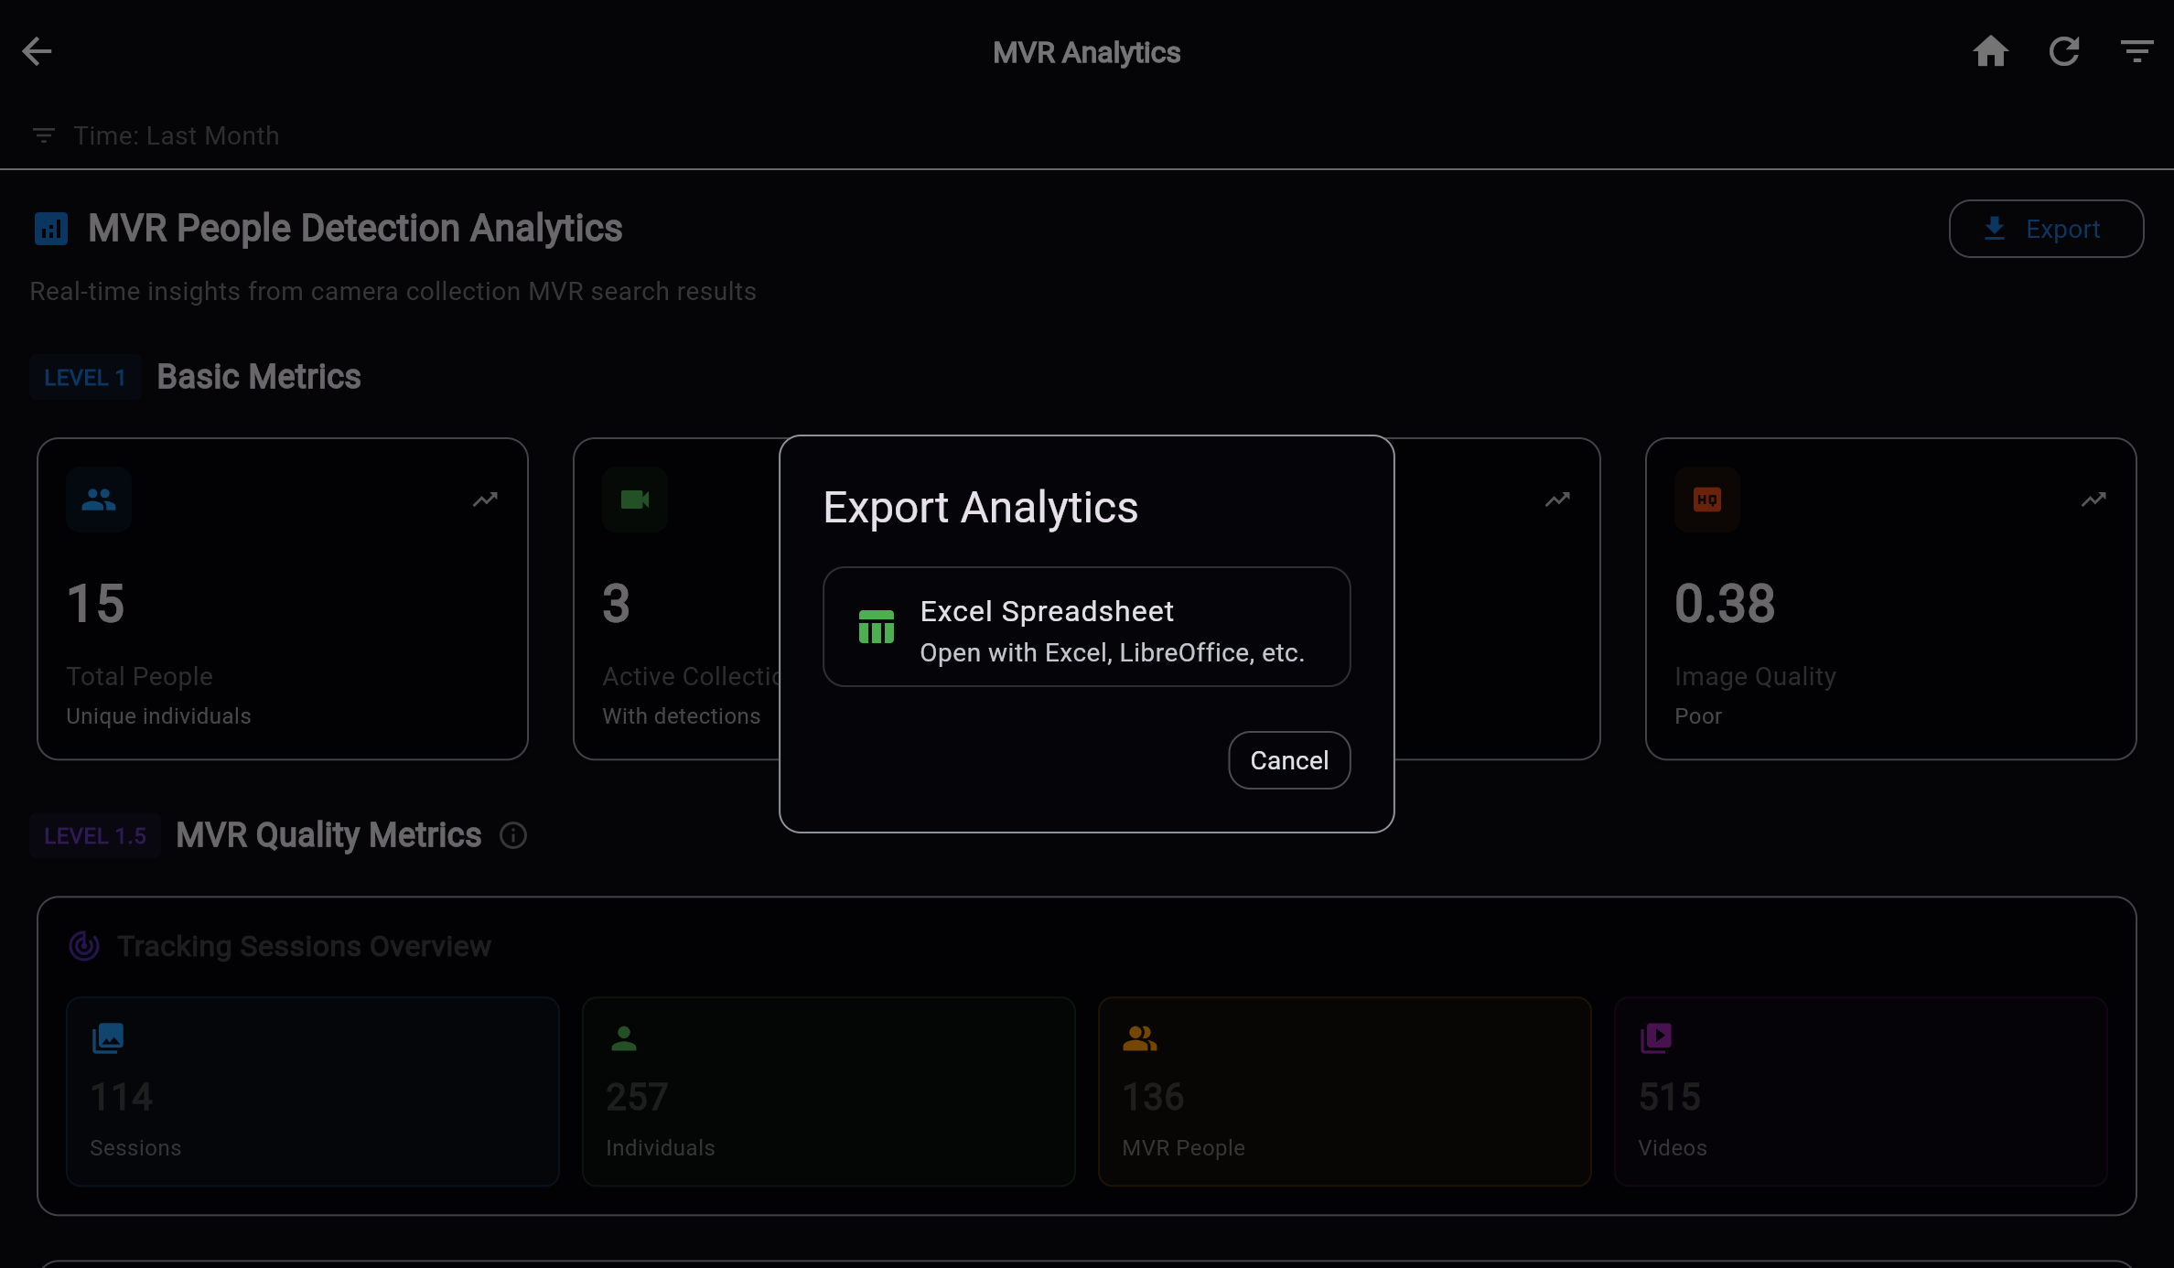
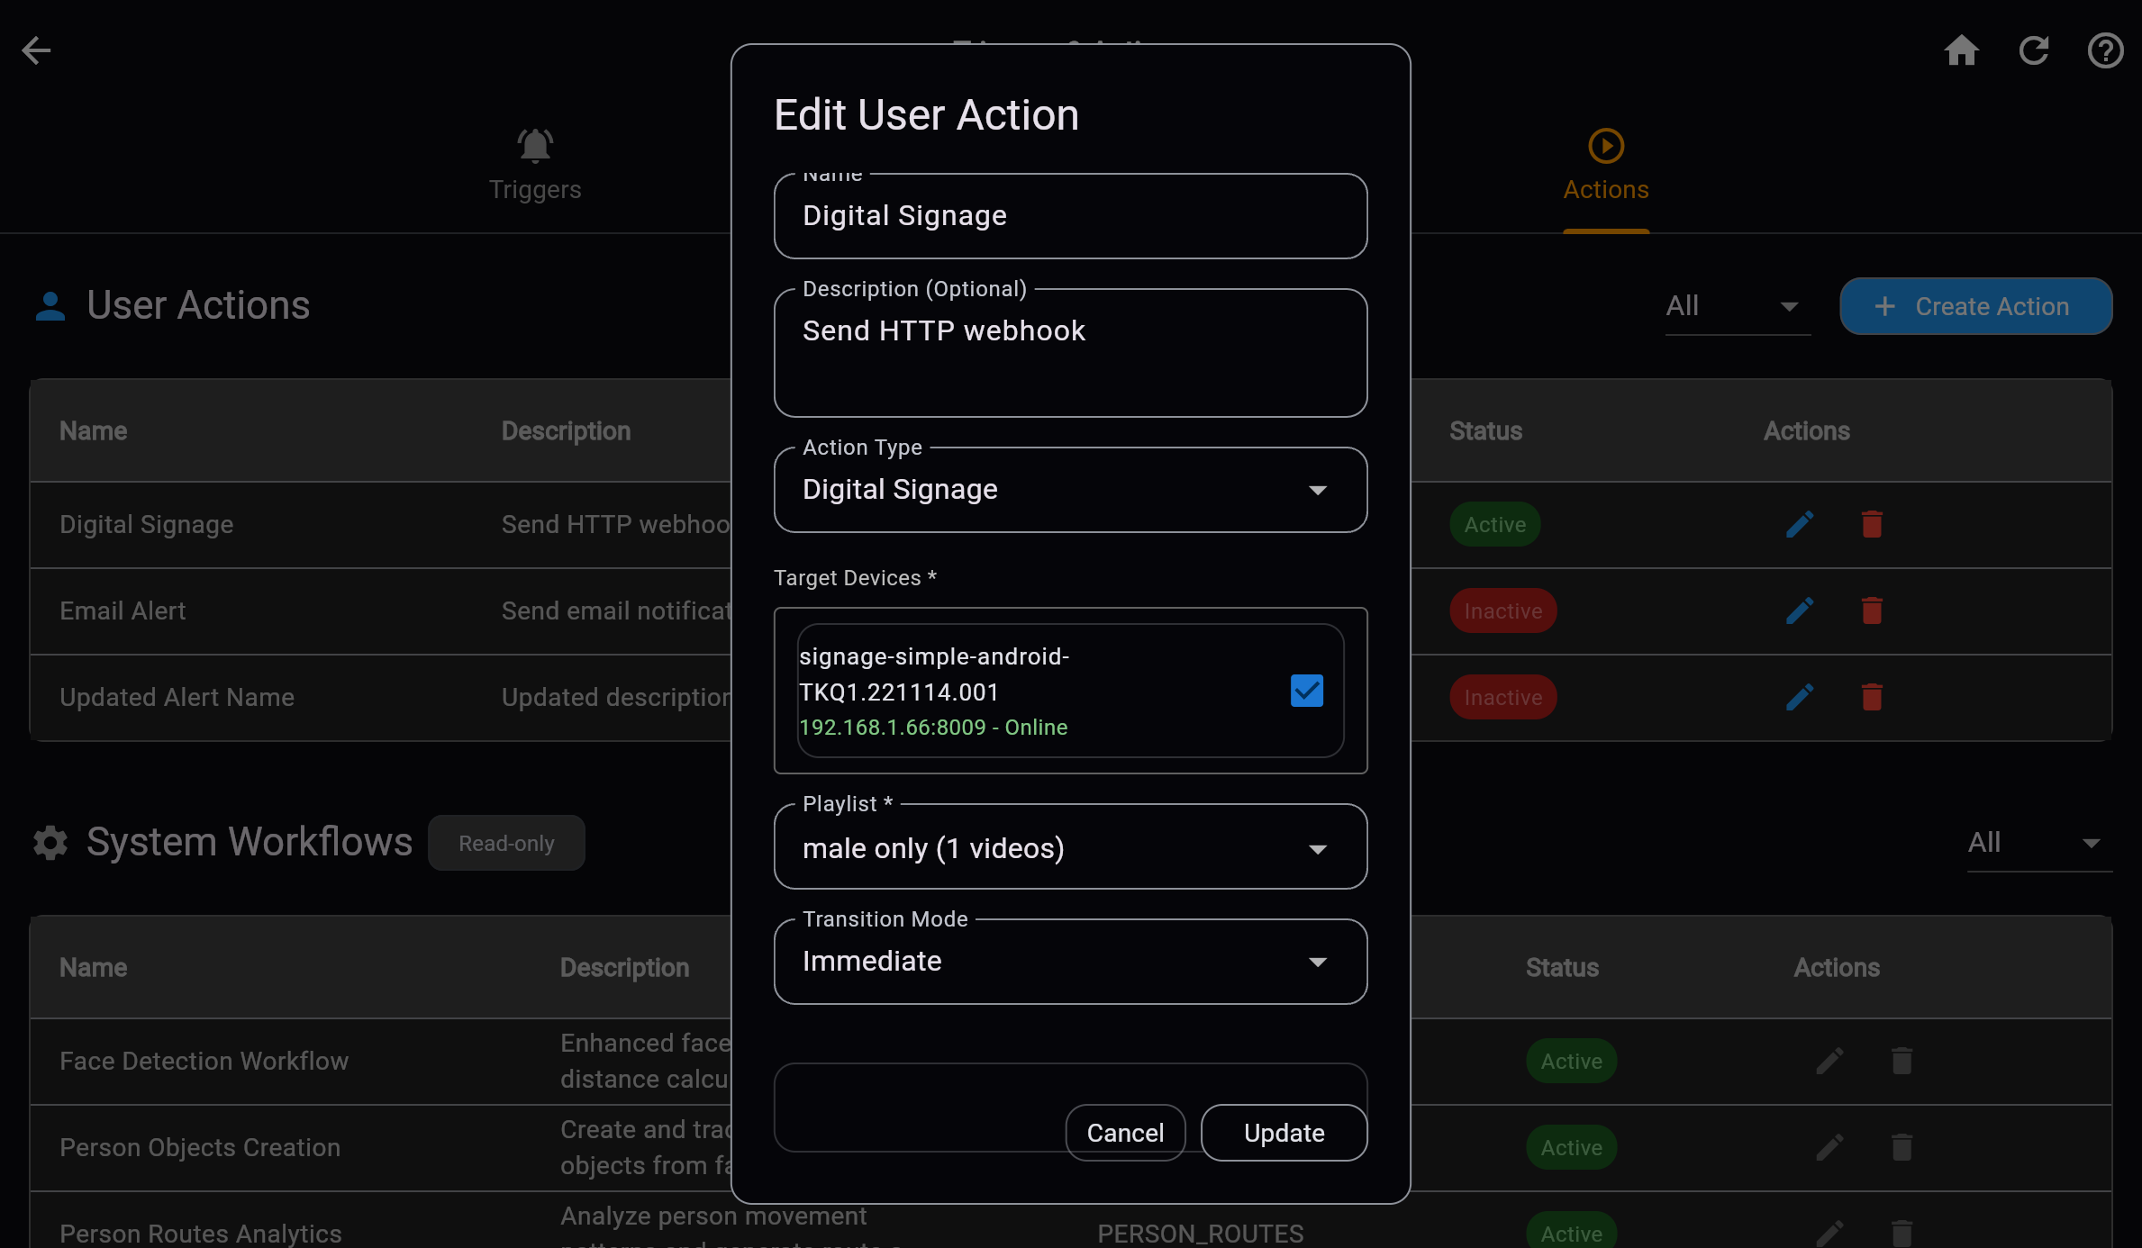
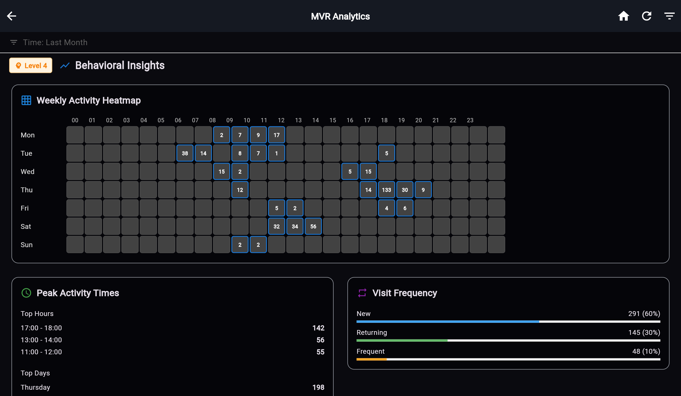
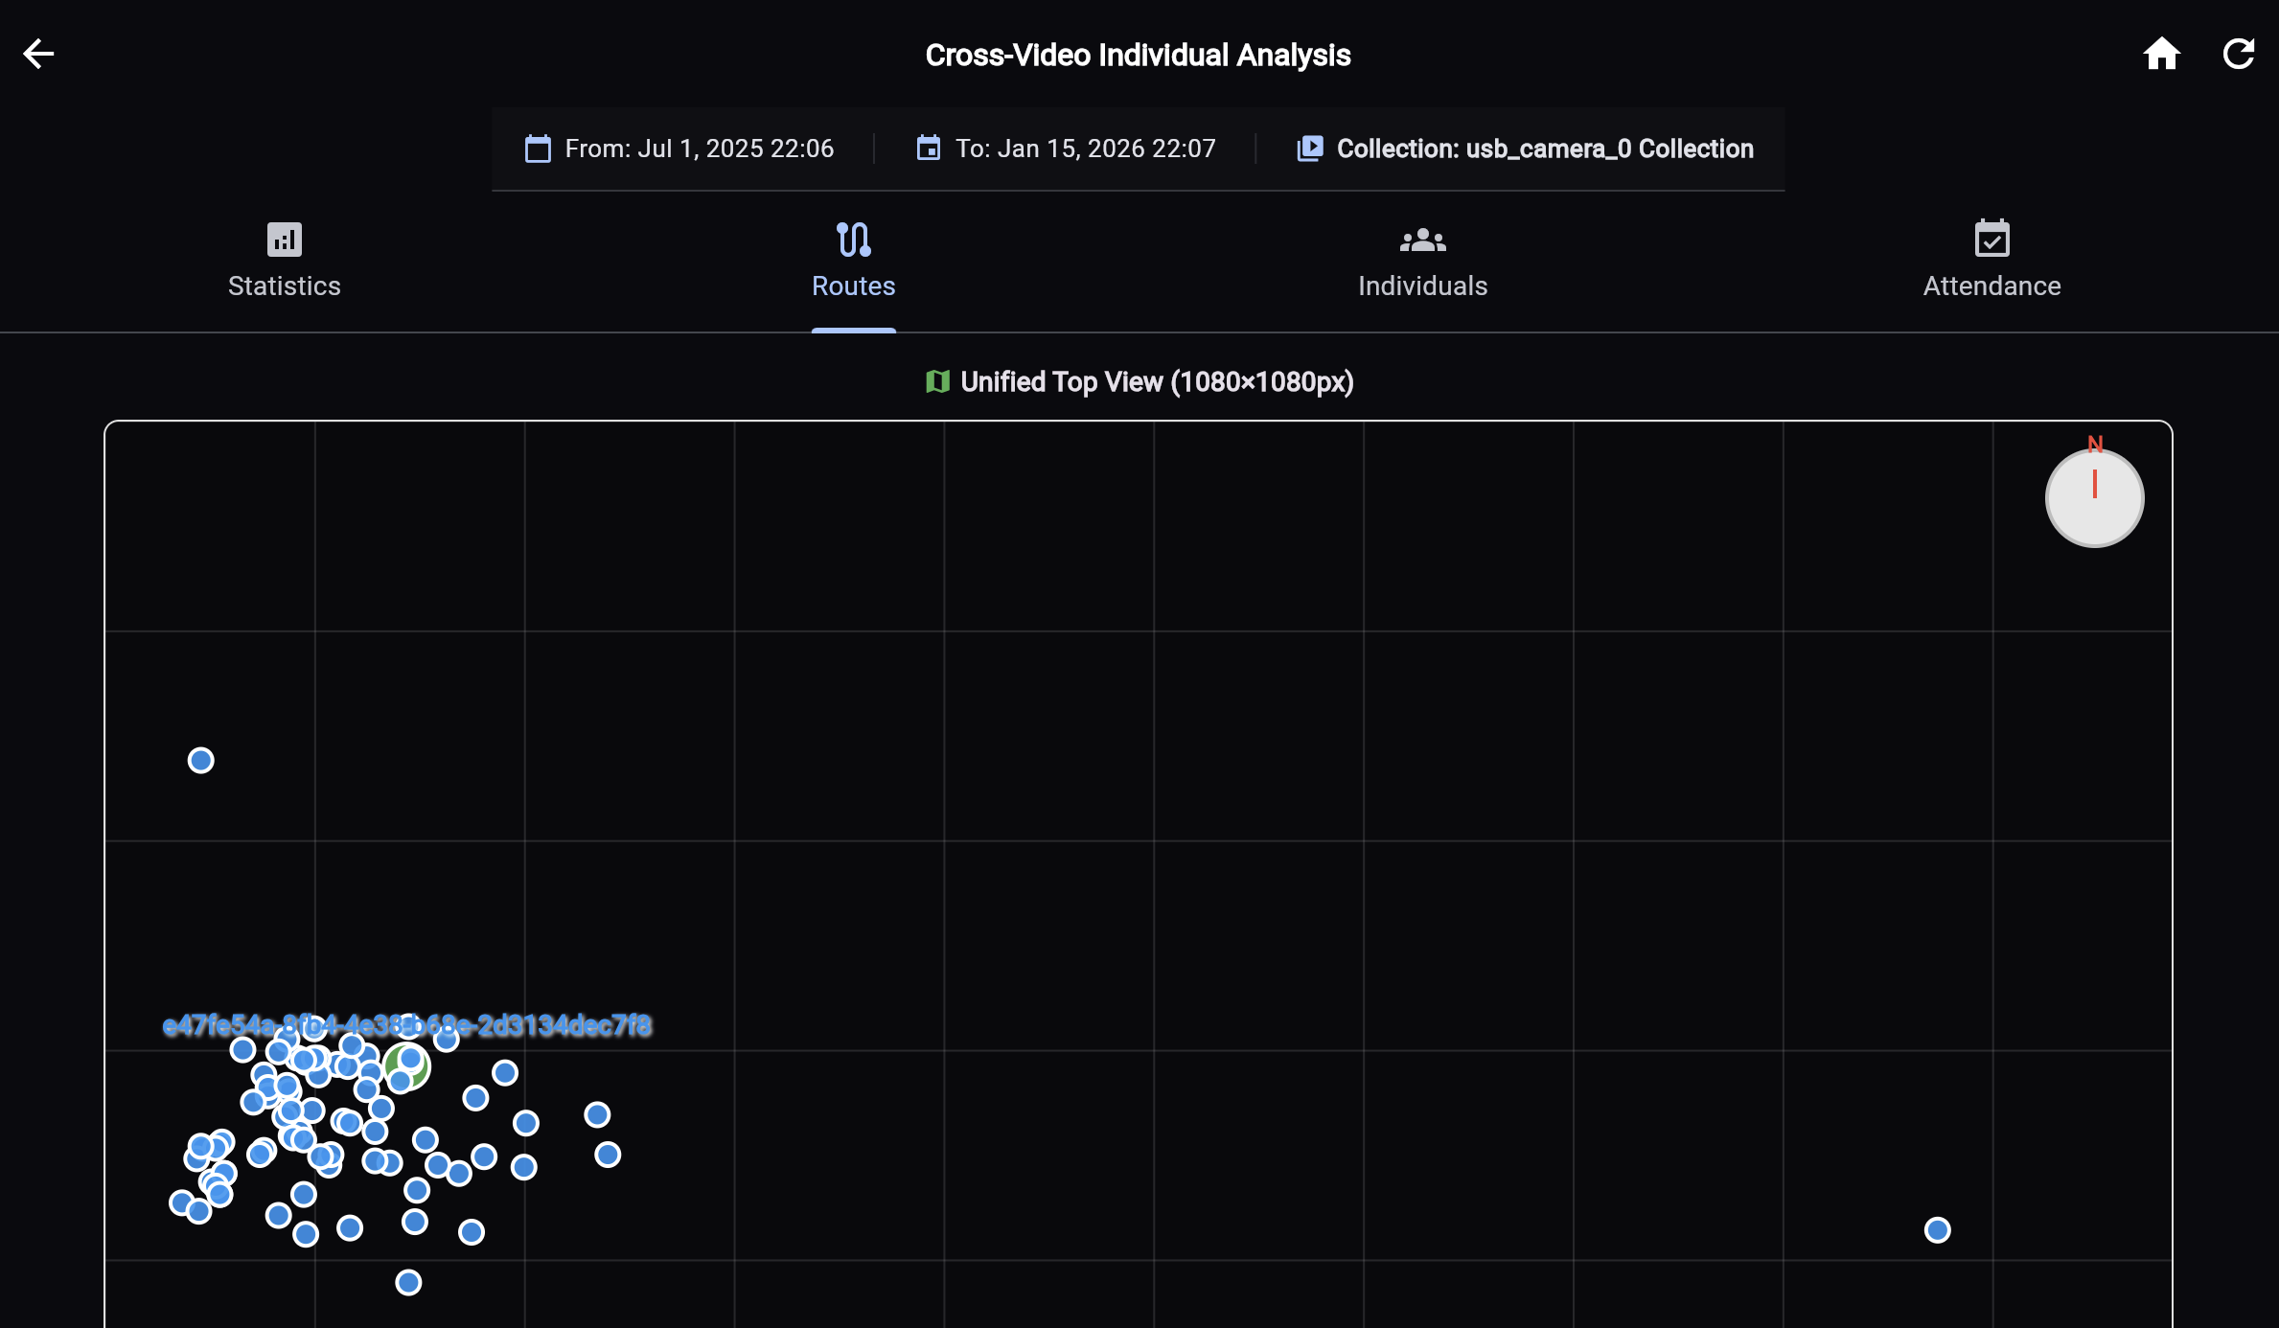
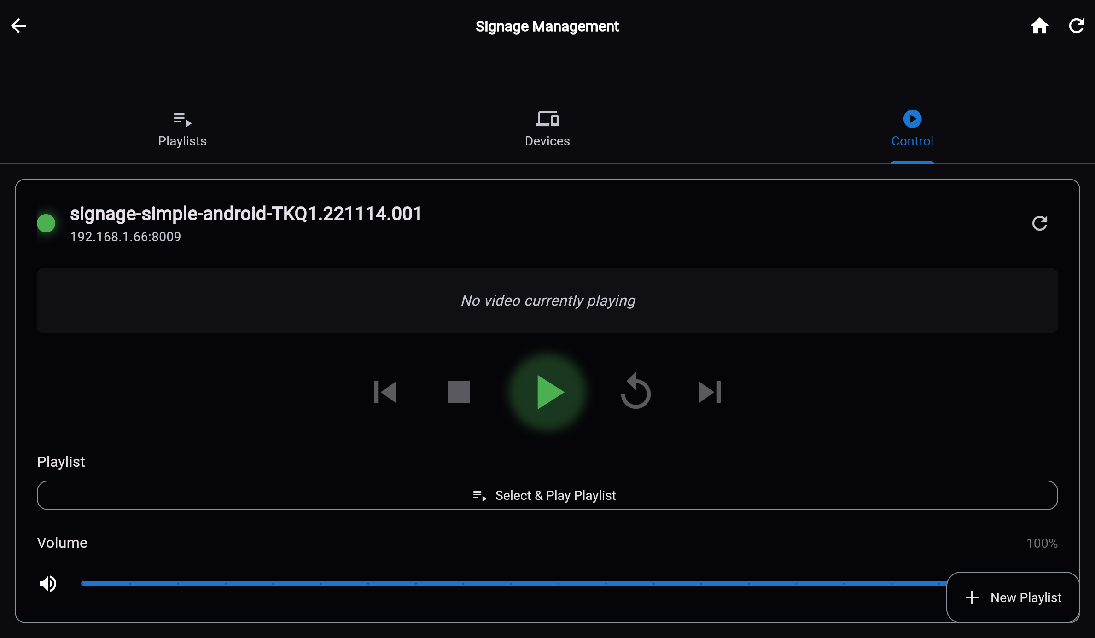
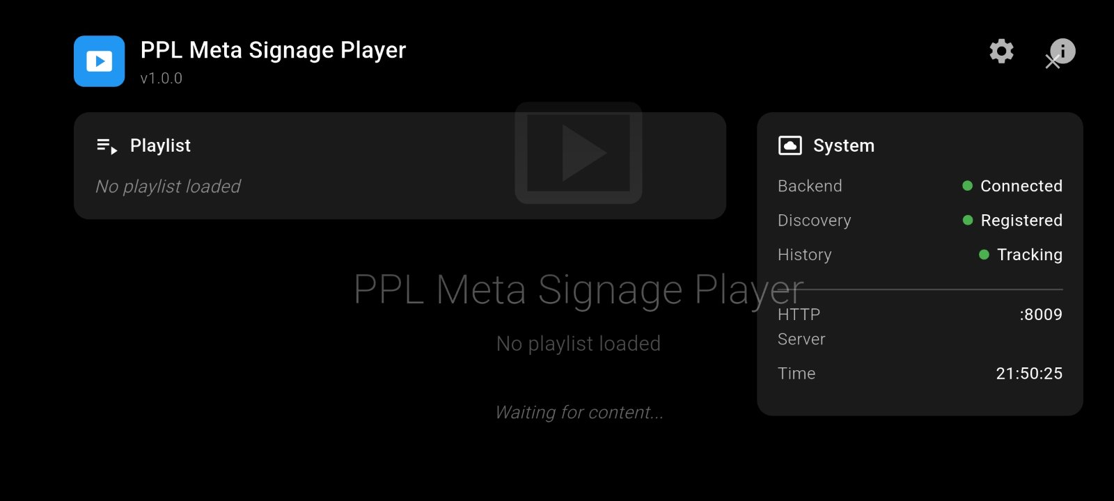
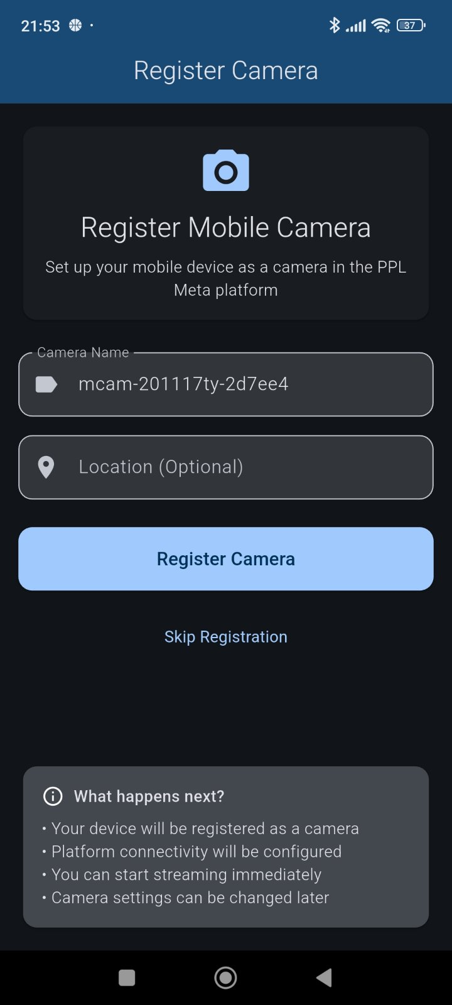
Eyenet in Action — Operations and Analytics
"Representative screenshots from the live platform UX included in the functionalities document."
Main Dashboard
System Settings
Detection Analytics
Analytics Filters
Analytics Dashboard
Camera Management
Eyenet Vision | Functionalities Presentation
Digital Signage 01
Signage Android App
Soft Camera 01
Eyenet Vision | Technology Retail Pitch

Slide 12
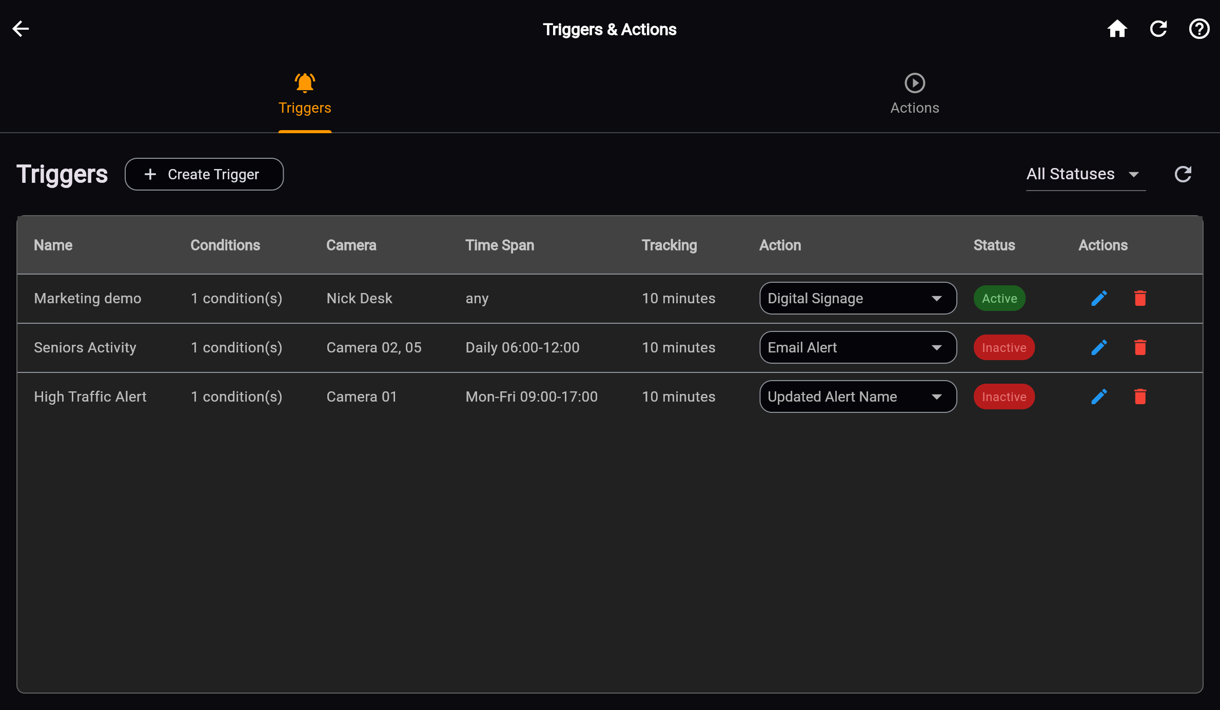
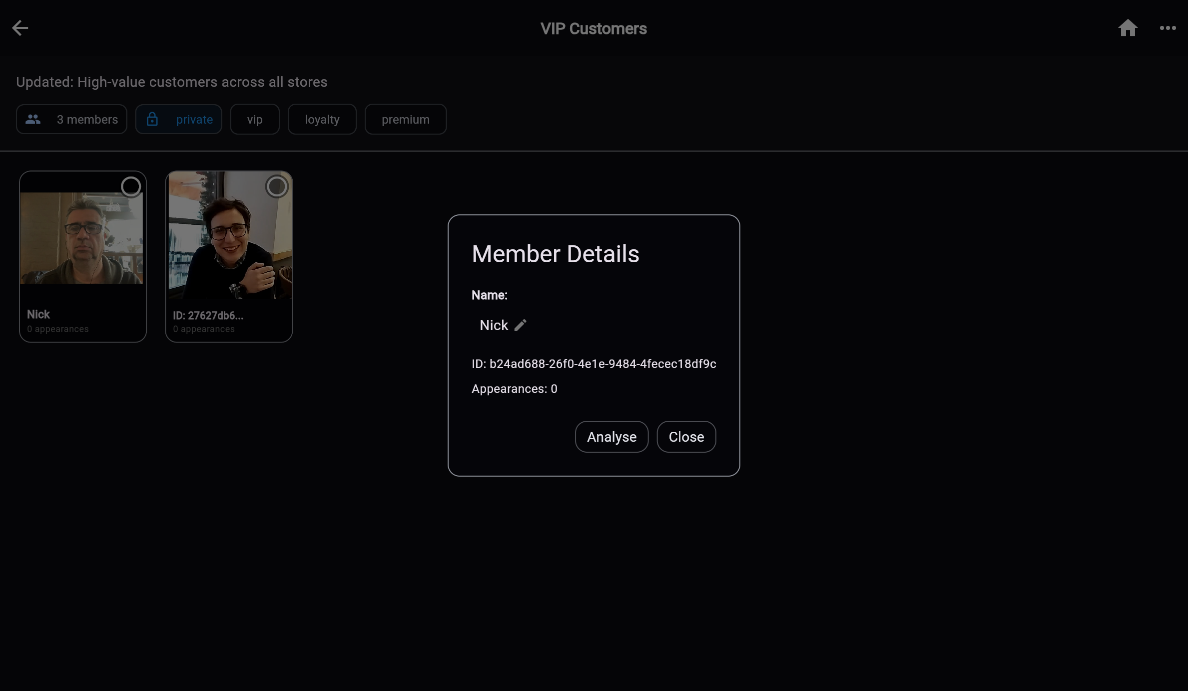
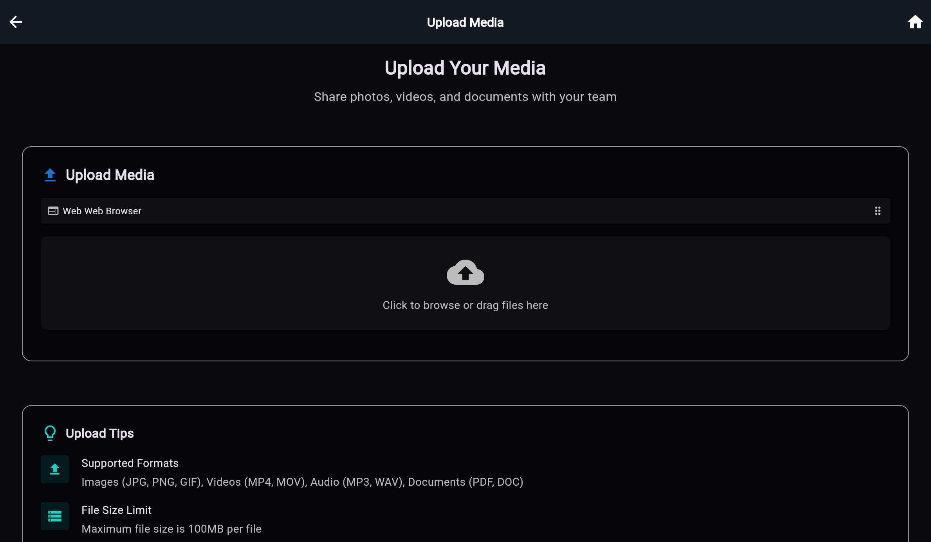
Eyenet in Action — Automation and Media
"Workflow and endpoint views covering trigger orchestration, signage, media, and playback operations."
Triggers Management
Digital Signage
Media Upload
Actions Editor
MVR Group Details
Signage Android App
Eyenet Vision | Functionalities Presentation
Digital Signage 01
Signage Android App
Soft Camera 01
Eyenet Vision | Technology Retail Pitch

