Slide 1
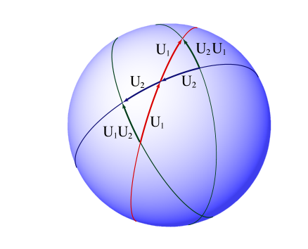
Oersted Medal Lecture 2002:
Reforming the Mathematical
Language of Physics
David Hestenes
Arizona State University

Slide 2
Reforming the Mathematical
Language of Physics
is the single most essential step toward
simplifying and streamlining physics education
at all levels from high school through graduate school
Notes:
I aim to convince you that

Slide 3
The relation between Teaching and Research is
a perennial theme in academia and Oersted Lectures.
PER puts the whole subject in a new light
because it makes teaching itself a subject of research.
The common denominator of T & R is learning!
Learning by students
Learning by scientists
Without getting deeply into learning theory,
I want to supply you with a nontrivial example showing
how integration of PER with scientific research
can facilitate learning and understanding by both
students and research physicists.

Slide 4
Five Principles of Learning
that have guided my own work in PER
1. Conceptual learning is a creative act.
2. Conceptual learning is systemic.
3. Conceptual learning is context dependent.
4. The quality of learning is critically dependent on the quality of conceptual tools at the learner’s command.
5. Expert learning requires deliberate practice with critical feedback.
Notes:
With suitable elaboration, these principles provide quite an adequate foundation for Learning Theory

Slide 5
Mathematical tools for introductory physics in 2D
• Vectors are primary tools
for representing magnitude and direction
But vector algebra cannot be used for reasoning with vectors
because a × b does not work in 2D
• Complex numbers are ideal for 2D rotations and trigonometry,
but they are seldom used for lack of time
and generalizability to 3D
A PER study at U. Maryland found that student use of vectors
is best described as “vector avoidance!”
• Student learning is limited by almost exclusive reliance on
weak coordinate methods
This problem is not so much with the pedagogy
as with the mathematical tools
It is symptomatic of a larger problem with the math in physics!

Slide 6
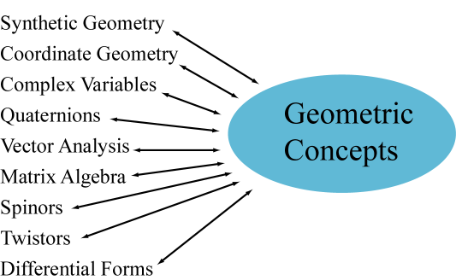
A Babylon of mathematical tongues contributes to fragmentation of knowledge
Babylon can be replaced by a single Geometric Algebra
– a unified mathematical language for the whole of physics !

Slide 7
To reform the mathematical language of physics,
you need to start all over at the most elementary level.
You need to relearn how to multiply vectors.
My purpose today is to show you how
and convince you that it is important!

Slide 8
How to multiply vectors
Multiplication in geometric algebra
is nearly the same as in scalar algebra
Rules for the geometric product ab of vectors:
(ab)c = a(bc) associative
a(b + c) = ab + ac left distributive
(b + c)a = ba + ca right distributive
contraction
These are the basic grammar rules for GA,
and they apply to vector spaces of any dimension.
The power of GA derives from
• the simplicity of the grammar,
• the geometric meaning of the product ab.
• the way geometry links the algebra to physics

Slide 9
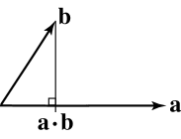
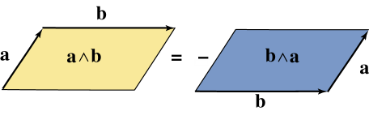
Geometric Product ab implies two other products
with familiar geometric interpretations.
Inner Product:
∧
Outer Product:
Bivector represents an
oriented area by a
Parallelogram rule:
(improves a × b)
Inner and outer products are parts
of a single Geometric Product:
The resulting object ab is a new entity with
a different kind of geometric interpretation!
Notes:
Geometric interp of geometric product is more subtle

Slide 10
Understanding the import of this formula:
is the single most important step in unifying the mathematical
language of physics.
This formula integrates the concepts of
• vector
• complex number
• quaternion
• spinor
• Lorentz transformation
And much more!
This lecture concentrates on how it integrates vectors and
complex numbers into a powerful tool for 2D physics.

Slide 11
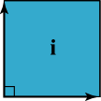
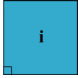
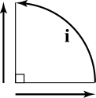
Consider first the important special case of a unit bivector i
It has two kinds of geometric interpretation!
Object interpretation as an oriented area (additive)
Can construct i from a pair of orthogonal unit vectors:
b
b
b
So
• i ≈ oriented unit area for a plane
a
a
a
Operator interpretation as rotation by 90º (multiplicative)
depicted as a directed arc
b
So
• i ≈ rotation by a right angle:
Proof:
a
Proof:

Slide 12
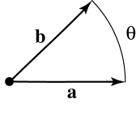
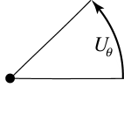
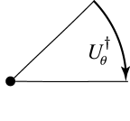
The operational interpretation of i generalizes to the concept of
Rotor , the entity produced by the geometric product ab
of unit vectors with relative angle θ.
Rotor is depicted as a directed arc on the unit circle.
a² = b² = 1
ab = U_{θ}
Reversion:

Slide 13
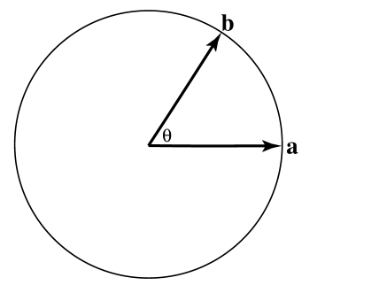
Defining sine and cosine functions
from products of unit vectors

Slide 14
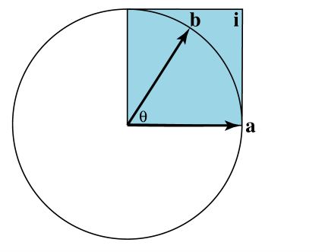
Defining sine and cosine functions
from products of unit vectors
i = unit bivector

Slide 15
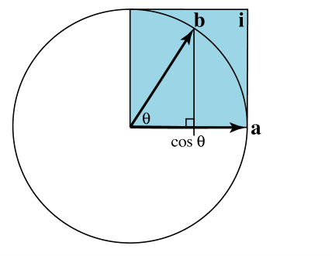
Defining sine and cosine functions
from products of unit vectors
i = unit bivector

Slide 16
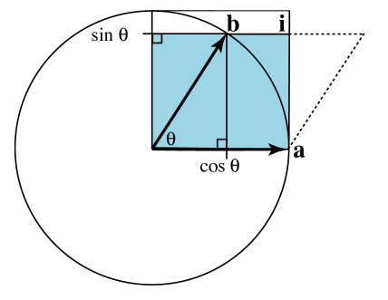
Defining sine and cosine functions
from products of unit vectors
i = unit bivector

Slide 17
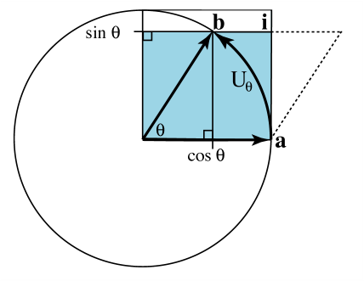
Defining sine and cosine functions
from products of unit vectors
i = unit bivector
Rotor:

Slide 18
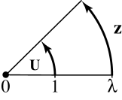
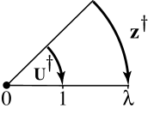
The concept of rotor generalizes to the concept of
complex number interpreted as a directed arc.
Reversion = complex conjugation
Modulus
This represention of complex
numbers in a real GA is a
special case of spinors for 3D.

Slide 19
• Our development of GA to this point is sufficient to
formulate and solve any problem in 2D physics
without resorting to coordinates.
• Of course, like any powerful tool, it takes some skill to
apply it effectively.
• For example, every physicist knows that skillful use of
complex numbers avoids decomposing them into real
and imaginary parts whenever possible.
• Likewise, skillful use of the geometric product avoids
decomposing it into inner and outer products.
• In the remainder of this lecture I demonstrate how
rotor algebra facilitates the treatment of rotations in 2D & 3D.
• In particular, note the one-to-one correspondence
between algebraic operations and geometric depictions!

Slide 20
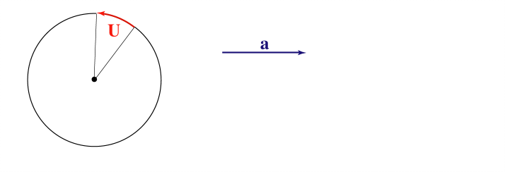
Properties of rotors
Rotor equivalence of directed arcs
is like
Vector equivalence of directed line segments

Slide 21
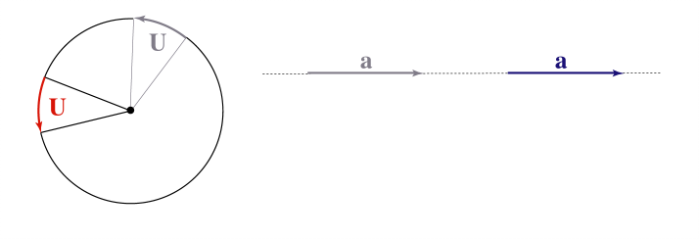
Properties of rotors
Rotor equivalence of directed arcs
is like
Vector equivalence of directed line segments

Slide 22
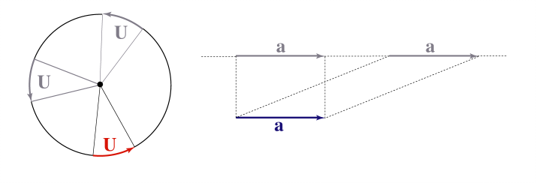
Properties of rotors
Rotor equivalence of directed arcs
is like
Vector equivalence of directed line segments

Slide 23
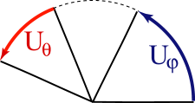
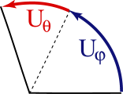
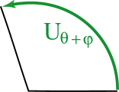
Properties of rotors
Product of rotors Addition of arcs
U_{θ}, U_{ϕ}
U_{θ}U_{ϕ}
= U_{θ+ϕ}

Slide 24
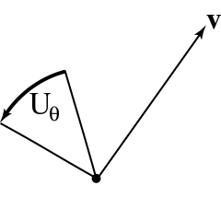
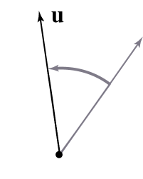
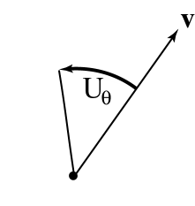
Properties of rotors
Rotor-vector product = vector
U_{θ}, v
U_{θ}v
= u

Slide 25
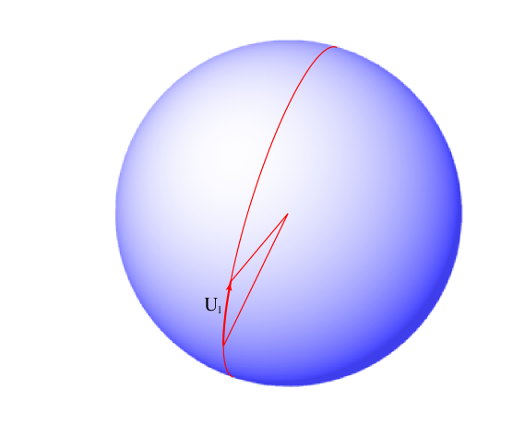
Rotor products ⇔ composition of rotations in 3D
U₁

Slide 26
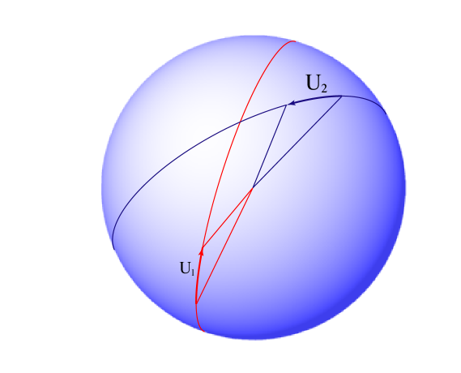
Rotor products in 3D
U₁ , U₂

Slide 27
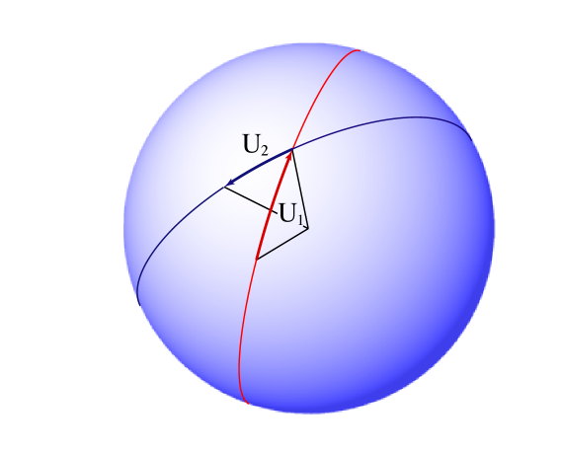
Rotor products in 3D
U₁ , U₂
U₂U₁

Slide 28

Rotor products in 3D
U₁ , U₂
U₂U₁ = (bc)(ca)

Slide 29

Rotor products in 3D
U₁ , U₂
U₂U₁ = (bc)(ca)
= ba = U₃
U₂ U₁ = U₃

Slide 30
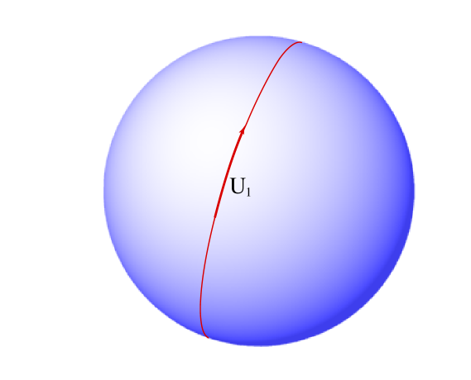
Noncommutativity of Rotations
U₂ (U₁) = U₂U₁
U₁ (U₂) = U₁U₂

Slide 31

Noncommutativity of Rotations
U₂ (U₁)

Slide 32

Noncommutativity of Rotations
U₂ (U₁) = U₂U₁

Slide 33

Noncommutativity of Rotations
U₂ (U₁) = U₂U₁
U₁ (U₂

Slide 34

Noncommutativity of Rotations
U₂ (U₁) = U₂U₁
U₁ (U₂)

Slide 35
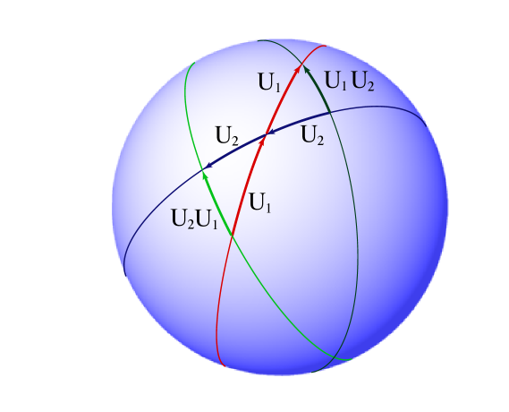
Noncommutativity of Rotations
U₂ (U₁) = U₂U₁
U₁ (U₂) = U₁U₂

Slide 36
What have we learned so far?
Rules for multiplying vectors that apply to vector spaces of any dimension.
Geometric meaning of the geometric product and its component parts in
Integration of complex numbers with vectors and interpretation as directed arcs.
How rotor algebra clarifies and facilitates
the treatment of rotations in 2D and 3D.

Slide 37
What next?
A greatly expanded written version of this lecture,
to be published in the AJP,
• demonstrates how GA integrates and simplifies
classical, relativistic and quantum physics,
• develops GA to the point where it is ready to incorporate
into the physics curriculum at all levels.
I will conduct a Workshop on GA in physics
at the summer AAPT meeting.
For those who can’t wait,
• A thorough introduction to 3D GA with applications in
my book New Foundations for Classical Mechanics
• Many papers and links to other web sites @
http:\\ modelingnts.la.asu.edu

Slide 38
A challenge to PER and the physics community!
Critically examine the following claims:
• GA provides a unified language for the whole physics that
is conceptually and computationally superior to
alternative math systems in every application domain.
• GA can enhance student understanding and
accelerate student learning of physics.
• GA is ready to incorporate into the physics curriculum.
• Research on the design and use of mathematical tools is
equally important for instruction and for theoretical physics.

Slide 40
Scientific Research
Learning Theory
How people learn
Modeling Theory
How science works
Theory of Instruction
Teaching Practice

Slide 41
What follows?
The coordinate-free representation of rotations by rotors and directed arcs generalizes to
• Rotations in 3D,
• Lorentz transformations in spacetime,
• Real spinors in quantum mechanics,
where the unit imaginary appears as a
unit bivector i related to spin!

