Slide 1
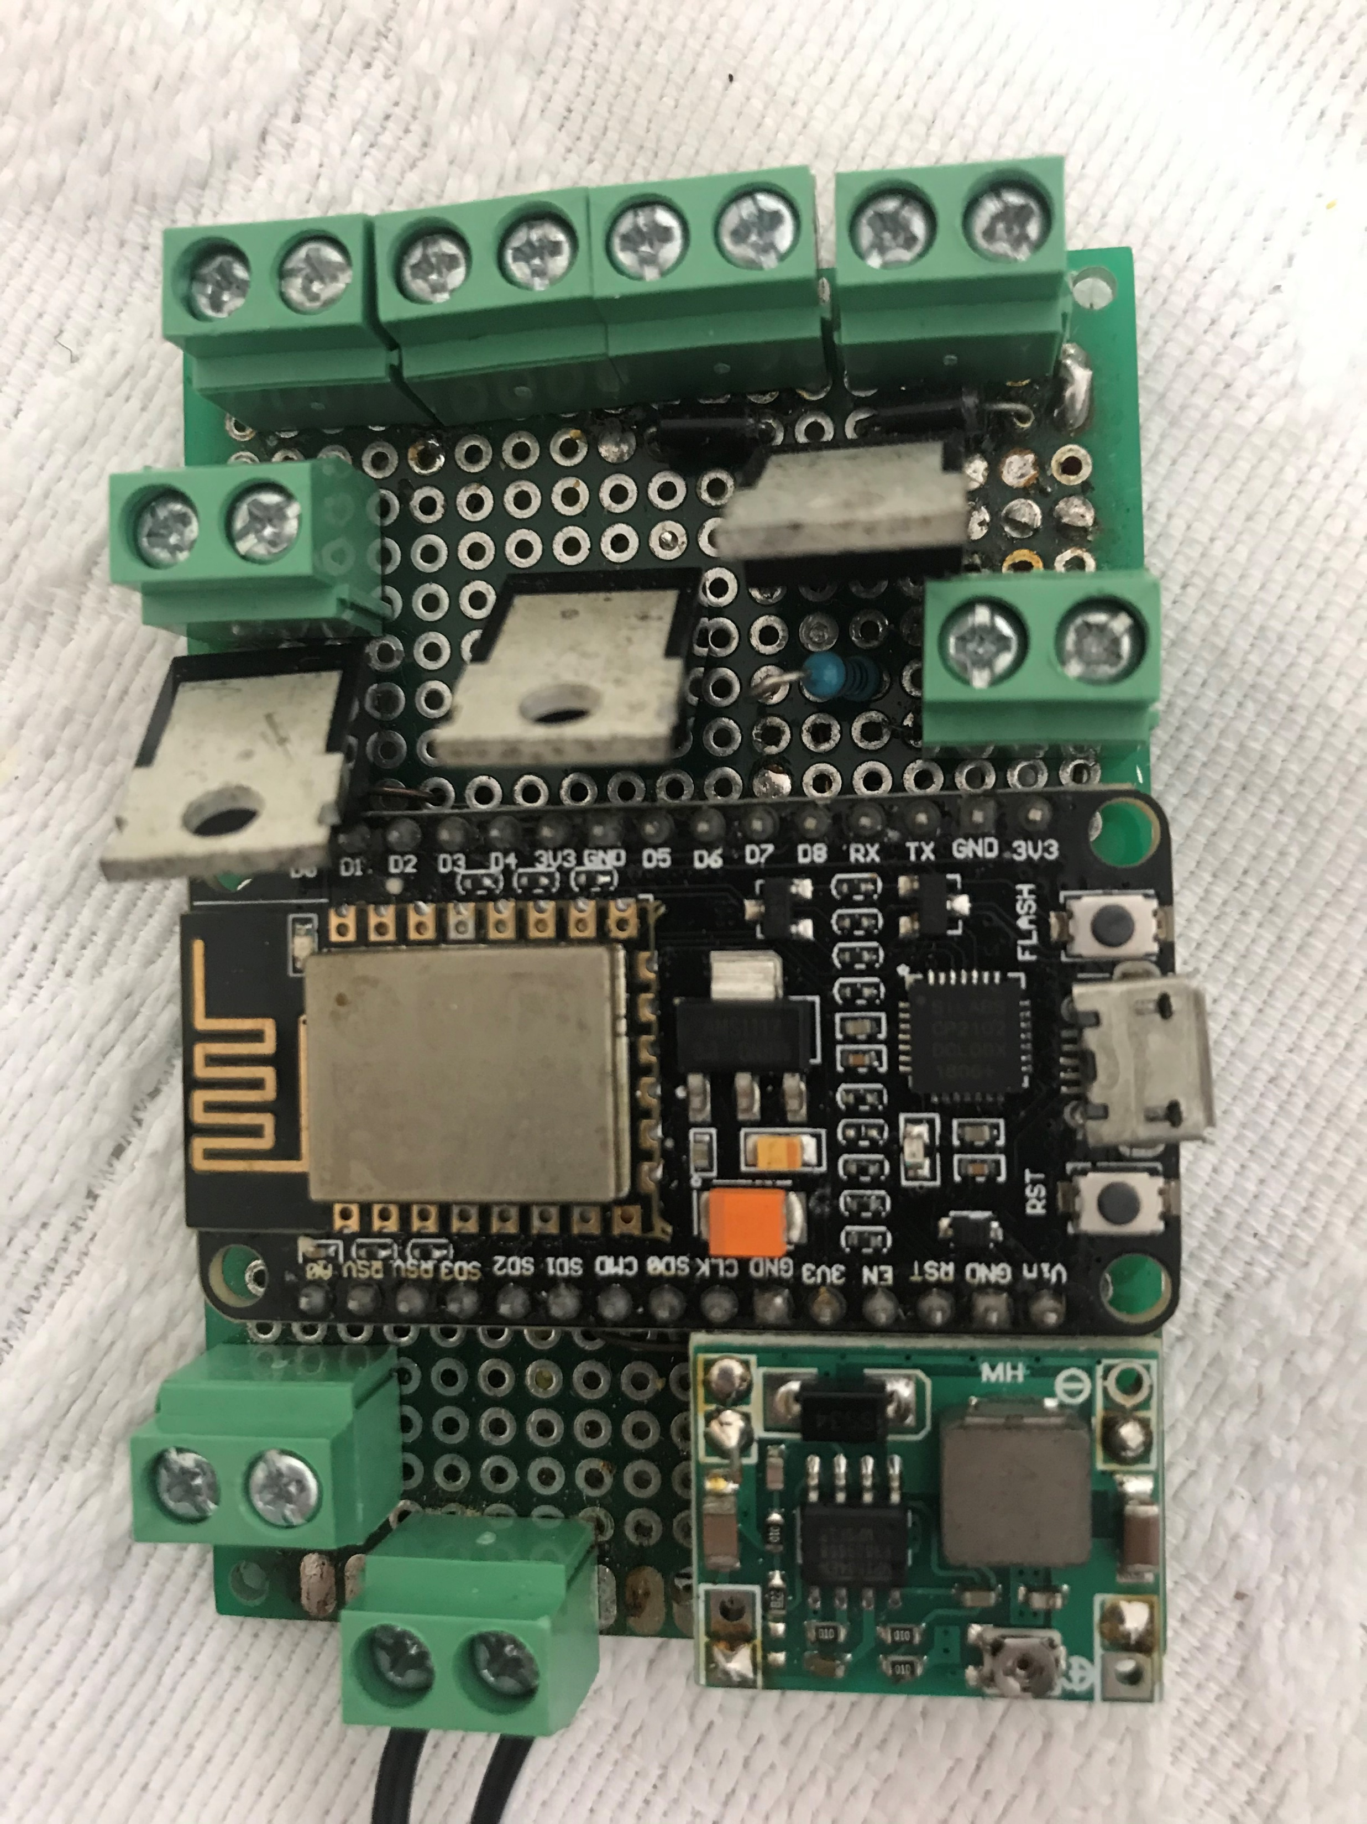
Pump +ve
D8
Pump -ve
D8
Analog Sensor Input
12V +ve
12V -ve

