Slide 1
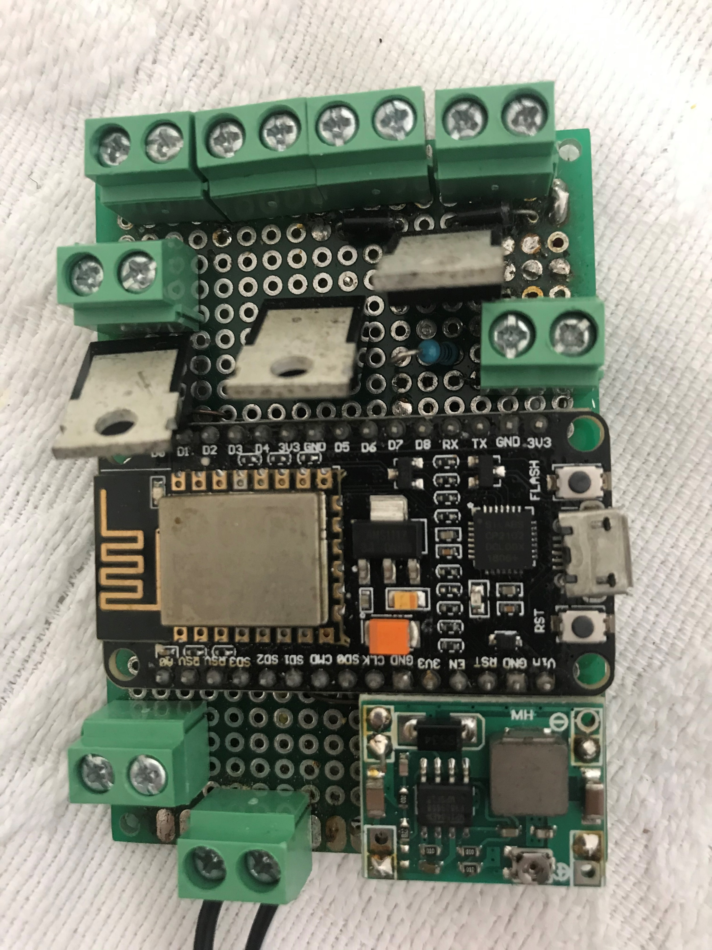
Fans –ve (D5)
Solenoid +ve (D2)
Fans +ve (D5)
Solenoid –ve (D2)
Multiplexer C3 (Battery Power)
Multiplexer Low Bit (D0)
Pump +ve
D8
Multiplexer High Bit (D1)
Pump -ve
D8
Multiplexed Analog Sensor Input
0=Moisture
1=Light
2= Sensor Power
3=Battery Power
3.3V +ve
3.3V GND
Humidity/Temp
D3
12V +ve
12V -ve

