Slide 1
What Do Novelists Write About?
Nicholas Halpern
March 2017

Slide 2
objectives
What topics do novelists write about?
Does the frequency of each topic change over time?
Are novels reflective of life at the time they are written, or are they a form of escapism?
How quickly can we see new ideas reflected in novels?

Slide 3
Data sources
Project Gutenberg
Text Files
retrieve from mirror site
Wikipedia
Novelists by Nationality
Book Publication Date
Book Texts and Metadata
Google Search
Book Publication Date
web scrape

Slide 4
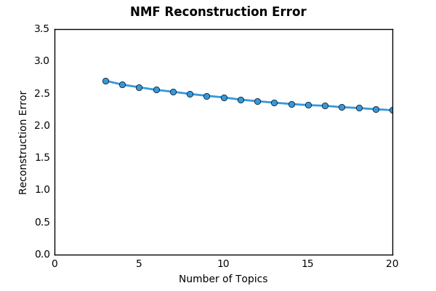
How many topics are there?

Slide 5






















How many topics are there?
Four Topics
Five Topics
Six Topics
Seven Topics

Slide 6
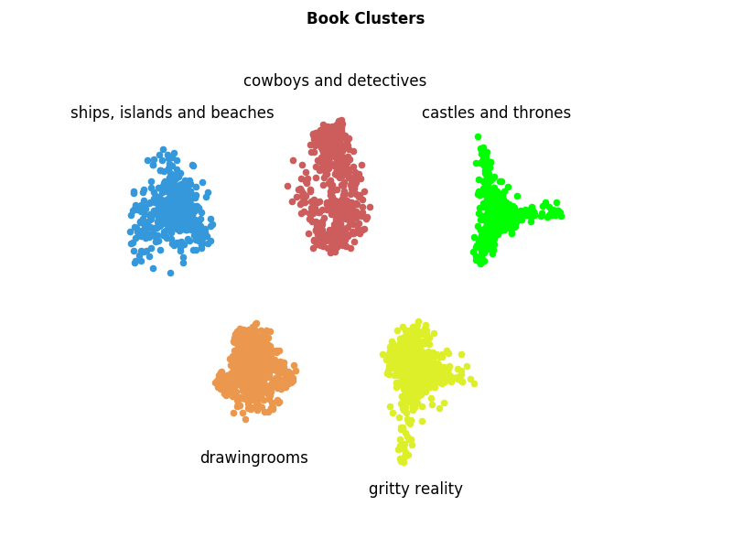
What are the five topics?

Slide 7
“give me”
give me that bottle
give me their plans
give me the way to the hall
give me a chance of catching somebody
give me a roll of dried ferns
give me the sugar
give me some account of him
give me your own face but for one instant
give me this house full of faith
give me thy good word
give me a dagger
give me that on the map
give me your confidence
give me a glass
give me pure water
give me one unneeded pang
give me some names
give me twenty dollars
give me back my gold piece
give me the things I’m going to suggest
give me a name – except saint george

Slide 8
“The man”
the man looked sympathetic and trustworthy
the man who prepared the fatal pie
the man who was inclined to run
the man looked stern and hard and long
the man must die
the man who pays his tithes
the man prepared for daring deeds
the man with wizard’s attributes
the man she cannot love
the man fled, and lied, and swore less
the man with too weighty a burden
the man fell with a large army
the man of erudition, but his hat was soft
the man with his regiment towards india
the man she adores
the man of brains is even half inclined to go into trade
the man I ran away from
the man drew a cigar from his hand
the man who had died recently
the man he hated for stealing his squaw
the man yonder leadin’ his horse

Slide 9
“She Said”
she said with the revolver
she said and kissed me on my side
she said she had seen the poor devil go to pieces
she said nothing, of course
she said to her rapt soul
she said no shepherd sought her
she said solemnly, “I trust my babes to the captain”
she said with passion, “listen, they will be of a wreck”
she said humbly, how broad his shoulders were
she said sweetly from the atlantic ocean
she said in a few verses written two years ago
she said loftily “and now I wish to be worth thirty thousand”
she said she pitied him, forever widowed
she said at length, leading the way to the oaks
she said pitifully
she said I was there to bring back gold for you
she said in wonderment, “heaven guard us!”
she said it was terror that dominated her
she said to his full six feet of height

Slide 10
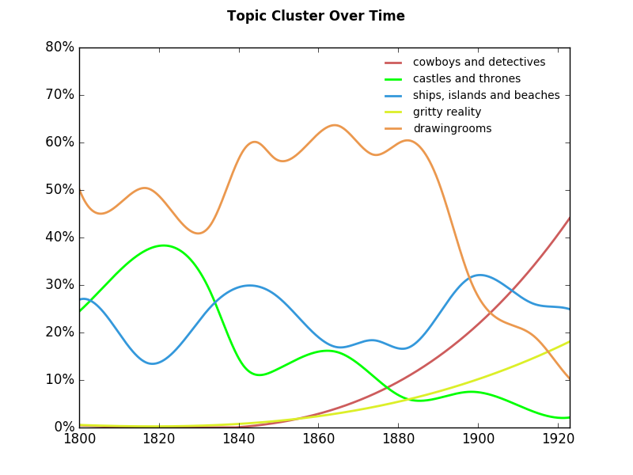
frequency of topics over time

Slide 11
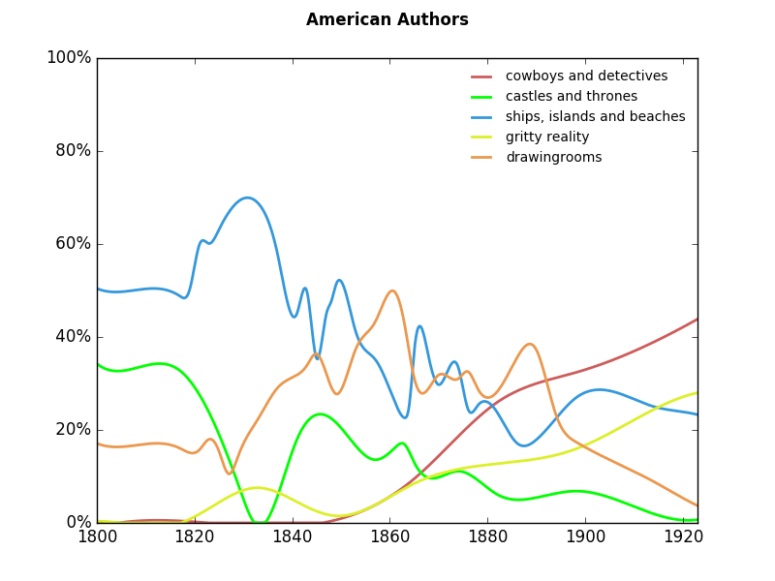
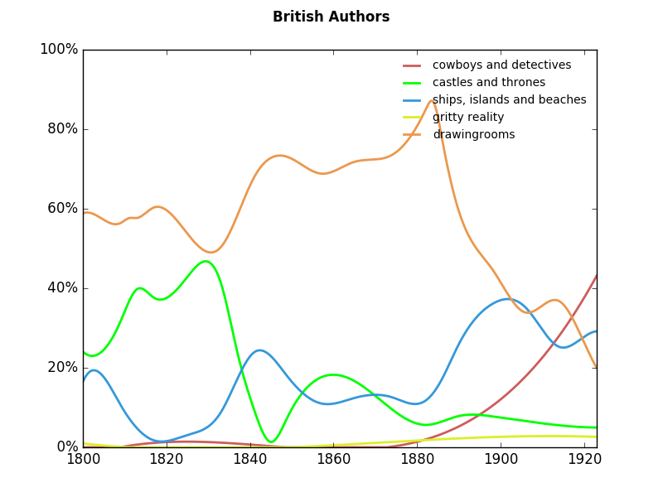
topic cluster by nationality

Slide 12
Sentiment analysis

Slide 13
do novels reflect economic reality?

Slide 14
next steps
Extend analysis to a sampling of off-copyright books
Consider novels in languages other than English

