Slide 1
Formula 1 Driver dataset EDA
Nick Harshaw and Ellie Landoch

Slide 2
Understanding the Dataset
What is the dataset about?
Formula 1 driver stats
Filtered data so it’s just race winners
What are the key columns?
['Driver', 'Nationality', 'Seasons', 'Championships', 'Race_Entries', 'Race_Starts', 'Pole_Positions', 'Race_Wins', 'Podiums', 'Fastest_Laps', 'Points', 'Active', 'Championship Years', 'Decade', 'Pole_Rate', 'Start_Rate', 'Win_Rate', 'Podium_Rate', 'FastLap_Rate', 'Points_Per_Entry', 'Years_Active', 'Champion']

Slide 3
Data Exploration
How many rows and columns are there?
113 rows, 22 columns
Are there any missing values?
Missing values in ‘Champion Years’ column for drivers who have never won a world championship
What are the data types?
object: [‘Driver’, ‘Nationality’, ‘Seasons’, ‘Championship Years’]
int64: [‘Decade’, ‘Years_Active’]
float64: ['Championships', 'Race_Entries’, 'Race_Starts', 'Pole_Positions', 'Race_Wins', 'Podiums', 'Fastest_Laps’, 'Points', 'Pole_Rate’, 'Start_Rate', 'Win_Rate', 'Podium_Rate', 'FastLap_Rate’, 'Points_Per_Entry’]
bool: [‘Active’, ‘Champion’]

Slide 4
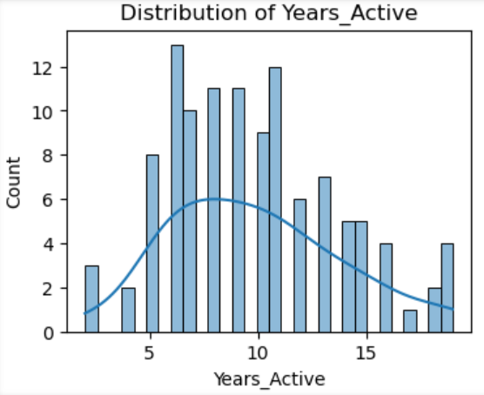
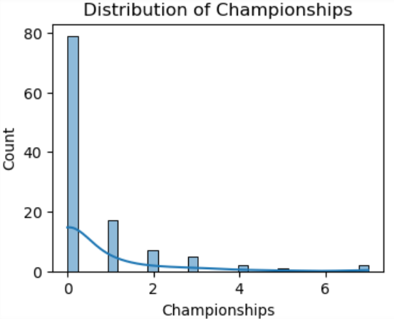
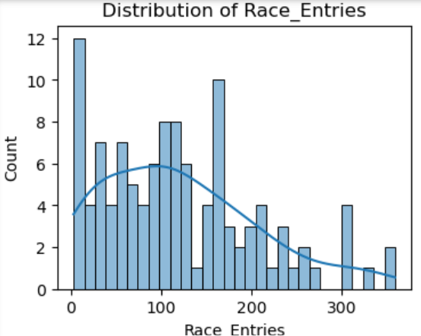
Univariate Analysis

Slide 5
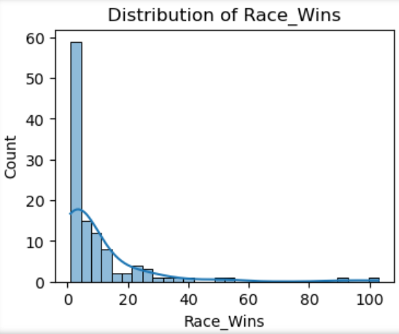
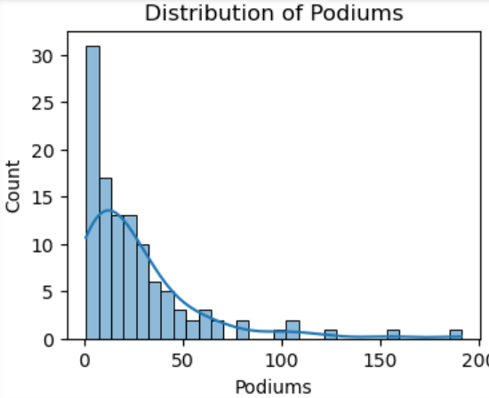
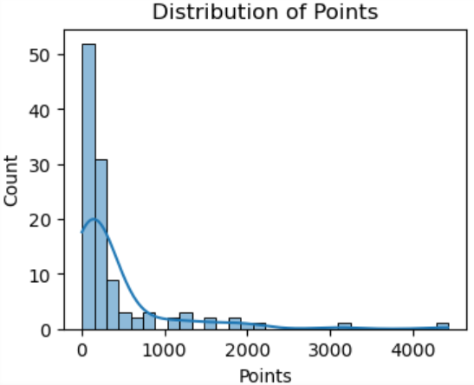
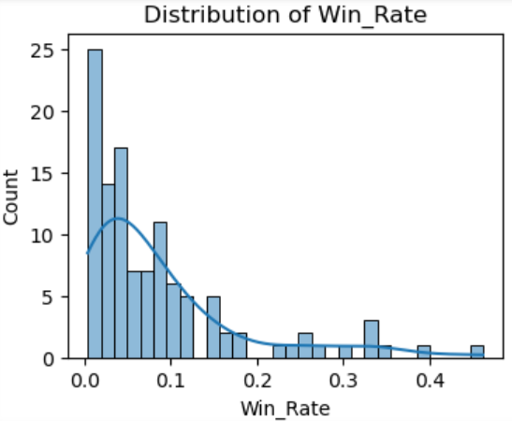
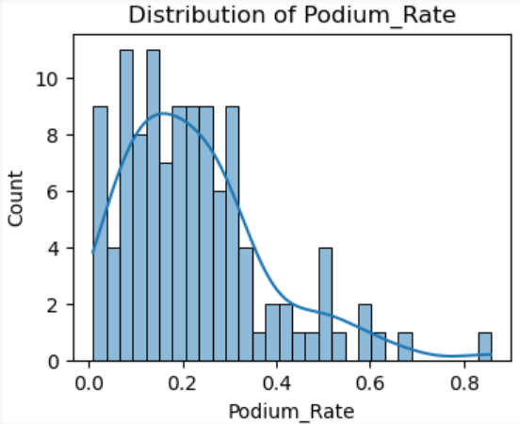
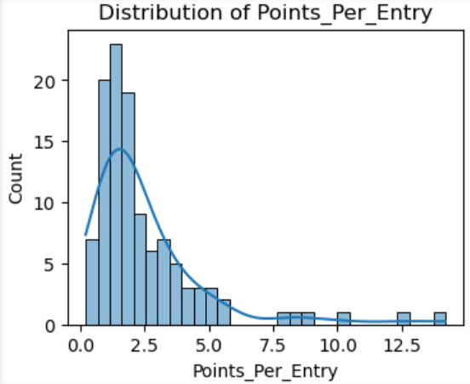
Comparing distributions of Wins, Podiums, Points vs. their respective rates

Slide 6
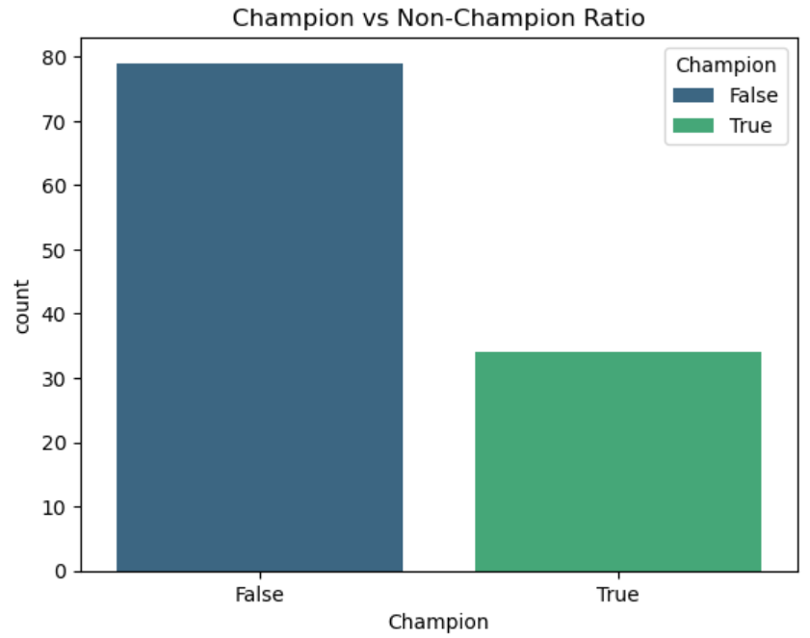
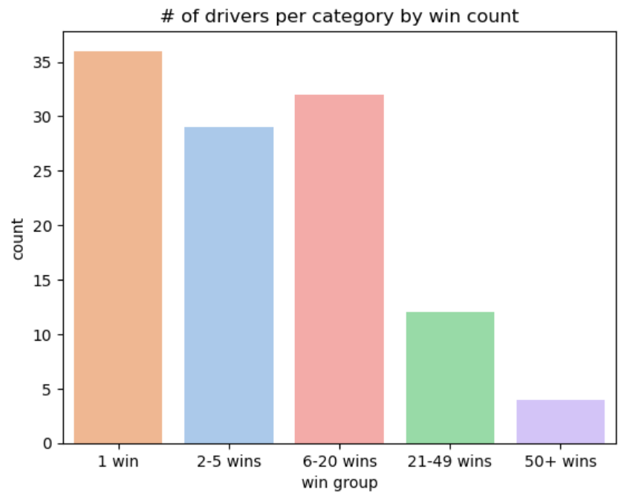
Ratio of Champions & distribution of total wins

Slide 7
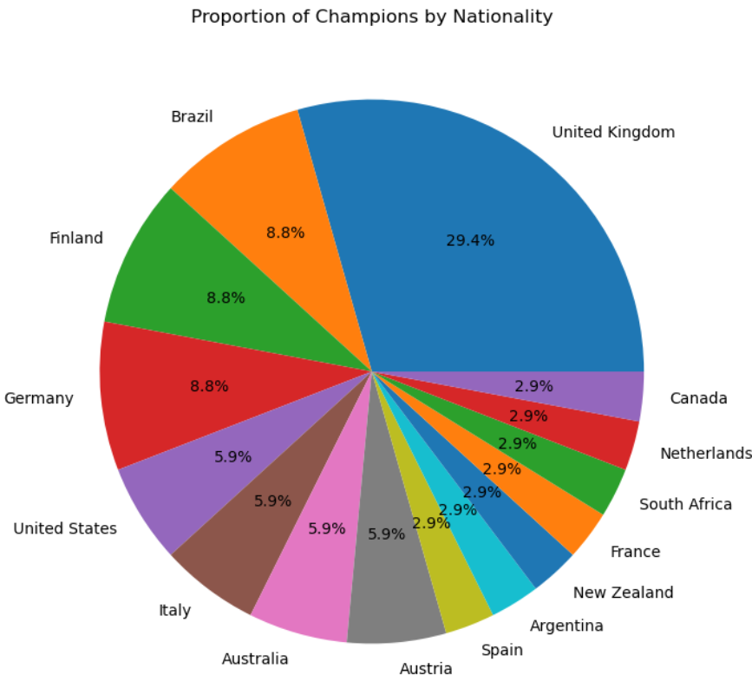
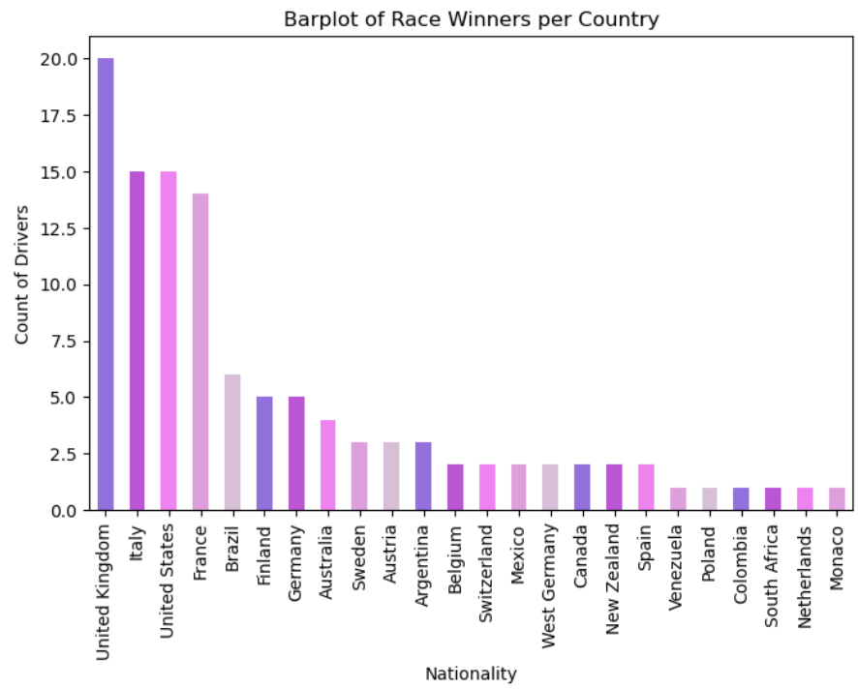
Data by Nationality

Slide 8
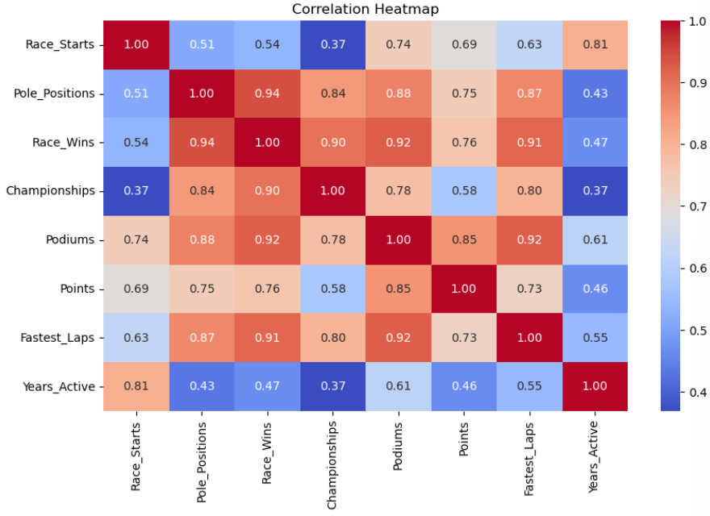
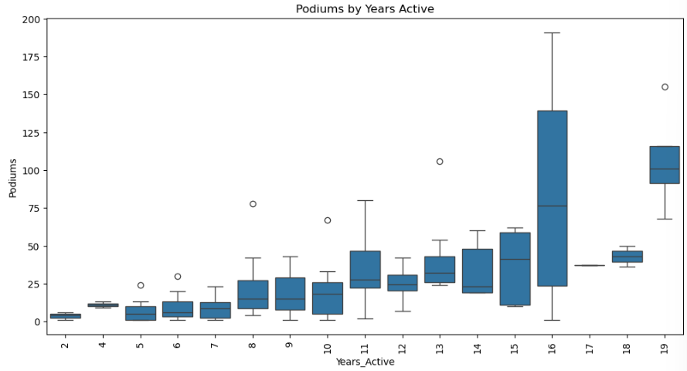
Bivariate Analysis

Slide 9
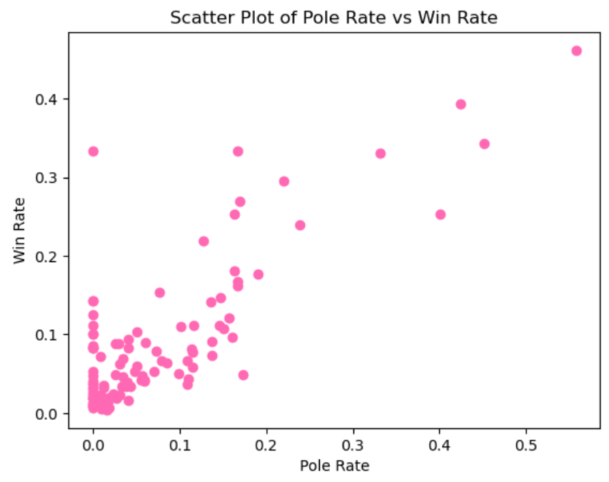
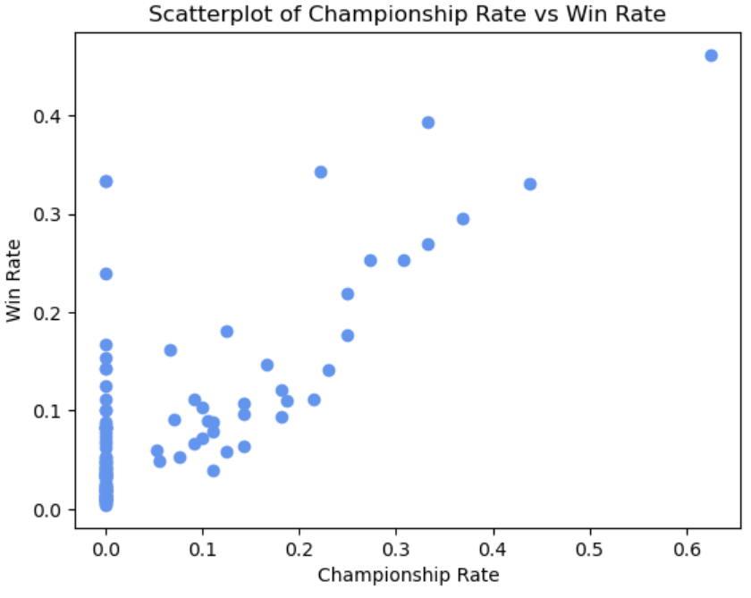
Scatter plots of Win Rate comparisons

Slide 10
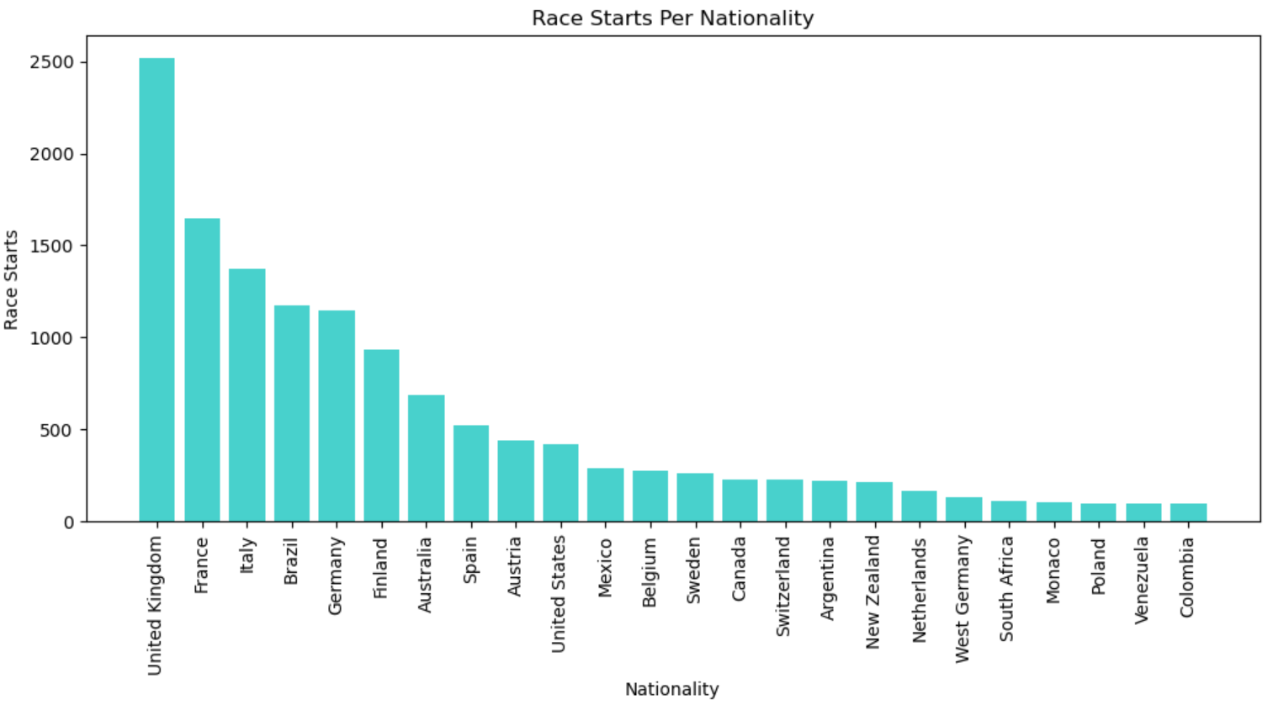
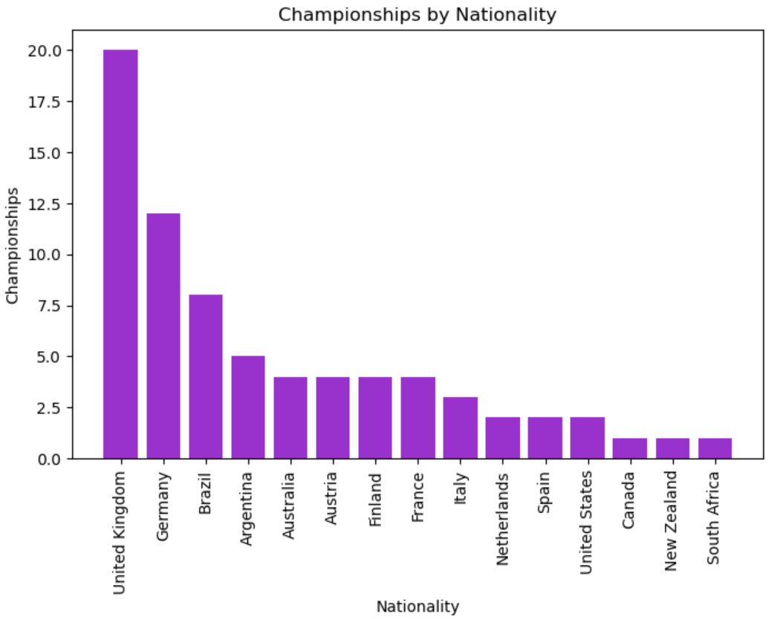
Data by Nationality

Slide 11
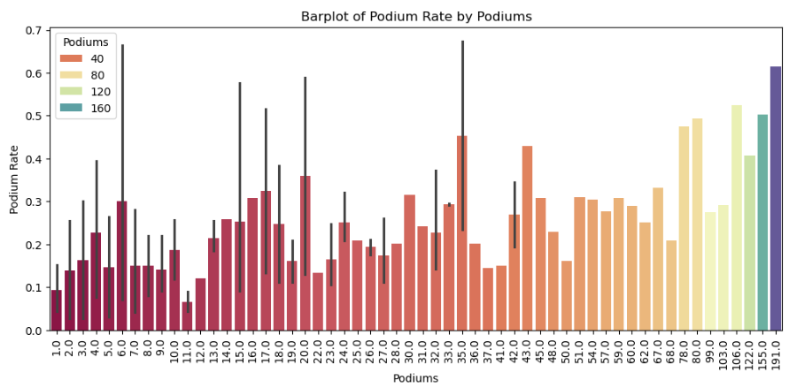
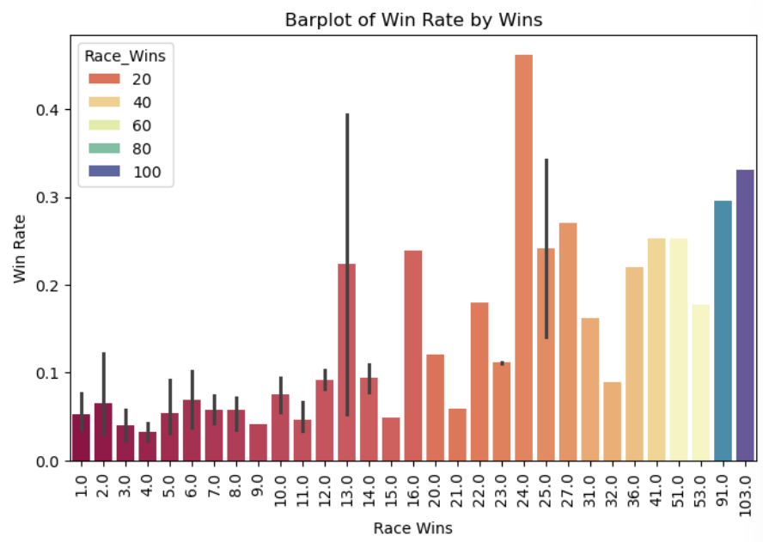
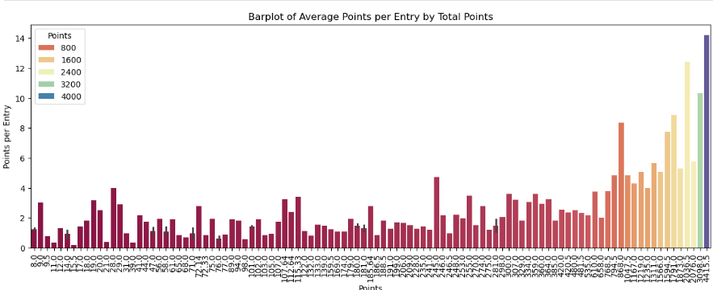
Comparing distributions of Wins, Podiums, Points vs. their respective rates

Slide 12
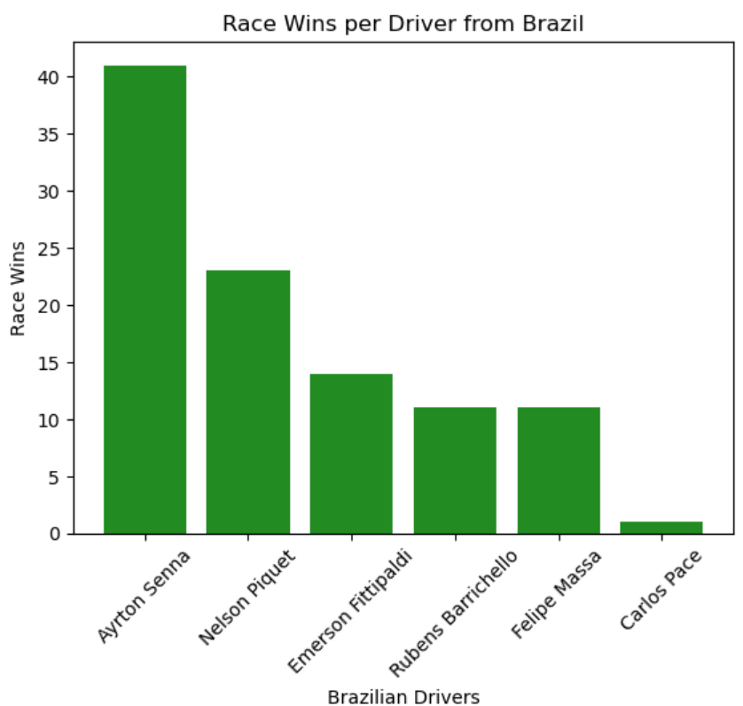
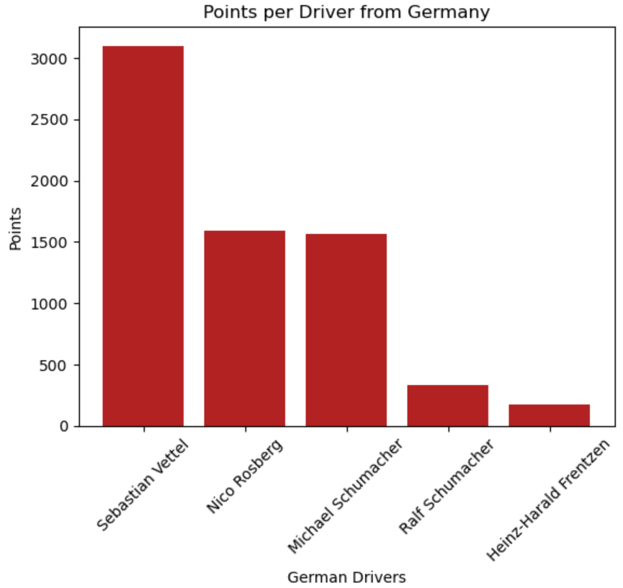
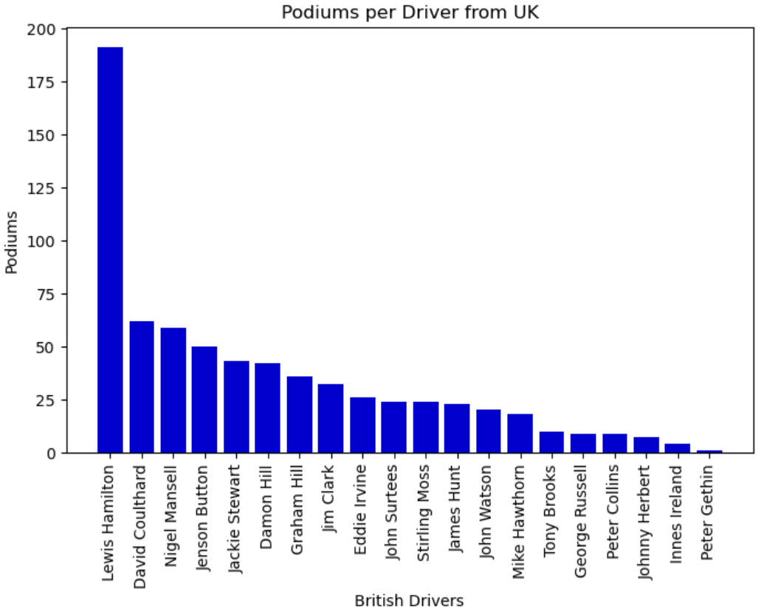
Individual Driver Stats by Nationality

Slide 13
Summary
What trends do you observe? What insights can you gain from the visualizations?
Most of the univariate histograms are skewed to the right
The values in the heatmap all show a positive correlation, but some are much more strong correlation than others
The bar plots showing the count of wins, podiums, and points vs the rates are all skewed to the left
Most F1 successes are from drivers from the same few countries
Are there any surprising findings?
Points and championships are not very strongly correlated
The number of years active is very weakly correlated to number of wins, championships, etc.
What additional analysis would you perform next?
Instead of looking at race winners, look at only active drivers to predict how they may continue to perform in the sport

