Slide 1
CMS Demographic Data An Incomplete Analysis
By Nick Hattwick

Slide 2
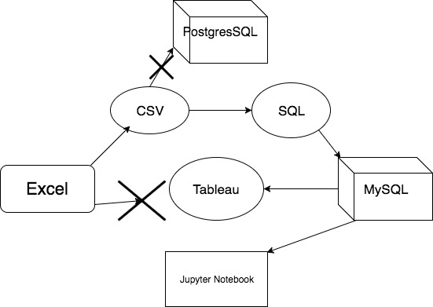
The Data’s Path

Slide 3
Approaching the data
Focus on demographics and enrollment in services
Focus on how they changed between 2007 and 2014
Try to find trends between the change

Slide 4
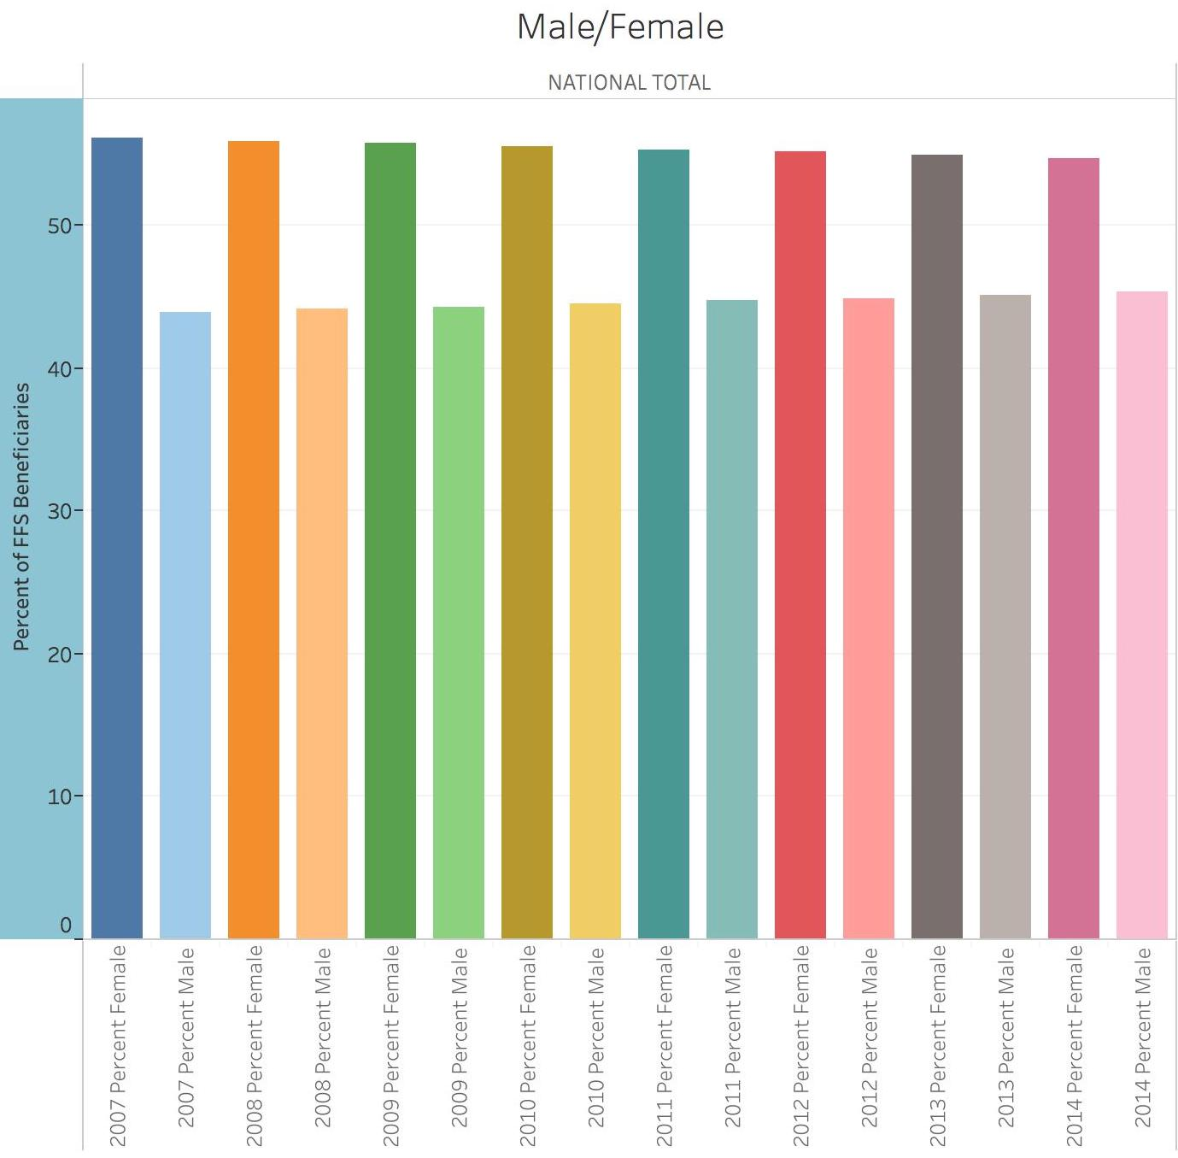

Slide 5
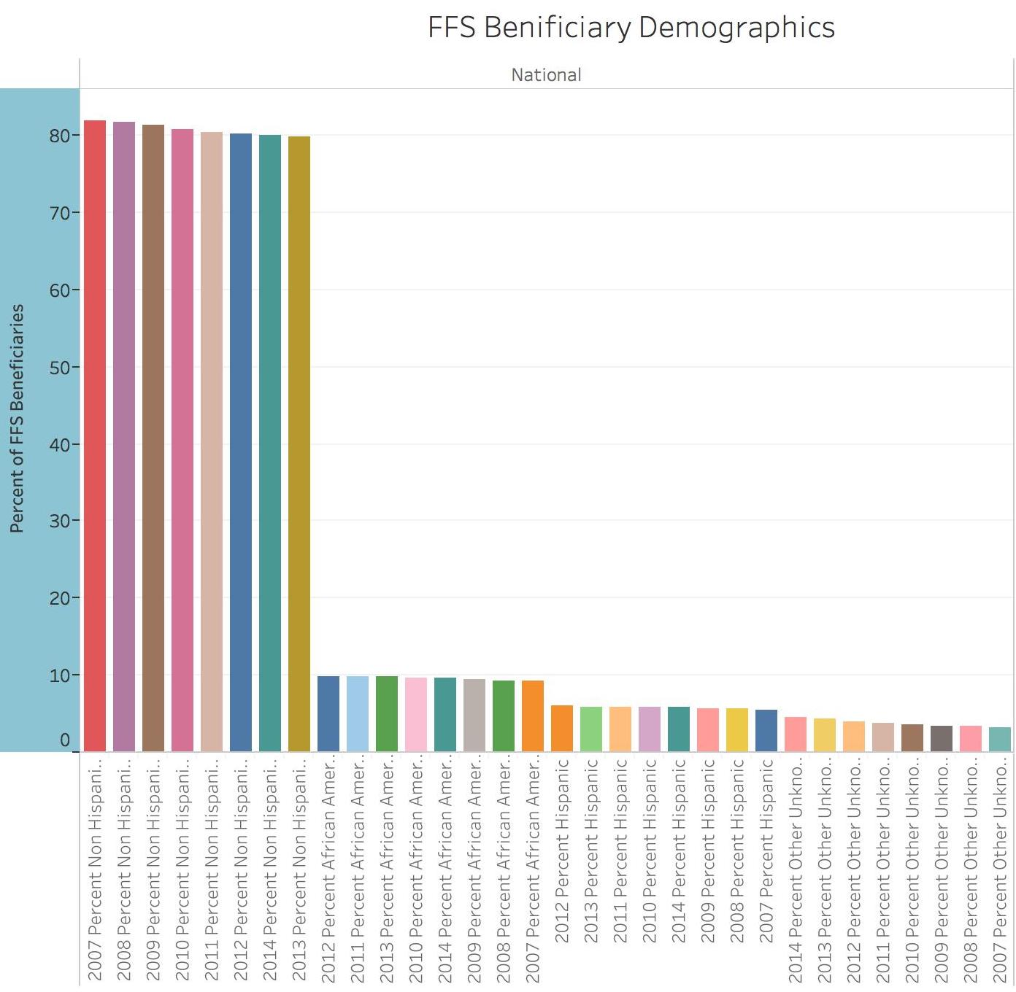

Slide 6
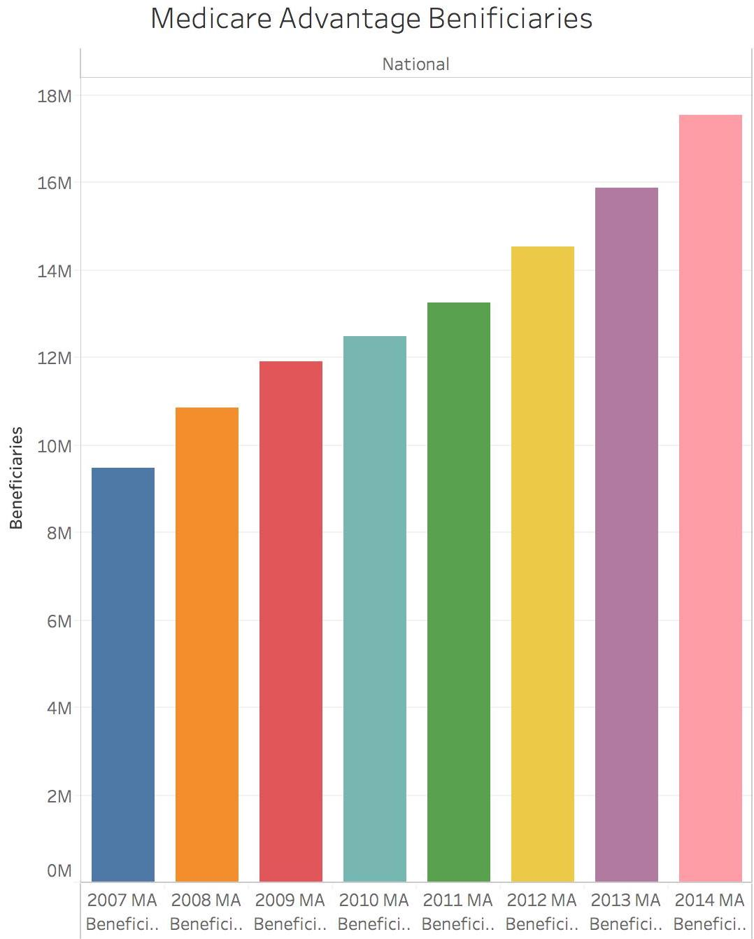
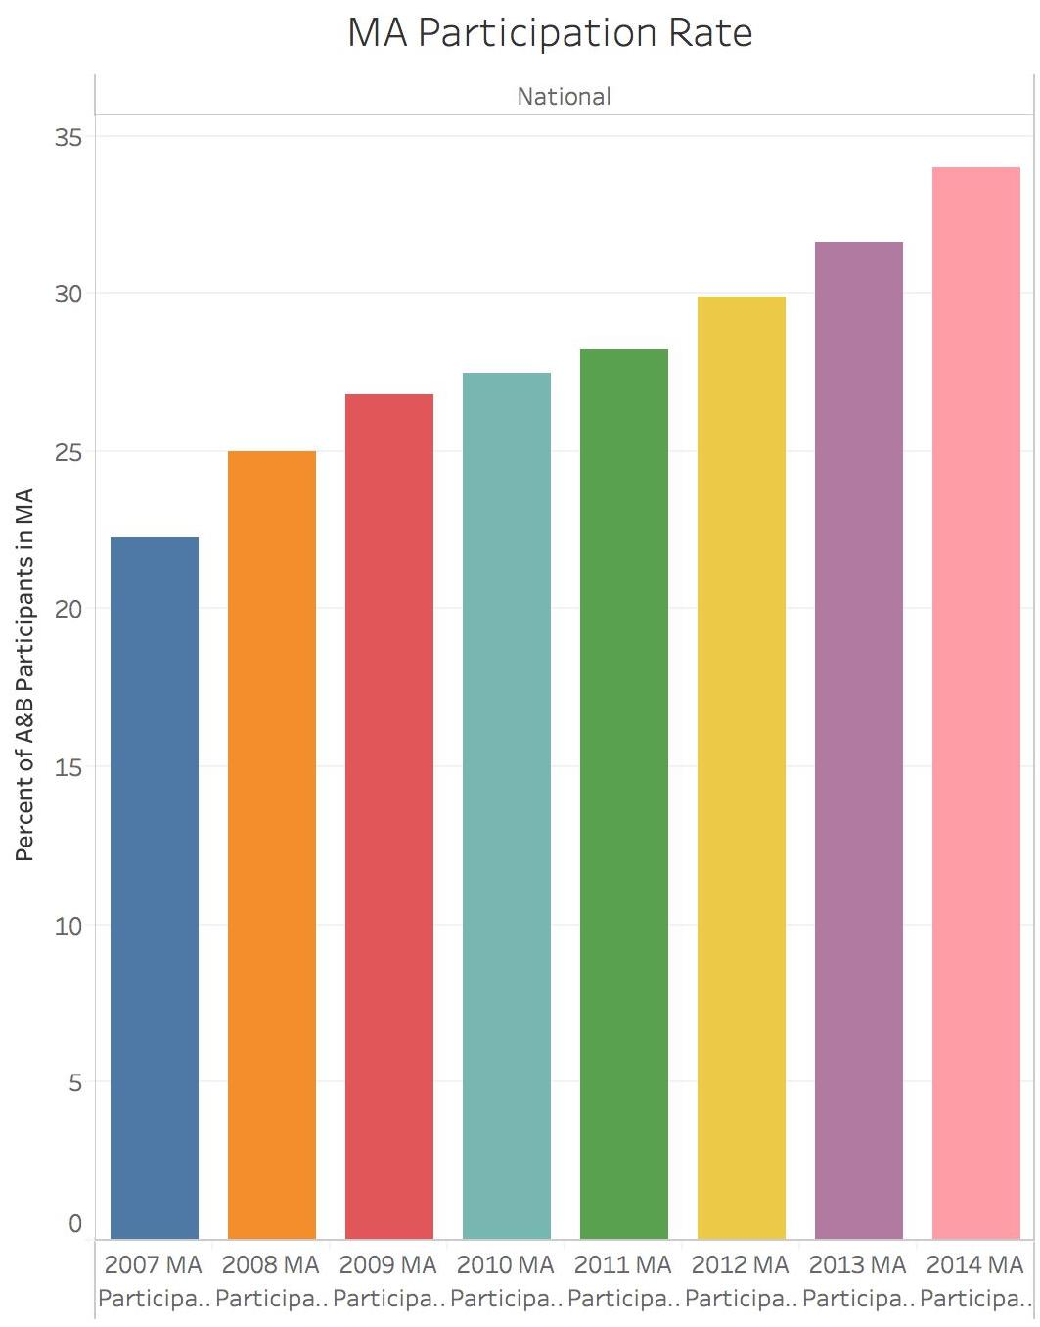

Slide 7
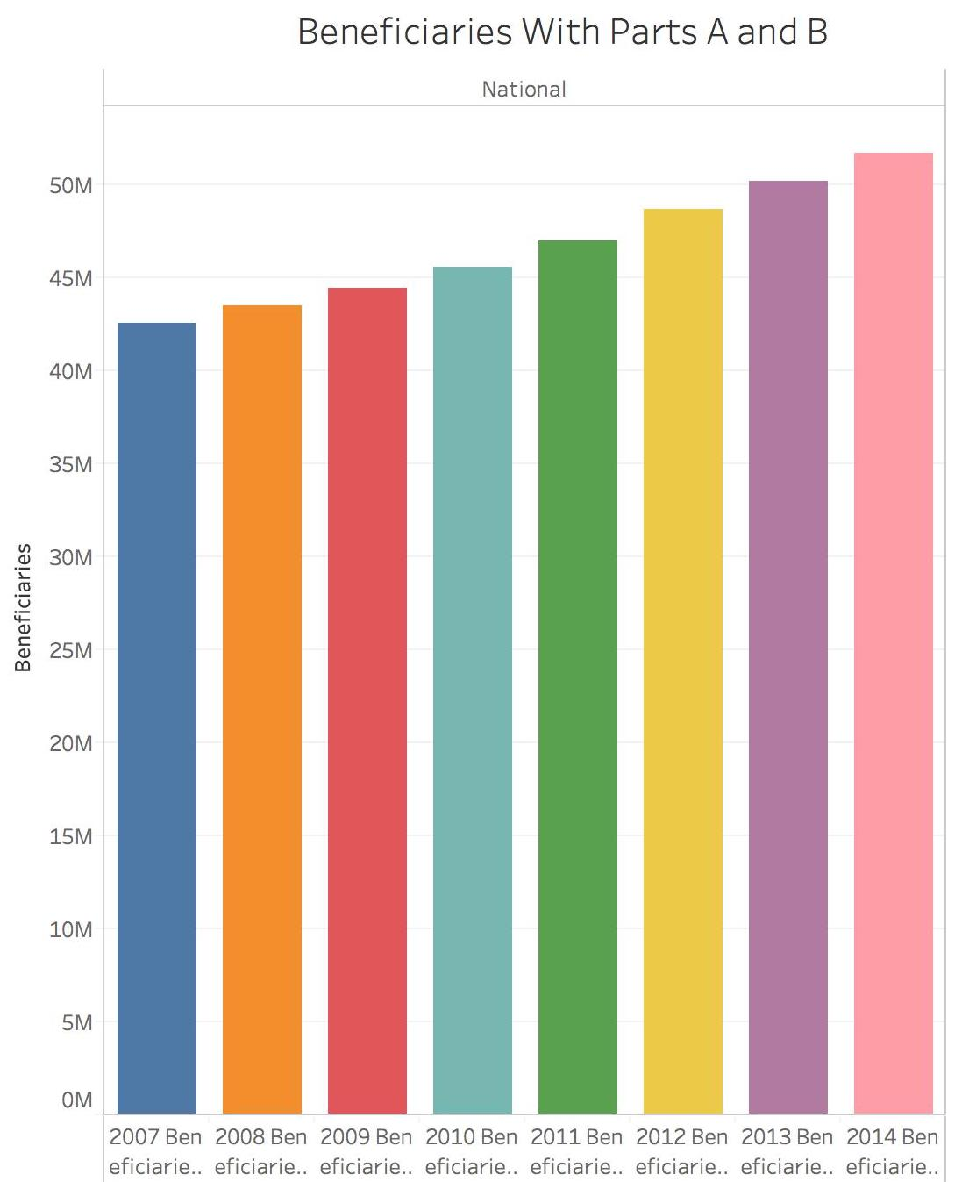

Slide 8
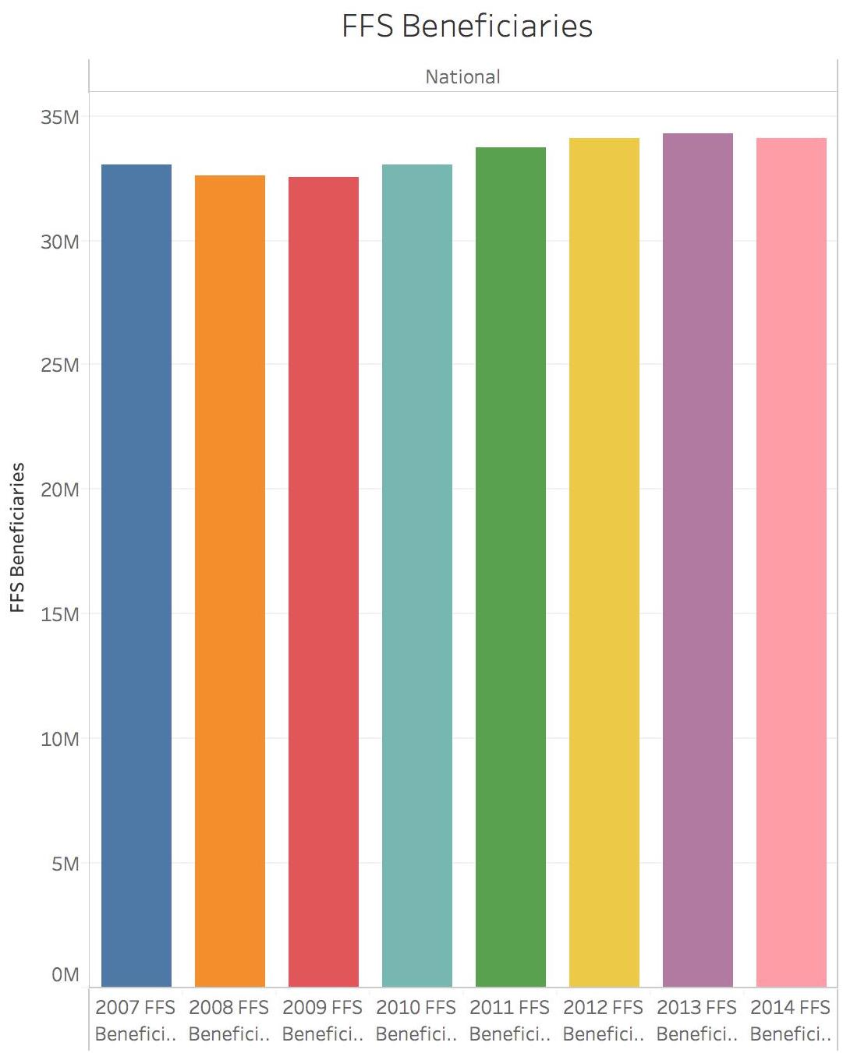
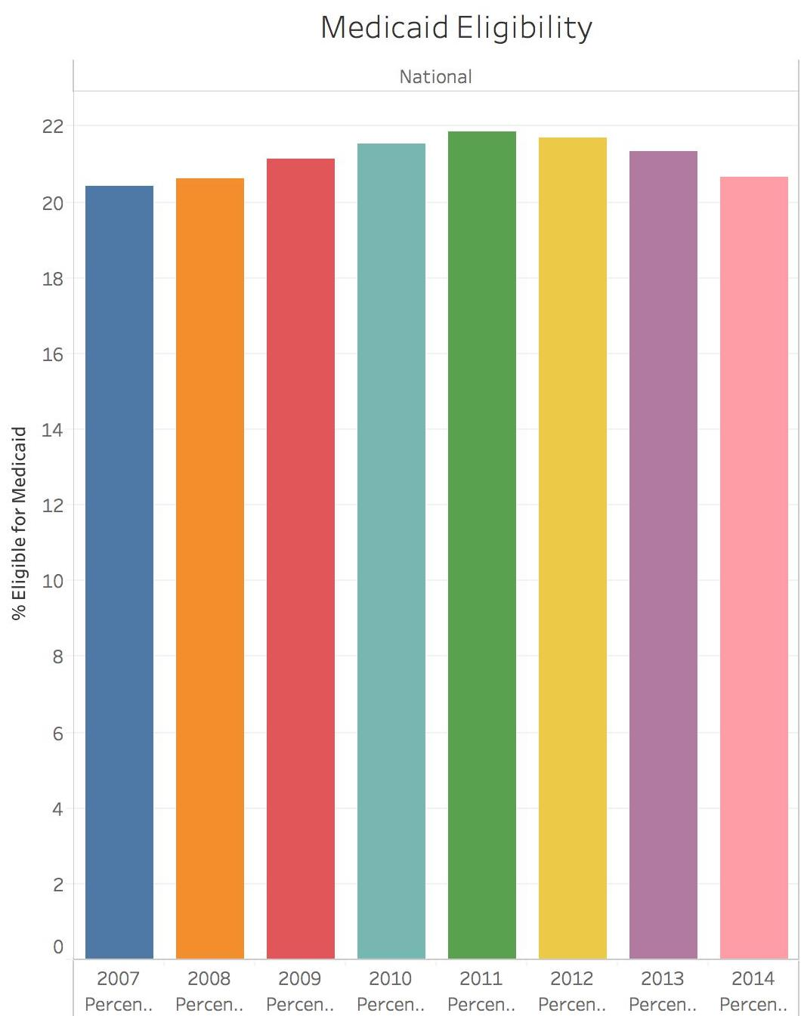

Slide 9
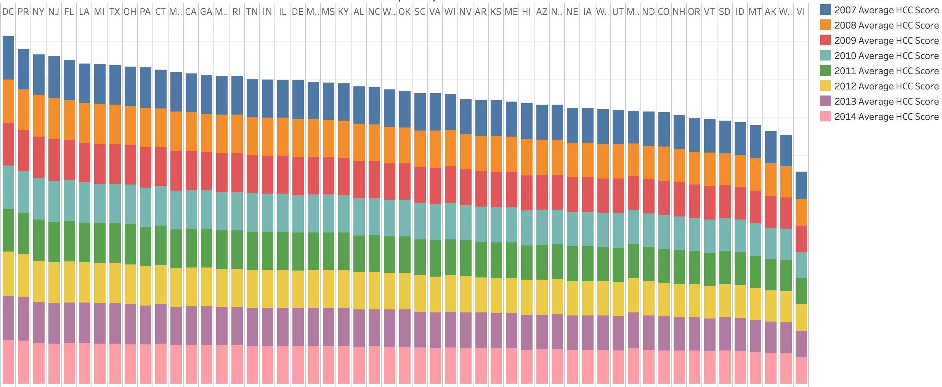
HCC Scores by State

Slide 10
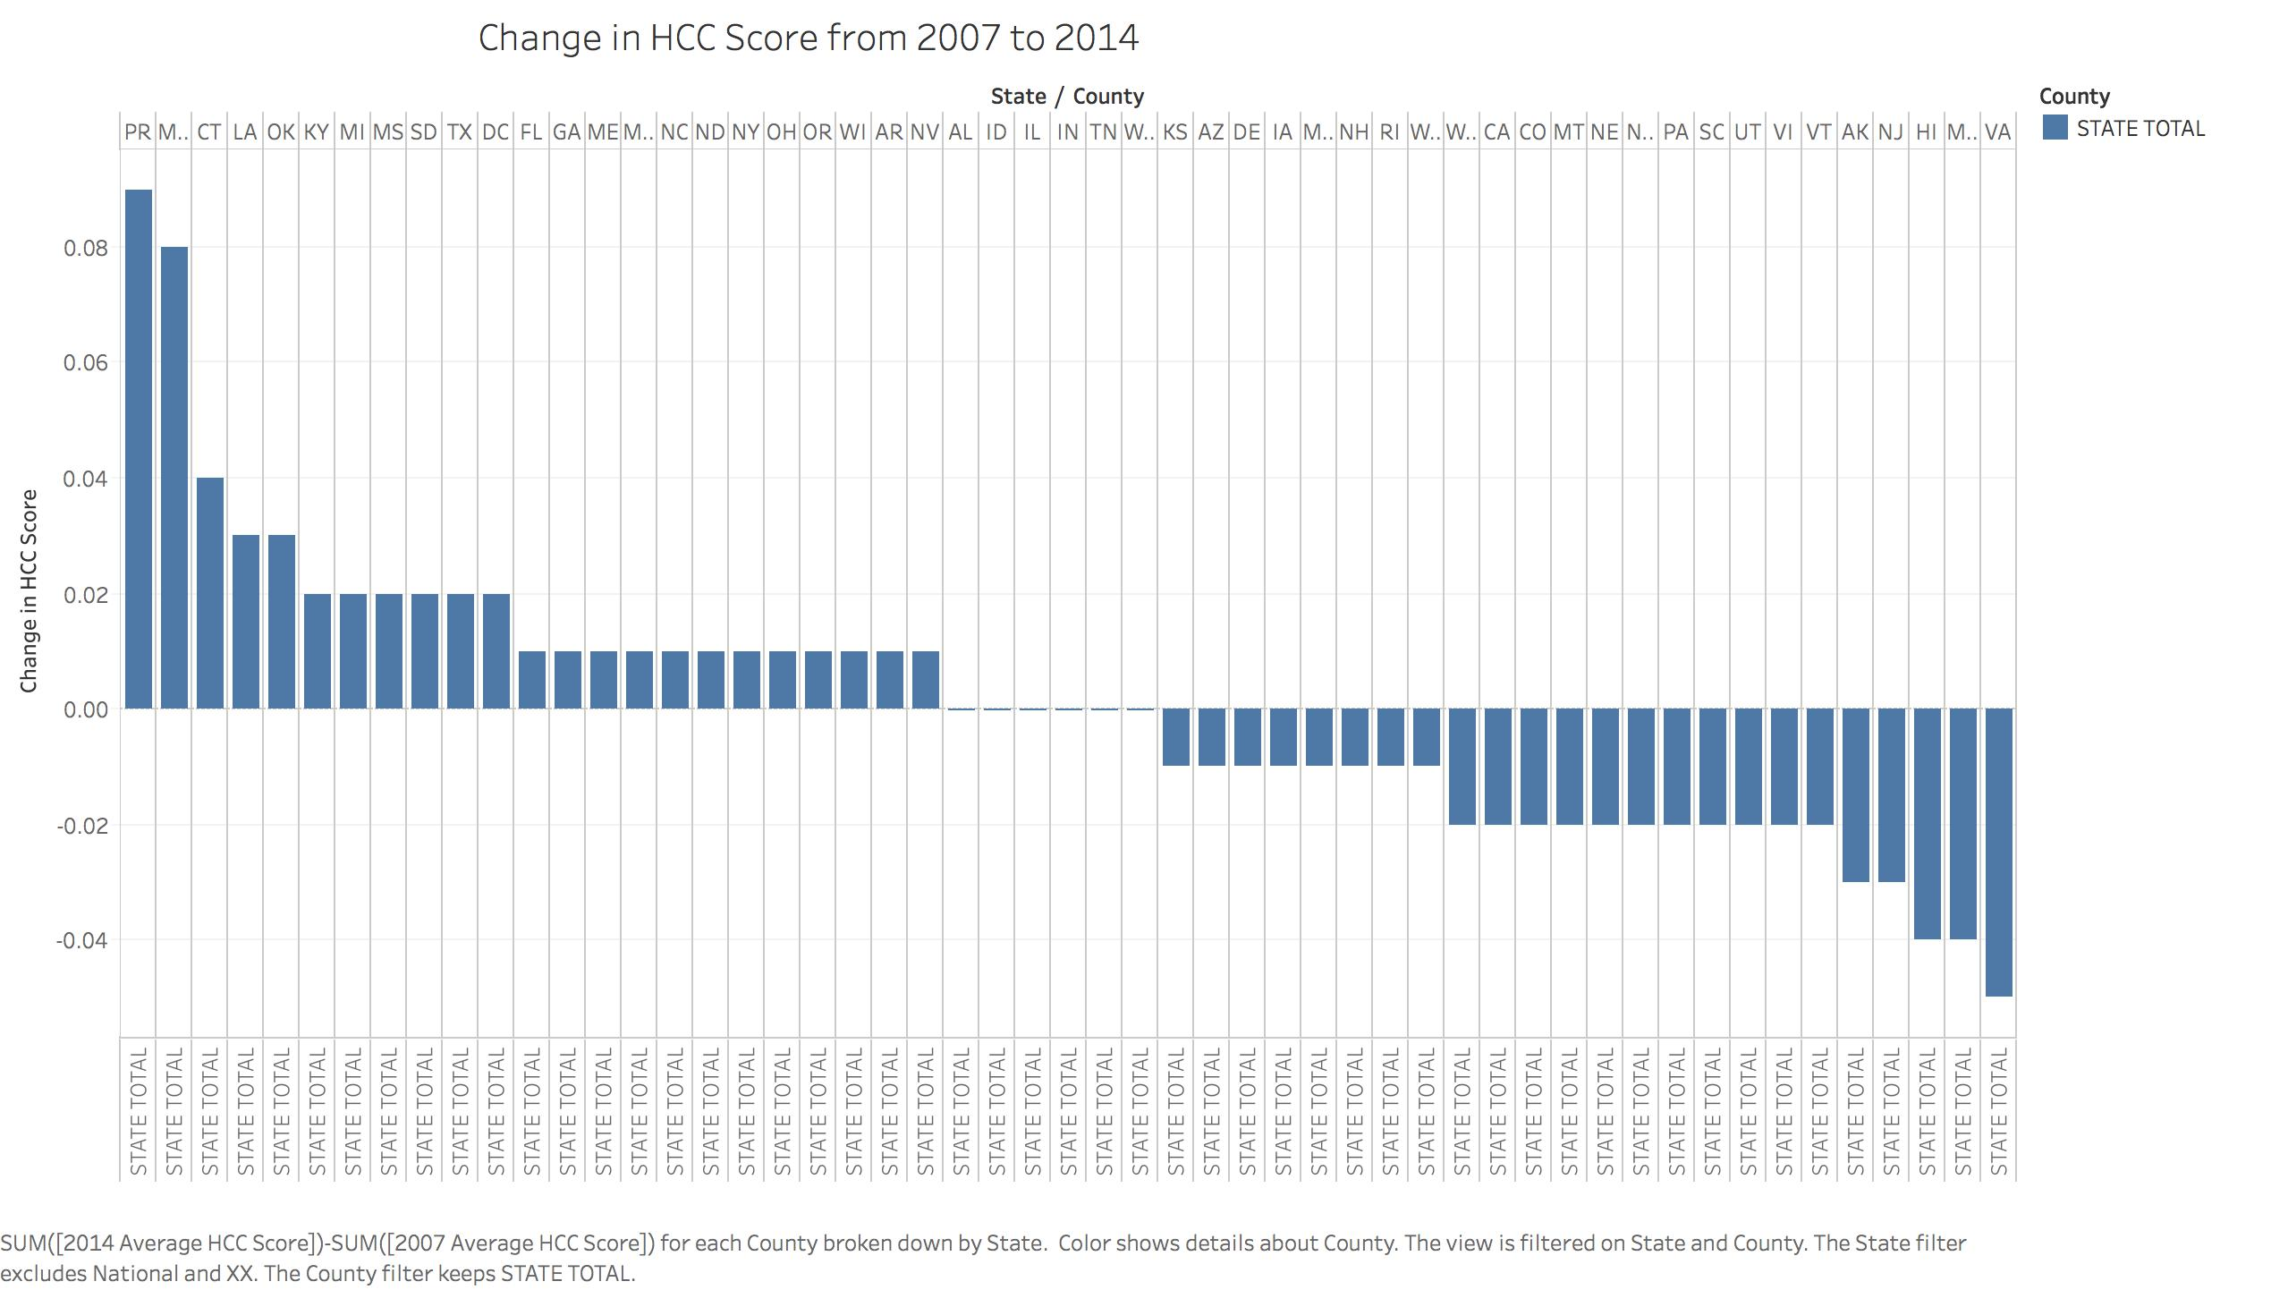

Slide 11
Reflecting
Learned a lot about SQL and working with Databases
Experience with Tableau outside of the classroom environment
Tested out different tools such as Postgres, Quicksight
Learned how to connect to a database with Python

Slide 12
Still need to learn
Need to learn a lot more about the domain
Still need to be more fluent with playing with data
I’m thankful the data was clean
How would Rowdmap approach the same problem

Slide 13
Thank you

