Slide 1

CS 7290 Final Project Presentation
Nickhil Tekwani (tekwani.n@northeastern.edu)

Slide 2
Project Background
Rumor: WHO sometimes delays announcements regarding contagious diseases
Research Question: Does the World Health Organization (WHO) report information on diseases drastically slower than other sources?
* Thanks to Professor Church for the initial idea

Slide 3
Dataset
Northeastern Discovery Cluster:
“deltas” (who and promed links)
“ids” summary of promed
Goal: Use dataset to determine if there is a delta between Promed’s crowdsourced reporting of a certain disease incident and WHO’s official reporting of a disease

Slide 4
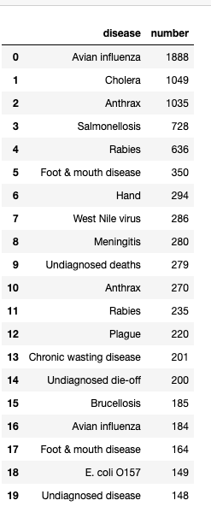
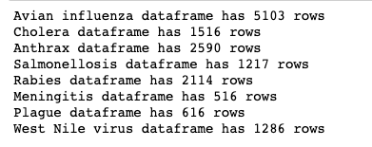
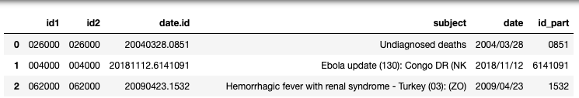
Promed Data Processing
Reg Ex within “subject” field to find top 20 relevant subjects
Split Date appropriately
Grouped into various dataframes for 8 diseases
40k+ Total Records

Slide 5
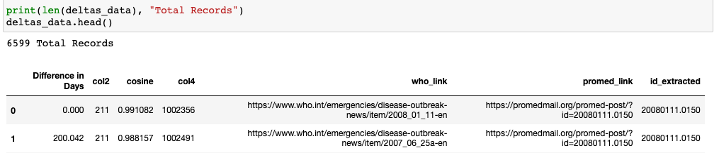
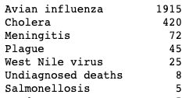
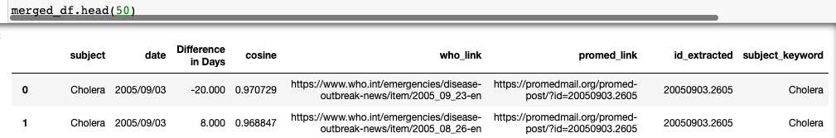
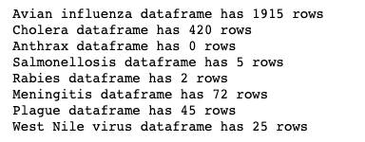
WHO Data Processing
~6k Total Records
Utilized delta dataset to associate WHO links with subjects from Promed “ids” (Merged based on UID of Promed link)
Split into appropriate dataframes

Slide 6
Time Series Analysis | Steps
Break into disease: dataframe mapping for both sources
Group data into 2 timeseries intervals (monthly across all time, weekly from 2007-2010)
Find 5 top peaks from each subset for each disease from each source
Identify and compare deltas

Slide 7
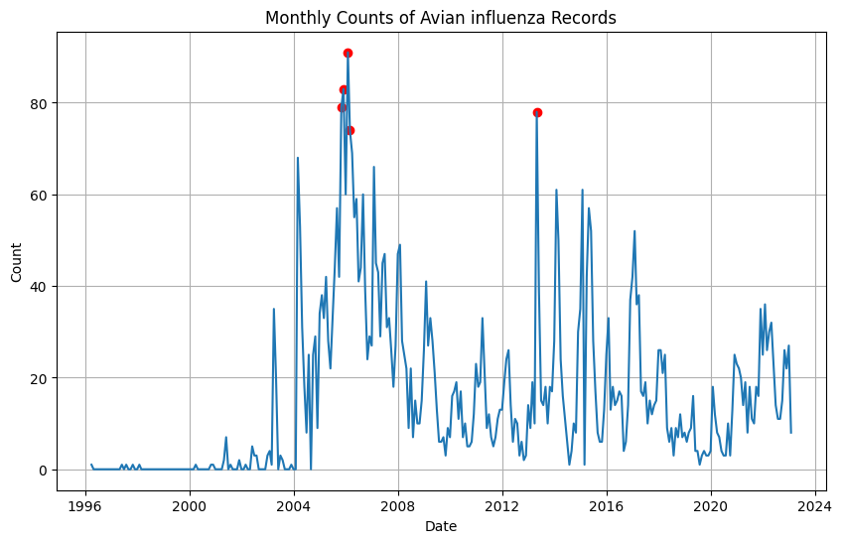
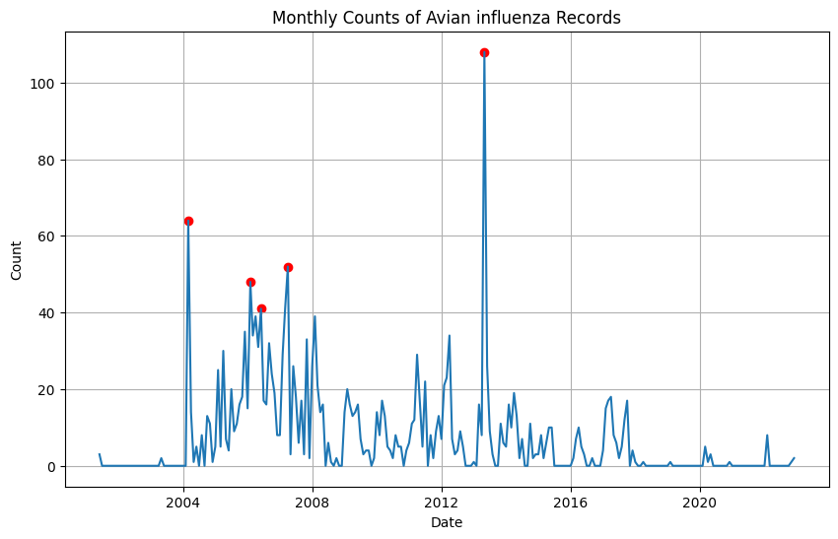
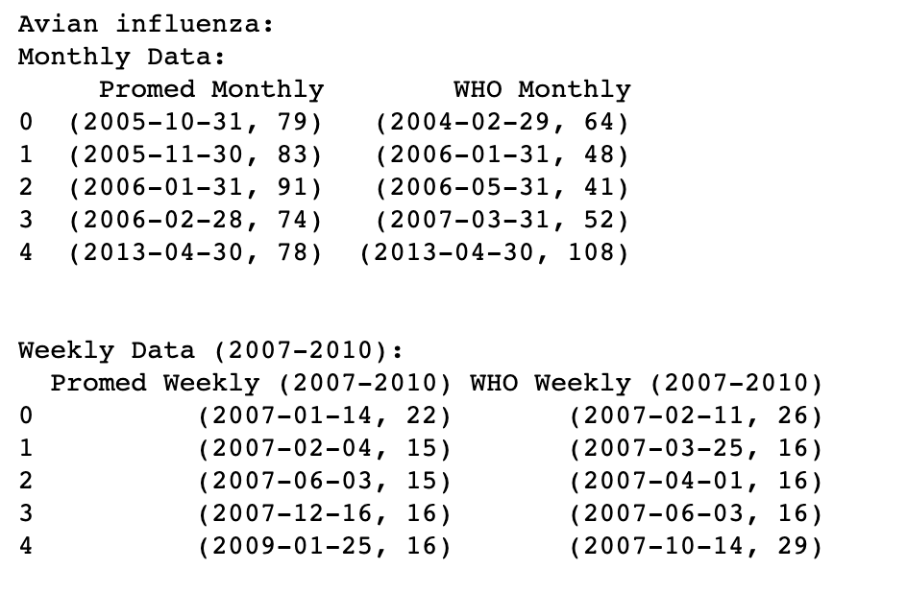
Avian Flu Monthly
Promed
WHO

Slide 8
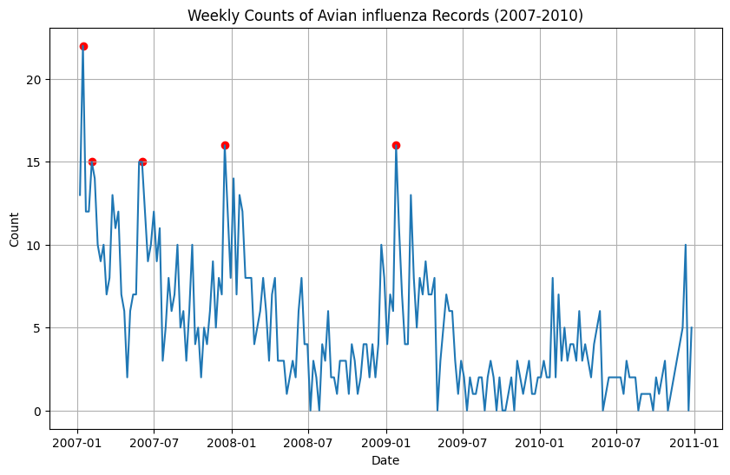
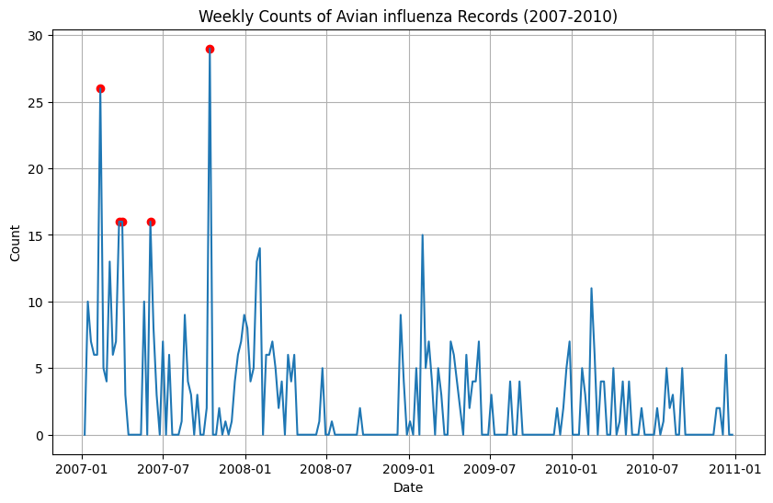
Avian Flu Weekly
Promed
WHO

Slide 9
Avian Flu Results
Monthly
Feb 2004 Peak checks out
Late 2005 Peak exists in Promed but not WHO, but we were seeing a general upwards trend still
Jan 2006 Peak Checks out
April 2013 Peaks is exact same day
Weekly (2007-2010)
Q1 2007, Promed peaks a couple weeks before WHO
June 2007 checks out
Jan 2009 checks out

Slide 10
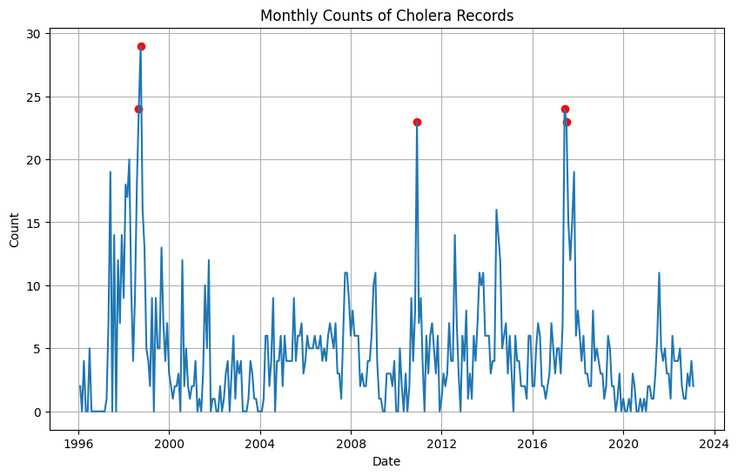
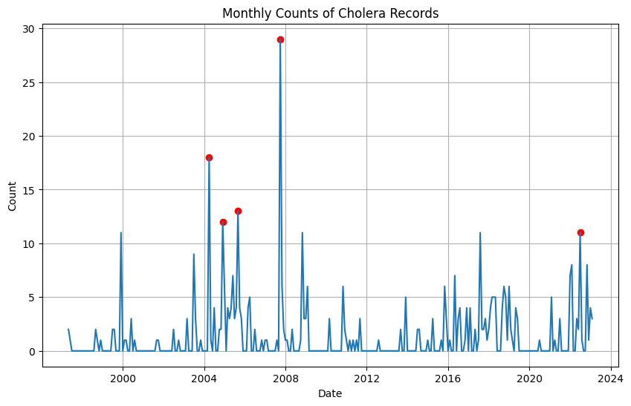
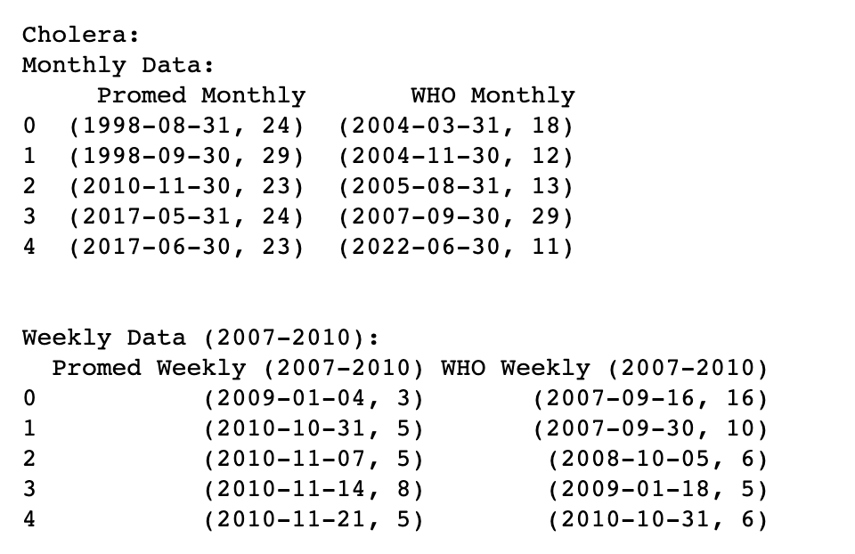
Cholera Monthly
Promed
WHO

Slide 11
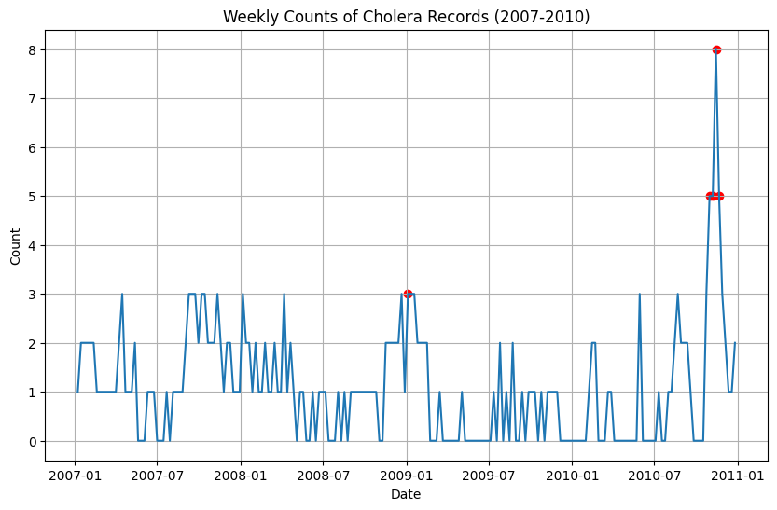
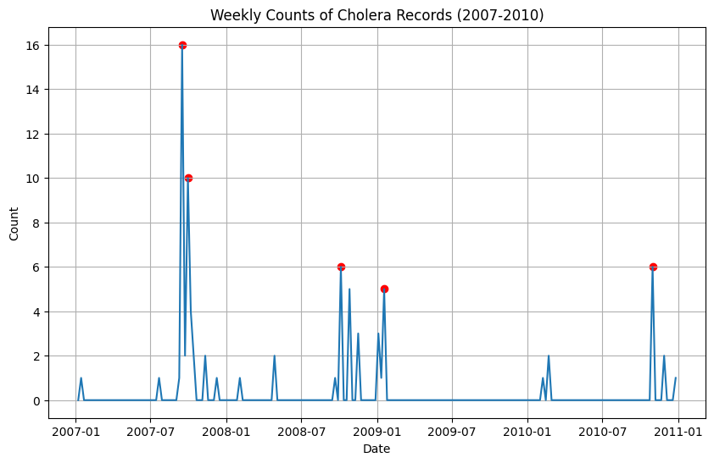
Cholera Weekly
Promed
WHO

Slide 12
Cholera Results
Monthly
Promed seems to peak right before 2000, while WHO seems to peak right after
2004 to 2005 checks out
2010 to 2017 trending checks out
2022 seems a little off, but mostly irrelevant at modern years
Weekly (2007-2010)
Sept 2007 peak checks out
Jan 2009 peak, WHO seems to be about 2 weeks delayed
2010 checks out

Slide 13
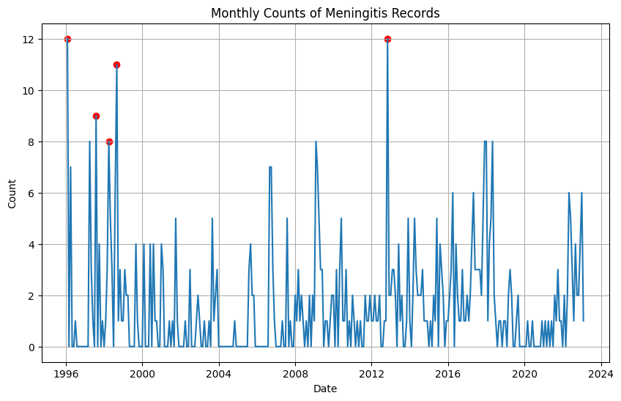
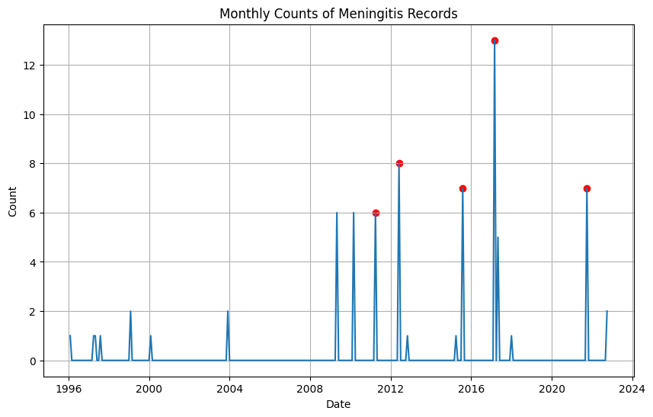
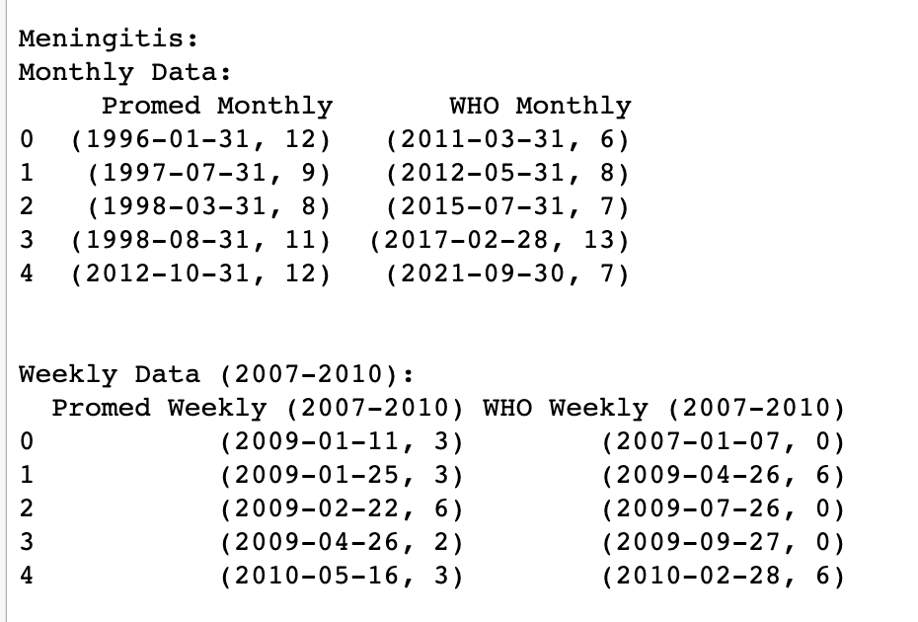
Meningitis Monthly
Promed
WHO

Slide 14
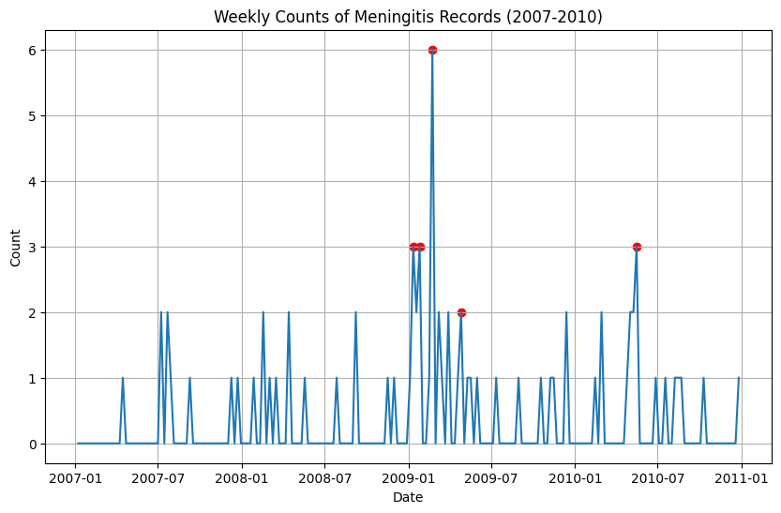
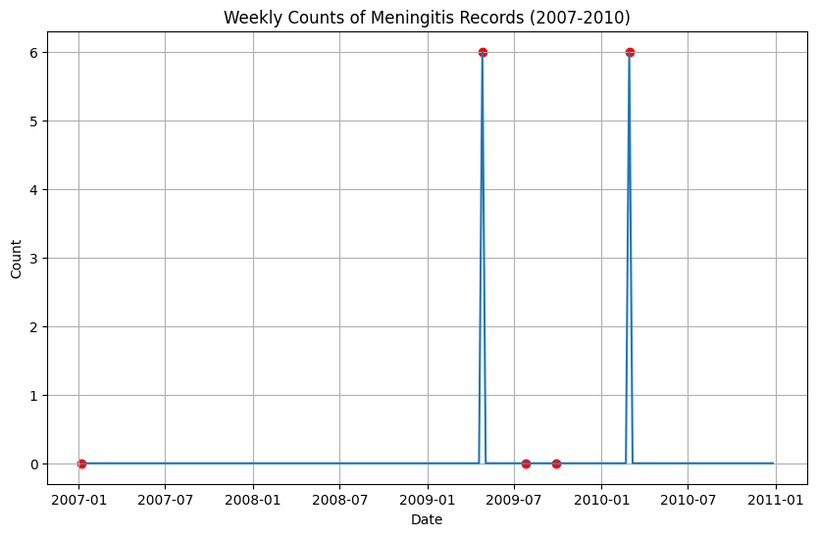
Meningitis Weekly
Promed
WHO

Slide 15
Meningitis Results
Monthly
Pre 2008 all seems to check out
WHO’s 2012 peak was 3 months prior?
2017 onwards seems to check out
Weekly (2007-2010)
Both had the same peak April 2009, but Promed had a Q1 2009 peak that WHO did not
Not enough WHO data besides that time period

Slide 16
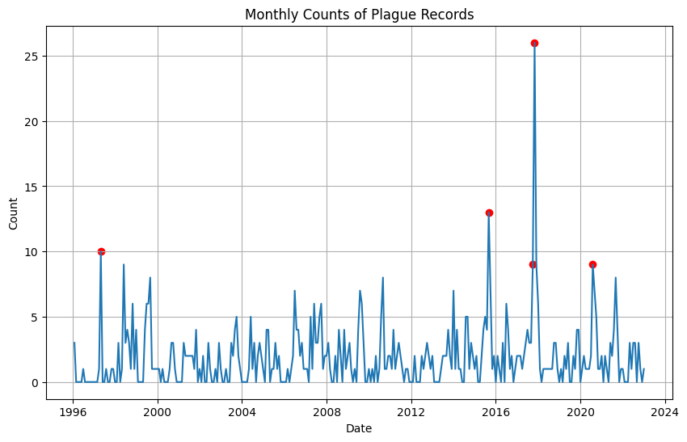
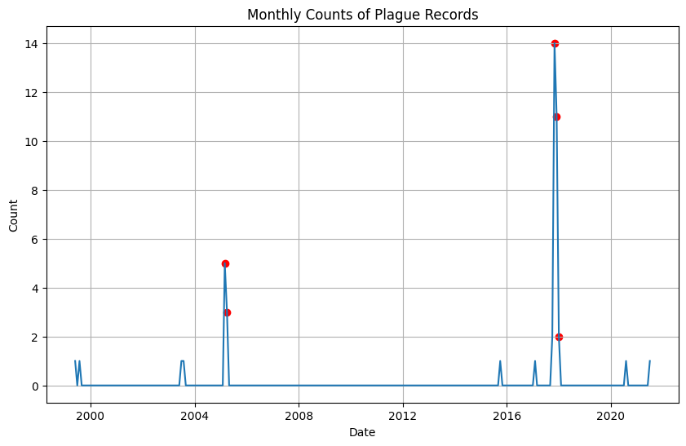
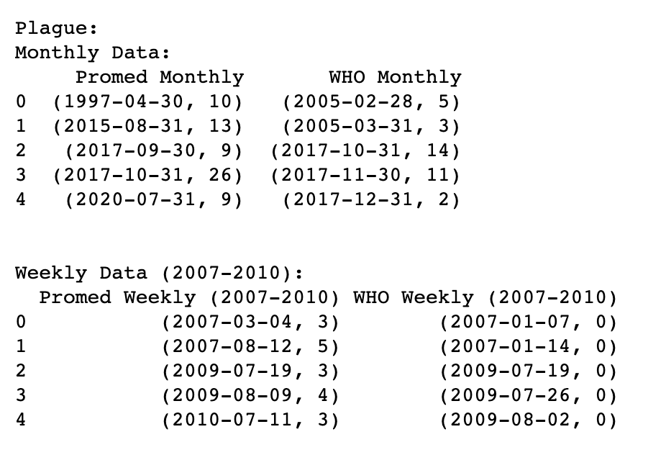
Plague Monthly
Promed
WHO

Slide 17
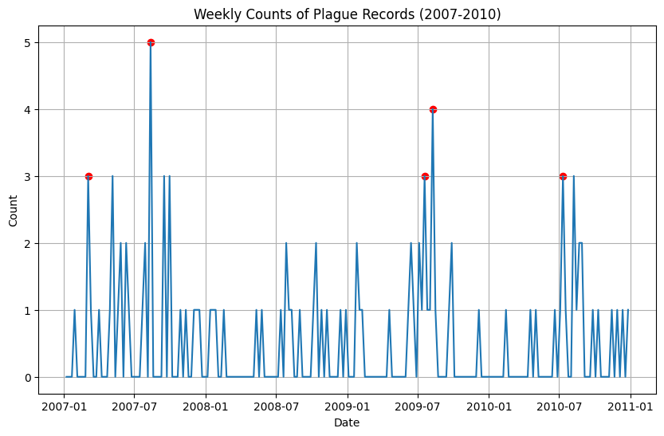
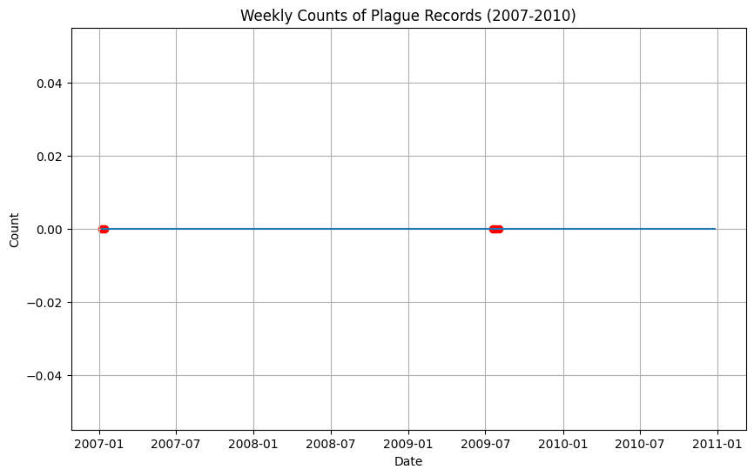
Plague Weekly – Not Enough WHO Data
Promed
WHO

Slide 18
Plague Results
Monthly
2005 seems to check out, not much other data pre 2017
October 2017 they had the same peak, but Promed had another peak a month prior that WHO did not
Not enough data after 2017
Weekly (2007-2010)
Not enough WHO Data

Slide 19
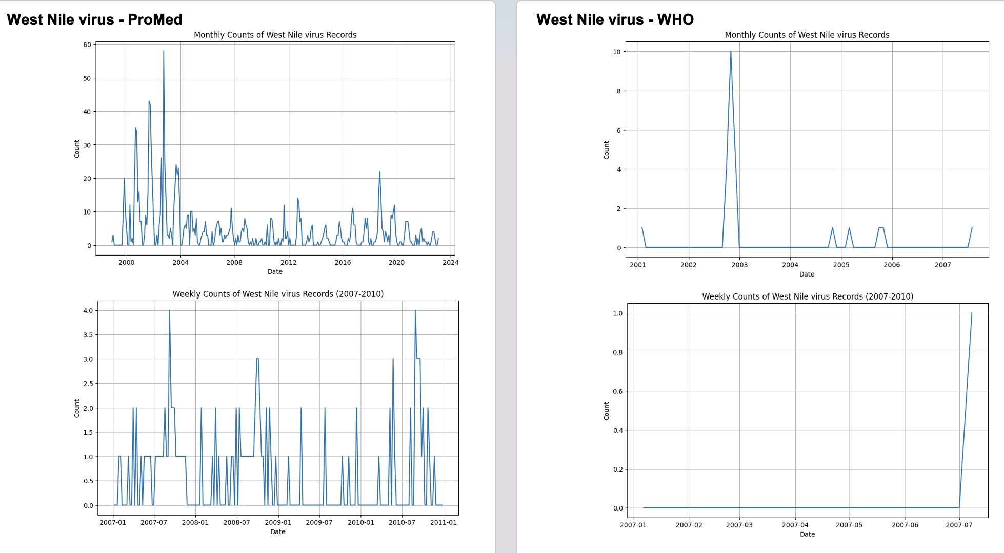
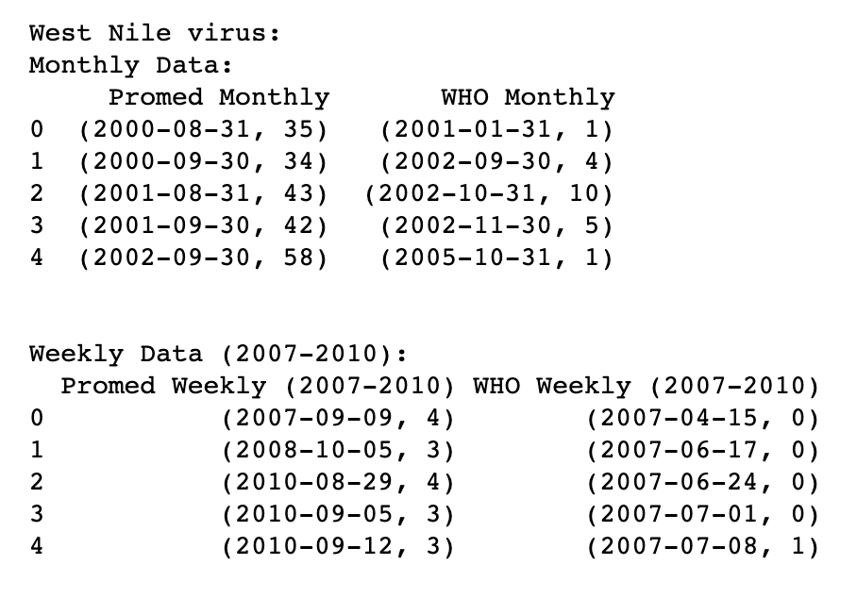
West Nile virus – Not Enough WHO Data

Slide 20
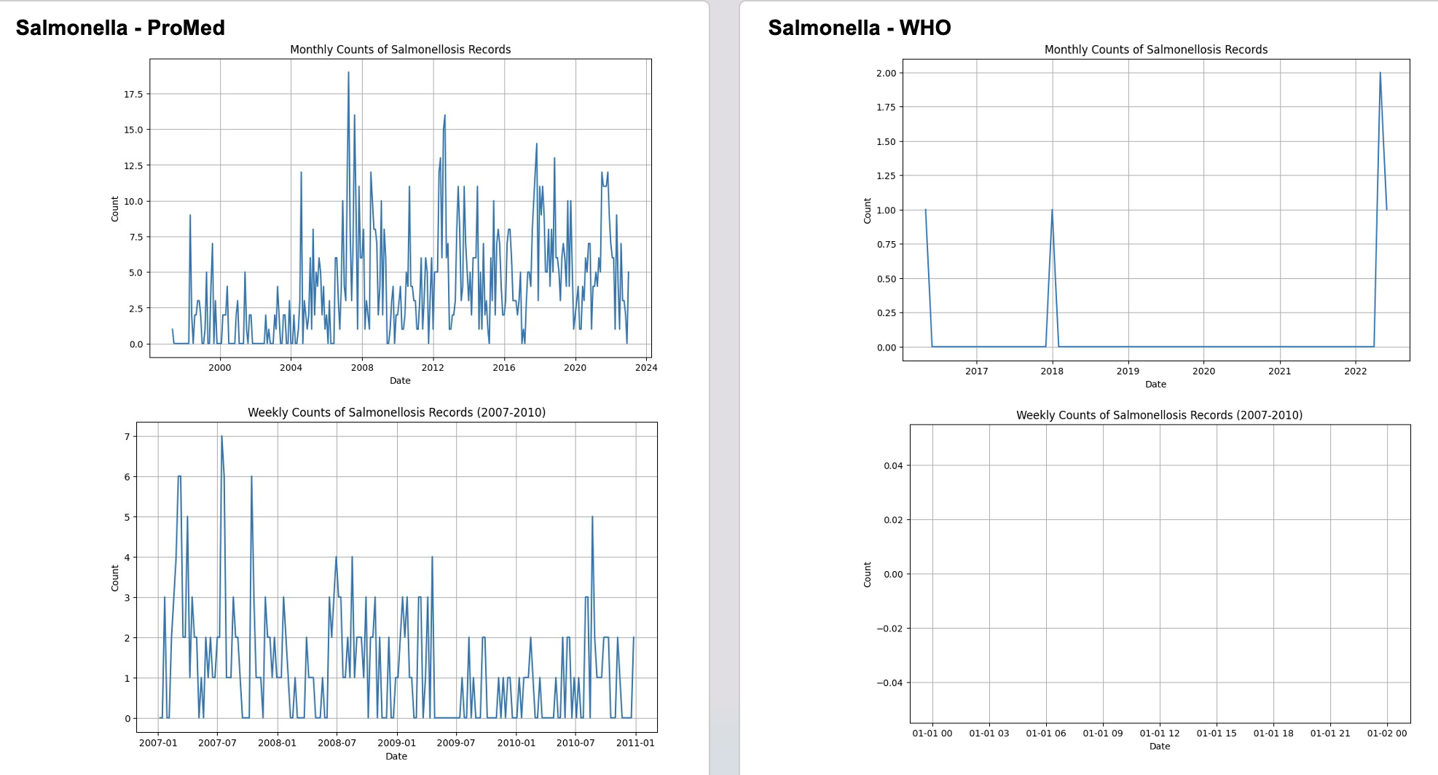
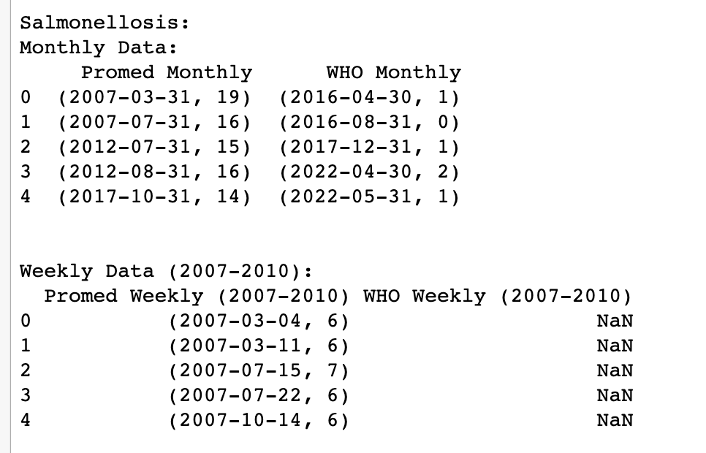
Salmonella – Not Enough WHO Data

Slide 21
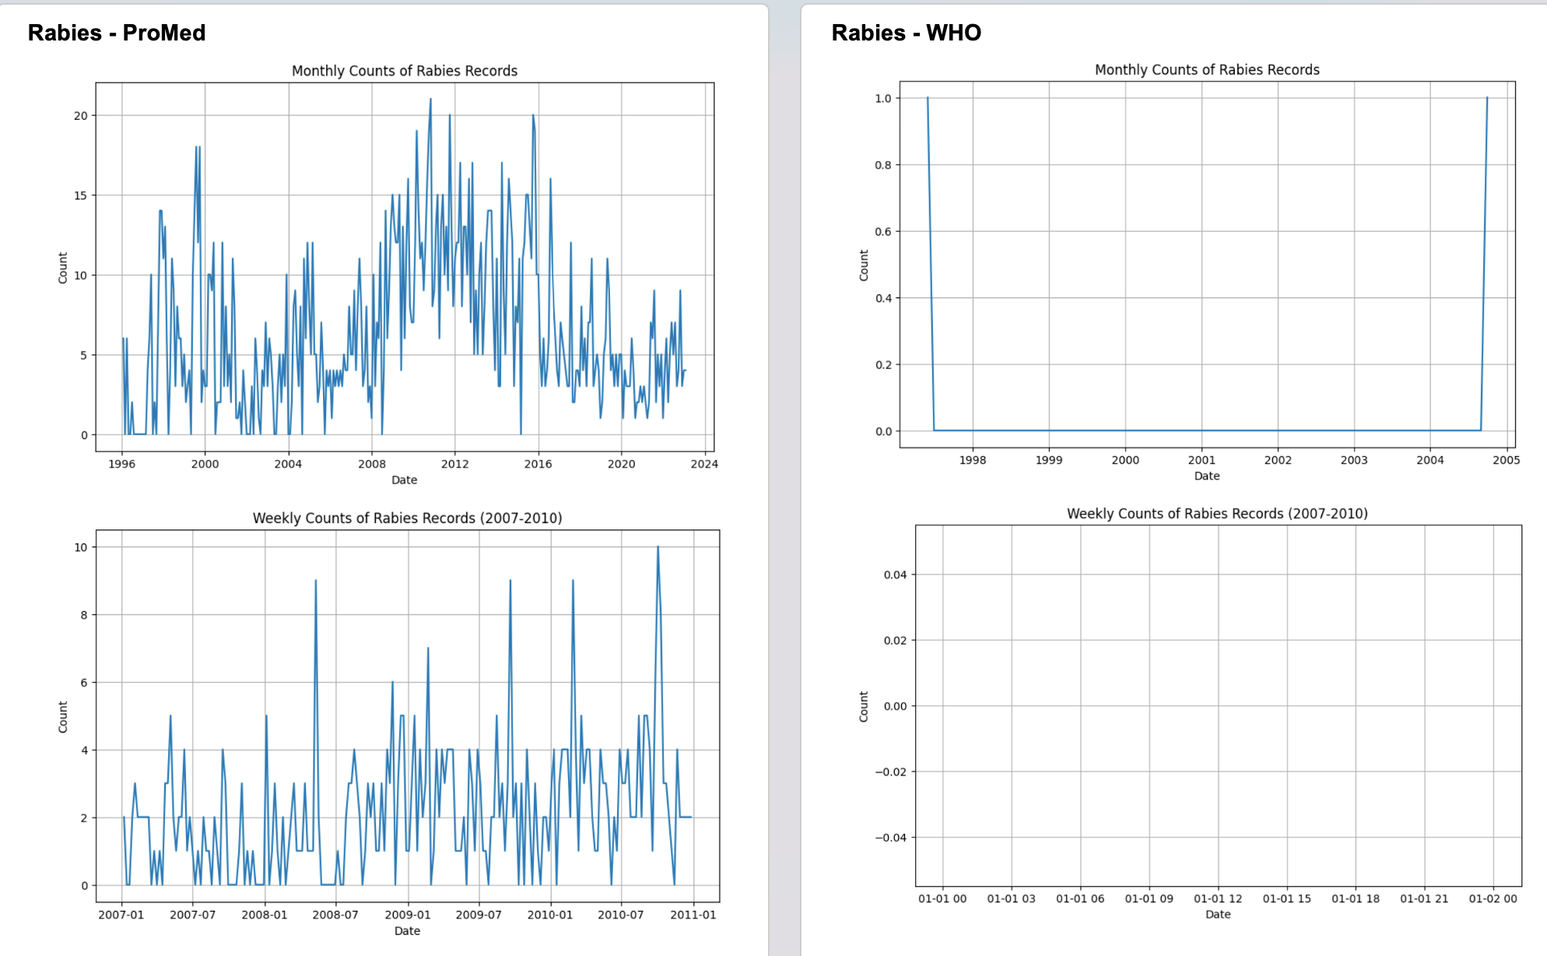
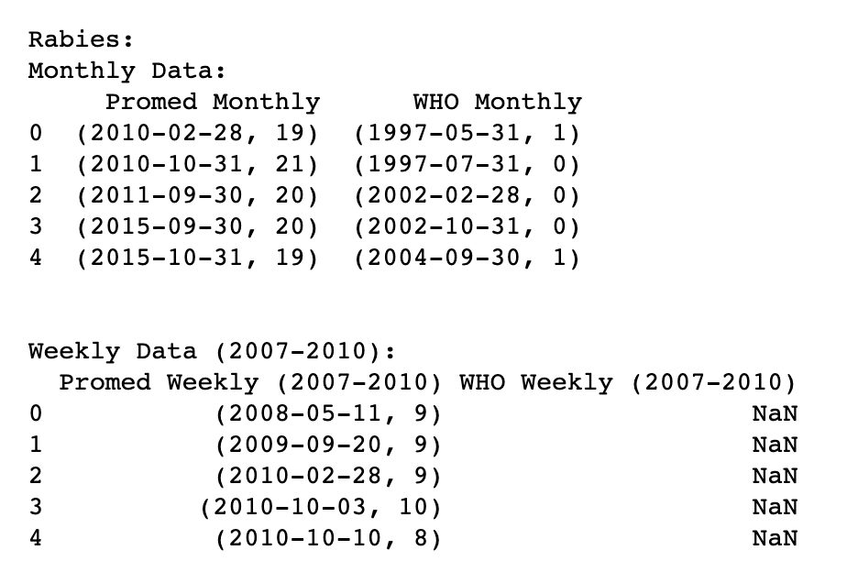
Rabies – Not Enough WHO Data

Slide 22
Future Expansions
Look at the start of a rise to a peak as opposed to just peaks
Identify trends at an extremely granular level
(such as graphs for each disease, each year, weekly. Or on a daily basis at a weeklong scale)
Get politicians/world health experts to corroborate information beyond just the numbers

Slide 23
Analysis Summary
Avian Flu (1915 records)
Monthly: 1 Medium Potential Discrepancy (Q4 2005)
Weekly* : 1 Strong Potential Discrepancy (Q1 2007)
Cholera (420 records)
Monthly : 1 Medium Potential Discrepancy (around 2000)
Weekly* : 1 Strong Potential Discrepancy (Jan 2009)
Meningitis (72 records)
Monthly : 1 Low Potential Discrepancy (2012)
Weekly* : 1 Low Potential Discrepancy (Q1 2009)
Plague (45 records)
Monthly : 1 Medium Potential Discrepancy (Q4 2017)
Weekly* : Not enough WHO Data
West Nile (25), Salmonella (5), Rabies (0) didn’t have enough WHO data
We do NOT have enough substantial evidence to 100% say that WHO is often delayed in its reporting.
* Note that weekly is only from 2007-2010

Slide 24
Plague Results
Monthly
2005 seems to check out, not much other data pre 2017
October 2017 they had the same peak, but Promed had another peak a month prior that WHO did not
Not enough data after 2017
Weekly (2007-2010)
Not enough WHO Data

