Slide 1
AVIAN INFLUENZA COMPARISON

Slide 2
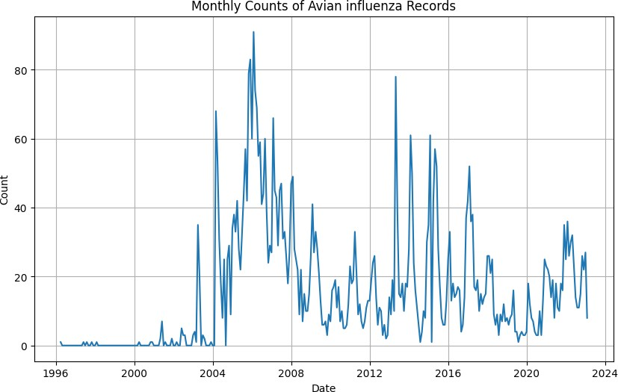
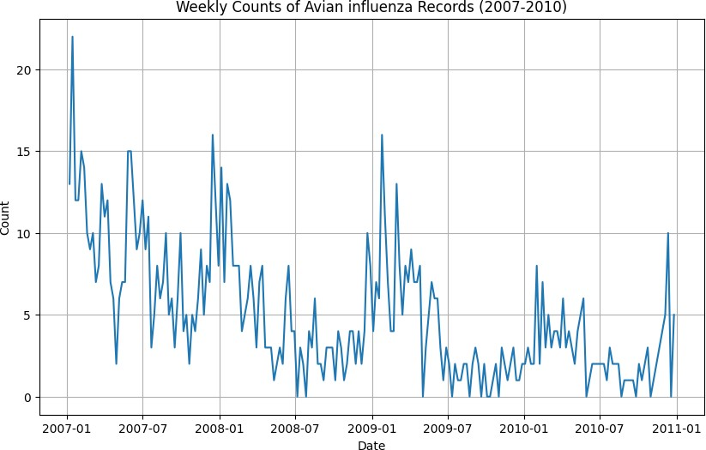
Avian - ProMed

Slide 3
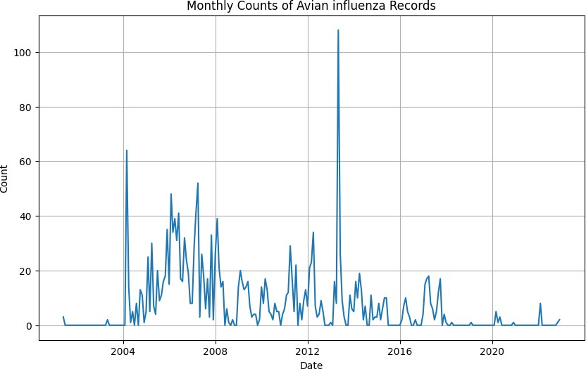
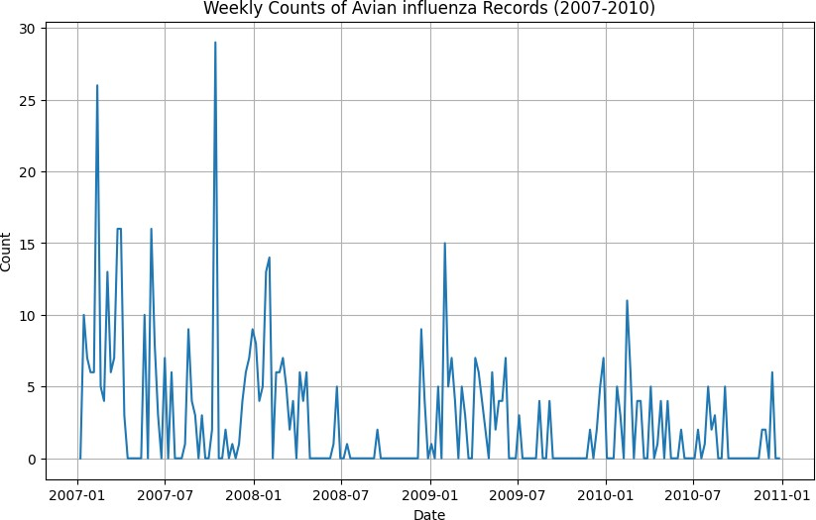
Avian - WHO

Slide 4
CHOLERA COMPARISON

Slide 5
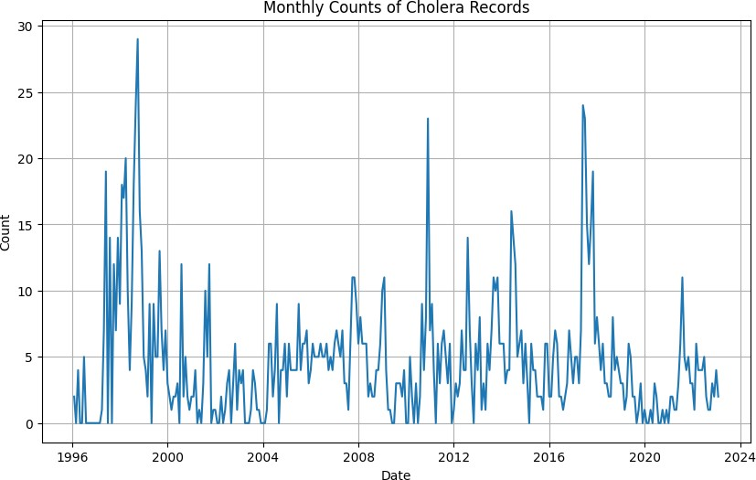
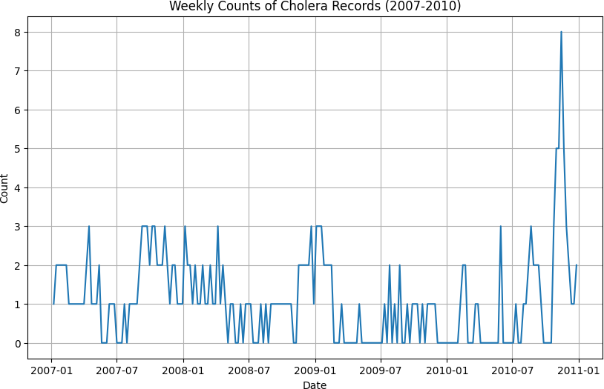
Cholera - ProMed

Slide 6
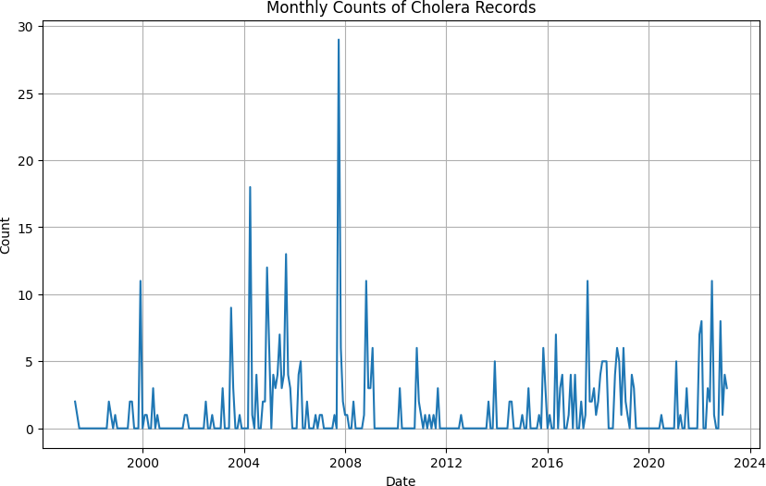
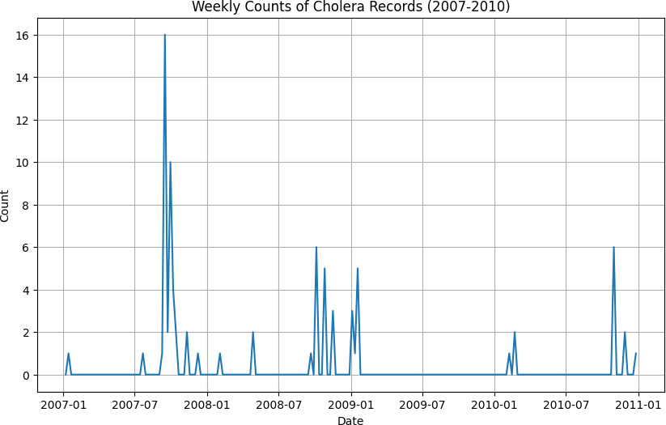
Cholera - WHO

Slide 7
MENINGITIS COMPARISON

Slide 8
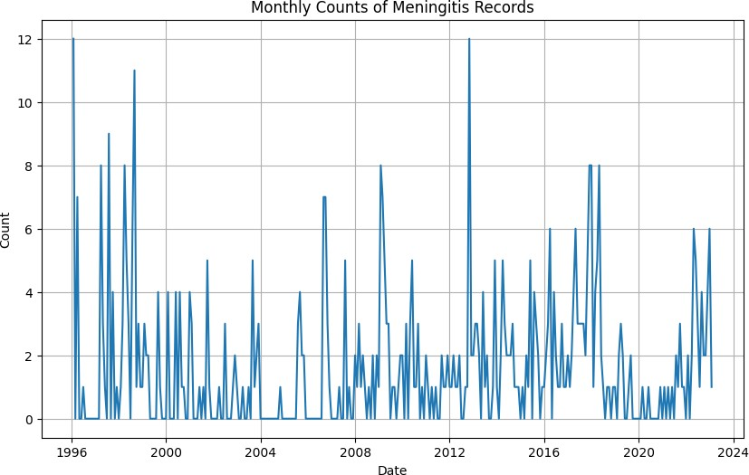
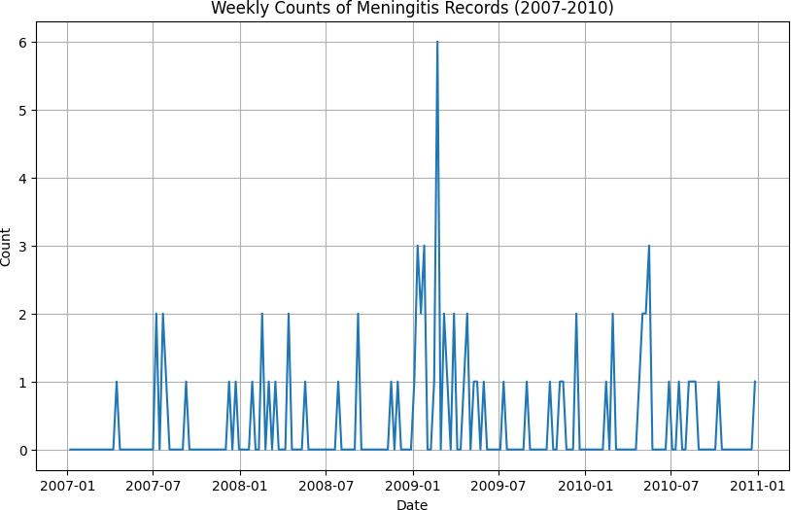
Meningitis - ProMed

Slide 9
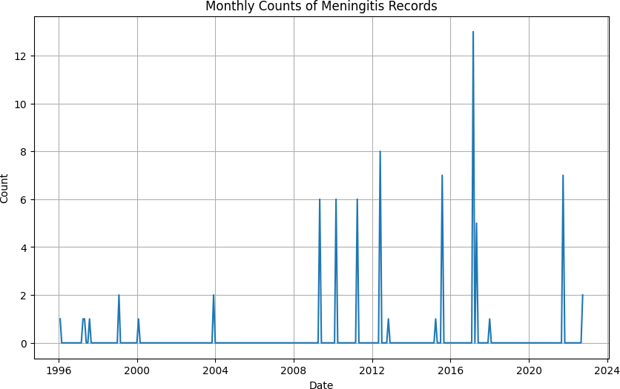
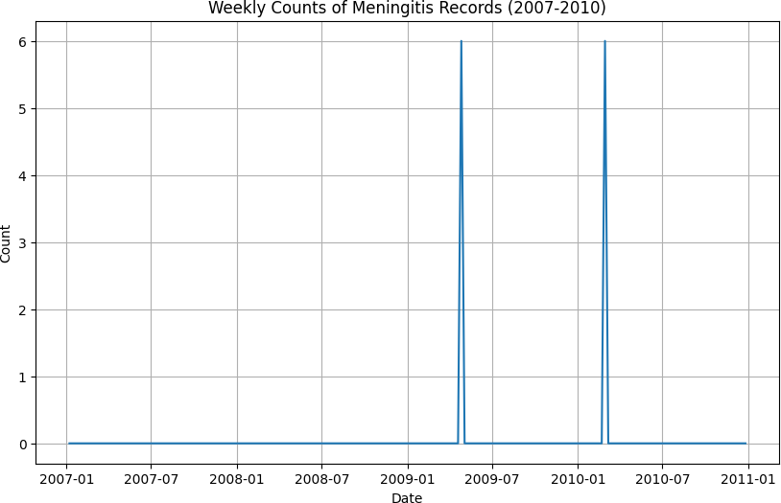
Meningitis - WHO

Slide 10
PLAGUE COMPARISON

Slide 11
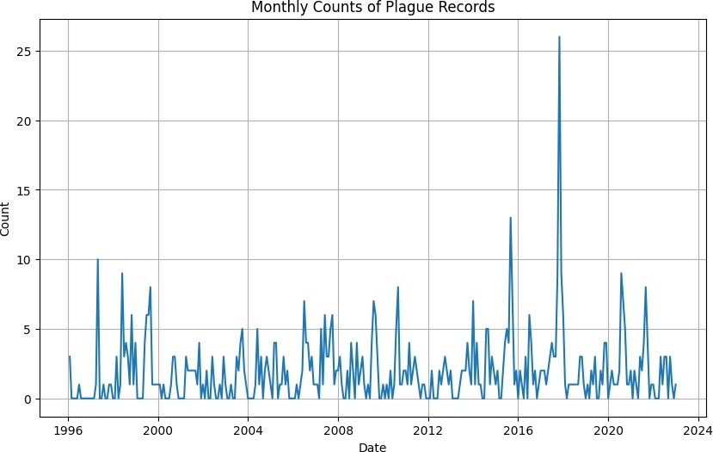
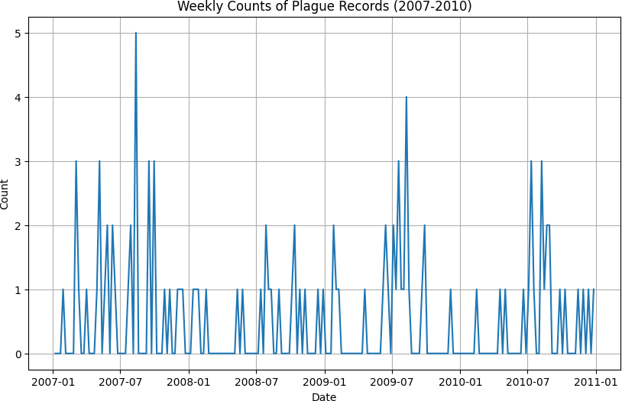
Plague - ProMed

Slide 12
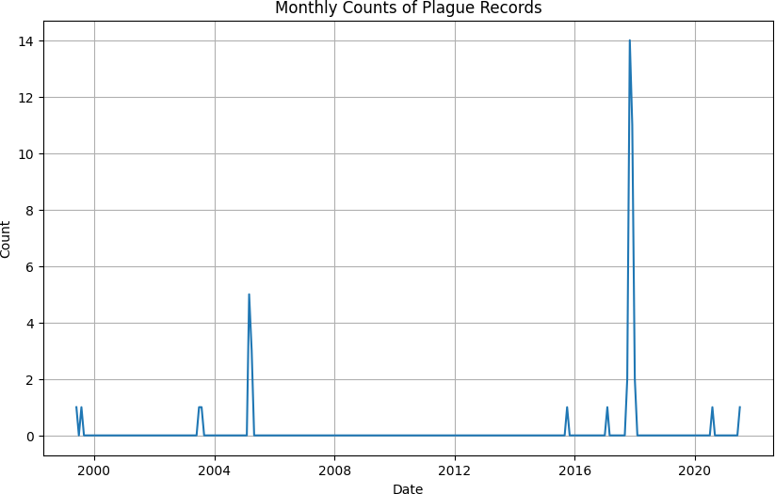
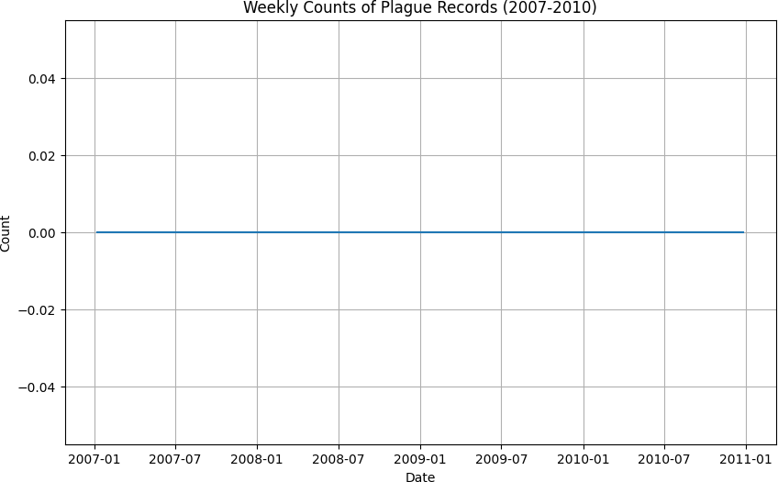
Plague - WHO

Slide 13
WEST NILE VIRUS COMPARISON

Slide 14
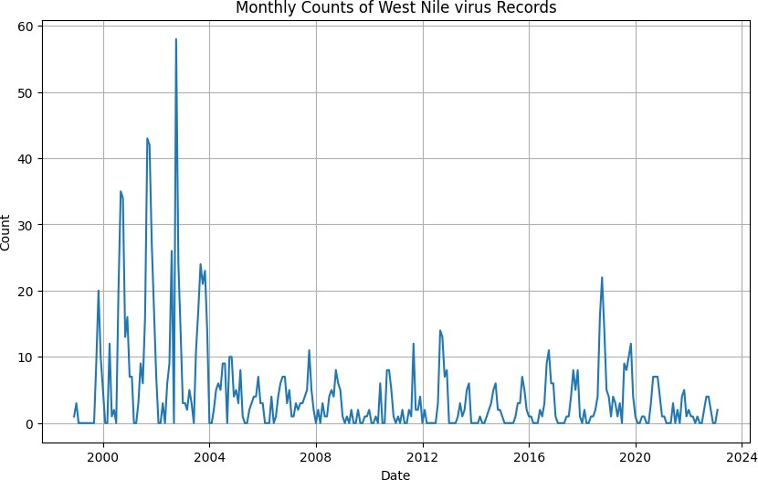
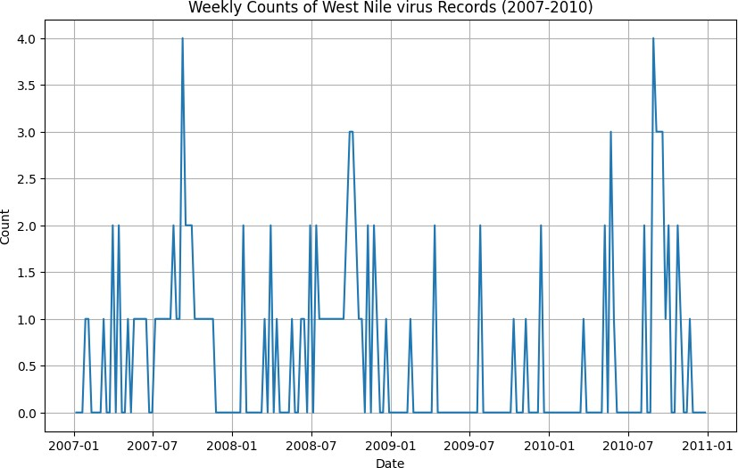
West Nile virus - ProMed

Slide 15
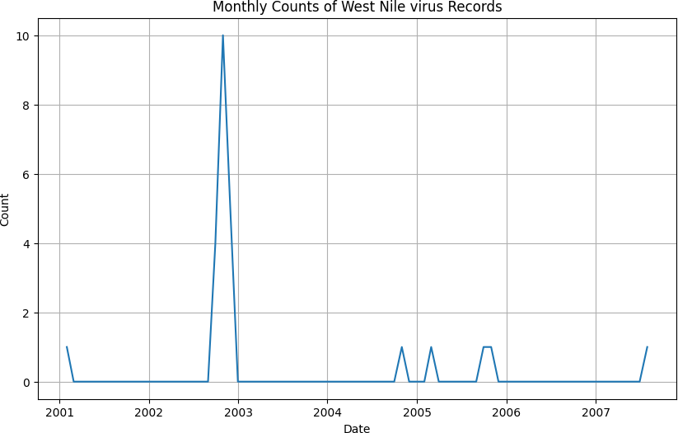
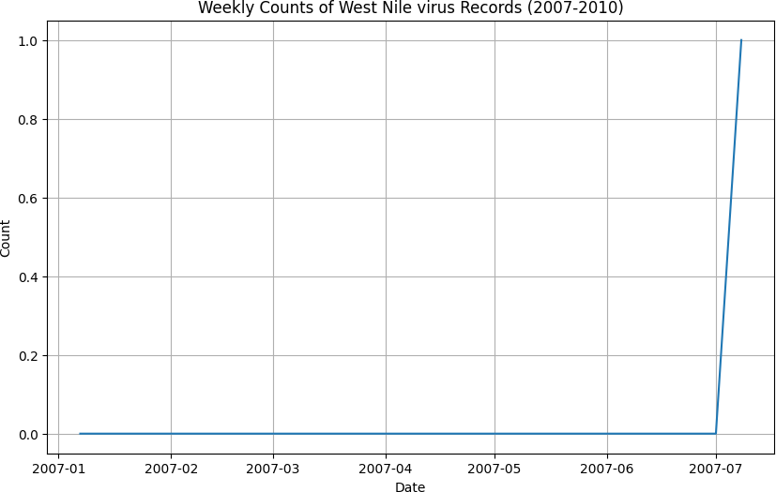
West Nile virus - WHO

Slide 16
SALMONELLA COMPARISON

Slide 17
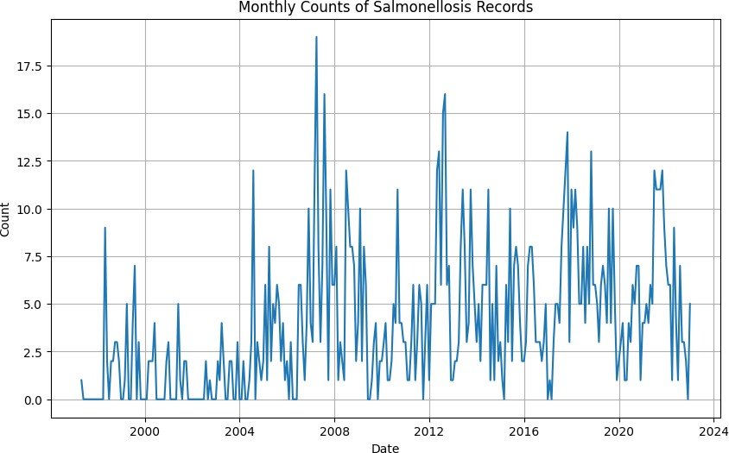
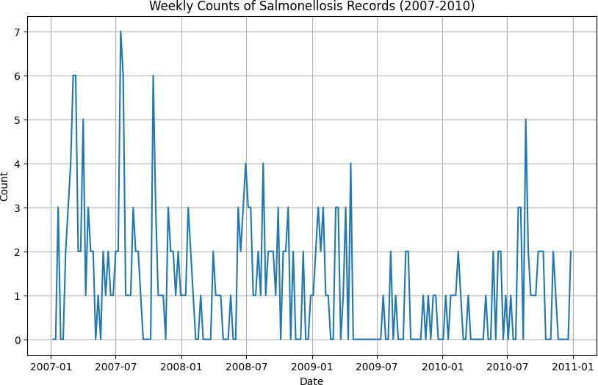
Salmonella - ProMed

Slide 18
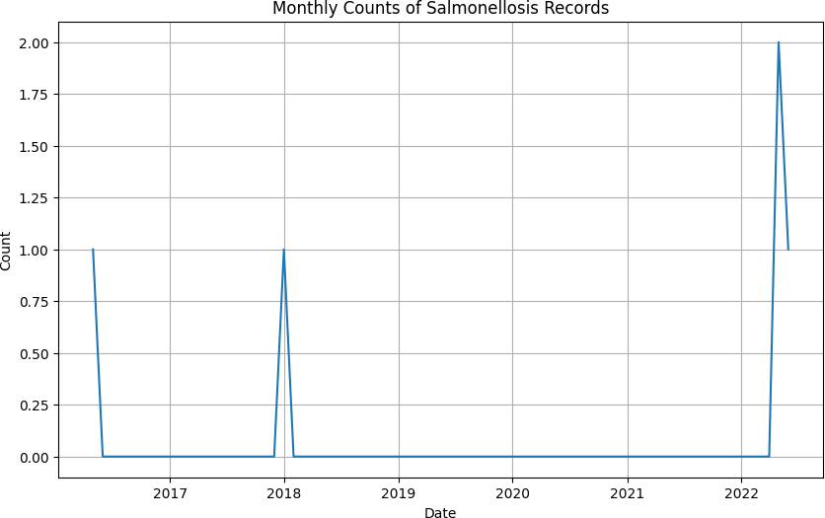
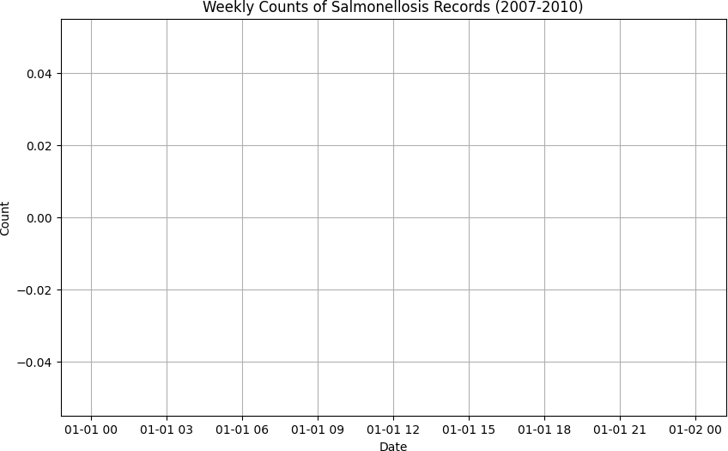
Salmonella - WHO

Slide 19
RABIES COMPARISON

Slide 20
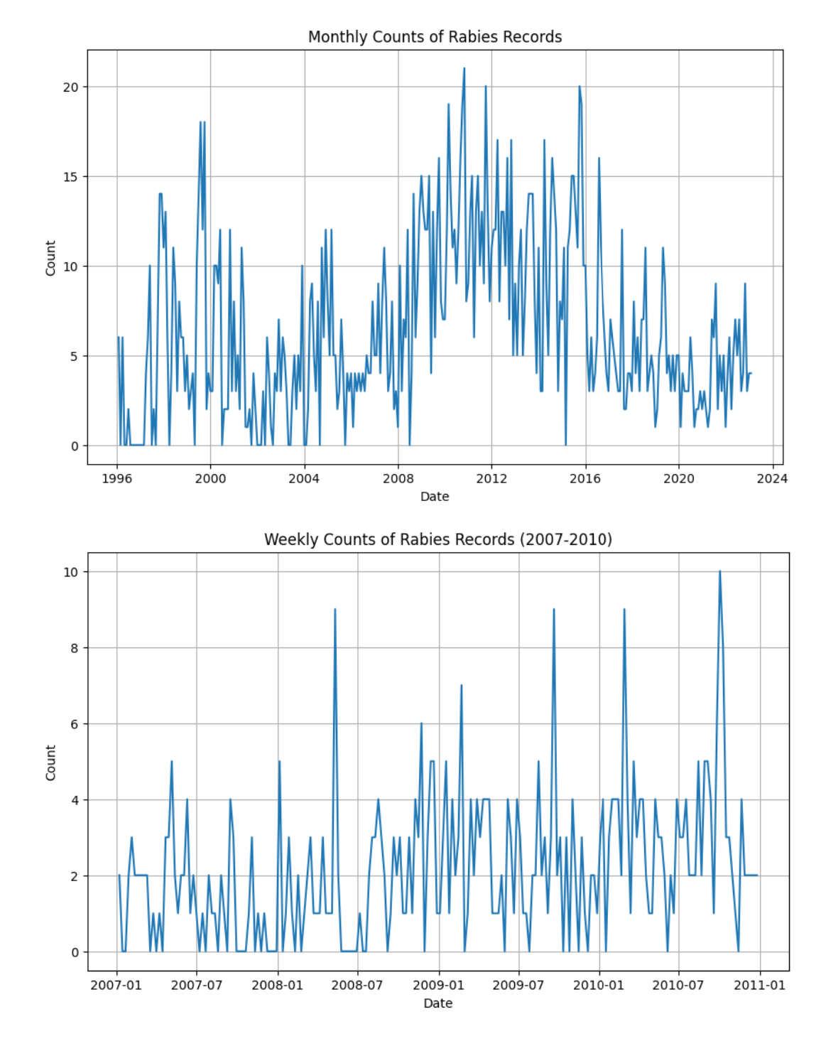
Rabies - ProMed
Monthly Counts of R.abies Records
 |  | 11���11
 |  |  | I
 | II
20
15
.µ
.::
:::,
8 10
5
0
1996
2000
2004
2008
2012
2016
2020
2024
Date
Weekly Counts of Rabies Records {2007-2010)
10
 |  |  |  |  |  |  |  |  | j |  |  | ill |  |  |  |  | l
 |  |  | }� |  |  |  |  |  | \ |  |  |  |  | ... | 11
 |  |  |  |  | M | ,
8
...
6
.::
:::,
8
4
2
0
2007-01
2007-07
2008-01
2008-07
2009-01
Date
2009-07
2010-01
2010-07
2011-01

Slide 21
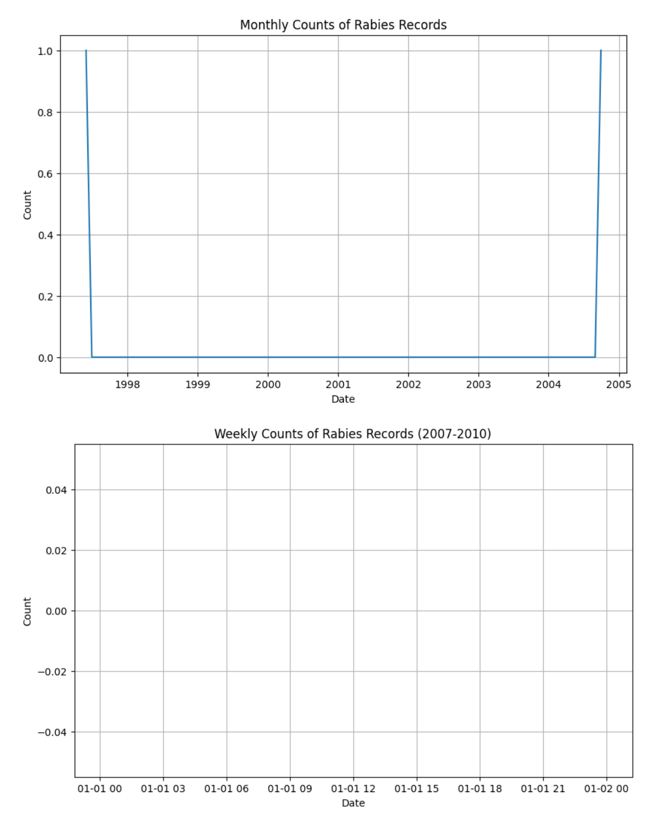
Rabies - WHO
Monthlly Counts of Rabies Records
+ l + +
1.0 l
1..
+
+
+
t-+-I
0.8+ +
+
+
1
+
+
+
+
t +-I
...
0.+6
t
+
+
1
+
+
+
+
+-+-I
C:
::,
8
0,4 + +
+
+
1
+
+
+
+
+
+-I
0,2 +
l
+
+
1
+
+
+
+
+ +-I
0.0
1
+
,
+
+
....._-+-I
2004 2005
1998
1999
2000
2001
Date
2002
2003
Weekly Counts of Rabies Records (2007-2010)
0.04 +
+
+
+
+
+
+
1
+
+
I
0.02 +
+
+
+
+
+
+
t
+
+
t
.µ
:^{C}:,: 0.00 +
+
+
+
+
+
+
1
+
+
I
8
-0,02 +
+
+
+
+
+
+
1
+
+
I
-0,04 +
+
+
+
+
+
+
t
+
+
1
01-01 00
01-01 03
01-01 06
01-01 09
01-01 12
Date
01-01 15
01-01 18
01-01 21
01-02 00

