Slide 1

Notes:
[Mở đầu] Exported as a static screenshot from HTML.

Slide 2
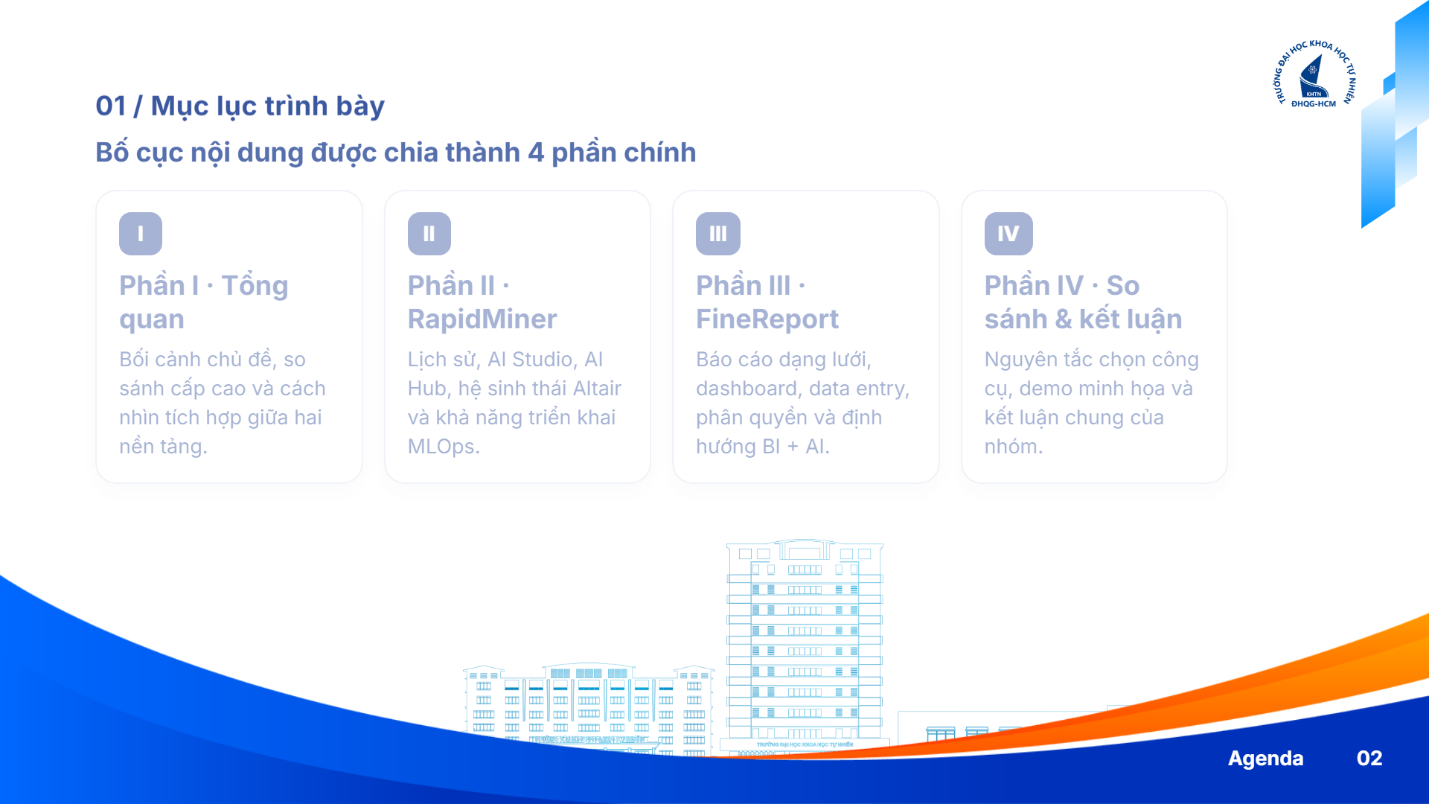
Notes:
[Mục lục] Exported as a static screenshot from HTML.

Slide 3

Notes:
[Bối cảnh chủ đề] Exported as a static screenshot from HTML.

Slide 4
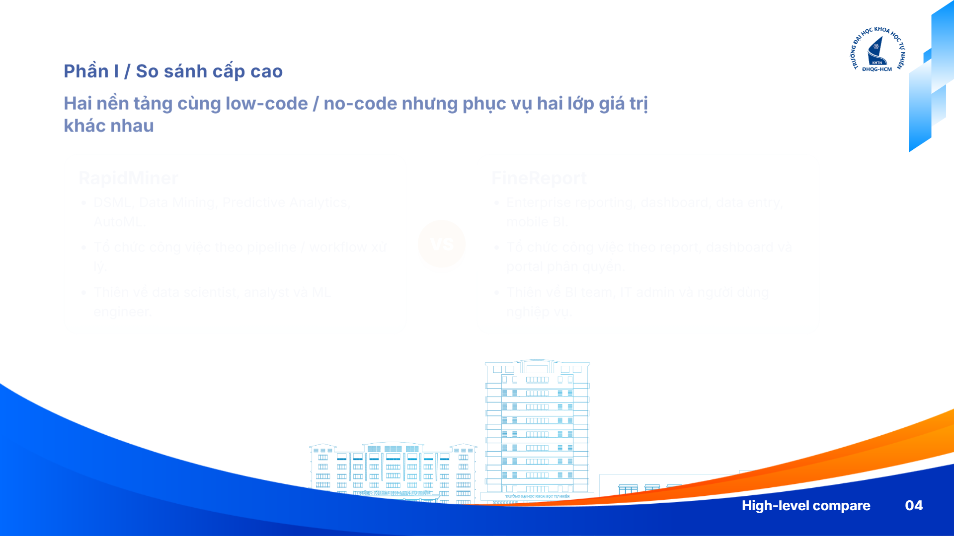
Notes:
[So sánh nhanh] Exported as a static screenshot from HTML.

Slide 5
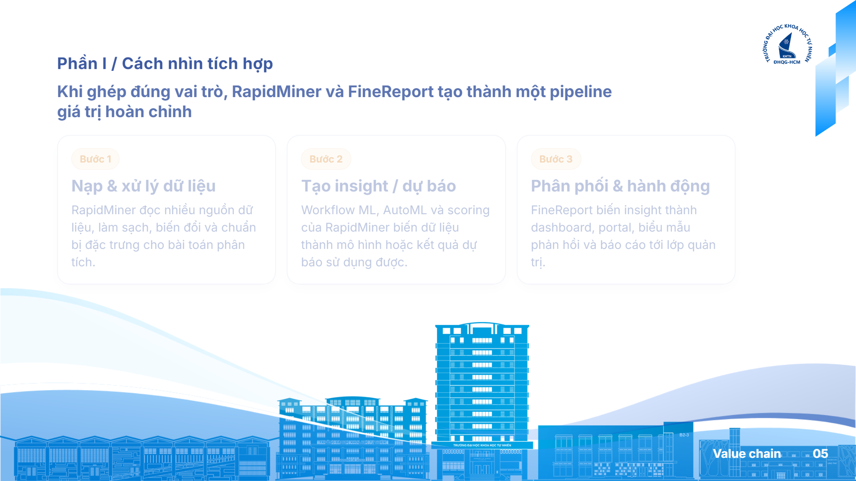
Notes:
[Chuỗi giá trị tích hợp] Exported as a static screenshot from HTML.

Slide 6

Notes:
[Phần RapidMiner] Exported as a static screenshot from HTML.

Slide 7

Notes:
[RapidMiner tổng quan] Exported as a static screenshot from HTML.

Slide 8
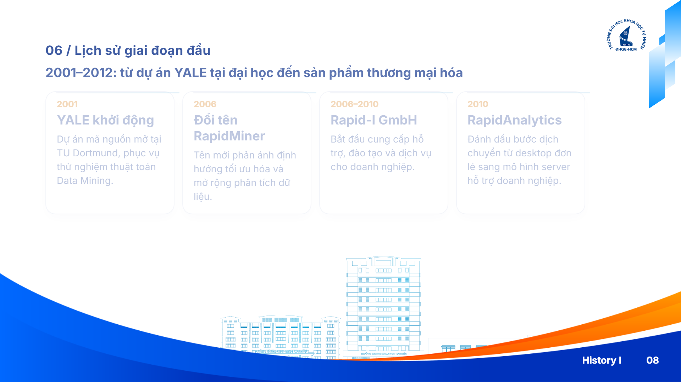
Notes:
[RapidMiner 2001-2012] Exported as a static screenshot from HTML.

Slide 9

Notes:
[RapidMiner 2013-nay] Exported as a static screenshot from HTML.

Slide 10

Notes:
[Hệ sinh thái Altair] Exported as a static screenshot from HTML.

Slide 11

Notes:
[Graph & Knowledge Studio] Exported as a static screenshot from HTML.

Slide 12

Notes:
[Monarch & Panopticon] Exported as a static screenshot from HTML.

Slide 13

Notes:
[SLC & license giáo dục] Exported as a static screenshot from HTML.

Slide 14

Notes:
[Kiến trúc DAG] Exported as a static screenshot from HTML.

Slide 15

Notes:
[ExampleSet & metadata] Exported as a static screenshot from HTML.

Slide 16

Notes:
[Process Designer] Exported as a static screenshot from HTML.

Slide 17

Notes:
[Results & Radoop] Exported as a static screenshot from HTML.

Slide 18

Notes:
[Turbo Prep & Auto Model] Exported as a static screenshot from HTML.

Slide 19

Notes:
[Python R SDK] Exported as a static screenshot from HTML.

Slide 20

Notes:
[AI Hub kiến trúc] Exported as a static screenshot from HTML.

Slide 21

Notes:
[AI Hub thực thi] Exported as a static screenshot from HTML.

Slide 22

Notes:
[Phần FineReport] Exported as a static screenshot from HTML.

Slide 23

Notes:
[FineReport tổng quan] Exported as a static screenshot from HTML.

Slide 24

Notes:
[FineReport 2006-2018] Exported as a static screenshot from HTML.

Slide 25

Notes:
[FineReport 2019-nay] Exported as a static screenshot from HTML.

Slide 26

Notes:
[Hệ sinh thái FanRuan] Exported as a static screenshot from HTML.

Slide 27

Notes:
[FineDataLink & FineVis] Exported as a static screenshot from HTML.

Slide 28
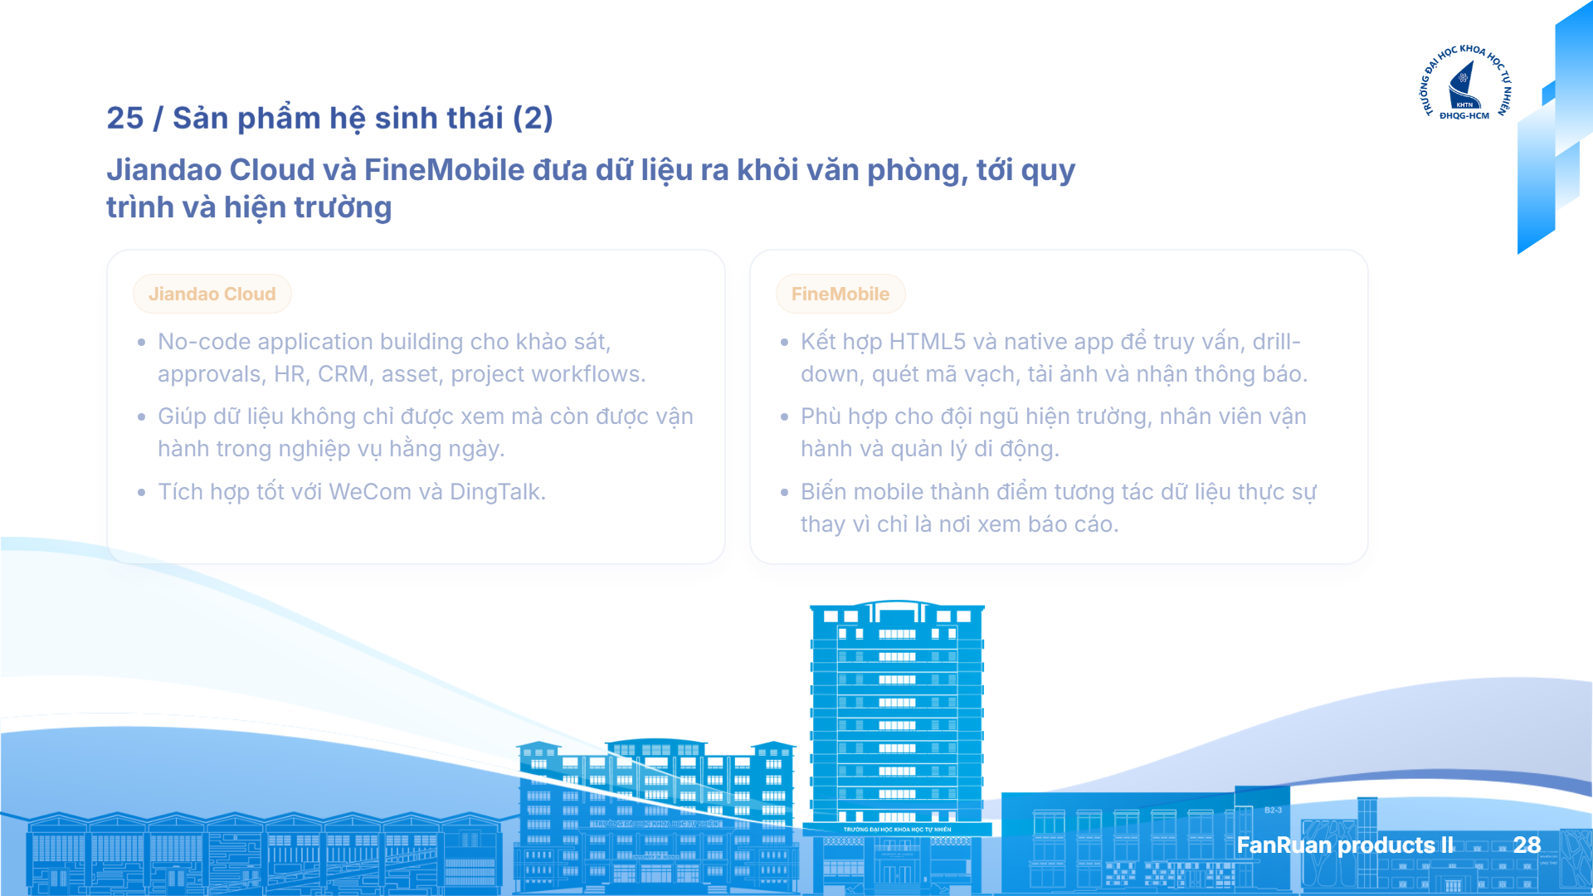
Notes:
[Jiandao Cloud & FineMobile] Exported as a static screenshot from HTML.

Slide 29

Notes:
[Dora AI & trial benefits] Exported as a static screenshot from HTML.

Slide 30

Notes:
[Giới hạn trial FineReport] Exported as a static screenshot from HTML.

Slide 31

Notes:
[Grid-style & zero-code] Exported as a static screenshot from HTML.

Slide 32
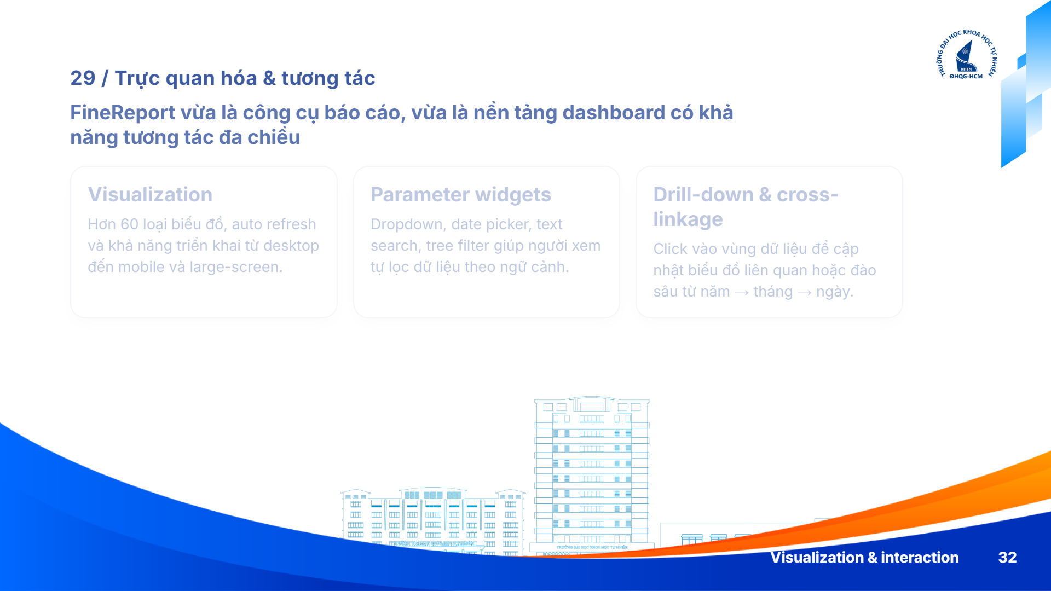
Notes:
[Visualization & interaction] Exported as a static screenshot from HTML.

Slide 33

Notes:
[Data Entry & platform] Exported as a static screenshot from HTML.

Slide 34

Notes:
[Schedule & export] Exported as a static screenshot from HTML.

Slide 35

Notes:
[Nguyên tắc chọn công cụ] Exported as a static screenshot from HTML.

Slide 36

Notes:
[Kịch bản demo] Exported as a static screenshot from HTML.

Slide 37
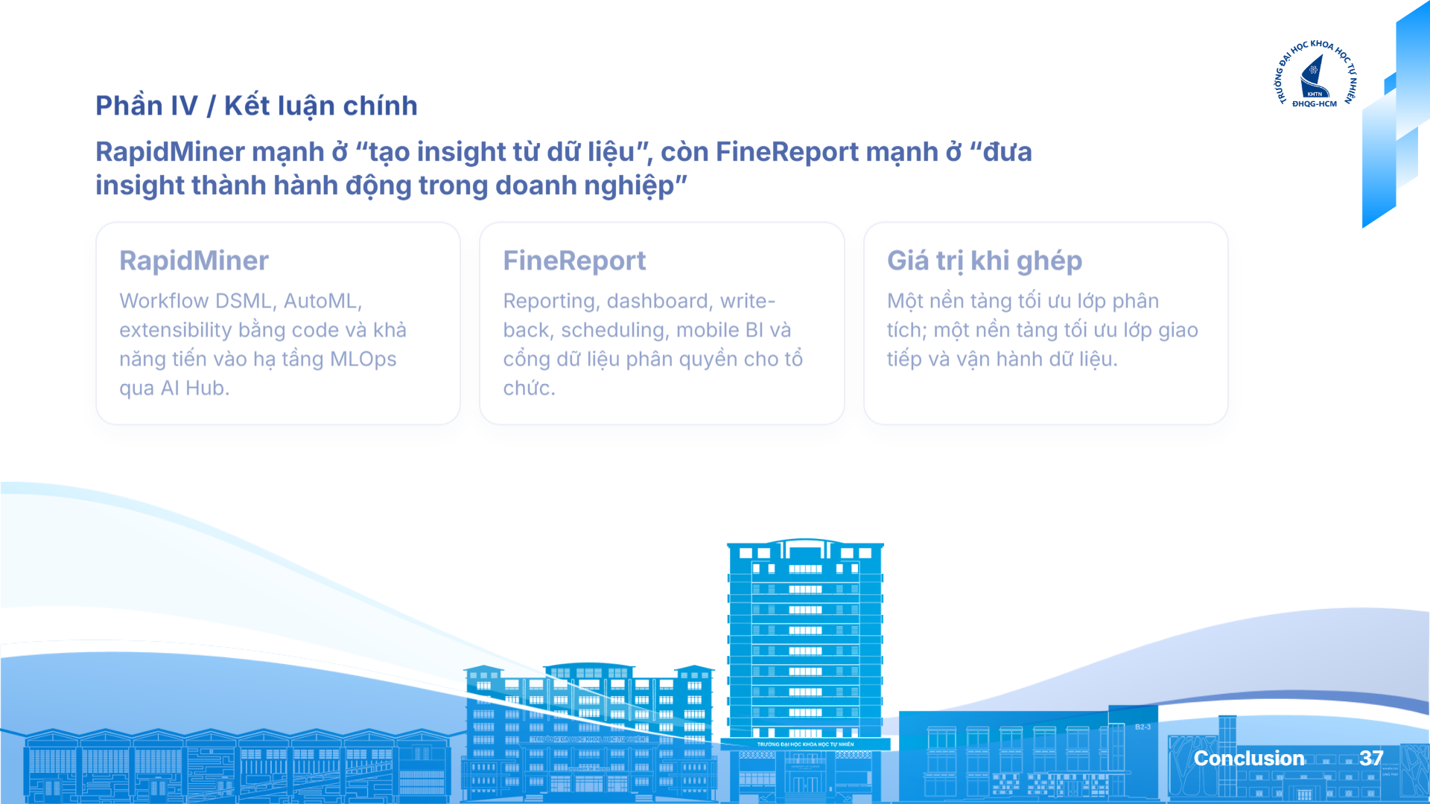
Notes:
[Kết luận] Exported as a static screenshot from HTML.

Slide 38

Notes:
[Cảm ơn] Exported as a static screenshot from HTML.

