Slide 1
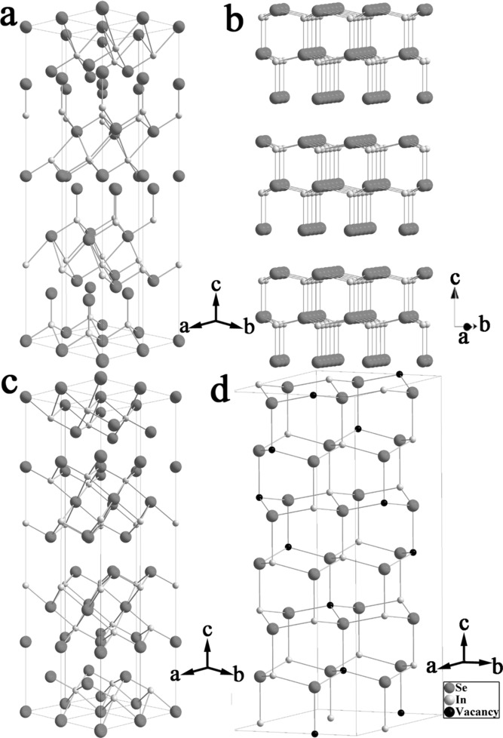
Indium Selenides: Structural Characteristics, Synthesis and Their Thermoelectric Performances
Small, Volume: 10, Issue: 14, Pages: 2747-2765, First published: 14 April 2014, DOI: (10.1002/smll.201400104)
Notes:
Crystal structure models of In2Se3 phases: (a) α(3R), (b) α(2H), (c) β(3R), and (d) γ.
IF THIS IMAGE HAS BEEN PROVIDED BY OR IS OWNED BY A THIRD PARTY, AS INDICATED IN THE CAPTION LINE, THEN FURTHER PERMISSION MAY BE NEEDED BEFORE ANY FURTHER USE. PLEASE CONTACT WILEY'S PERMISSIONS DEPARTMENT ON PERMISSIONS@WILEY.COM OR USE THE RIGHTSLINK SERVICE BY CLICKING ON THE 'REQUEST PERMISSIONS' LINK ACCOMPANYING THIS ARTICLE. WILEY OR AUTHOR OWNED IMAGES MAY BE USED FOR NON-COMMERCIAL PURPOSES, SUBJECT TO PROPER CITATION OF THE ARTICLE, AUTHOR, AND PUBLISHER.

