Slide 1
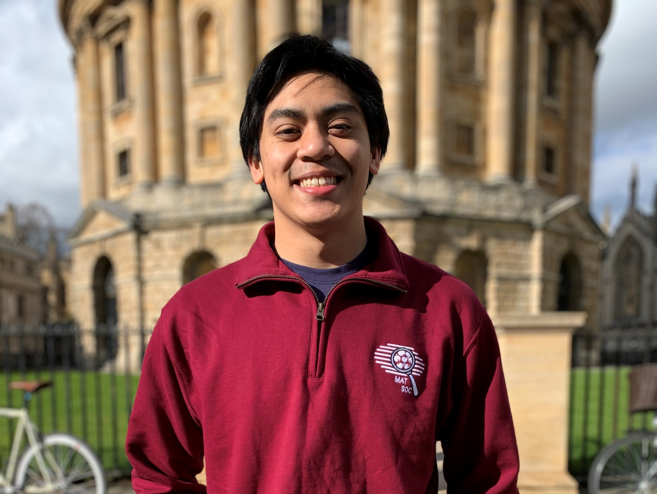
Nicholas (Nick) Ignacio
Education:
B.S. Materials Science and Engineering - MIT 2021
Ph.D. Student Materials Science and Engineering UT Austin
Advised by Prof. Akinwande
Research Interests
2D material based Phase Change Memory
Focus on Indium Selenide
Characterization with electron microscopy
STM and TEM
Personal Interests
Running
Cooking/Baking
Finding new food in Austin

