Slide 1
DoConnect
Capstone project

Slide 2
Project Done By
Group4
Mike Xie
Nicholas Isakson
Khoa Huynh

Slide 3







Technologies Utilized
Spring Boot
Angular
Git/GitHub
Postman
Bootstrap
MySQL
VS code
AWS

Slide 4
Abstract
DoConnect is a question and answer forum where technical questions are asked and answered
This application supports user and admin registration and login, question and answer posting, admin delete and approve rights, and a chat service
User details, question and answer data, and chat information are stored in a MySQL database
The database is accessed by SpringBoot and user requests are handled with Angular on the front end
The application is hosted by AWS and can be accessed by anyone

Slide 5
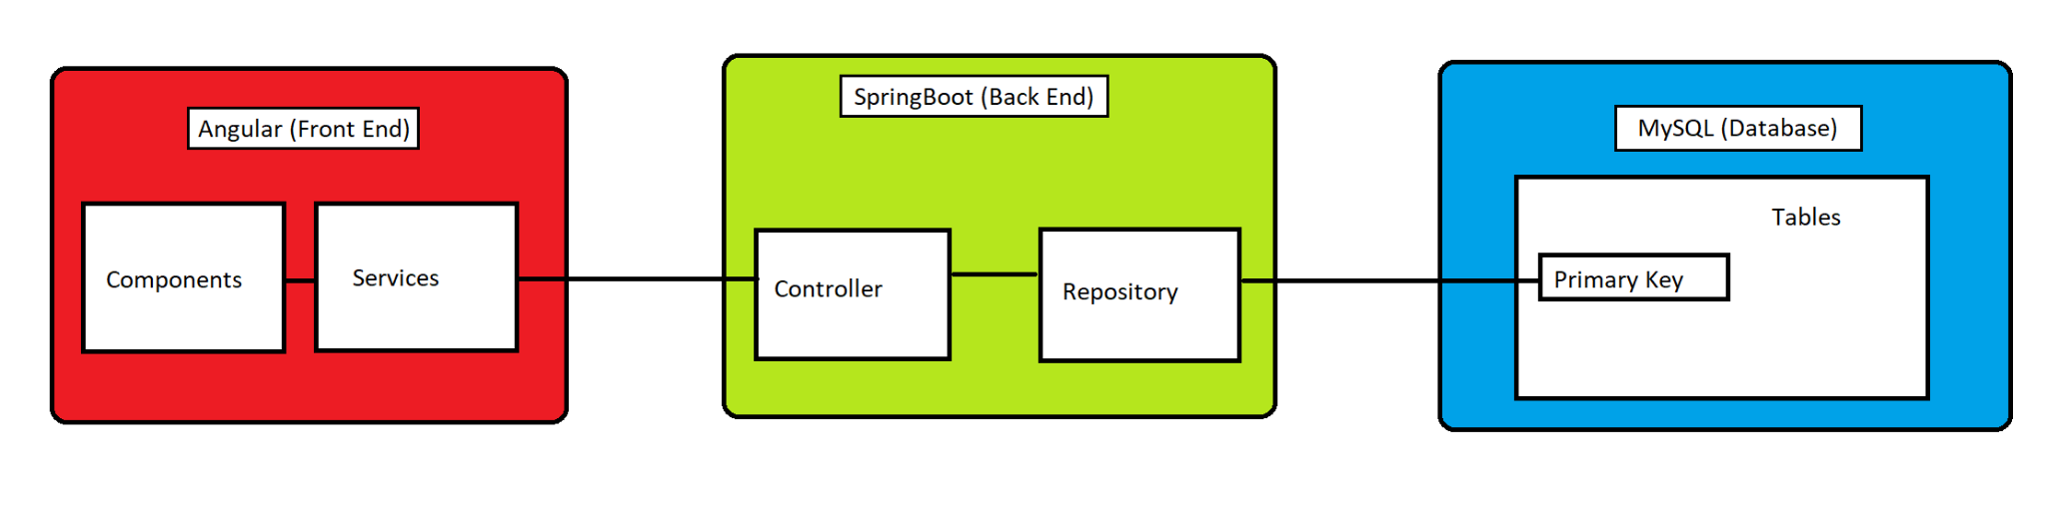
Architecture Diagram
S3 Bucket
EC2
RDS

Slide 6
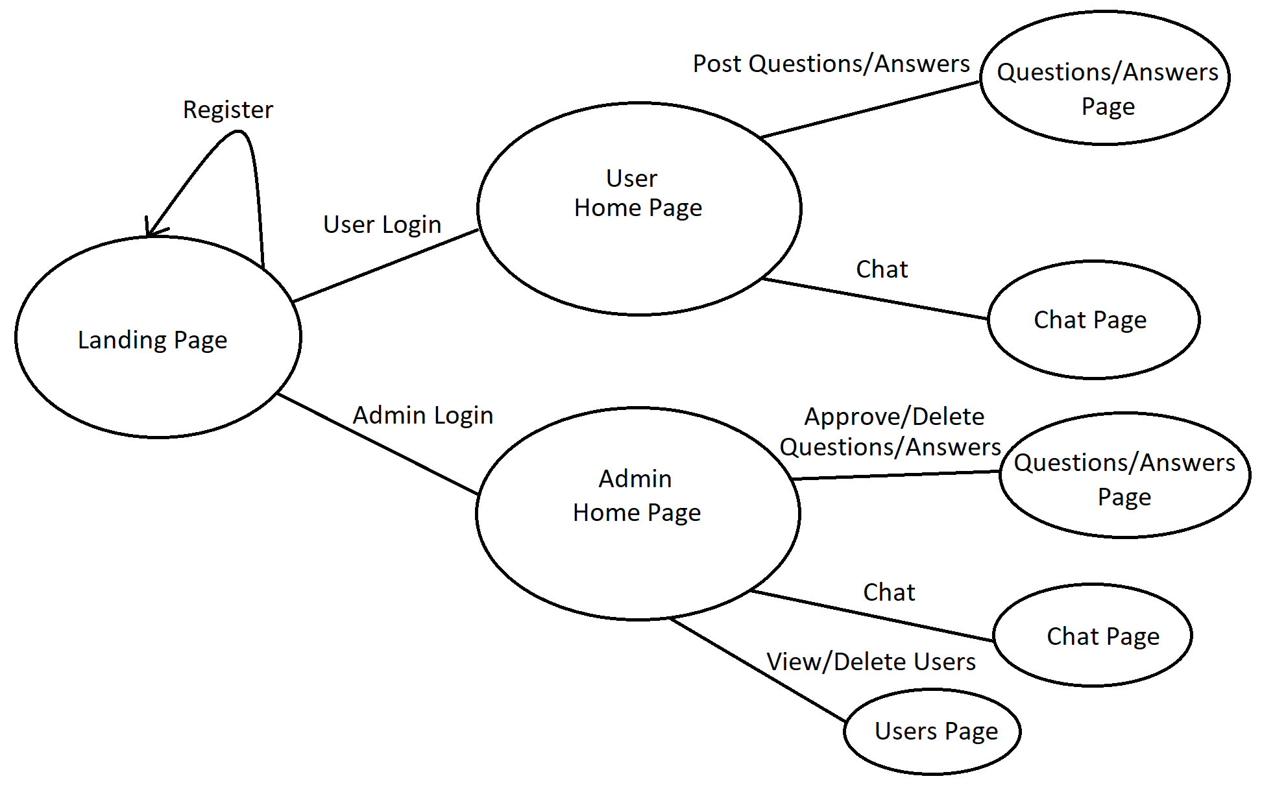
Application Flow

Slide 7
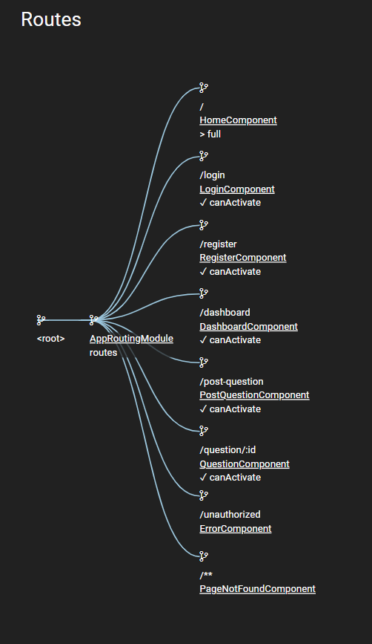
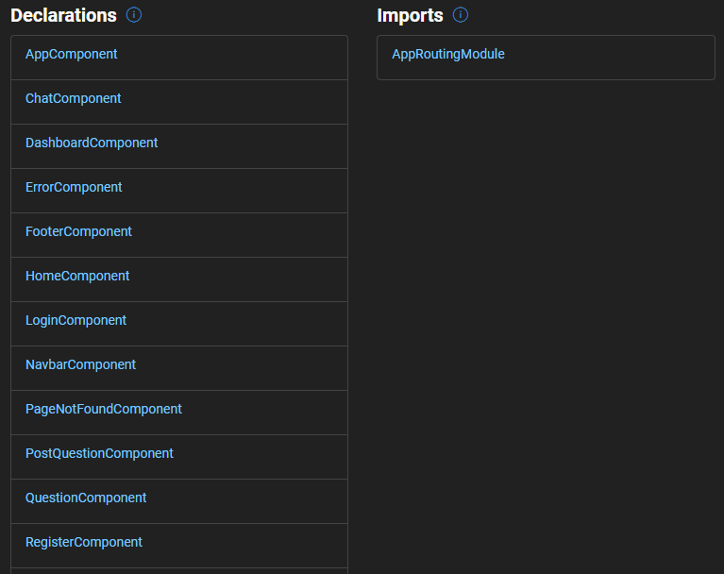
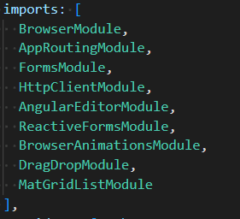
Angular routes, components and imports

Slide 8
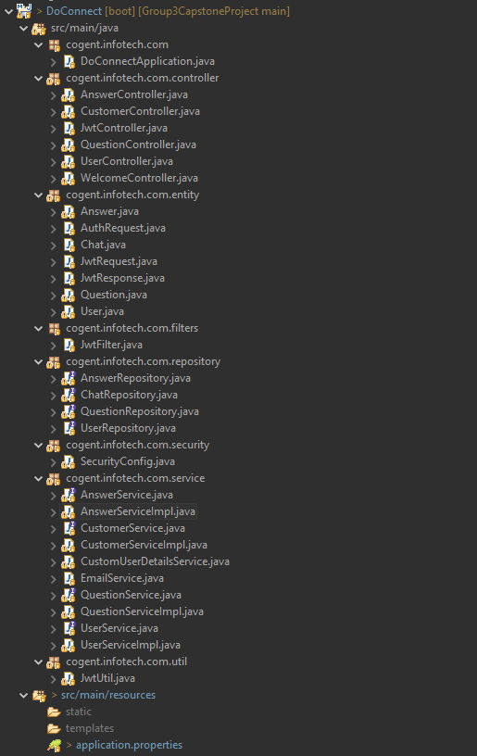
Java Backend Class Hierarchy

Slide 9
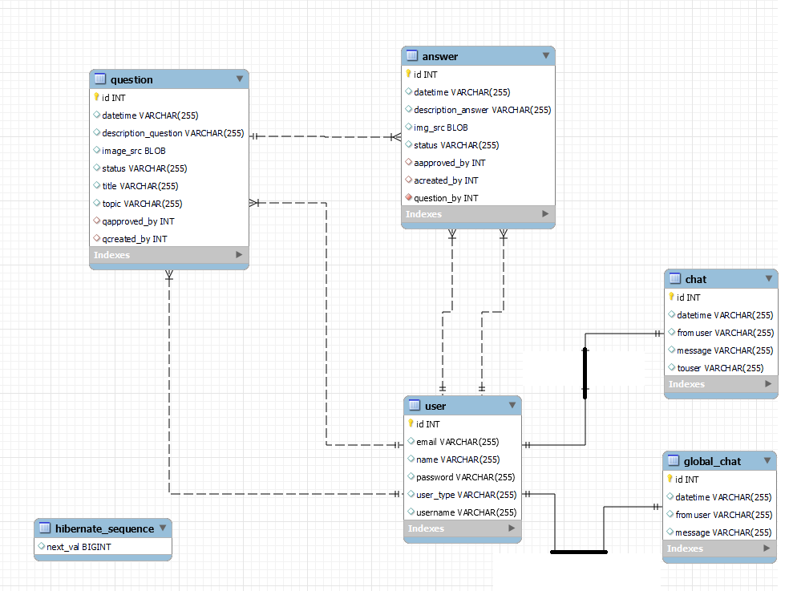
EER Diagram for MySQL

Slide 10
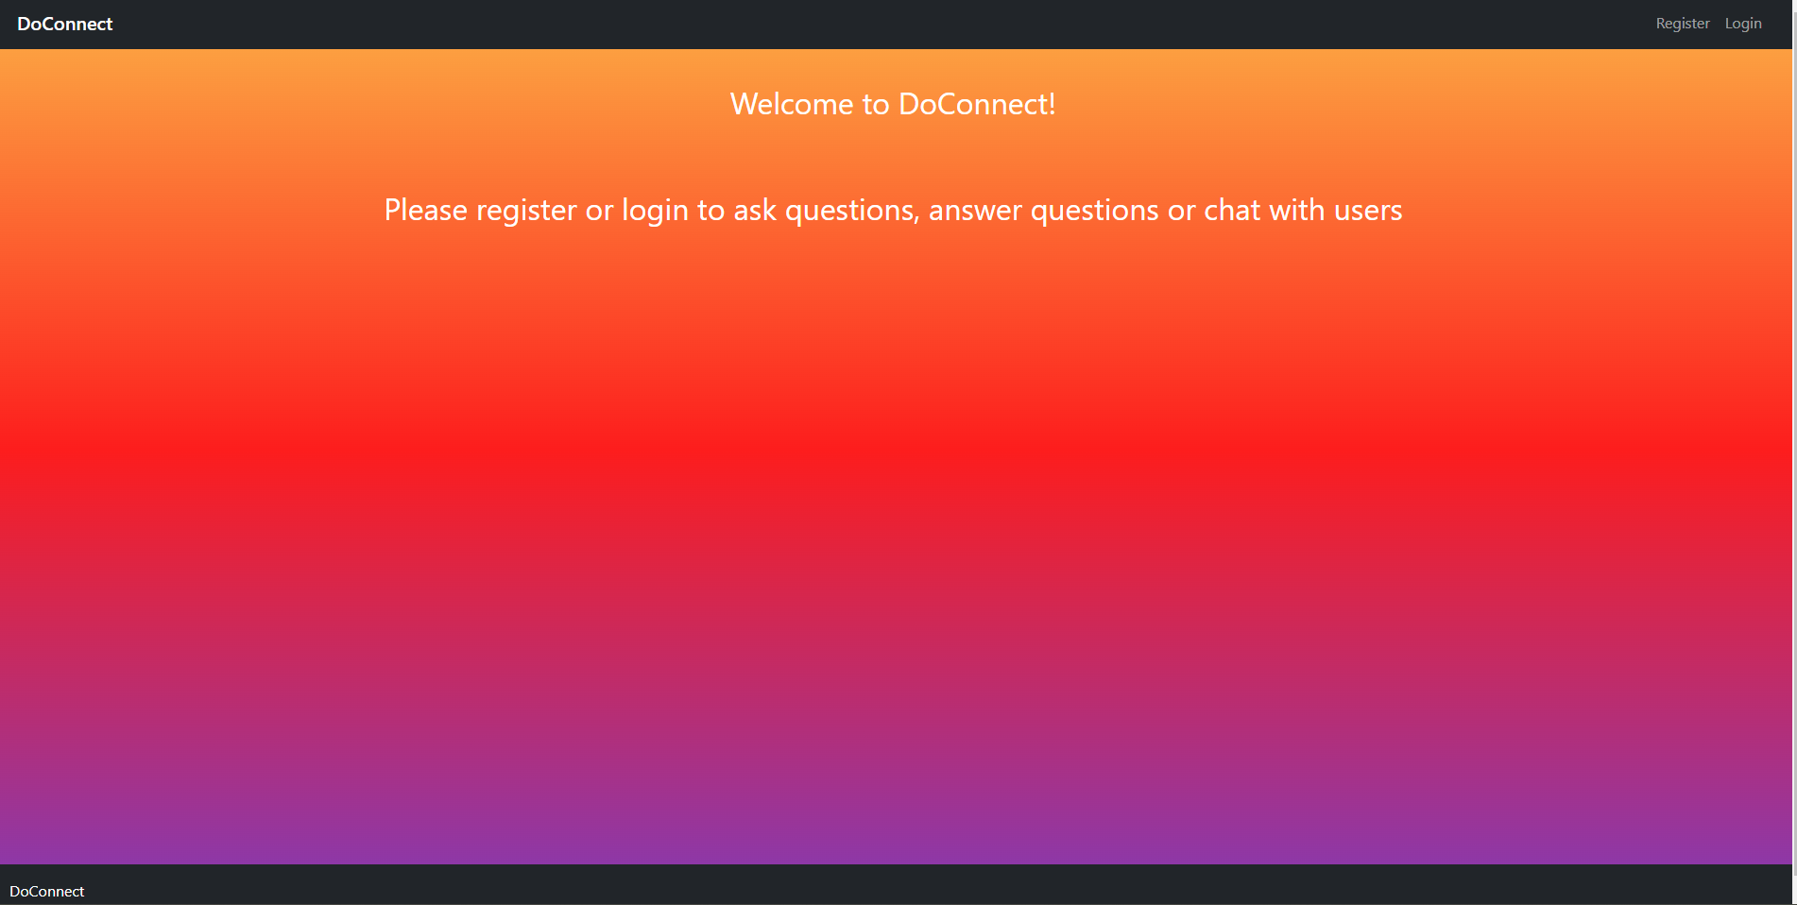
Landing page

Slide 11
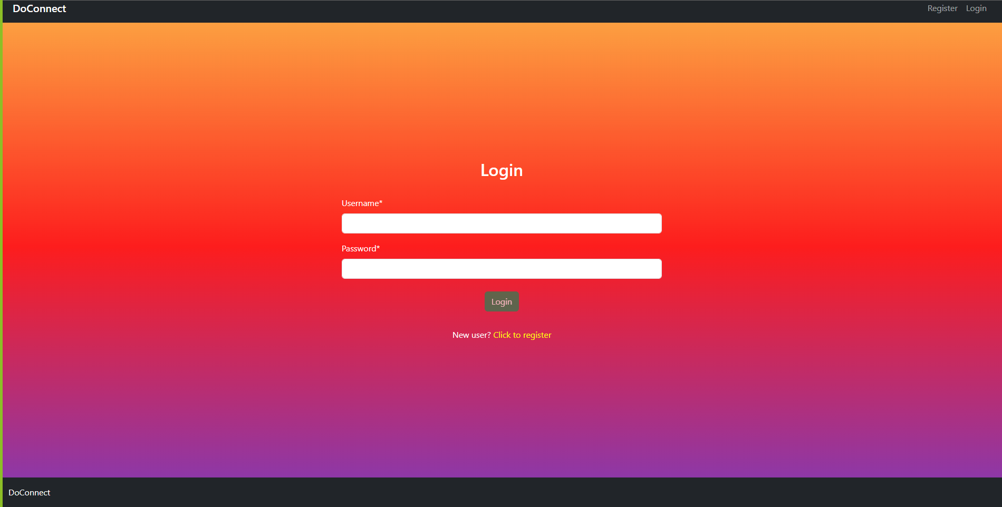
Login page

Slide 12
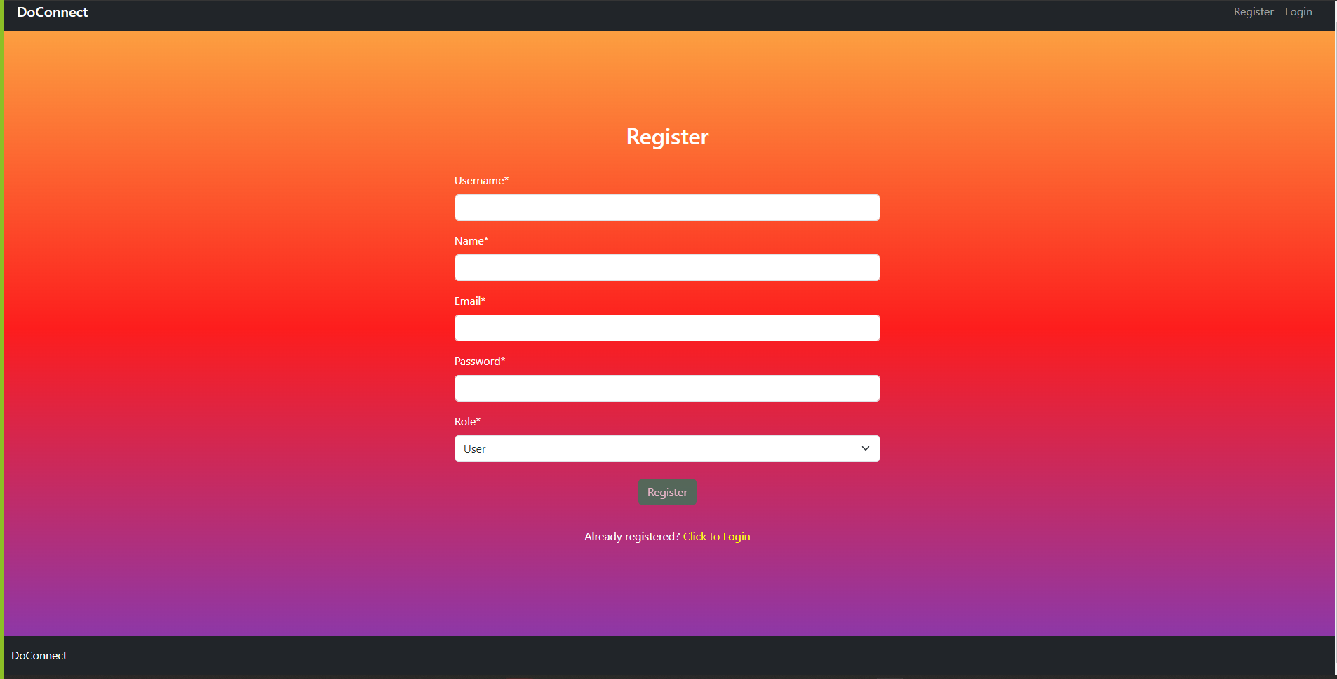
Register

Slide 13
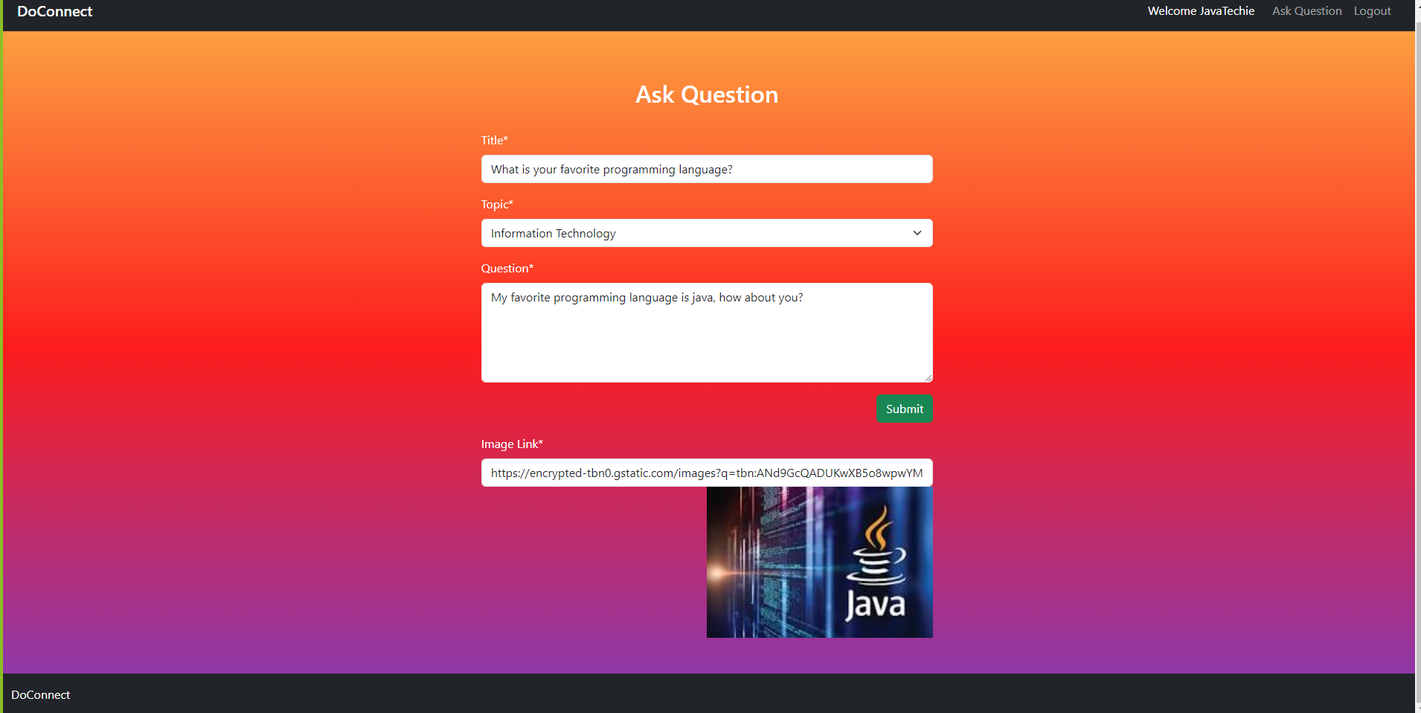
User post Question

Slide 14
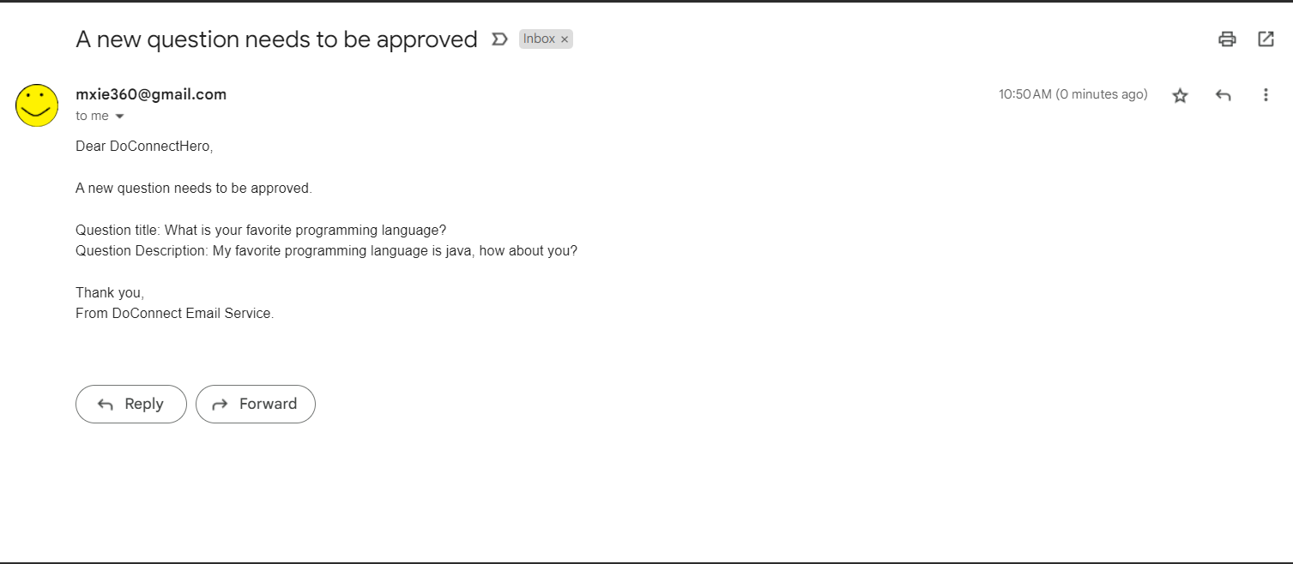
Email for question post

Slide 15
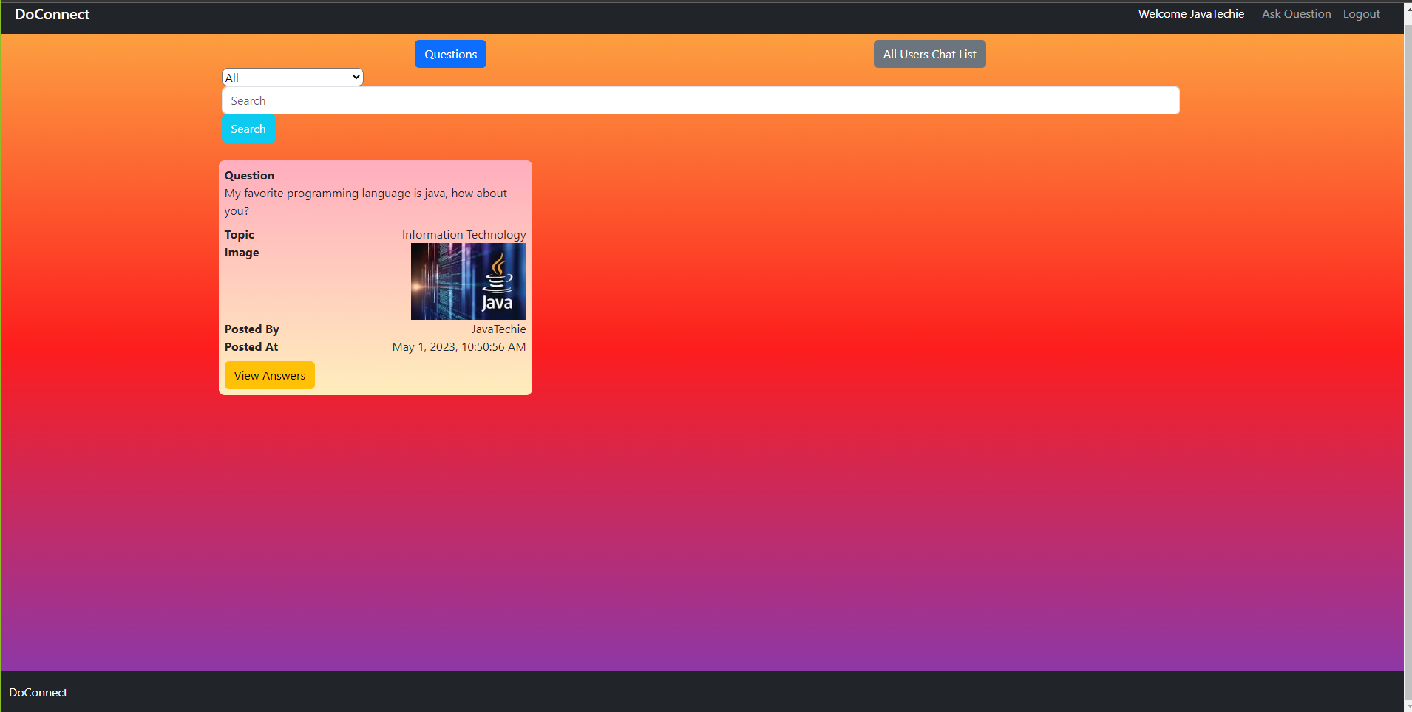
List of Questions

Slide 16
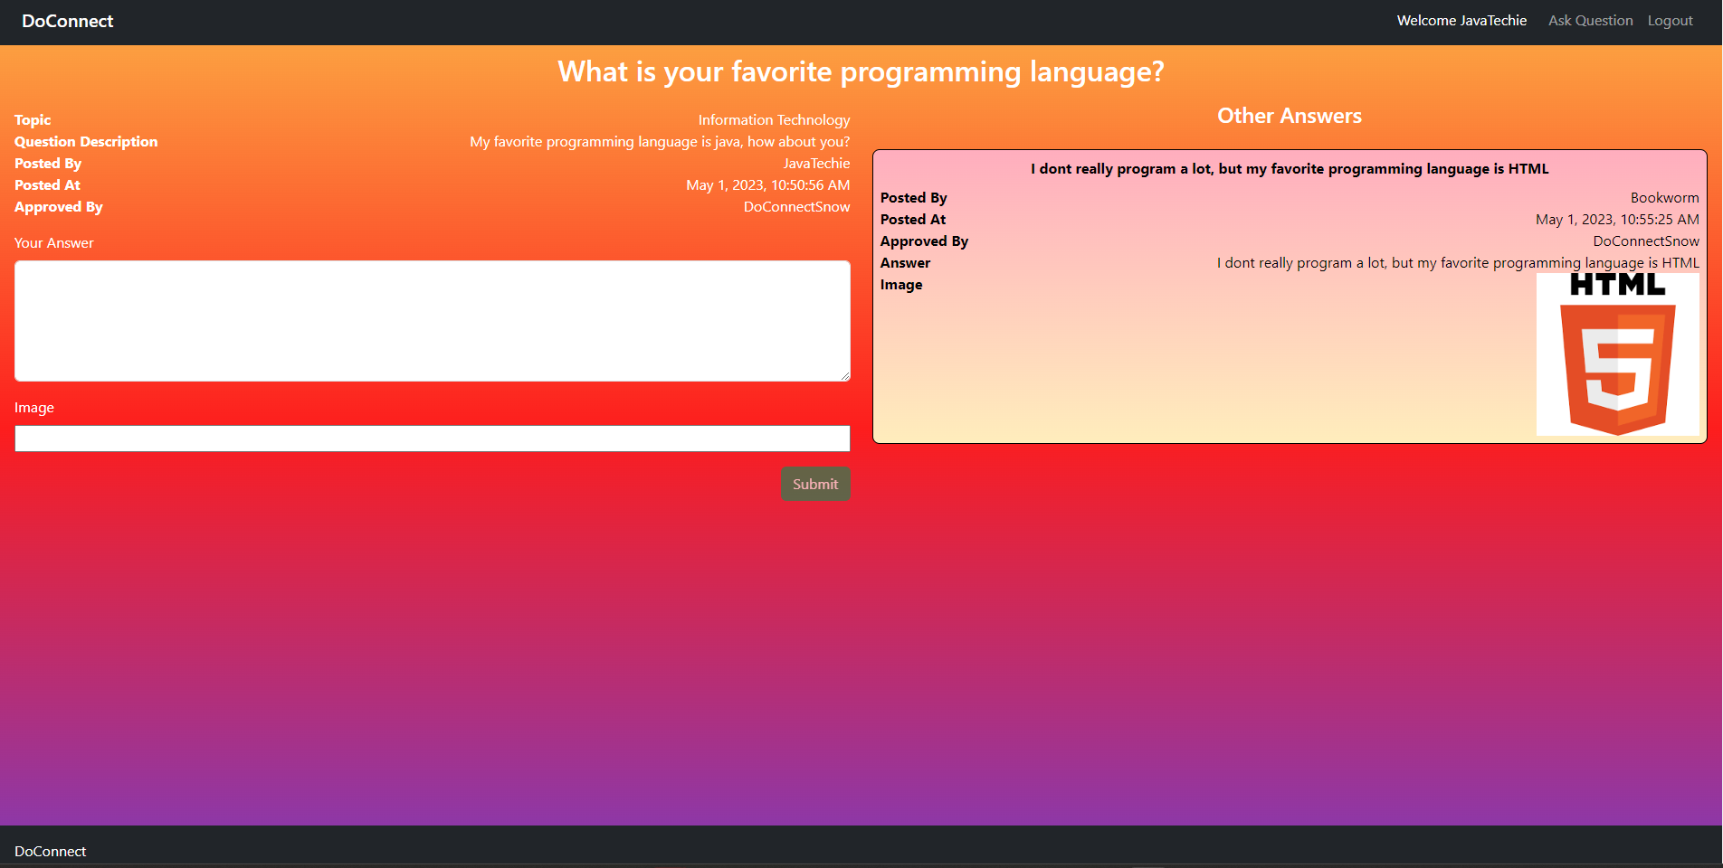
Posting and seeing other answers

Slide 17
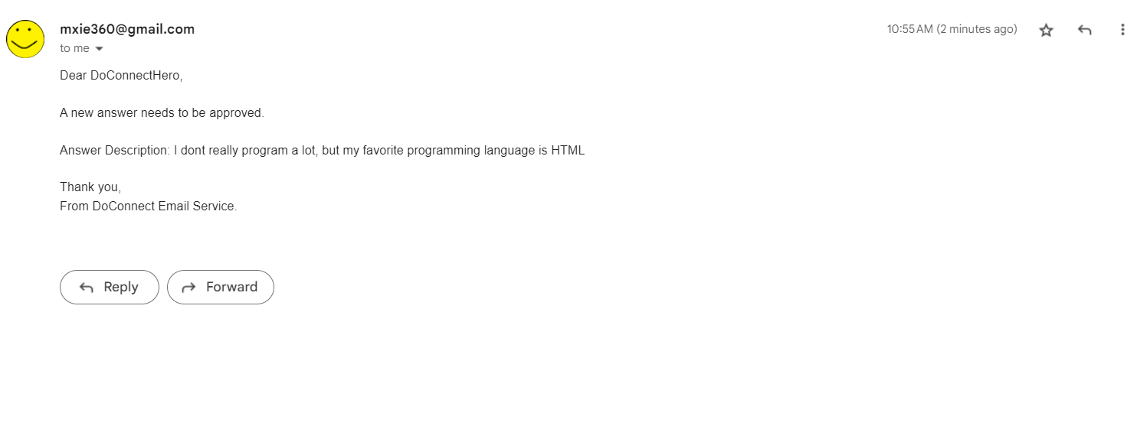
Email for answer post

Slide 18
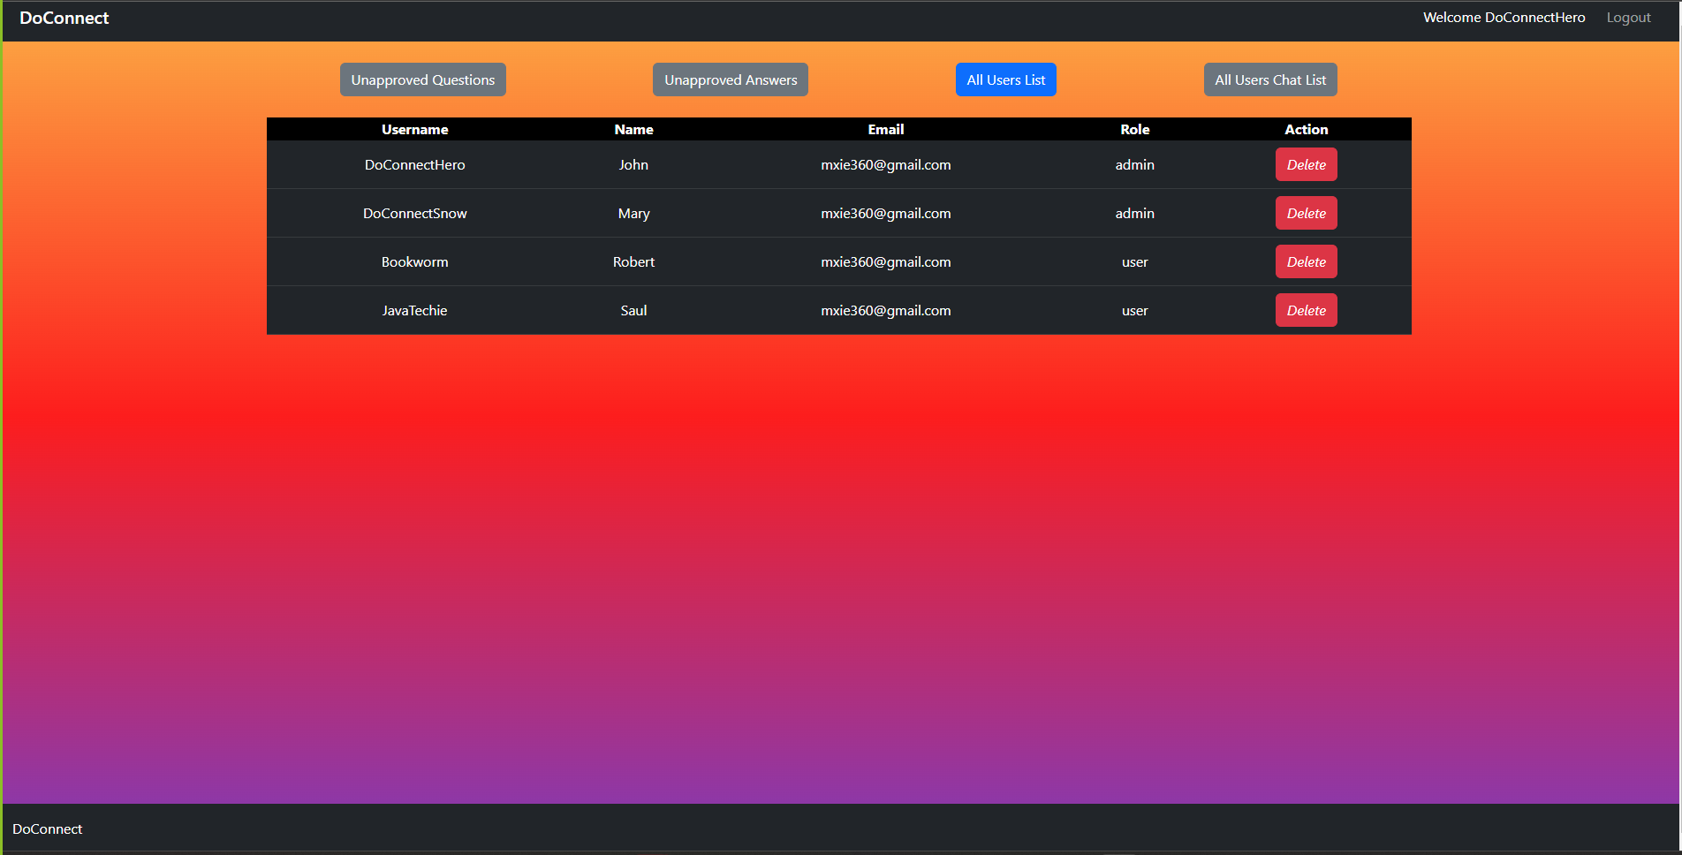
Admin

Slide 19
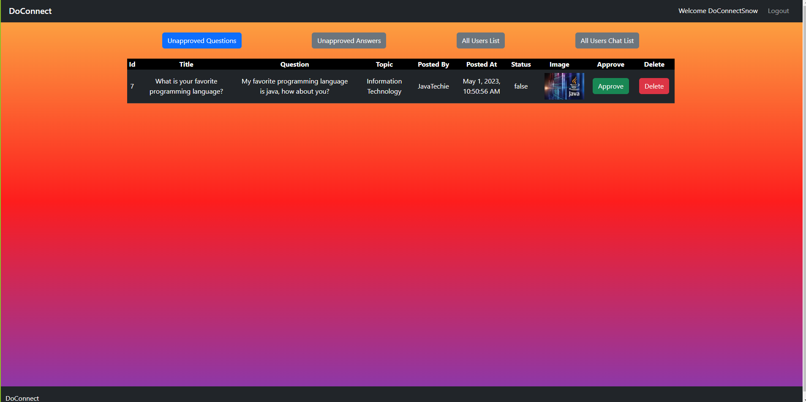
Admin question approved /delete

Slide 20
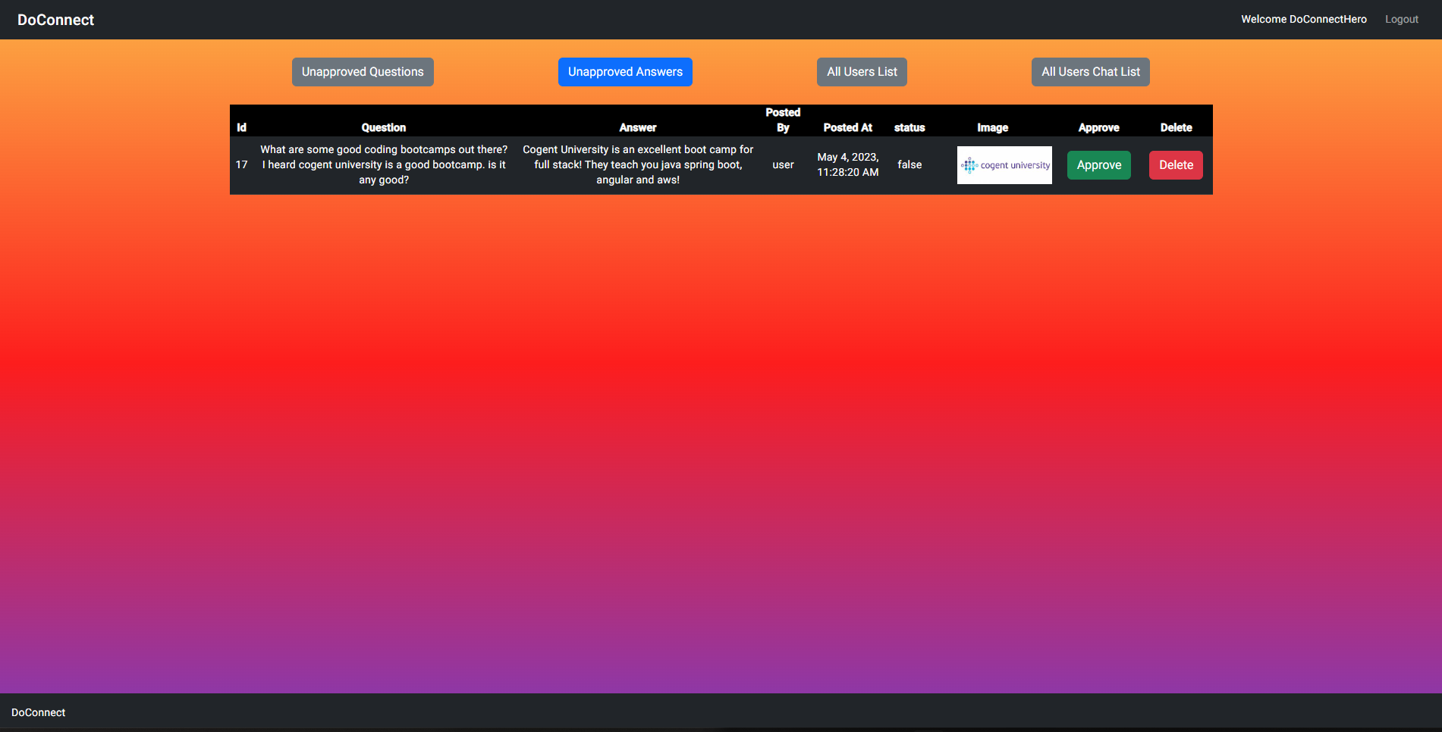
Admin answer approved /delete

Slide 21
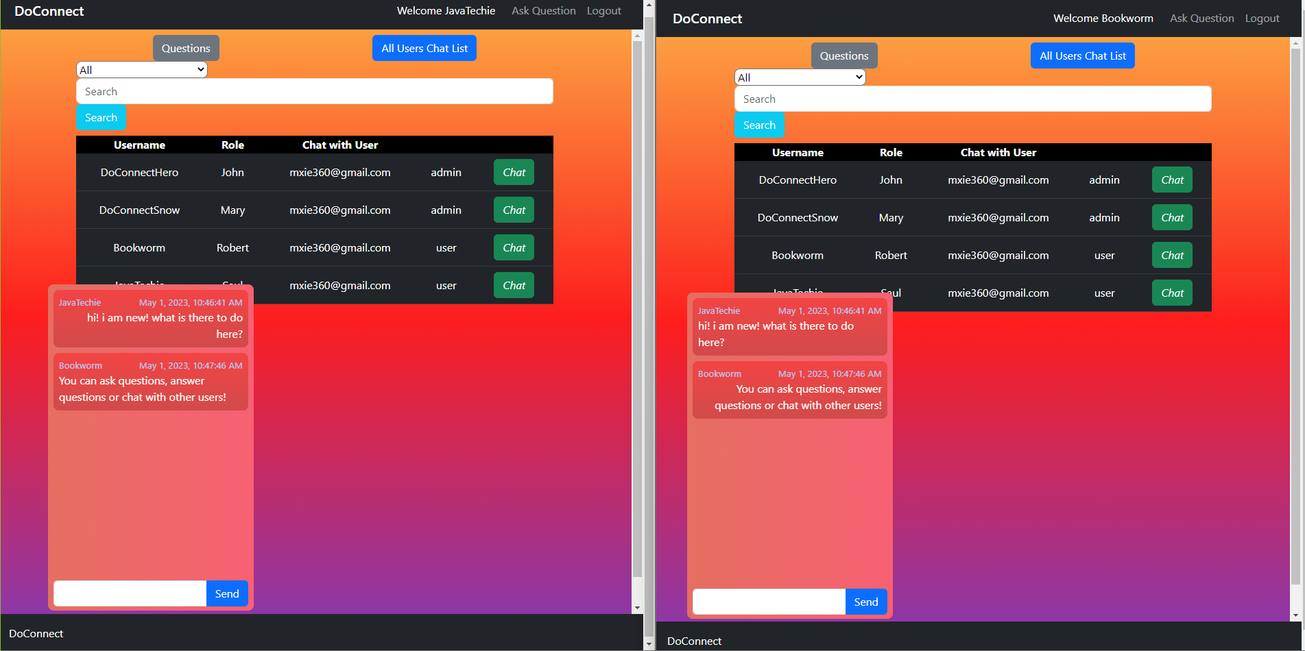
Chat

Slide 22
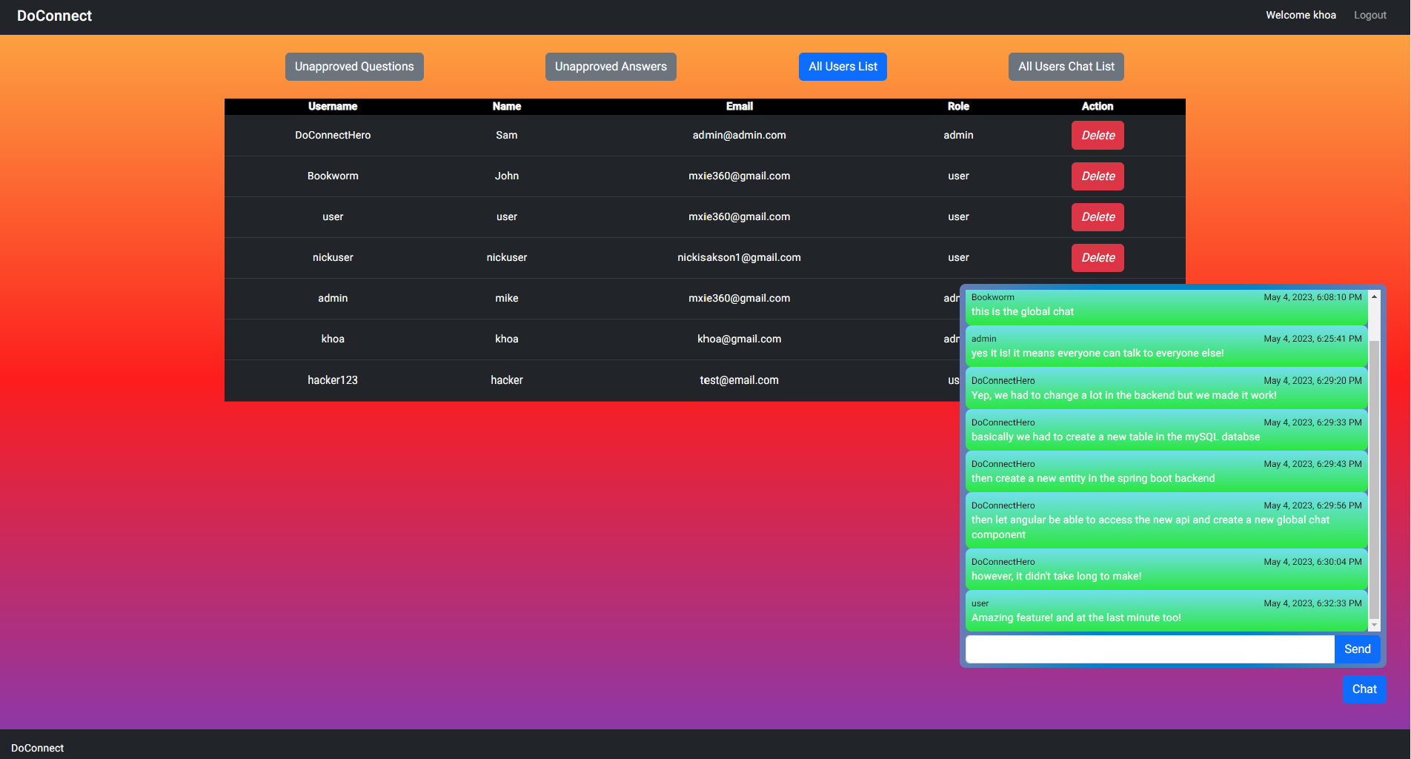
Chat

Slide 23
Conclusion
We have implemented a Doconnect Question and Answer demo which allow user to ask and answer technical and nontechnical question.
Our project has using JWT to authorized user and admin login. Questions and answers are successfully stored in the backend and are showing to the frontend. Chat is available for both user and admin.
The demo is public and accessible through AWS.

Slide 24

Thank you for listening !

